Slide 1
Romance in popular culture

Slide 2
Romance
Romance does not require physical sex, but is often seen as leading up to it
Recent depictions in popular culture and changes in public opinion have questioned the association
“Hook up” culture
Characters seek sex without commitment or even a relationship

Slide 4
Portrayals of romantic love
Early portrayals of romantic love are found in the writings of Ovid in ancient Rome, but it wasn’t till the 12th century in Europe that a significant literary movement extolling the virtues of romantic love blossomed

Slide 5
The concept of romantic love was popularized in Western culture by the game of courtly love. Troubadours in the Middle Ages engaged in trysts—usually extramarital—with women as a game created for fun rather than for marriage. Since at the time marriage was a formal arrangement, courtly love was a way for people to express the love typically not found in their marriage. In the context of courtly love, "lovers" did not refer necessarily to those engaging in sex, but rather in the act of emotional loving.

Slide 6
The vision of romantic love gradually took hold within the upper class during the Renaissance and in the latter portion of the Middle Ages across Europe
The literary vision of fair ladies and knights errant fostered a new vision of emotional attachment among men and women of the upper classes

Slide 8
The United States
Although we hear of specific cases of romantic love in histories of the United States prior to the late 1800s, it was during this latter period that the concept of marrying for love became widespread among Americans
European and eventually American literature championed the concepts of romance and romantic love

Slide 9
Factors affecting the basis of marriage on love and romance
Increased wealth
Geographic and socioeconomic mobility
Education and decline in parental/church authority

Slide 10
The Big romance or Something
Wild?: romantic comedy today
STEVE NScreen 33:3 Autumn 1992 Neale • The Big romance or Something Wild?
Downloaded from screen.oxfordjournals.org at University of Kentucky Libraries on April 25, 2011EALE

Slide 11
Forms of love
Romantic/sexual love
Love for children
Love of friends
Love for one’s fellows

Slide 12
Scientific approaches
Because we can observe its effects but not ‘love’ itself, it is difficult to study love scientifically
Because of their importance and compelling nature, a number of theories about love and romance have been developed

Slide 13
Sociobiology

Slide 15
Love and Desire in the Cinema Author(s): Torben Grodal Source: Cinema Journal, Vol. 43, No. 2 (Winter, 2004), pp. 26-46 Published by: University of Texas Press on behalf of the Society for Cinema & Media Studies Stable URL: http://www.jstor.org/stable/1225913

Slide 16
People cheat on their partners, love may fade, and homosexual love and desire are options, as are the formation of harems and of promiscuity. That the evolutionary function of sex is procreation and DNA recombination and that the evolutionary reason for the bond of love is to provide resources for the care of infants do not in themselves restrict the manner in which an individual may wish to follow through on his or her innate predisposition to bond. There is no such thing as a natural morality.
Love and Desire in the Cinema Author(s): Torben Grodal Source: Cinema Journal, Vol. 43, No. 2 (Winter, 2004), pp. 26-46 Published by: University of Texas Press on behalf of the Society for Cinema & Media Studies Stable URL: http://www.jstor.org/stable/1225913

Slide 17
This description of love and desire is in perfect sync with typical gender-based preferences for film genres. While both men and women enjoy romantic love stories as well as pornography, on average women have stronger preferences for the former and men have stronger preferences for the latter. In part, this may be culturally constructed, and more women today view pornography than they did decades ago. Yet cultural construction cannot wholly explain gender-related preferences.

Slide 18
Robert Sternberg’s Triangular Theory of Love

Slide 19
Rules of the ‘game’
Heterosexual love may be a 'many splendored thing', but it is also a game with quite precise though not immutable sets of rules or conventions. Courtship, seduction, adultery and marriage are all highly codified and regulated activities, subject to individual inflection but never open totally to individual control.
Screen 33:3 Autumn 1992 • Neale The Big romance or Something Wild? screen.oxfordjournals.org

Slide 20
Changing views of love
One major trend in the popular view of love is that rather than a commitment to an indivisible couple contemporary views of love are more likely to emphasize the maintenance of individuality in a committed partnership
Less expectation of sacrifice of individual self-identity in the name of a couple identity

Slide 21
“The traditional notion of love in America is that of a “mythic” union between two devoted individuals. In our mythology, love conquers all. One only attains “completeness”—a full identity—through choosing a love partner and remaining true to that choice against all odds. The search for self-identity is thus fused with the search for a mate, for only through marital union can the self be “whole.”

Slide 22
The new emphasis on individual development calls this into question and questions love as permanent commitment
“The modern love myth denies the dependence that was part of the traditional love myth, and argues instead that love must be capable of stimulating and absorbing perpetual change.”

Slide 23
“Bygrave goes on to quote director Ivan Reitman:
'I think the problem Hollywood has with romance is a reflection of the problems people are having in real life. What are the rules of a relationship today? There are no rules. And how do you get as far as a relationship anyway in the age of AIDS? How do you even meet the other person? There's a whole industry of video dating and phone services and personal ads that has sprung up in our society because the old ways don't work any more, or don't work for many people.'

Slide 25
Radway’s outline
The heroine’s social identity is destroyed
The heroine reacts antagonistically to an aristocratic male
The aristocratic male responds ambiguously to the heroine
The heroine interprets the hero’s behavior as evidence of a purely sexual interest in her
The heroine responds to the hero’s behavior with anger or coldness
The hero retaliates by punishing the heroine
The heroine and hero are physically and/or emotionally separated

Slide 26
The hero treats the heroine tenderly
The heroine responds warmly to the hero’s act of tenderness
The heroine reinterprets the hero’s ambiguous behavior as the product of a previous hurt
The hero proposes/openly declares his love for/demonstrates his unwavering commitment to the heroine with a supreme act of tenderness
The heroine responds sexually and emotionally
The heroine’s identity is restored

Slide 27
Galician Sex Love and Romance in the Mass media
Myths of romance
Your perfect partner is cosmically predestined, so nothing/nobody can ultimately separate you.
There’s such a thing as “love at first sight.”
Your true mate should KNOW what you’re thinking or feeling (without your having to tell).
If your partner is truly meant for you, sex is easy and wonderful.
To attract and keep a man, a woman should look like a model or a centerfold.

Slide 28
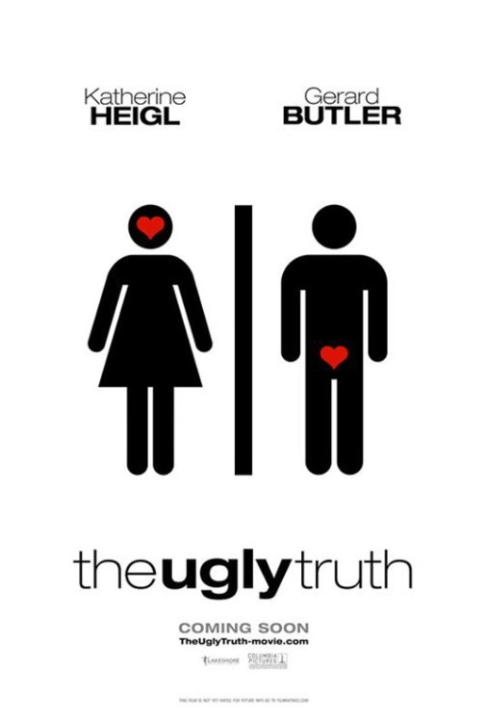
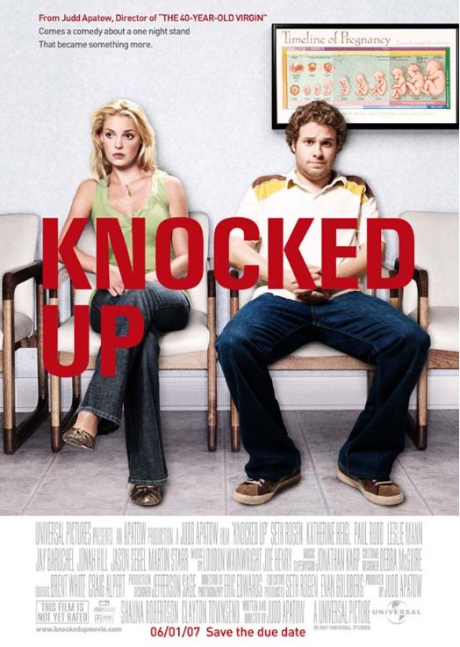

Slide 29
The man should NOT be shorter, weaker, younger, poorer, or less successful than the woman.
The love of a good and faithful true woman can change a man from a “beast” into a “prince.”
Bickering and fighting a lot mean that a man and a woman really love each other passionately.
All you really need is love, so it doesn’t matter if you and your lover have very different values.

Slide 30
The right mate “completes you”—filling your needs and making your dreams come true.
In real life, actors and actresses are often very much like the romantic characters they portray.
Since mass media portrayals of romance aren’t “real,” they don’t really affect you.

Slide 33
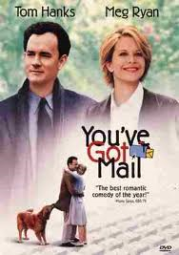
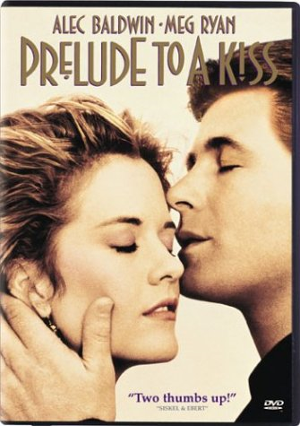
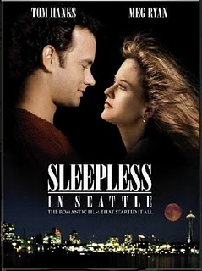
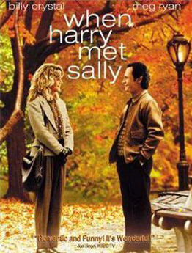

Slide 36
Romance-related beliefs
 | 1 | 2 | 3 | 4 | 5 | 6 | 7
1. Current relationship status |  | -.18* | .11 | .10 | .04 | .06 | -.03
2. Number of recent relationships |  |  | -.02 | -.02 | .01 | .06 | .00
3. Female gender |  |  |  | .34* | .10 | .14* | -.21*
4. Preference for romance media |  |  |  |  | .28* | .24* | .00
5. Belief in predestined soul mates |  |  |  |  |  | .38* | .17*
6. Mind reading expected in relationships |  |  |  |  |  |  | .24*
7. Belief in sexual perfectionism
Holmes, B. (2007) In Search of My One-and-Only, The Electronic Journal of Communication

Slide 37
Dangerous ideas
Women are encouraged to consider strong (violent), emotionally aloof and morally questionable men (“Bad Boys”)
Men who are dangerous physically, emotionally or even economically
Sex, Drugs and Rock-and-Roll (or Hip Hop, I guess)
“Nerds” are treated as unappealing, wimpy and inept in all ways but scholastically

Slide 38
Dangerous ideas
Romance may be treated as:
Competitive (battle of the sexes)
Mercenary (men hunt women)
Hopelessly naïve (hook up culture)

Slide 39
These visions often:
Rob women of their ability to control their sexuality—to be assertive when they would prefer to be
Rob men of their opportunity for emotional gratification and caring
Macho image valued above relationship that is mutually emotionally satisfying

Slide 40
Problems stemming from unrealistic visions of romance
Unrealistic views of romance, especially among the young
There are a lot of unhappy, disillusioned teens out there
Single parenthood
Angry people taking it out on former partner
Unnecessary pain, distrust and uncertainty in relationships
Loss of good relationships seeking unrealistic and unattainable ideals
Less stable marriages, abuse

Slide 41
Denigration of other goals, sources of reward, pleasure
Waste of time, opportunities, future options
School drop-outs
Cycle of poverty
Loss of youth experiences that cannot be reclaimed

Slide 42
Portrayals of couples over time
Early portrayals emphasized continuity and harmony
Occasional Jezebel or homewrecker, usually ending in reaffirmation of traditional gender-based relationships

Slide 43
Gradual move away from traditional couplehood
Emphasis on pre-marital romance increases
Extra-marital affairs, reduction in emotional commitment tied to sex
Gradual increase in same-sex portrayals
Non-traditional families portrayed

