Slide 1
Student Employment Pay Rate Changes Office for Student Success

Slide 2
What is Federal Work Study?
The Federal Work-Study (FWS) Program is a federally funded program that provides jobs for undergraduate and graduate students with financial need, allowing them to earn money to help pay education expenses.
Wages earned are paid to the student via the University Payroll System and are direct deposited to the checking account specified by the student.
Earnings are not credited to the student’s university account and therefore do not pay the student’s billed charges.
Eligibility is determined from information provided on a student’s Free Application for Federal Student Aid (FAFSA). To be eligible, a student must show need on their federal need analysis report. The number of hours a student may work will depend upon the amount awarded.
The maximum award is $7,800 per academic year ($3,900 per semester) and students who participate in the program receive bi-weekly paychecks.

Slide 3
Charge
Elevate the utilization of the Federal Work Study (FWS) program throughout the university to accomplish the following goals:
Goals
Increase utilization of the federal grant funding that supports this program
Positively impact student retention and persistence through student employment as a high impact practice
Tactics
Increase the base pay for Federal Work Study positions to $12/hour to make the positions more attractive and accessible to potential student employees
Updated and streamlined communication strategy to on-campus employers and students regarding utilization of the program
Piloting a review process for all student employees in Student Success for FWS eligibility
Increase in inclusion of Federal Work Study as part of student’s financial aid award packages to maximize potential acceptance by students

Slide 4
Increase the base pay for Federal Work Study positions to $12/hour to make the positions more attractive and accessible to potential student employees
 | Incurred Cost | Cost Savings for your Unit
Student Employer Costs (Non- FWS) | $77,112.00 | $0
100% students switched to FWS (17% wage responsibility) | $13,109.04 | ($64,003)
50% of students switched to FWS cost (17% wage responsibility) | $45,110.52 | ($32,001.48)
Office Assistant
$12.00/hour
14 employees
9 hours/week average
51 weeks worked/year

Slide 5
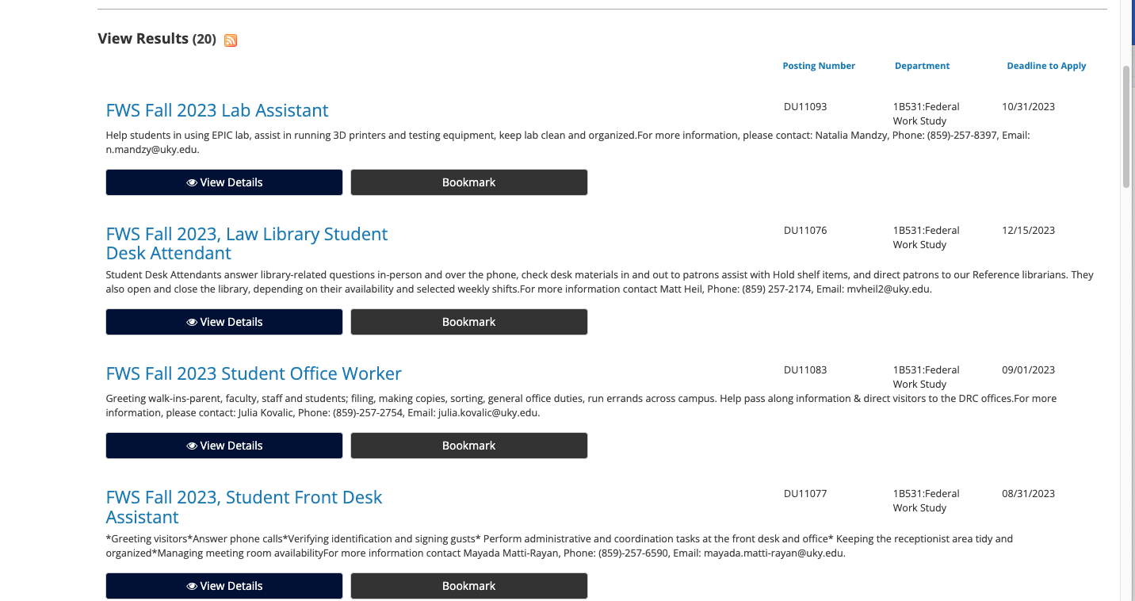
Updated and streamlined communication strategy to on-campus employers and students regarding utilization of the program
Updated website with more navigable options for student employees and supervisors
Streamline job postings into one link via UK Jobs website

Slide 6
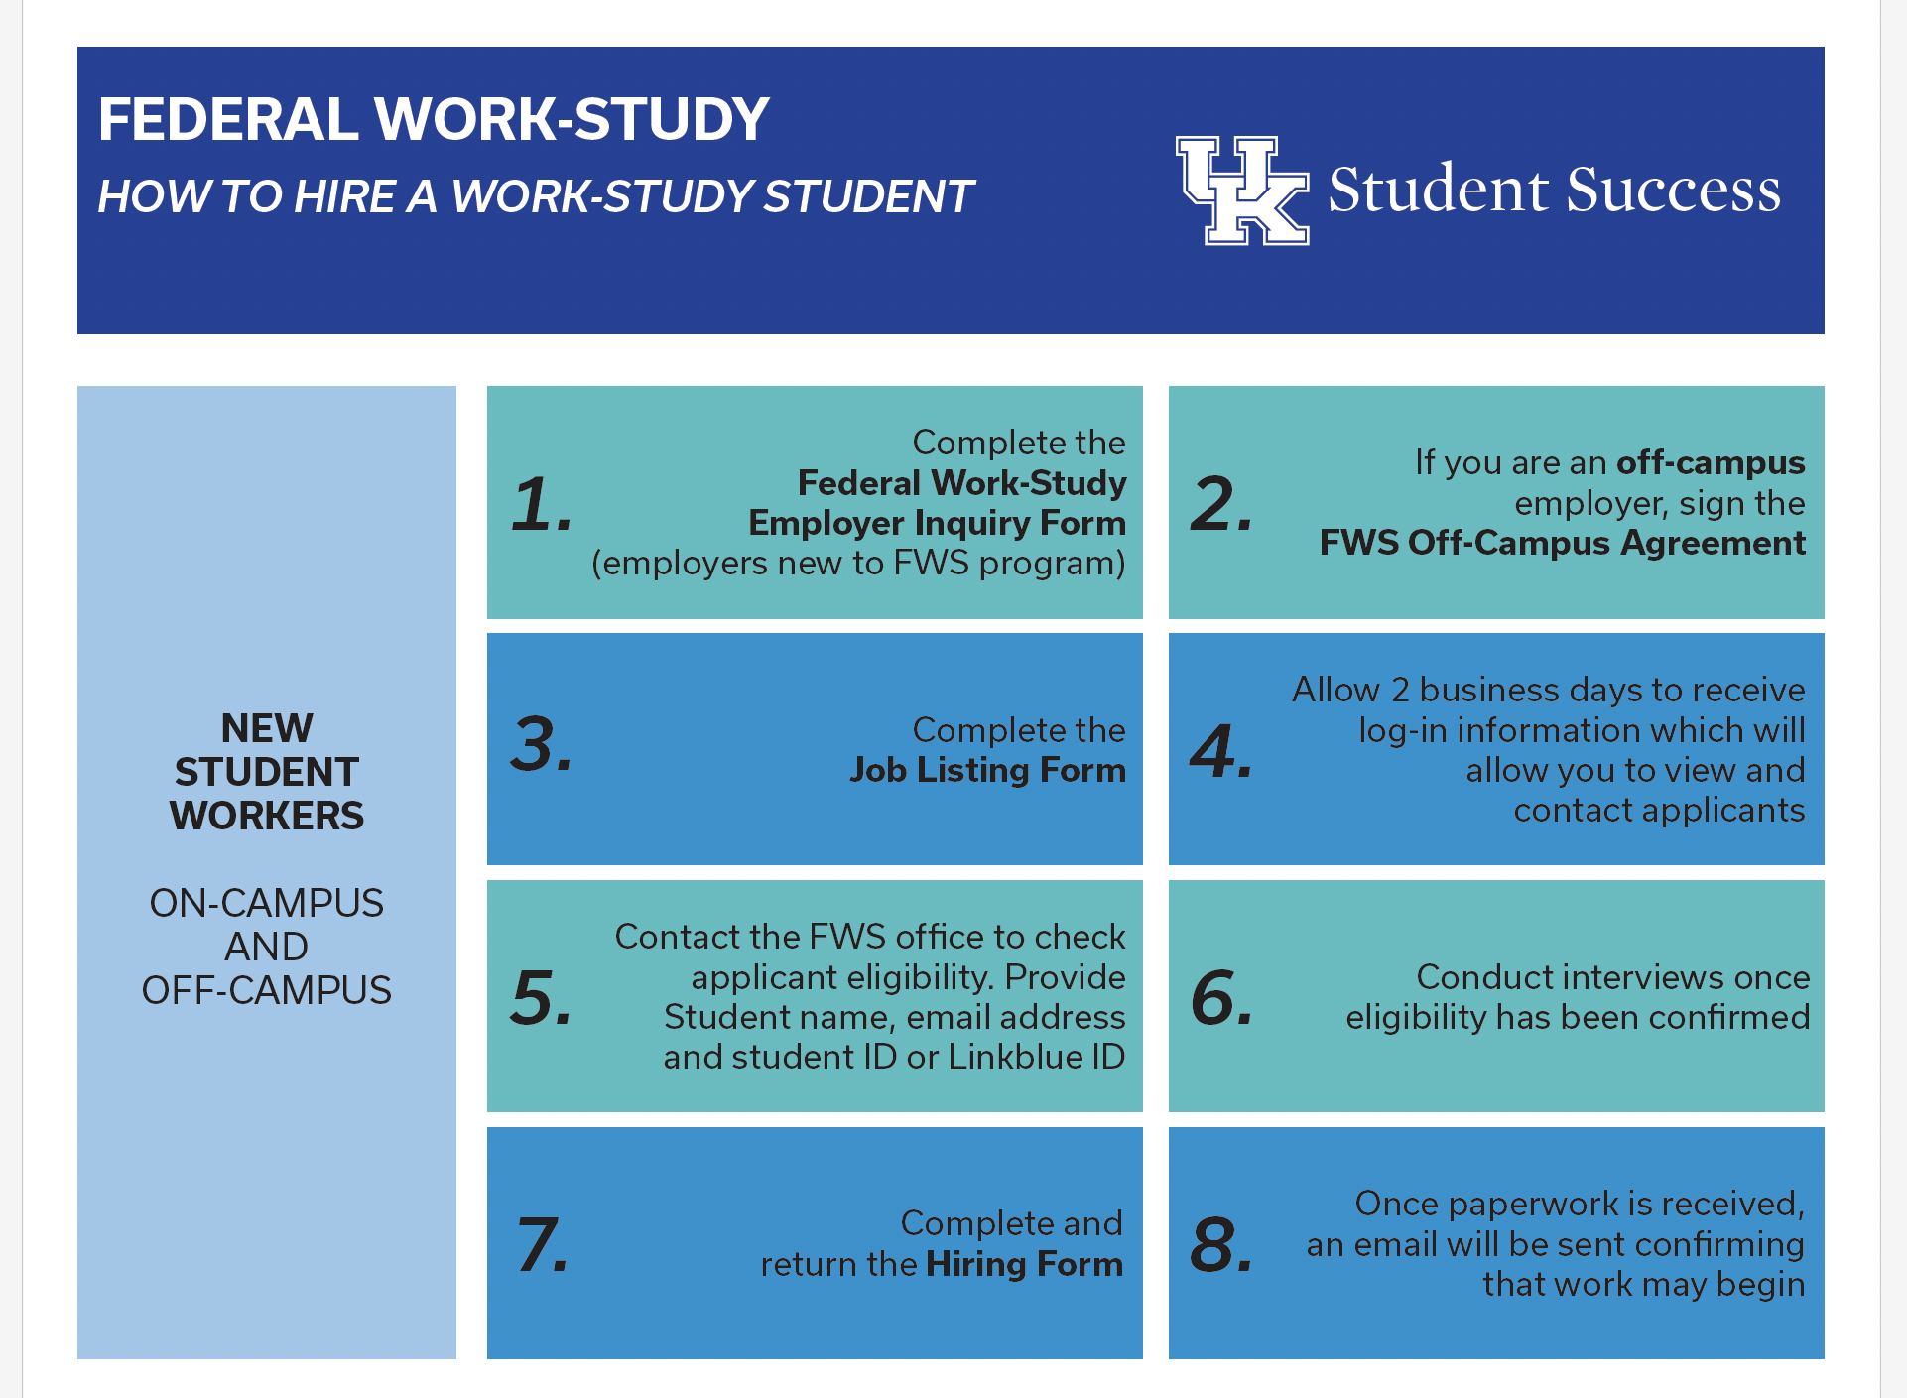
Updated and streamlined communication strategy to on-campus employers and students regarding utilization of the program
Outreach to students who were awarded FWS, but had not accepted the award
Outreach to students who accepted FWS about how they can find a position
Outreach and communication with strategic campus partners

Slide 7
Pilot a review process for all student employees in Student Success for FWS eligibility
Student employee hiring process does not change for departments
Tableau workbook allowing payroll specialists to determine if student is eligible and has accepted FWS as part of their financial aid package
Expedited process with Federal Work Study Office hire students into work study positions
Increased utilization of FWS eligibility in our hiring processes will allow us to increase our base hourly rate for all student employees in Student Success to $12/hour

Slide 8
Utilize Federal Work Study in AY24
Provides cost savings to your college/unit
Positively impacts student persistence and retention
How we can help…..
Template email to Department Chairs/Supervisors
Graphics to share with your units and supervisors to assist with navigating the process
Questions? – FWS@uky.edu
Notes:
How we can help…..
Template email to Department Chairs/Supervisors
Graphics to share with your units and supervisors to assist with navigating the process

