Slide 1
Dress for Success
One Step at a Time

Slide 2
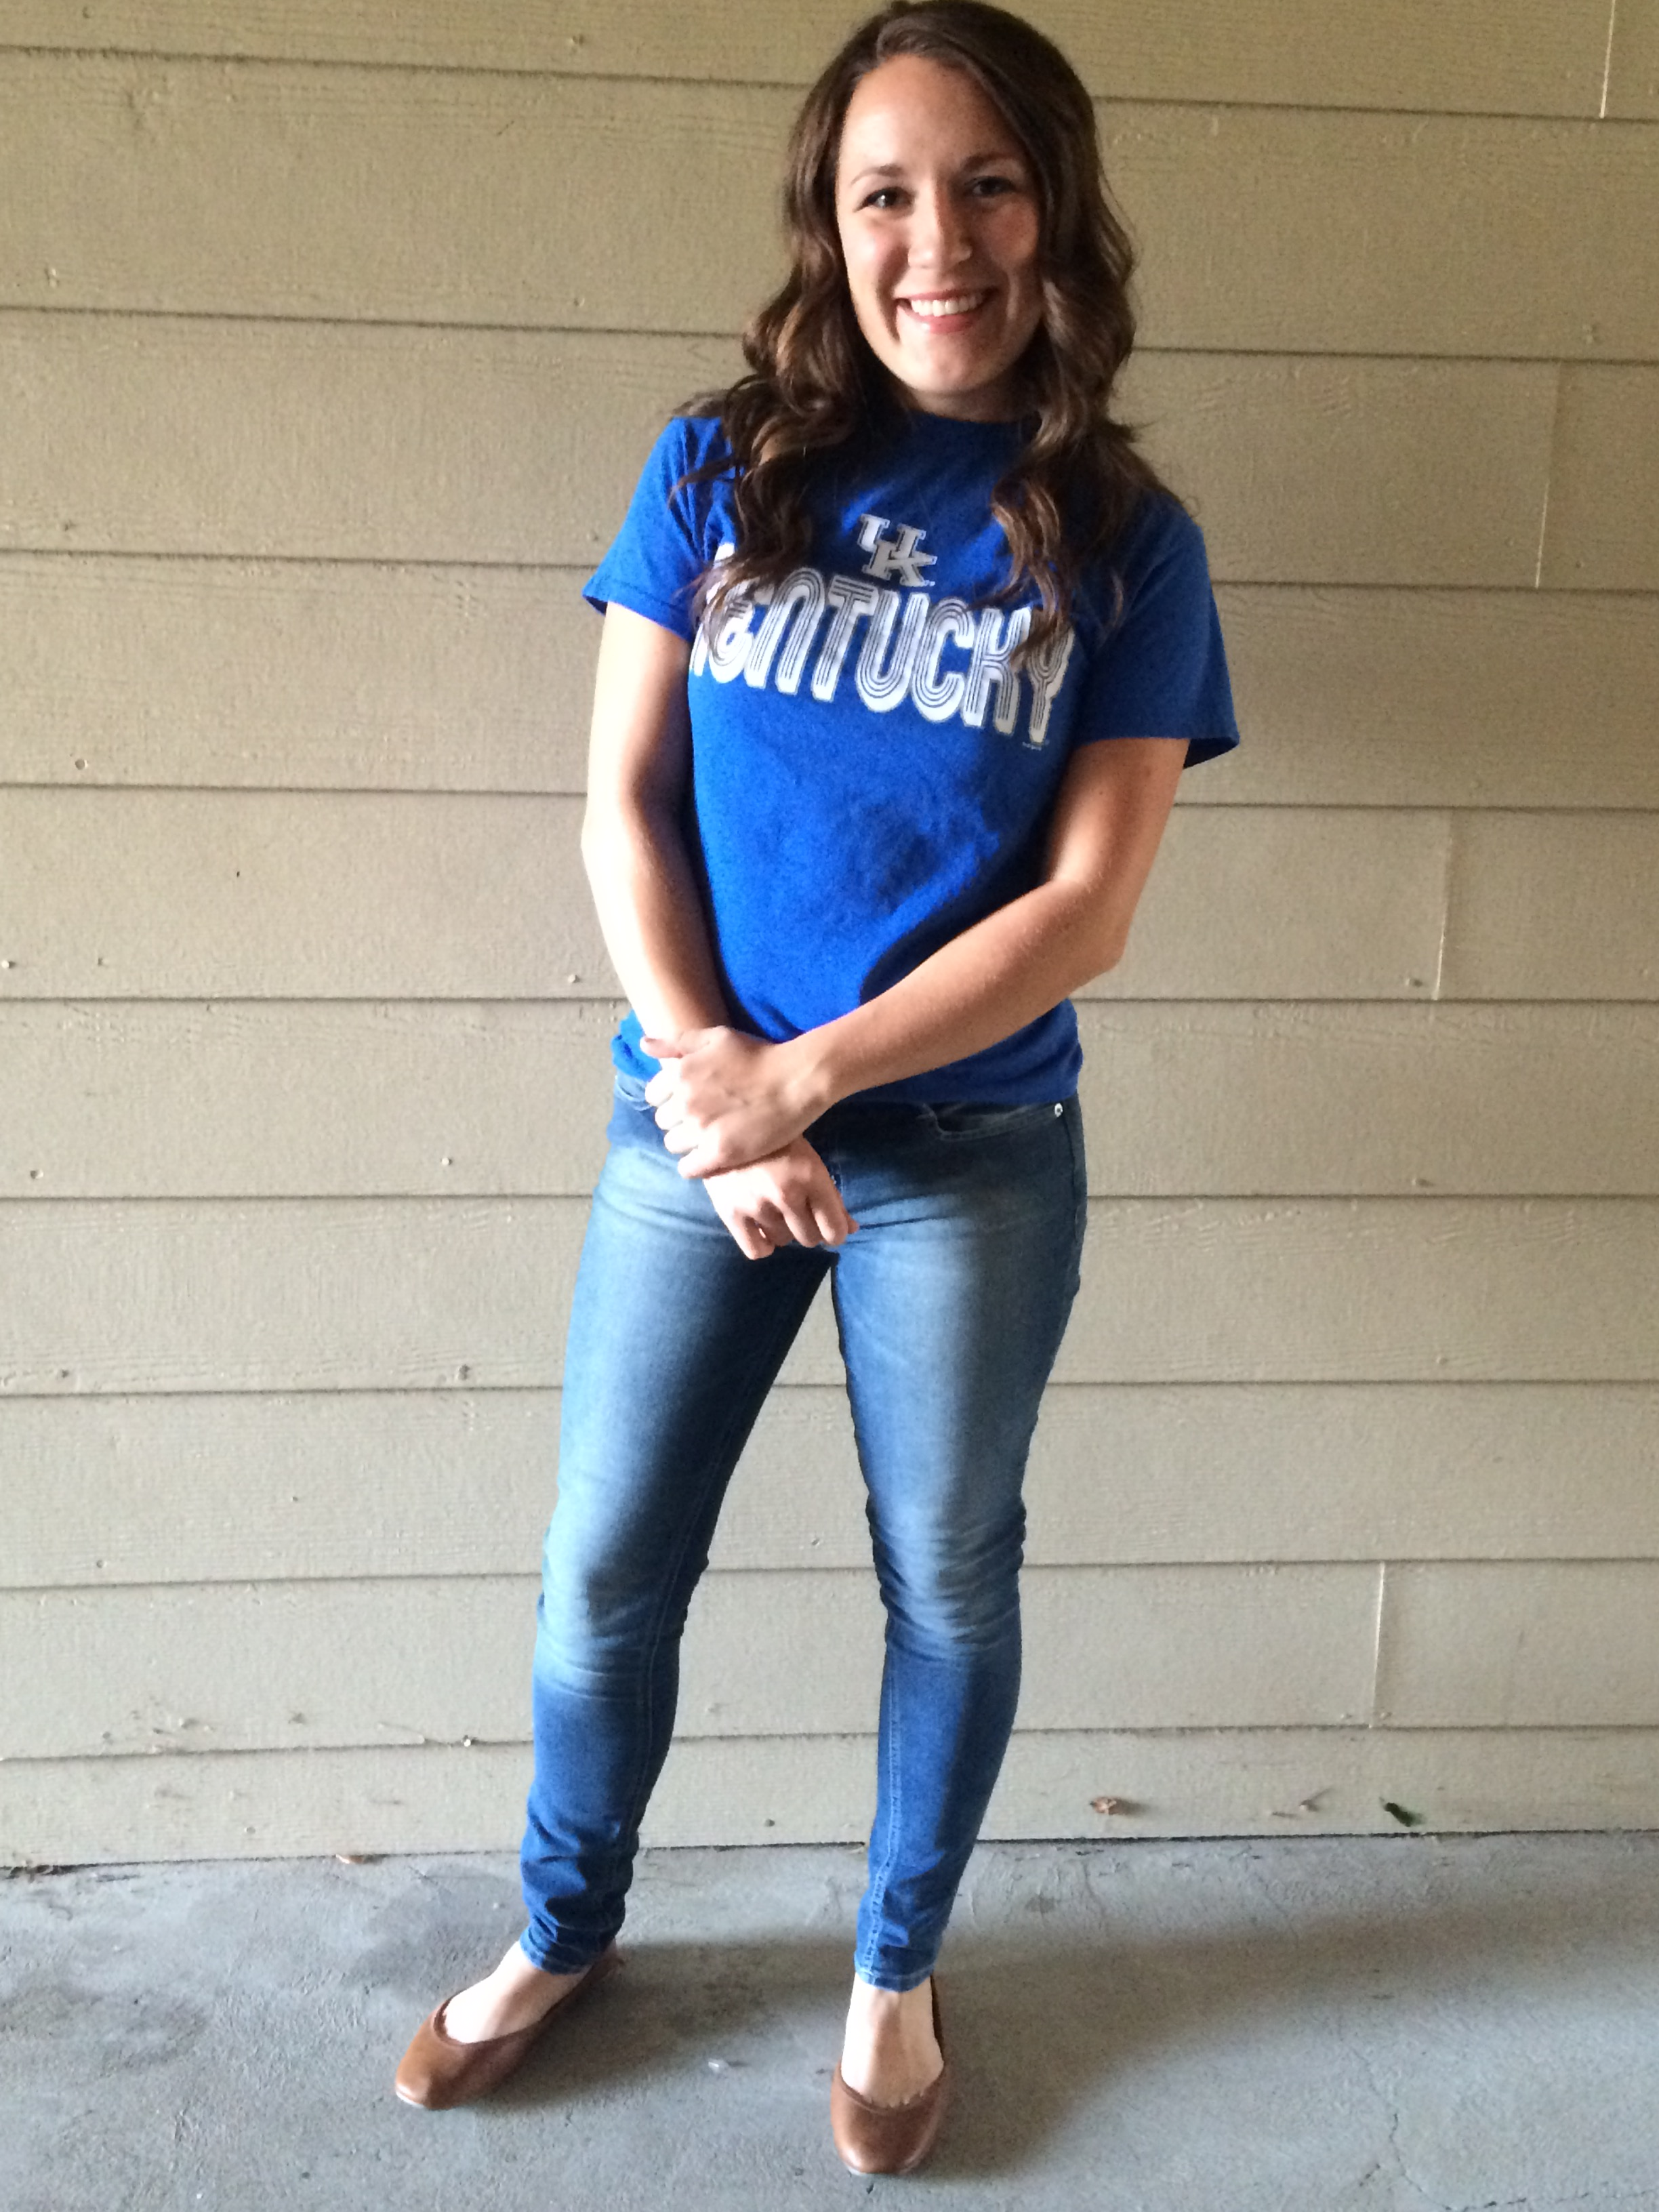
4 tops
4 bottoms
Casual to Professional Dress
3 pairs of shoes
1 necklace
9 looks
Casual Wear
Business Casual
Business Professional
Lounge

Slide 3
Game Day Loungewear
Game Day Casual Wear
College Team Spirit T-shirt
Joggers and sneakers
vs.
Jeans and flats

Slide 4
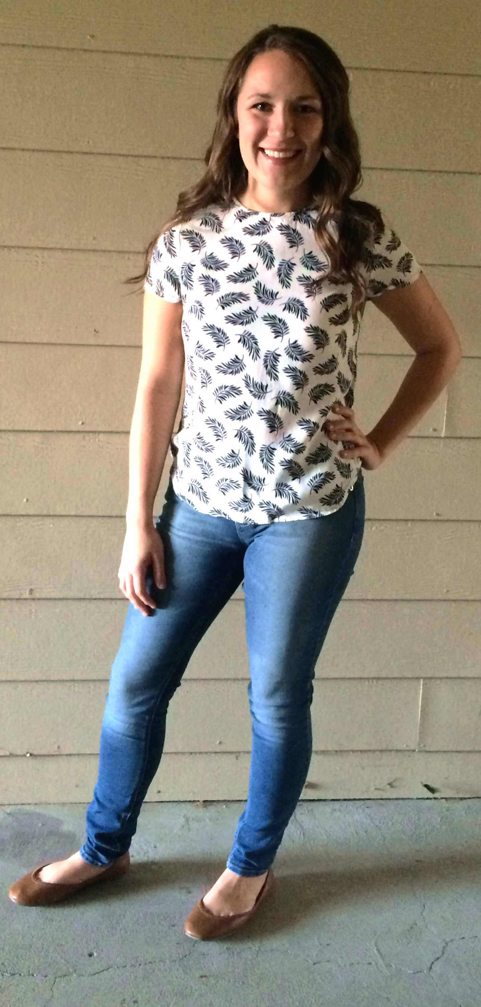
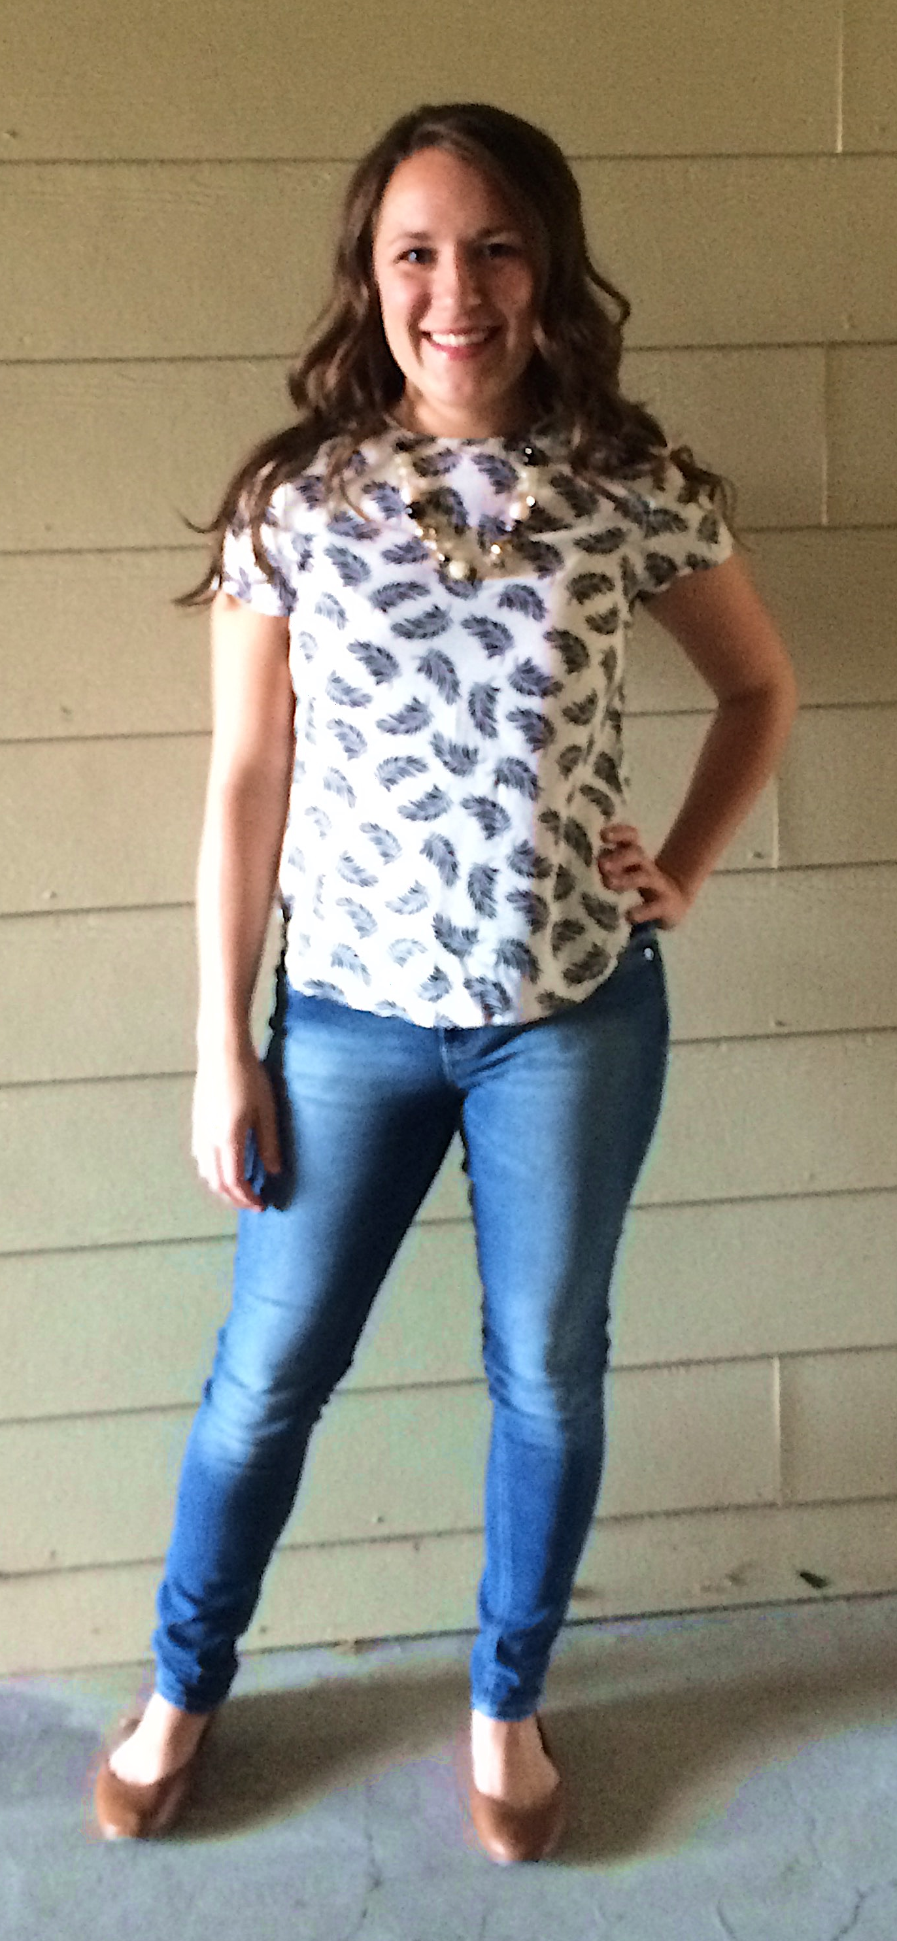
Daytime Casual
Evening Casual
Chunky Necklace
No Jewelry
vs.
Printed Blouse
Jeans and flats

Slide 5
(More Casual)
Business Casual
(More Business)
Chunky Necklace
Cardigan Sweater
or
Blazer Jacket
Printed Blouse and Jeans
Flats
or
Pumps

Slide 6
(More Casual)
Business Professional
(More Business)
Chunky Necklace and Printed Blouse
Chunky Necklace and Printed Blouse
Blazer Jacket
Dress Slacks
Pencil Skirt
or
Pumps
Pumps

Slide 7
Casual to Professional Dress
4 tops
4 bottoms
3 pairs of shoes
1 necklace
9 contrasting looks
9 outfits

