Slide 1
Is their chair supportive?
Is there a safe food?
Too much snacking?
Why Won’t My Toddler Eat?
Are they unsure how to eat a food?
Is the portion size correct?

Slide 2
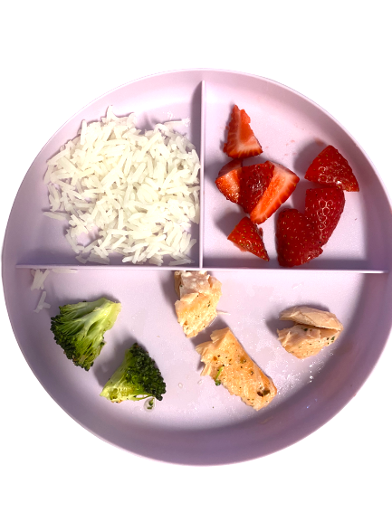
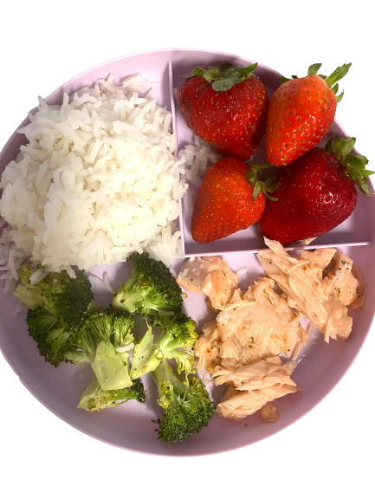
Is the portion size correct?
You can offer seconds if they eat all of something
An overly full plate can be overwhelming
Toddlers actually need much less food than we think they do
Children know when they are full
Visual spaces on the plate is less intimidating
Reduces food waste and throwing
back

Slide 3
Too much snacking?
Child might hold out for snacks
Snacks take up all of child’s caloric intake
Snacks are too close to mealtime
Child gets used to snacks over real meal
back

Slide 4
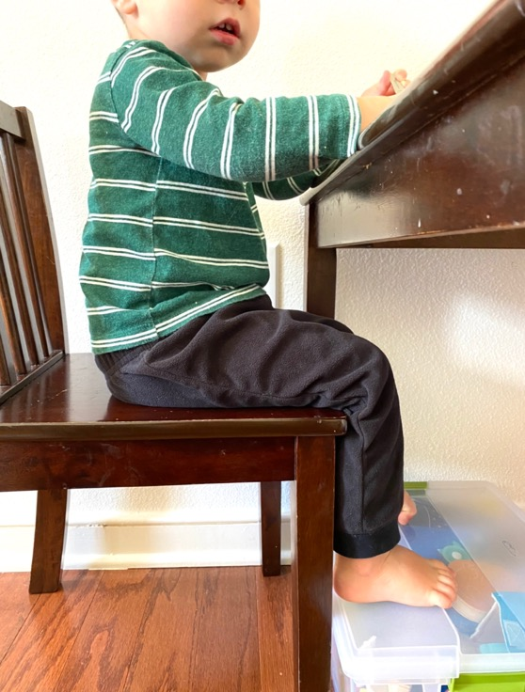
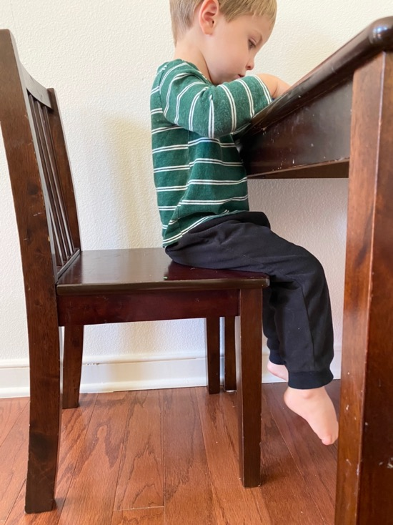
Is their chair supportive?
A child may not eat well if they are not sitting properly and are uncomfortable
Hips, knees, and ankles should be at 90 degree angles
Feet should always be supported by a footrest in order for proper positioning
Arms, chest, and head should be above eating surface
back

Slide 5
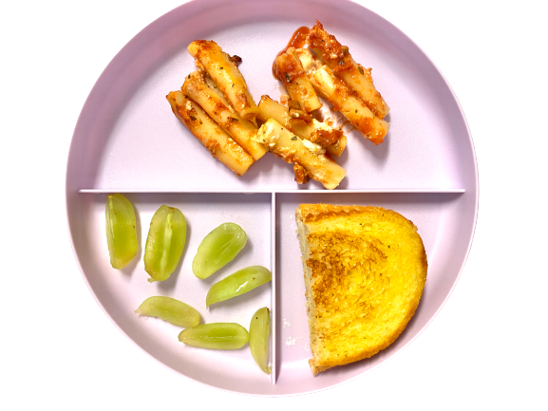
Is there a safe food?
New foods can be overwhelming
When introducing a new food, pair it with a food/foods that are familiar or a favorite (safe food) such as fruit or bread so that the new food isn’t so daunting
back

Slide 6
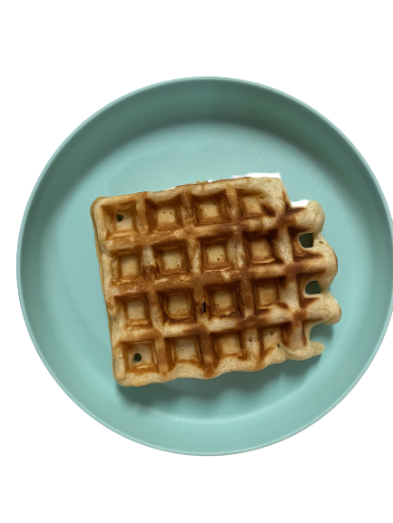
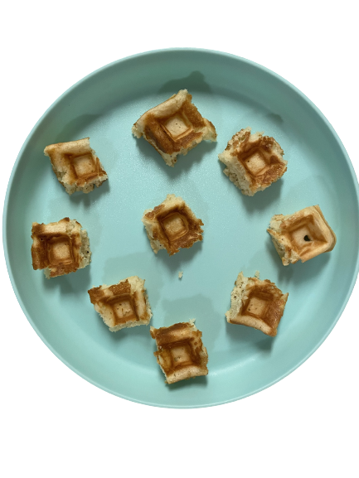
Are they unsure how?
Child may not understand how a food should be eaten with the way it is presented
If they are overwhelmed, they may refuse altogether
Break things down into easier pieces to understand
If child still seems unsure about how to start, give specific visual such as the fork or food pick already in a bite
back

