Slide 1
“First, there is a difference in data and evidence. Data are the things you collect. They can be qualitative or quantitative. They can be descriptive and even predictive. However, all the data in the world does not constitute evidence. Evidence is only achieved when the data are put into a logical order that reveals patterns or trends AND reasoning is applied to address the phenomena.”
-Stephen L. Pruitt

Slide 2
ev·i·dence
/ˈevədəns/
noun
noun: evidence
the available body of facts or information indicating whether a belief or proposition is true or valid. "the study finds little evidence of overt discrimination”
synonyms: proof, confirmation, verification, substantiation, corroboration, affirmation, attestation "they found evidence of his plotting"

Slide 3
Reinventing the wheel

Slide 4
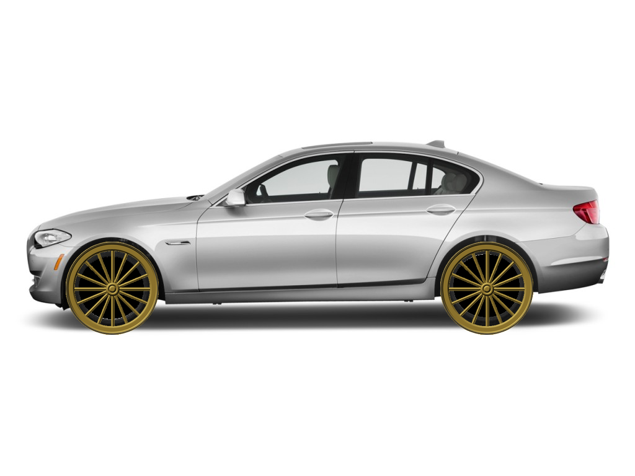

Slide 5
What if we reinvented evidence?
(and how we bank it)

Slide 6
Reinventing Portfolios
An example of reinventing structures

Slide 7
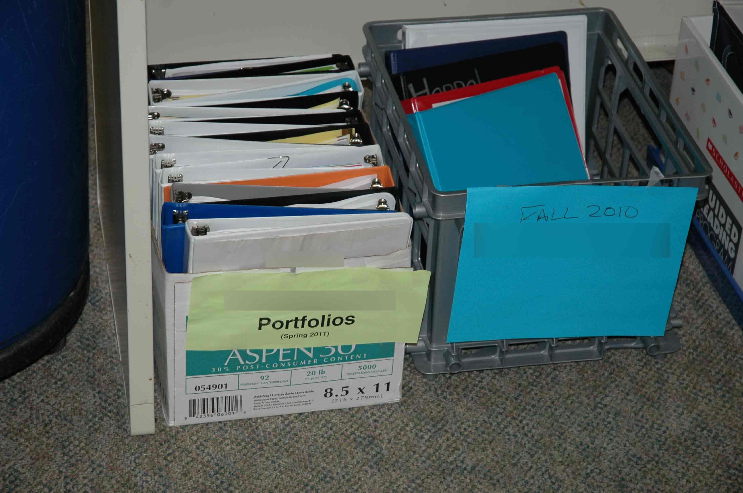

Slide 9
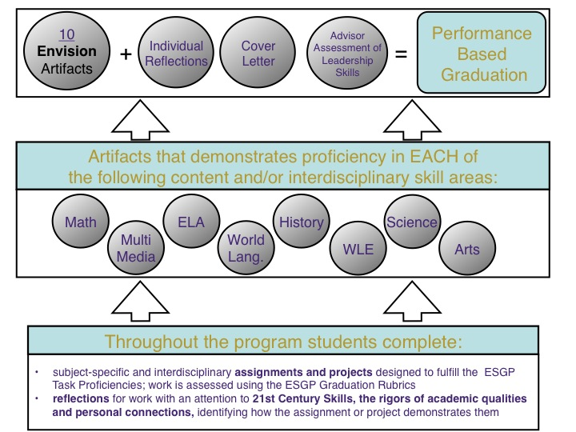

Slide 11
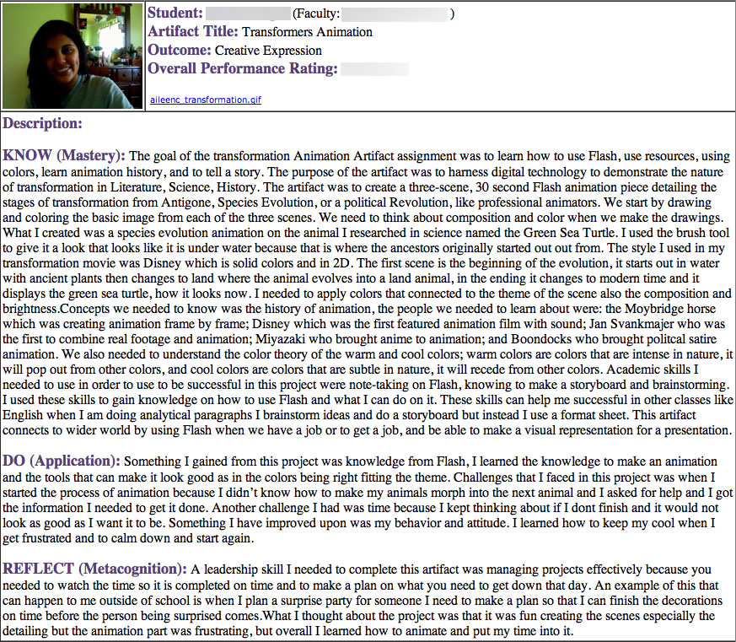

Slide 13
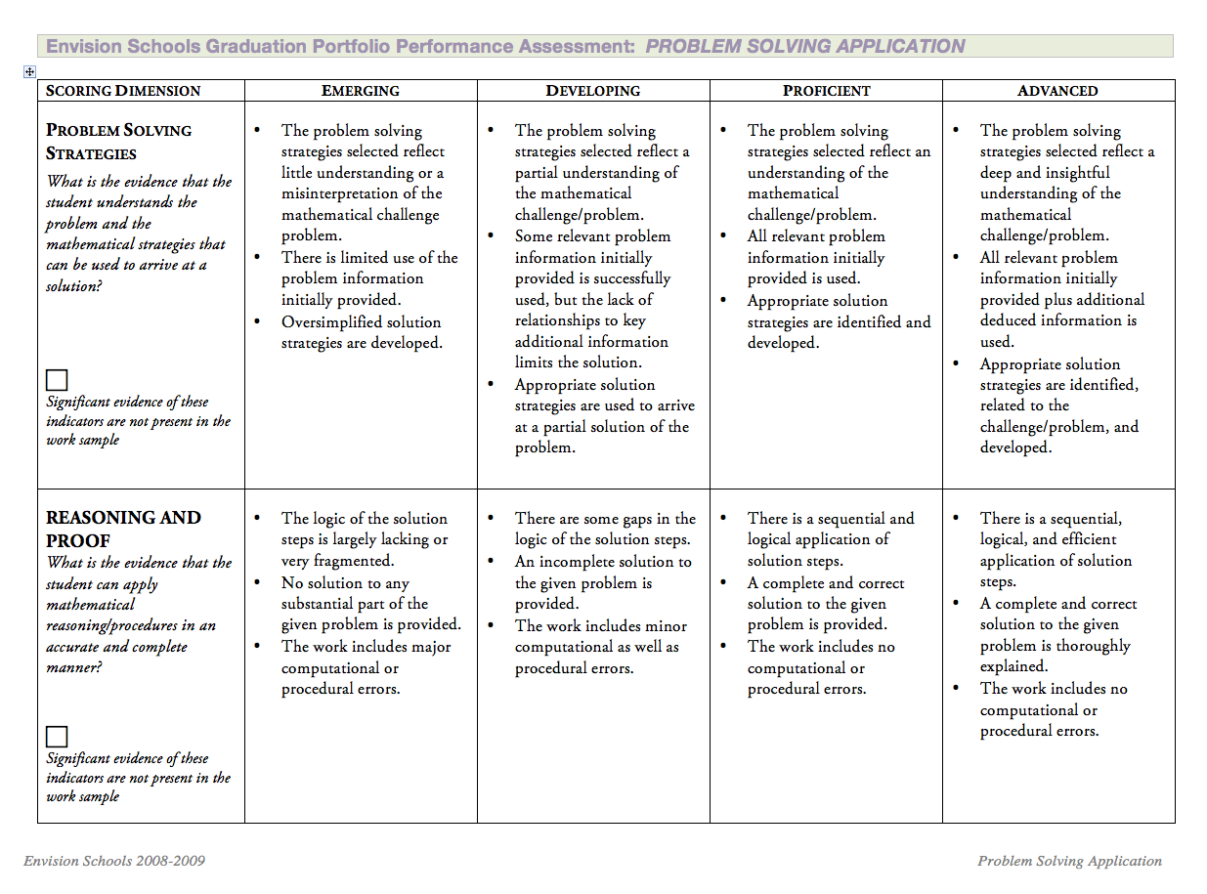

Slide 14
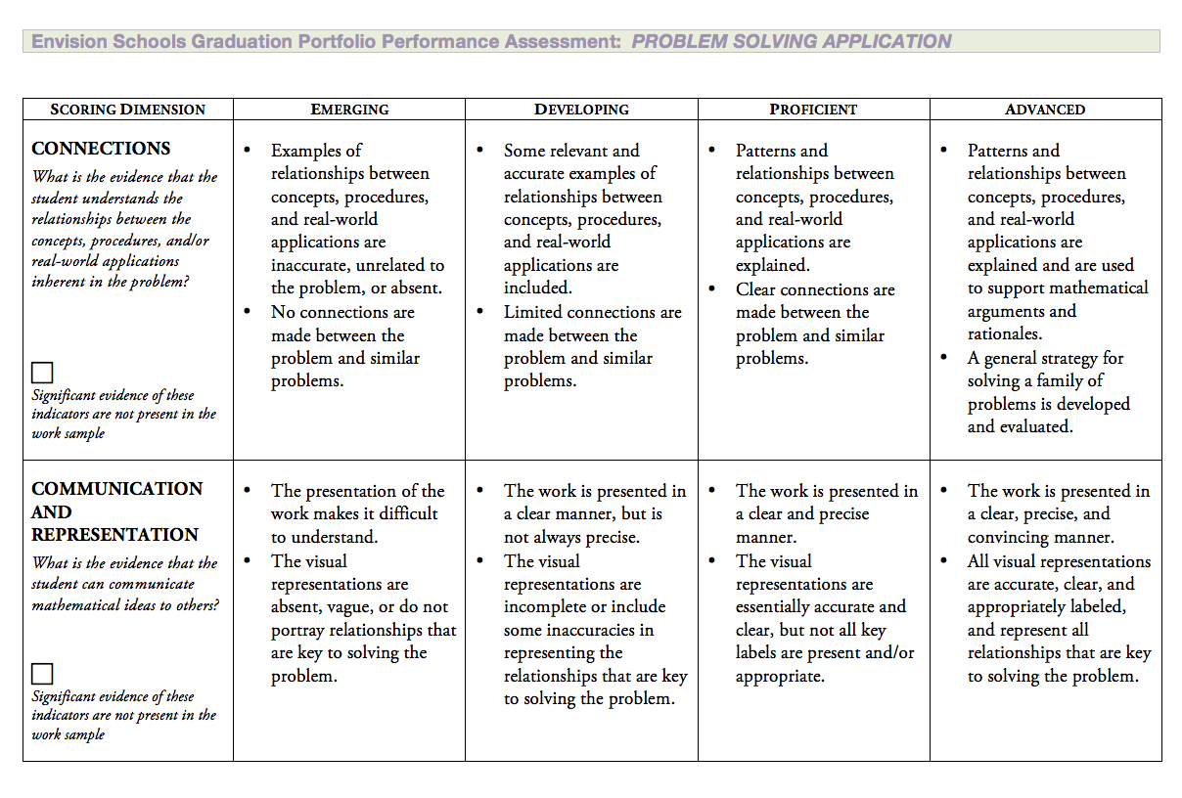

Slide 15
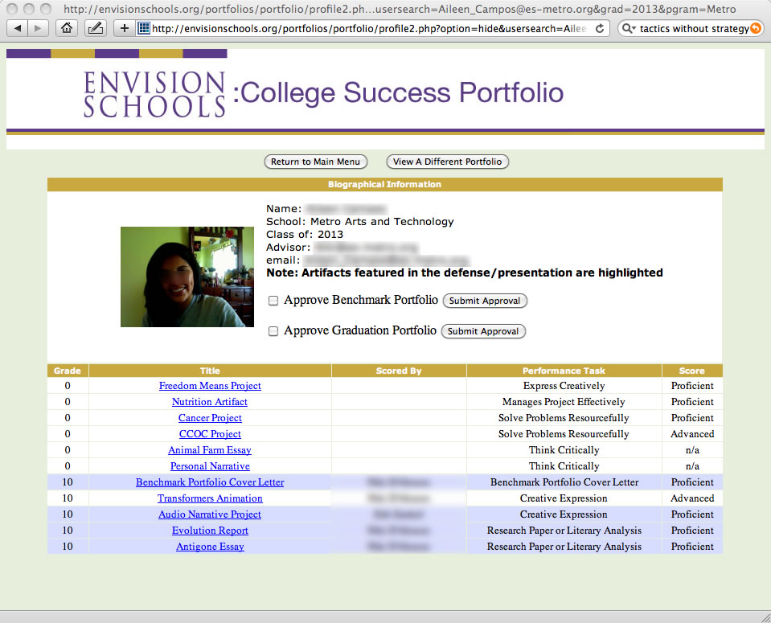

Slide 16
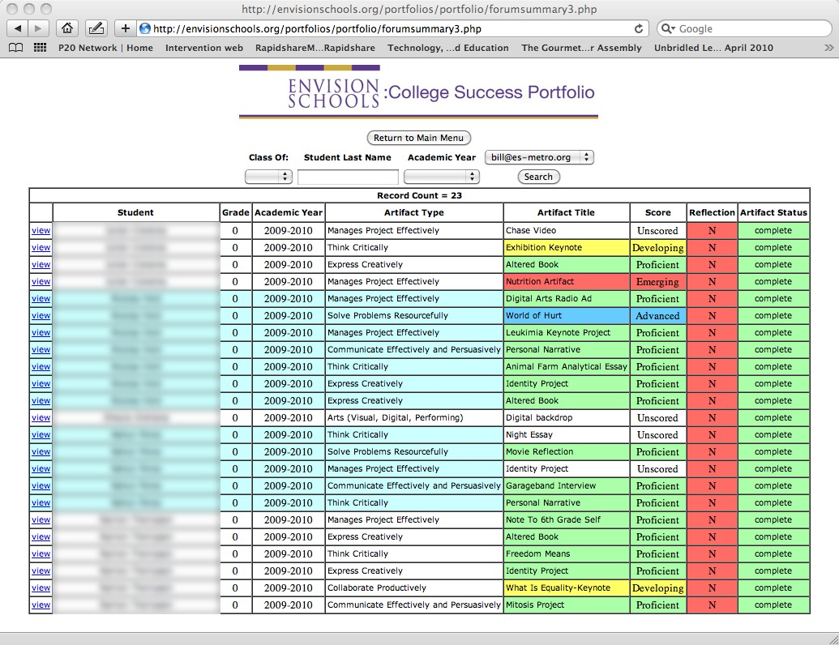

Slide 18
Media Rubric
Language Arts Rubric
Math Rubric

Slide 21
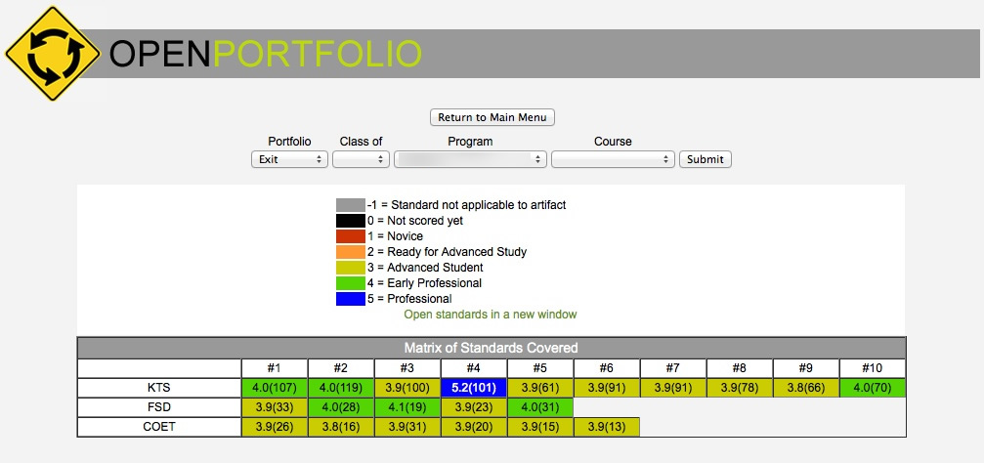

Slide 22
Step 1: Decide what’s important.

Slide 23
Step 2: Decide what it looks like.

Slide 24
Step 3: Operationalize what makes it good.

Slide 25
Atomic Level
Molecular Level
Complex Compound
A group of students
A Student

Slide 28
Don’t be afraid

Slide 29
Put Old Wine in New Bottles

Slide 30
Reinvent the wheel

