Slide 1
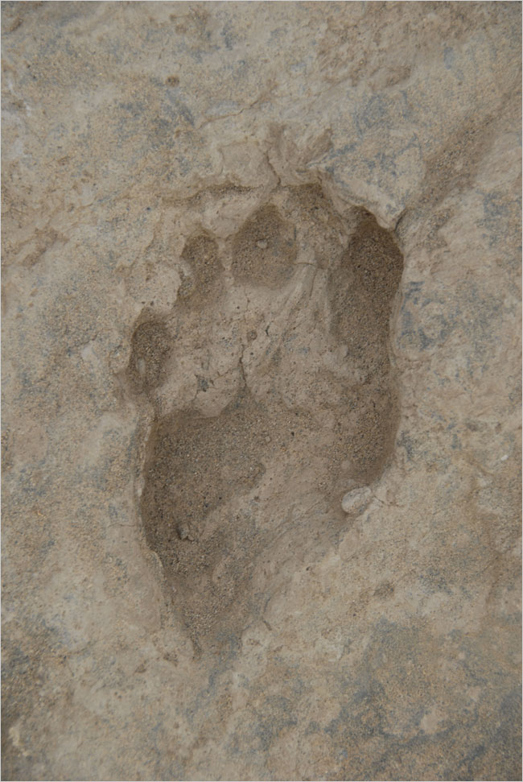

Notes:
Earliest footprints of our hominin relatives (Homo erectus) found in Kenya: the footprints, dated to between 1.51 million and 1.53 million years ago
How did we get to the Anthropocene, from so few to so many?

Slide 2
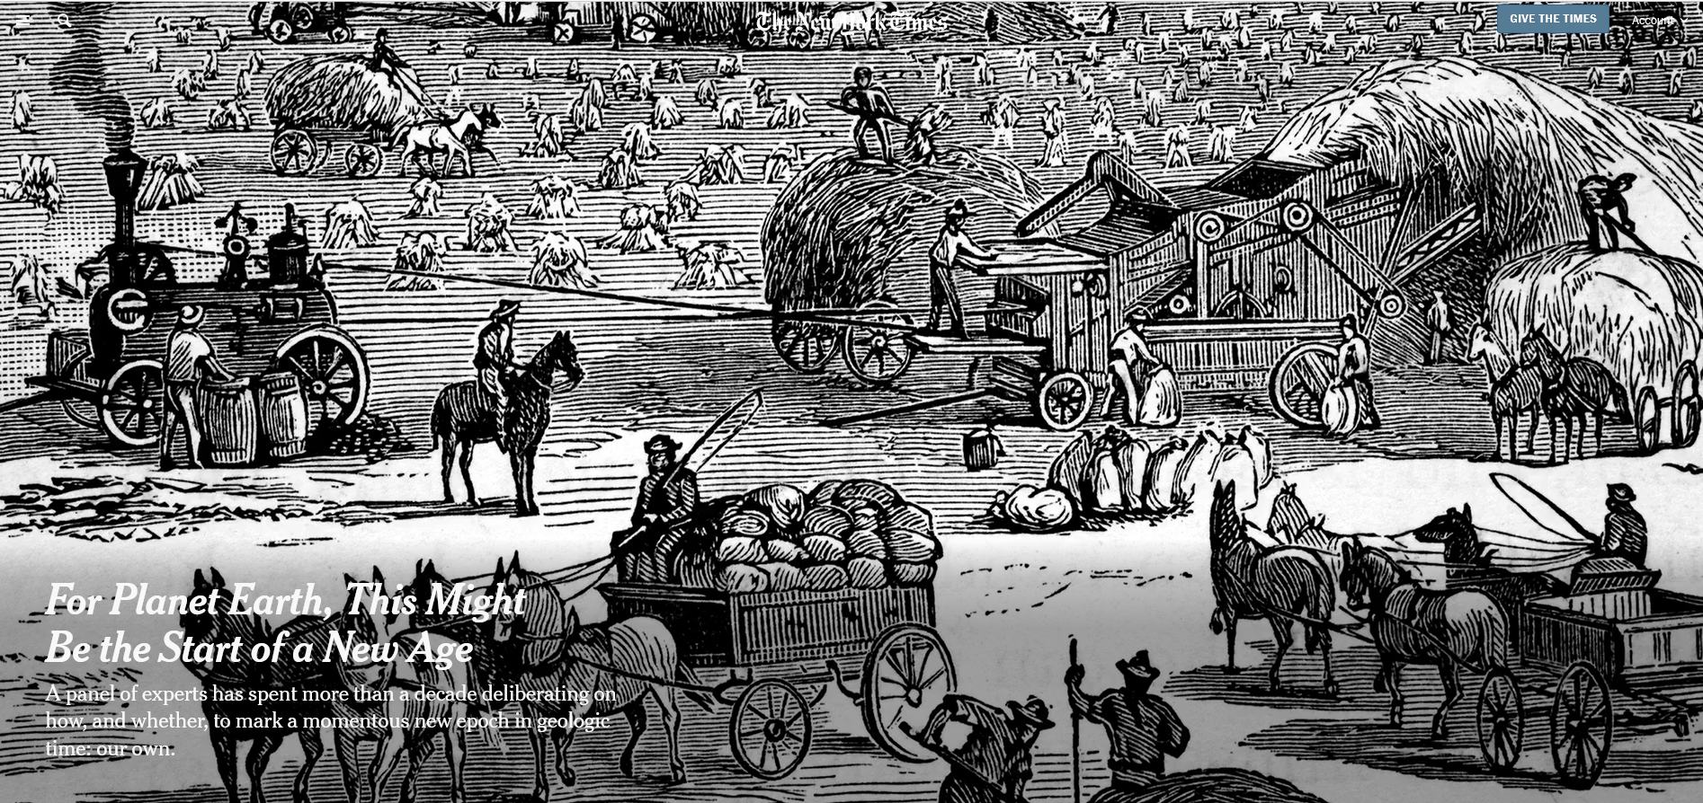
Notes:
https://www.nytimes.com/2022/12/17/climate/anthropocene-age-geology.html
This is one of your readings for Unit 1. It discusses the different ways in which the start of the Anthropocene can be designated and what markers in the geologic record best signify it.

Slide 3
When did the Anthropocene begin?
Plio-Pleistocene megacarnivore extinctions
Pleistocene megafaunal extinctions
Neolithic Revolution
Orbis Spike
Industrial Revolution
Post World War 2 Great Acceleration
Post World War 2 US economic policies
Notes:
Vote and submit on a half sheet of paper

Slide 4
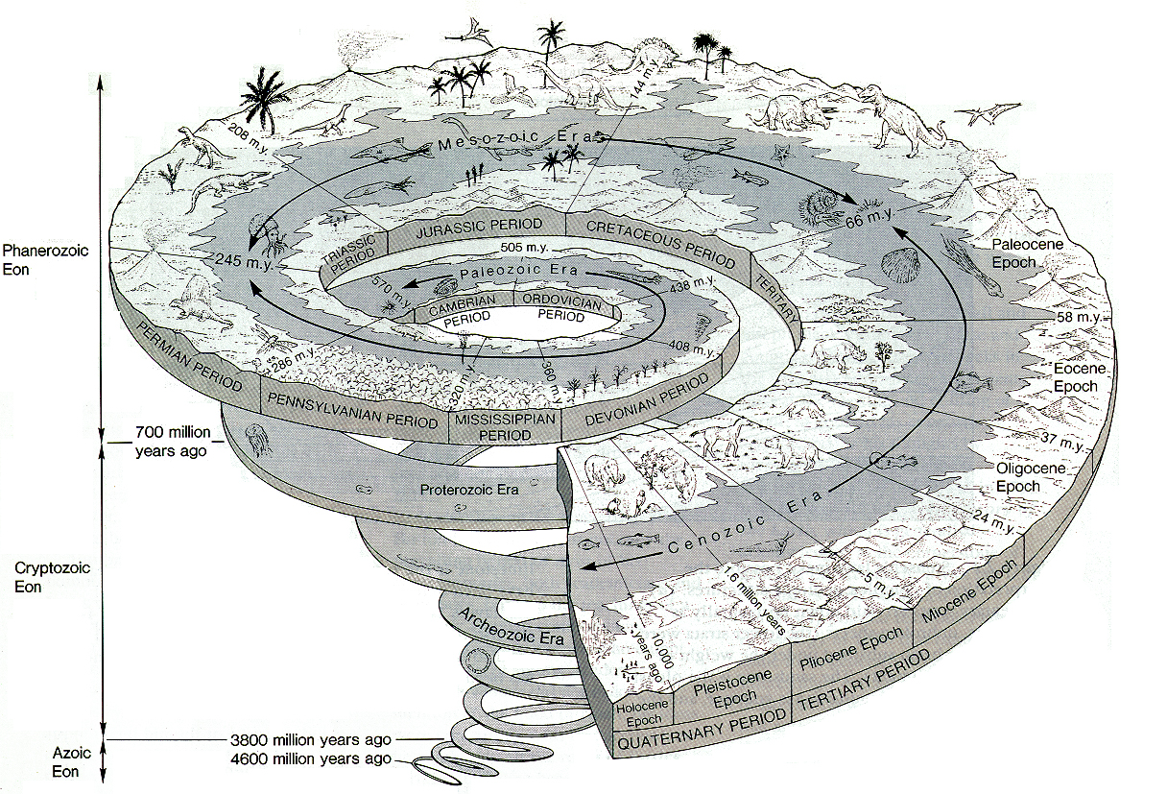
The geologic time scale
Notes:
But first we need to conceptualize the human presence in geologic time. We will focus in this class on the Quaternary period, which includes the Holocene Epoch and the Pleistocene Epoch

Slide 5
The Quaternary geologic period contains the:
Pleistocene epoch
  Began approximately 2 million years ago and ended 10,000 years ago
  Marked by prominent oscillations in climate: warm interglacial intervals and cold glacial intervals
Holocene epoch
  Began approx. 10,000 years ago when the last glacial interval ended and the world began to warm (and coincidentally, so did the emergence and spread of agriculture)
Notes:
Were humans around in the Pleistocene? Yes. However, their numbers were small. It was only in the last 10,000 years that human numbers have began their rapid increase.

Slide 6
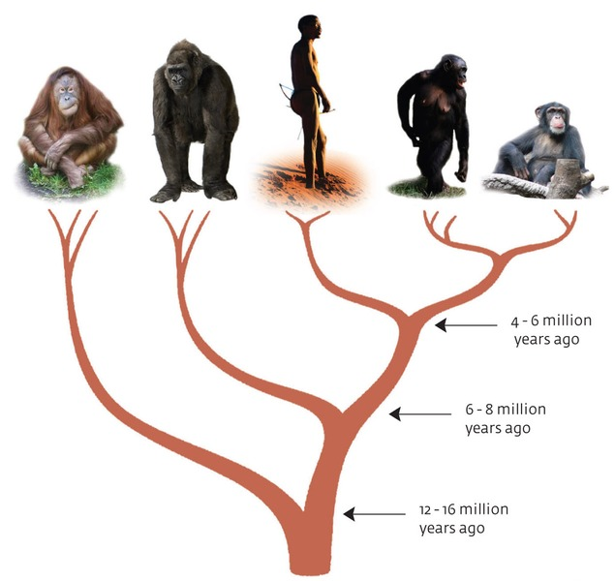
Origins of Homo sapiens
6-8 million years ago: lineage currently represented by humans, chimpanzees and bonobos diverges from the ancestors of the gorillas.
4-6 mya: human lineage originates
Evolution of humans involves interaction of our ancestors with the environment and technology
Notes:
mya: millions of years ago

Slide 7
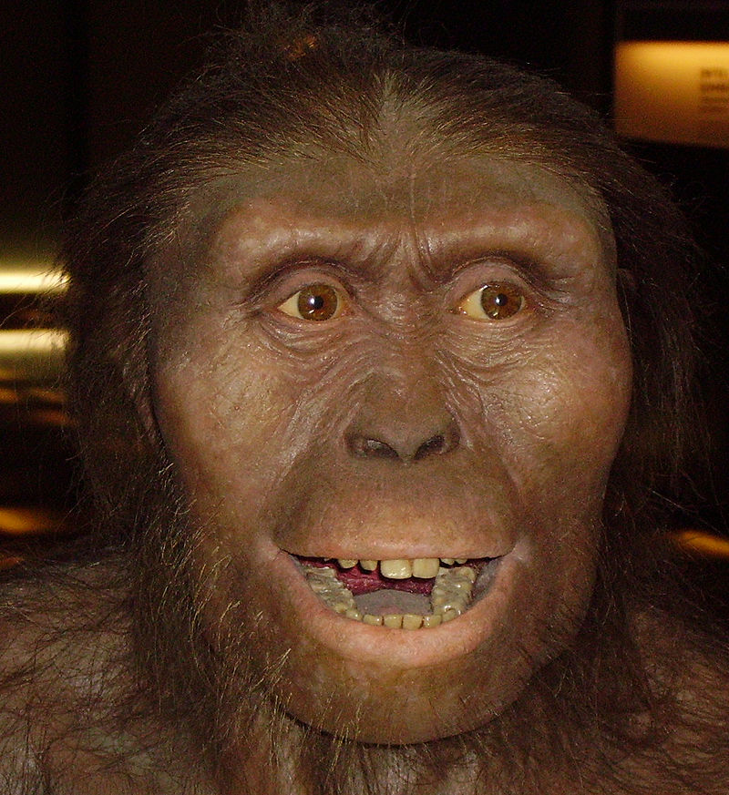
Origins of Homo sapiens
3 - 4 mya: Australopithecus afarensis provides strong evidence of full-time bipedalism
Notes:
https://www.youtube.com/watch/xT8Np0gI1dI

Slide 8
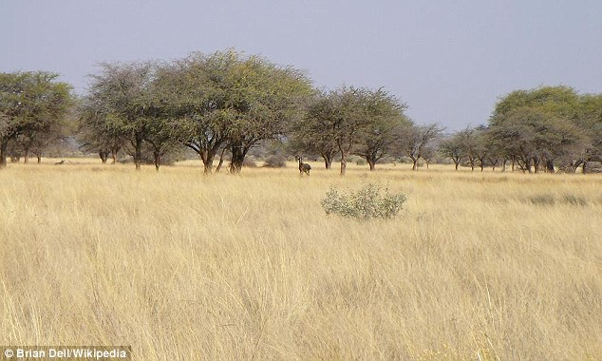
Notes:
With the decline of dense forest, our ape-like ancestors were forced to descend from the trees. The new challenges presented by these wide open spaces forced our ancestors to develop new flexible diets, different vocal sounds, large brains and complex social structures.

Slide 9
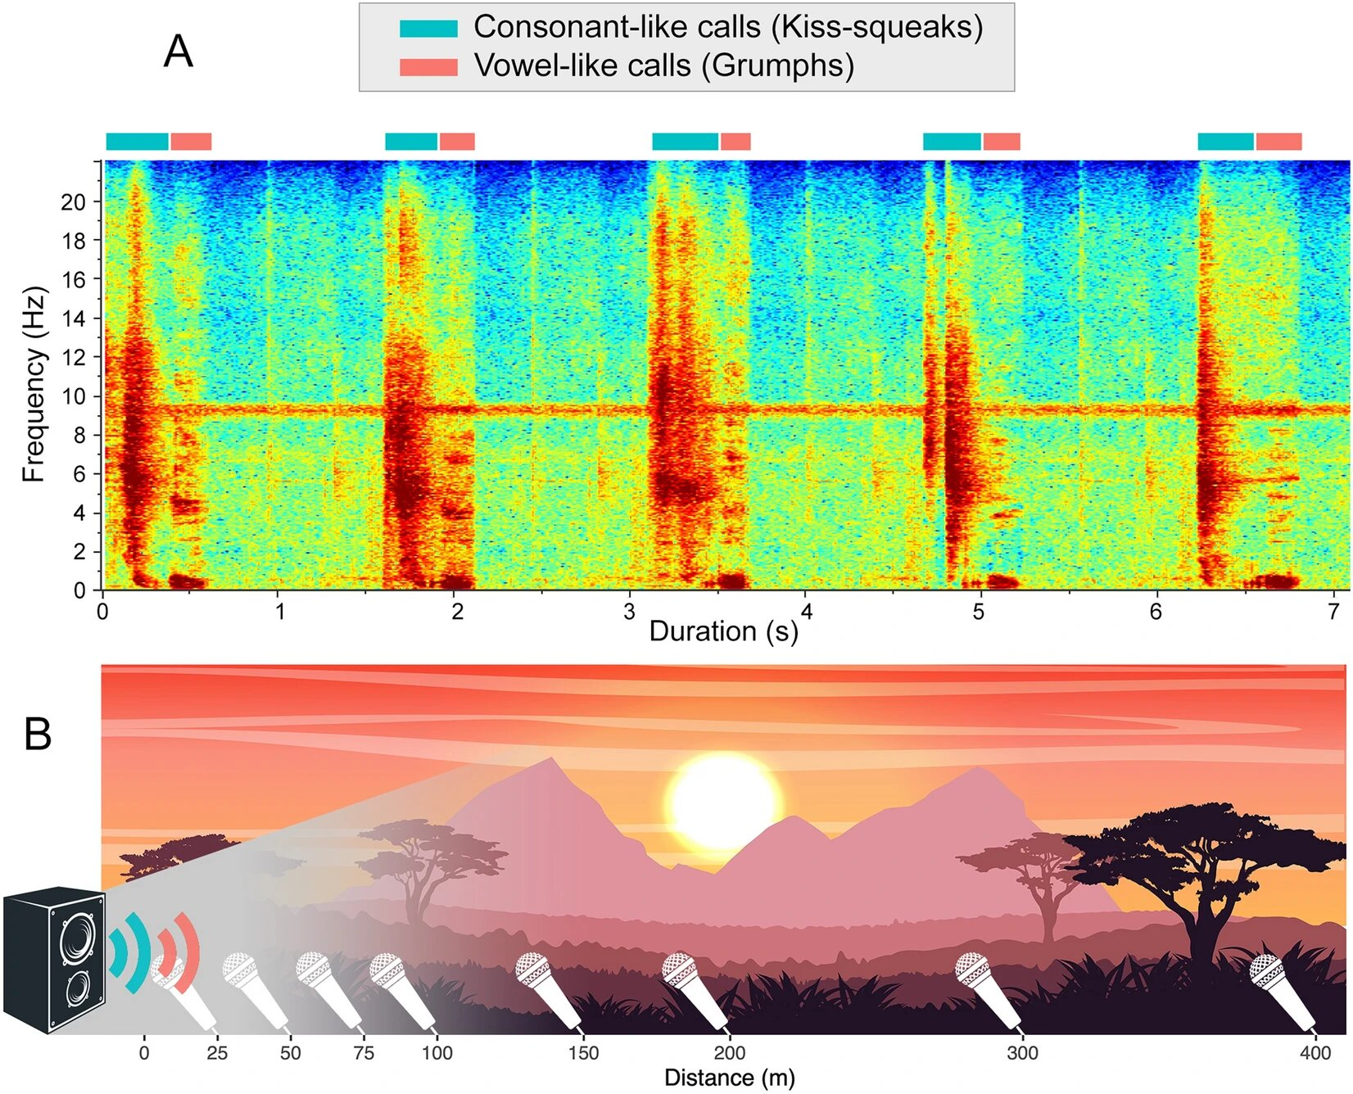
Notes:
The shift from dense forests to open plains in Africa may have caused our ancient ancestors to change their vocal calls. Consonants are heard much farther than vowels in open environments.
80% of consonant-based calls were audible at 400 meters, while less than 20% of vowel-based calls remained audible at the same distance.
This showed that consonant-based calls remained audible over longer distances than vowel-based calls.
These findings suggest that consonant-based calls are more effective in open landscapes and were possibly influenced around 5.3 to 16 million years ago, during the middle and late Miocene Era, when Africa's landscapes turned from forests to wide-open grasslands, pushing ancient primates out of the trees and onto the ground. As consonants play a significant role in modern human languages, the findings suggest that the transition to open plains might have been pivotal in shaping early human vocal communication.
Gannon, C., Hill, R.A. & Lameira, A.R. Open plains are not a level playing field for hominid consonant-like versus vowel-like calls. Sci Rep 13, 21138 (2023). https://doi.org/10.1038/s41598-023-48165-7

Slide 10
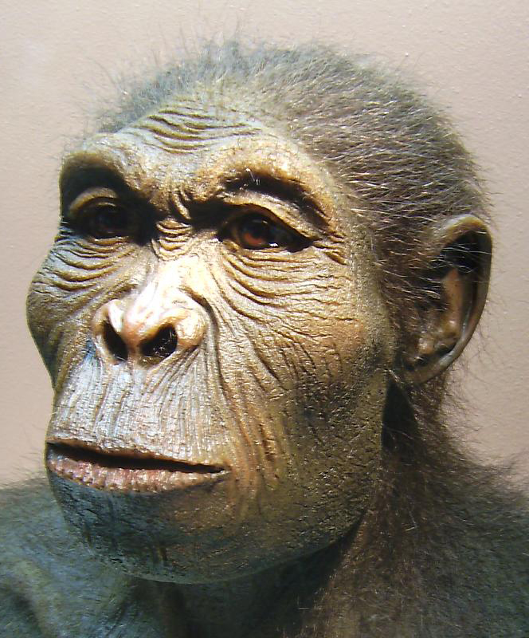
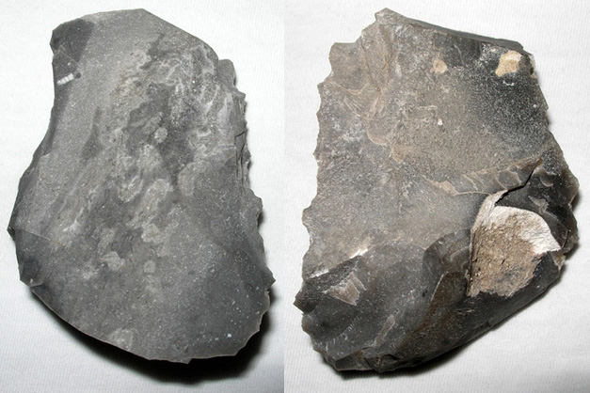
Origins of Homo sapiens
2.5 mya: Homo habilis, first stone tools
Notes:
Aka the handyman

Slide 11


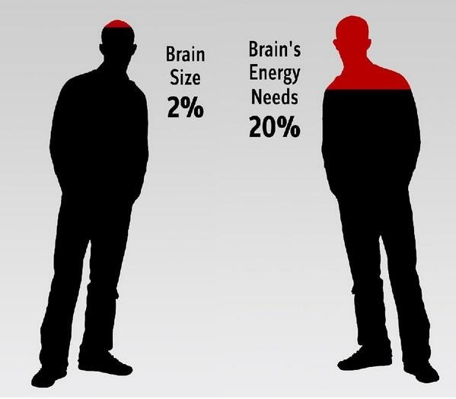
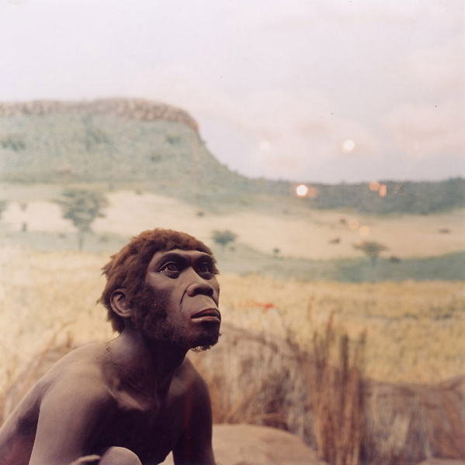
Origins of Homo sapiens
1.8 mya: Homo erectus used fire for cooking. Fire changed us physically as well as socially and cognitively
Notes:
Fire is a technology. Fire, like the stone tools before it, was a major technological transition and it had a large impact on our physical, social, cultural, and cognitive evolution.
Cooking food in general, not only meats, make them more digestible and more calories can be extracted from cooked food.
It is well established that the brain uses more energy than any other human organ, accounting for up to 20 percent of the body's total haul. Fire facilitated a metabolism that favored the evolution of larger brain size in humans.

Slide 12
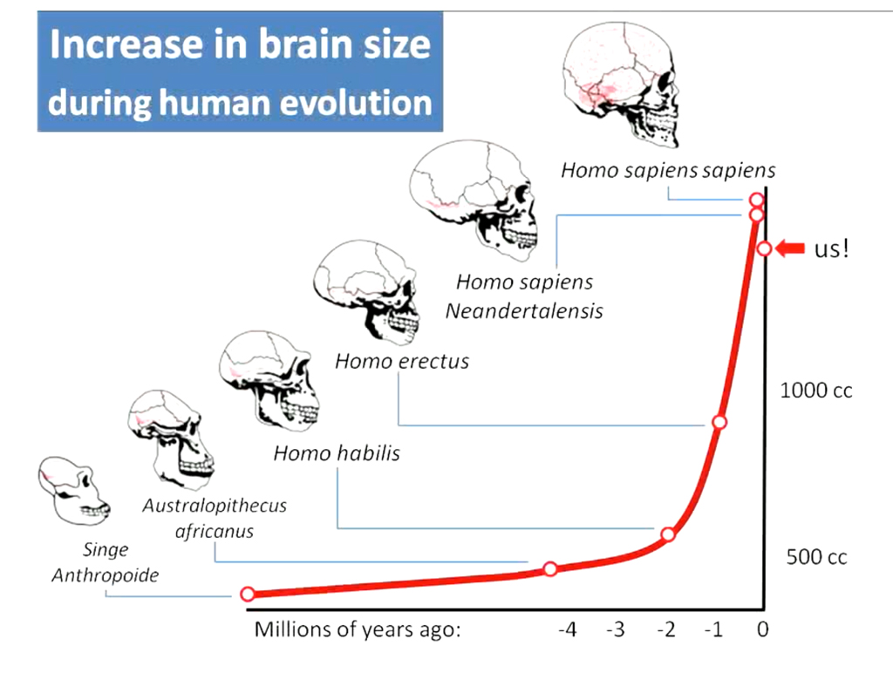

Slide 13
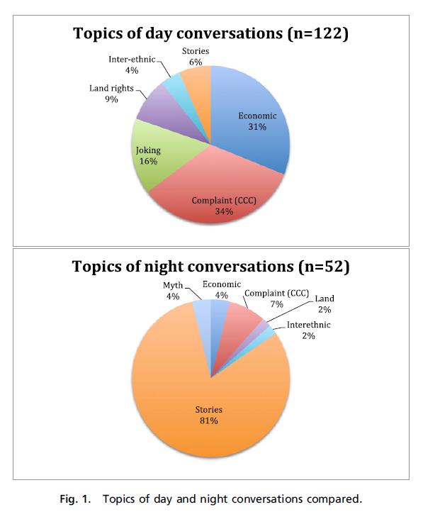
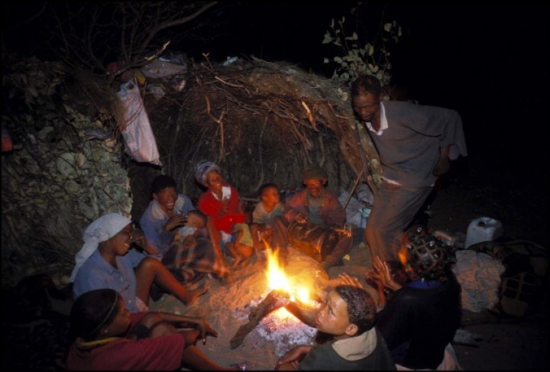
Fire also allowed us more time for storytelling and the creation of culture. Group learning and cultural transmission took place around the fire at night. Technology is part of who we are – from fire and stone tools to the technologies we use today. They change us and our environment.
!Kung Bushmen of southern Africa
Notes:
Much attention has been focused on control of fire in human evolution and the impact of cooking on anatomy, social, and residential arrangements. However, little is known about what transpired when firelight extended the day, creating effective time for social activities that did not conflict with productive time for subsistence activities. Comparison of 174 day and nighttime conversations among the !Kung Bushmen of southern Africa, supplemented by 68 translated texts, suggests that day talk centers on economic matters and gossip to regulate social relations. Night activities steer away from tensions of the day to singing, dancing, religious ceremonies, and enthralling stories, often about known people. Such stories describe the workings of entire institutions in a small-scale society with little formal teaching. Night talk plays an important role in evoking higher orders of theory of mind via the imagination, conveying attributes of people in broad networks (virtual communities), and transmitting the “big picture” of cultural institutions that generate regularity of behavior, cooperation, and trust at the regional level. Findings from the !Kung are compared with other hunter-gatherer societies and related to the widespread human use of firelight for intimate conversation and our appetite for evening stories. The question is raised as to what happens when economically unproductive firelit time is turned to productive time by artificial lighting.

Slide 14
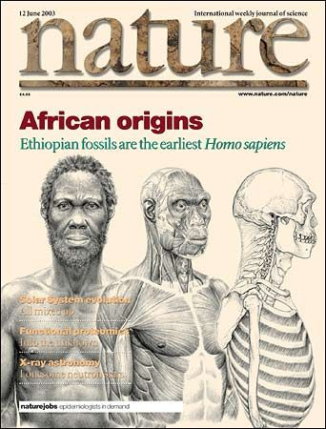
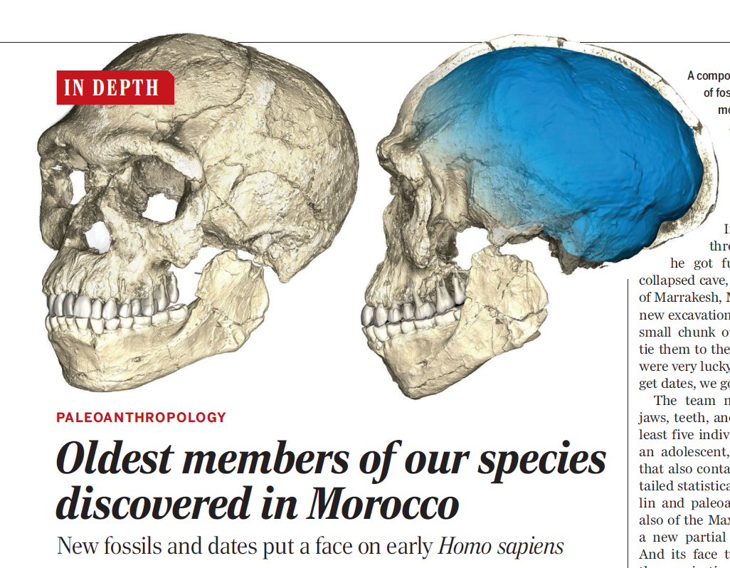
Homo sapiens
Anatomically modern humans emerged in Africa approximately 200,000 – 300,000 years ago
The largest dispersal of Homo sapiens out of Africa began 60,000 years ago
Notes:
All numbers are approximate and debated in the scientific literature. I have approximated them to communicate the basic idea

Slide 15
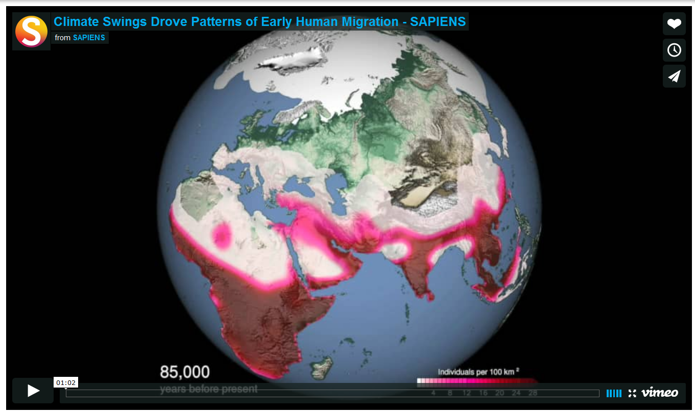
Notes:
With stone tools and fire, and increasingly larger numbers the stage was set. With changes in climate that made parts of north Africa and the Middle East warm and wet and capable of supporting more vegetation and wildlife, we began to disperse out of Africa.

Slide 16
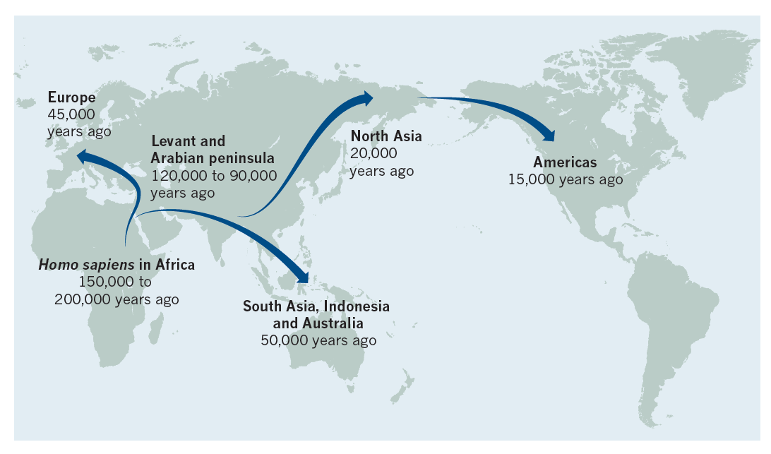
3
Began 120,000 ya
Began 60,000 ya
Notes:
Levant means the Middle East
Two departure waves, one that began 120,000 years ago, and a larger one 60,000 years
Aboriginals in today still retain a small genomic signal of the earlier wave of immigration.

Slide 17
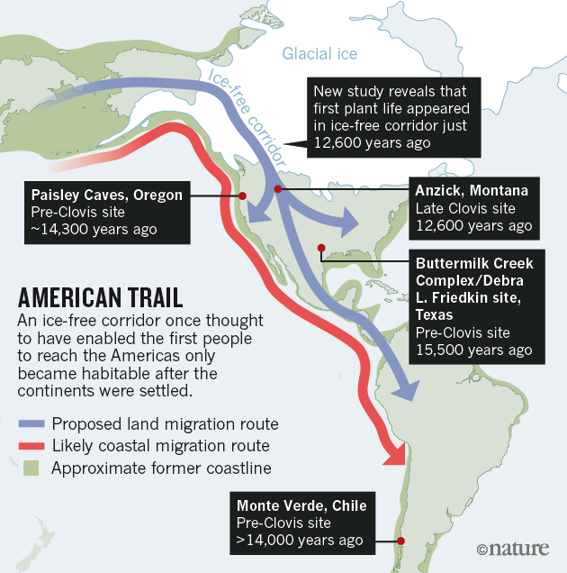
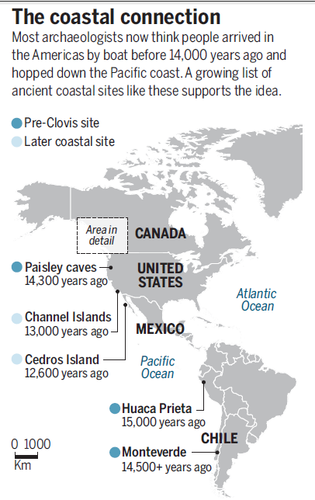
Dispersal into the Americas
Notes:
Coastal route is now the more preferred explanation for how we humans arrived in North America.
Arrival dates are now earlier, greater than 14,000 years ago.

Slide 18
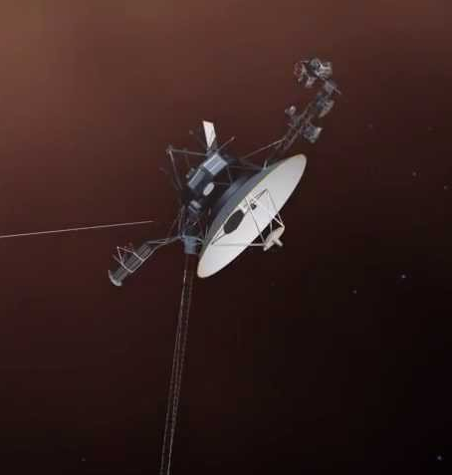
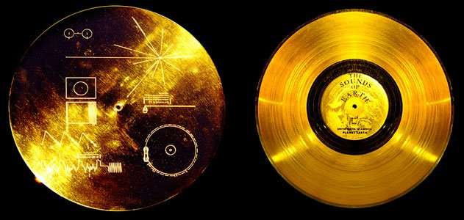
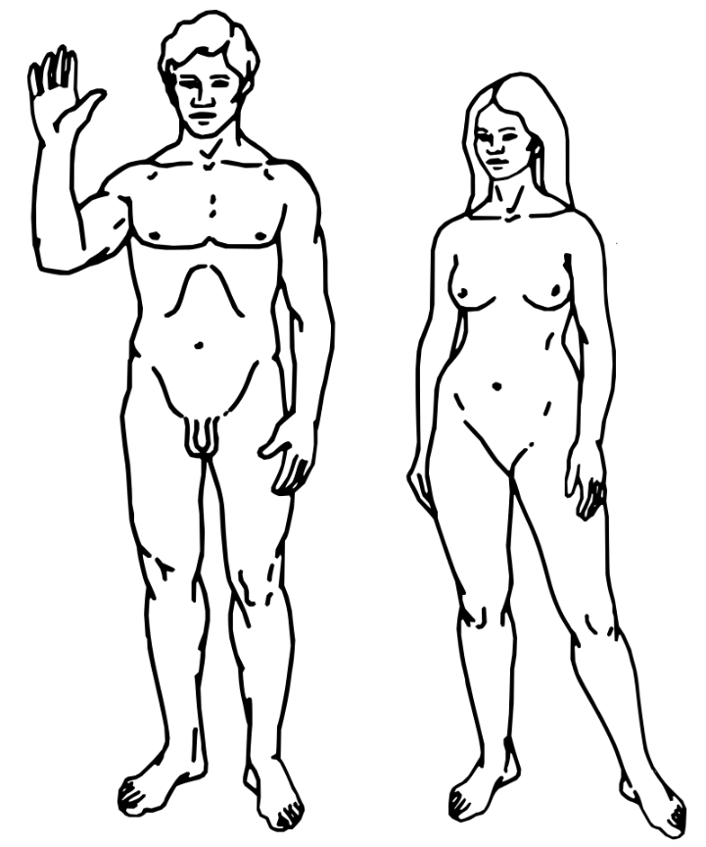
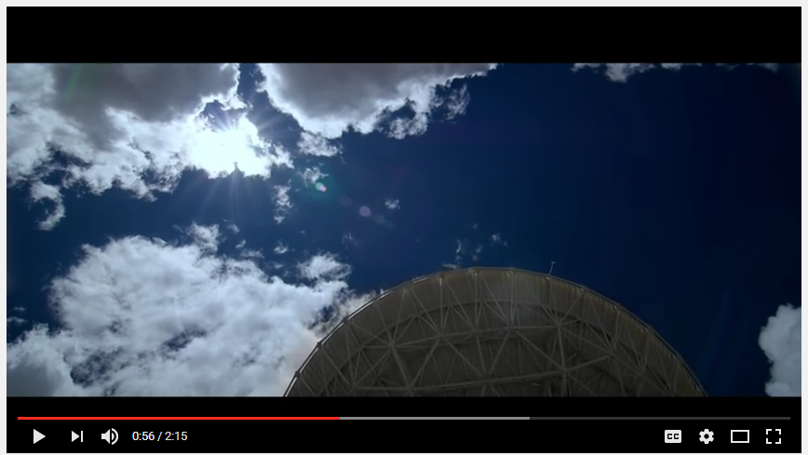
Voyager 1 and 2
Notes:
http://voyager.jpl.nasa.gov/
Voyager 1 and 2 launched in 1977
The Voyager message is carried by a phonograph record-a 12-inch gold-plated copper disk containing sounds and images selected to portray the diversity of life and culture on Earth.
The contents of the record were selected for NASA by a committee chaired by Carl Sagan of Cornell University. Dr. Sagan and his associates assembled 115 images and a variety of natural sounds, such as those made by surf, wind and thunder, birds, whales, and other animals. To this they added musical selections from different cultures and eras, and spoken greetings from Earth-people in fifty-five languages, and printed messages from US President Jimmy Carter. Each record is encased in a protective aluminum jacket, together with a cartridge and a needle. Instructions, in symbolic language, explain the origin of the spacecraft and indicate how the record is to be played. It will be forty thousand years before they make a close approach to any other planetary system.
Both spacecraft are still sending information about their surroundings through the Deep Space Network, or DSN, but the quantity and quality of this information continues to decline as these old computer systems on board begin to fail.

Slide 19


Slide 20
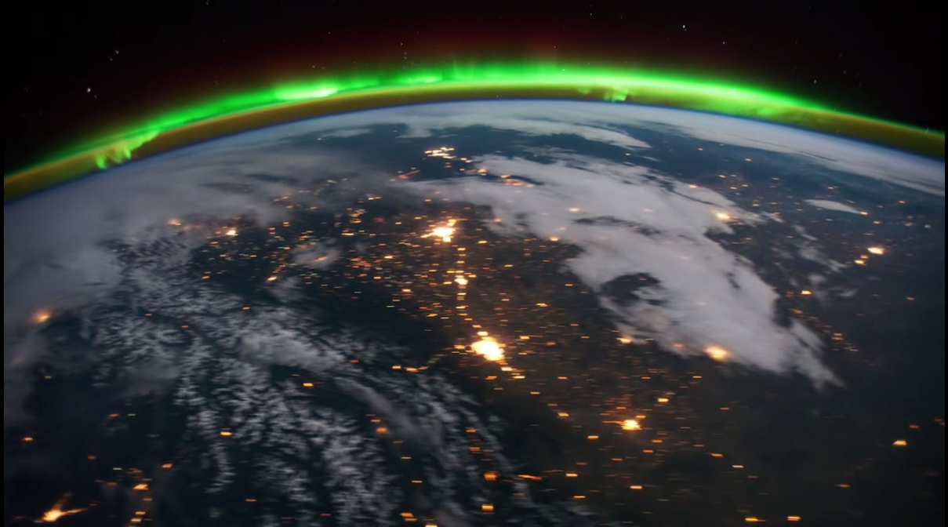

Slide 21
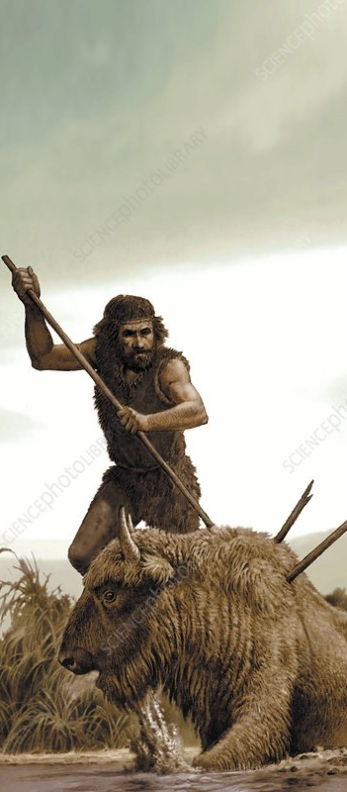
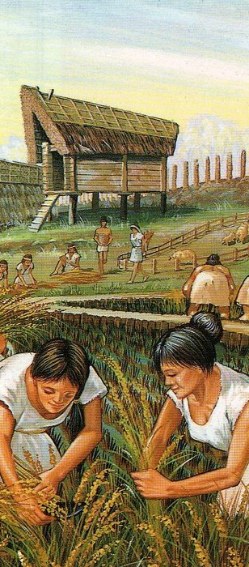
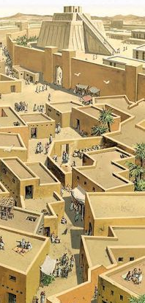
When did the Anthropocene begin?
Notes:
The dispersal of Homo sapiens around the world? The domestication of crops – what is knonw the Neolithic Revolution? Establishment of the first cities? European exploration of the world? The Industrial Revolution? The Great Acceleration?

Slide 22
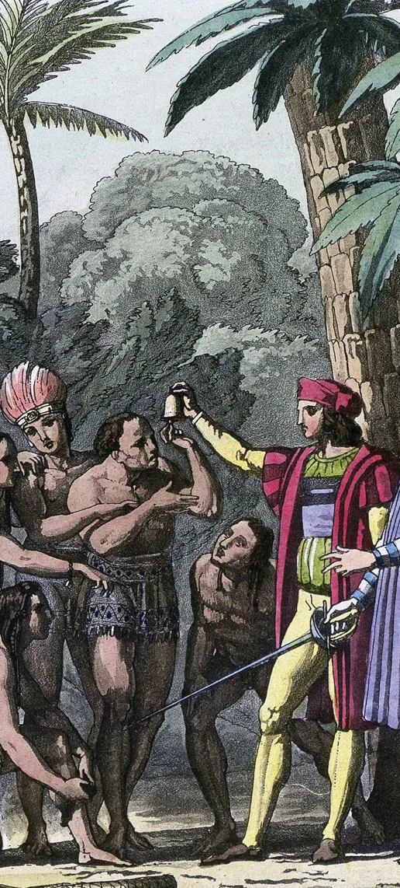

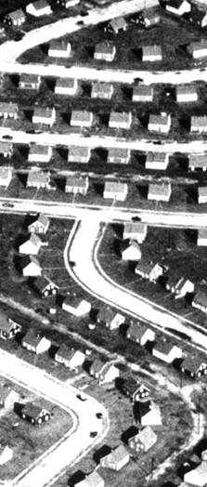
When did the Anthropocene begin?
Not just one, but many starts of the Anthropocenes
How you define the onset and causes of the Anthropocene shapes what policy approaches you prioritize.
Some scholars even argue that the Anthropocene does not represent a human-dominated era, but one that shows us how nature still exerts its power over humans
Notes:
“…but one that shows us how nature exerts its power over humans.” What this means is that: The Anthropocene, at least to some scholars, is not so much a period in which human exert a dominant control over the Earth, but one in which human impacts alters nature in ways that are not entirely favorable. In a sense, it is not the age of humans, but still, the age of nature. At a time when human processes dominate the planet, the Earth is responding in ways that convey a reaction that we may not be able to control or mitigate. The feedbacks in the biosphere set in motion on Earth by increasing concentrations of carbon dioxide from combustion of fossil fuels now threatens facets of human dominance of the Earth.

Slide 23
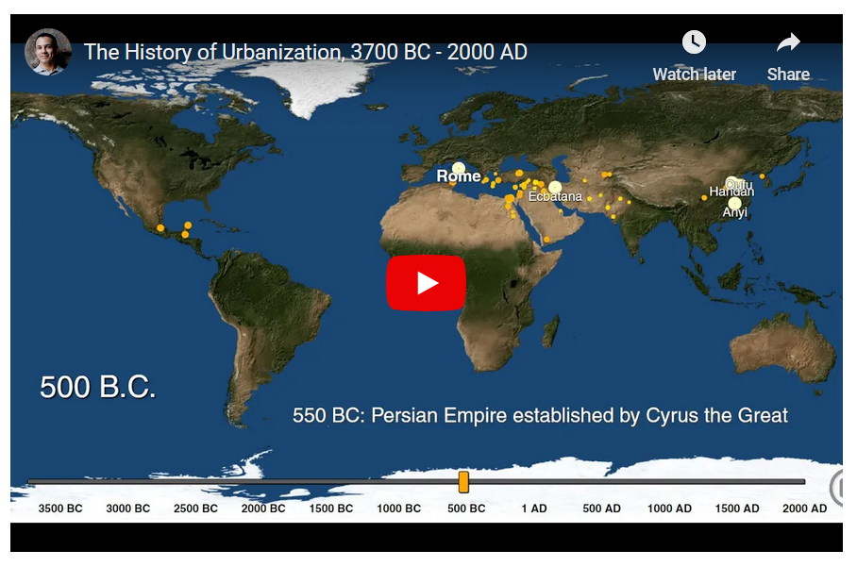
Notes:
https://www.openculture.com/2017/05/timelapse-animation-lets-you-see-the-rise-of-cities-across-the-globe-from-3700-bc-to-2000-ad.html

Slide 24
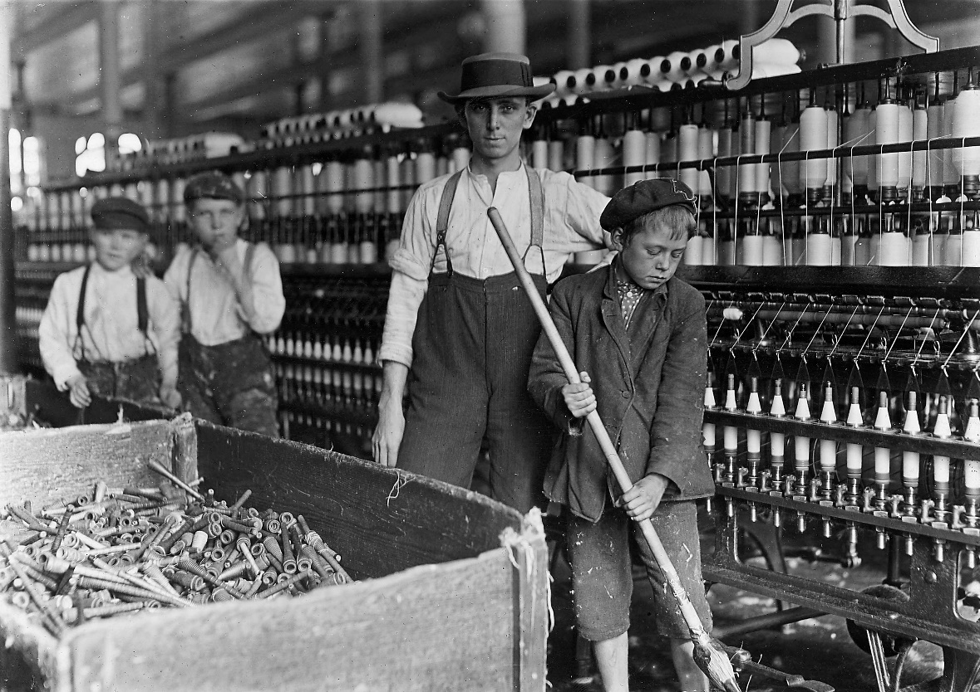
The Industrial Revolution (1780 to 1945) as the start of the Anthropocene
Invention of the steam engine catalyzed radical social, economic, political and environmental change
Notes:
Carbon dioxide levels recorded in ice cores begin to increase at this time
The Industrial Revolution was a period in which fundamental changes occurred in agriculture, textile and metal manufacture, transportation, economic policies and the social structure
However, keep in mind that coal was being used in China 800 years earlier, but the industrialization that occurred in Europe later was far vaster and much more mechanized

Slide 25
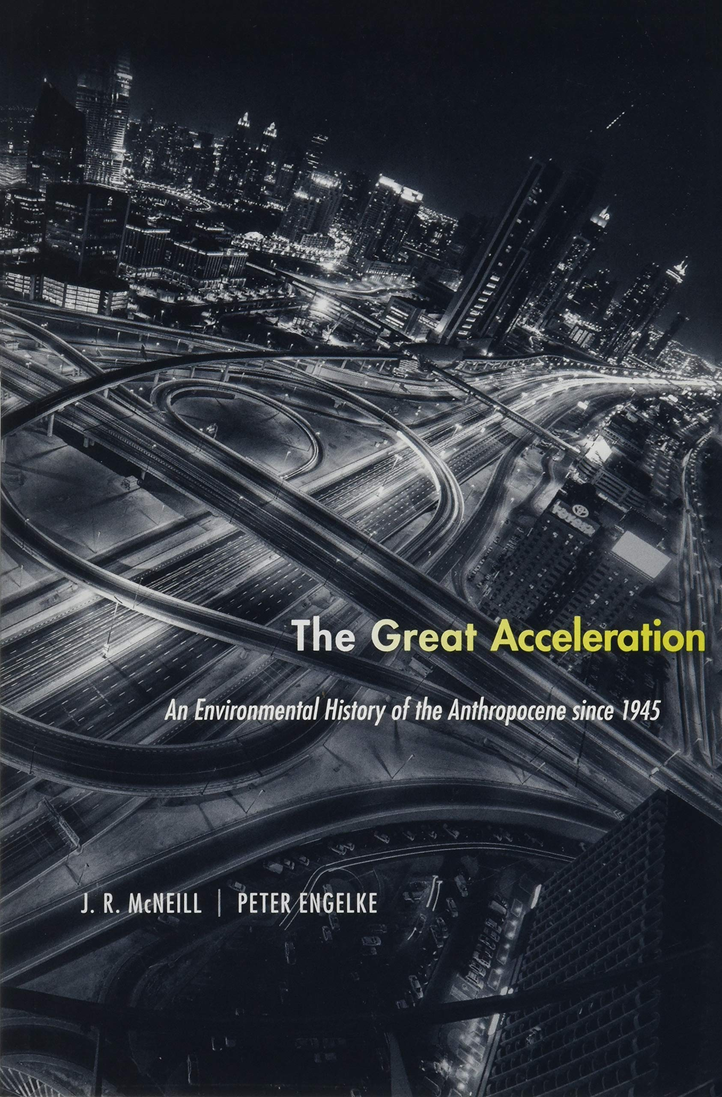
The Great Acceleration as the start of the Anthropocene
Began with economic expansion after World War II
Unlike the Industrial Revolution, the Great Acceleration is considered post-industrial.
Post-industrial encompasses global infrastructure of finance, information, and trade and not just industrial manufacturing
Notes:
In 2016, the Anthropocene Working Group agreed that the Anthropocene is different from the Holocene, which began 10,000 years ago. The Anthropocene, in their decision, began in the year 1950 when the Great Acceleration, a dramatic increase in human activity affecting the planet, took off

Slide 26
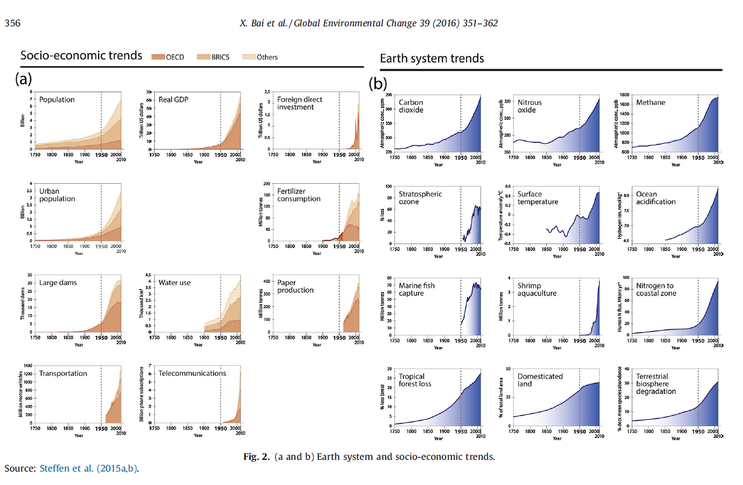
Notes:
The Post World War 2 period marks the start of the Anthropocene based on the Great Acceleration
Steffen, W., Broadgate, W., Deutsch, L., Gaffney, O., & Ludwig, C. (2015). The trajectory of the Anthropocene: the great acceleration. The Anthropocene Review, 2(1), 81-98.

Slide 27
The distinctly American origins of the Anthropocene
The 1953 report “Resources for Freedom: Foundations for Growth and Security” proposed a novel redefinition of the way that resource scarcity was measured: from the absolute scarcity of previous assessments to a relative, price-based definition of scarcity.
  If demand was high and price was up for a resource, the policy view in this report argued that this would spark investments to acquire new resources or to innovate and find replacements
  There was no actual scarcity as defined from this economic point of view, just endless expansion
Notes:
The federal Materials Policy Commission, more commonly known as the Paley Commission published a report in 1952 that initiated the Great Acceleration.
Lane, R. (2019). The American anthropocene: Economic scarcity and growth during the great acceleration. Geoforum, 99, 11-21.

Slide 28

“Resources for Freedom” reconceptualized material resource reserves from one that was exhaustible, to one of a replenishable working inventory.
The report advocated for the expansion of overseas resource extraction and importation instead of domestic self-sufficiency and conservation of resources.
The economy was understood as free to continue a trajectory of continuous growth
Notes:
Lane, R. (2019). The American anthropocene: Economic scarcity and growth during the great acceleration. Geoforum, 99, 11-21.

Slide 29
Pre-industrial human impacts
Industrialization was latest manifestation of deep historical human modification of Earth and its biota
The Paleoanthropocene:
  The Orbis Spike
  Neolithic Revolution
  Pleistocene megafaunal extinctions
  Plio-Pleistocene megacarnivore extinctions
Notes:
Technologies involved in all of these events – just like with the technology of fire, of spoken and then written language. Technology, human evolution, and environmental impacts are all deeply interwoven.

Slide 30
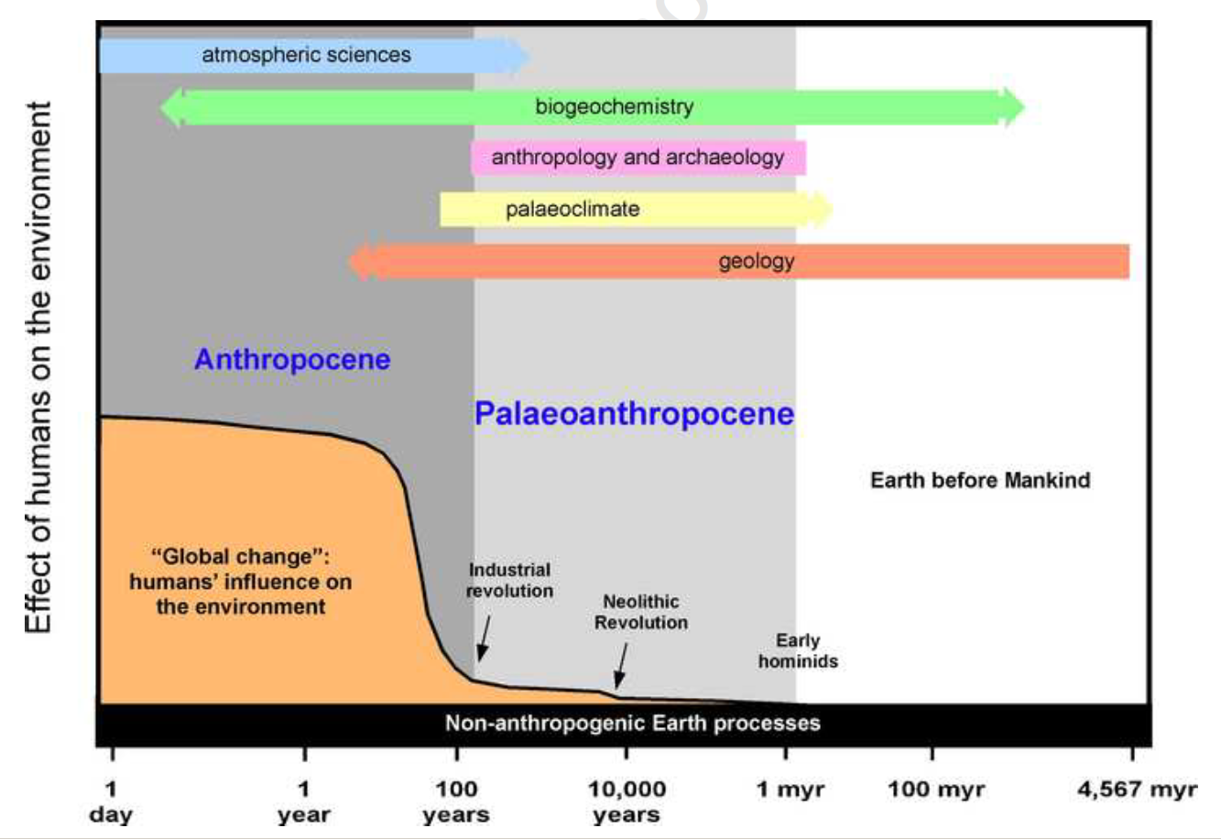
Notes:
Period between the first, barely recognizable, anthropogenic environmental changes and the Industrial Revolution when anthropogenic changes accelerated

Slide 31
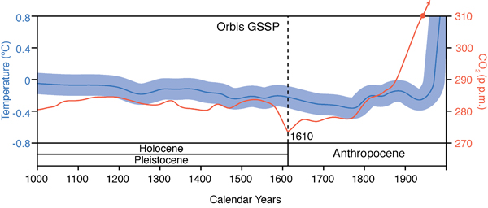
The Orbis spike
Notes:
http://www.scientificamerican.com/article/mass-deaths-in-americas-start-new-co2-epoch/
European contact began in late 1400s – Columbus
Balboa and De Soto in early 1500s
Jamestown, Virginia – 1607
What could make this sharp drop in the CO2 in the atmosphere?

Slide 32
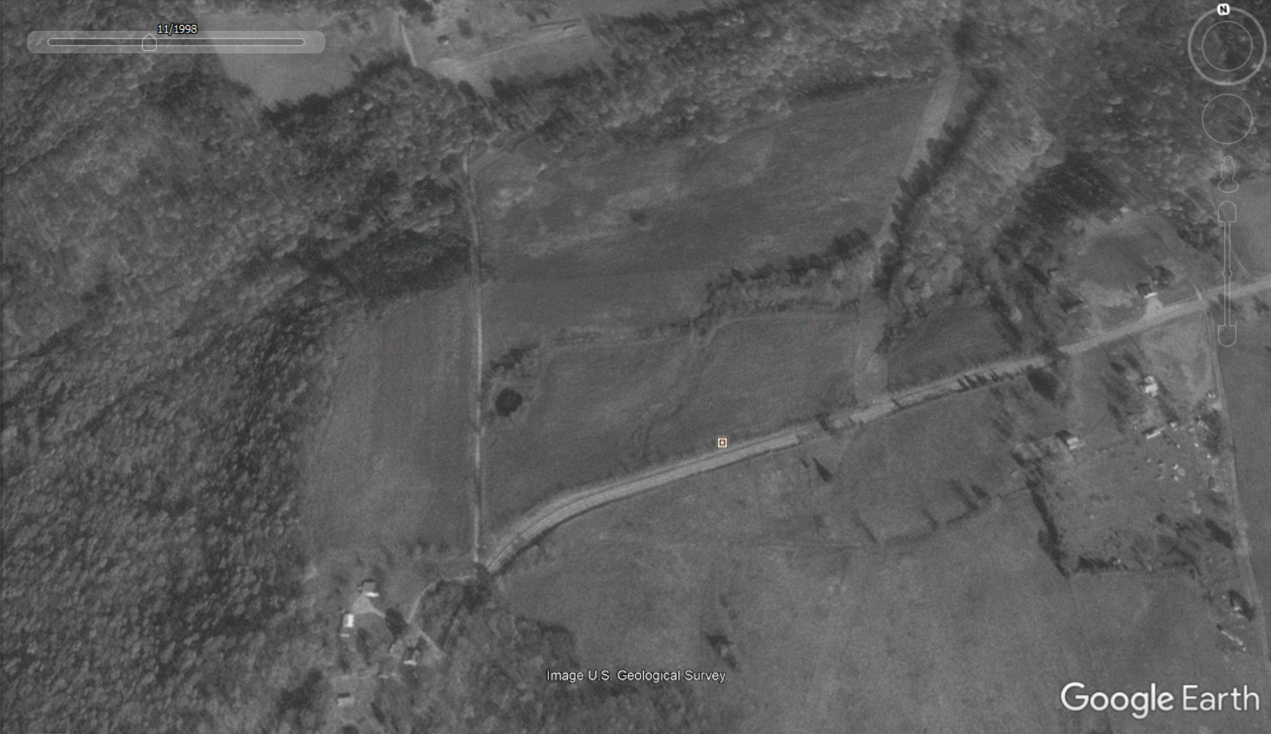
1998, the family farm near Princeton Kentucky on Highway 62
Notes:
1998

Slide 33
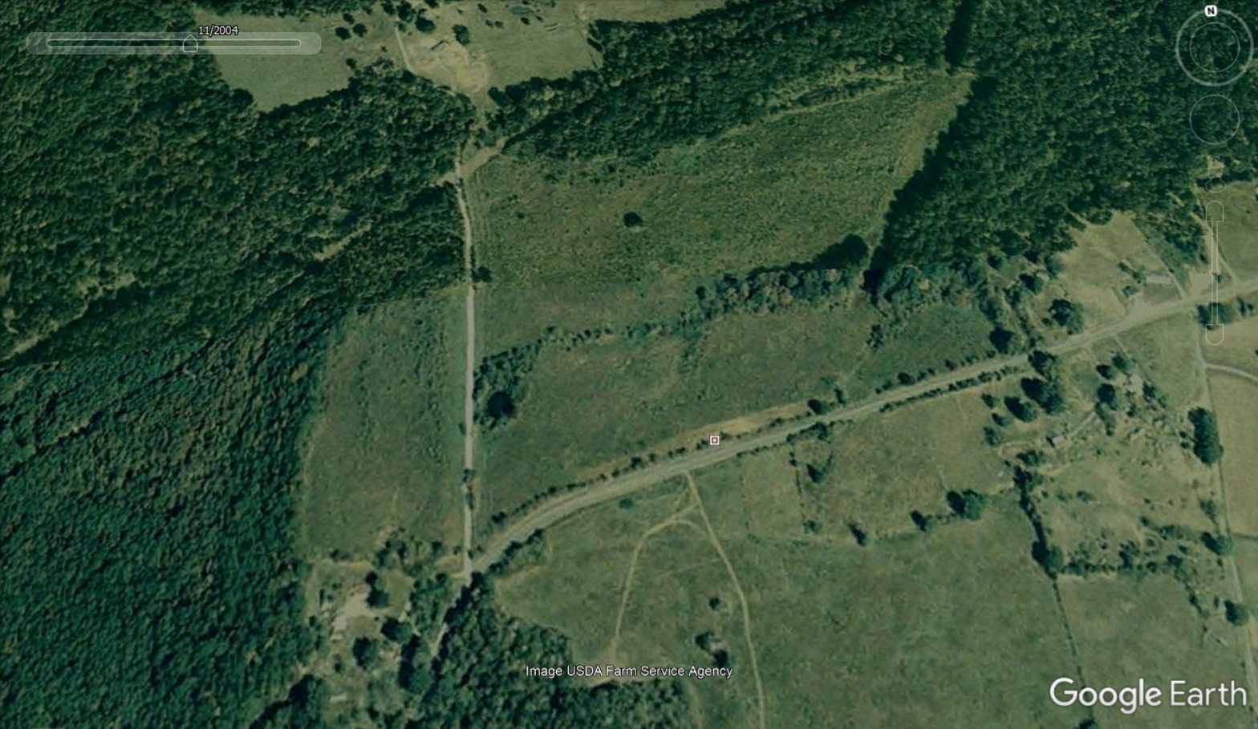
2004, the family farm near Princeton Kentucky on Highway 62
Notes:
2013

Slide 34
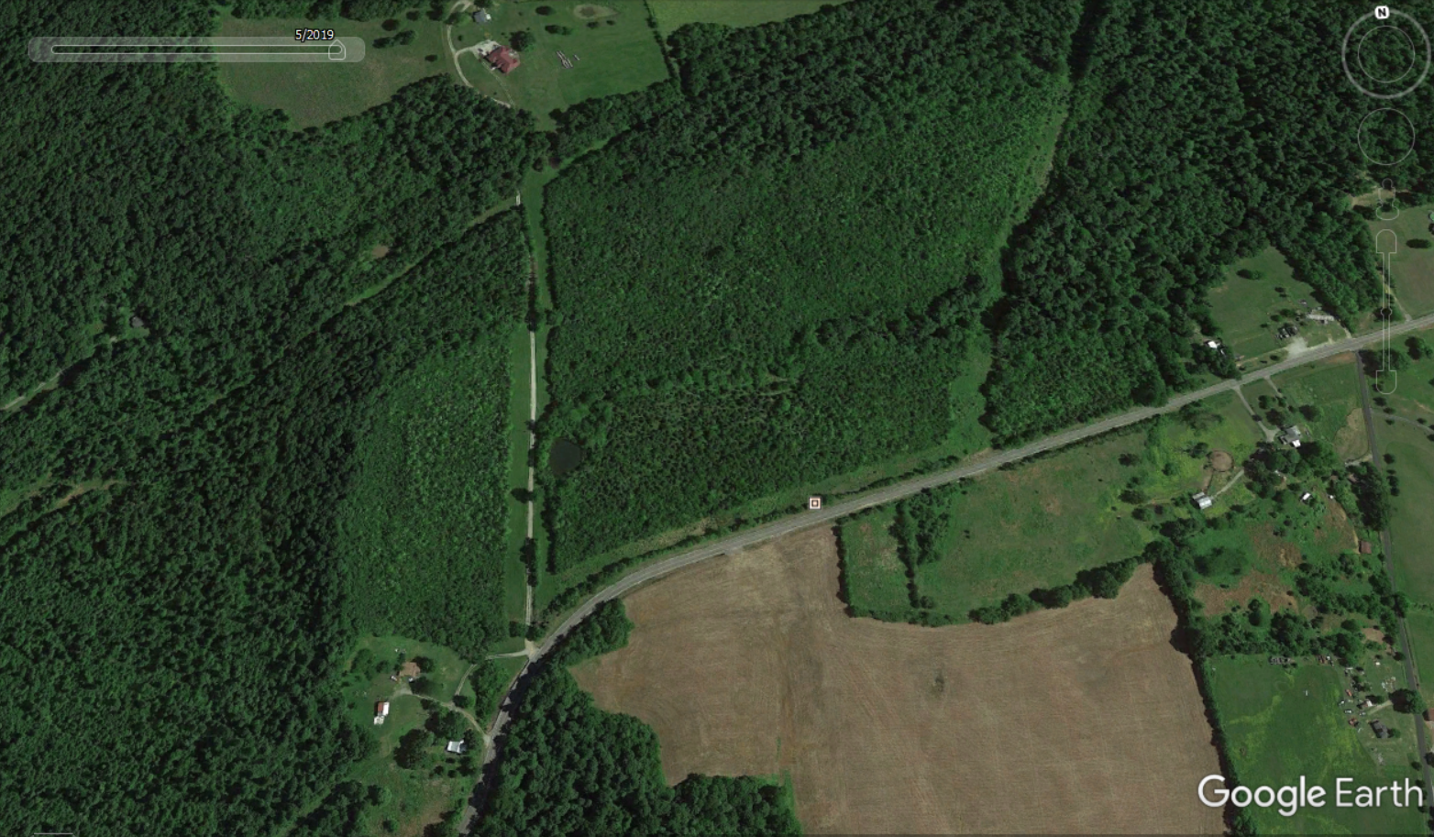
2019, the family farm near Princeton Kentucky on Highway 62

Slide 35
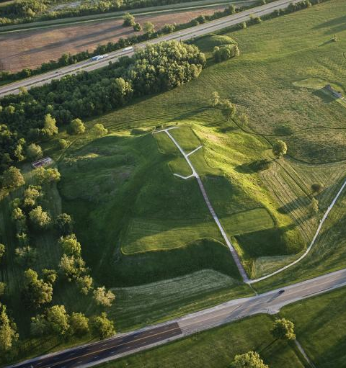
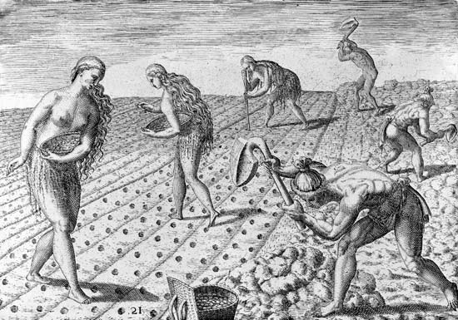
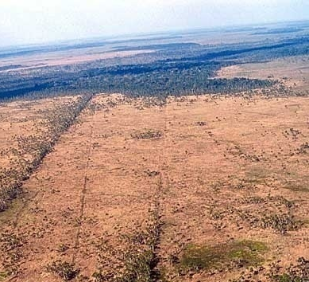
Prior to European arrival, North and South American landscapes had been highly modified by large numbers of native Americans. Grasslands kept open thru the use of fire. Earthworks, roads, cultivated fields common. Forest cover was reduced by human activity
Cahokia Mounds (southern Illinois)
Relict fields in S. America
Notes:
Regional population estimates sum to a total of 54 million people in the Americas in 1492, with recent population modelling estimates of 61 million people.
Numbers rapidly declined to a minimum of about 6 million people by 1650 via exposure to diseases carried by Europeans, plus war, enslavement and famine.
Timucua native Americans planting in large cleared fields, early 1500’s, in Florida.
http://emedicine.medscape.com/article/237229-overview

Slide 36
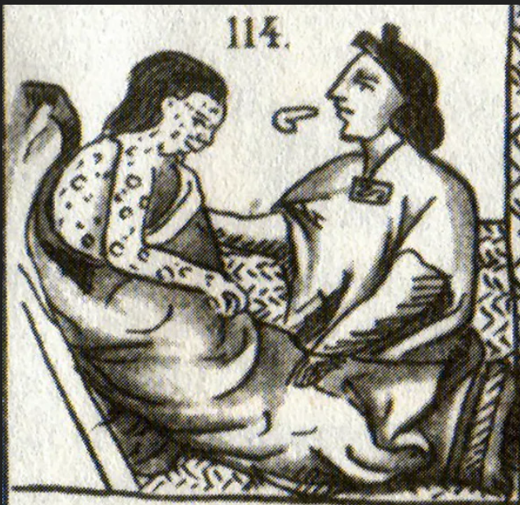
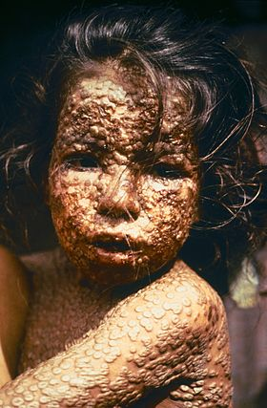
Pre-European contact Americas may have held as many people as in Europe at that time
Estimates range up to 50-90 million
After arrival of smallpox and influenza (flu), indigenous population greatly reduced (90-95%)
Depopulation left fields fallow
Forests recovered because of the drastically reduced numbers of native Americans
Notes:
Numbers rapidly declined to a minimum of about 6 million people by 1650 via exposure to diseases carried by Europeans, plus war, enslavement and famine.
The Great Dying

Slide 37
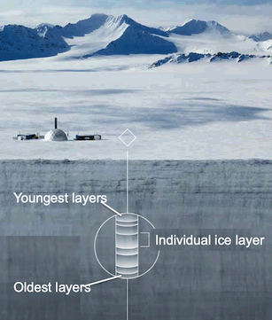
The Orbis spike is a result of reforestation. Regrowth of forests took up carbon dioxide. This drop in carbon dioxide levels was large enough to leave a signal in the air bubbles trapped in ice core layers dating from that time
Notes:
With reforestation, plants took in CO2, causing its concentration to drop globally.
The accompanying near-cessation of farming and reduction in fire use resulted in the regeneration of over 50 million hectares of forest, woody savanna and grassland with a carbon dioxide uptake by vegetation and soils. The approximate magnitude and timing of carbon sequestration suggest that this event significantly contributed to the observed decline in atmospheric CO2 of 7–10 p.p.m. between 1570 and 1620 documented in two high-resolution Antarctic ice core records.
There is evidence that some of the forest regrowth had begun earlier, before the Great Dying of American peoples. This is hypothesized for regions of Amazonia, where social strife and environmental change may have led to reduction of cropland and subsequent reforestation. On the other hand, one might argue that perhaps Europeans arrived earlier and brought the diseases sooner. Either way, it is likely that the Orbis signal varies regionally depending upon the context of timing of the arrival of humans with the events and circumstances endogenous to the Americas.
Bush, M. B., Nascimento, M. N., Åkesson, C. M., Cárdenes-Sandí, G. M., Maezumi, S. Y., Behling, H., ... & McMichael, C. N. H. (2021). Widespread reforestation before European influence on Amazonia. Science, 372(6541), 484-487.

Slide 38


Neolithic Revolution
10-12,000 years ago
Less dependence upon hunting-gathering
Domestication of crops
Permanent settlements
Emergence of systems of writing and first legal codes

Slide 39
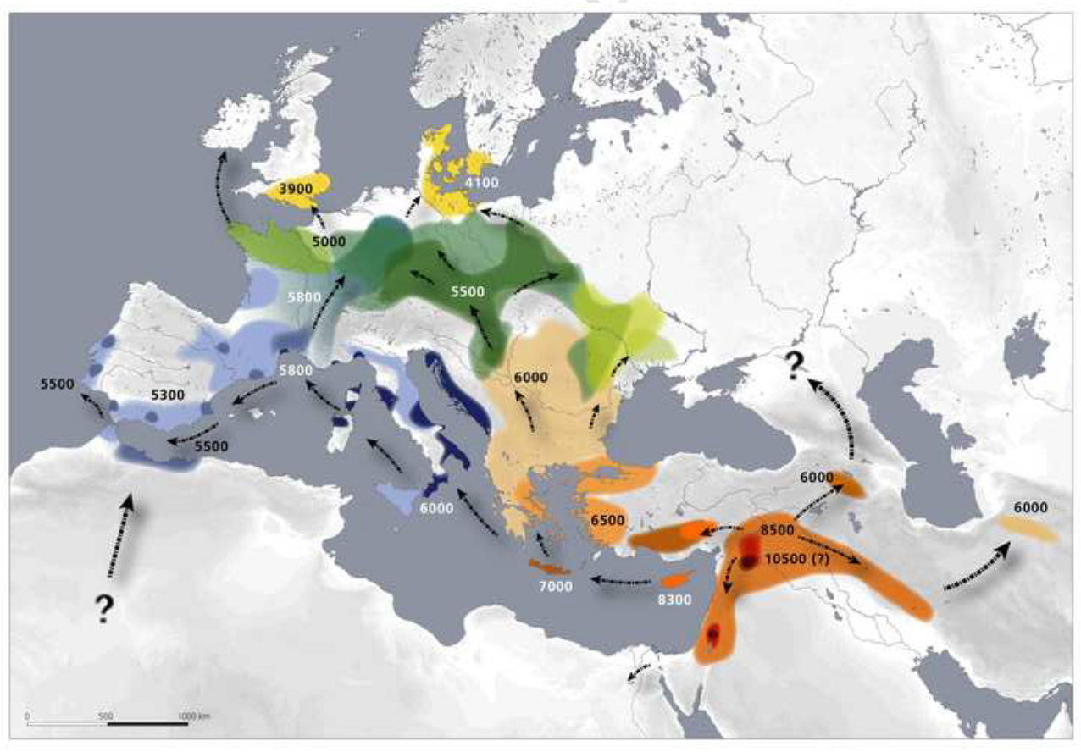
Dispersal in farming, in years before present. About 10,000 years ago (the approximate start of the Holocene), climate started to warm as part of a natural cycle. Agriculture emerged and begin spreading northward.

Slide 40
Notes:
12,000 years ago

Slide 41
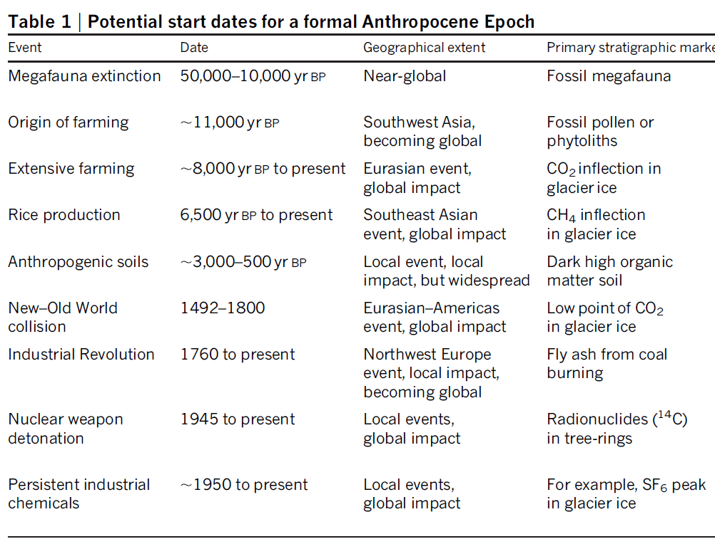
Notes:
12,000 years ago

Slide 42
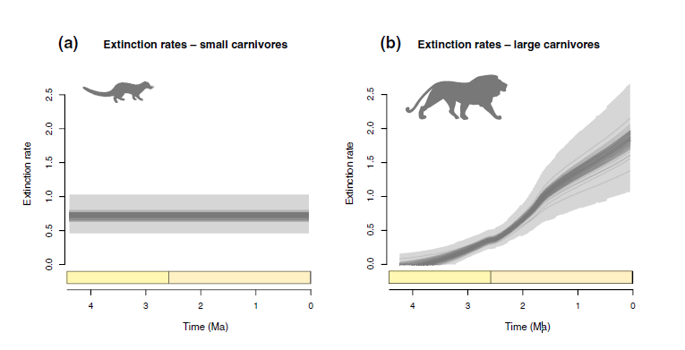
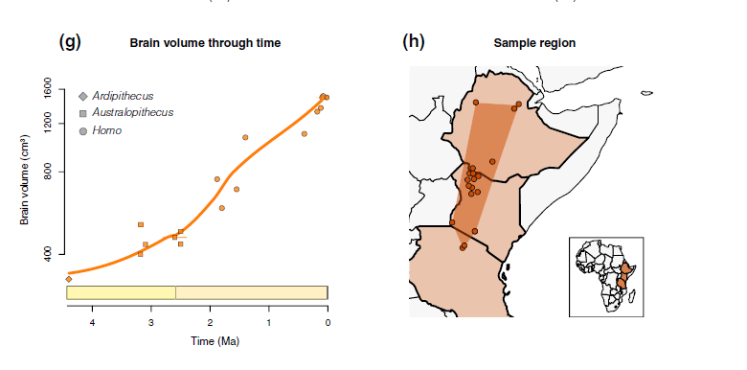
Plio-Pliestocene carnivore decline in Africa (5 mya)
Notes:
More evidence suggests that carnivores may have decline more in tandem with brain capacity evolution in humans, along with reductions in forest cover as grasslands expanded.
Faurby, S., Silvestro, D., Werdelin, L., & Antonelli, A. (2020). Brain expansion in early hominins predicts carnivore extinctions in East Africa. Ecology Letters, 23(3), 537-544.
Our results provide strong support for a hominin causation of the increases in extinction rate among large carnivores in East Africa in the Pliocene and Pleistocene. Our results further point towards scavenging and kleptoparasitism as driving the initial extinction pattern. Later, increased brain size and novel locomotor adaptations in hominins likely led to increased levels of active hunting of herbivores and therefore reduced prey availability for the carnivores. Extinction rates further increased with the progressive invention of more advanced tools (Režek et al. 2018) and the evolution of adaptations promoting long distance movement. Our results thus contribute to the increasing recognition of a more prolonged and multi-faceted hominin exploitation of large mammal resources than traditionally assumed (Thompson et al. 2019).
If the extinction of East African carnivores was primarily driven by hominins rather than by climatic changes as we propose, we should expect a difference between the extinction patterns for large and small carnivores, similar to the pattern seen in the spatial analysis of contemporary patterns (Table 1). Carnivores smaller than c. 21 kg generally feed on a large number of smaller prey items, with short handling time for each prey item. In contrast, large carnivores feed through rare successful hunts on larger prey items (Carbone et al. 1999). The effect of human kleptoparasitism should therefore be negligible for smaller carnivores but detrimental for larger carnivores. Our results show no evidence for any increase in extinction rates for small carnivores through the last 4 Myr: the simplest model with constant extinction rate is not rejected against the alternatives (log Bayes factors < 2, Table S3). These results further reject the models of climatically driven extinction, which predict that small and large carnivores should be affected similarly by climatic changes (Fritz et al. 2016). We also note that the temporal variation for all climatic variables (Fig. 1) is well within the range of contemporary climate data from elsewhere in Africa, whereas the fossil diversity of large carnivores is completely outside of the spatial variation observed today.
Kleptoparasitism whereby humans steal food from lions has been repeatedly observed in contemporary Africa (Schoe et al. 2009). There is also direct evidence for competitive interactions between hominins and giant hyenas (Pachycrocuta brevirostris) on the same carcass from the Pleistocene in Europe (Espigares et al. 2013). It is therefore plausible that kleptoparasitism was also important for earlier hominins. Hominins may be too fundamentally different from other animals for direct comparisons, but we note that the rate of kleptoparasitism in birds is known to be associated with cognitive ability (Morand-Ferron et al. 2007), which would further support the interpretations of this study.

Slide 43
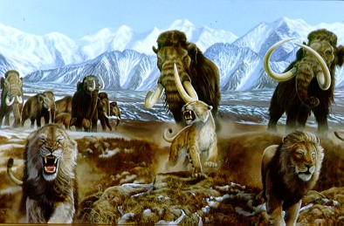
Pleistocene megafaunal extinctions in North America (10,000 to 12,000 ya)
Rapid extinctions coinciding with migration of humans into North America
Keystone herbivores overhunted
Dire wolf, American lion lost in extinction cascade after their large herbivorous prey hunted out
Notes:
The large-bodied mammal extinctions occurred between 10-12,000 years ago in North and South America, with 73 and 80%, respectively, of megafauna becoming extinct.

Slide 44

The Paleoanthropocene vs Anthropocene
Difference in tempo and in the power of our technology – an unprecedented rupture in the relationship between humans and the earth in the Anthropocene
Difference in collective self-awareness of our impacts and our capacity to manage them
Notes:
Paleoanthropocene had regional human impacts, the Anthropocene spans global human impacts

Slide 45

Notes:
Registered for this class versus my mom and dad meeting
Requirements for graduation versus evolution of humans in Africa

Slide 46

Notes:
The ash layer contains iridium, an indicator of its source from a meteorite. The ash layer is found globally. It marks the end of the Cretaceous geologic time period and the demise of the dinosaurs

Slide 47

Notes:
https://www.nytimes.com/2019/03/29/science/dinosaurs-extinction-asteroid.html

Slide 48


Notes:
Fossils from the day the meteor hit:
https://www.nytimes.com/2019/03/29/science/dinosaurs-extinction-asteroid.html

Slide 49

Notes:
Cretaceous-Tertiary boundary defined by ash layer left by asteroid and deposited in geological record across planet
This stratigraphic layer coincides with demise of dinosaurs. It is a distinctive geologic marker (and has a golden spike designation) because this layer is found all over the earth. This layer of ash is also high in iridium, which could have only originated from a meteor

Slide 50

Thinking about the Anthropocene as a stratigraphic marker
Designation will help future geologists and archaeologists identify distinct acceleration in human impacts

Slide 51

Notes:
1964 was the year that plutonium fallout from nuclear explosions peaked.

Slide 52



Slide 53


Tradeoffs for humans in the Anthropocene
Pro: increases in life expectancy
Con: dependency upon fossil fuels
Notes:
Pro – supportive, a positive
Con – not supportive, a negative
Along with higher life expectancy, there are dramatic improvements in the rate of childhood mortality.

Slide 54

Notes:
https://www.washingtonpost.com/climate-environment/interactive/2024/global-heat-sea-surface-temperature-records/

Slide 55


Pro: we now have large and complex societies capable of problem solving
Con: but this size and complexity also results in the production of new social and environmental issues

Slide 56

Pro: higher standards of living
Con: uneven development and inequality
Notes:
1980 – 2016
If one assumes that globalization is a defining feature of the Anthopocene, then the globalization that occurs over the last three decades has had an uneven impact on income growth around the world. Income growth can be associated with overall standards of living, which higher income signifying greater access to resources, lower incomes signifying less access to resources. The Anthropocene has improved income in the lower income levels, but the biggest gains are in the upper one percent. The middle class has seen less income growth. This plot conveys not that middle income countries in the US and Europe have it worse than in emerging countries. It shows that we had these gains earlier, but now have largely stagnated in terms of income growth.
https://www.givingwhatwecan.org/how-rich-am-I
Along with higher standard of living, one can include higher rates of consumption of resources, but this access is not evenly distributed

Slide 57

Con: costs of development passed on to those who may not benefit directly. Examples:
  Resource extraction in one country and its exportation and consumption in other countries
  Climate change impacts in less developed countries brought on by industrialization and fossil fuel use in other countries
Notes:
https://visualign.org/2018/02/16/world-inequality-and-the-elephant-curve/

Slide 58

Notes:
https://www.youtube.com/watch?v=hW9EAkqu6aY

Slide 59

Notes:
https://www.nytimes.com/2020/01/11/business/drought-increasing-worldwide.html

Slide 60

Notes:
https://www.nytimes.com/2018/08/15/magazine/the-super-bowl-of-beekeeping.html

Slide 61


Notes:
https://www.nytimes.com/2023/10/05/us/summer-climate-change.html6161

Slide 62

If early animal extinctions and the Neolithic Revolution are designated as the start of the Anthropocene…
Human activity is inseparable from modification of the environment
Modification of the environment is inherent to all life forms
Evolution of organisms encompasses these environment-modifying propensities
Notes:
https://www.youtube.com/watch?v=ih2P46AjgV8

Slide 63

If the Orbis Spike is designated the start of the Anthropocene…
…it implicates colonialism and imperialism, unequal power relationships between different groups of people, as a cause of the Anthropocene
From this angle, policies should seek to address issues related to governance and power, racism, and colonialism as drivers of environmental change
Notes:
Choosing the Orbis spike as marker has implications for what kind of policies are sought to address the environmental issues of the Anthropocene
The accompanying near-cessation of farming and reduction in fire use resulted in the regeneration of over 50 million hectares of forest, woody savanna and grassland with a carbon dioxide uptake by vegetation and soils. The approximate magnitude and timing of carbon sequestration suggest that this event significantly contributed to the observed decline in atmospheric CO2 of 7–10 p.p.m. between 1570 and 1620 documented in two high-resolution Antarctic ice core records.

Slide 64

If the Industrial Revolution is designated the start of the Anthropocene…
…it Implicates fossil fuels and the industries it supports as causes of the Anthropocene
Industrialization and technological change are at the root global environmental change

Slide 65

If the Great Acceleration is designated the start of the Anthropocene…
…it implicates globalization as a cause of the Anthropocene
Policies to address the environmental issues of the Anthropocene should target the way in which the global economy operates
Notes:
Different shades of brown reflect different estimates of the trends.

Slide 66

If Resources for Freedom is designated as the start of the Anthropocene…
It implicates American economic policies as the cause of the Anthropocene
Reworking economic concepts and practices becomes the strategy to address environmental problems
Notes:
Lane, R. (2019). The American anthropocene: Economic scarcity and growth during the great acceleration. Geoforum, 99, 11-21.

