Slide 1
Notes:
https://ourworldindata.org/population-growth-over-time

Slide 2
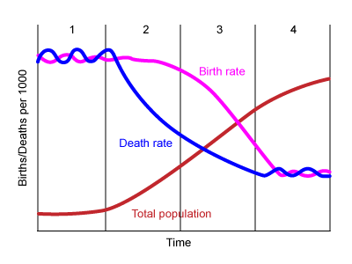
The demographic transition
Refers to the transition of a country from high birth and death rates to low birth and death rates as a country develops from a pre-industrial to an industrialized economic system.
Notes:
Four stages in its original formulation. The demographic transition model is a valid generalization for population growth but there are also criticism

Slide 3
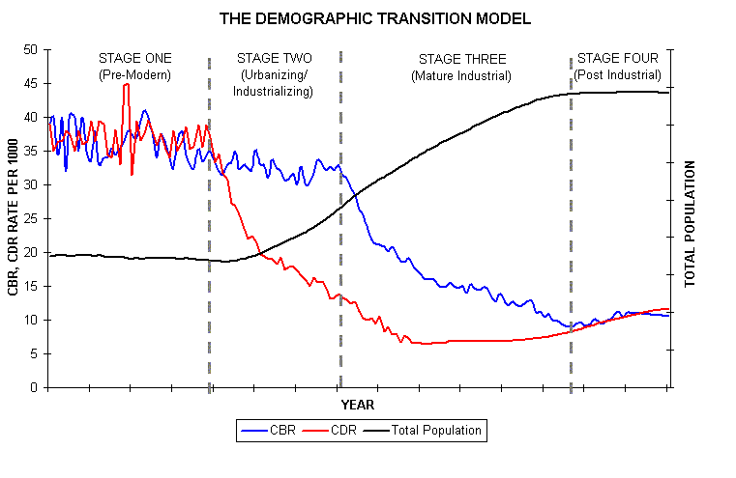

Slide 4
Stage 1 – high birth and death rates: This results in slow population growth. Limited access to healthcare, education, and technology. Large number of children, high childhood mortality
Stage 2 – high birth rates and falling death rates: Decreased death rates due to improvements in healthcare, sanitation, and overall living conditions. Birth rates remain high, family sizes large, leading to a rapid increase in population.
Stage 3 - falling birth rates and low death rates: Increasing rates of education, urbanization, and improvement in economic conditions. Steady population growth.
Stage 4 - Low birth and death rates: Population growth stabilizes with advanced economic development, higher levels of education, and increased access to family planning resources. Smaller family size.

Slide 5
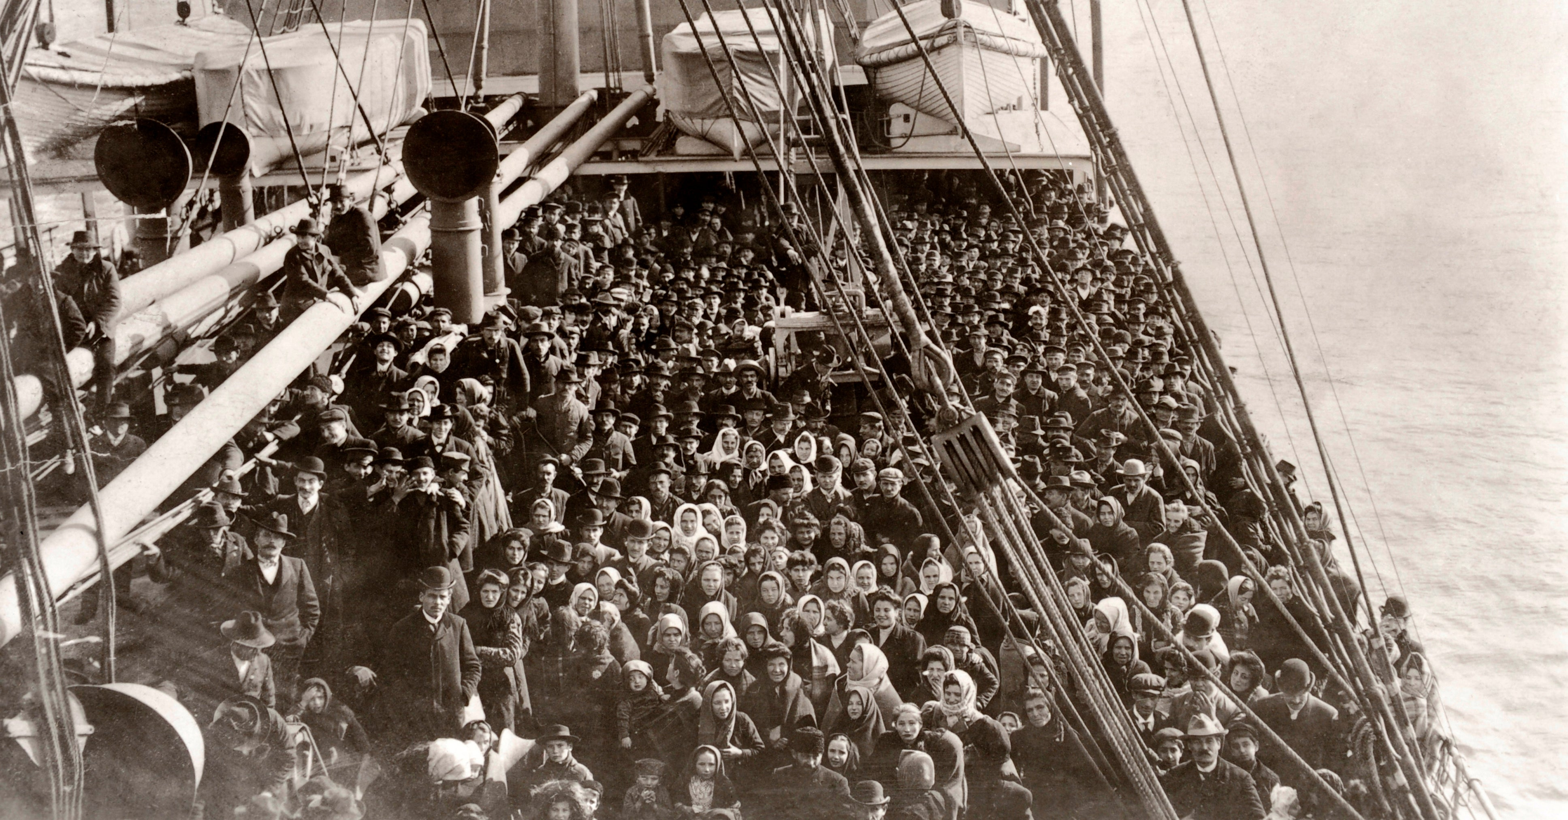
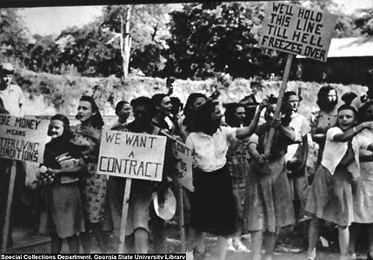
Criticisms of the demographic transition
Global applicability: DT may not accurately represent experiences of non-Western societies or those with different historical, cultural, and economic contexts.
Incomplete explanation: DT puts too much emphasis on economic development over a complex suite of factors, including ecological ones, and the migration and mobility of people
Power accounting: DT may have been fostered by exploitation of laborer and extraction of resources from other countries
Notes:
The textile workers’ general strike of 1934 was the largest strike in U.S. labor history at the time, involving as many as half a million textile workers from New England, the Mid-Atlantic states and the U.S. Southern states, lasting twenty-two days.
The United Textile Workers (UTW), which had 15,000 members in February 1933, grew to 250,000 members by June of 1934, about half cotton mill workers. Issues involved deplorable working conditions, low wages, and lack of union recognition.

Slide 6
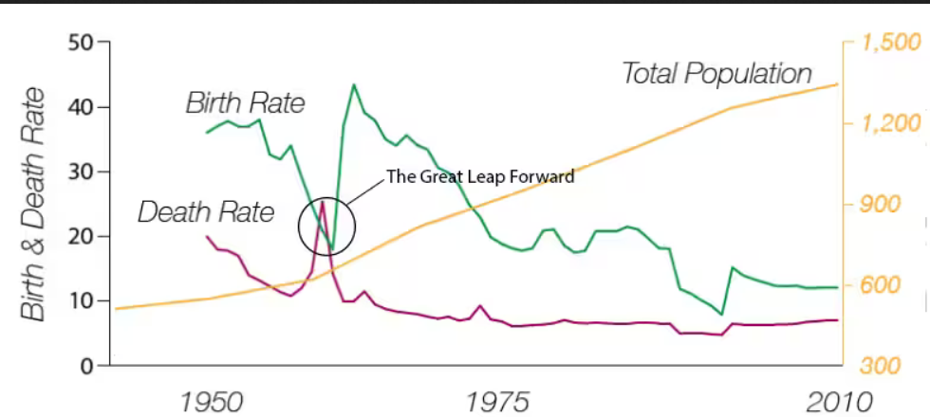
Reverse transitions: some countries have experienced reverse transitions instead of progressive development
Transition speed variability: Speed and timing of DT can vary widely
Population policies: DT does not adequately consider the impact of population policies on fertility rates
Notes:
Criticisms of the demographic transition (continued) China went through the demographic transition very rapidly after a reversal during the Great Leap Forward. Population is shown in millions. https://www.washingtonpost.com/news/wonk/wp/2015/10/29/one-chart-captures-why-chinas-letting-families-have-more-kids/
Some African nations have remained in Stage 2 due to the impact of HIV-AIDS

Slide 7
Discourses on global overpopulation in the 1960s and 1970s
By 1960’s and early 1970’s, countries had gone through Stage 4 or were going through Stage 3 of demographic transition
Thus rose the first prominent environmental debates about global population and the human carrying capacity of Earth
Malthusian ideas about overpopulation and famine became a prominent public discourse

Slide 9
Criticisms of Malthusian overpopulation
Societal context often drives population growth not innate biological propensities of a particular cultural group
Cultural and political factors can impact birth rate and determine women’s reproductive rights
Many factors determine the potential for collapse and famine: it’s simplistic to consider only number of people
Famine is often caused by unequal distribution of food and economic systems that favor some groups over others

Slide 10
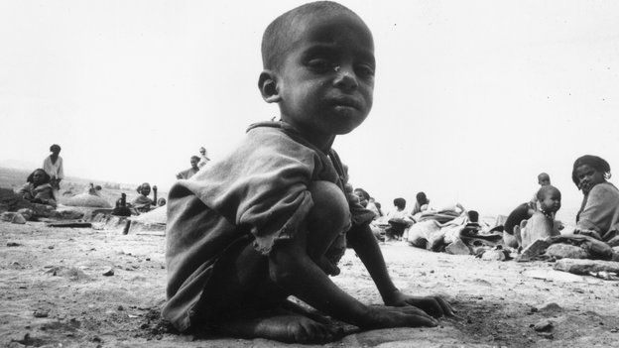
Famine in Eritrea and Ethiopia (1980’s)
Not due to overpopulation, but:
Drought and civil war
Confiscation of farmland by elite
Government spent money on military instead of basic infrastructure
Displacement and resettlement of local agriculturalists
Food policies sought to enhance food supply in city vs rural areas
Notes:
https://www.nytimes.com/2011/09/18/books/review/three-famines-by-thomas-keneally-book-review.html

Slide 11
The Great Leap Forward famine in China
Notes:
Famine in China during the Great Leap Forward (1958-1962) It is widely regarded as the deadliest famine and one of the greatest man-made disasters in human history, with an estimated death toll due to starvation of 35-45 million people. The major contributing factors in the famine were the policies of the Communist Party, which included collectivization of the population and establishment of communes; the Four Pests campaign that reduced sparrow populations (which disrupted the ecosystem and caused crop pests to resurge), the inefficient distribution of food within the nation's planned economy; over-reporting of grain production; and ordering millions of farmers to switch to iron and steel production

Slide 12
Notes:
https://www.nytimes.com/interactive/2017/06/15/sunday-review/overpopulated-and-underfed-countries-near-a-breaking-point.html

Slide 17
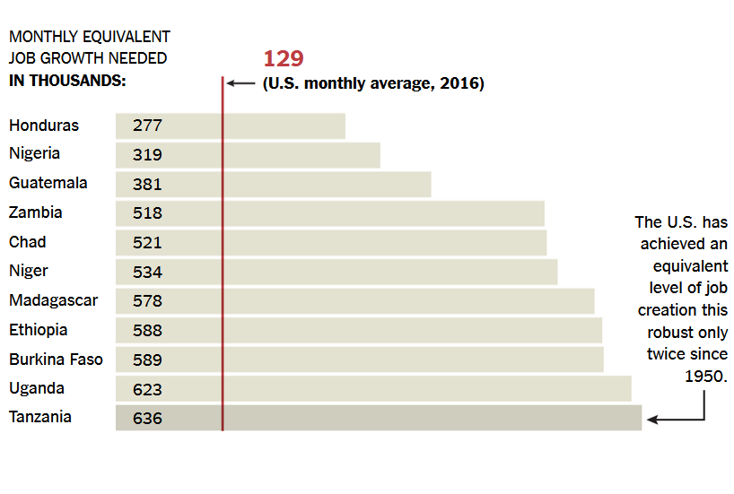

Slide 18
Which is a ‘greying’ population pyramid and what does that say about population growth?

