Slide 2
Notes:
https://www.nytimes.com/interactive/2023/09/18/opinion/human-population-global-growth.html

Slide 3
The second demographic transition
Global population numbers increasing but at a slowing rate
Subreplacement fertility occurring in some countries – not enough children born to replace parents.
Reasons:
Postponement of marriage and parenthood
Increased autonomy of women
Two household incomes now needed, thereby curtailing child-rearing
Single head of household families less able to support multiple children
Notes:
The demographic transitions started in the 1960s in the US and developed nations with a series of multifaceted revolutions. First, there was the contraceptive revolution, with the introduction of hormonal contraception and far more efficient IUDs; second, there was the sexual revolution, with declining ages at first sexual intercourse; and third, there was the sex revolution, questioning the sole breadwinner household model and the gendered division of labor that accompanied it. These three “revolutions” fit within the framework of an overall rejection of authority, the assertion of individual freedom of choice (autonomy), and an overhaul of the normative structure. The overall outcome of these shifts with respect to fertility was the postponement of childbearing: mean ages at first parenthood rise again, opportunities for childbearing are lost due to higher divorce rates, the share of childless ever-partnered women increases, and higher parity births (four or more) become rare. The net result is structural and long term below replacement fertility. Consequently, some countries are greying. In some countries, there is a concern that there will not be enough young people to make their economies stable, barring immigration.
http://www.pnas.org/content/111/51/18112.abstract?sid=d3a61a1a-1a38-4d60-8c3b-4e3348814b9a

Slide 4
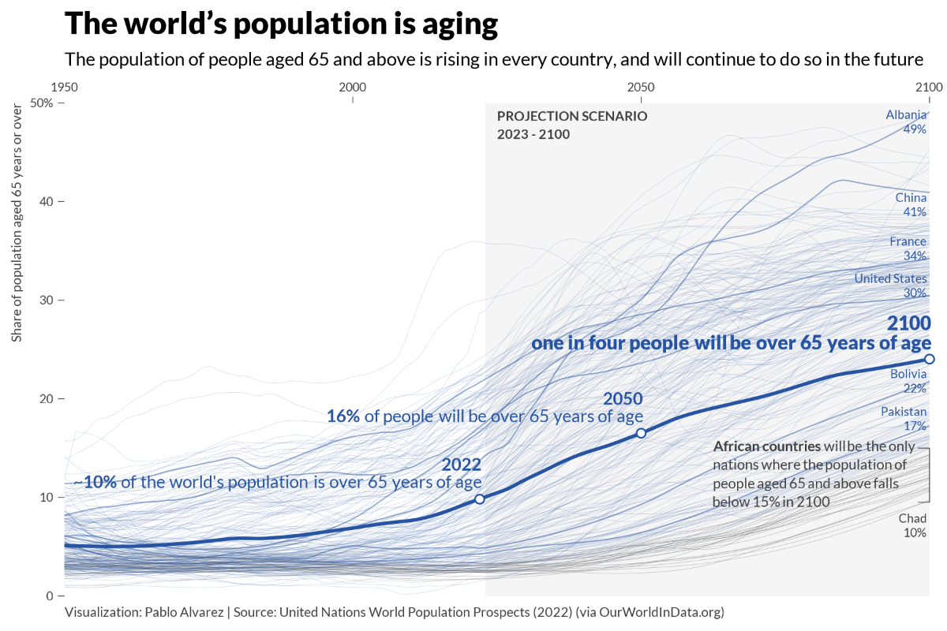

Slide 5
Notes:
In Japan adult diapers now outsell ones for babies
https://qz.com/103000/sales-of-adult-diapers-surpass-baby-diapers-in-aging-Japan
https://www.washingtonpost.com/video/world/japans-dementia-cafes-where-forgotten-orders-are-the-norm/2023/11/18/e4211463-d9ee-471a-92b4-f6f2a343aacf_video.html

Slide 6
Notes:
https://youtu.be/gmehUgOy5ok?si=VT00iwG0kJNQ8Fd6

Slide 7
The shift to an older population has demographic momentum and once under way it is difficult to reverse
Notes:
Once a couple has a small number of children, it locks in the number of potential children that their children may have A village school in Gangjin County, South Korea, has enrolled illiterate older people so that it can stay open as the number of children in the area has dwindled.

Slide 8
National initiatives to produce more children have minimal long-lasting impacts
Notes:
Sees it as mostly ineffective given that once depopulation starts it is hard to reverse

Slide 10
‘Depopulation’ is a tragedy of the commons because decisions to not have children can be logical and desired for an individual but have undesired consequences for society

Slide 11
Notes:
https://www.nytimes.com/interactive/2023/10/28/world/africa/africa-youth-population.html

Slide 12
The African youthquake

Slide 13
Africa’s soaring population is partly a result of the demographic transition. Africans eat better and live longer than ever, on average. Infant mortality has been halved since 2000; calorie intake has soared.
African countries have a vital resource that aging societies are losing: a youthful population

Slide 14
Nigeria adds another five million people every year, and by 2050 is expected to overtake the United States as the world’s third most populous country.
Yet some African countries risk being swamped by this youthquake
A large question is will there be enough development and jobs to provide livelihoods for these young people
Notes:
Experts say these demographic predictions are reliable, and that an epochal shift is underway. The forecasts for 2050 are sound because most of the women who will have children in the next few decades have already been born. Barring an unforeseeable upset, the momentum is unstoppable.

Slide 15
Even in Nigeria, Africa’s most populous nation today, two-thirds of its 213 million people live on less than $2 per day; extremist violence is increasing; and life expectancy is just 53, nine years below African average.
Notes:
https://www.nytimes.com/interactive/2023/10/28/world/africa/africa-youth-population.html

Slide 16
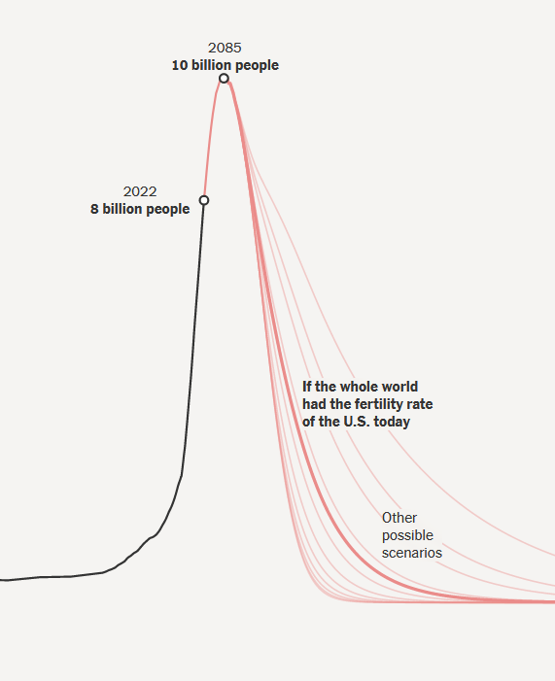
Africa’s working age population (15-65) will reach 1 billion in the next decade, but the question is will there be enough jobs and economic opportunities
However, even Africa youthquake will likely age out and eventually overall population on Earth is expected to begin a decline
Notes:
https://www.nytimes.com/interactive/2023/09/18/opinion/human-population-global-growth.html

Slide 17
A bottleneck and breakthrough policy for the future?
A compromise between environmentalism emphasizing conservation and degrowth versus ecomodernist perspectives emphasizing resource use, economic growth and innovation:
If society were to focus only on limiting economic growth to protect nature, then population growth and poverty could overwhelm what remains in the absence of innovation
If society focuses too much on letting growth and innovation run unchecked then what remains of nature could well be sacrificed.
Notes:
Proposed ways we will have a good Anthropocene

