Slide 1
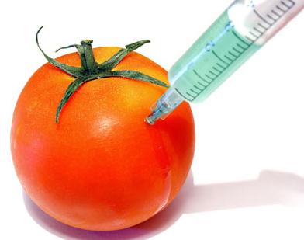
GMO crops as part of a second Green Revolution
Genes from one organism can be inserted into another in order to:
Produce pesticides within a plant (Bt GMO crops)
Promote tolerance to herbicides within a plant (Roundup Ready GMO seeds)
Confer disease resistance (Hawaiian papaya, Cavendish banana)
Produce other kinds of chemicals, like vitamins (golden rice)
An organism’s own genes can also be edited to turn on or off particular traits (specific varieties of mushrooms, tomatoes, lettuces, potatoes)
Notes:
The Cornucopian’s ace card

Slide 2
Where GMO crops fit into the timeline of pesticide and herbicide use
First generation crop chemicals
Arsenic, cyanide-based chemicals. Many of these were abandoned because they were ineffective and/or too toxic to humans
Second generation crop chemicals
Developed out of WWII chemical warfare infrastructure and used as part of the Green Revolution
Many of the more dangerous of these now banned
Third generation chemicals
GMOs integrated into the plants
Two decades of their use
Notes:
During World War II, both Allied and Axis powers extensively used chemical weapons such as mustard gas, phosgene, and nerve agents like sarin. After the war, there was considerable expertise in chemical synthesis and manipulation of organic compounds gained from the research and development of these weapons. The surplus of chemical manufacturing capacity and the scientific knowledge gained during wartime efforts led to the exploration of civilian applications for these chemical compounds. One significant area of application was in agriculture. Chemical companies and agricultural scientists began to investigate how these chemical agents could be repurposed as herbicides and pesticides to combat weeds, pests, and diseases in crops. The first generation of pesticides, such as DDT, had already been developed before World War II. However, the post-war period saw an acceleration in research and development efforts to create more effective and targeted pesticides. This resulted in the development of second-generation pesticides, which were often more potent and targeted specific pests or plant types. One of the key factors driving the growth of the herbicide and pesticide industries was the desire to increase agricultural productivity to meet the growing demands of post-war populations. Additionally, the availability of cheap chemical inputs and the perception of chemical solutions as modern and efficient further fueled the expansion of these industries.

Slide 3
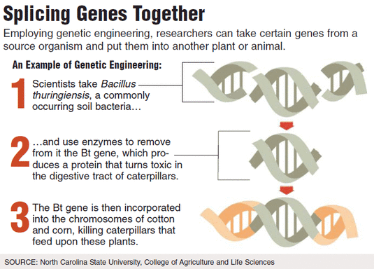
Putting pesticides into plants: GMO Bt crops
Bacillus thuringiensis, is a soil bacteria
It produces a protein that repels insects
Bacterial gene that produces this protein has been spliced into corn DNA to make it repel insects
Also added to cotton, potatoes, cacoa (chocolate)
Convenience for farmers who can afford them
Notes:
Bt corn, on the market since 1996, produces a protein, derived from a bacterium called Bacillus thuringiensis, which is toxic to moth larvae like the European corn borer.

Slide 4
Resistance to Bt is emerging
In areas where Bt crops have been used extensively, some insects are developing resistance
Corn earworm and the fall armyworm have evolved resistance from feeding on Bt corn
Without Bt or a replacement gene, older and more toxic insecticides may get used.
Pests may already be resistant to these older more toxic chemicals.
Notes:
A criticism of technological solutions….

Slide 6
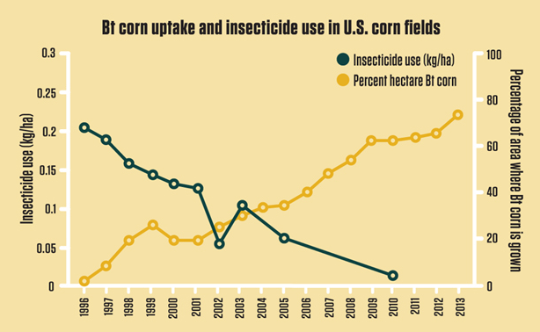
Notes:
Overall insecticide use rates declined with the introduction of Bt crops

Slide 7
Small farmers in India
A criticism of Bt crops was that they required farmers to forego traditional seed saving in the place of buying Bt seeds each year
Bt crops were targeted as the cause of high suicide rates of small farmers in India
However, there were several other factors
GMOs were not the sole cause
Banking and credit systems have long been risky and underdeveloped
Semi-marginal land and drought complicate farming
Absence of alternative income sources
Competition from farmers and lack of access to markets
Widespread protests in recent years have sought to bring resolution to their predicament
Notes:
http://www.nytimes.com/2014/02/23/world/asia/after-farmers-commit-suicide-debts-fall-on-families-in-india.html?_r=0
https://youtu.be/b2nzgEVUvns?si=YN0bdf_84of4x4Mo
So, here, GMO cotton may not be the best solution, it might work for some, but maybe not the poorest, but it is the economic and social context of GMOs not the GMO itself.

Slide 8
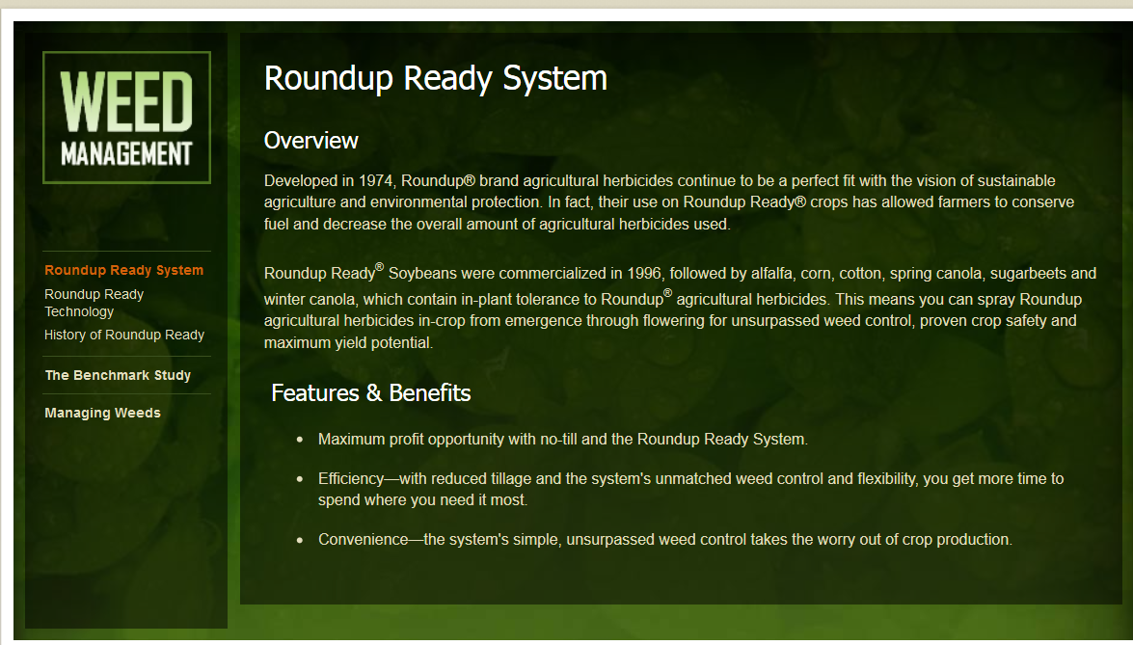
Herbicide-tolerant GMO crops: Roundup-ready seeds
Notes:
Round-up ready seeds are tolerant to the herbicide Round-Up, which contains glyphosate. This allows farmers to plant crops that have been engineered to resist Round-Up and then spray their fields to control weeds. The weeds suffer the effects of Round-Up but not the engineered crops.
There are Roundup Ready seeds for corn, sugar beets, soybeans, and cotton

Slide 9
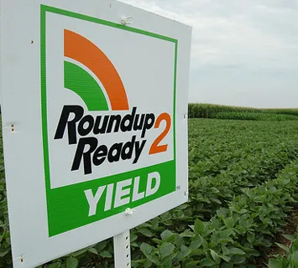
The Roundup Ready herbicide is glycophosphate
It kills undesired weeds in the field
If farmer uses Roundup Ready seeds, the crop plant is resistant to herbicide but surrounding weeds are not
Roundup Ready seeds are an example of plant-incorporated protectants (PIPs)
The same company, Monsanto, sells the seed and Roundup (Monsanto was bought in 2023 by Bayer)
Notes:
Monsanto developed and patented the glyphosate molecule in the 1970s, and marketed it as Roundup from 1973.

Slide 10
Roundup ready seeds have decreased the use of older more toxic herbicides on farmland
But overall use of glyphosate has increased overall use of herbicides

Slide 11
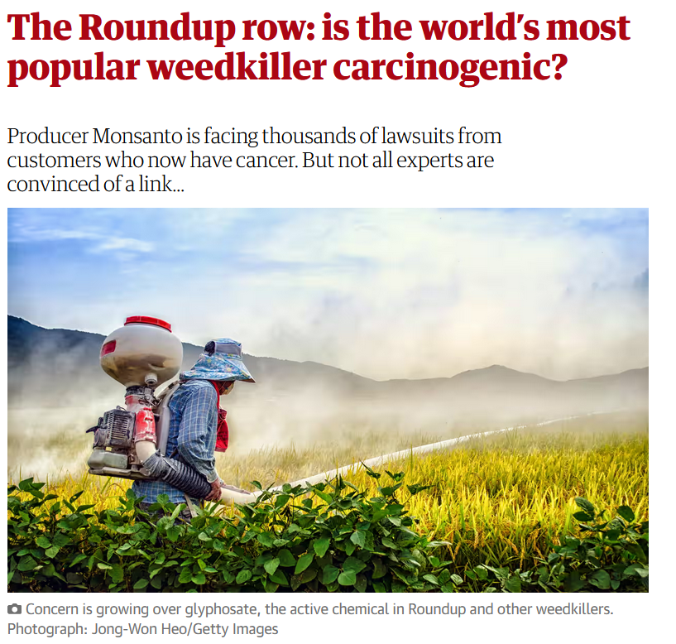
Glyphosate was originally thought to have negative health effects on humans
That position is less clear now, with some regulatory bodies ruling that Roundup may be associated with negative health effects
Although used in large volumes with Roundup Ready crop seeds, Roundup is widely used as a home lawn and garden weed killer on its own
Notes:
https://www.theguardian.com/environment/2019/mar/09/spray-pray-is-roundup-carcinogenic-monsanto-farmers-suing

Slide 12
Emergence of weeds resistant to glyphosate (active ingredient in Roundup)
Notes:
In fact, since 1996, most cultivated GMOs have been herbicide-tolerant (HT) crops, which involve the use of an associated herbicide, generally glyphosate. In their very first years of adoption, HT crops often led to some decrease in herbicide use. However, the repetition of glyphosate-tolerant crops and of glyphosate only applications in the same fields without sufficient alternation and herbicide diversity has contributed to the appearance of glyphosate-resistant weeds. These weeds have resulted in a rise in the use of glyphosate and other herbicides.

Slide 13
Dicamba, proposed replacement for Roundup Ready GMO crops
Notes:
There have been issues with Dicamba drifting over to adjacent fields and at present has not been as successfully introduced as Roundup Ready seeds

Slide 14
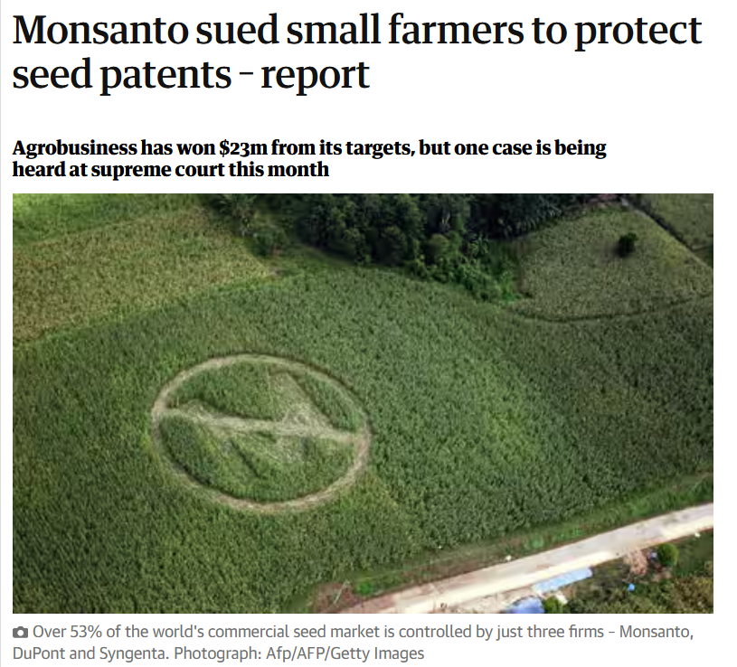
Monsanto, Roundup, and the bad reputation that stuck to the first GMO crops
Farmers were required to sign restrictive contracts to use patented seeds – they could not reuse seed from one year to the next
Monsanto aggressively prosecuted those who tried to use the seeds outside of their rules
Environmental groups grew concerned because of the skyrocketing use of RoundUp and the abrupt decline in agricultural diversity.
Notes:
At one point, Monsanto had a 75-person team dedicated solely to investigating farmers suspected of saving seed — a traditional practice in which seeds from one year’s crop are saved for planting the following year — and prosecuting them on charges of intellectual-property infringement. This policing and the fact that seeds had long not been a patented, trademarked property, gave GMOs a bad reputation. There were seen as corporate, profit-oriented, disruptive entities. https://www.theguardian.com/environment/2013/feb/12/monsanto-sues-farmers-seed-patents

Slide 15
Monsanto is the same company that made Agent Orange and PCBs, an environmental toxin that the E.P.A. banned in 1979
This history is troubling, but the worst outcome over disputes over Roundup Ready seeds is that is made the public very suspicious of GMOs.
They were seen as corporate, out for profit, but it was only these large companies at that time that had the knowledge and economic resources to develop them
Notes:
PCBs were initially used as coolants and lubricants in electrical equipment such as transformers and capacitors due to their excellent insulating properties and resistance to heat. They were also used as plasticizers in paints, plastics, and other industrial products. However, their production and use were eventually banned or severely restricted in many countries due to their toxicity and environmental persistence. PCBs are now recognized as persistent organic pollutants and pose significant risks to human health and the environment.
GM crops are developed and implemented as though they were silver bullet solutions because investors look for rapid returns on their investment

Slide 16
The irony of big agribusiness
Distrust of GMOs and the companies that made brought increased regulation in the US and Europe
Now only companies big enough to work through the regulation are doing GMOs – small companies do not have the finances and expertise to introduce new GMOs
Industrial agriculture’s sprawling, consolidated, multinational market domination of GMOs has become entrenched
Arguments are made that if GMOs were more in the hands of smaller research interests there could be more innovation and diversification of crop foods instead of the current focus on industrial scale crops

Slide 17
How the WWW contributed to the initial negative reception of GMOs
The well, wealthy and worried adopted a stance of epistemic opacity
When you imagine you know how something works, or where it comes from, that’s comforting,, but if you don’t know what genetically modified means, it’s alienating
This demographic advocated organic food and made it into a multi-million dollar industry
Set back the acceptance of GMOs

Slide 18
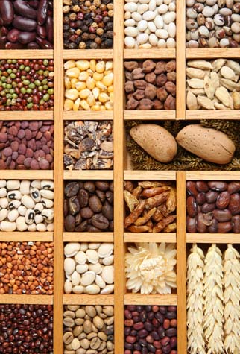
Terminator seeds
Genetic use restriction technology
GMO plant is engineered so that its seeds are not viable
Farmers cannot save seeds
Commercialization of terminator seeds has been limited, and there are regulatory barriers and public opposition in many regions that have prevented widespread adoption.
Notes:
As of January 2022, terminator seeds, also known as genetic use restriction technologies (GURT), have been a controversial topic in agriculture. Terminator technology refers to genetically modified seeds that are designed to produce sterile plants, preventing farmers from saving and replanting seeds from their harvests. The use of terminator seeds has been largely opposed by many environmental and social advocacy groups due to concerns about farmers' rights, food security, and biodiversity. However, the commercialization of terminator seeds has been limited, and there are regulatory barriers and public opposition in many regions that have prevented widespread adoption.

Slide 19
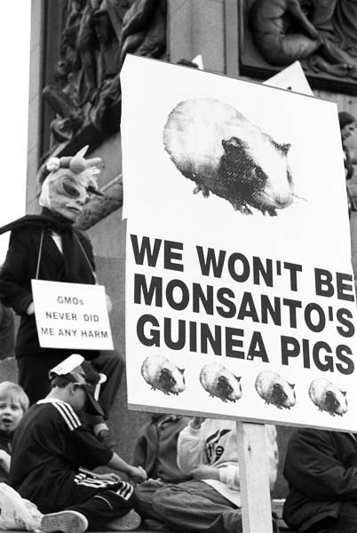
What about eating GMOs? Is it safe?
Notes:
Frankenfood? https://youtu.be/ynyB2fNn8kQ?si=_7Lww8YK7WToi0n5

Slide 20
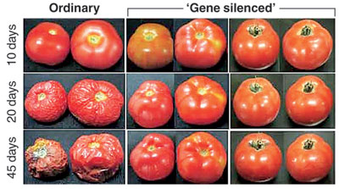
Notes:
Flavr Savr tomato

Slide 21
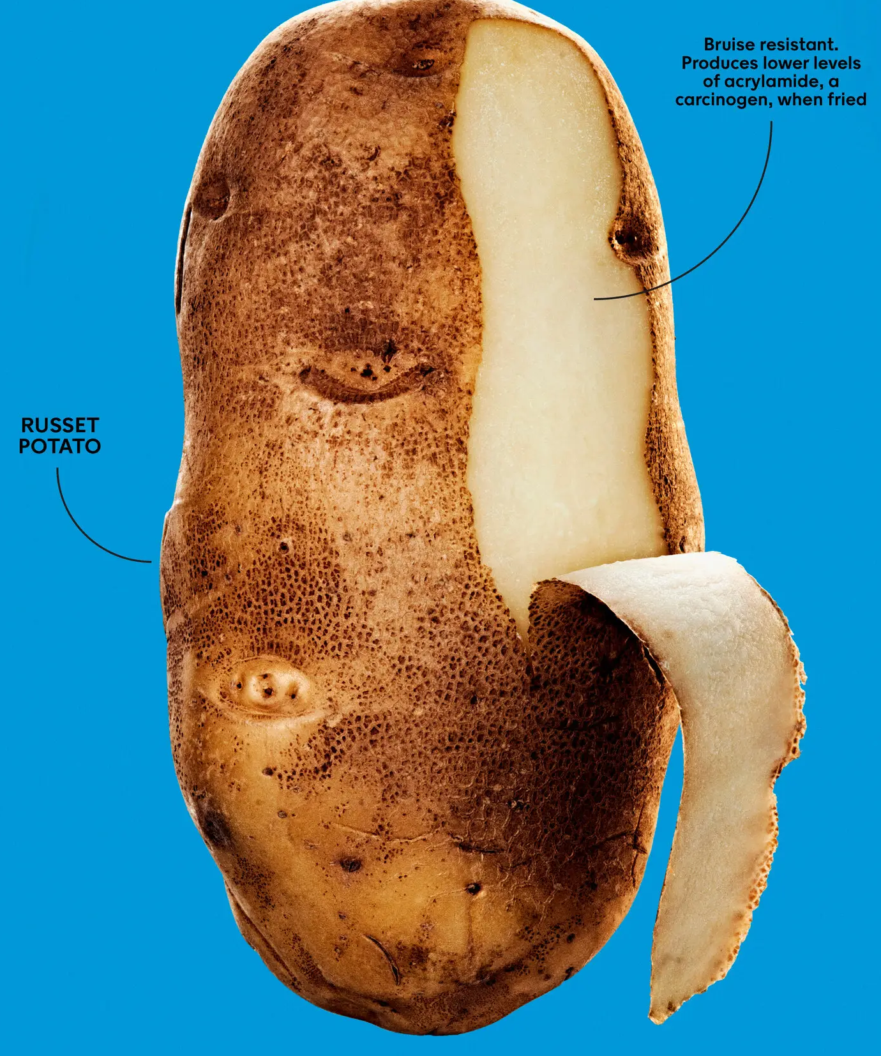
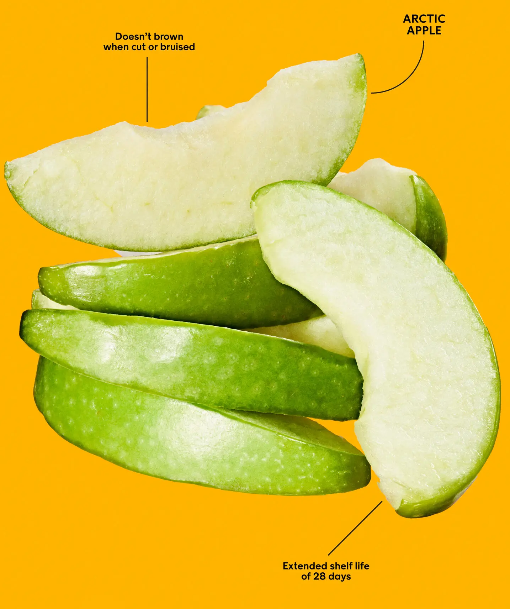

Slide 22
Scientific assessments deem GMOs safe
Notes:
AAAS, the American Association for the Advancement of Science https://www.aaas.org/sites/default/files/AAAS_GM_statement.pdf

Slide 23
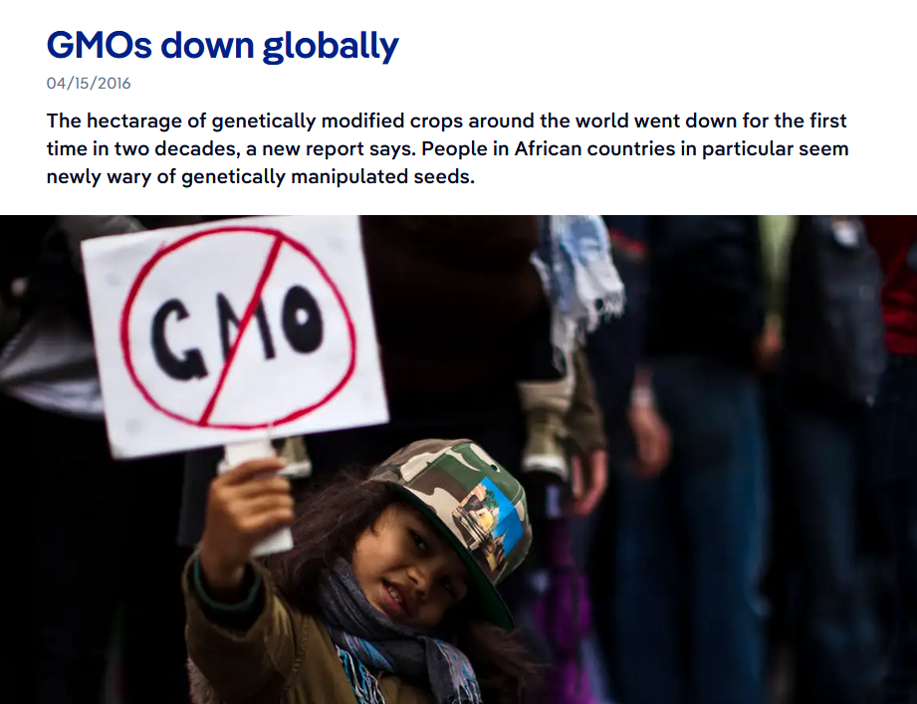
In recent years, many environmental groups have also quietly walked back their opposition as evidence has mounted that existing GMOS are both safe to eat and not inherently bad for the environment.
Historically, GMO crops have been viewed skeptically in parts of Africa, areas that were historically colonized
Notes:
The power associated with GMOs rather than their health effects have been suspect in Africa.

Slide 24
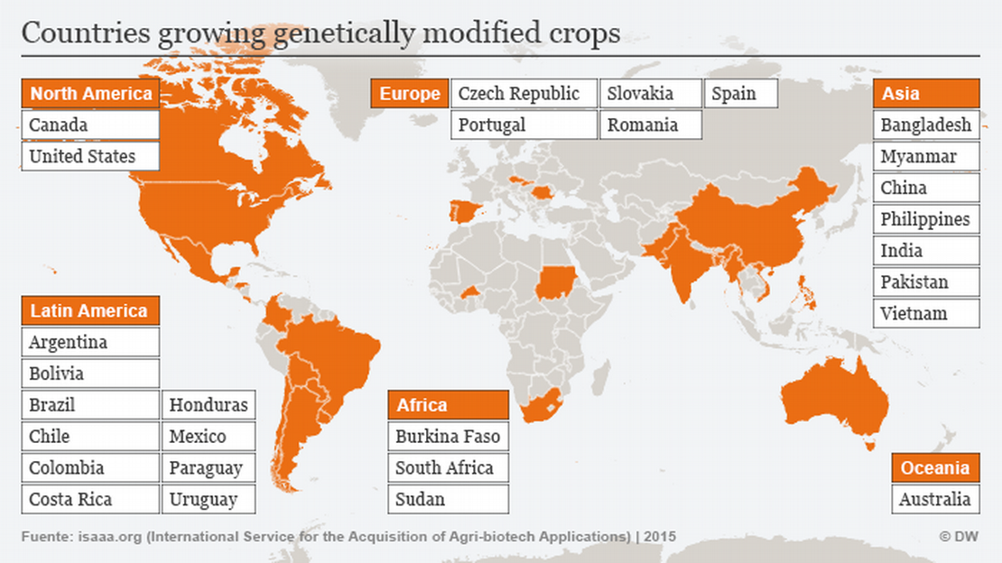

Slide 25
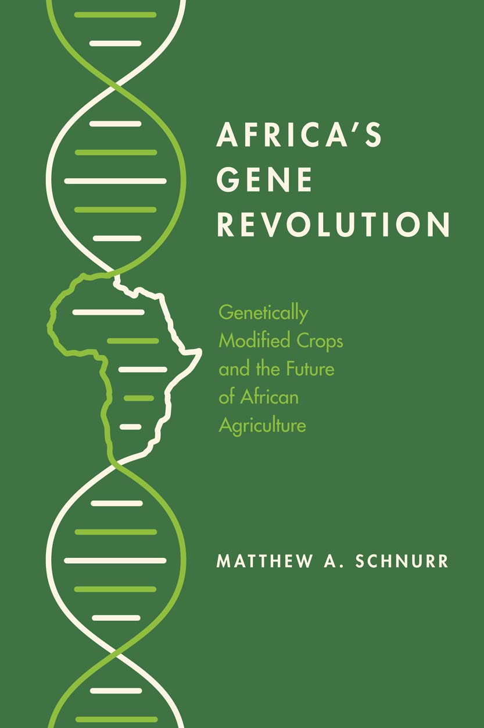
GMOs have been used in some African countries for two decades
Several African countries are not lowering their barriers and opposition to GMOs
The question is whether the corporate, industrial aspect of GMOs can be altered to improve food security there rather than destabilize it

Slide 26
Notes:
https://www.nytimes.com/2021/07/20/magazine/gmos.html

Slide 27
Notes:
Blindness can develop from a lack of vitamin A, particularly in regions of the world that are food scarce.
Corneal blindness often affects people at a young age, such as this twelve year old girl from Ethiopia who is blind from vitamin A deficiency. Corneal grafts may restore some sight, but these are operations that are not always available
http://www.cehjournal.org/article/corneal-blindness-prevention-treatment-and-rehabilitation/
Golden rice was developed by a nonprofit group called the International Rice Research Institute with the aim of providing a new source of vitamin A to people where households get most of their calories from rice, and eventually in many other places in a world where rice is eaten every day by half the population..

Slide 28
Golden rice
Engineered to combat vitamin A deficiency, a simple but devastating ailment that causes blindness in millions of people in Africa and Asia annually, and that can also be fatal.
Protests by anti-G.M.O. activists alarmed governments and populations in developing countries.
Its commercial deployment has been limited until recently – the first commercial plantings have taken place in the Philippines
Notes:
Golden Rice has finally hit markets across the Philippines as the country embraces the genetically modified crop to boost local food production and counter Vitamin A deficiency, an affliction caused by a poor diet that can lead to blindness, especially in children. The Philippines started transplanting Golden Rice in the 2022 wet season, becoming the first country in the world to commercially cultivate the crop, locally branded as Malusog Rice (malusog is the Filipino word for healthy). The rice is being market-tested country-wide, with consumers giving it positive initial results. In contrast, Bangladesh faces regulatory inertia, with approval for Golden Rice pending for six years since November 2017. Despite efforts by scientists to demonstrate Golden Rice’s safety and efficacy, bureaucratic delays have hindered its adoption by farmers, even as malnutrition remains a problem among vulnerable populations in the country

Slide 29
Notes:
https://allianceforscience.org/blog/2024/02/bangladesh-still-stuck-in-the-past-as-locally-grown-golden-rice-hits-markets-in-the-philippines/ Golden Rice has finally hit markets across the Philippines as the country embraces the genetically modified crop to boost local food production and counter Vitamin A deficiency, an affliction caused by a poor diet that can lead to blindness, especially in children. The Philippines started transplanting Golden Rice in the 2022 wet season, becoming the first country in the world to commercially cultivate the crop, locally branded as Malusog Rice (malusog is the Filipino word for healthy). The rice is being market-tested country-wide, with consumers giving it positive initial results. In contrast, Bangladesh faces regulatory inertia, with approval for Golden Rice pending for six years since November 2017. Despite efforts by scientists to demonstrate Golden Rice’s safety and efficacy, bureaucratic delays have hindered its adoption by farmers, even as malnutrition remains a problem among vulnerable populations in the country

Slide 30
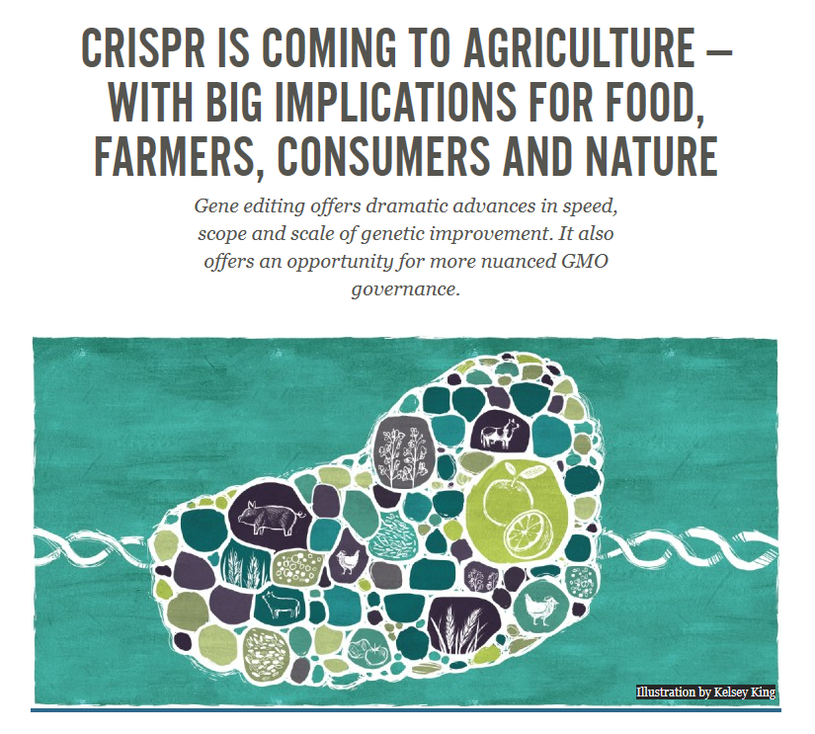
CRISPR Cas-9
First generation of genetic modification techniques were imprecise
CRISPR: a revolutionary technique for targeted gene editing
Very precise and predictable technique
Patented in 2014
Genetic engineering has entered a new era – your food (and health) will not be the same
Notes:
Clustered regularly interspaced short palindromic repeats (CRISPR)
https://ensia.com/voices/crispr-is-coming-to-agriculture-with-big-implications-for-food-farmers-consumers-and-nature/ https://www.pairwise.com/what-we-are-creating/
https://www.forbes.com/sites/juergeneckhardt/2024/03/26/the-era-of-healthier-produce-thanks-to-science-is-just-getting-started/?sh=79b967bd67e3

Slide 31
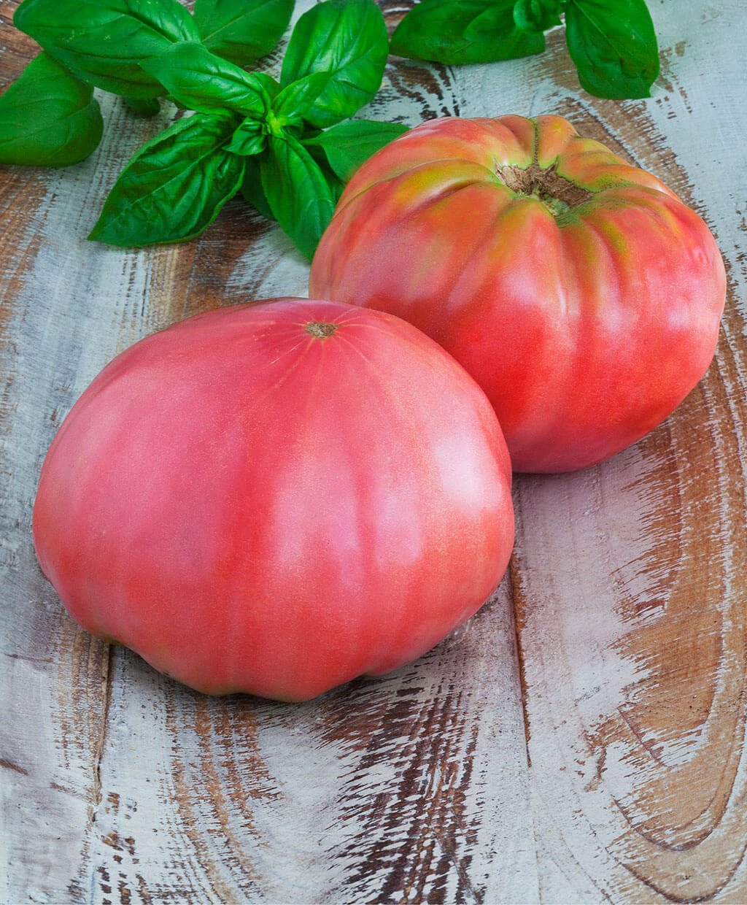
GMOs can reintroduce the variety of landraces and heirlooms lost from industrial agriculture
Even before GMOs were introduced, US had lost 93% of the genetic diversity in our fruits and vegetables.
Industrial fruit and vegetable varieties are durable and bred for standardization and transport
They often lack taste and flavor of landraces and heirloom varieties, which are often not as well suited for widespread marketization
Small growers and academics can incorporate modifications that would improve these lost varieties for the malison market while also retaining their texture and flavor.
Notes:
One famous example is the Brandywine tomato, an heirloom variety known for its exceptional taste. The genes of Brandywine tomatoes have been used by plant breeders to improve the flavor of commercial tomato varieties. By crossbreeding Brandywine tomatoes with other tomatoes, breeders aim to create hybrids that retain the delicious flavor while also possessing traits such as disease resistance and higher yields.

Slide 32
Traditional breeding of plants still retains some advantages over GMOs
Environmental variations alter how genes are expressed.
This complicates engineering of a GMO crop even with CRISPR if these environmental variations are not taken into account
Traditional breeding can utilize the field setting to find individuals with desired traits that are expressed on their own

Slide 33
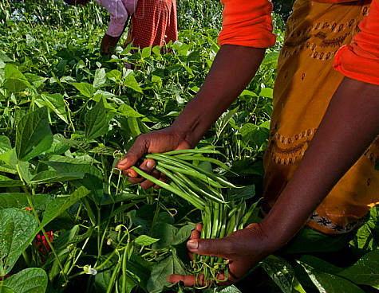
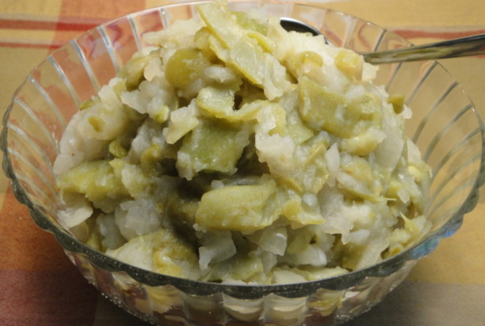
Making a better string bean thru traditional breeding
A protein source for the poor is needed that grows well in dry, low phosphorous (P) soils, a key plant nutrient
Ideal to have string bean with shallow roots (P is near surface) yet also have taproot that goes deep to access water during drought
Through a traditional breeding program, it thousands of plants were dug up until some were found with a few shallow roots and single taproot with long root hairs. These were subsequently used in breeding
Notes:
Locating a green beans with desired qualities greatly shortened the experimental procedures that would have to take place in the lab to produce a green bean plant with shallow roots and a taproot structure.
Maybe looking and digging up candidate plants may be faster in some cases, in others, it may not. It depends upon the traits desired, the environmental conditions of where a crop grows, the way a gene works. Genetic modification, even with CRISPR is not meant to be a blanket fix, the only tool left for us to use.
South African stewed green beans and potatoes (bottom)

Slide 34
Scuba rice
Genetic techniques can be used to speed up traditional breeding
No gene modification, genetic technique used only to select desired traits
In Bangladesh farmers have embraced flood-tolerant “scuba rice,” a variety bred to survive being submerged for up to 14 days rather than just three.
Each year, Bangladesh and India lose roughly four million tons of rice to flooding — enough to feed 30 million people — and waste a corresponding volume of pesticides and herbicides, which then enter the groundwater.
Notes:
Scuba rice is not a GMO in the sense that genes were inserted into it, or its own genes turned on or off through genetic manipulation.

Slide 35
Context matters with GMOs
Social, economic, and environmental context determine the suitability of GMO crops
GMOs are not a silver bullet, and issues over them should not be portrayed in strict black and white terms
Ongoing experimentation and innovation in the human relation to plants and food is likely necessary, although the equivalent priority should be making what food is already available accessible to those who are food insecure because of social, economic, and environmental inequities

