Slide 1
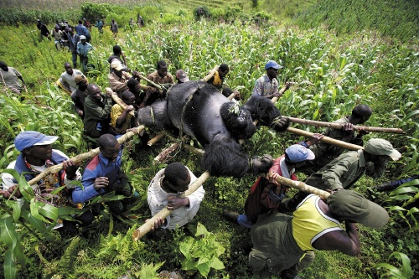
Notes:
Our hunting is fundamentally different. We have little reason to be concerned over own safety. Prefer large big often healthy animals with disproportionate influence on reproduction in a population. Predation by non-humans tends to favor the diseased, the weak, the very young or the very old. In our last lecture we looked at home attitudes toward megafauna can lead to their protection or their harm when encounters occur. These encounters are often about livelihoods. From an elephant trampling the crops of a subsistence farmer to a Bangladeshi mauled by an Indian tiger in a poor fishing village, it is difficult to divorce economics from wildlife. Our attitudes toward charismatic wildlife like lions and tigers lead us to donate money to conservation organizations. These discourses that motivate us to save megafauna elsewhere are often incomplete, as we saw with the example of the Indian tiger and the complexities surrounding what will happen with future populations of these tigers in one of the most populous countries in the world. Today we want to continue to look at overexploitation, but from a slightly different perspective: we look at the consumptive use of animals, their use as food, folk medicines (that rarely have any true medical value), their collection and captivitiy as pets, and as animals for hunting in canned trophy hunts
Since the late 1990s, approximately 6 million people have died in a civil war raging sporadically in the Democratic Republic of the Congo, although the exact number is hard to determine.
The country is also home to the largest remaining population of mountain gorillas

Slide 2
Notes:
The gorilla victims were part of Congo’s resource wars, reportedly killed by a corrupt park official who was trying to spite a warden for cracking down on the illegal charcoal trade. Local people go into the forest to collect wood to make charcoal, an efficient fuel source (raw wood is smokier and burns unevenly. Partially burned wood, as charcoal, is easier to work with.

Slide 3
Notes:
Our hunting is also motivated by reasons to kills that are uniquely human.
http://www.usnews.com/news/world/articles/2008/02/06/the-story-behind-the-killings-of-congos-rare-mountain-gorillas
Civil war in the Democratic Republic of Congo

Slide 4
Notes:
https://youtu.be/GPPlH_yKgr4?si=2mBoxqT60OYbl9-f
Hunting is a form of exploitation

Slide 5
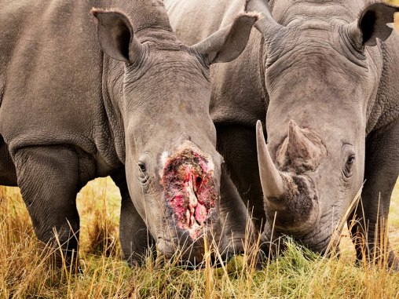
Notes:
Poaching to acquire animal parts to be consumed as food or as shown above, as traditional medicines and curatives. Rhino horn is believed to have properties that improve health and vigor by humans, particularly in parts of Asia.

Slide 6
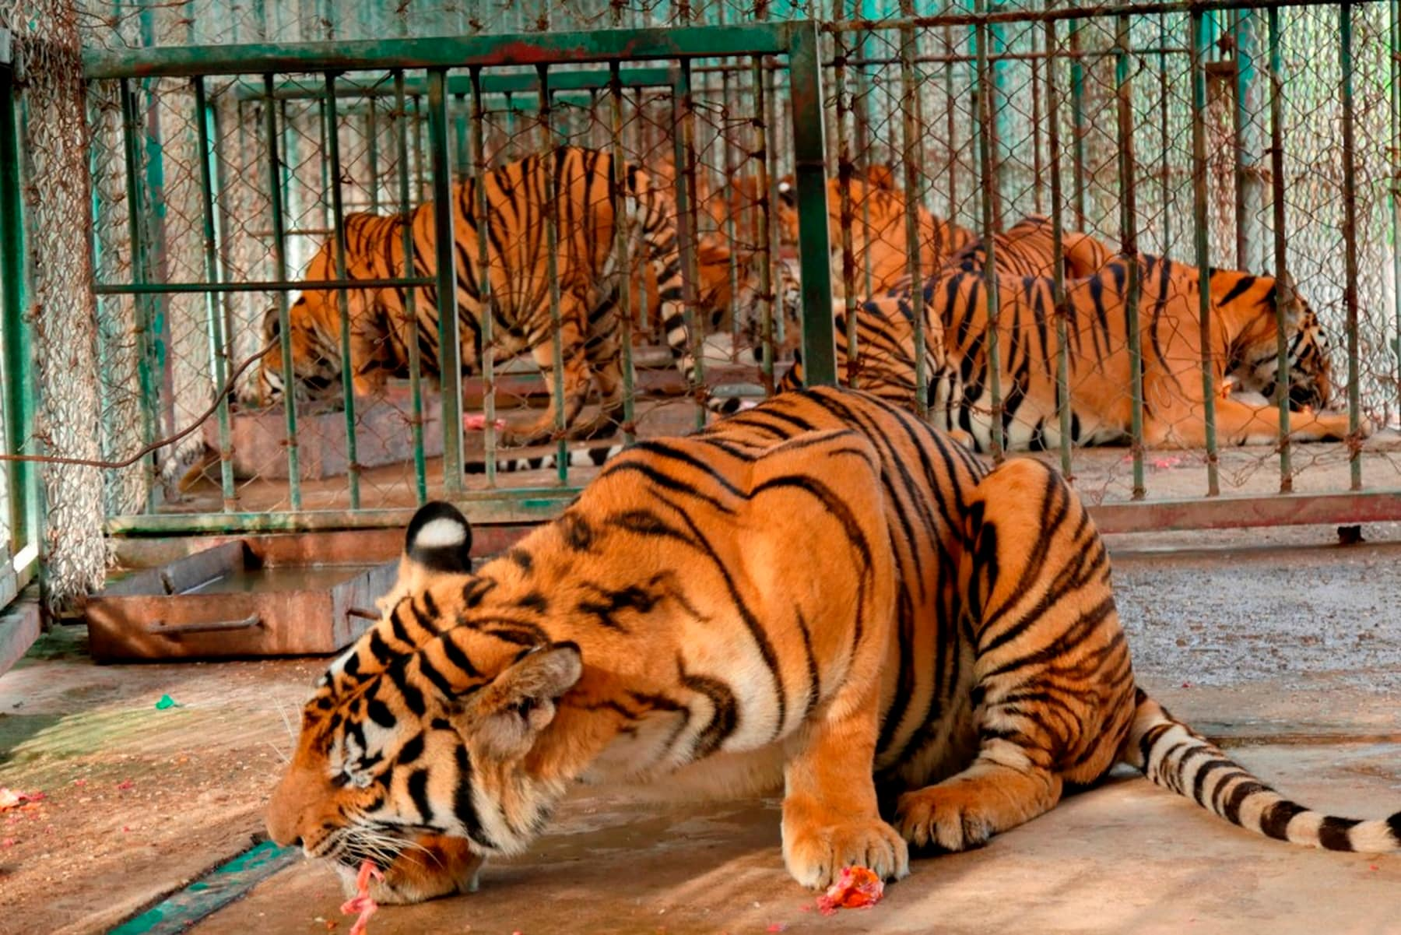
Notes:
Tiger farming

Slide 7
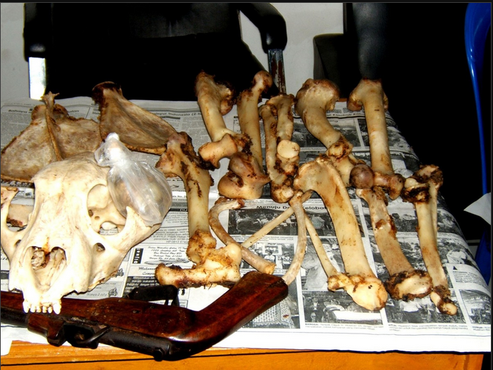
Set of tiger bones worth as much as $7,000

Slide 9
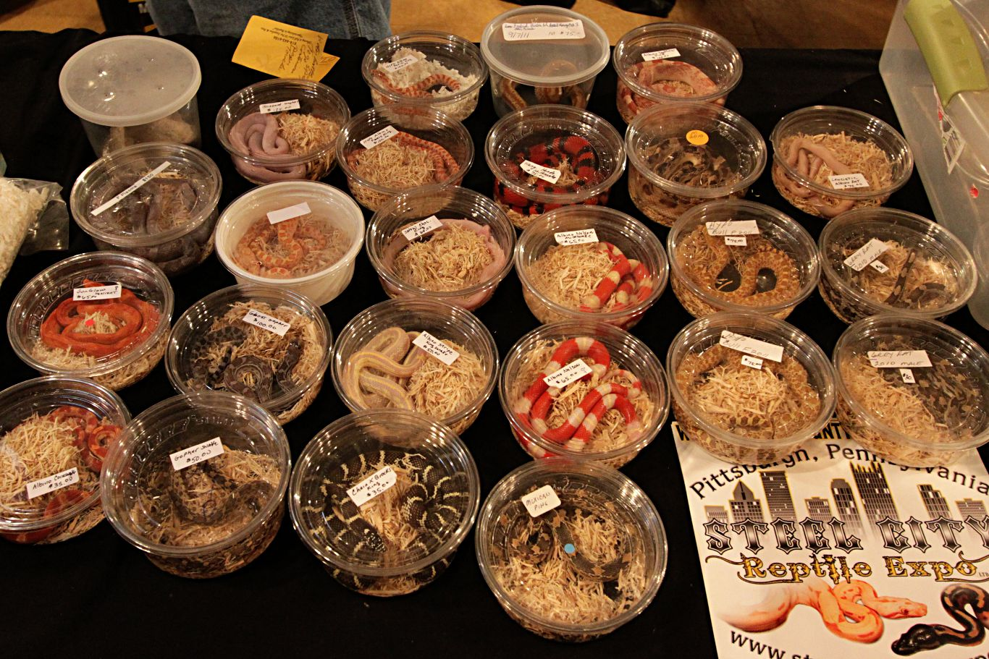
Notes:
Wildlife pet trade

Slide 10
Notes:
https://www.nytimes.com/2017/11/04/world/africa/ape-trafficking-bonobos-orangutans.html

Slide 11
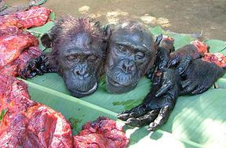
Notes:
Bushmeat

Slide 12
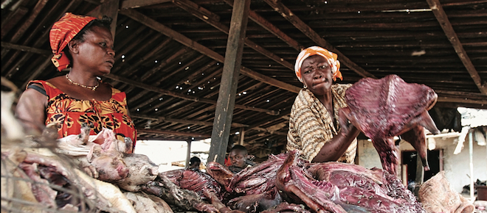
Notes:
Bushmeat – illegal, unsustainable trade in wildlife for income or meat Ghana

Slide 13
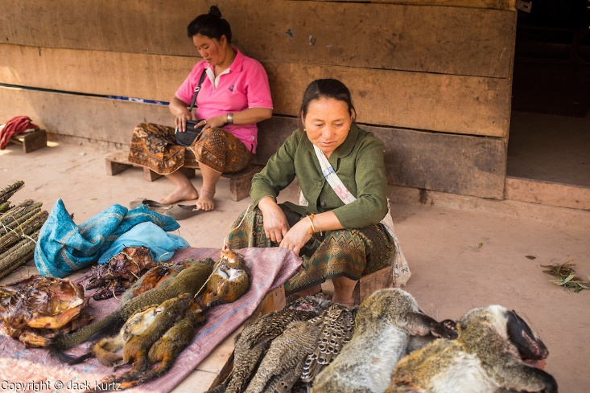

Slide 14
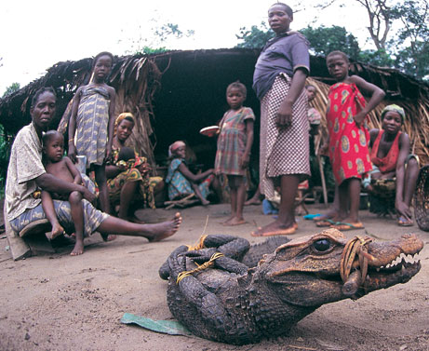
Notes:
Bushmeat trade endemic in many parts of Africa and Asia
Bushmeat is illegal as defined by: 1) where hunting took place; 2) method of hunting; 3) status of the species taken.
Some game meat can be legally hunted, farmed, and sold in a market. Not all meat sold is illegal.

Slide 15
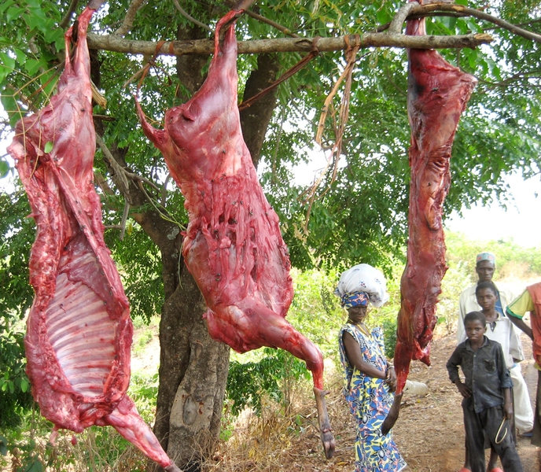
The bushmeat trade
Provides protein where other sources lacking
Instability in food supply
Poverty and the need for an income from hunting and selling bushmeat
Cultural, ceremonial uses of animals
Bushmeat needs to be understood in its historical, social, political context
Notes:
Bushmeat provides food, but also a livelihood and a role in society

Slide 17
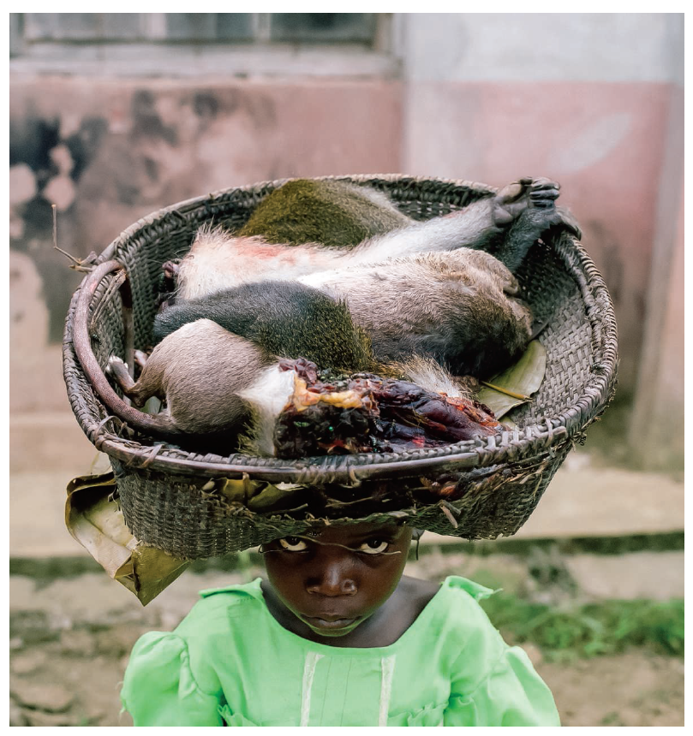
Bushmeat unfairly targets one type of overexploitation specific to a group of people (rural) and a location (the developing world)
However many cultures have or have had practices like bushmeat
Notes:
A child carries a basket containing a Gambian rat and a monkey in Lomela, Democratic Republic of the Congo.

Slide 18
Notes:
Bushmeat, as a larger practice of unregulated or illegal consumption of wildlife, is common across economic circumstances
Bluefin tuna is considered wildlife and it is being taken illegally such that it is in danger of being fished out of existence.

Slide 19
Notes:
Although Southeast Asia has long been regarded as a hotspot of turtle diversity, the fauna of Laos, Cambodia, and Vietnam (formerly known as French Indochina) remains poorly known. Biological investigation was limited prior to World War II, and since then decades of civil unrest, political instability, and military conflict have largely prevented fieldwork. Exploitation of turtles for food and medicinal markets is widespread in Laos, Cambodia and Vietnam. Hunters in rural villages capture turtles and tortoises for local consumption or to sell to traders who periodically visit villages to purchase wildlife. Although turtles and tortoises are locally consumed and domestically traded in Laos, Cambodia, and Vietnam, most are exported to markets in southern China. Turtles from Laos and Cambodia are usually transported to Vietnam, where they join with Vietnamese turtles on northward routes to China

Slide 20
Notes:
Markets are places to see rare turtles bound for consumption. Some of these turtles have been bought in markets and taken into captivity by herpetologists to become, in some cases, some of the only known specimens.

Slide 21
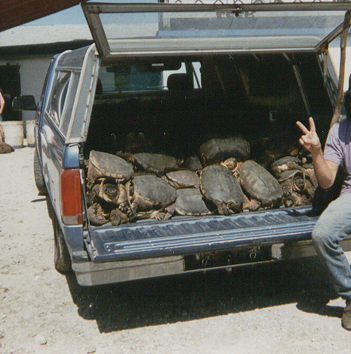
Notes:
Demand for turtle meat in Asia has increased illegal and legal hunting pressure on turtles in the US. Turtles are caught here but sold and exported mainly to China where household incomes have risen over the last several decades. Many states are now strengthening legislation to more tightly control turtle hunting. Turtle hunting has been legal in many states, but the hunting regulations (length of season, number of turtles taken) need to be reassessed in light of increasing pressure

Slide 22
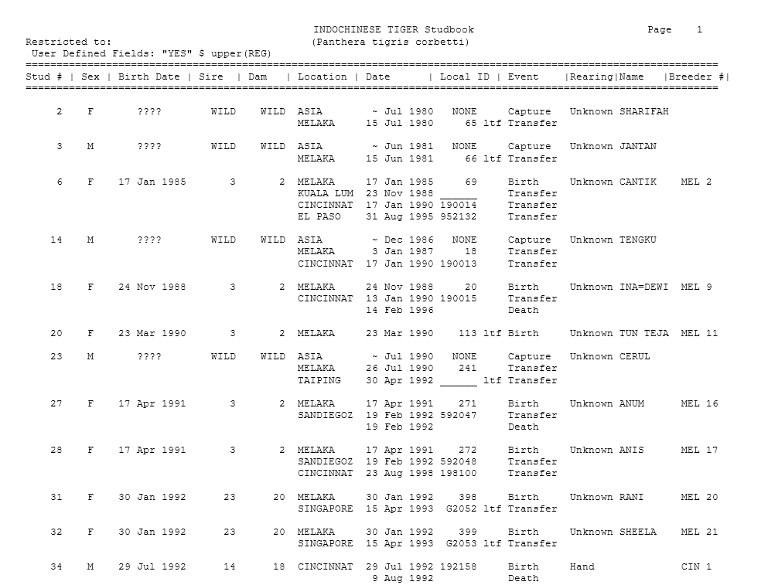
More tigers in captivity than in their habitat
3900 tigers remaining in the wild
Estimated 10,000 individuals in captivity,
Of these in captivity perhaps only 1500 are tracked and their subspecies identities known
Notes:
http://library.sandiegozoo.org/studbooks/carnivores/indochinesetiger2002.pdf This is a tiger studbook maintained for Indonesian tigers at the San Diego Zoo.

Slide 23
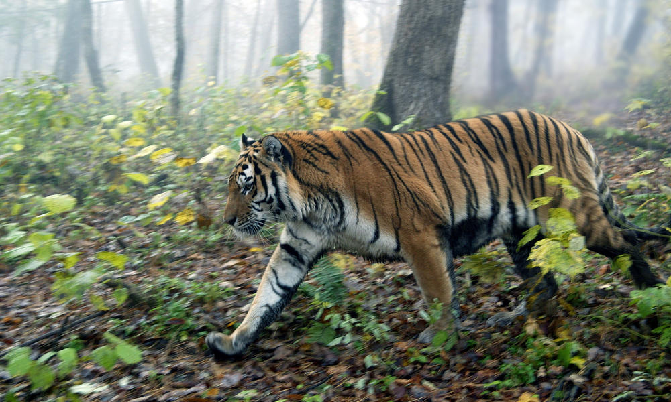
Amur or Siberian tiger
Notes:
The largest tiger subspecies, up to 660 pounds and 10 feet in length.
Amur tigers were once found throughout the Russian Far East, northern China, and the Korean peninsula. By the 1940s, hunting had driven the Amur tiger to the brink of extinction—with no more than 40 individuals remaining in the wild. By the 1980s, the Amur tiger population had increased to around 500. Although poaching increased after the collapse of the Soviet Union, continued conservation and antipoaching efforts by many partners—including World Wildlife Fund—have helped keep the population stable at several hundred individuals. The Amur tiger’s habitat is now restricted to the Russian Far East, and to small pockets in the border areas of China and possibly North Korea.
Amur tigers represent the largest unfragmented tiger population in the world, but there are fewer of them than Indian tigers.

Slide 24
Notes:
Rare Amur tigers in Russia are succumbing to infection with canine distemper virus (CDV), a pathogen most commonly found in domestic dogs. Pressure from poaching, decimation of their prey base, and habitat fragmentation have diminished the population of Amur tigers (also called Siberian tigers) to fewer than 500. In the study, a team of scientists from the US and Russia show that CDV infected and caused fatal neurological disease in members of this critically endangered species. They estimate that the virus has killed at least 1% of Amur tigers since 2009. Normally a reclusive species, tigers have been seen entering villages and wandering onto roads in the Russian Far East, stumbling, emaciated, and unafraid of humans.
http://blogs.scientificamerican.com/extinction-countdown/2014/11/06/canine-distemper-siberian-tigers/
http://journals.plos.org/plosone/article?id=10.1371/journal.pone.0110811

Slide 25
Notes:
The tiger has a rich cultural history through art, literature, and folklore in China
Outlaws of the Marsh, a classic Chinese novel. Wu Song kills a tiger but soon learns that the human world is more dangerous.

Slide 26
Notes:
Mao Zedong is the founder of the Chinese Communist Party (1921) and the Peoples Republic of China (1949). Tigers declared pest by Chairman Mao which subjected to uncontrolled hunting during Great Leap Forward program of Communist China in 1950’s "Eradicate pests and diseases and build happiness for ten thousand generations" (1960). A poster (right) used during the Four Pests Campaign. The main focus was on mosquitoes, sparrows, rats, and flies

Slide 27
Notes:
Photo of traditional Chinese medicine store. These are common in China and in Chinese communities and neighborhoods throughout the world.
TCM does use tiger bone, but in limited amounts and infrequently. No proven medical value to tiger parts

Slide 28
Notes:
Fragmentation in Asia, emergence of China
What accounts for growing demand for tiger parts? Affluence and the rise in economic power and personal wealth in China over the past three decades. Note how the economic center of the world was toward in Europe in the past century. Now it has switched back to Asia

Slide 29
Notes:
This 1979 book is a listing of tiger bones and their properties. The book describes the bones as a “precious crude medicine,” whose medicinal use in China traced back more than 1,400 years. But as China’s economy grew, the animal’s mythical qualities — none of which are substantiated by modern medicine — ignited a market for tiger products that, the book said, “sold well domestically and abroad.” So well, in fact, that within years of the book’s 1979 publication, a country as vast as China estimated it had only a few dozen tigers left, and something needed to be done. The Chinese government passed a law that banned killing endangered species in the wild while encouraging their “domestication” and breeding. The idea was that the farms would expand the tiger population, sating demand for tiger products while protecting those in the wild. But that wasn’t what happened. Instead, demand exploded further,inciting rampant poaching of wild tigers all over Asia and ushering in an era of “catastrophic consumption.”

Slide 30
Notes:
Poaching for traditional medicines

Slide 32
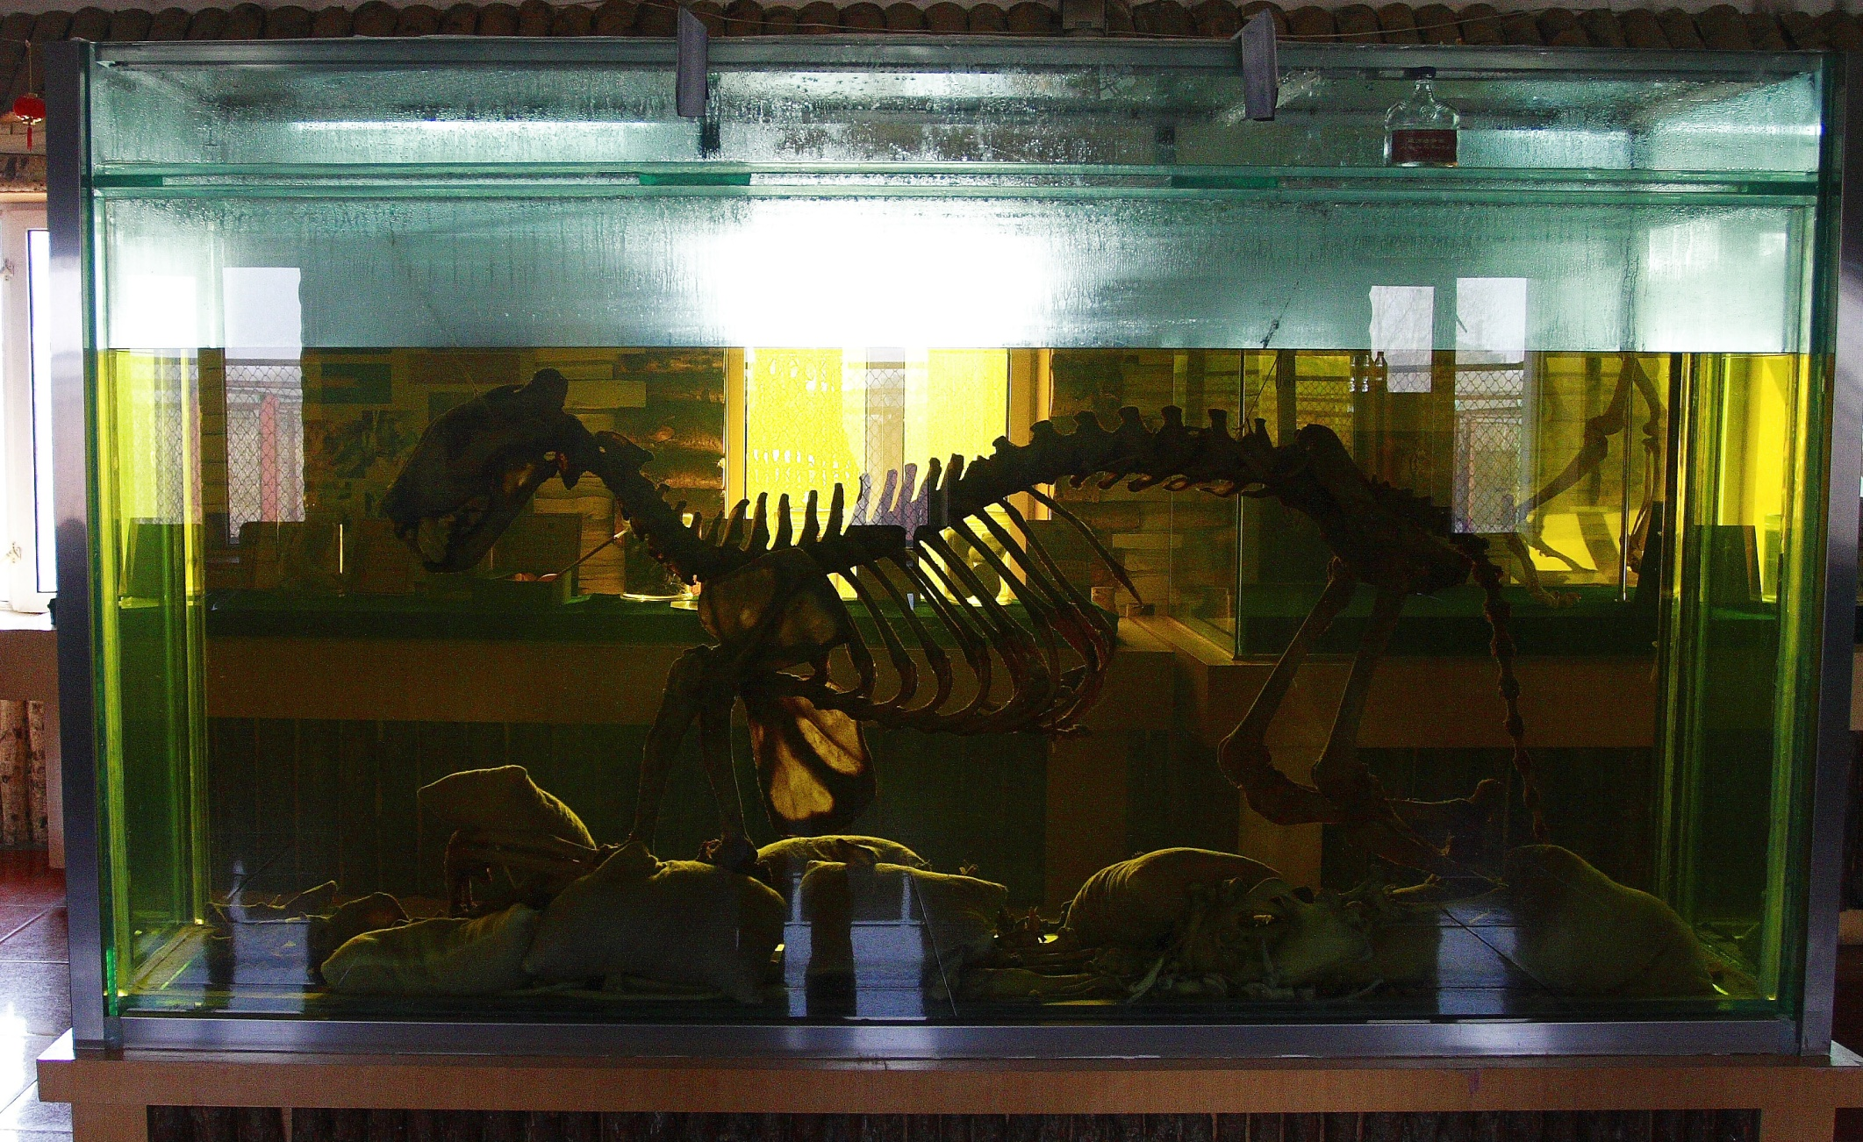
Notes:
Tiger bone wine, made by steeping tiger bones in huge vats of potent 38 per cent-proof rice wine

Slide 33
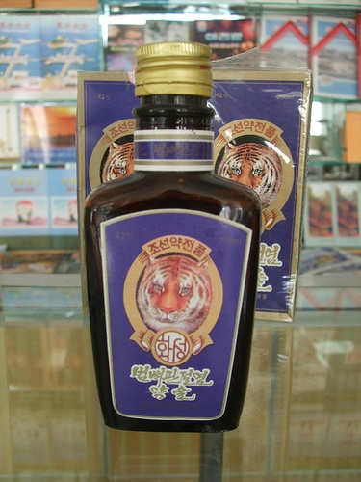
Notes:
Tiger wine (left) Older generation was not responsible for increased demand for tiger parts, but the young who are newly wealthy due to China’s recent economic ascendance.
New pruportmedicinal uses of tiger parts (tiger wine, shampoo, and soup) socially constructed as traditional Chinese medicine

Slide 35
Notes:
Tiger wine (left)

Slide 36
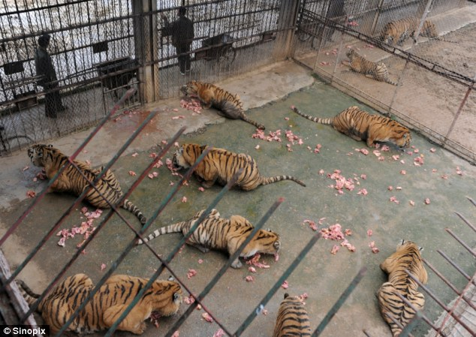
Notes:
10 – 25 pounds of food per day, dollar a pound, $25/day, $250 a day for the 10 tigers in this scene

Slide 37
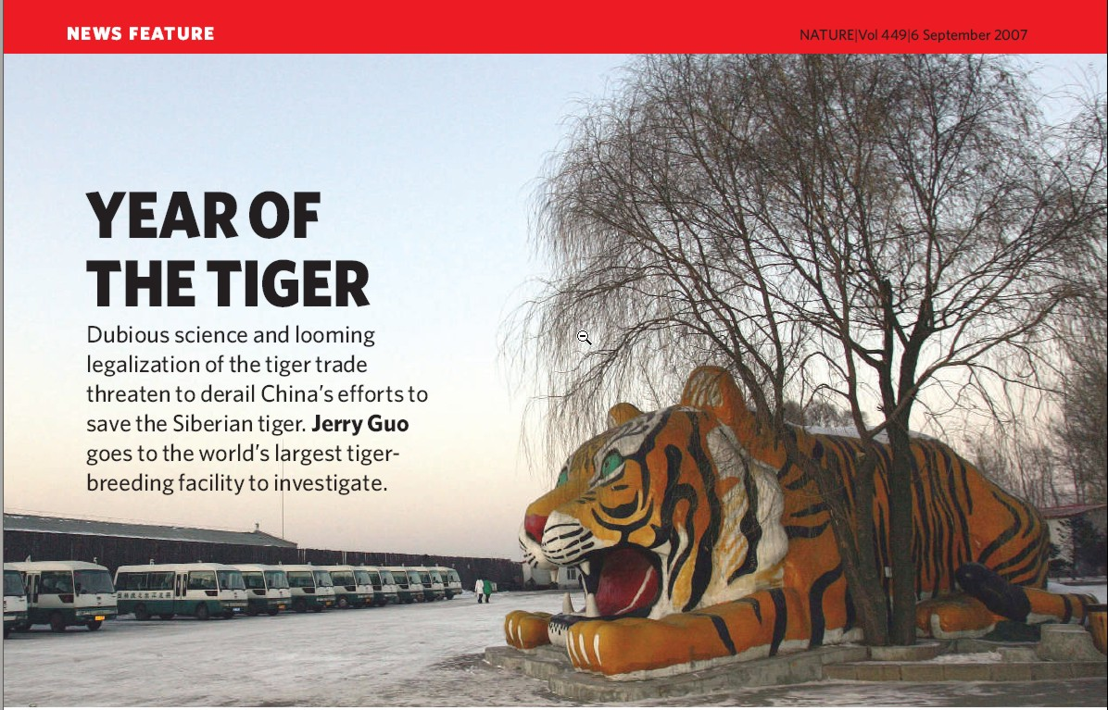

Slide 38
Notes:
http://www.youtube.com/watch?v=uHmcsJ0DaOk
Zoos are used more as a profit-making enterprise, and the revenues are not widely used to enhance conservation.
Chinese state media reported that dozens of endangered tigers and other animals died from malnutrition at the Northern Forest Zoo in the city of Harbin. Disenfranchised workers leaked the story to the media, revealing a mass gravesite for tigers, lions and leopards. Workers had buried them in a 10-foot deep pit order to avoid getting caught by authorities. In March another report had surfaced of 11 rare Siberian tigers starving to death at the Shenyang Forest Wild Animal Zoo in northeast China.

Slide 39
Arguments pro and con for Chinese tiger farming
Pro: takes pressure of wild populations
Con: farming may maintain or even enhance demand
Con: if demand grows, hunting of wild tigers may increase, as it still cheaper to hunt a wild tiger
$15-20 to pay poachers to kill a wild tiger versus much higher farm costs
Con: wild animals may be preferred over captive animals for medicine - thought to be more potent
Notes:
A simple cost analysis of wild versus farmed tiger parts indicates that it would cost at least US$4000 to raise a tiger to adulthood in captivity and as little as $15–$20 to poach a wild tiger. Even allowing for the costs of transporting wild tiger products to end markets and occasional losses to enforcement action along the way, the cost of producing farmed tiger parts would clearly be far higher, perhaps even by a factor of 10. This gross discrepancy would offer substantial economic incentives for poachers and smugglers to undercut farmers in any legal market, despite the risks associated with being caught and penalized. Furthermore, consumers of traditional Chinese medicine (TCM) prefer products made from wild individuals, believing they are more potent than farm-raised ones. These, therefore, can command a significantly higher price—as demonstrated in the bear-bile market
You could argue that these breeding farms will take the pressure off wild animals. This is the argument for crocodile farms, which produce meat and skin. But the reality is that farms maintain demand for the animal parts, yet cannot cope with any surge in demand. If this happens, the temptation will be to satisfy it by hunting — putting pressure on wild populations. There are millions of crocodiles in the world, but only a few thousand tigers. So farming tigers not only encourages the capture of wild animals for breeding but also stimulates demand for the products. With so few tigers left in the wild, it would only take a small increase in demand to push them over the edge into extinction.

Slide 40
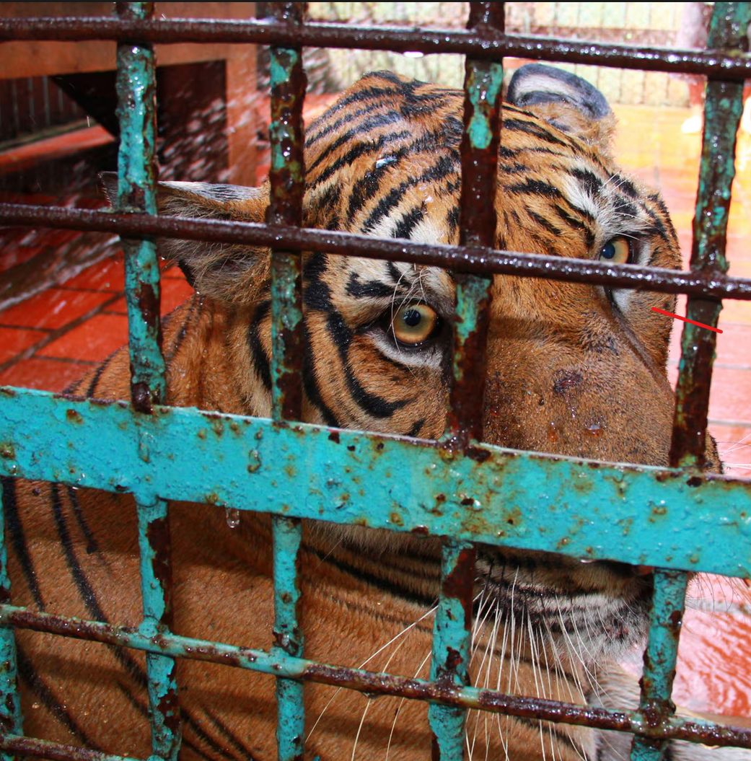
Other criticisms of tiger farming
Cruelty
Has not met conservation goals or introduced tigers in the wild.
Tigers mate freely on farms. Breeding facilities are not member of the international stud book for Siberian tigers, which includes almost all US and European zoos.
Promotes investing in extinction
Notes:
There is a need to manage the genetics of these populations

Slide 41
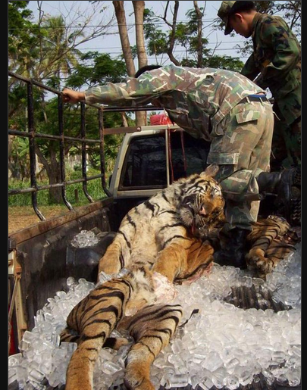
Investing in extinction
Farms and investors may be buying up and stockpiling tiger parts
They are anticipating rarity and the potential to profit from it
Stockpiling may encourage further poaching as others want to invest

Slide 42
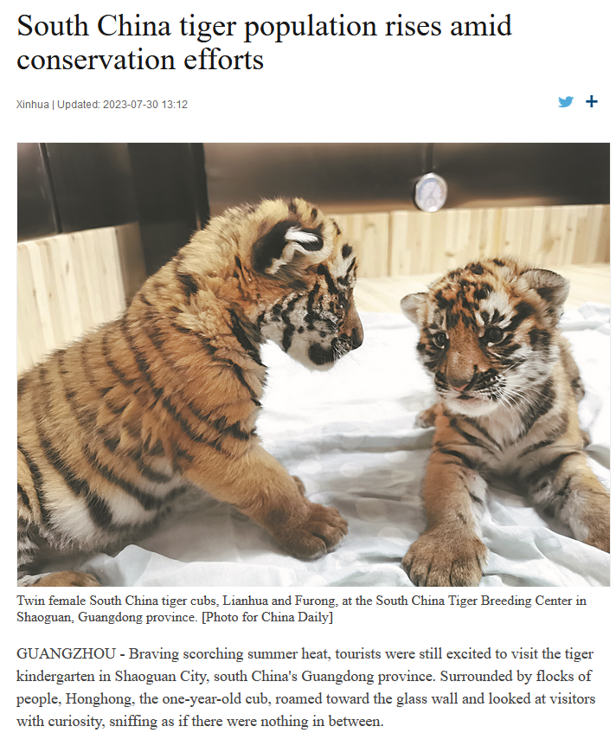
Changes in the tiger trade
Illegal trade persists in China
Tiger farms outsourced to neighboring countries like Laos
Conservation-oriented attitudes toward tiger in China now coexist with the economic, utilitarian ones associated with tiger farming
Recent declines seen in the consumption of wildlife in urban populations in China
Notes:
Wildlife consumption and conservation awareness in China: a long way to go
Biological Conservation Li Zhang and Feng Yin An attitudinal survey on wildlife consumption and conservation awareness was conducted in Beijing, Shanghai, Guangzhou, Kunming and Nanning of China recently. Comparison with the results from a similar survey we did in 2004, after 8 years, the proportion of respondents who had consumed wildlife was dropped slightly from 31.3 % down to 29.6 %. It showed that the rates of wildlife consumed as food and as ingredients for traditional medicines in Guangzhou and Nanning ranked in the top. The consumptions in these two cities were mostly driven by utilitarian motivation, and mainly for food. Meanwhile, the rate of consumers taking wildlife as food was declining significantly in Beijing after 8 years. The results also showed that 52.7 % agreed that wildlife should not be consumed, which was significantly increased comparison with the survey result of 42.7 % in 2004. In addition, respondents agreed that wildlife could be used significantly decline from 42.8 to 34.8 %. It’s indicated that wildlife conservation awareness was raised in China in the past years. We also found that consumers with higher income and higher educational background were having higher wildlife consumption rate. It suggested that to strengthen the law enforcement and to promote the public awareness were keys to reduce wildlife consumption in China

Slide 43
Proposed national park for Siberian tigers in China
Notes:
https://e360.yale.edu/features/china-carves-out-a-park-for-the-imperiled-siberian-tiger

