Slide 2
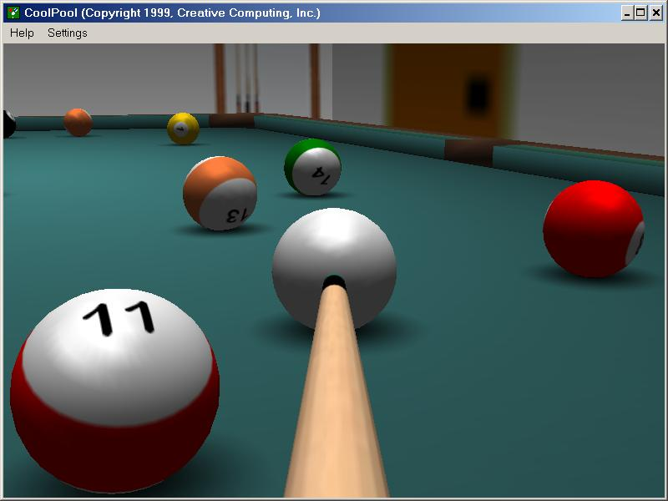
The Newtonian world
Mechanistic and deterministic, predictable
In a pure Newtonian world, all objects would have a clear identifiable position and movement
One could map out the future based on series of solvable equations
Notes:
Newtonian physics can explain a lot about the world, but it works best when things are not too complicated, when there aren’t too many interacting entities. Simple Newtonian equations (like the ones from physics class), when used to track an increasing large number of objects, quickly become cumbersome. Can people be treated like billiard balls?

Slide 3
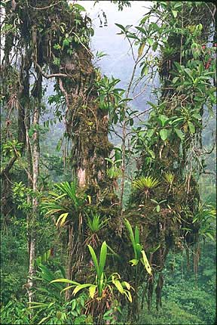
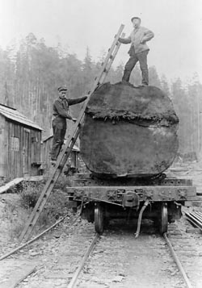
Notes:
However, Newtonian concepts are not fully capable of explaining ecological change and how human systems work. We are limited in the way we can incorporate the details in the world around us, its fine grain and large extent pose fundamental challenges. How can we take account of this detail, but not be overwhelmed by it and still be able to understand and anticipate environmental change.

Slide 4
Challenges to a Newtonian view of the world
Fine grain and immense extent of the world
Vast number of interacting entities
Contingencies
Feedbacks
Teleconnections
Notes:
However, Newtonian concepts are not fully capable of explaining ecological change and how human systems work. We are limited in the way we can incorporate the details in the world around us, its fine grain and large extent pose fundamental challenges. How can we take account of this detail, but not be overwhelmed by it and still be able to understand and anticipate environmental change.

Slide 5
Contingency
Events that are difficult if not impossible to predict but can have a large impact on the function of a system

Slide 6
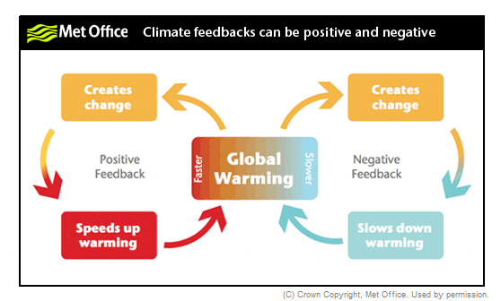
Feedbacks
Feedbacks make prediction of the outcome of interactions difficult
Positive feedback: externally generated change is reinforced
Negative feedback: externally generated change is minimized

Slide 7
Teleconnections
Events can propagate their effects over large distances and through time
Notes:
Smoke from wildfires in Australia blew out over the ocean and settled onto the surface. The ash contained nutrients that are consumed by marine phytoplankton. These organisms quickly expanded their numbers with the added nutrients (the mid ocean is often nutrient poor compared to coastal regions) causing a large phytoplankton bloom. These are photosynthetic marine organisms, and what is shown in the right-hand map is the chlorophyll content of the ocean. Chlorophyl concentration spiked following wildfire ash deposition.

Slide 8
Complex adaptive systems theory
A response to the limits of understanding the world through a Newtonian lens
The shear number of interacting entities limits prediction of change using Newtonian concepts alone
Contingencies, feedbacks, and teleconnections limit prediction into the future.
Interactions can develop which we often cannot anticipate, and these in turn guide the expression of other interactions and outcomes.

Slide 9
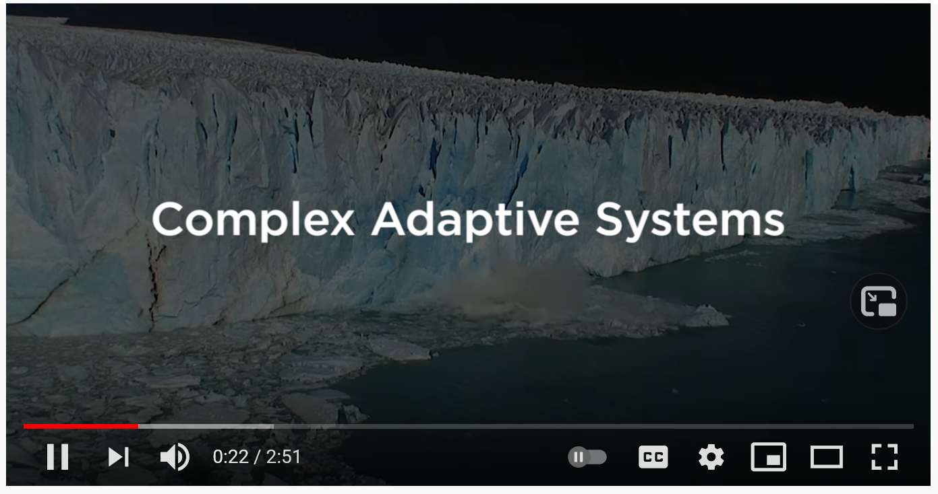
Basic examples of complex adaptive systems
Systems for us will be any natural or human collection of a large number of interacting entities
These systems have the capacity to exhibit complex adaptive systems dynamics
Human societies
Ecosystems
Economic systems
Financial systems like the stock market
Notes:
Note: ecosystems today are very much part of a larger system comprising human societies and economic systems

Slide 10
Characteristics of complex adaptive systems
Path dependence
Emergence
Self-organization
Cross-scalar structure

Slide 11
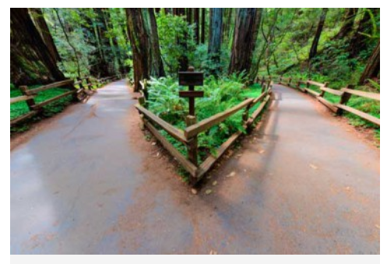
CASs have path dependency
Events that have unfolded in the past constrain the present and the future to varying degrees
The QWERTY keyboard

Slide 14
CASs exhibit emergence
Occurs when agents residing on one scale start producing behavior that lies one scale above them
Local patterns or behaviors create emergent pattern when summed across many interacting individuals
Emergent patterns cannot be identified by isolation of a single agent, but appear only through their interaction
Notes:
Emergence is a phenomena that emerges out of the interactions of many smaller interacting parts.

Slide 15
CASs can self-organize
Self-organization is the process in which order arises from local interactions between parts of an initially disordered system.
This can be as small as the development of an organism or as large as the order arising spontaneously from many interacting agents

Slide 17
CASs have cross-scalar structure
Global properties emerge from interactions among many individual components
These global properties can then feed back to influence the subsequent development of these interactions of individuals
In this way, complex adaptive systems link local reductionist mechanisms with global emergent, holistic patterns

Slide 18
Notes:
An example of cross-scale interactions (and emergence).

Slide 19
Studying CASs
We use models and modeling to represent patterns and processes in the real world, including those of complex adaptive systems.
The characteristics of complex adaptive systems can be seen in these modeling techniques:
Cellular automata
Agent-based modeling
Notes:
These two types of modeling techniques are very good at capturing complex systems dynamics

Slide 20
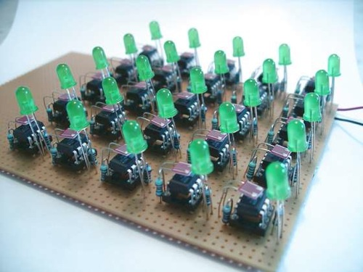
Cellular automata (CA)
Notes:
Originated in 1940’s

Slide 21
In a cellular automata, simple rules are assigned to cells, and then the cellular automata is allowed to run over time. Each individual cell is sensitive to the neighborhood around it and responds to it according to the rules that define it.
Notes:
https://www.microsoft.com/en-us/p/conways-game-of-life/9wzdncrdj0pg

Slide 22
Cellular automata
A computational method to study the dynamics of complex adaptive systems
Patterns self-organize and exhibit emergence
Simple local rules among individuals play out to shape global properties
Cellular automata can exhibit path dependency in that a small change in initial conditions may lead to different outcomes
Future states may be resistant to variations in initial conditions and converge to the same end state, or they may continue to unfold without reaching any particular end state
Cellular automata are used to model plant succession, water flow, wildfire movement, land use change, disease spread, and many other phenomena

Slide 23
Agent-based modeling
A computational method to study the dynamics of complex adaptive systems
Agents in the program are programmed to interact with other agents
Agents have local instead of global knowledge
Agents can have different behaviors and adapt over time
Initial conditions can vary and result in very different endpoints
However, the system may be robust to local changes and repeatedly converge upon the same endpoint.

Slide 24
Notes:
In an agent-based model, individual agents have local rules and a much more mobile capacity than with cellular automata. They can ‘see’ their local environment and respond accordingly. With many agents, their individual behaviors can scale up to create emergent patterns. In this agent-based model, the agents are kids in different neighborhoods. They interact with each other and their neighbors in how they buy and talk about candy sold by three companies. Agent-based models are ways to simulate the dynamics of the world that are not readily done with Newtonian equations.

Slide 25
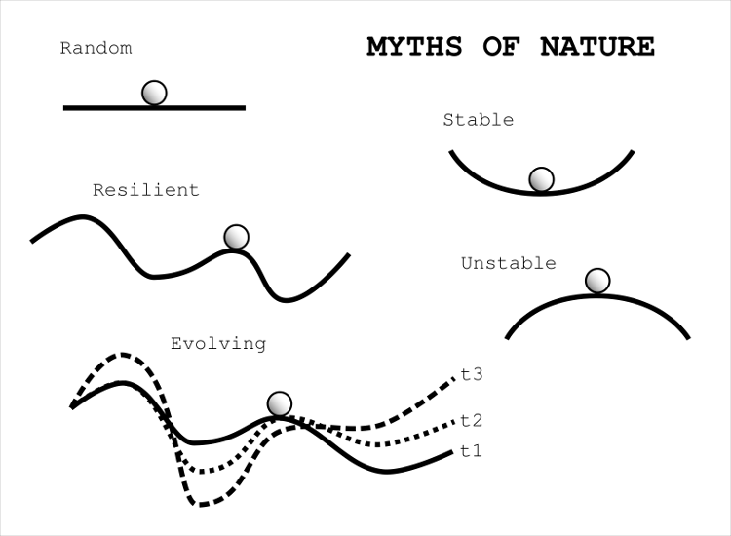
A complex adaptive systems viewpoint unifies equilibrium and non-equilibrium dynamics
Equilibrium dynamics
Systems may converge toward configurations that are stable persistent, and self-reinforcing
Non-equilibrium dynamics
Systems may change from one stable state smoothly or abruptly
System may not converge and exhibit instability constantly change over time.
Notes:
These fitness landscapes shown illustrate how ecosystems change. These particular sketches are also known as ball and cup diagrams.

