Slide 1
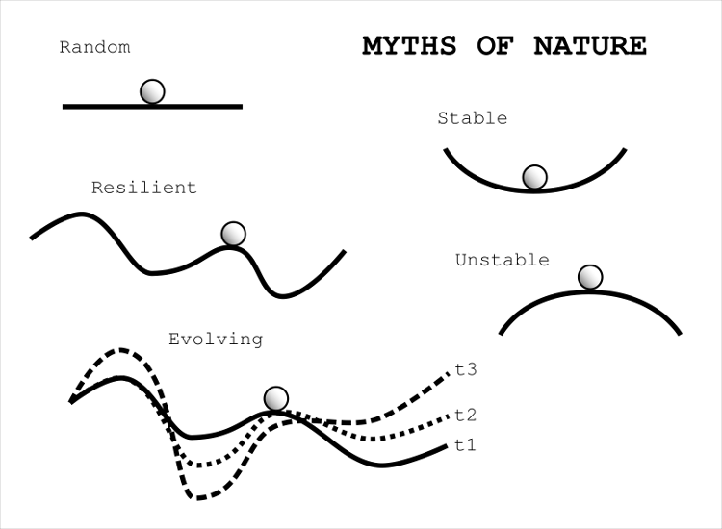
A complex adaptive systems viewpoint unifies equilibrium and non-equilibrium dynamics
Equilibrium dynamics
Systems may converge toward configurations that are stable persistent, and self-reinforcing
Non-equilibrium dynamics
Systems may change from one stable state to another
System may not converge and exhibit instability constantly change over time.
Notes:
These fitness landscapes shown illustrate how ecosystems change. These particular sketches are also known as ball and cup diagrams.

Slide 2
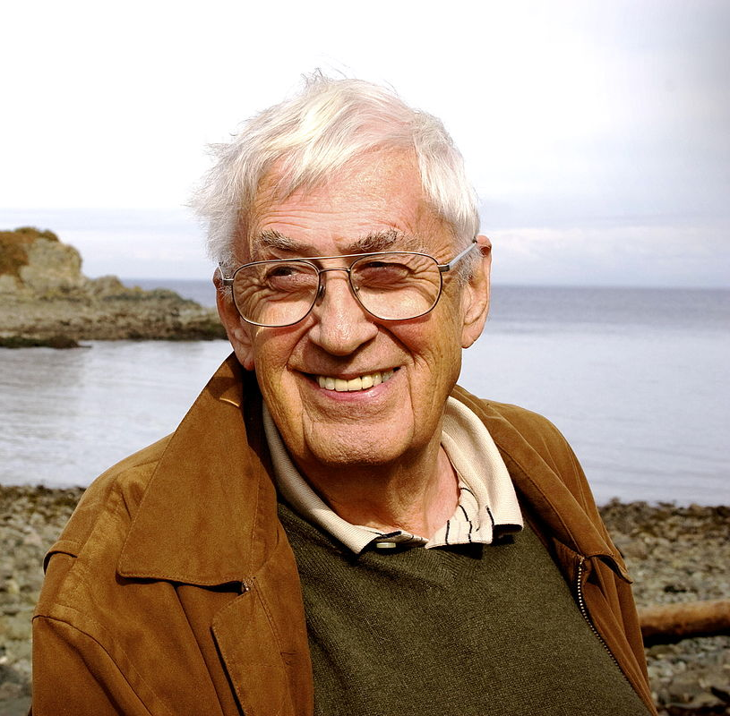
Resilience theory
Considered a subset of complexity adaptive systems theory
Also seeks to explain how systems organize and change
Posits a range of dynamics from near equilibrium stable states to non-equilibrium unstable states
Began with the work by C.S. Holling in 1970’s

Slide 3
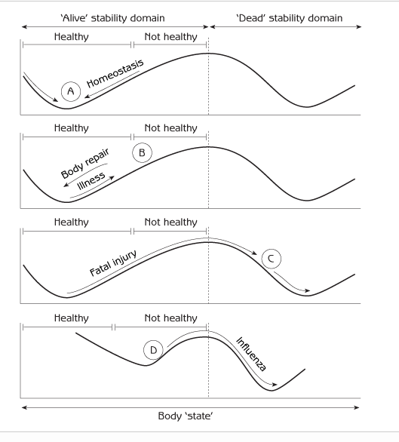
Balance, or stability, in resilience theory is different from our usual definition of it
Stability in its usual sense often implies a tendency to return to a “normal” mode of equilibrium functioning – as in when we get sick and recover.
However, ecological and social systems are not organized around a single equilibrium like an individual human is
They can tip from one to one or more various states, which in resilience theory are called stability domains

Slide 4
Engineering resilience
Denotes recovery and the return of ‘normal’ functioning in a system.
Recovery capacity
A measure of how quickly a system rebounds to its pre-disturbance state
This is an equilibrium concept that captures the engineering aspects of ecosystems
Notes:
By engineering, we mean the capacity of a system to withstand disturbance and maintain present structure and functions.

Slide 5
Ecological resilience
Amount of disturbance or change that can be accommodated before a system crosses a threshold and reorganizes into another state, or stability domain
Captures the capacity of a system to reorganize into another state
Reorganization capacity

Slide 7
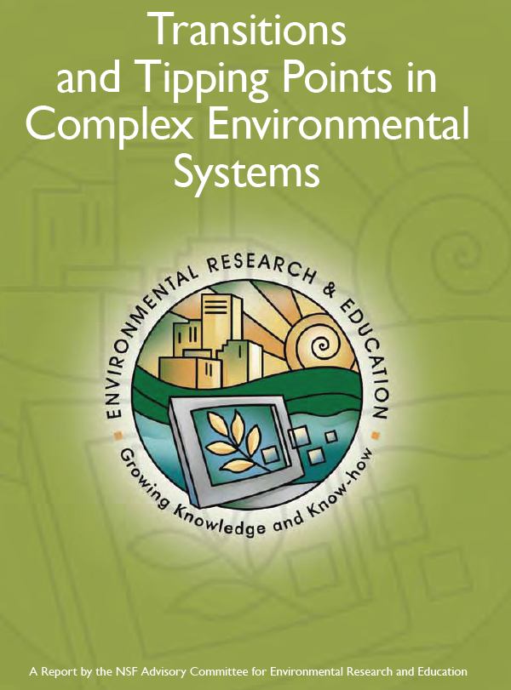
A system may change, or tip, from one stability domain to another when a threshold is crossed due to human impacts and/or natural environmental change
These transitions are also called regime shifts
Change in a system may be rapid, as with tipping, or it may be slower and gradual
These dynamics apply to many different kinds of systems

Slide 8
Notes:
http://www.csun.edu/~sd51881/overview.htm
Mussel-dominated stability domain

Slide 9
Notes:
http://www.csun.edu/~sd51881/overview.htm Seaweed dominated stability domain

Slide 10
Notes:
The rocky intertidal marine community, where these two stability domains can develop: a mussel-dominated state and a seaweed-dominated state. Storm disturbances are often the factor driving these transitions between stability domains.
Petraitis, P. S., Methratta, E. T., Rhile, E. C., Vidargas, N. A., & Dudgeon, S. R. (2009). Experimental confirmation of multiple community states in a marine ecosystem. Oecologia, 161(1), 139-148.

Slide 13
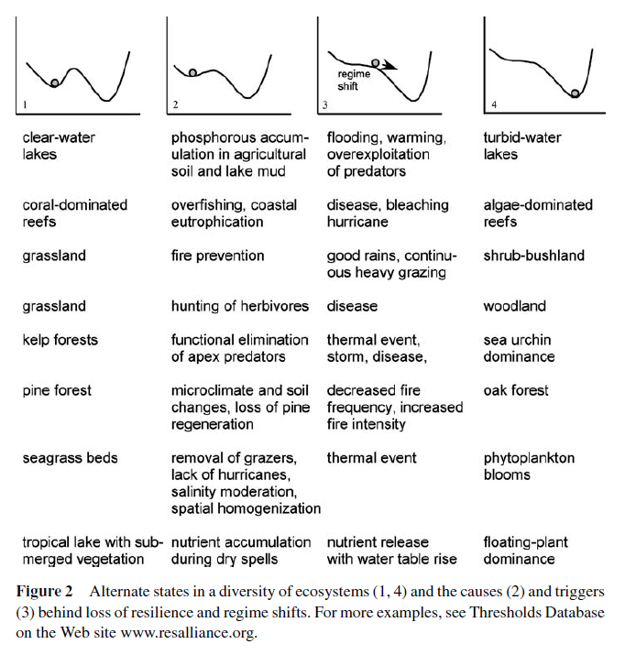

Slide 15
Notes:
Echinoids – sea urchins When the fish that eat algae are overfished, algae growth may increase on a coral reef. This can result in a dead reef, especially when algae growth is extensive. However, sea urchins may increase in abundance, as they eat algae that grows on the surfaces of the reef. However, if overfishing continues, and the fish that prey on sea urchins become scarce, the sea urchin population may explode. Eventually, the sea urchins population can crash if algae is consumed until it is scarce. This results in a rock bottom with very little marine life.

Slide 16
Notes:
Alternate states here is used to mean stability domains

Slide 17
Notes:
17

Slide 18
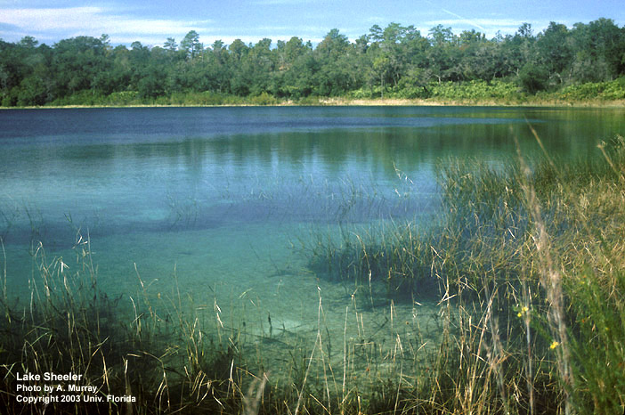

Slide 19
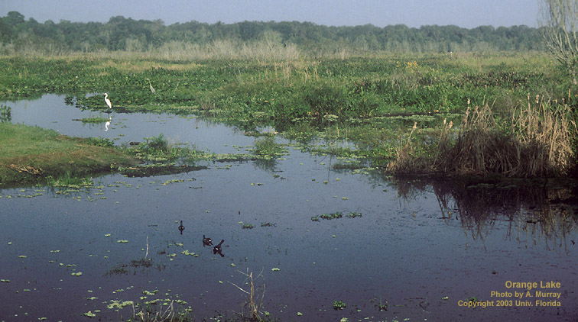

Slide 20
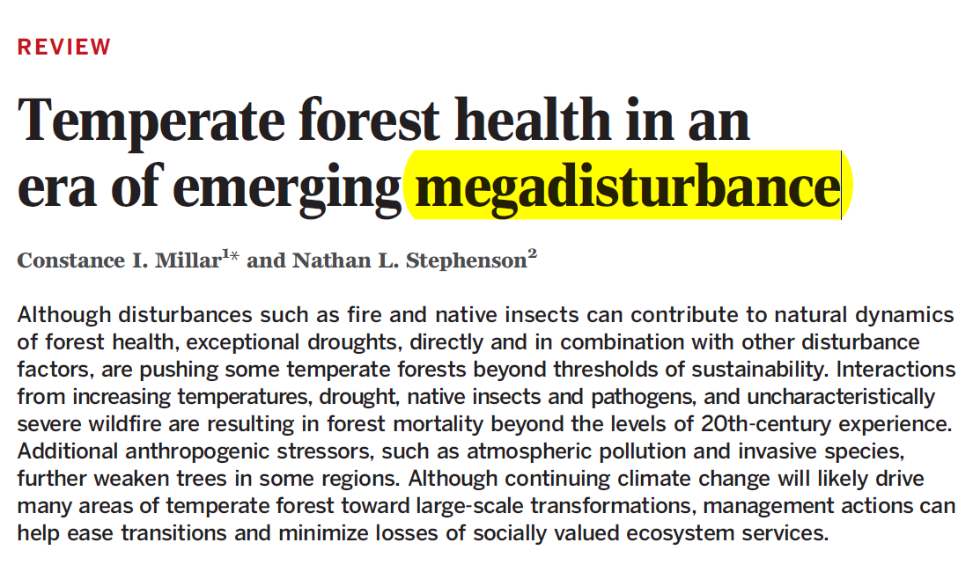
Megadisturbance
Megadisturbance: co-occurrence of multiple disturbance events
Today, with pervasive global human impacts, historic range of variability is being exceeded
If threshold of severity or frequency crossed, transition to a new vegetation state
Notes:
Integration of many disturbance factors that result in catastrophic disturbance, one that shifts forests to new state

Slide 21
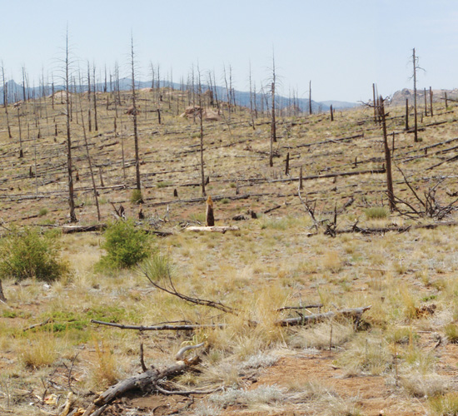
Large areas of western forests underoing shift to new vegetation type
Fires, heat, and drought may cause shift to a new vegetation state, from forests to shrub and grasslands in western US
Majority of forests cannot survive
Where megafires have occurred prior forest composition and structure is not returning
Notes:
http://www.nature.com/nclimate/journal/v3/n3/full/nclimate1693.html
http://e360.yale.edu/feature/megadrought_in_us_southwest_a_bad_omen_for_forests_globally/2665/

Slide 22
Notes:
Ridge lines with scorched trees from the 2011 Las Conchas fire in New Mexico, the second-largest blaze in the state's history. The fire, exacerbated by rising temperatures and a severe "megadrought" that has gripped the U.S. Southwest for more than a decade, burned 156,000 acres. (Photo by USGS)

Slide 24
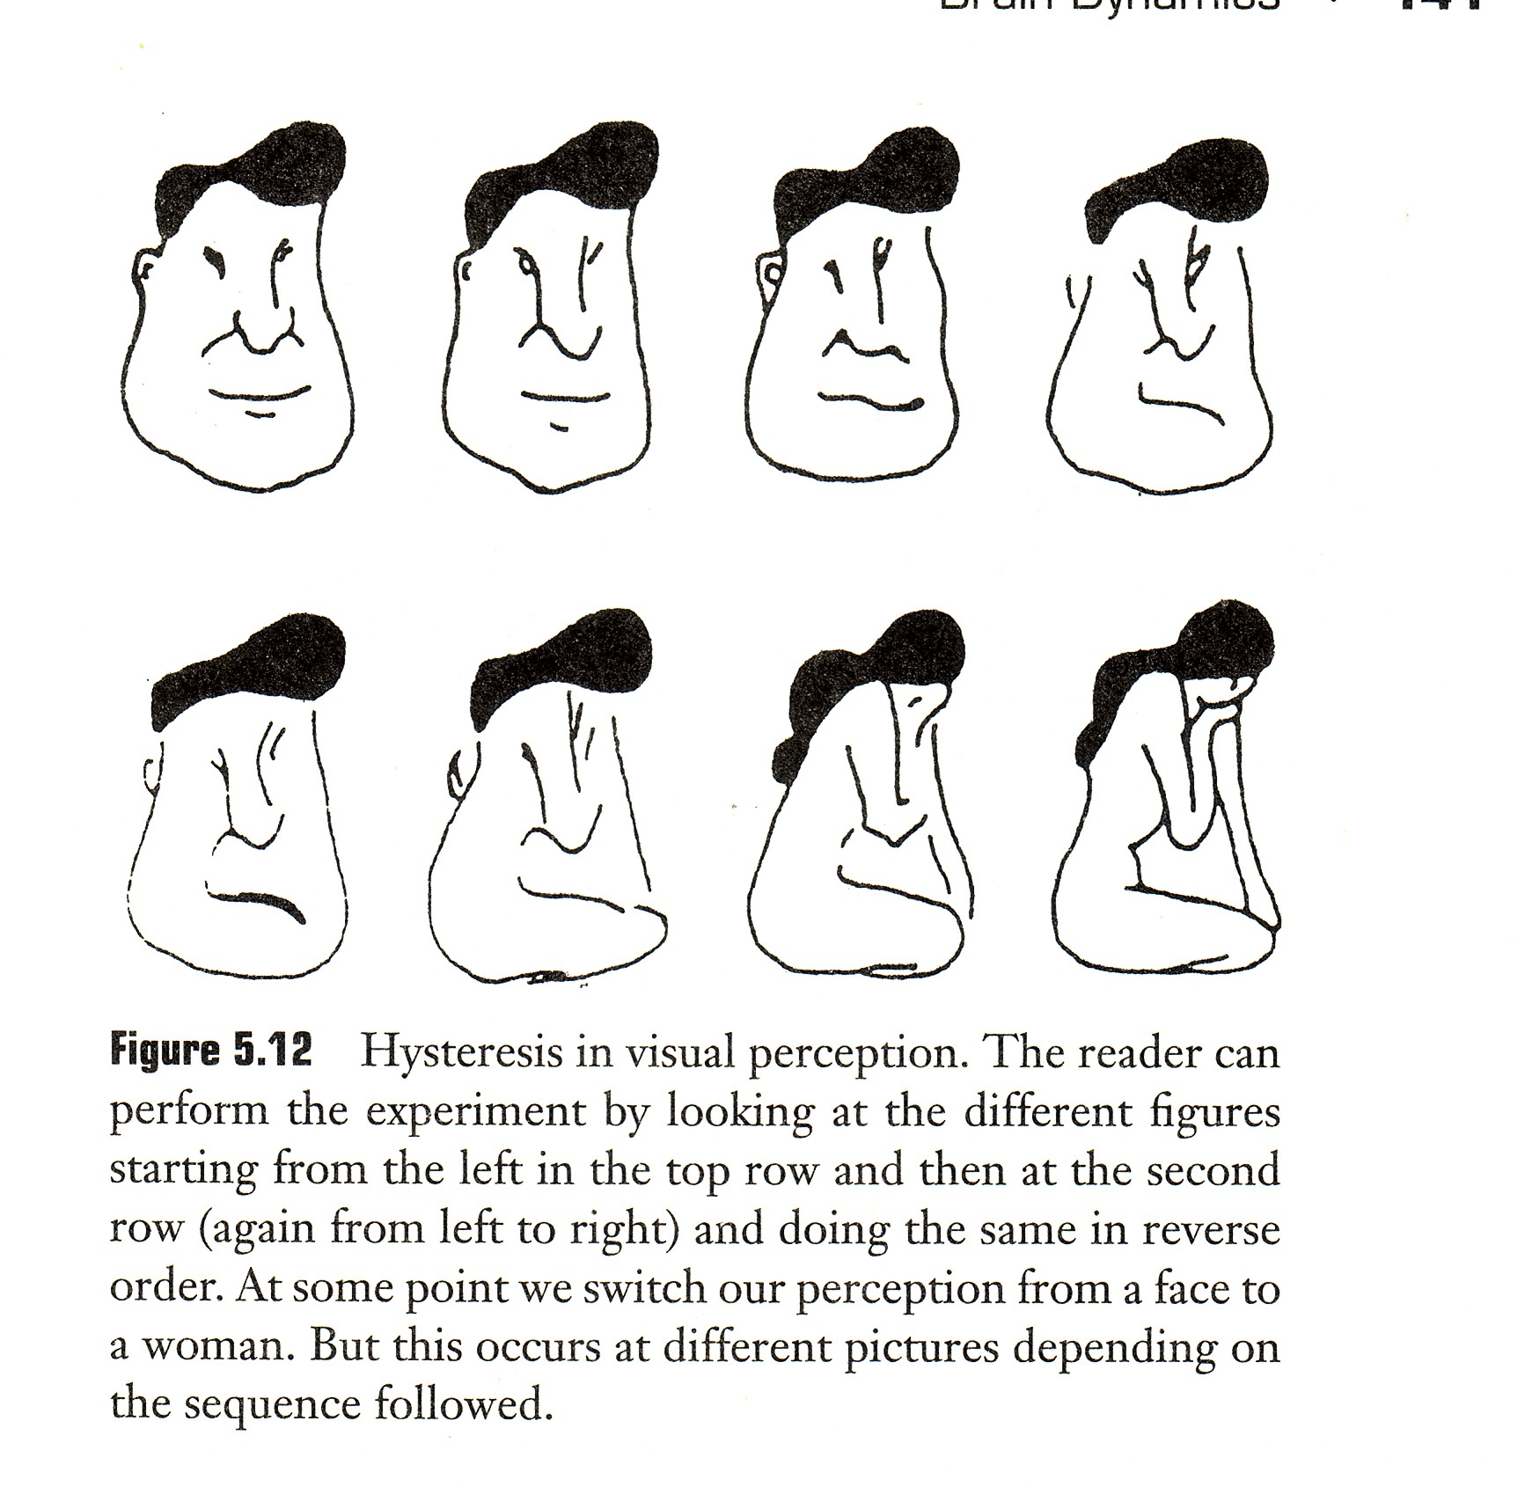

Slide 25
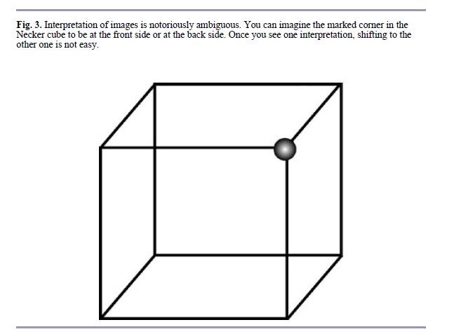

Slide 27
Hysteresis
Change in state of a system that is irreversible
The change in one direction cannot simply be reversed to go back to the initial state.
Creates the potential for the same environmental conditions to exist in two different states, which is called bistability

Slide 28
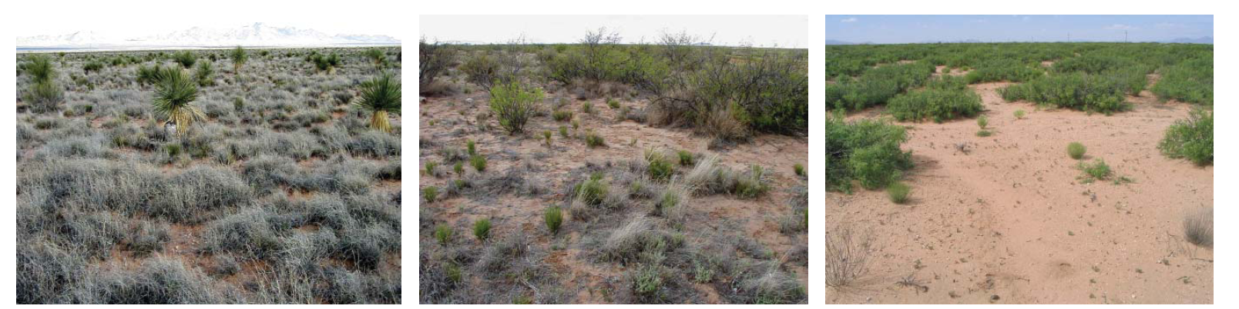

Slide 30
Notes:
The rainforest ‘pump’ is lost with fires, leading to a lock-in of drier, shrub and grassland-dominated forests. The environmental conditions can no longer support tropical rainforest vegetation

Slide 31
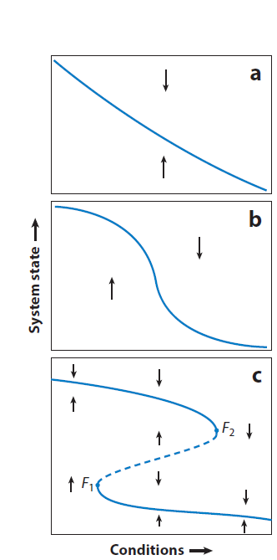
How systems change
Gradual transition within a single state
Threshold transition without hysteresis in an emerging two state system
Threshold transition with hysteresis, bistability, and two well developed states

