Slide 1
The critical concept of scale
How do you relate phenomena across scales? How can you interpret and communicate pattern and process when it extends across time and space?
Notes:
Increasing technological sophistication now allows observations to be made across microscopic to global scales. Consequently, as there is a need to integrate our observations, there is also a need to develop and use a set of common terms related to scale.

Slide 2
Notes:
http://htwins.net/scale2/ https://www.youtube.com/watch?v=uaGEjrADGPA

Slide 3
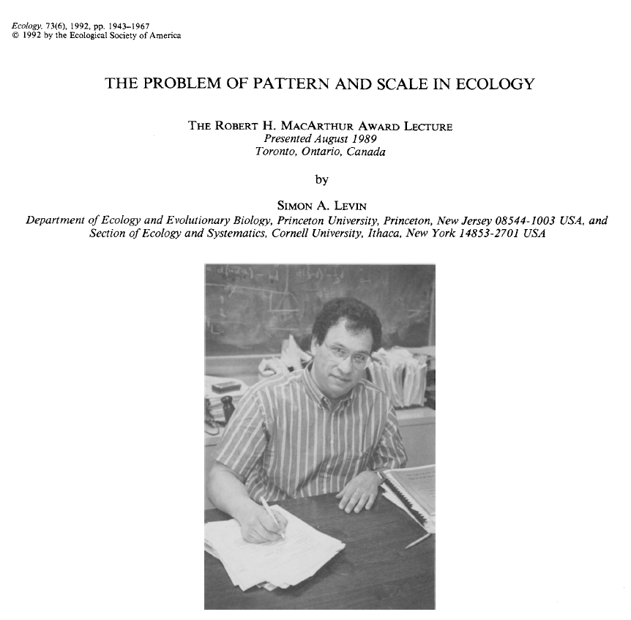
Why is the concept of scale important for ecology and conservation?
Scale shapes the perception, measurement, and interpretations we make about the world
Scale greatly influences our comprehension of patterns
Patterns are keys to understanding processes and causality
Without attention to scale, our knowledge has an ad hoc quality
Notes:
https://esajournals.onlinelibrary.wiley.com/doi/abs/10.2307/1941447

Slide 4
Example: what makes it warm or cold?
A simple question, right? One that would be necessary to understand if you wanted to make climate policy, correct?
The cause you select could depend upon temporal and spatial scale
Cloud cover and humidity (minutes to hours)
Diurnal (day-night) cycles
Seasonal cycles (1 year)
Atmospheric oscillations (El Nino – La Nina, North Atlantic Oscillation (2 – 10 years)
Cyclical fluctuations due to sunspots (10-50 years)
Anthropogenic contribution of greenhouse gases (10-100 years)
Milankovitch orbital cycles (10,000 yrs)
Notes:
We can perceive the world at different scales – our choice of spatial and temporal scale influence what we can say about how the world works.

Slide 5
Notes:
Macroclimate

Slide 6
Notes:
Microclimates

Slide 7
Notes:
From Lewis Carroll’s Alice in Wonderland

Slide 8
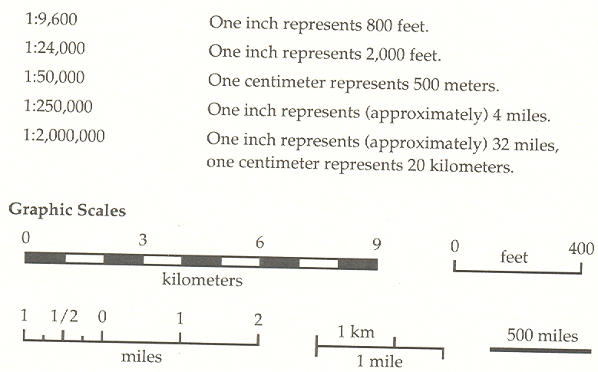
Cartographic scale

Slide 9
Cartographic scale
1:250,000
1:50,000
1:2500
Representative fractions

Slide 10
Assuming that you have two maps of the same paper size, but with different representative fractions (shown below). Which map could show the most real-world detail and smaller surface area?
1:24,000 1:62,500

Slide 11
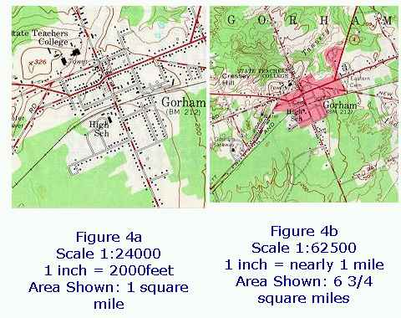
Large cartographic scale
Small cartographic scale
Notes:
Note subjectivity involved in portraying small cartographic scale, Figure 4c

Slide 12
Absolute and relative scale
Scale can be a description of relatedness or similarity
Absolute scale
Distance is spatial, physical measurable as on the ground distance, whether in miles or micrometers.
Relative scale
Distance is not a physical distance but an intangible construct, often a similarity in some property

Slide 13
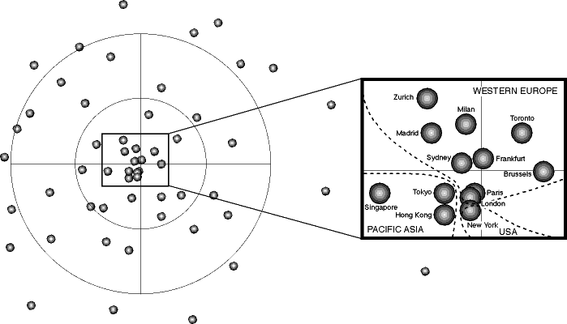
Distance among cities is in this plot is relative. They are scaled according to the volume of financial transactions that pass through them on a daily basis.
Notes:
What are the absolute and relative distances of relevance in this map?

Slide 14
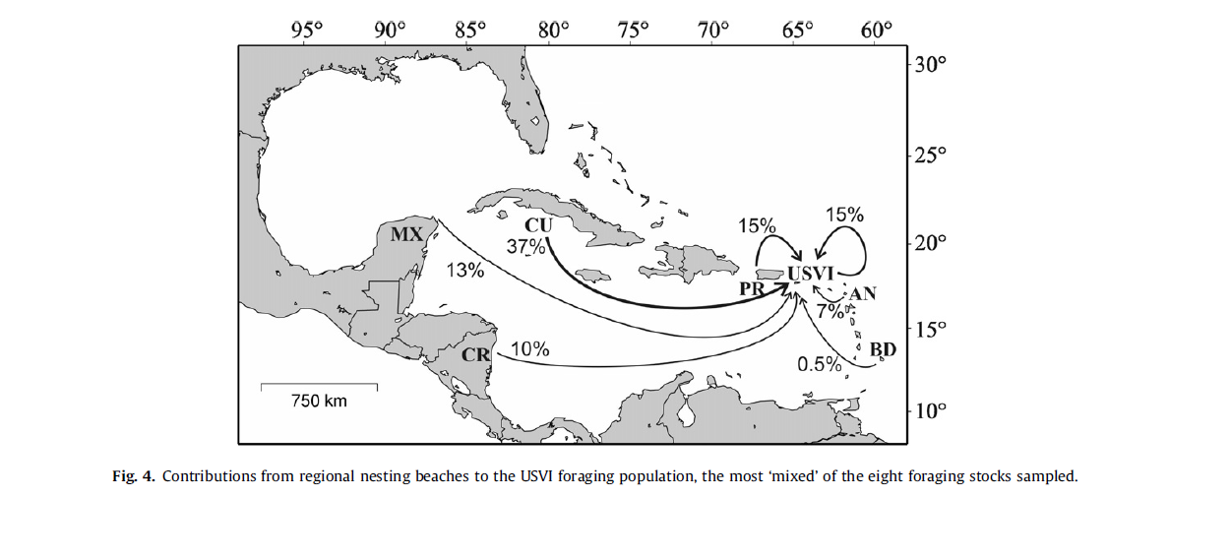
Sea turtles nesting in the US Virgin Islands originate from other countries. The percentages indicate the contribution of these other countries to the nesting sea turtle population in the US Virgin Islands.
Notes:
What are the absolute and relative distances of relevance in this map?

Slide 15
Notes:
https://en.wikipedia.org/wiki/Blind_men_and_an_elephant#John_Godfrey_Saxe

Slide 16
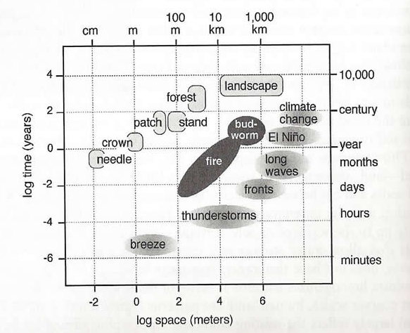
Operational scale
Refers to the spatial and temporal dimensions of an object or a process

Slide 17
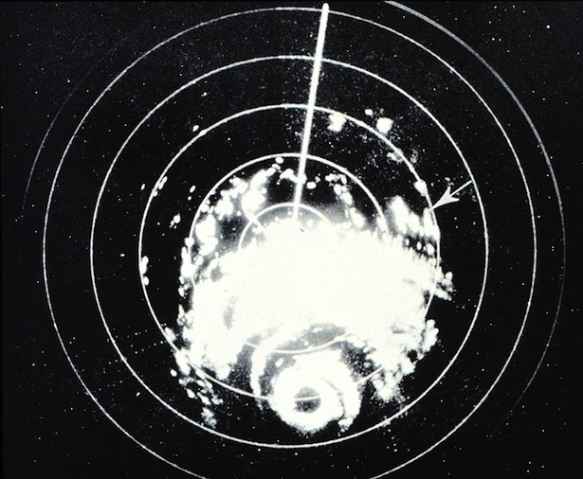
Operational scale of a phenomena can change as our technology changes
As operational scales increase, policy may need to change as well.

Slide 18
Cartesian scale
Scales are imposed by observer
Often tied to XYZ coordinate system
Space is viewed as a container with things in it that have no influence on the space itself
Operational scale is Cartesian, it assigns sizes and ranges of entities and phenomena

Slide 19
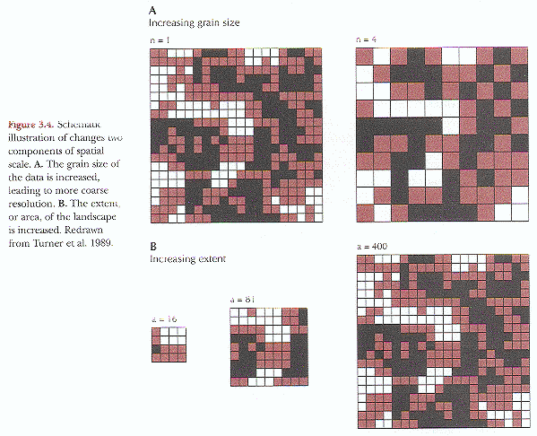
Ecological scale
Decreasing (finer) grain, extent is constant
Defines how we process observations of the world, and how we statistically analyze it and communicate the results
Extent: the spatial (or temporal) dimension of the object or process observed or analyzed
Grain: level of spatial (or temporal) resolution at which an object or process has been measured or observed.
Increasing extent, grain is held constant

Slide 20
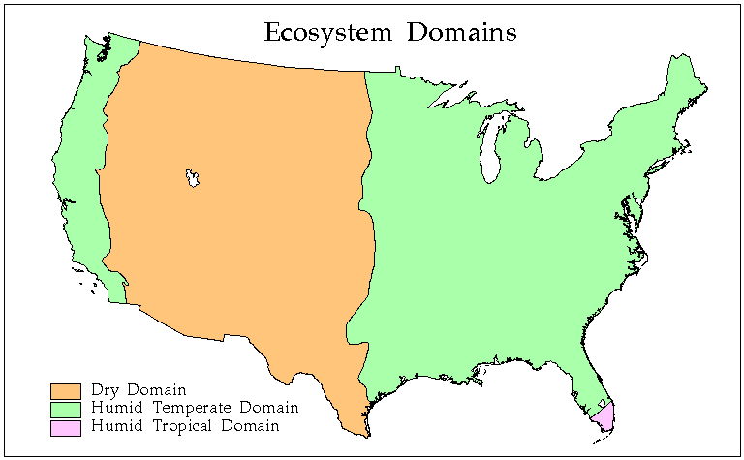
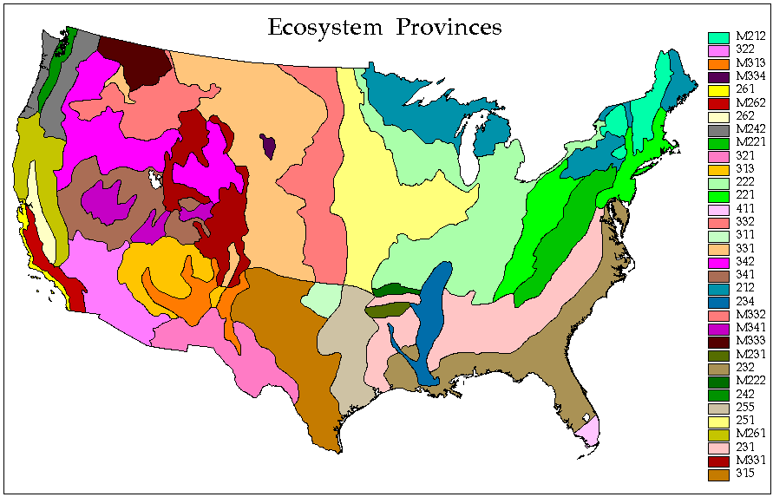
Which map shows more grain?
Notes:
20

Slide 21
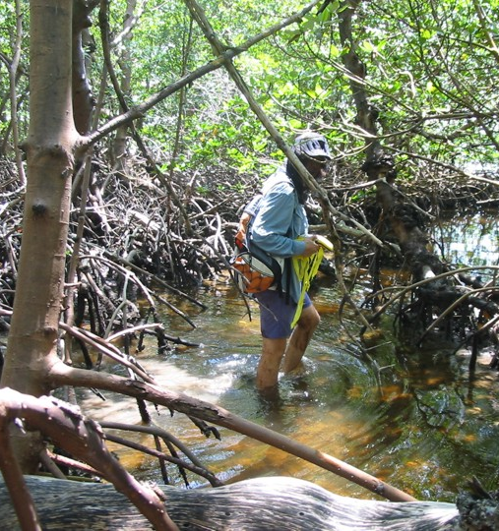
Haggett’s scale coverage problem
Nature has an immense extent and a fine grain
We cannot perceive it all simultaneously
Makes it difficult to establish to make measurements of it and to establish relationships between pattern and process

Slide 22
Notes:
What if you wanted to map the mangrove coasts of Florida?

Slide 23
Haggett’s scale coverage problem
To make descriptions of it, we have to sample
Sampling requires:
Sacrificing fine grain for a larger extent
Sacrificing large extent for finer grain.

Slide 24
Sampling error
Sampling error is the error caused by observing a sample instead of the whole population
The act of sampling introduces uncertainty in inferences simply because a sample is only a representation of the population.
Sampling bias is related to the designation of what to sample, sampling error is the inherent random component

Slide 25
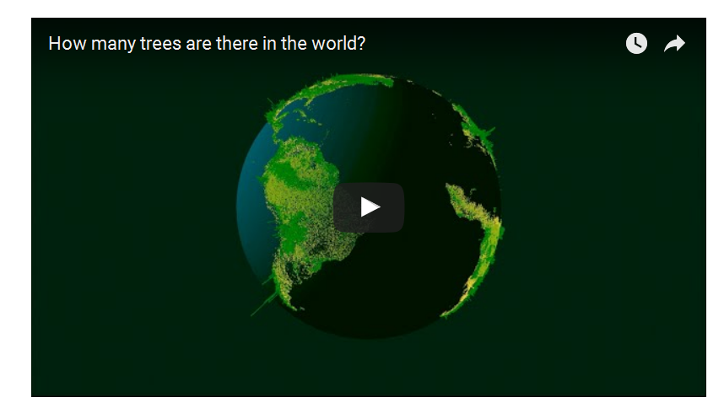
How many trees in the world?
Notes:
400 billion was initial estimate, now estimated to be 3 trillion trees
400 trees for every person

Slide 27
Notes:
27

Slide 28
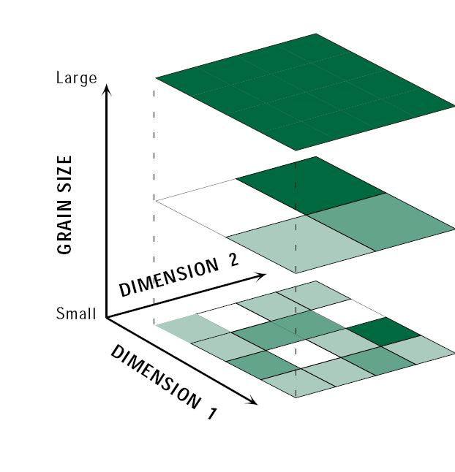
Fallacies of spatial inference
Individualistic fallacy: extrapolating to the broad extents based on observations conducted at small, local extents
Ecological fallacy: making local-scale characterizations based on observations at broad extents.
To an extent, humans are going to have to commit these fallacies in order to understand the world, for better or for worse

Slide 29
Notes:
Here is another example of how scale shapes our interpretation of the world and knowledge claims we make about it

Slide 30
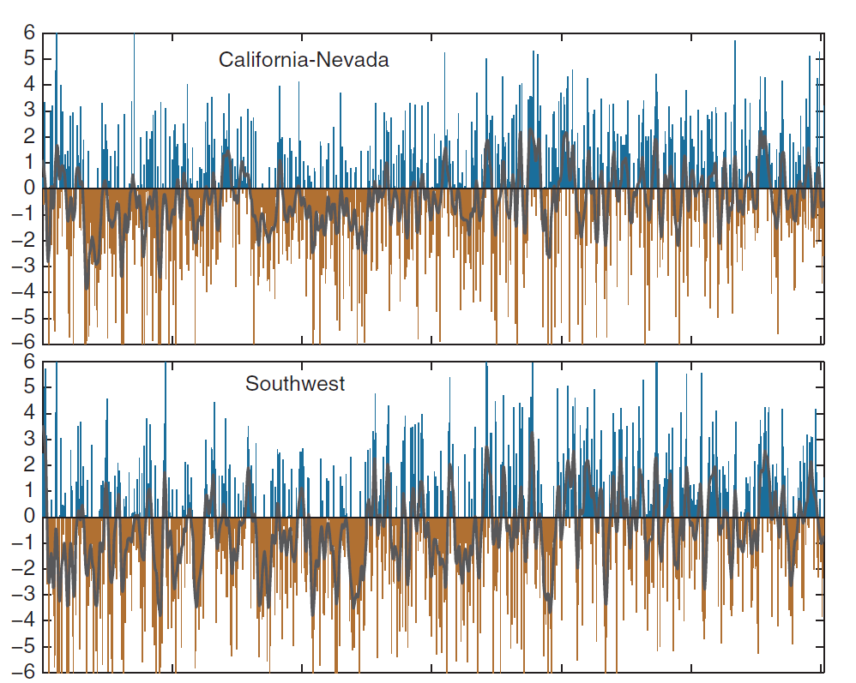
Wet
Drought index
Dry
Wet
Drought index
Dry
Notes:
How does scale apply to the interpretation of these graphs? The western US was settled during the last 200 years. What can you tell me about the climate over that period? Was it wetter or drier than what the record shows over the last 400 years?
Drought index – more negative values indicate drier conditions. Drought conditions were interpolated from tree rings

Slide 31
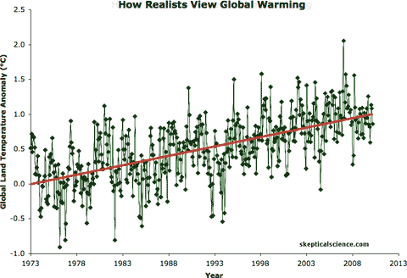

Slide 32
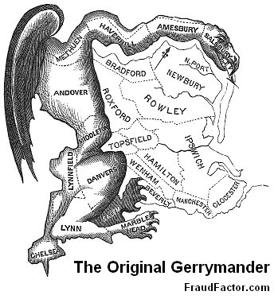
The modifiable areal unit problem (MAUP)
How we designate the shape of units determines the properties of the entities within them
Using different extents and grains can produce different results
Two components
Aggregation problem
Zoning problem

Slide 33
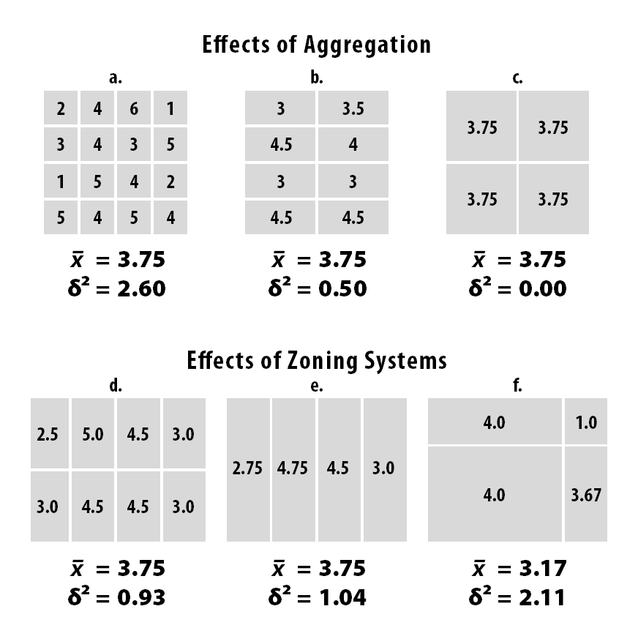
Notes:
Mean and variance are shown, standard deviation squared gives you the variance

Slide 34
MAUP and lead exposures in drinking water in Flint, Michigan
Prior to 2013, the city piped treated water for its residents from Detroit
In 2014, the financially struggling city decided to temporarily pump water from the Flint River to save money
Flint city officials failed to treat it, and lead leached out from aging pipes into thousands of homes and into the bloodstream of children
Water quality measurements were being aggregated to the level of zip codes. This meant that the high lead values in the water were being masked by water testing in outlying county area that were not using the Flint city system
Notes:
http://theconversation.com/how-zip-codes-nearly-masked-the-lead-problem-in-flint-65626 One-third of all homes with a Flint ZIP code lie outside the city. Thus, the state’s numbers for Flint were watered down by an additional 50 percent of addresses that weren’t in the city and weren’t using Flint water.

Slide 35
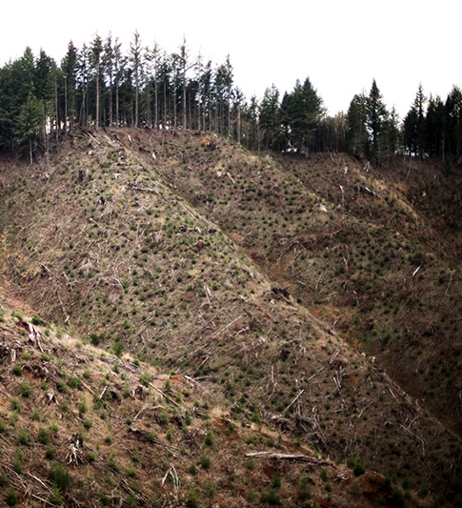
MAUP and ecological recovery
MAUP can be used to justify or refute management policies about ecological recovery
Is clearcutting good or bad?
It depends upon how you delineate boundaries and use extent and grain to describe post-logging recovery.

Slide 36
MAUP and ecological recovery
Resurvey over large extent and fine grain over multiple points in time: criteria for recovery not likely to be met – clearcut logging is bad
Resurvey over small extent and coarse grain at a single point in time: criteria for recovery easier to meet – clear cut logging is not bad
Could also be applied to restoration – what determines recovery is shaped by the extent and grain of your observations

Slide 37
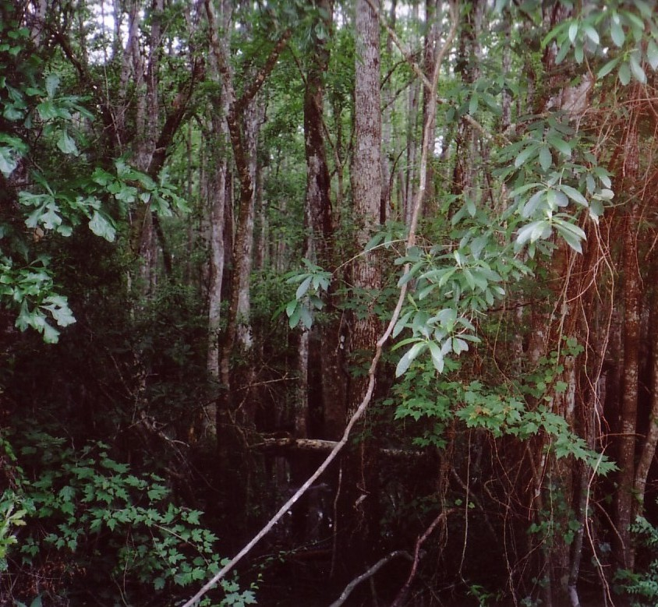
Sampling bias
Sampling bias develops when the procedures used to select the sample tend to favor the inclusion of individuals of the population with certain characteristics.
The method of selecting samples causes it to differ from the population.
Can be intentional, as in the example just given about clearcutting, or it can be unintentional.
Notes:
Picking study sites based on how easy it is to access and sample is an example of sampling bias.

Slide 38
Notes:
Hughes, A. C., Orr, M. C., Ma, K., Costello, M. J., Waller, J., Provoost, P., ... & Qiao, H. (2021). Sampling biases shape our view of the natural world. Ecography.

Slide 39
Notes:
Records of observations of organisms recorded in OBIS, Ocean Biodiversity Information System and GBIF, the Global Biodiversity Information Facility There is a strong sampling bias toward North America and Europe. Hughes, A. C., Orr, M. C., Ma, K., Costello, M. J., Waller, J., Provoost, P., ... & Qiao, H. (2021). Sampling biases shape our view of the natural world. Ecography.

Slide 40
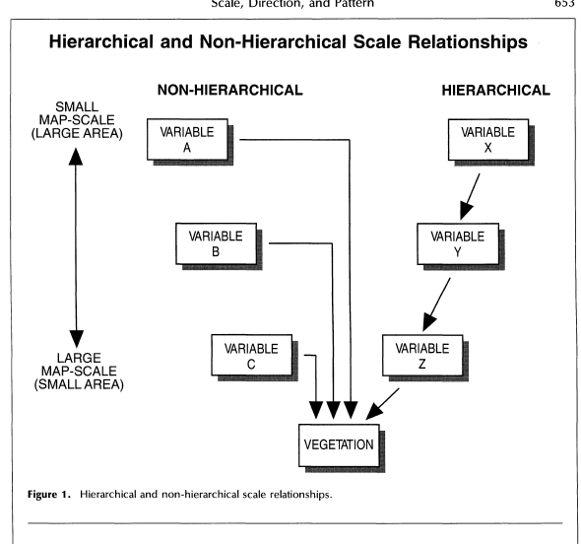
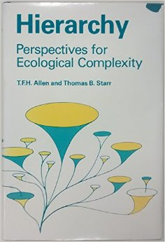
The Earth’s tilt (X) constrains the amount of sunlight (Y), which constrains temperature (Z) and ultimately the properties of the vegetation.
Human disturbance (A), competition from other plants (B ), insect herbivory (C) also shape the properties of vegetation

Slide 41
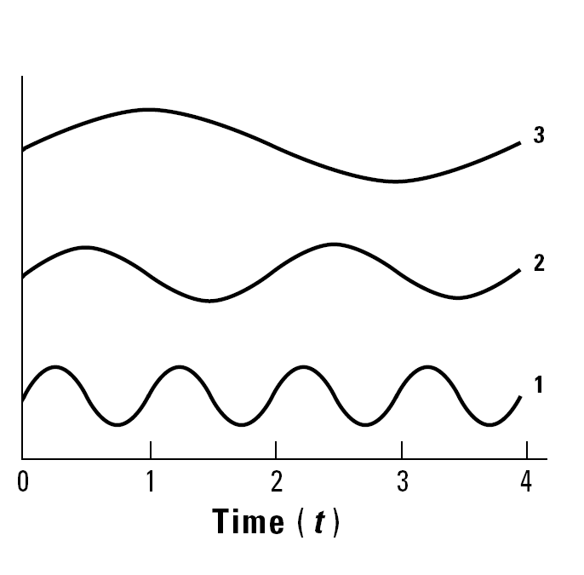
Hierarchy theory
Landscapes organized into spatial and temporal domains of processes
System of vertical interconnections
Higher levels (slow and extending over large extents) set the context for the lower levels (fast and expressed at local extents)
Hierarchy theory exemplifies a Cartesian scaling of the world – it works well if you assume the world is a container and things are just passively in it
Notes:
Slow and large extent variables at top, like climate; fast, local extent variables at bottom, like weather
From the bottom looking up, the highest level variable can be assumed not to change over small time and space scales
From the top looking down, the lowest level variable fluctuates randomly over large time and space scales
What is your hierarchy of controls? (Religious, community, family, spouse, military, family, self, kids?)

Slide 42
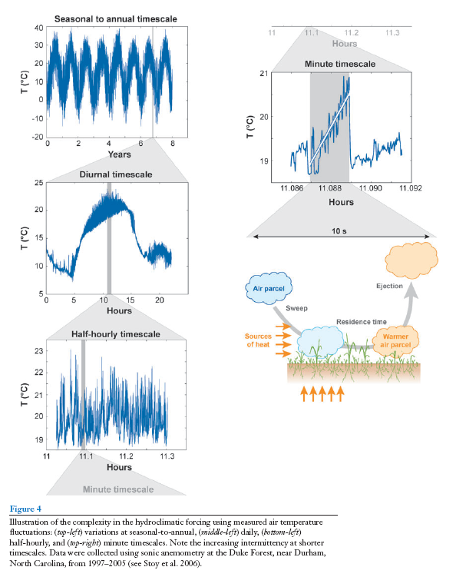
Notes:
Hierarchical controls on temperature

Slide 43
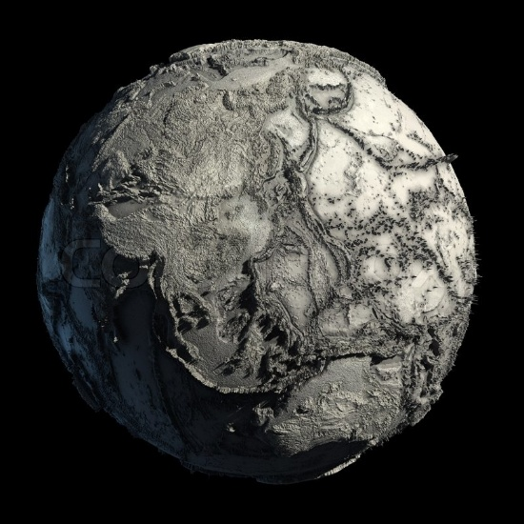
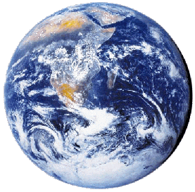
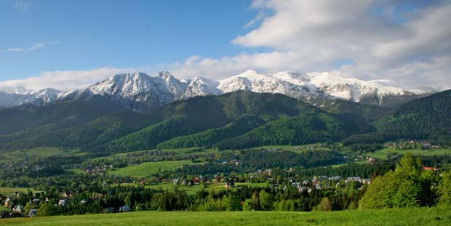
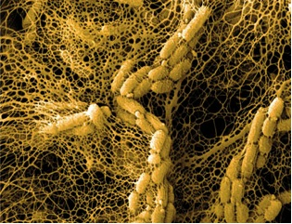
Constructivist scale
There is no fixed and unchanging hierarchy of scales

Slide 44
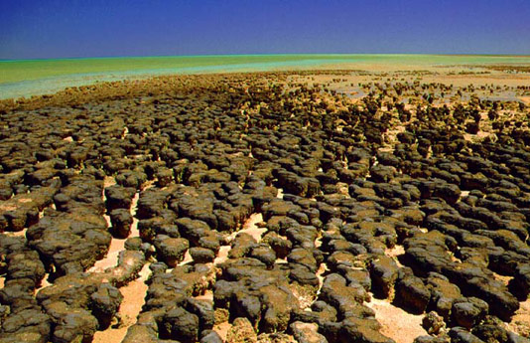
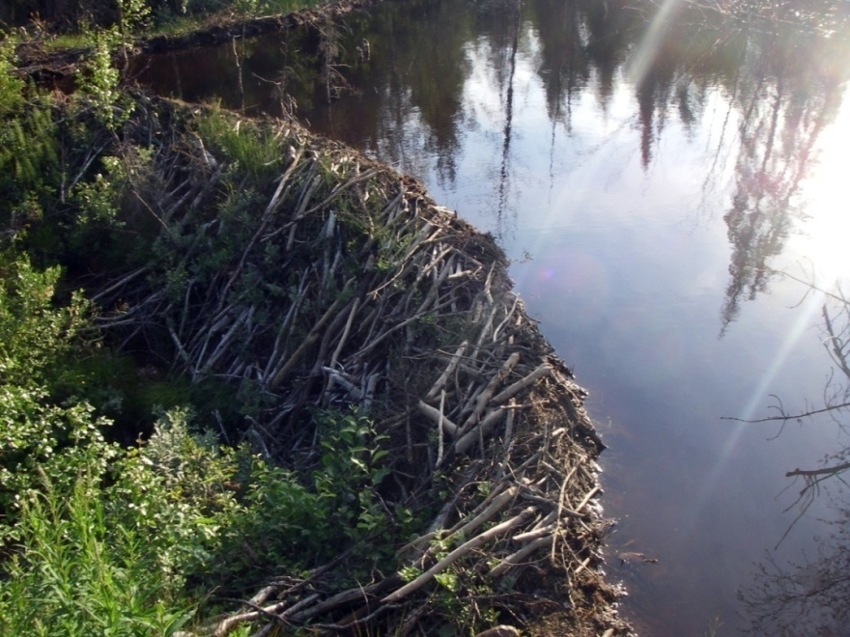
Constructivist scale
Life shapes the environments in which it resides
Differentiation of the world through abiotic and biotic processes
Scale in this sense is produced, not an a priori given, a container in which organisms have no influence upon
Think of the boundaries produced by these organisms, the way they influence the extent and distribution of environmental conditions and resources
Notes:
Top, modern stromatolites. These were the organisms that contributed to the initial oxygenation of the atmosphere.

Slide 45
Rules for ecological scale
Patterns are dependent upon the scale of observation
The important explanatory variables change with scale.
Statistical relationships may change as scale changes.
Patterns are generated by processes acting over various temporal and spatial scales.

Slide 46
Patterns are dependent upon the scale of observation
Notes:
Trees, polluted water wells, lightning strikes – some point process

Slide 47
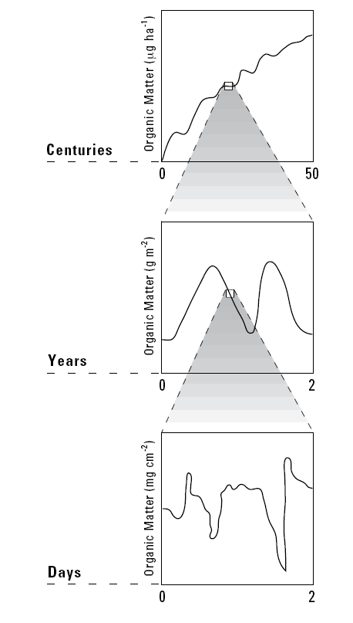
The important explanatory variables change with scale.
Notes:
Climate shapes the accumulation of organic matter over centuries. Fluctuations over years due to annual variation and the seasons. Biological activity determines accumulations at finer resolutions

Slide 48
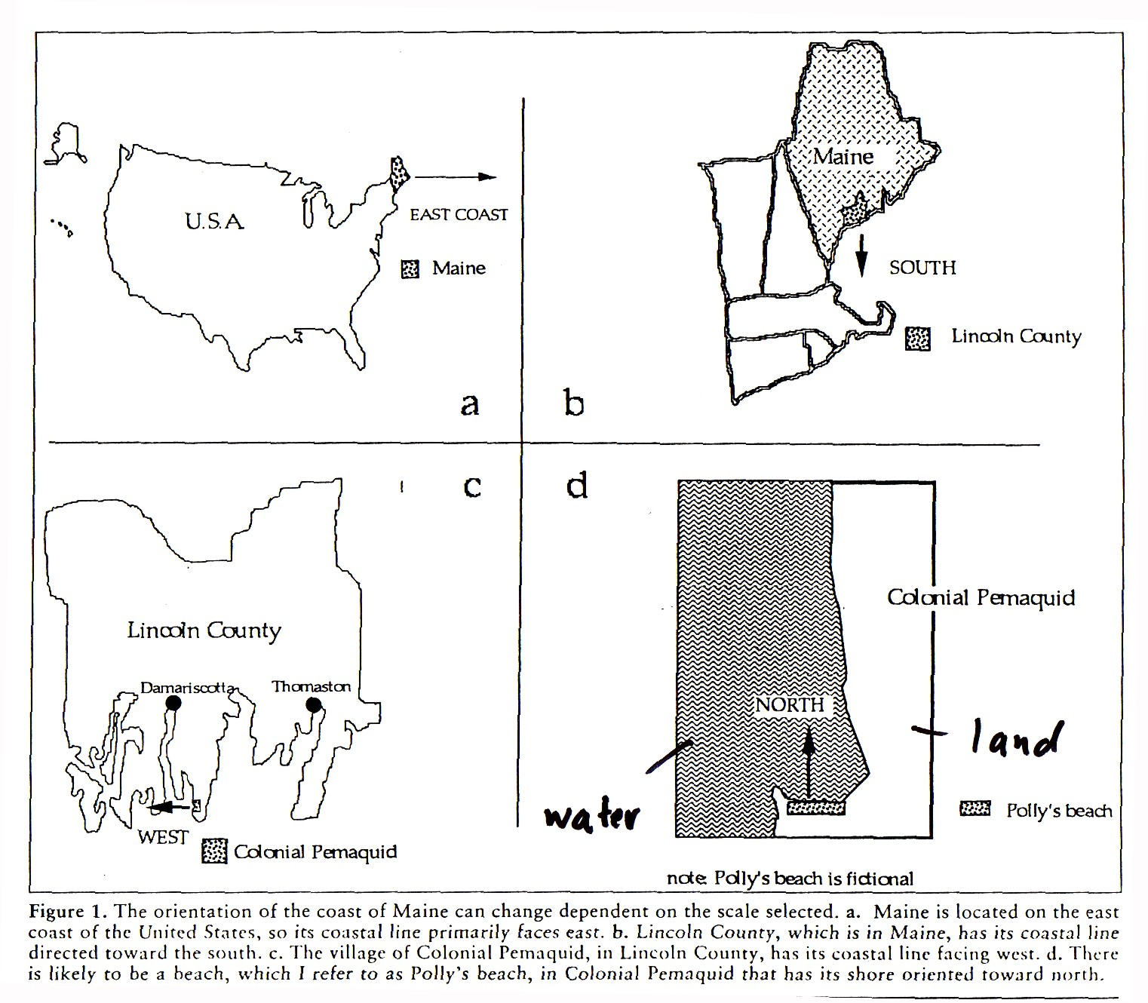
The important explanatory variables change with scale.
Patterns are dependent upon the scale of observation.

Slide 49
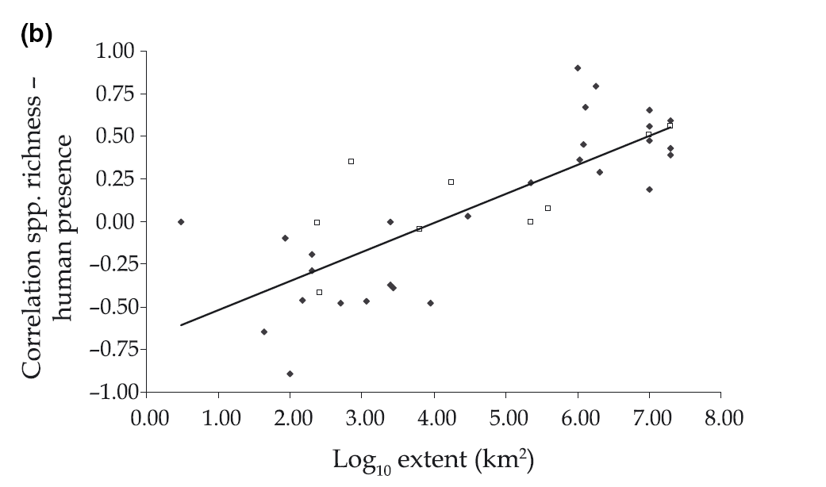
The important explanatory variables change with scale.
Patterns are dependent upon the scale of observation.
Statistical relationships may change as scale changes.
Notes:
8.00 - 10,000 km x 10,000 km
1.00 – 10 km x 10 km
Scale dependence of the correlation between human population presence and vertebrate and plant species richness
Human presence is generally negatively related to species richness locally, but the relationship is positive at coarse scales. The correlation turns from positive to negative below a study grain of approx.1 km and below a study extent of approx. 10 000 sq km. The broad-scale positive correlation between human presence and species richness suggests that people have preferentially settled and generally flourished in areas of high biodiversity and/or have contributed to it with species introductions and habitat diversification. The scale dependency of the correlation between people and biodiversity's presence emphasizes the importance of the preservation of green areas in densely populated regions.

Slide 50
Rules for ecological scale
5. Scale can be used to justify or refute certain management practices and ideas about nature

Slide 51
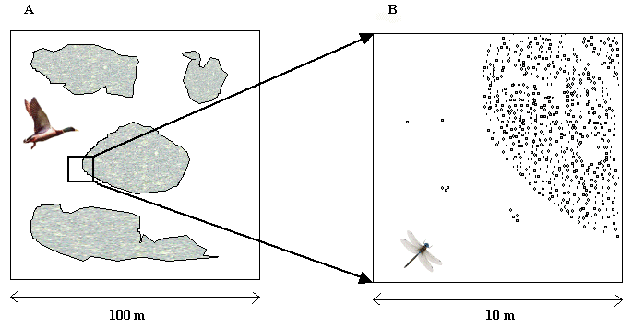
Rules for ecological scale
6. Don’t be anthropocentric – other organisms scale the world differently from us. The scales experienced by an organism define what it sees and responds to. For example, what might constitute a patchy resource to an insect, could be perceived by a larger vertebrate such as a bird as a homogeneous patch.

Slide 52
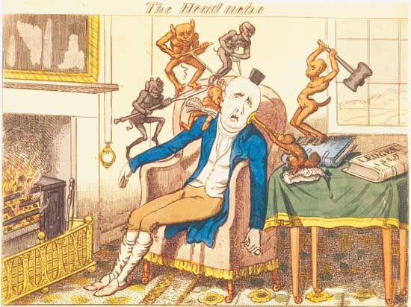
Rules for ecological scale
7. There is no single correct scale or level at which to describe a system. It depends upon one’s goals.

Slide 53
Rules for ecological scales
Be aware of the different types of scale and scale issues.
Use methodologies are sensitive to how patterns change with changes in extent and grain
Nested observations and fractals
Power laws
Networks
Spatial autocorrelation

Slide 54
Scale-sensitive methods: nested observations
Sp - species
Notes:
Species – area plots

Slide 57
Fractals
A way of conceptualizing how patterns change at different extents
A true fractal pattern appears the same across all extents. It is scale invariant.
Measuring how well patterns approach this scale invariance gives you an indication of how patterns change with scale
Notes:
A fractal is a pattern that can be split into parts, each of which is a reduced-size copy of the whole, a property called self-similarity.

Slide 58
Power laws
Notes:
Number of microbes = constant (animal mass)^{z}
The exponent is 1.07, this provides an indication of how relationships between mass and number of microbes chance as a function of larger animals and their larger foraging spaces.

Slide 59
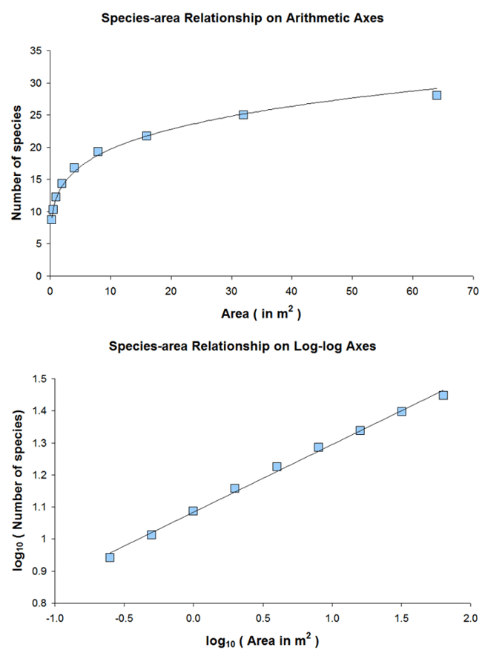
Power laws summarize how relationships change with changes in extent
Often expressed on a log-log plot.
Y = constant (X)^{n}
For example
Species-area relationships (left): S=cA^{z}
Can be used to predict number of species when only area is known
Using power laws permits assessment of how patterns change across scale
Fractals are a special kind of power law.
Similar slopes are thought to have similar structuring processes (n = slope)
Notes:
In statistics, a power law is a functional relationship between two quantities, where one quantity varies as a power of another.
S=cA^{z} where
S = number of species A = area The constants C and z are fitted from the data on island area and number of species and so are specific to a data set.
Number of microbes = constant (animal mass)^{z}

Slide 60
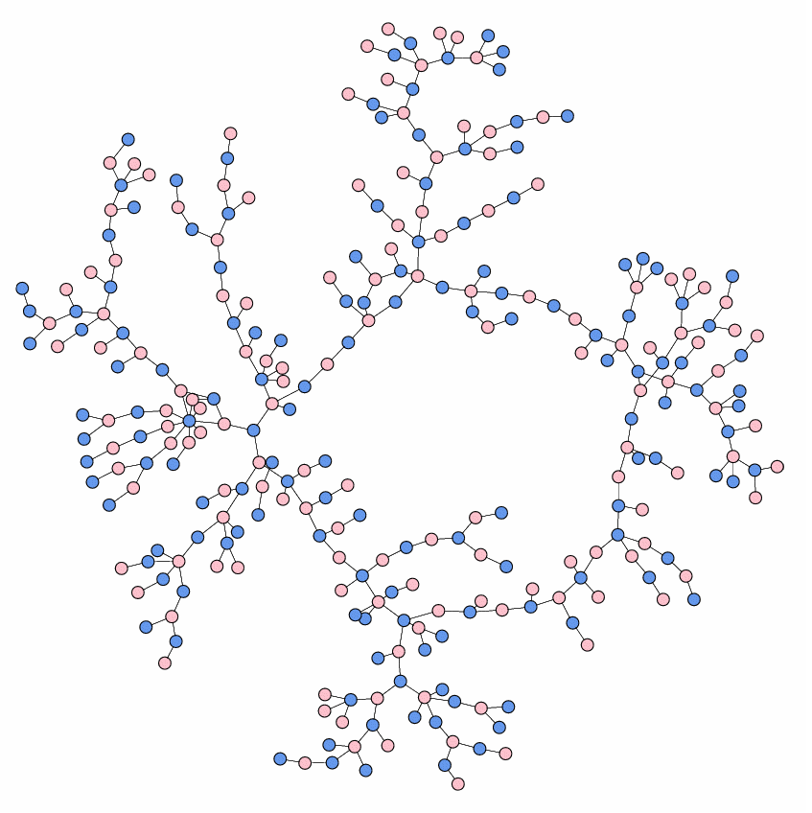
A high school dating network
Notes:
High school dating network

Slide 61
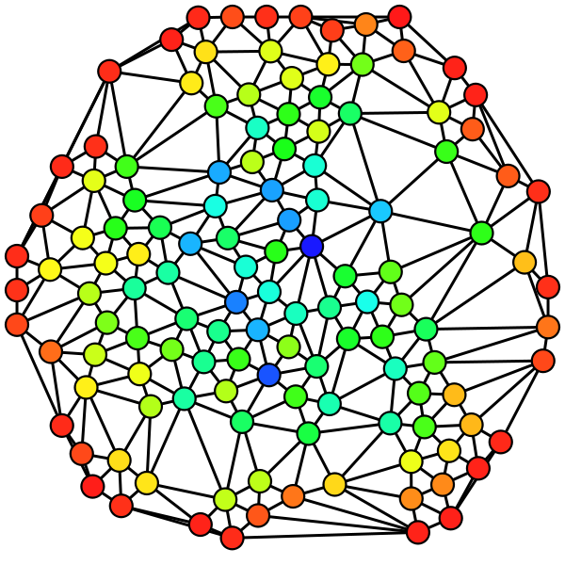
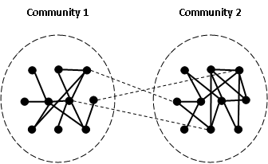
Networks
Box is drawn around
node with high betweenness
Can represent relationships at a variety of scales at once.
Structural properties of networks provide means of understanding how they work
Nodes and links
Betweeness
Weak versus strong links
Random versus scale-free networks
Weak links shown as dashes; strong links are solid lines
Notes:
Degree centrality – number of connections
Betweenness – measure of the connectivity of a particular entity, the node that everyone may have to pass through
Weak links shown as dashes; strong links are solid lines. Weak links connect neighborhood networks or communities.

Slide 62
Random versus scale free networks can reflect different processes of assembly and different dynamics
Notes:
A few nodes highly connected, most are not.
If this pattern holds for all observations, the distribution is said to “scale” as a power law and be “scale-free”.
Node degree implies how connected a node is – how many links it has

Slide 63
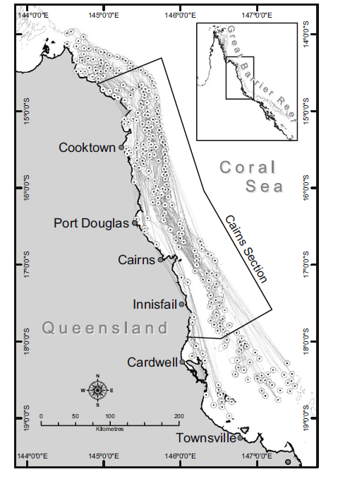
Coral dispersal patterns on the Great Barrier Reef is scale-free network. What does that imply about reef conservation policy?

Slide 64
Autocorrelation
A method to summarize how patterns change with scale.
Based on Tobler’s Law: near things are more likely to be similar than things at a greater distance apart
Applies to space (spatial autocorrelation) or time (temporal autocorrelation)

Slide 65
+1 0
-1
Spatial autocorrelation
+1 0
-1
Notes:
The pattern in the top diagram has high positive spatial autocorrelation at short distances and decreasing spatial autocorrelation at larger distances. The pattern in the bottom figure has very little spatial autocorrelation

Slide 66
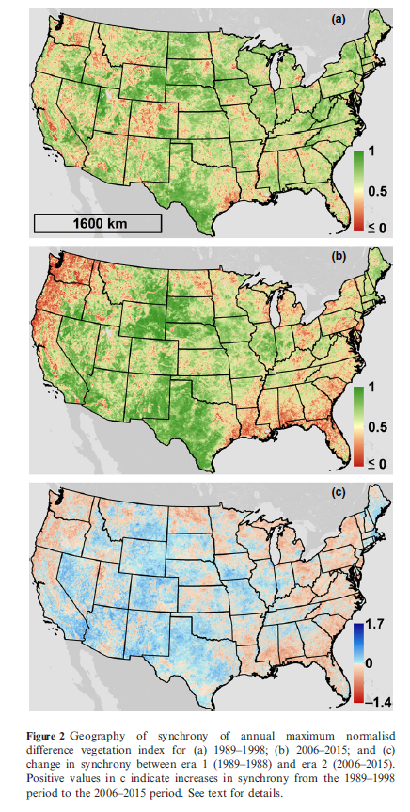
1989-1998
Green values are where maximum greenness occurred in synchrony over the time interval of study. They have high temporal autocorrelation. Red values are where maximum greenness did not synchronize across years. There is lower temporal autocorrelation.
2006-2015

