Slide 1
Reading/Questions 9
Notes:
https://www.nytimes.com/2020/07/15/sunday-review/coronavirus-history-pandemics.html

Slide 2
Video

Slide 3
In September 1940, an Oxford police constable, Albert Alexander, 48, was near death from sepsis he acquired from a small cut. As an experiment, he was given penicillin
He recovered, but died the next day because there wasn’t enough penicillin to give him another dose
In March 1942, Mrs. Anne Miller, age 33, of New Haven, Connecticut, was near death from sepsis due to an infection after a miscarriage.
After experimental administration of penicillin, she recovered, becoming the first person in the world to be saved by an antibiotic.
Notes:
https://www.nytimes.com/1999/06/09/us/anne-miller-90-first-patient-who-was-saved-by-penicillin.html https://www.ynhh.org/publications/bulletin/090717/medication-superstar-made-its-us-debut-right-here.aspx https://www.med-dept.com/medical-kits-contents/class-9-items-drugs-chemicals-and-biological-stains-sulfa-drugs/
In March 1942, Mrs. Miller was near death at New Haven Hospital suffering from a streptococcal infection, a common cause of death then. She had been hospitalized for a month, often delirious with her temperature spiking to nearly 107, while doctors tried everything available, including sulfa drugs, blood transfusions and surgery. All failed.
As she slipped in and out of consciousness, her desperate doctors obtained a tiny amount of what was still an obscure, experimental drug and injected her with it. Her hospital chart, now at the Smithsonian Institution, registered a sharp overnight drop in temperature, and by the next day she was no longer delirious and soon was eating full meals, one of her doctors reported. Mrs. Miller's life was saved, and so eventually were the lives of all those previously felled by infections of bacteria like streptococci, staphylococci and pneumococci. Penicillin also saved the lives of an untold number of servicemen and civilians wounded in World War II; in earlier wars, people died by the thousands from bacterial infections resulting from their injuries.
Although Sir Alexander Fleming, the Scottish biologist, was the first to recognize the therapeutic potential of penicillin through a chance discovery at St. Mary's Hospital in London in 1928, nearly a dozen years passed before scientists fully appreciated its significance and were able to produce it for experimental use in humans. Largely forgotten, it came to the fore only when researchers picked up on it again at Oxford University at the outbreak of World War II. The small quantity of penicillin rushed to New Haven came from a laboratory in New Jersey, and news of Mrs. Miller's full, seemingly miraculous recovery helped inspire the American pharmaceutical industry to begin full production of penicillin.
In 1935, the first ever sulfa drug was developed by a German scientists at the Bayer Laboratories.. The drugs were further developed by French researchers in the late 1930s, and by exploiting the German discovery, they in fact opened the way for bacterial chemotherapy. The pioneering work carried out at these German laboratories soon became global news, as the discovery of the sulfonamide group opened a new era in medicine. Both the “John Hopkins Medical School” and the “Medical Field Service School” became involved, and after intensive research, it was decided in 1939 to introduce the antimicrobial drug for official Army use. Indeed it was not until the late 1940s and early 1950s that Sulfa Drugs began to be phased out in favor of the new Penicillin (discovered in 1928, and mass-produced in the early 1940s).
https://www.med-dept.com/medical-kits-contents/class-9-items-drugs-chemicals-and-biological-stains-sulfa-drugs/

Slide 4
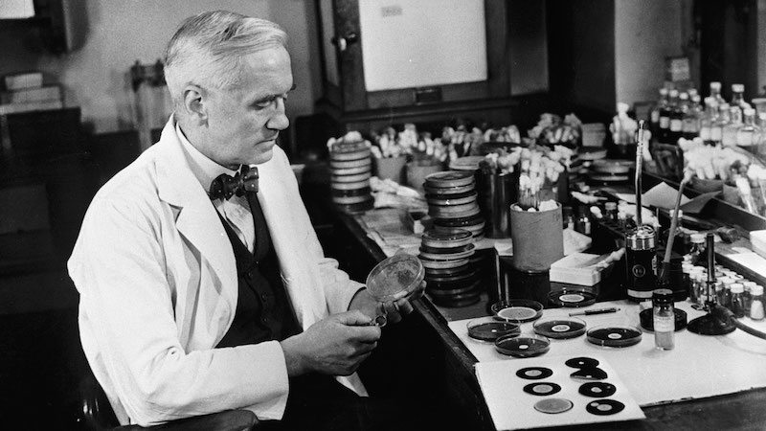
Notes:
The story began much earlier. In 1928, upon examining some colonies of Staphylococcus aureus, Dr. Fleming noted that a mold called Penicillium notatum had contaminated his petri dishes. After carefully placing the dishes under his microscope, he was amazed to find that the mold prevented the normal growth of the staphylococci. Fleming realized that there was great potential in penicillin, but there were significant challenges in translating what could be demonstrated in the laboratory into a medicine that could be made widely available. He tried to attract the interest of chemists over a number of years but finally gave up in 1940 to pursue other interests.

Slide 5
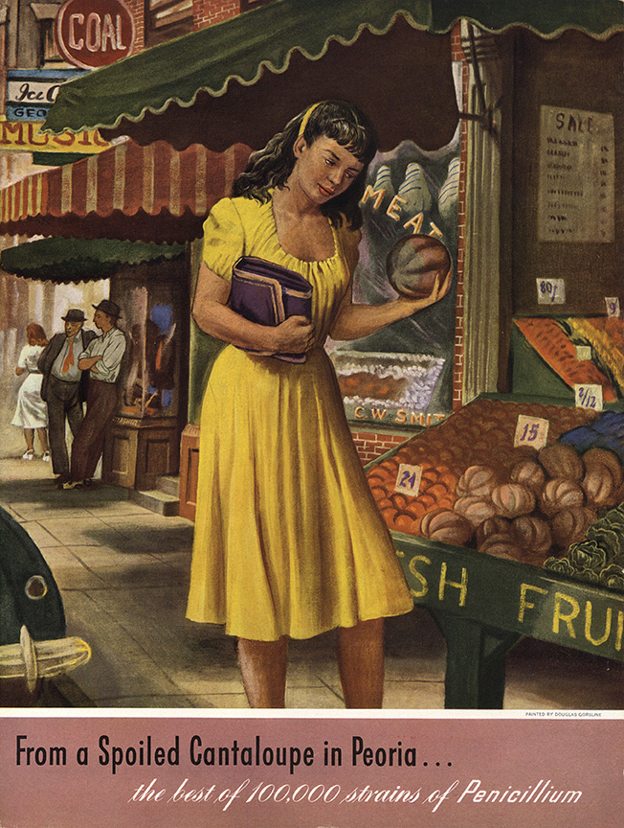
Notes:
Howard Florey (1898–1968), a pharmacologist and pathologist, Ernst Chain (1906–1979), a biochemist, were instrumental in testing penicillin’s effectiveness and pushing penicillin closer to commercial production. It was later, In September 1940, that the Oxford police constable, Albert Alexander, 48, provided the first test case. Alexander nicked his face working in his rose garden. The scratch, infected with streptococci and staphylococci, spread to his eyes and scalp. Although Alexander was admitted to the Radcliffe Infirmary and treated with doses of sulfa drugs, the infection worsened and resulted in smoldering abscesses in the eye, lungs and shoulder. Florey and Chain heard about the horrible case at high table one evening and, immediately, asked the Radcliffe physicians if they could try their ”purified” penicillin. After five days of injections, Alexander began to recover. But Chain and Florey did not have enough pure penicillin to eradicate the infection, and Alexander ultimately died. Another vital figure in bringing penicillin to market was a biochemist, Dr. Norman Heatley, who used every available container, bottle and bedpan to grow vats of the penicillin mold, suction off the fluid and develop ways to purify the antibiotic. In the summer of 1941, shortly before the United States entered World War II, Florey and Heatley flew to the United States, where they worked with American scientists in Peoria, Ill., to develop a means of mass producing what became known as the wonder drug. Aware that the fungus Penicillium notatum would never yield enough penicillin to treat people reliably, Florey and Heatley searched for a more productive species. One hot summer day, a laboratory assistant, Mary Hunt, arrived with a cantaloupe that she had picked up at the market and that was covered with a ”pretty, golden mold.” Serendipitously, the mold turned out to be the fungus Penicillium chrysogeum, and it yielded 200 times the amount of penicillin as the species that Fleming had described. Yet even that species required enhancing with mutation-causing X-rays and filtration, ultimately producing 1,000 times as much penicillin as the first batches from Penicillium notatum.

Slide 6
Discovery of penicillin by Alexander Fleming in 1928 in United Kingdom
Commercialization of penicillin in the mid-1940’s
Golden Era of antibiotic prospecting and commercialization from 1940s to 1960s
During this period antibiotics penicillin and streptomycin were extracted from fungi; tetracycline, erythromycin, vancomycin from bacteria
However, when accepting Nobel Prize in 1945, Fleming gave the first public warning about bacterial resistance
Notes:
In the ‘Golden Age’ of antibiotic discovery, the best source of new agents was from other naturally occurring soil microorganisms. After streptomycin was isolated in 1944 from Streptomyces griseus (a fungal organism found in soil), a worldwide search began. Every effort was made to reach all corners of the globe, but resources were limited. Eli Lilly had the bright idea of asking Christian missionaries to send back a soil sample from every exotic place that they visited. A sample from Borneo sent in 1952 grew Streptomyces orientalis, from which vancomycin was eventually extracted; vancomycin became available for patient use in 1958.
https://www.pbs.org/newshour/health/the-real-story-behind-the-worlds-first-antibiotic

Slide 7
Common infections like urinary tract infections, pneumonia, strep throat, could be cured
Minor cuts and scrapes no longer led to sepsis
Millions of lives could be saved, quality of life improved, and economic losses prevented
These first drugs were broad-spectrum antibiotics and they quickly became indispensable for modern medicine.
Yet when accepting Nobel Prize in 1945, Fleming gave the first public warning about bacterial resistance
Notes:
https://wwwnc.cdc.gov/eid/article/23/5/16-1556_article

Slide 8
Notes:
By the late 1950’s, resistance to antibiotics was becoming apparent, and scientists looked at new ways to improve on existing agents to combat this obstacle.

Slide 9
Notes:
https://www.who.int/news/item/15-04-2021-global-shortage-of-innovative-antibiotics-fuels-emergence-and-spread-of-drug-resistance

Slide 10
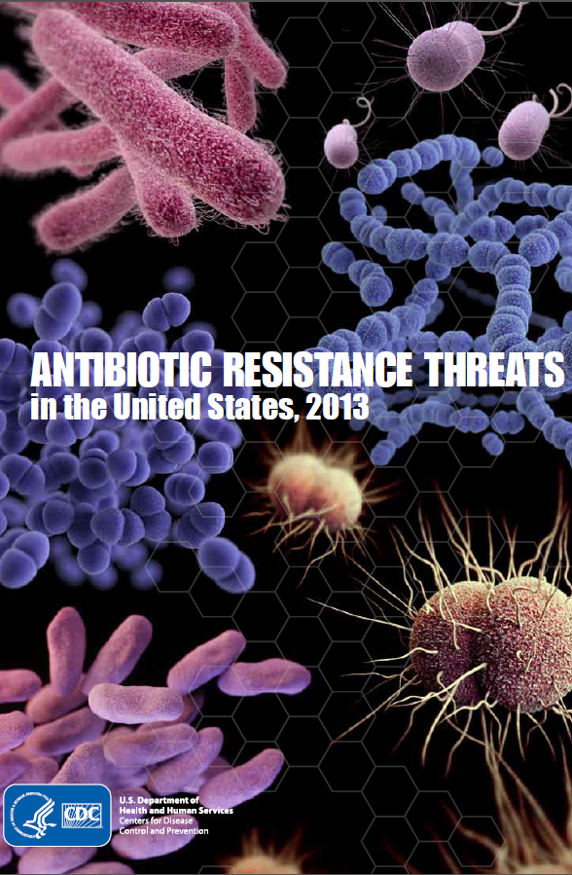
Notes:
In addition to the World Health Organization, many other global and national agencies have sounded a warning about antibiotic resistance.

Slide 11
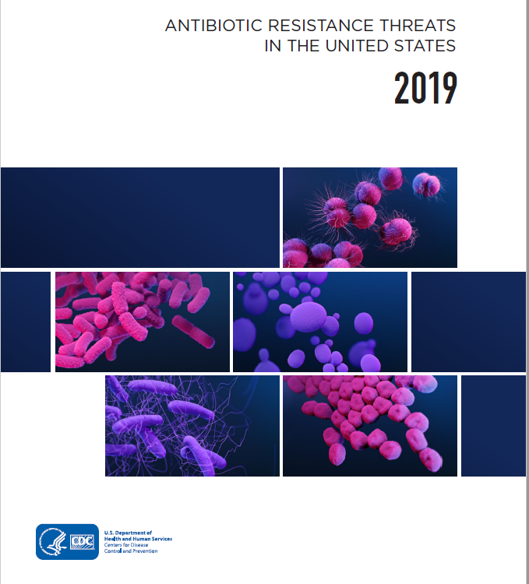
Drug-resistant organisms sicken about 3 million people every year in the United States and kill about 35,000
Killing 700,000 people a year globally, and it is predicted to cause 10 million deaths per year by 2050 if the current situation is not improved.

Slide 12
Notes:
http://www.bbc.com/news/health-30416844 AMR will account for an extra 10 million human deaths a year worldwide - more than currently die from cancer - by 2050 unless action is taken. Antimicrobial drugs include antibacterial, antifungals, and antiprotozoals AMR means antimicrobial resistance. These are antibacterials, antivirals, antifungals, and antiprotozoals

Slide 14
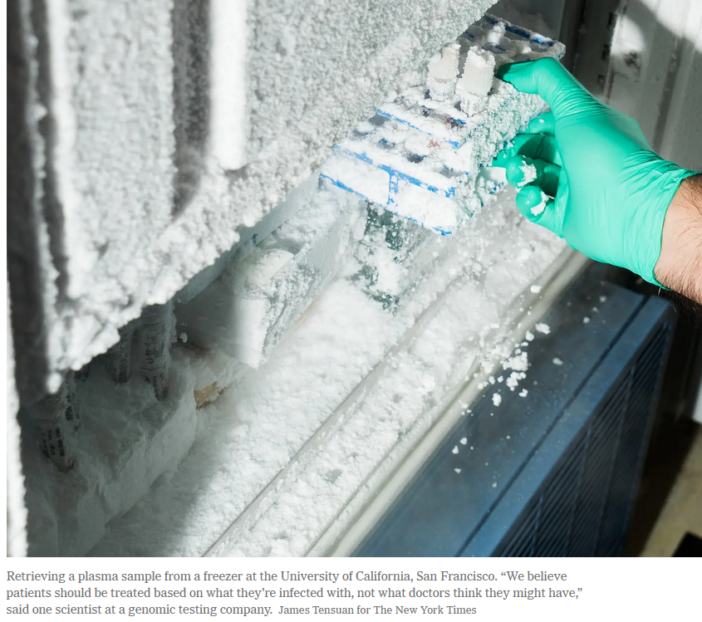
Reading/Questions 9
Notes:
https://www.nytimes.com/2020/02/24/health/genomic-diagnostic-tests.html

Slide 15
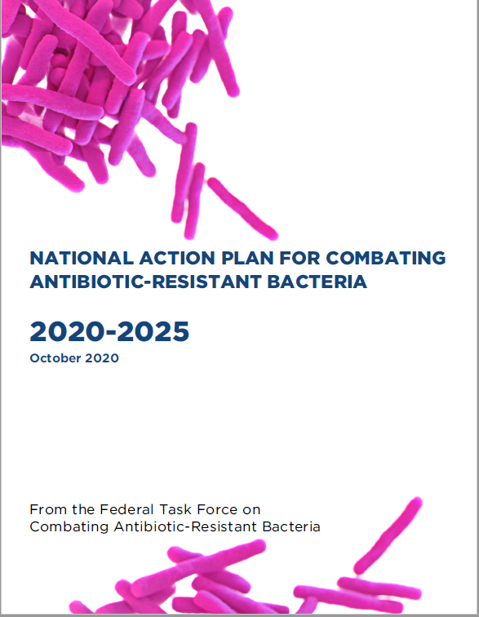
Why has the AMR issue persisted?
Recognition of AMR has been known for decades
Many national and international reports from prominent governmental and non-governmental agencies
Much of the public recognizes the threat
Reasons are different for developed versus undeveloped countries
First, here are the reasons for the AMR issue for developed countries
Notes:
https://aspe.hhs.gov/pdf-report/carb-plan-2020-2025 Developed versus developing countries is a false dichotomy. A country could have parts of it that are developed and others developing. The idea of ‘developed’ supposes that a state of advancement is technologically advanced and having a global economy. This falsely assumes that development is only this particular definition and not development in other ways,

Slide 16
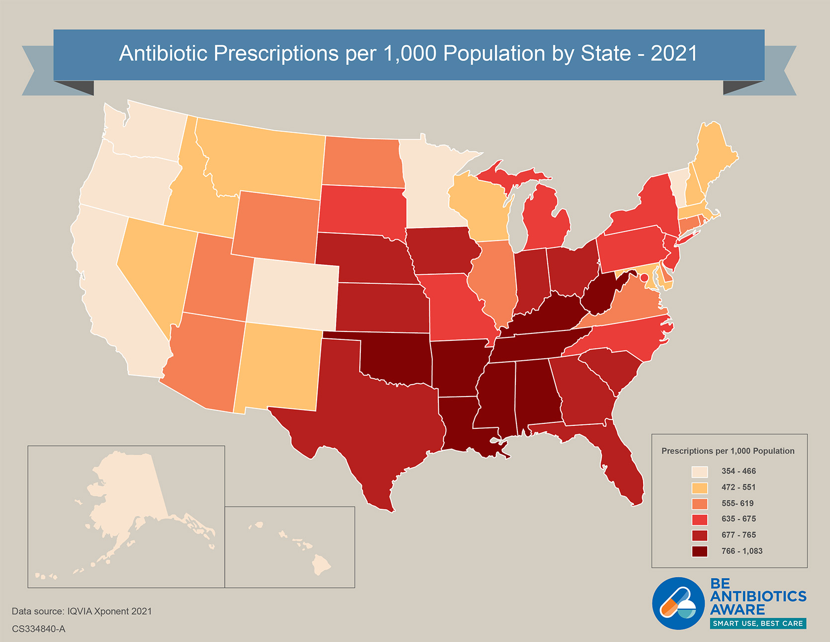
Overuse and inappropriate use
Total inappropriate antibiotic use, inclusive of unnecessary use and inappropriate selection, dosing and duration, may approach 50% of all outpatient antibiotic use
Notes:
https://www.cdc.gov/antibiotic-use/data/outpatient-prescribing/index.html?CDC_AA_refVal=https%3A%2F%2Fwww.cdc.gov%2Fantibiotic-use%2Fcommunity%2Fprograms-measurement%2Fmeasuring-antibiotic-prescribing.html

Slide 17
Notes:
Antibiotic resistant bacteria and bacterial genes that confer resistance now move among humans, domesticated animals, wildlife, and the environment
AMR is a challenge because it is an environmental issue. Antimicrobials are used in agriculture. However, veterinary and human medicine not well integrated

Slide 18
Notes:
https://www.youtube.com/watch/zzKqEZmUGxY&t=139s

Slide 19
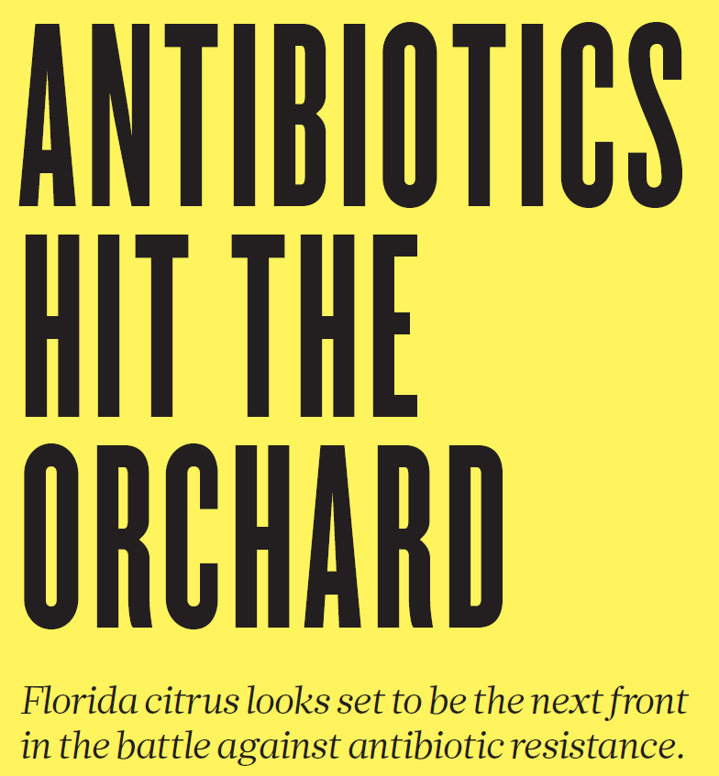
Notes:
Citrus greening is caused by a bacteria carried in these insects shown above. This disease has crippled the Florida citrus industry. 90% of the state’s citrus trees are infected. Antibiotics are being sprayed on orange crops. There is little publicly available science on the long-term use of these drugs in crop settings. There have not been any studies done so far that looked at whether this use could lead to greater resistance. The bacterial disease is transmitted by an invasive psyllid insect and moves through the vascular tissue under the tree’s bark, a circulatory system that is difficult to access. Emergency applications on citrus crops since 2016 have shown that the antibiotics can slow disease progression, allowing growers to eke a few more harvests out of infected trees. But the drugs do not eliminate greening

Slide 20
Notes:
https://www.youtube.com/watch/_HBhXpbPPuE

Slide 21
Antifungals are applied in far greater quantities on crops
Notes:
https://www.youtube.com/watch?v=AgXAmtybfKU

Slide 22
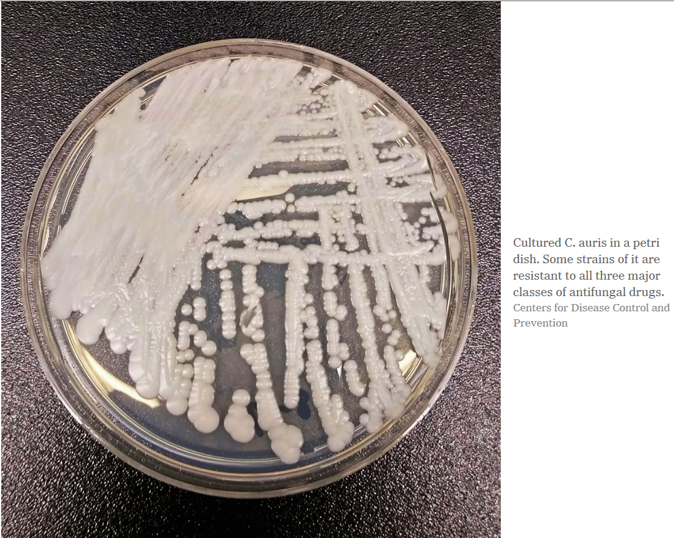
Reading/Questions 9
Notes:
https://www.nytimes.com/2019/04/06/health/drug-resistant-candida-auris.html Other prominent strains of the fungus Candida — one of the most common causes of bloodstream infections in hospitals — have not developed significant resistance to drugs, but more than 90 percent of C. auris infections are resistant to at least one drug, and 30 percent are resistant to two or more drugs, the C.D.C. said. Nearly half of patients who contract C. auris die within 90 days, according to the C.D.C.

Slide 23
Notes:
Three outbreaks of Candida auris, three separate times, producing three different resistant strains, on three continents
This argues for a common origin of resistance

Slide 24
Notes:
Hence, one might have expected that C. auris to have been known as a human and animal pathogen first, and then acquired drug resistance, rather than simultaneously emerging as a drug resistant human pathogen from agricultural drug use. Another suggested explanation for the emergence of C. auris is that it recently acquired virulence traits that conferred the capacity for virulence. Although this explanation cannot be ruled out, the capacity for virulence is a complex property that emerges from many attributes, and it is improbable that it would have occurred concurrently in three continents, unless driven by another factor that selected for it.

Slide 25
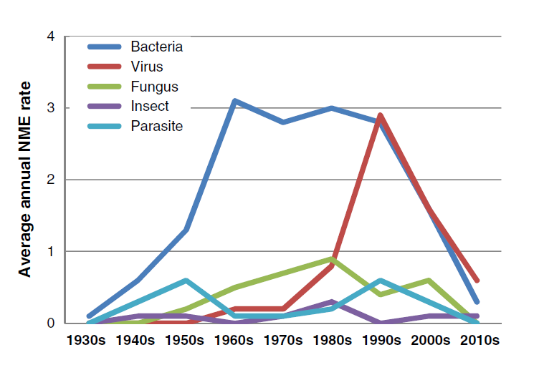
New molecular entities (NME) for drugs to combat disease-causing organisms
Notes:
Antibacterial new molecular entities (NME)
Kinch, M. S., Patridge, E., Plummer, M., & Hoyer, D. (2014). An analysis of FDA-approved drugs for infectious disease: antibacterial agents. Drug discovery today, 19(9), 1283-1287.

Slide 26
Entry and exit of antibacterial agents in the market
Notes:
Kinch, M. S., Patridge, E., Plummer, M., & Hoyer, D. (2014). An analysis of FDA-approved drugs for infectious disease: antibacterial agents. Drug discovery today, 19(9), 1283-1287.
Recent collapse of antibacterial new molecular entities (NMEs): the entry (blue) and exit (red; because of obsolescence or resistance) is indicated on an annual basis.

Slide 27
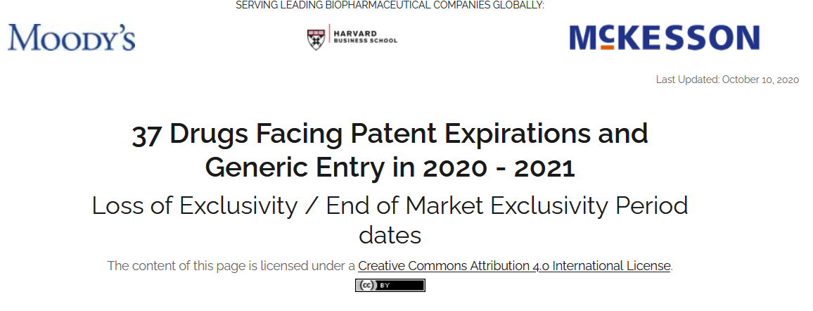
The antibiotic paradox
There is a built-in economic self-destruct mechanism due to the evolutionary inevitability of AMR
Antimicrobials have limited financial shelf-life since they are often held in reserve as drug of last choice - delaying returns on investment
Once put into use, pressure to make it a generic increases. This also lowers return on investment.
This is what makes it financially risky to focus on new AMR drugs.
Notes:
Moreover, antimicrobials viewed as less profitable by pharma companies because taken only for short period and for one course of treatment.
Amoxicillin is the generic name for Amoxil.
Drug patents typically last 20 years before they can be turned into generics, but pharma companies have strategies to extend them including slight changes to the molecular structure of the active ingredients in the drug, which make it different from the one defined in the original patent. Getting a nee patent allows returns on their investment to continue.
Patented drugs are subject to litigation aiming to make them generic earlier. Health care relies on generic antibiotics, which account for about 80% of all prescriptions. https://www.thelancet.com/journals/laninf/article/PIIS1473-3099(10)70246-2/fulltext
https://www.theatlantic.com/health/archive/2015/03/generic-drugs-the-same-but-not/388592/ https://www.nytimes.com/2020/01/17/health/antibiotics-resistance-new-drugs.html

Slide 28
Video
Notes:
https://www.pbs.org/newshour/show/how-a-crumbling-antibiotics-infrastructure-could-yield-catastrophe

Slide 29
Reading/Questions 9
Notes:
https://www.nytimes.com/2020/07/09/health/antibiotics-pharma-drug-resistance.html

Slide 30
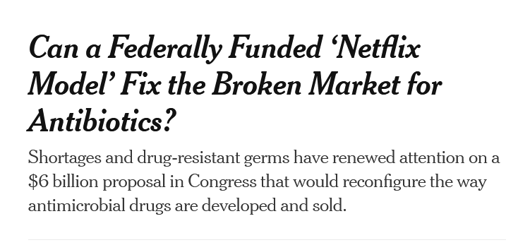
Reading/Questions 9
Notes:
https://www.nytimes.com/2022/12/16/health/congress-antibiotics-drug-resistance.html

Slide 31
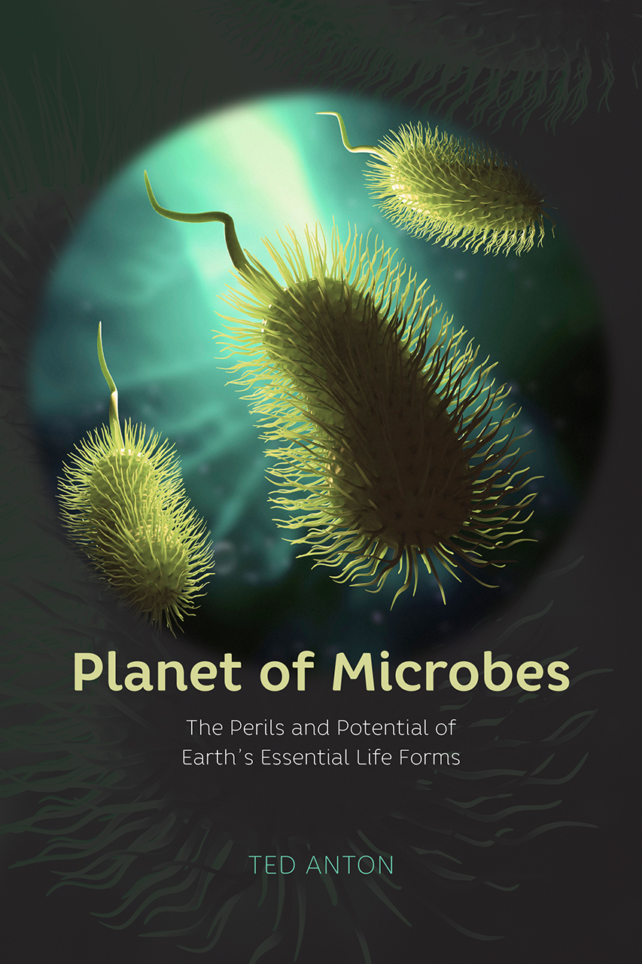
Globalization 1.0
Non-human life globalized and colonized the planet billions of years ago, as have many other life forms (Globalization 1.0)
For much of Earth’s history, microbes were the only life form on the planet
Human health exists within this deep time history of a deeply microbial planet

Slide 32
Bacteria are far more abundant and mobile than our conceptions of ‘clean’ or ‘sterile’
Bacteria are ubiquitous in all environments
We shed millions of bacterial cells per hour.
A deeply intertwined life with bacteria is unavoidable
Rooms take on the microbial properties of those who enter it.
Notes:
https://www.ncbi.nlm.nih.gov/books/NBK458823/
https://www.nytimes.com/2019/05/20/opinion/hospitals-antibiotic-resistant-bacteria-superbugs.html

Slide 33
Hedgehogs
Methicillin-resistant Staphylococcus aureus—a notorious human pathogen—appeared in European hedgehogs in the pre-antibiotic era.
These resistant lineages spread within the local hedgehog populations and between hedgehogs and secondary hosts, including livestock and humans.
A hedgehog fungal dermatophyte Trichophyton erinacei produces antibiotics
These antibiotics, over time, selected for Staphylococcus aureus on hedgehogs that were resistant to them.
Notes:
Dube, F., Söderlund, R., Lampinen Salomonsson, M., Troell, K., & Börjesson, S. (2021). Benzylpenicillin-producing Trichophyton erinacei and methicillin resistant Staphylococcus aureus carrying the mecC gene on European hedgehogs–A pilot-study. BMC microbiology, 21(1), 1-11. https://www.nytimes.com/2022/01/05/science/hedgehog-mrsa-drug-resistant-bacteria.html Trichophyton is a type of fungus that causes ringworm

Slide 34
Notes:
Resistance genes travel with them. MDR – multidrug resistance

Slide 35
Resistance does not correlate neatly with industrialization and antibiotic use
Despite limited access to the full range antibiotics in Fiji, resistance genes for most classes of antibiotics were found in the Fijian population.
Resistance genes have also been detected in isolated Amazon tribes
The same genetic resistance mechanism occurred among a population of people in rural El Salvador and more urban locations in Peru
Notes:
https://www.smithsonianmag.com/smart-news/even-isolated-amazonian-tribes-microbes-are-antibiotic-resistant-180955076/
https://advances.sciencemag.org/content/1/3/e1500183
https://pib.socioambiental.org/en/Povo:Yanomami
These Yanomami harbor a microbiome with the highest diversity of bacteria and genetic functions ever reported in a human group. Despite their isolation, presumably for >11,000 years since their ancestors arrived in South America, and no known exposure to antibiotics, they harbor bacteria that carry functional antibiotic resistance (AR) genes, including those that confer resistance to synthetic antibiotics

Slide 36
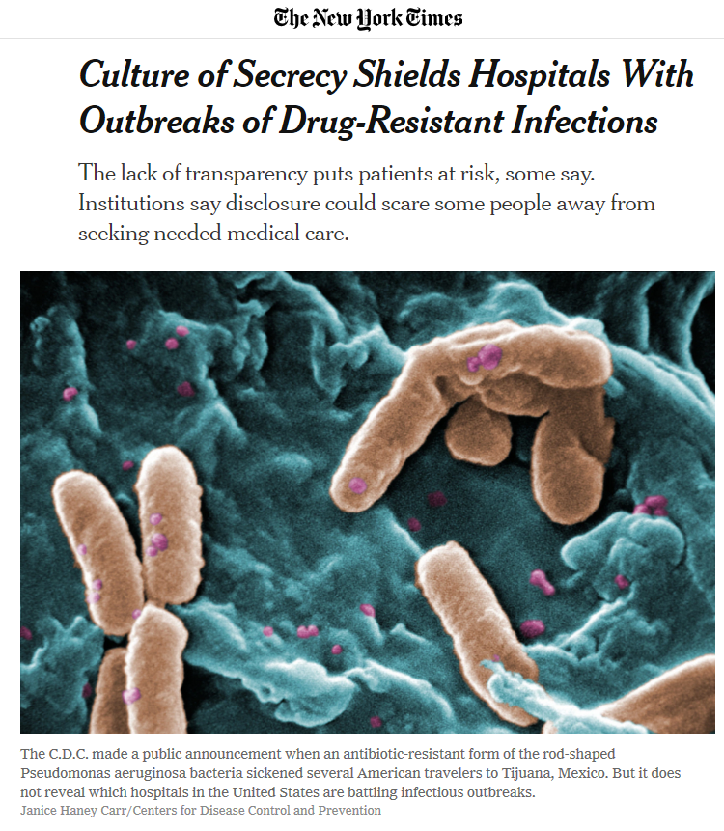
The secrecy problem
CDC says a degree of confidentiality is necessary to encourage the cooperation of hospitals and nursing homes, which might otherwise seek to conceal infectious outbreaks.
Medical institutions want to protect their reputations
If people become wary of hospitals, they may not go, making it more likely they may have other health issues from not seeking care
Notes:
Restaurants and cruise ships also announce outbreaks of bacterial disease immediately – but hospitals do not.

Slide 37
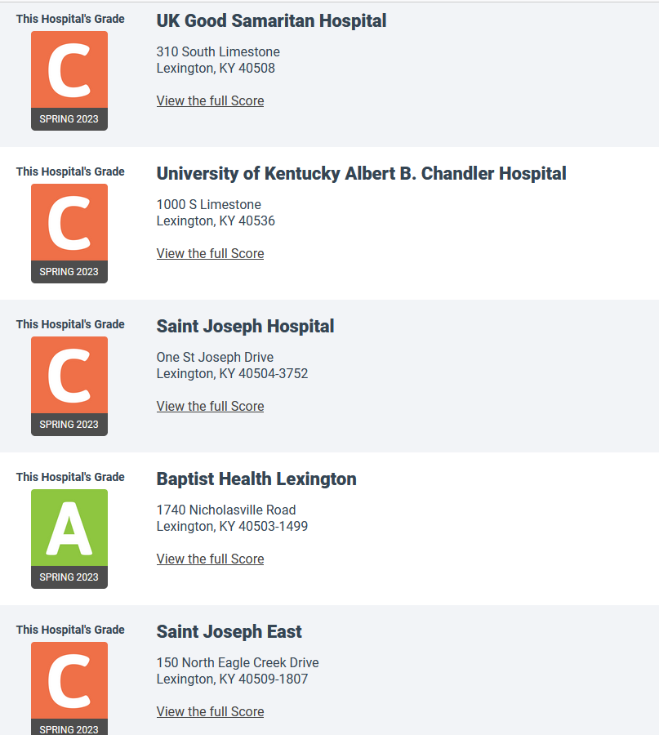
Announcing outbreaks could lead to patients avoiding medical care out of fear of encountering drug-resistant bacteria.
Hospitals might start refusing patients with certain infections, especially those coming from nursing facilities where AMR is more common
These are ratings for Lexington area hospitals based on statistics about infections contracted through hospital care
Notes:
https://www.nytimes.com/2019/05/20/opinion/hospitals-antibiotic-resistant-bacteria-superbugs.html
Revealing a microbe list would only freak patients out. It wouldn’t explain where the microbes came from, whether any patients were infected, and how they were cured.

Slide 38
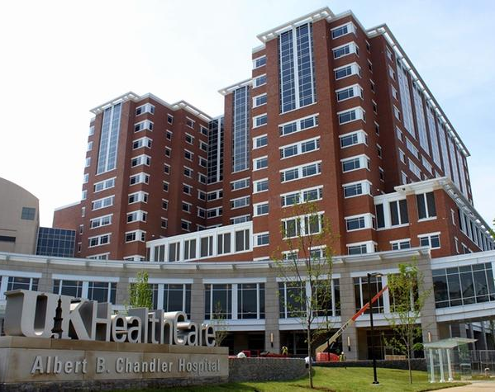
The secrecy problem
Large, advanced public hospitals have greater challenges – they are more likely to have higher rates of drug-resistant infections because of who they treat
At a hospital of last resort, you’re going to see repeat patients with infections, many resistant
Yet these hospitals are also better equipped to detect, identify and report infections
Notes:
The hospitals that see the most superbugs are often the best ones we have, for the simple reason that they have the most sophisticated diagnostic platforms, the most powerful antibiotics and the experts to administer them.

Slide 39
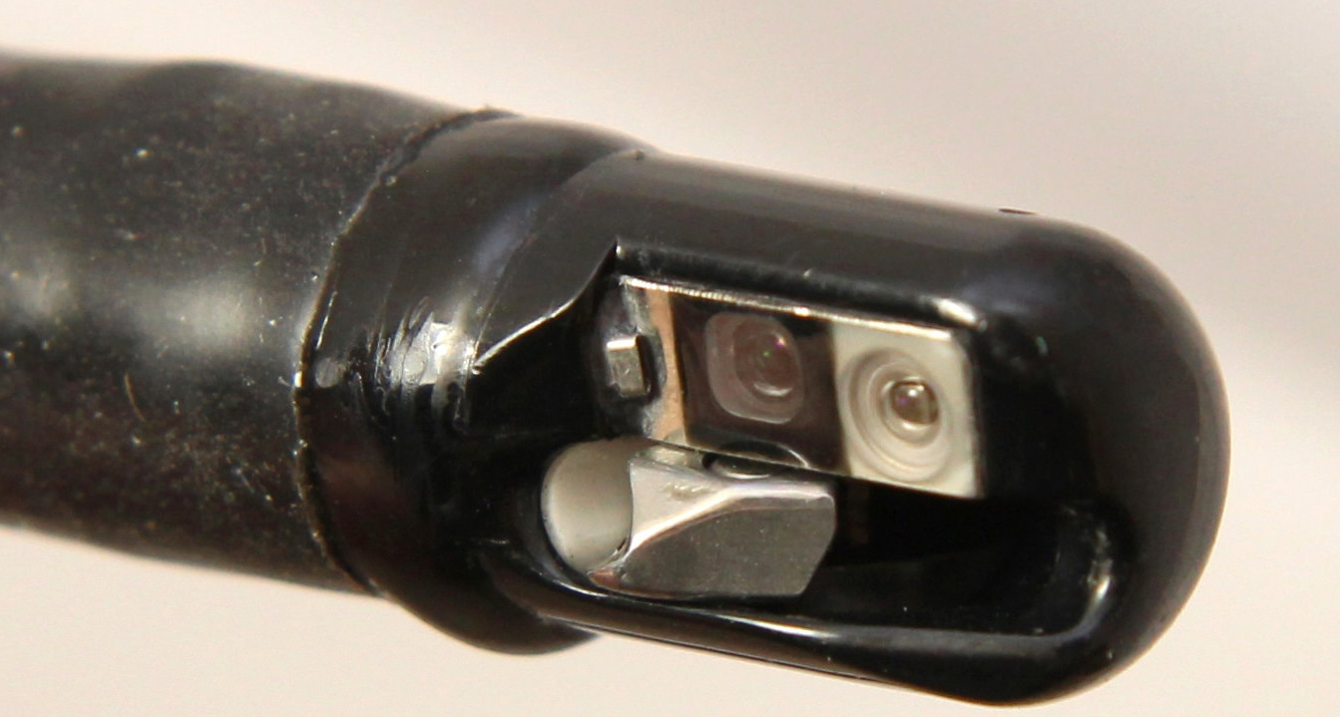
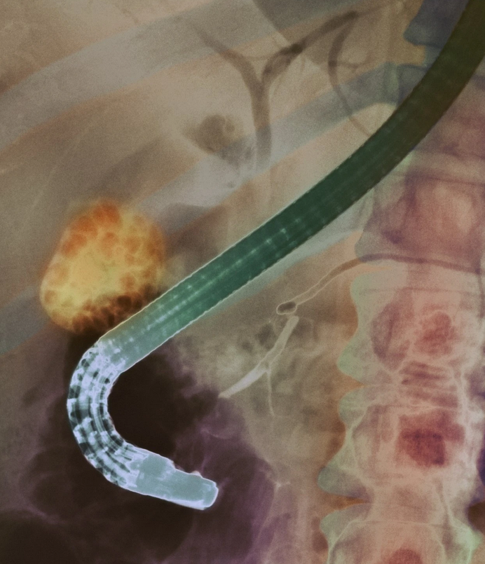
AMR incidents in the US
2016: Carbapenem-resistant Enterobacteriaceae outbreak in rural Kentucky hospital.
C.D.C. issued a report on that outbreak in 2018 and even then, the agency did not name the hospital where it occurred.
In 2012-2014, more than three dozen people at a Seattle hospital were infected with a drug-resistant bacteria from a contaminated medical scope.
Eighteen died, but the hospital did not disclose the outbreak, saying at the time it did not see the need to do so.
Notes:
http://www.cidrap.umn.edu/news-perspective/2018/01/2016-cre-outbreak-kentucky-highlights-need-vigilance
https://www.cdc.gov/mmwr/volumes/66/wr/mm665152a5.htm
https://www.nytimes.com/2019/08/06/health/duodenoscopes-infections-hospitals-antibiotics.html
https://www.help.senate.gov/imo/media/doc/Duodenoscope%20Investigation%20FINAL%20Report.pdf
https://academic.oup.com/cid/article-abstract/68/8/1327/5094756?redirectedFrom=fulltext Also incidents have happened in neonatal wards

Slide 40
AMR incidents abroad
In 2019 the Centers for Disease Control and Prevention sent out an urgent alert about a deadly bacteria, resistant to virtually every known antibiotic, that sickened more than a dozen Americans who had elective weight loss surgery at Grand View Hospital in Tijuana, Mexico.
When outbreaks occur in other countries, however, warning are issued quickly
Video

Slide 41
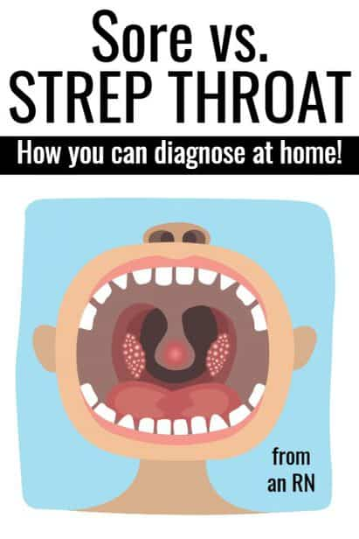
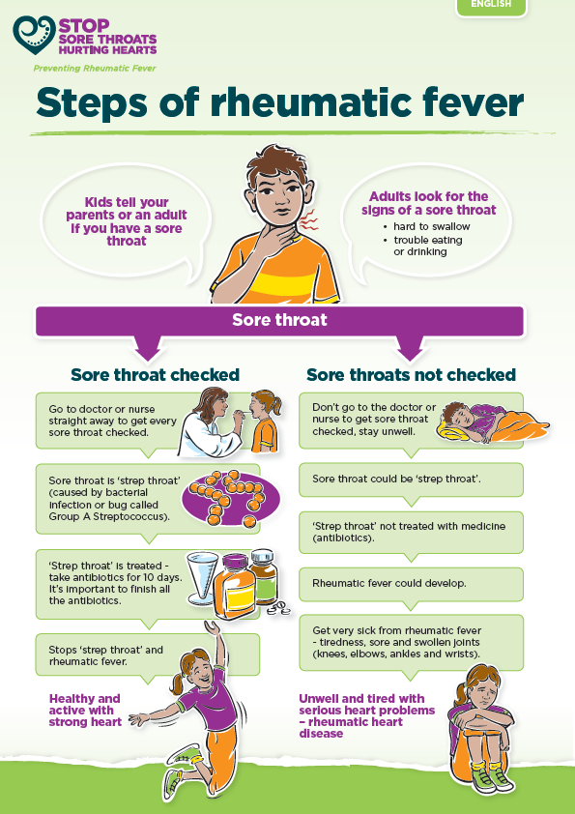
Notes:
Rheumatic fever is an inflammatory disease of the heart, bone, skin or brain that can develop as a complication of streptococcal throat infections like strep throat

Slide 42
Reading/Questions 9
Notes:
But in poor countries, strep throat often goes undiagnosed and can become a long, slow death sentence. Without treatment, it can lead to rheumatic fever and rheumatic heart disease, in which the immune system attacks the heart valves — intricate flaps of tissue that must open and shut properly 100,000 times a day for the heart to work normally. As the valves deteriorate, the heart struggles and gradually wears out. Patients become weak, short of breath and unable to attend school or work. Many die before they reach 30. Women with the illness who become pregnant can suffer severe and sometimes fatal complications.
https://www.nytimes.com/2018/09/16/health/rwanda-strep-heart-disease.html

Slide 43
Global AMR
Much less data from the lower and middle income nations
International reports disproportionately reflect data from resource-rich settings
Few well-studied low-income surveillance sites
Only 25% of countries have implemented a national policy to tackle AMR.
Less than 40% of countries have put in place infection prevention and control programs for AMR.
ResistanceMap
Notes:
https://resistancemap.cddep.org/AntibioticResistance.php

Slide 44
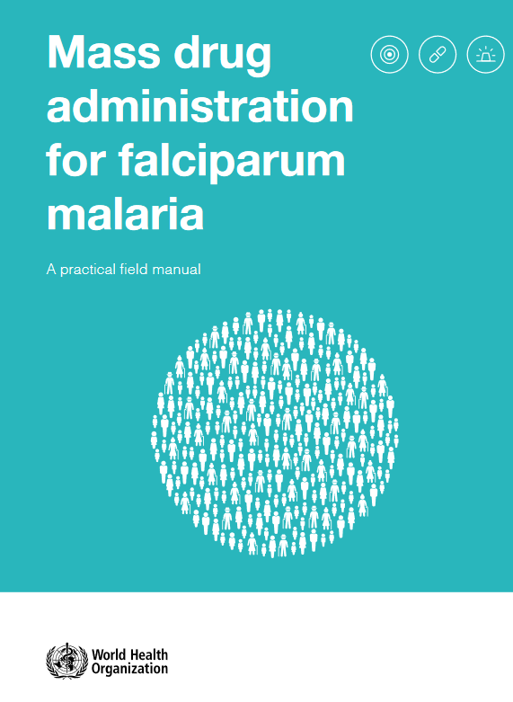
Mass antimicrobial administration
Fell out of favor in the late 1960s, after programs to prevent malaria through the large-scale distribution of a drug called chloroquine led to resistance in the malarial parasite
But opinions on mass drug administration seem to be changing.
Several African countries have reduced deaths from malaria by pre-emptively treating millions of children
Notes:
Resistance developed rapidly because thousands of people with insufficient levels of chloroquine in their systems became infected with malaria parasites. Strains that were susceptible to the drug died, but more-resilient ones multiplied. Eventually, chloroquine stopped working.
https://apps.who.int/iris/bitstream/handle/10665/259367/9789241513104-eng.pdf;jsessionid=08C1FFE11C7824F6488A535544E1A839?sequence=1

Slide 45
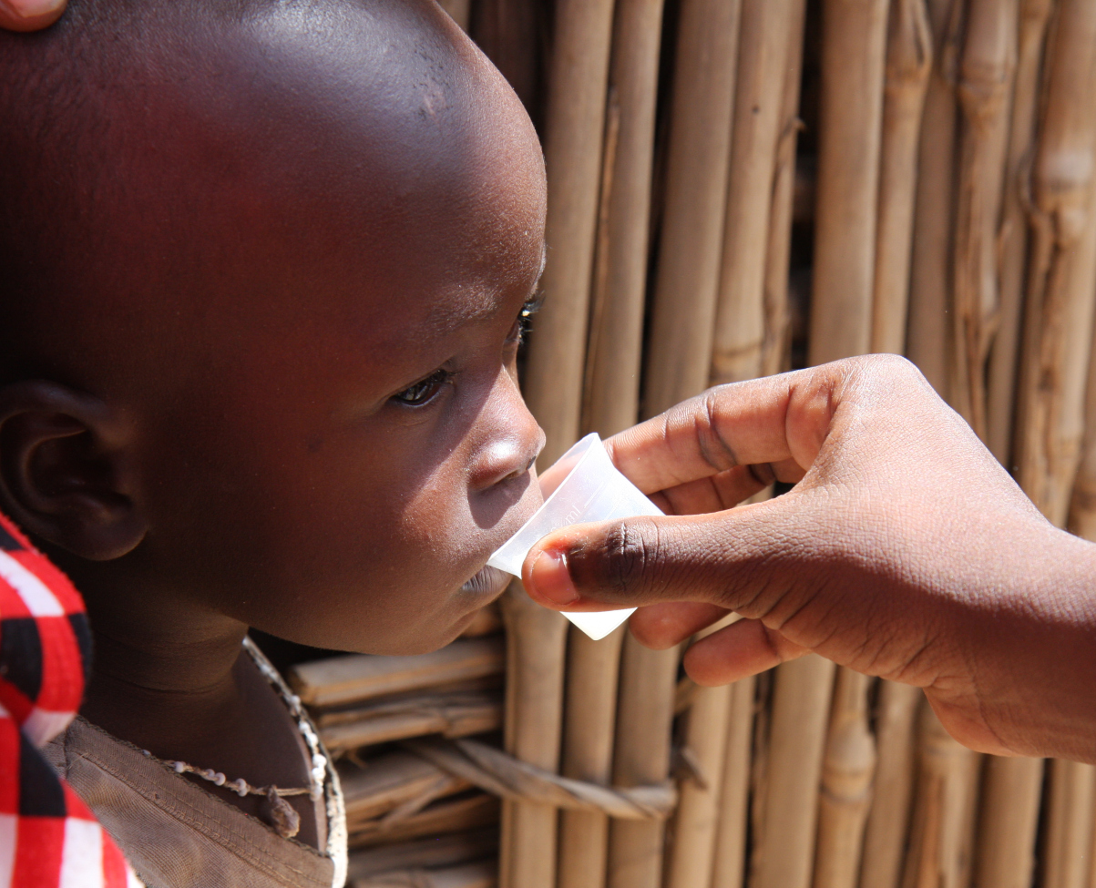
Mass drug administration of Azithromycin
A single twice-yearly dose of azithromycin given prophylactically within randomized villages to children less than 5 years of age in districts of Niger, Tanzania, and Malawi led to an 18% overall reduction in all-cause mortality in Niger compared to control villages
Notes:
Niger probably experienced the greatest benefit because it has the highest childhood mortality rate of the three countries. About 9% of children die before the age of 5 in Niger, compared with about 5% in Tanzania and Malawi. https://blog.cartercenter.org/2018/04/26/groundbreaking-study-could-revolutionize-public-health/

Slide 46
Video
Notes:
https://www.science.org/content/article/remote-pacific-island-doctor-has-revived-60-year-quest-eradicate-disfiguring-disease

Slide 47
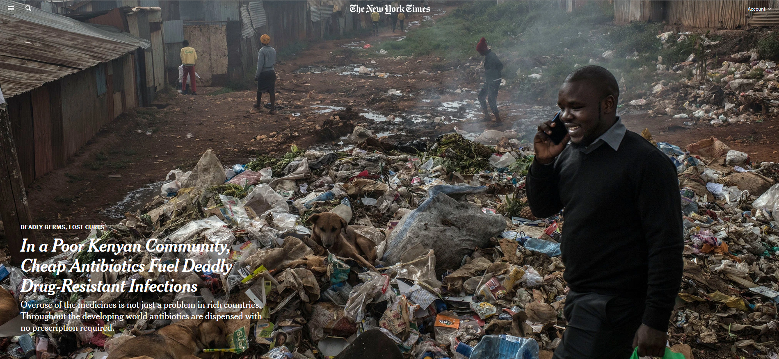
Antibiotic use in low and middle income countries:
Reading/Questions 9
Notes:
Kirchhelle, C., Atkinson, P., Broom, A., Chuengsatiansup, K., Ferreira, J. P., Fortané, N., ... & Chandler, C. I. (2020). Setting the standard: multidisciplinary hallmarks for structural, equitable and tracked antibiotic policy. BMJ Global Health, 5(9), e003091.

Slide 48
The Drug Resistance Index (DRI)
Combines use and resistance in a single index
Allows for global assessment of the relative efficacy of countries’ antibiotic therapy.
Countries with highest relative effectiveness included Sweden, Canada, and Norway
Countries with lowest relative effectiveness of antibiotic therapy, included India, Thailand, Ecuador, and Venezuela.
Notes:
Klein, E. Y., Tseng, K. K., Pant, S., & Laxminarayan, R. (2019). Tracking global trends in the effectiveness of antibiotic therapy using the Drug Resistance Index. BMJ global health, 4(2), e001315.
Evaluating trends in antibiotic resistance and communicating the results to a broad audience are important for dealing with this global threat. The Drug Resistance Index (DRI), which combines use and resistance into a single measure, was developed as an easy-to-understand measure of the effectiveness of antibiotic therapy. We demonstrate its utility in communicating differences in the effectiveness of antibiotic therapy across countries. We calculated the DRI for countries with data on antibiotic use and resistance for the disease-causing organisms considered by the WHO as priority pathogens: Acinetobacter baumannii, Escherichia coli, Klebsiella pneumoniae, Pseudomonas aeruginosa, Staphylococcus aureus, Enterococcus faecium and Enterococcus faecalis. Additionally, we estimated pooled worldwide resistance rates for these pathogens. 41 countries had the requisite data and were included in the study. Resistance and use rates were highly variable across countries, but A. baumannii resistance rates were uniformly higher, on average, than other organisms. High-income countries, particularly Sweden, Canada, Norway, Finland and Denmark, had the lowest DRIs; the countries with the highest DRIs, and therefore the lowest effectiveness of antibiotic therapy, were all low-income and middle-income countries. The DRI is a useful indicator of the problem of resistance. By combining data on antibiotic use with resistance, it captures a snapshot of how the antibiotics a country typically uses match their resistance profiles. This single measure of the effectiveness of antibiotic therapy provides a means of benchmarking against other countries and can, over time, indicate changes in drug effectiveness that can be easily communicated.

Slide 49
Inefficient antibiotic use and more resistance
Efficient antibiotic use and less resistance
DDD – defied daily doses of antibiotics, a measure of how many antibiotics are being taken.
Notes:
Klein, E. Y., Tseng, K. K., Pant, S., & Laxminarayan, R. (2019). Tracking global trends in the effectiveness of antibiotic therapy using the Drug Resistance Index. BMJ global health, 4(2), e001315.

Slide 50
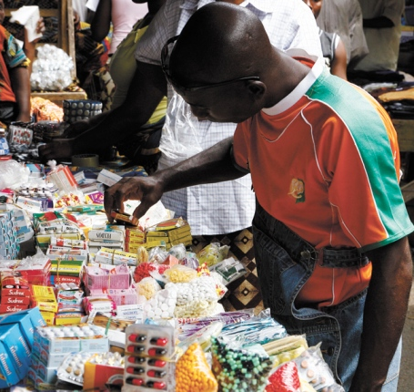
Reasons for antibiotic resistance in LMIC
Antibiotic use is largely unsupervised and underregulated
Less dependable access to key antibiotics
Quality of antibiotics is variable
No prescription is necessary in many countries.
Because doctors are unavailable or too expensive, many buy cheap antibiotics over-the counter or from street vendors
Generics from China and India can make antibiotics locally abundant in cities
Notes:
https://www.who.int/antimicrobial-resistance/interagency-coordination-group/IACG_final_report_EN.pdf?ua=1 ‘Paper tiger’ initiatives to address AMR which are not enforced, such as bans on over-the-counter sales

Slide 51
Another reason for greater resistance in low and middle income countries is the increasing use of broad-spectrum antibiotics. These target a wide number of bacteria and therefore set the stage for resistance
Notes:
http://dx.doi.org/10.1126/science.aau4679

Slide 52
LMIC have more unique interfaces at which bacteria and their resistance genes can be exchanged between humans and food animals (farms, butchers, markets, street vendors, community kitchens) and between humans and untreated water or sewage
Notes:
Nadimpalli, M. L., Stegger, M., Viau, R., Yith, V., de Lauzanne, A., Sem, N., ... & Price, L. B. (2023). Plugging the leaks: antibiotic resistance at human–animal interfaces in low‐resource settings. Frontiers in Ecology and the Environment.

Slide 53
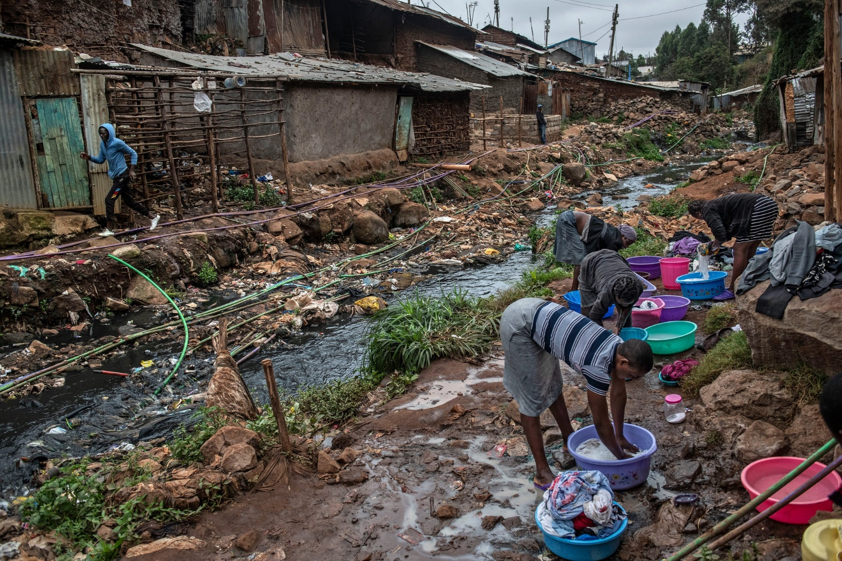
Low and middle-income countries:
Higher burden of disease due to poor water quality and inadequate sanitation
Access to antibiotics is uneven
Lower but growing per capita antibiotic use
More resistance due to how antibiotics are used
Need to reduce resistance yet also expand more closely supervised access
High income countries
Lower burden of disease
Greater per capita antibiotic use
Resistance correlates with the amount of use
Need to reduce use
Notes:
Women wash clothes just outside a river polluted with sewage and waste in the Kibera neighborhood of Nairobi, Kenya. The rate of drug-resistant infections in the community is high.
https://www.nytimes.com/2019/04/29/health/un-drug-resistance-antibiotics.html?rref=collection%2Fseriescollection%2Fdeadly-germs-lost-cures&action=click&contentCollection=health&region=stream&module=stream_unit&version=latest&contentPlacement=4&pgtype=collection

Slide 54
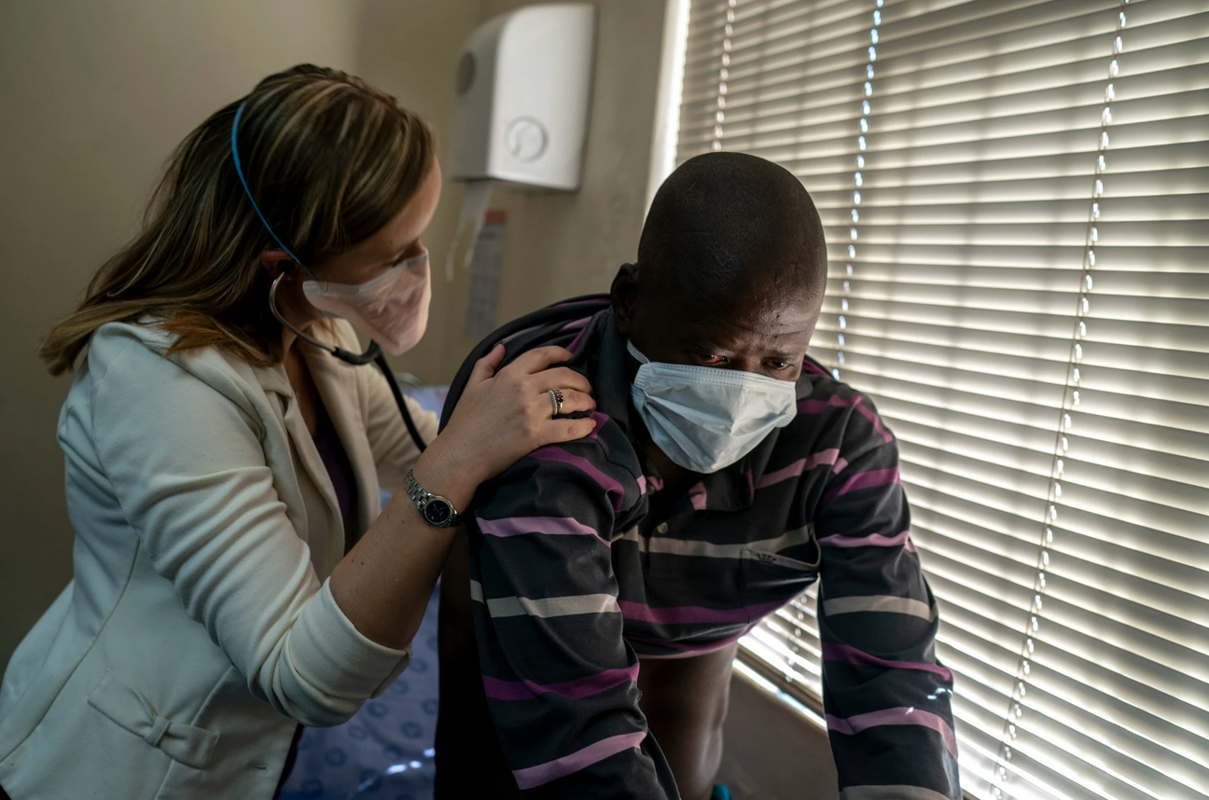
Notes:
https://www.nytimes.com/2019/08/14/health/tuberculosis-xdr-tb-cure.html

Slide 55
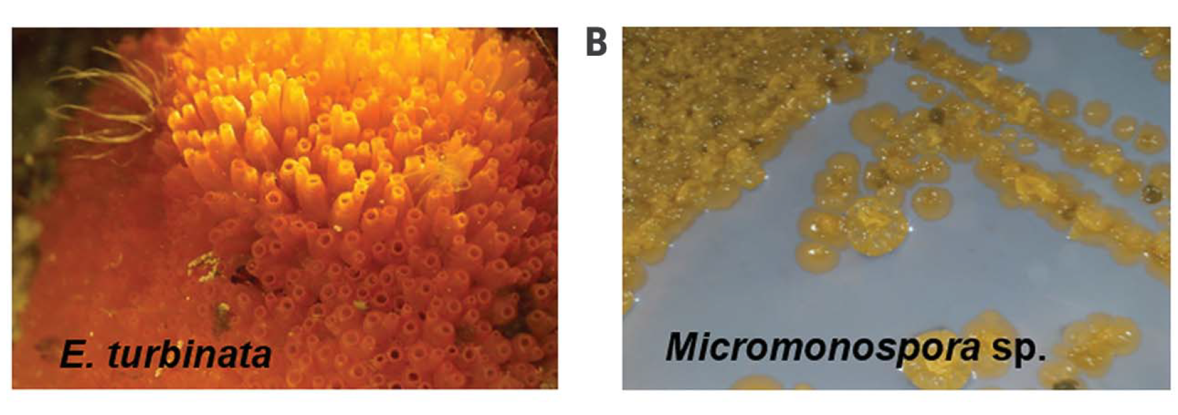
Discovery of antifungal for C. auris
Turbinmycin, a bacteria isolated from the microbiome of a sea squirt
Notes:
Many antifungals can not readily be used because of their toxicity. They are toxic to mammal cells. Topical (skin) applications are not a concern because little of these medicines go beyond the skin surface.
Zhang, F., Zhao, M., Braun, D. R., Ericksen, S. S., Piotrowski, J. S., Nelson, J., ... & Bugni, T. S. (2020). A marine microbiome antifungal targets urgent-threat drug-resistant fungi. Science, 370(6519), 974-978.

Slide 56
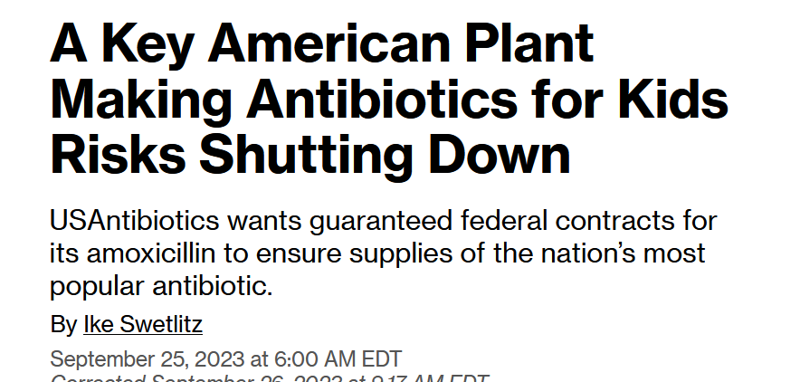
Dependence upon India and China for drugs and their precursor chemicals
Notes:
Pharmaceutical manufacturing has been outsourced to other countries. After the FDA declared amoxicillin to be in shortage in October 2022, prescriptions for it dropped more than 90% as doctors pivoted to sometimes stronger antibiotics like augmentin and cefdinir. These substitutions can result in harsher side effects for patients and can contribute to antibiotic resistance. They can also create a domino effect if the sudden shift in demand wipes out supplies of substitutes.
https://www.cnn.com/2023/09/22/health/amoxicillin-drug-shortage/index.html https://mann.usc.edu/news/blame-capitalism-why-hundreds-of-decades-old-yet-vital-drugs-are-nearly-impossible-to-find/

Slide 57
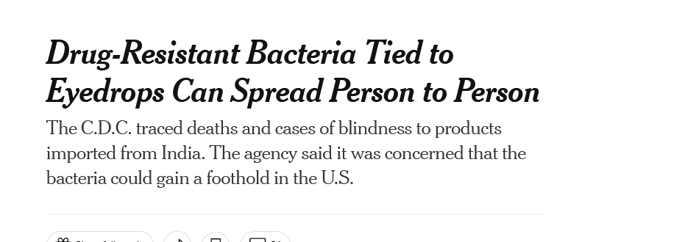
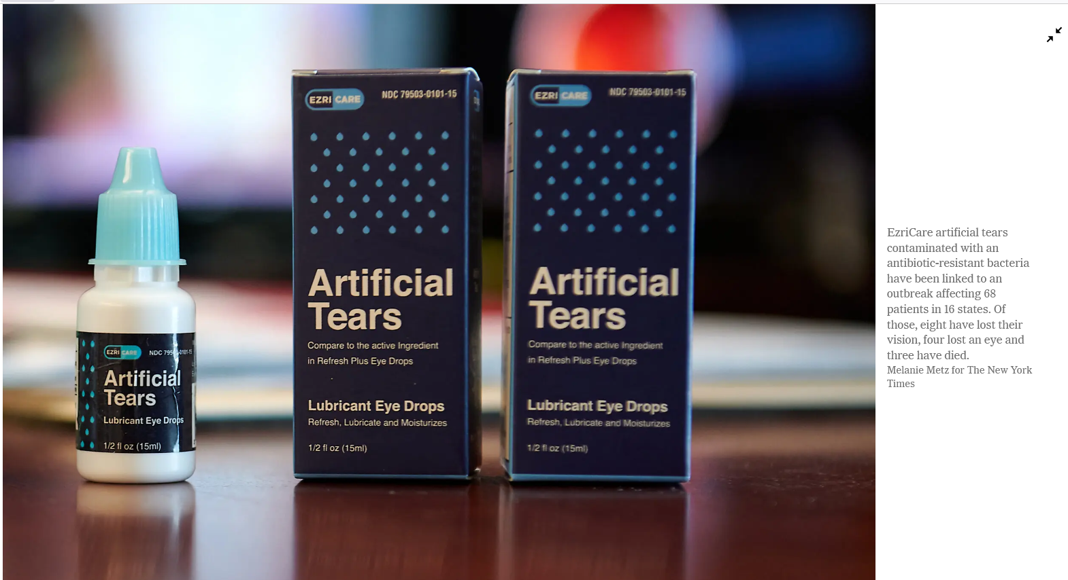
Reading/Questions 9
Notes:
https://www.nytimes.com/2023/04/03/health/superbug-eyedrops-blindness.html

