Slide 1
A guide to the slides
Linked content has a blue border around the image. See the next slide for an example.
Required readings for questions are identified by:
Make sure to watch linked videos, as marked by:
Additional explanations as well as references for the content are provided in the notes section below the slides
Slides and readings are also posted at: http://www.uky.edu/~jast239/courses/global/globalhealth.html
Tests cover the material in the Powerpoint slides and any content or explanations presented in lecture.
Reading/Questions
Video
Notes:
This is the notes section, additional content is provided here.

Slide 2
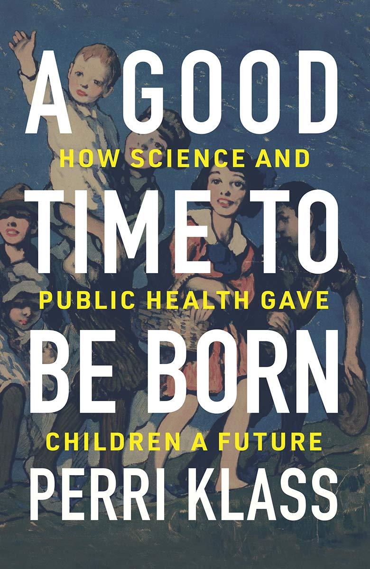
The context and challenges of global health
Notes:
https://www.nytimes.com/2019/12/28/opinion/sunday/2019-best-year-poverty.html
https://www.nytimes.com/2020/10/13/books/review/a-good-time-to-be-born-perri-klass.html 90% global literacy rate in 2019 Some global health scholars and journalists think too much emphasis is given to the tragedy and not the gains and improvements.

Slide 3
Large gains in health and poverty reduction in last three decades
Large reductions in the mortality of children under 5 (down more than 50%)
Many of these gains achieved through global cooperation among national governments, private foundations, and non-governmental organizations (NGOs)
Global initiatives like the United Nations Sustainable Development Goals and UN Millennium Development Goals have also contributed
Notes:
https://www.nytimes.com/2019/12/28/opinion/sunday/2019-best-year-poverty.html

Slide 4
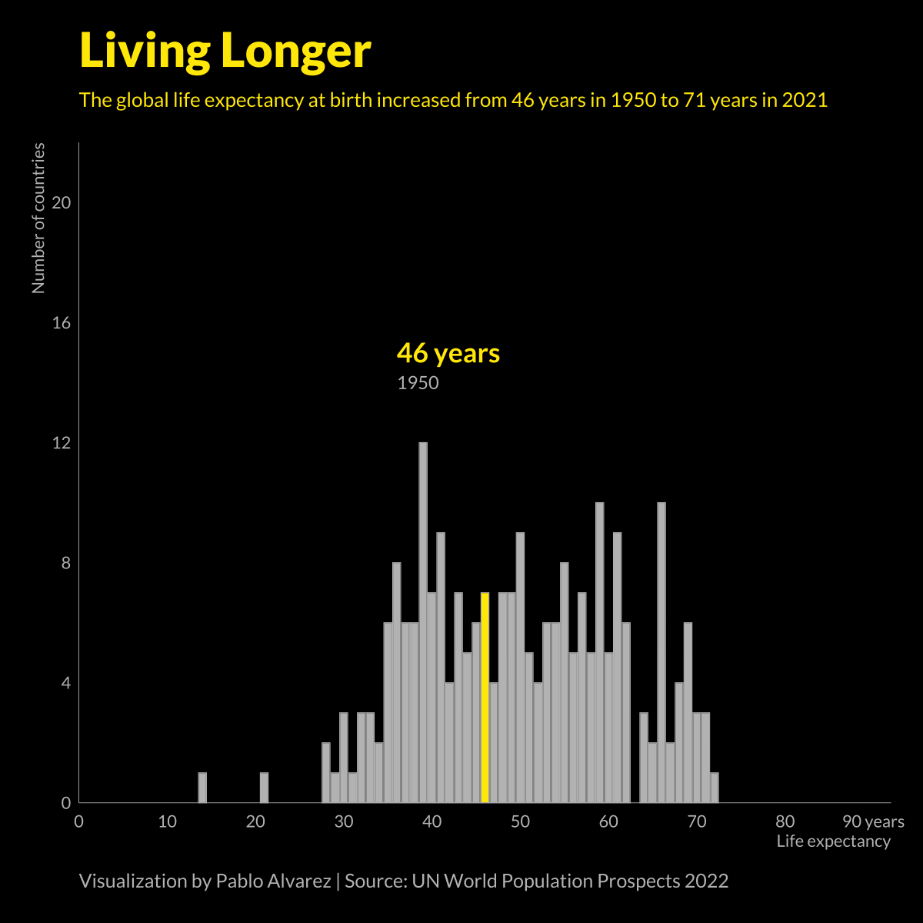
Halving of deaths of women at childbirth
Significant decreases in death from malaria
Turnaround in the HIV-AIDS epidemic
Increased life expectancy in nearly every country
Although Covid created a small reversal, it is minor compared to gains of past few decades
Notes:
https://www.nytimes.com/2013/09/29/opinion/sunday/kristof-a-way-of-life-is-ending-thank-goodness.html
https://www.nytimes.com/2019/02/04/upshot/giant-strides-in-world-health-but-it-could-be-so-much-better.html https://ourworldindata.org/life-expectancy-globally

Slide 5
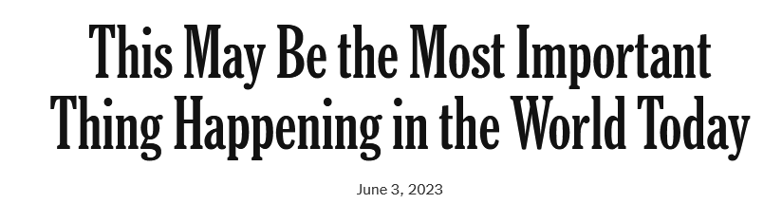
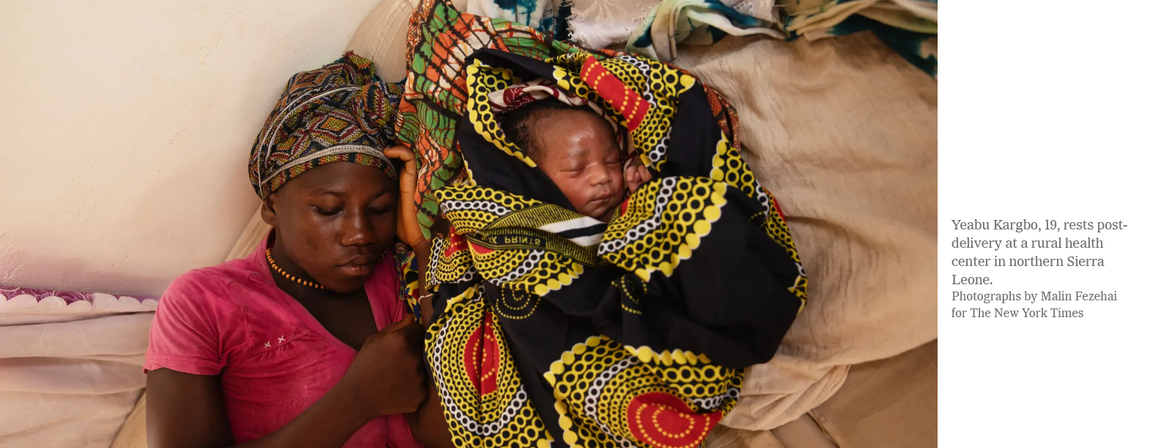
Reading/Questions 1
Notes:
https://www.nytimes.com/2023/06/03/opinion/sierra-leone-progress-health-children.html

Slide 6
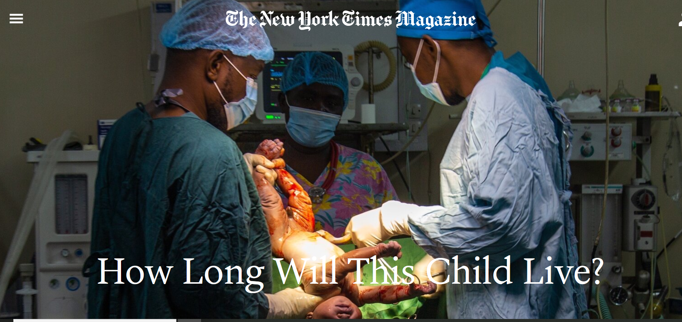
Reading/Questions 1
Notes:
This reading best viewed in Google Chrome.
No one can say what the future holds for Crispin Brake, born at the Bwaila District Hospital in Malawi. But he and the other babies born in Malawi this year have an expected life span of more than 65 years — an unimaginable outlook just two decades ago, when the nation’s life expectancy was only 44

Slide 7
Reading/Questions 1
Notes:
https://www.nytimes.com/interactive/2023/07/16/world/world-demographics.html

Slide 8
However, stark differences in global health remain
Notes:
Global incidence and mortality of cervical cancer, an easily detected, preventable, treatable cancer. Despite global gains in health and poverty reduction, there are stark contrasts in the incidence of some diseases among countries. ASR: age-standardized rate
Data from WHO and https://acsjournals.onlinelibrary.wiley.com/doi/10.3322/caac.21492

Slide 9
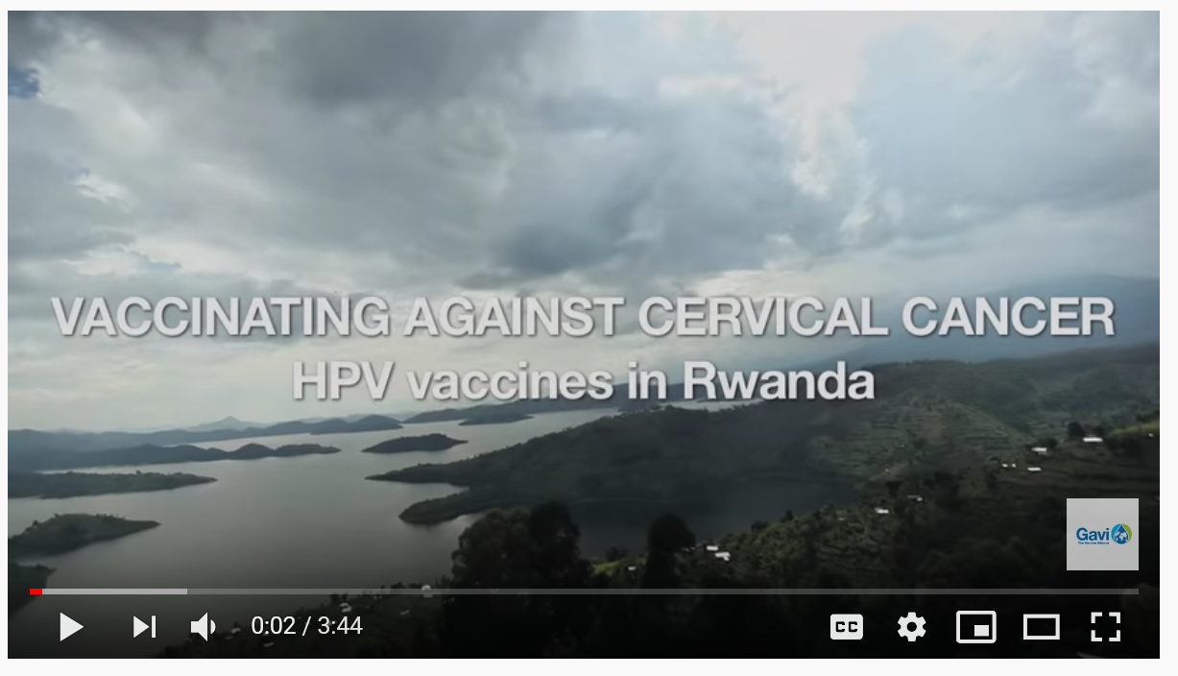
Global and continental averages can obscure differences among nations
Video
Notes:
HPV is the human papilloma virus. It causes cervical cancer. A vaccine is available to inoculate women and prevent cervical cancer. Even though overall incidence of cervical cancer is high in Africa, some countries, like Rwanda. have been successful with HPV vaccination programs and stand apart from their neighbors.

Slide 10
Health inequities can develop within a country even over very small distances.
Click on this image and type in your hometown to see how life expectancy varies there
Notes:
Even with a country, county, or city, health disparities can be extreme. On the map above, life expectancy can vary by several years as a result of local conditions of poverty, unemployment, and exposure to environmental hazards like air pollution. In Lexington, life expectancy can be expected to vary by up to 15 years (85 versus 70) depending upon your neighborhood. https://www.cdc.gov/nchs/nvss/usaleep/usaleep.html#life-expectancy https://qz.com/1462111/map-what-story-does-your-neighborhoods-life-expectancy-tell/ This map shows “period life expectancy,” which is the average age at death for somebody who lived their whole life through the current conditions of the neighborhood

Slide 11
How is health defined in the context of global health?
According to the World Health Organization, health is a state of complete physical, mental, and social well-being not merely the absence of disease
A measurement of health must include not only an indication of changes in the frequency and severity of diseases but also an estimation of quality of life
According to WHO, quality of life denotes an individual's perception of their position in life in the context of the culture and value systems in which they live

Slide 12
The World Health Organization Quality of Life Survey
Notes:
Health is much more than the absence of disease, it is also the quality of life, as perceived from within one’s culture and value systems. In recent years there has been a broadening of focus in the measurement of health, beyond traditional health indicators such as mortality and morbidity to include measures of the impact of disease and impairment on daily activities and behavior as well as perceived health measures..

Slide 14
What sets global health apart from other disciplines of medicine?
Goal is to have just and equitable distribution of risk of suffering from disease and of tools to lessen or prevent it
Encompasses the ‘resocializing’ disciplines and the social production of knowledge
Takes a multi-scalar view of health
Involves health delivery
Considers the larger evolutionary, ecological, and environmental contexts of disease
Places health and quality of life within the context of globalization

Slide 15
1. Seeks a just and equitable distribution of risk
Notes:
https://ourworldindata.org/uploads/2013/05/ourworldindata_life-expectancy-cumulative-over-200-years.png https://ourworldindata.org/health-meta Everyone today is, on average, better off in terms of living longer, but the gap between the extremes of life expectancy has widened.

Slide 16
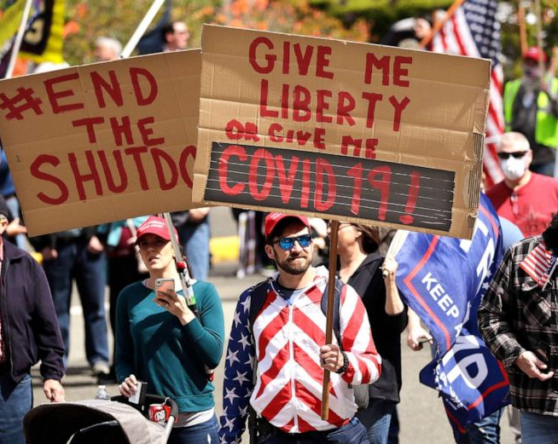
2. Encompasses the ‘resocializing’ disciplines
Global health takes a ‘biosocial’ perspective, it ‘resocializes’ medicine
The resocializing disciplines include anthropology, sociology, history and geography.
Aim is to put more culture and the context of individuals back into medicine
Notes:
The photo conveys how the health issue of the Covid-19 pandemic is also cultural and political and not likely to solved solely be medical innovations and technology. Culture matters, and it matters in the way in which differs around the globe.

Slide 17
Example: the translational gap
Randomized controlled trials are useful for developing new drugs – they work and are indispensable.
Some medicines and treatments, however, can potentially be greatly dependent upon an individual’s context – the intersection of their biology with their life conditions and experiences
For example, even among genetically homogeneous Berber people of Morocco, urban and rural communities had large differences in what genes were expressed due to different diets, exposure to microbes, and environmental stresses
Notes:
Another example of the resocializing disciplines. Translational gap here means the distance spanning the objective identification of a drug or treatment and how it might actually work (or not) when you start deploying it in many different contexts of where and how people live
More social knowledge about how people live, and how they live differently, matter for medicine, even medicine that we consider scientific and built on principals of genetics, biochemistry, and physiology. We need to record biographical narratives for individual patients to bridge the ‘translational gap’

Slide 18
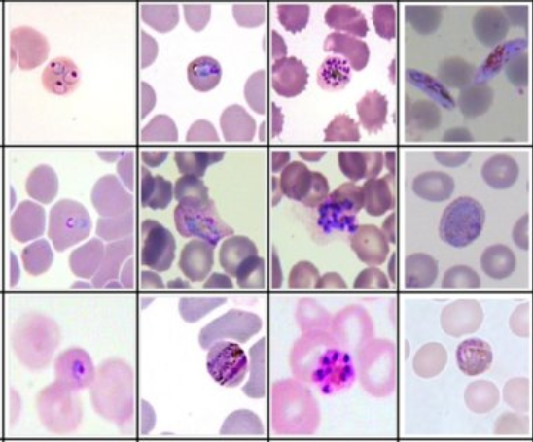
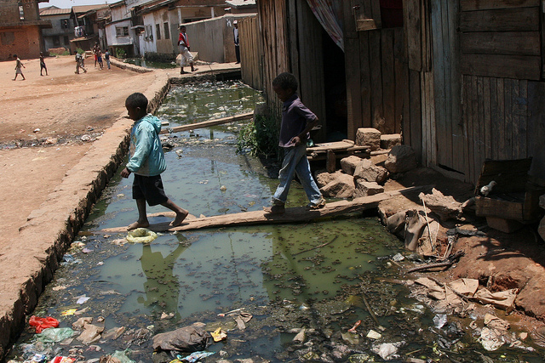
3. Global health is multi-scalar
Health is shaped by processes occurring at multiple scales.
The scales we choose shape how we attribute causality and designate a response
For example, clinicians (medical doctors and nurses), epidemiologists, and planners associate causes of disease and ways to counter it that is scale dependent
Notes:
The scales of clinicians: Malarial parasites (Plasmodium) in human red blood cells (top photo). Artemisinin, a drug prescribed to treat and prevent malaria (center). Epidemiologists and planners might address the causes of malaria and its treatment at a larger scale, such as the open canal carrying waste water in Madagascar (bottom)

Slide 19
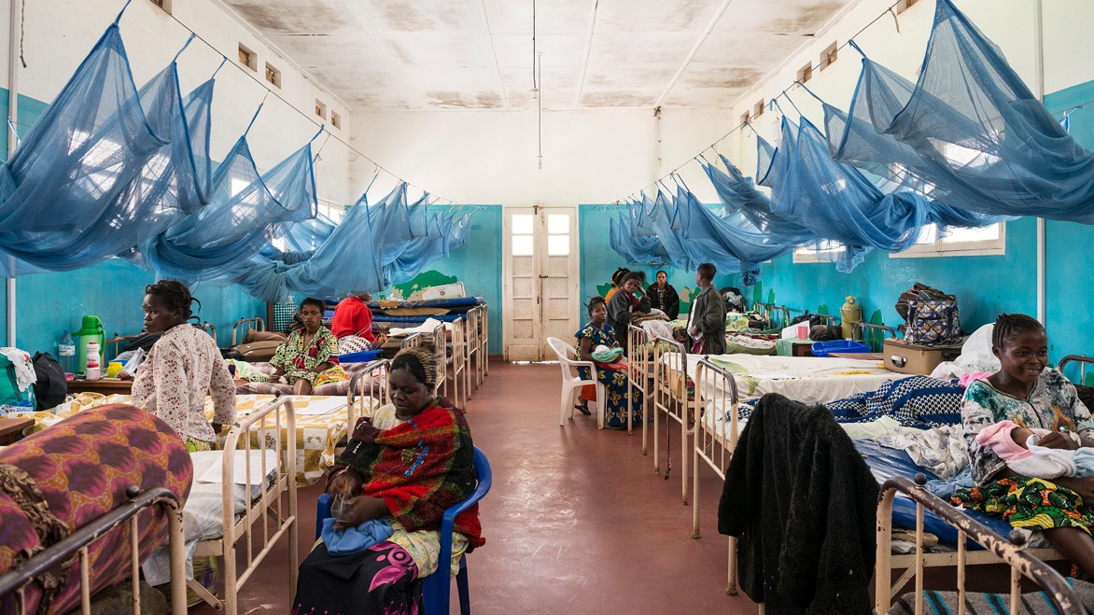
Notes:
Women in a hospital ward with malaria bed nets in Bunia, the Democratic Republic of the Congo.

Slide 20
Malaria as a multi-scalar process
In clinical practice, the cause of malaria is the protozoal parasite Plasmodium and the treatments of choice are artemisinin-based therapies
Epidemiologists, public health planners, and environmental scientists might focus on standing water that needs draining. Insecticides and mosquito nets would be their recommendation.
Ethnographers, economists, historians, and geographers may lean toward causes related to unequal and unjust access to housing that puts some people at greater risk of exposure to mosquitos
Notes:
Malaria has causal relationships that span scales – it is not just one particular scale that is important, but all of them. You could include the spatial and temporal domains that define ecology and evolution, as the co-evolution of the malarial parasite, mosquitoes, and the human immune system are also a key part of understanding how to lessen the burden of malaria.

Slide 21
4. Involves health delivery
Reading/Questions 1
Notes:
https://www.nytimes.com/2023/04/21/world/europe/belgium-geel-psychiatric-care.html

Slide 22
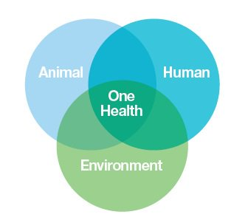
Considers the evolutionary, ecological, and environmental contexts of disease
Notes:
Recent textbooks on evolutionary medicine.
One Health is the idea that the health of people is connected to the health of animals and the environment. It prioritizes the recognition of the interconnection between people, animals, plants, and their shared environment. A One Health approach is important because 6 out of every 10 infectious diseases in humans are spread from animals. For example, Covid is not just about humans. It is also about the bat populations that harbor the virus.
https://www.cdc.gov/onehealth/index.html

Slide 23
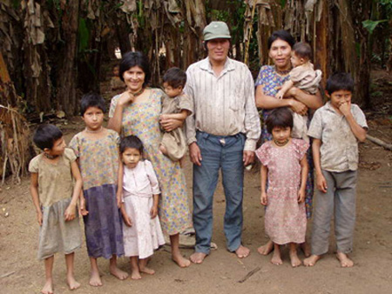
Evolution, ecology, and environment shape global health
The Tsimane, a remote people living in the Bolivian rain forest. They experience very low levels of atherosclerosis (hardening of the arteries) because of frequent exposures to infectious agents. Their immune systems do not readily trigger the inflammation that underlies the stages of atherosclerosis because of these constant environmental exposures.
Notes:
Heart disease has an evolutionary explanation
While it’s hard to recreate ancient human life and find a causative link, the Tsimane, (in photo) a remote people living in the Bolivian rain forest, provide a sneak peek. The Tsimane, who have minimal atherosclerosis, are under relentless assault by infectious organisms. Ancient humans predating the Tsimane were under even greater siege. The only human beings who could survive were those with a vigilant immune system, always on the lookout for foreign invaders.
In response to infections, the immune system unleashes a powerful response called inflammation. In extreme forms, such as after catching the flu, inflammation can set the body ablaze and is our best means to keep us sterile and free of infection. Inflammation also plays an important role when someone gets hurt and the barrier between the body and the world outside is breached. Inflammatory cells unleash a cascade that results in blood clots forming to quickly plug nicks and cuts. As species have evolved, they have also developed stronger mechanisms of clot formation.
After the institution of better public hygiene, our great guardian, inflammation, no longer busy with outsiders, turned its menacing guns inward. Inflammation is responsible for every important step in the story of atherosclerosis, from its birth as fatty streaks in the lining of the blood vessels, to the dramatic eruption of cholesterol-laden plaques in blood vessels supplying the heart, brain and legs, that activate our clotting cascade, leading to blockages that cause heart attacks, strokes and blood-choked limbs needing amputation. The Tsimane, a remote people living in the Bolivian rain forest. They experience very low levels of atherosclerosis (hardening of the arteries) because of frequent exposures to infectious agents. Their immune systems do not readily trigger the inflammation that underlies all the stages of atherosclerosis because of these constant environmental exposures.
https://www.nytimes.com/2019/08/06/opinion/evolution-heart-disease.html?smid=nytcore-ios-share http://tsimane.anth.ucsb.edu/tsimaneinfo.html
https://doi.org/10.1016/S0140-6736(17)30752-3
Kaplan, H., Thompson, R. C., Trumble, B. C., Wann, L. S., Allam, A. H., Beheim, B., ... & Rodriguez, D. E. (2017). Coronary atherosclerosis in indigenous South American Tsimane: a cross-sectional cohort study. The Lancet, 389(10080), 1730-1739.

Slide 24
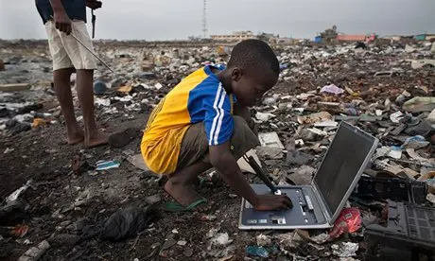
Places health and quality of life within the context of globalization
Notes:
What is the idea of health on a globally connected planet? What you do here may have health implications for some one far away for one. Using a computer impacts the health of others far from where you live, through the industries that make the computers and their components, as well as the waste streams that recycle our discarded devices. https://www.theguardian.com/world/2013/dec/14/ghana-dump-electronic-waste-not-good-place-live

Slide 25
Globalization 1.0 and 2.0
Non-human life globalized and colonized the planet billions of years ago, as have many other life forms (Globalization 1.0)
Misleading to consider only recent (post World War 2) human element of globalization to understand global health.
Even modern-appearing humans have been dispersing around the globe for tens of thousands of years (Globalization 2.0)
Embodied globalization refers to the physical mobility of human bodies across the world. It is the oldest formation of globalization and endures today in the contemporary movements of refugees, migrants, workers, and tourists.

Slide 26
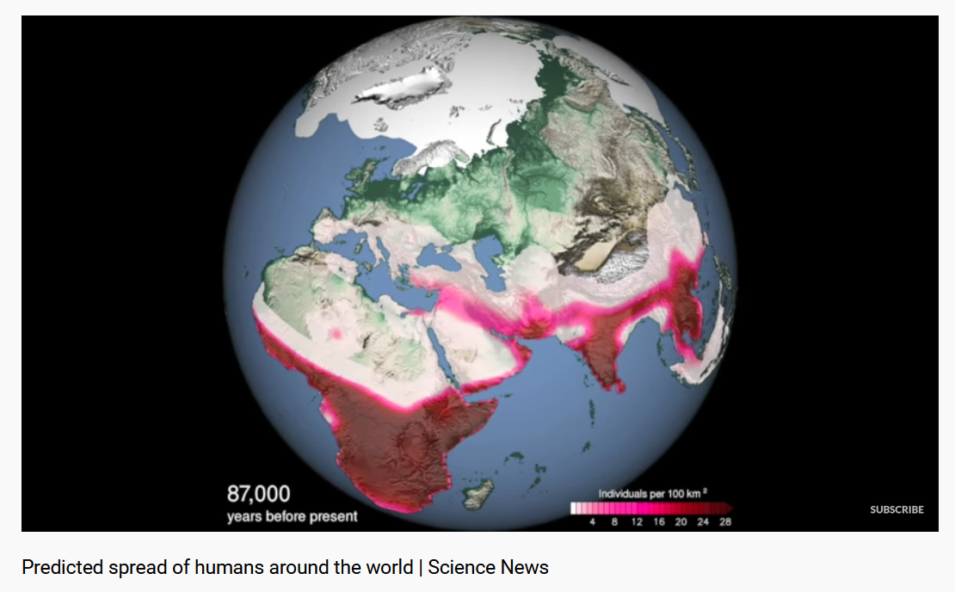
Video
Notes:
Globalization 2.0

Slide 27
Globalization 3.0
The expansion of scope, volume, velocity and impacts of international trade, investments, communications, and migrations beginning with the Columbian Exchange
Increasing integration of economies and societies
What happens in one place affects many other places
Globalization is not simply economic: also simultaneously political, cultural, and spatial

Slide 28
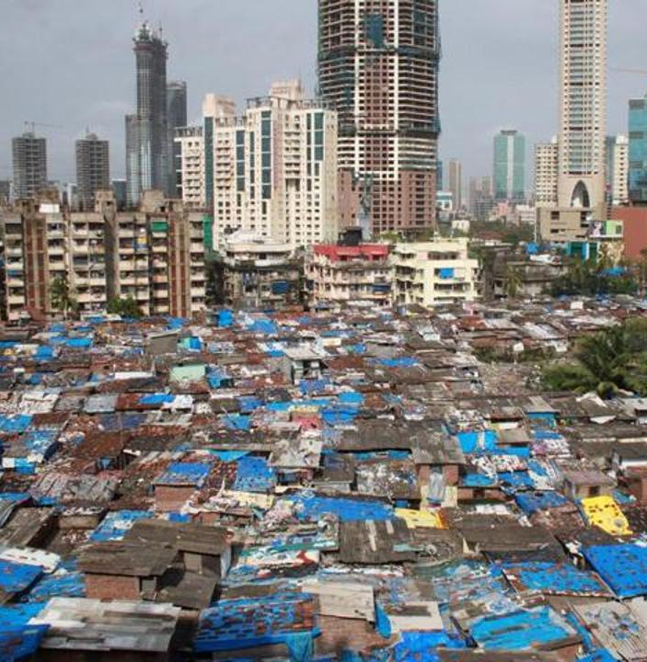
Globalization’s impacts are not uniform
Globalized economies are among the wealthiest with high rates of literacy and longer life spans
But globalization also produces poverty and new health issues
Displacement of local producers with outsourcing of jobs (as with factory workers in the US)
Exploitation of low wage labor in other countries – sending the jobs to where people will work for less.
Notes:
Not entirely valid to say that globalization raises standards of living everywhere and creates wealth.
Displacement of workers have health impacts, for example, part of the rise of the opioid epidemic in the US were the layoffs of thousand of workers in factories and manufacturing when jobs went overseas because of lower wages that could be paid there.

Slide 29
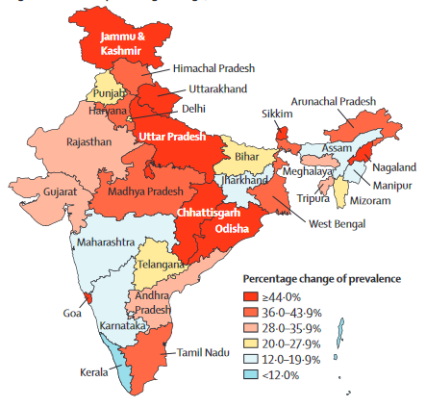
Infectious (communicable) diseases may decrease in globalized countries yet they may also have increases in non-communicable diseases of affluence (such as Type 2 diabetes in India, right, from 1990-2016) as countries develop economically and enter the global economy and experience shifts in the types of foods consumed
Notes:
Percentage change of prevalence of diabetes (1990-2016)
https://www.thelancet.com/pdfs/journals/langlo/PIIS2214-109X(18)30387-5.pdf
As part of the epidemiological transition from communicable diseases to non-communicable diseases, the burden of diabetes and its risk factors has been increasing in India. Globalization, and urbanization have altered traditional diets and increased rates of obesity and diabetes.

Slide 30
Glocalization
It is a simplification to assume globalization is just homogenization (the McWorld metaphor, everywhere the same)
Impacts of globalization are often mediated through national, regional, and local cultures, practices and policies
Glocalization implies that the global and the local can become intertwined, as in the glocalization of McDonalds in India
Notes:
In India cow is considered as a holy animal. McDonald’s localized its menu to suit Indian taste buds by providing food items ranging from McAloo tikki burgers which consisted of vegetables like mashed potato patty Obesity and Type 2 diabetes have a common biological basis among all humans. However, we can’t assume that the factors that initiate lifestyle diseases like Type 2 diabetes are exactly the same everywhere, and a single strategy to prevent and treat it would likewise work the same everywhere. Circumstances of diet, access to health care, level of physical activity required at work, and the population genetics that determine susceptibility will vary from place to place and culture to culture. The epidemic of obesity and diabetes is global, but it is also local, or glocalized.

Slide 31
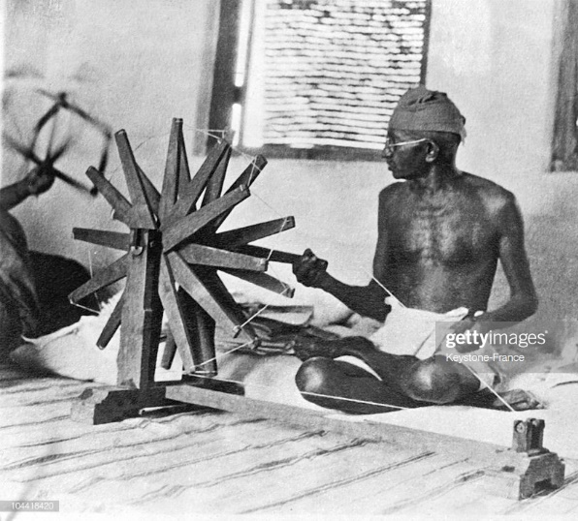
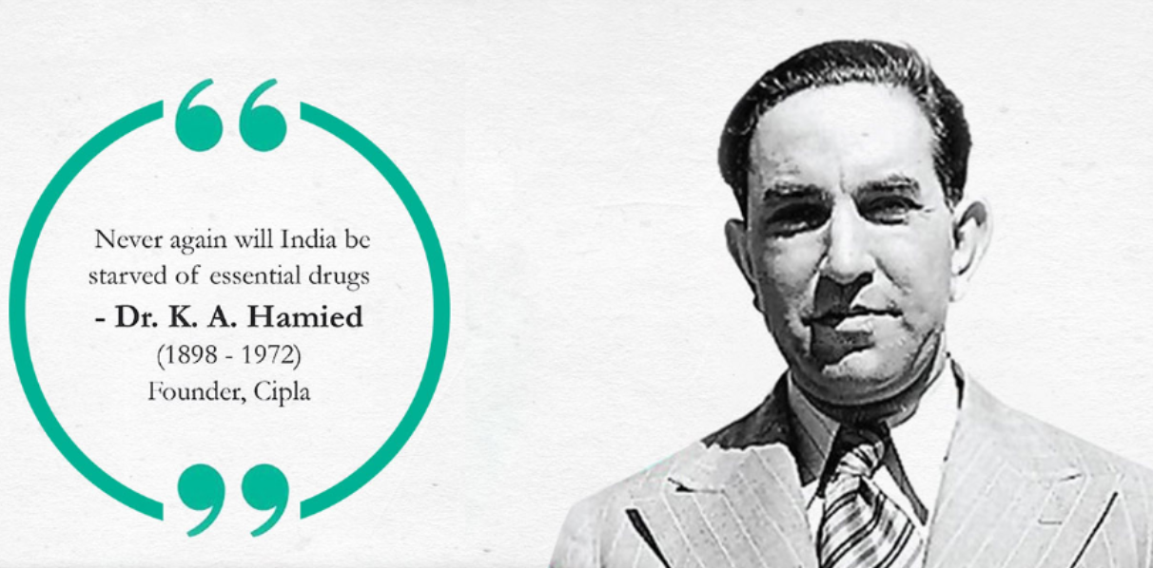
Generic drugs: a story of globalization
In 1939, Gandhi urged a fellow Indian nationalist to manufacture copies of Western drugs to bring affordable medicine to India as a way to free India from British rule
This was the birth of the generic drug industry.
The company, Cipla, was soon supplying India and other countries with low-cost drugs by the 1950s
Notes:
Gandhi (top) fought a non-violent protest against British colonial rule in India and Africa.
Under Indian law, only manufacturing processes, not the products themselves, are covered by patents. So Indian drug companies can boldly reverse-engineer best-selling drugs and sell copies cheaply.
https://www.cipla.com/about-us/our-history

Slide 32
1980’s: imports of generic drugs begin to increase in the US in response to prices charged by big pharmaceutical companies in the US.
Early 2000s, Cipla revealed it would sell an HIV antiviral drug at far lower price than ‘Big Pharma’, and Gandhi’s dream had gone global
In US and other developed countries 70-90% of medications are now generic and originate in other countries
China and India produce many of the world’s generics as well as the active pharmaceutical ingredients (APIs) necessary to manufacture them
Notes:
Cipla has a long tradition of serving poor countries. In 2001, its chairman, Yusuf K. Hamied, shocked the global pharmaceutical industry by offering a triple-therapy AIDS cocktail for $350 a year to Doctors Without Borders at a time Western companies were charging $12,000. Today it is one of the companies offering low cost cancer drugs to African nations. India and China make many of our generic drugs. However, the management practices of these manufacturing facilities has come under scrutiny as reports of contaminated and ineffective drugs become more common.
Facilities that produce generic drugs in India and China for consumption in other countries are making perfect data(i.e. doctoring the books, making it look like their production facilities are up to standards) not perfect drugs. Cutbacks in the funding of the FDA in the US has made inspecting of these facilities in India and China less frequent and effective. Payoffs and corruption are a larger influence in India. The lack of consumer protection laws are weaker in China. How these drugs become tainted is not uniform globally, but reflects the national and local management practices and governance.

Slide 33
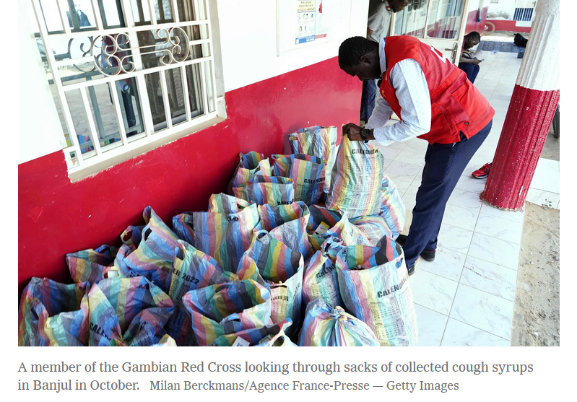
Reading/Questions 1
Notes:
https://www.nytimes.com/2022/11/03/world/asia/india-gambia-cough-syrup.html

Slide 34
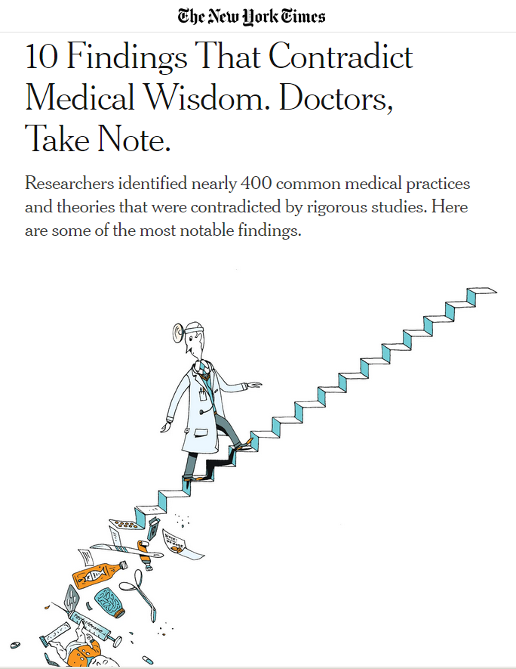
TRUE OR FALSE Step counters and calorie trackers help you lose weight. For a torn knee meniscus, physical therapy or surgery are equally effective.
Ginkgo biloba protects against memory loss and dementia.
A lifelike doll carried around by teenage girls can deter pregnancies.
Fish oil reduces heart disease.

Slide 35
Step counters and calorie trackers help you lose weight. (FALSE)
For a torn knee meniscus, physical therapy or surgery are equally effective. (TRUE)
Ginkgo biloba protects against memory loss and dementia. (FALSE)
A lifelike doll carried around by teenage girls can deter pregnancies. (FALSE)
Fish oil reduces heart disease (FALSE)
Step counters and calorie trackers help you lose weight. For a torn knee meniscus, physical therapy or surgery are equally effective.
Ginkgo biloba protects against memory loss and dementia.
A lifelike doll carried around by teenage girls can deter pregnancies.
Fish oil reduces heart disease.
Notes:
How did you answer these questions? Why did you answer them the way you did? You answered them the way you did because your knowledge is socially produced. Of course, some of you may be up on the scientific literature and you knew the right answers. But for many of us, the knowledge we had to answer these questions was assembled from bits and pieces of things you read here and there, an experience you might have had, and from what you hear people in authority say.

Slide 36
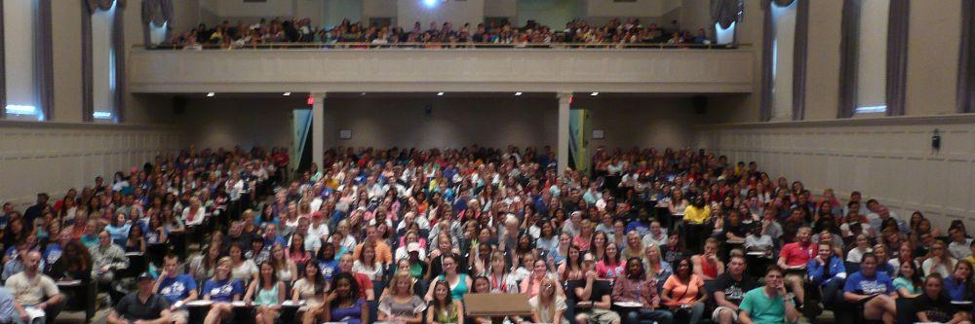
Knowledge is filtered through:
Lived experiences
Education
Social networks
Gender
Internet use
Age
Economic status
Social class
Political ideology
Language
Ethnicity/culture
Mental and physical state
Notes:
A full house of GEO 261 students in Memorial Hall on the UK campus. Your knowledge is socially produced, everyone’s is. This doesn’t mean there is no objectivity to knowledge. Science does indeed illuminate stable meanings and interpretations of the world. But that doesn’t mean science exists outside of human subjectivity. What scientific ideas you are exposed to, or how you view scientific knowledge can be a consequence of choices that reflect where and when you were born and how you were raised, and the choices that you prioritize – any and all of the above factors listed on this slide.

Slide 37
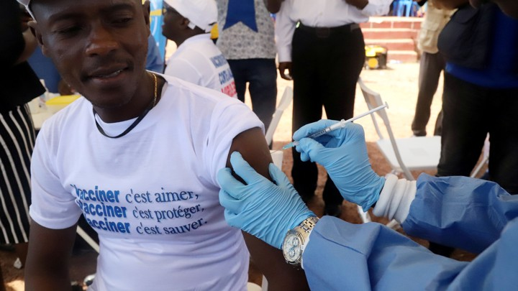
Knowledge is social
What counts as meaningful knowledge arises from its context.
For example, the effectiveness of the science that goes into the creation of a vaccine is limited without an understanding of the context in which it is deployed.
The social context of some groups of people in the Congo may make them fearful of aid workers and those in positions of power.
This kind of socially produced knowledge must be taken into account to slow the spread of Ebola.
Notes:
https://www.theatlantic.com/health/archive/2018/05/vaccines-alone-wont-beat-ebola/561128/
The social, cultural, economic, and historical context of public health measures in the Democratic Republic of Congo will determine the effectiveness of the vaccine.
A vaccine may seem straightforward to you, but to some it may be more complicated. Distrust of authorities for example can lead to the rejection of vaccines. Masks with Covid-19 are another example. Even though there is objective evidence that masks limit exposures, the social context and situation of an individual determines the degree they will wear them. Strictly ‘scientific’ facts of knowledge will not be enough to fully address any large public health issue. Global health places more emphasis on how knowledge is socially produced and how it intersects with scientific and technological perspectives on health

Slide 38
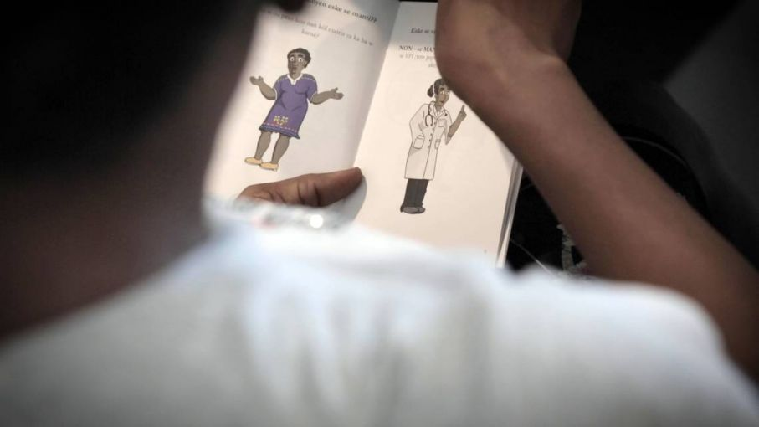
Reading/Questions 1
Notes:
Another example of how socially produced knowledge matters for the development of successful health campaigns. The scientific basis for reducing cervical cancer exists – routine pap smears and vaccination for HPV. Yet to address cervical cancer requires understanding how scientific knowledge and practice takes on social meaning. It’s not just the availability of screening and vaccinations, but also cultural and social contexts that go with it.
https://pulitzercenter.org/reporting/how-ums-little-haiti-cervical-cancer-research-overcomes-haitian-cultural-barriers

Slide 39
Socially-produced knowledge arises though discourse
Discourses are the stories we hear and tell, the signs and stories were here on the internet, the habits of thinking we practice, and the rules that circumscribe and enforce certain behaviors.
Discourses encompasses education, social networks, political views, your surroundings
Notes:
Santa Claus exists through discourse. Belief in his existence arises from discourse – advertising in December, television specials, stories our parents tell us when we are children, Santa at the mall, mailboxes for letters to Santa, putting out cookies for Santa. All of these things socially produce the existence of Santa (well, at least for a while)

Slide 40
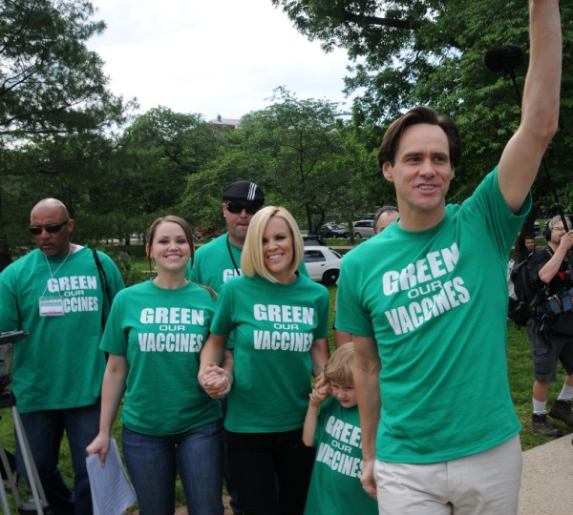
An example of discourses in global health: anti-vaxxers
Antivaxxers tell stories that they broadcast online and communicate directly to friends and neighbors.
They have bumper stickers, wear antivaxx t-shirts, and hype celebrity endorsements.
They articulate arguments that appeal to emotion
Just say no to vaccines to guard your freedom.
Refusing vaccines is healthier, i.e., more natural or ‘green’
Vaccines cause autism
Vaccines are just a way of sterilizing the poor
Notes:
Anti-vaxx attitudes are everywhere – not just in the US. Some of the highest rates of the world can be found in Western Europe.

Slide 41
To understand the state of socially-produced knowledge one must:
Investigate the social organization that permits the definers to do their defining.
Perform discourse analysis to get at what arguments and circumstances produce local knowledge
Identify how socially-produced knowledge is often shaped by power relations and authority, which can take several forms
Knowing how knowledge is produced makes it easier to change it

Slide 42
Rational-legal authority
Unparalleled in its ability to administer.
Unlike traditional or charismatic, authority is more distributed in an institution instead of a single individual.
What counts as evidence and precedent requires formal or legal standards with this type of authority.
Rational-legal authority enacted through the practices of:
Biopower – the power to regulate life, to decide who lives, who dies, and how one lives
Governmentality – the administration of power through bureaucracy
Structural violence

Slide 43
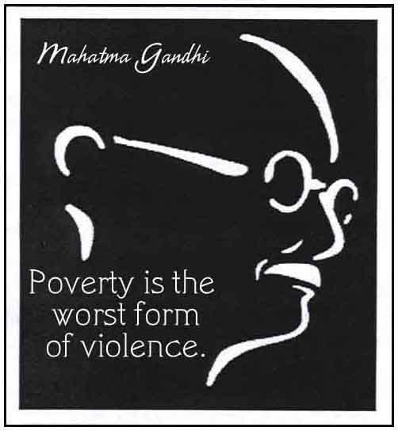
Structural violence
A form of indirect violence wherein social structure or a social institution can bring physical, mental, or financial harm through its potential to exercise biopower
Structural violence is embedded in social structures that have become normalized by institutions and experience
It is not overt, direct violence, but a slow violence that causes harm through the way society operates
Notes:
Farmer, P. E., Nizeye, B., Stulac, S., & Keshavjee, S. (2006). Structural violence and clinical medicine. PLoS Med, 3(10), e449.
https://doi.org/10.1371/journal.pmed.0030449 Mosquito-borne diseases like malaria and dengue, for example, can be conceived of as structural violence. Systems of governance and planning persist that result in people living in neighborhoods with inadequate stormwater drainage and exposure to malaria-transmitting mosquitoes.

Slide 44
Structural violence in the American medical system
Video/Questions 1
Notes:
https://www.nytimes.com/2023/01/04/opinion/covid-flu-rsv-children-hospitals.html

Slide 45
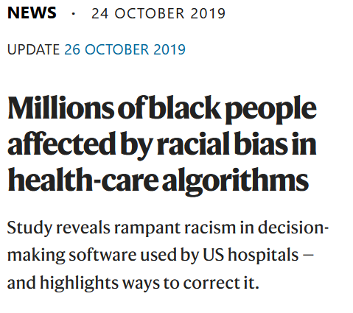
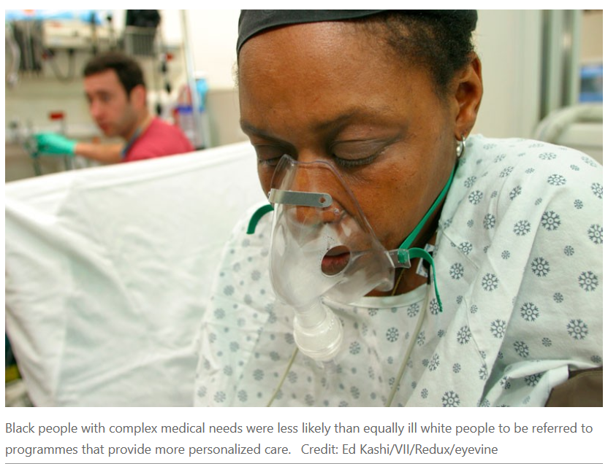
Health care algorithms have the potential for structural violence
‘Big data’ approaches in medicine use machine learning (artificial intelligence) to guide decisions about treatment
These are software programs that aim to make the best medical decisions based on large volumes of patient records and observations
Program are written by programmers who may not be racist or have bad intentions
However, not all nuances of health can be represented in the code of these software programs
Health care algorithms were shown to be less likely to refer black people than white people who were equally sick to programs that aimed to improve care for patients with complex medical needs
Notes:
Structural violence is also quiet and not always easy to perceive. Ledford, H. (2019). Millions of black people affected by racial bias in health-care algorithms. Nature, 574(7780), 608-609. 10.1038/d41586-019-03228-6

Slide 46
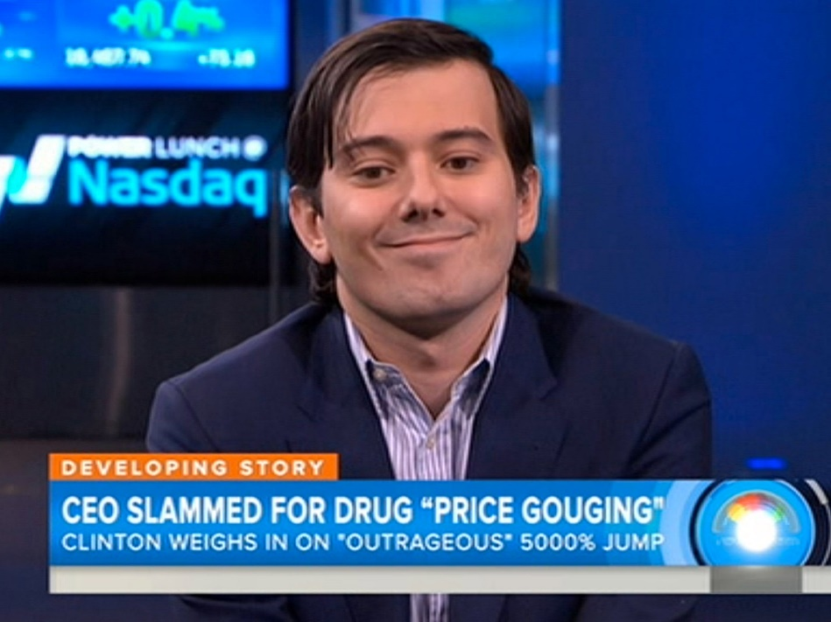
Structural violence: medical pricing
High prices charged by some drug companies can be seen as predatory in that essential medicines may be too costly, even with insurance.
Prices for many pharmaceuticals can be high for poor living in other countries.
Developing countries have several international trade law provisions to help them buy life-saving medicines at affordable prices for public health needs, particularly for HIV/AIDS.
Notes:
Scroll down for the video
In 2015, the CEO of Turing Pharmaceuticals, increased the price of a recently acquired drug from $13.50 to $750 a pill. The medicine, Daraprim, is used to combat parasites, especially for patients with immune-system deficiencies like HIV. https://www.who.int/bulletin/volumes/84/5/news10506/en/
https://www.carnegiecouncil.org/publications/ethics_onfilm/0011

Slide 47
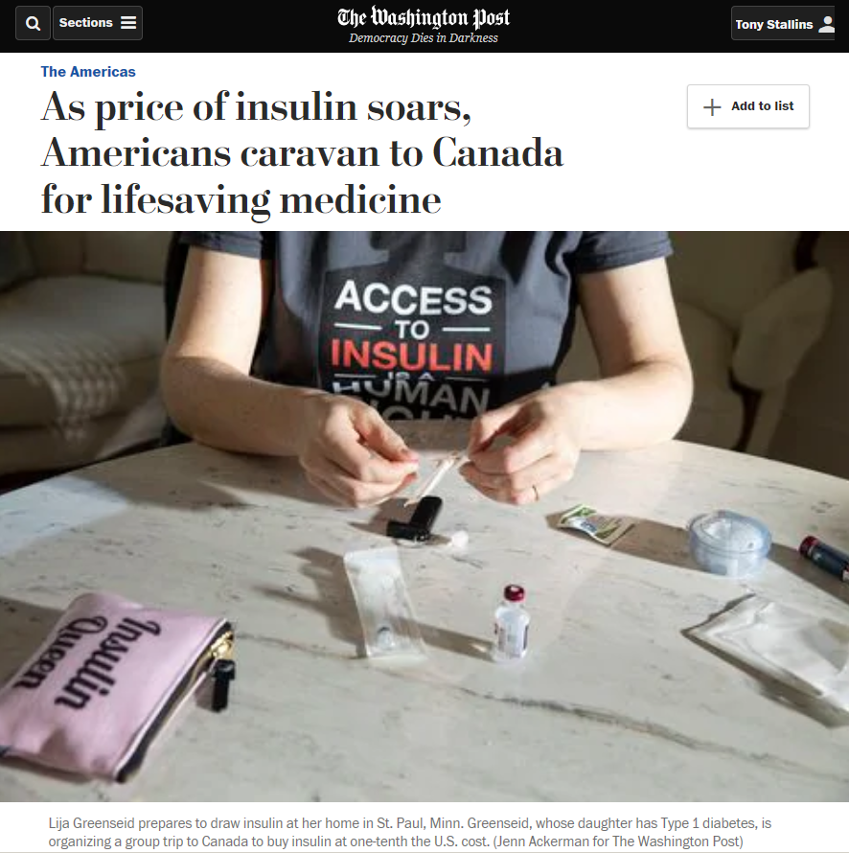
But only a few countries are using these trade law provisions because these programs are complex and hard to decipher and can end up as a barrier for those with fewer resources to pursue them.
Political pressures to accept higher priced drugs may even be applied.
Even in the US, access to some drugs at an affordable price is often not possible, even for the insured. If programs exist to obtain them for less, they too may also have a labyrinthine application process.
E
Notes:
Political pressures to accept higher priced drugs may even be applied. For example, a country in a position of power may call for trade policies to force a country to accept higher prices for drugs. “We won’t import your products if you don’t accept our high drug prices” Many other drugs are often purchased at much lower prices in Canada.
https://www.who.int/bulletin/volumes/84/5/news10506/en/
https://www.carnegiecouncil.org/publications/ethics_onfilm/0011
https://www.washingtonpost.com/world/the_americas/as-price-of-insulin-soars-americans-caravan-to-canada-for-lifesaving-medicine/2019/06/14/0a272fb6-8217-11e9-9a67-a687ca99fb3d_story.html?noredirect=on

Slide 48
High prices for procedures can also be a form of structural violence – surgeries end up being postponed, or conditions ignored by the ill or injured until they become far more serious
However, MRIs, plastic surgery, joint replacements, and dental procedures, as well as extensive physical exams can be bought overseas.
Medical tourism is the industry that caters to global travelers seeking medical care at a discount in another country
Notes:
An example of globalization – medical tourism.

Slide 49
Companies differ in their policies toward making drugs available at discounts. Development of new drugs can be an expensive endeavor, and incentives to do so need to be in place. Yet large companies can also make moves to produce large quantities of medicines cheaply and make them available at low costs.
Notes:
Corporatization does not automatically correlate to pervasive ‘evil’ and harm. Large corporations and institutions can do things that small entities cannot. Structural violence emerges as a by product of size and the way in which aspects of a large system can work against the goals of the institution in unexpected ways. Structural violence is in this sense a systems issue in addition to one of power, economics, and politics.

Slide 50
The origins of global health: colonialism and colonial medicine
Colonial power expanded rapidly in the 15th century with the advent of navigational innovations.
Lands and people in Africa, Central and South America, and the Caribbean fell under the rule of colonial powers emanating from England, France, Germany, Italy, Spain and Portugal, and the U.S. up through the middle of the 20th century
Many of the attributes of global health and medicine today were unintended consequences of the colonial era
.
Notes:
HIV-AIDS, SARS make it seem that global health perspectives are new. But their global focus are not entirely novel. The origins of global health are in colonial era medicine.

Slide 51
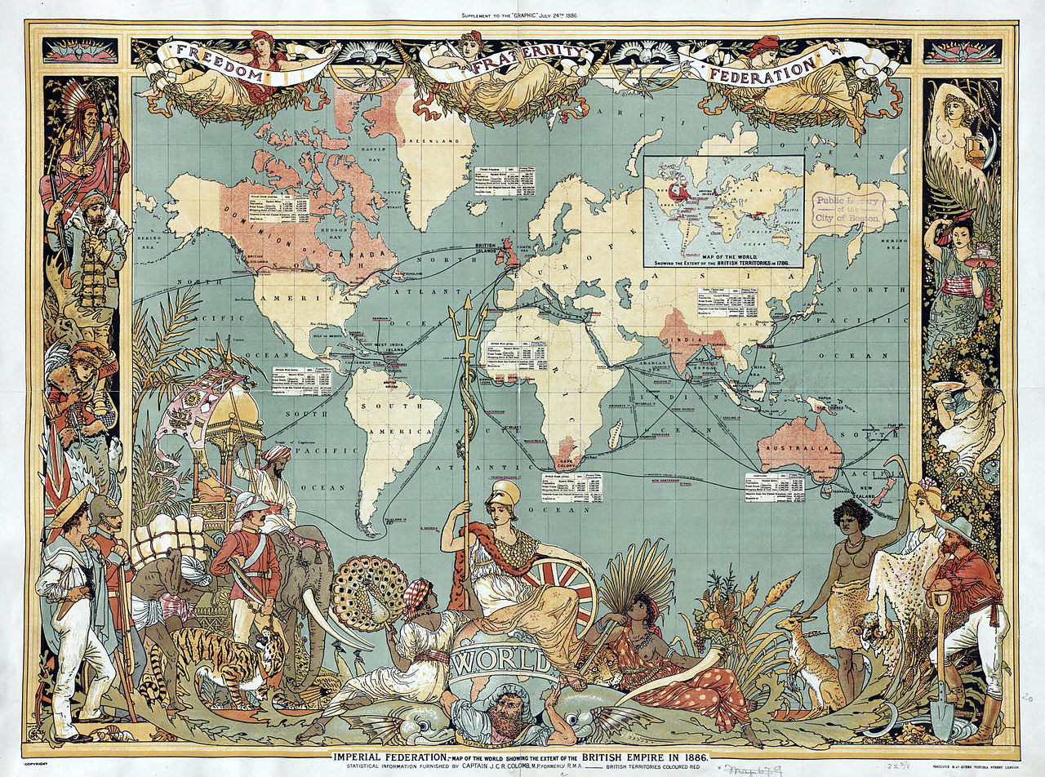
The Columbian Exchange
A global movement not only of people, but also of animals, plants, and pathogens as European countries colonized the world
But it brought with it an exchange of disease-causing bacteria and viruses, as well as animals that served as a source of zoonotic diseases

Slide 52
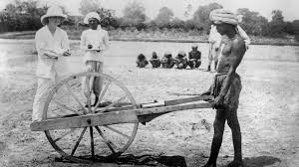
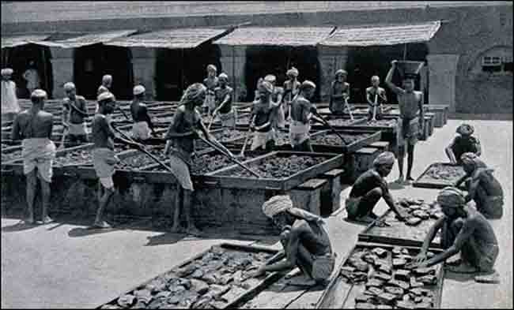
Europeans brought measles, smallpox, and tuberculosis which killed millions in the Americas
However, the indigenous people were also seen as a commodity, whose health was necessary in order to profit from their labor.
This spurred research into how to maintain the health of laborers as well as the civil servants serving their colonial masters.

Slide 53
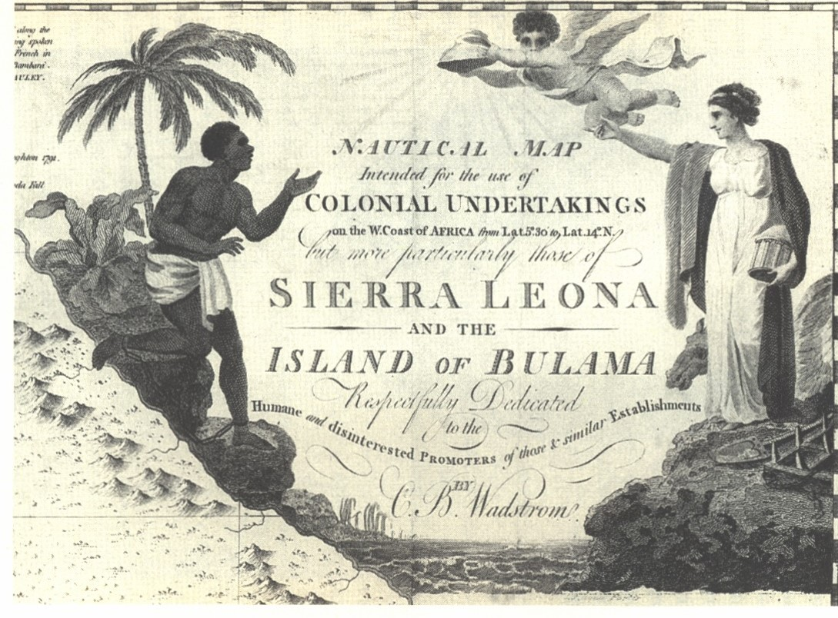
European encountered new tropical diseases as they travelled around the world.
Mortality along the Gold Coast of West Africa was 300-700 per 1000 colonizers in early 1800's.
This spurred research into the causes of disease among the colonizers.
.

Slide 54
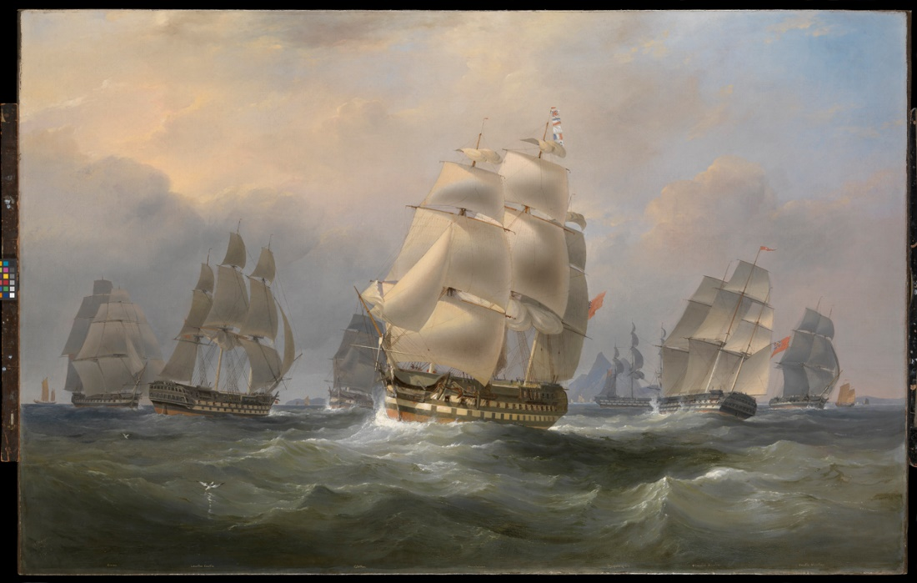
Disease traveled back to Europe from colonized countries in Asia and Africa.
Indian Ocean shipping lanes of the British Empire in the first decades of the 20th century provided new routes for the transmission of cholera.
Cholera that began in India could impact the manufacturing towns of France and England
Thus the health of others in distant land was realized as being important for the health of others far away.
.

Slide 55
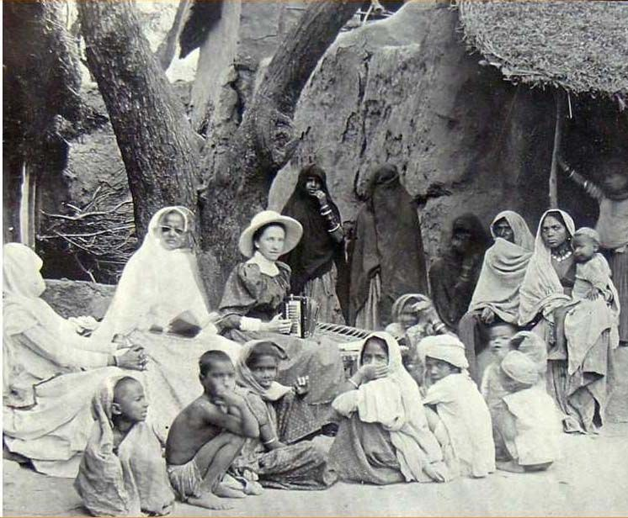
Medicine was used as a pretext for colonial rule
The constructive imperialism argument
Holds that one of the aims of colonization should be medical.
Colonialism could be presented as beneficial, it helped the locals.
However, colonial medicine became an agent of penetration and pacification.
Often medical care was limited to those who agreed to be ruled or who provided labor and other services
Notes:
During the colonial period, the practice of “Doctory” or Western medicine gained momentum in India, buoyed with the support of the British as well as Western-educated Indians. Many Indians were trained in Western medicine and employed by the administration as “native doctors” in the medical service for Indians, and the superior medical service by and large comprised Europeans.
When these people lived outside of the major colonial cities, the first field-based public health programs were begun.
Saini, A. (2016). Physicians of colonial India (1757–1900). Journal of Family Medicine and Primary Care, 5(3), 528.
Photo of woman missionary in India in 1900s
This paternalistic stance – we will take care of you – was common for many colonial relationships

Slide 56
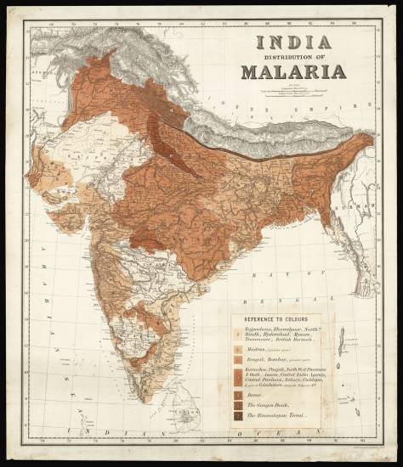
Medicine was intertwined with colonial rule
The infrastructure of imperialism argument
Medical care and doctors were needed to keep the military and administrative officers of the ruling power healthy, as well as the ruled citizenry who labored in the service of empire.
Medical care was essential to maintaining power of the colonize
Notes:
https://www.crouchrarebooks.com/maps/view/distribution-of-malaria-in-british-india
Map is from 1880 – malaria was a serious illness for the British in India and in many of their tropical colonies
Formation of the London School of Tropical Medicine in 1899 was meant to foster this kind of imperial medicine.

Slide 57
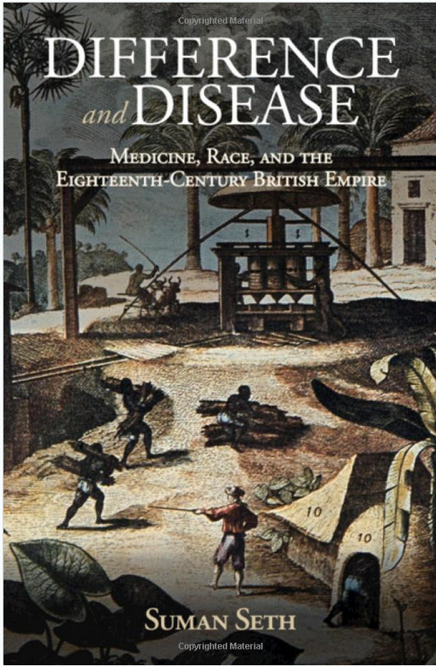
Discourses about the health of the colonized were used to justify the actions of the colonizers
British mortality rates in 1835 were 12:1000 in the United Kingdom, but 500:1000 when stationed in west Africa.
Africans did not have these high mortality rates
This gave way to the idea that the native bodies were better suited or ‘seasoned’ to labor in these hot climates, in Africa and in the slave trade in the Americas.
Slavery was also justified by the socially-constructed idea that Africans did not feel pain like white people
Notes:
https://news.cornell.edu/stories/2018/10/acclimate-or-die-book-examines-disease-british-empire

Slide 58
Notes:
https://www.nytimes.com/interactive/2019/08/14/magazine/racial-differences-doctors.html?smid=nytcore-ios-share The pain myth still exists: https://www.nytimes.com/2019/11/25/upshot/opioid-epidemic-blacks.html

Slide 59
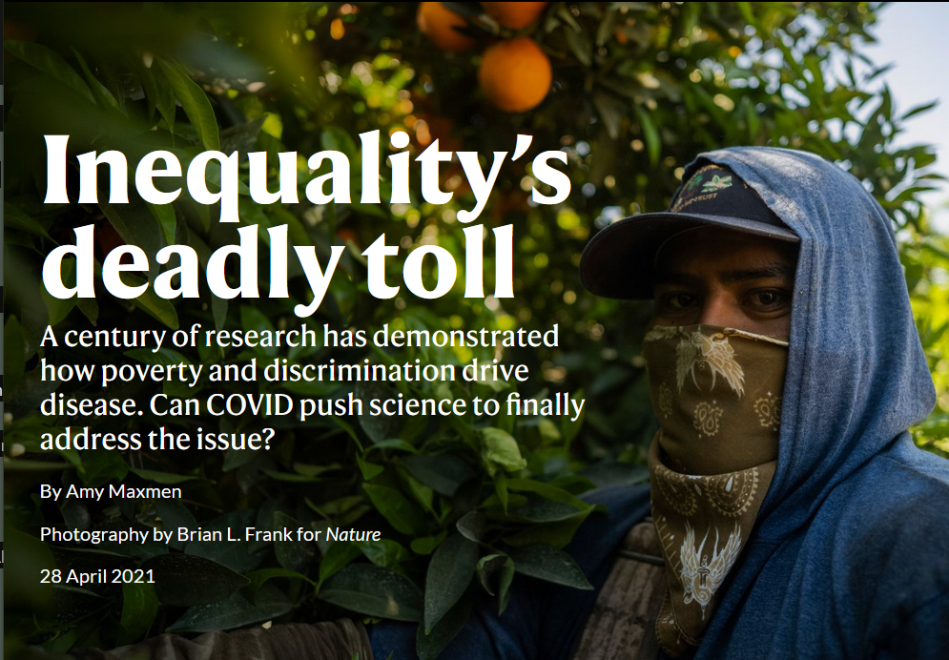
Myths about physical racial difference hide social origins of disease
“African-Americans have higher rates of hypertension”
They do. But it is not simply race and biology
African-Americans have higher rates of hypertension due to the way in which racism marginalizes social groups and creates disparities in access to lives and livelihoods with healthy foods, time for exercise, and a reduction in stress.
Notes:
https://www.nature.com/immersive/d41586-021-00943-x/index.html Social and cultural factors rather than physical racial differences account for health differences Hypertension is high blood pressure

Slide 60
What are some historical events leading to the emergence of global health?
Through expeditions in Egypt and India, the microbiologist Robert Koch isolated Vibrio cholerae in 1883, proving that heat and humidity were not barriers to tropical colonization – many of the time thought it was the ‘bad air’ of the tropics that caused cholera.
The still relatively new idea of germ theory developed by Pasteur also implied that addressing the problem of germs would allow new tropical lands to be made more accessible.
Formation of the London School of Tropical Medicine in 1899 was meant to foster this kind of imperial medicine. This is another way in which global health had its origins in colonialism.
Notes:
Imperial medicine aimed to make it safe for Europeans to travel to other parts of the world.

Slide 61
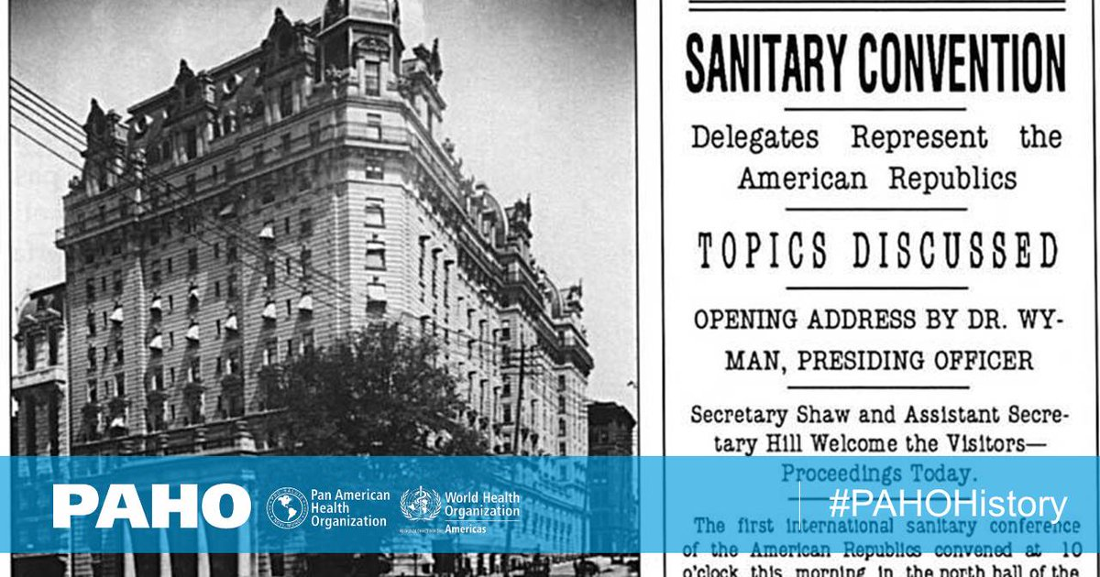
The Pan American Sanitary Bureau (the Pan American Health Organization today) was formed to coordinate the ultimately successful international effort to control yellow fever during the construction of the canal (1903-1914)

Slide 62
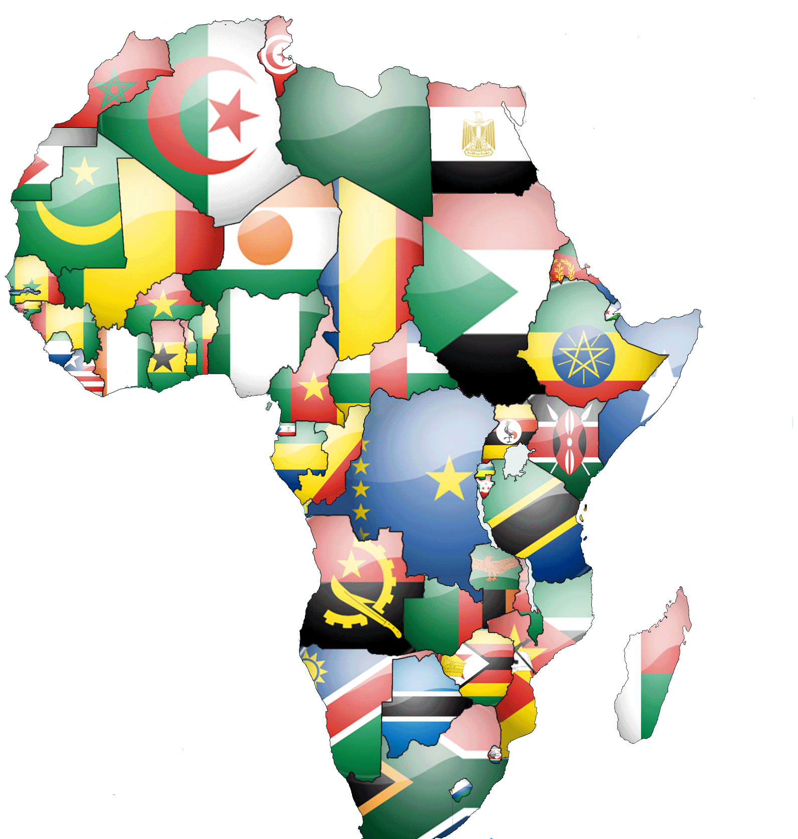
After World War 2, colonial power weakens throughout Asia and Africa and the era of colonial revolutions and self-determination begins.
Global political and economic power becomes focused on contrasts in development among wealthier and more recently formed and poorer countries
Internationalization of health along issues of health equity became more important under the newly formed United Nations in 1945

Slide 63
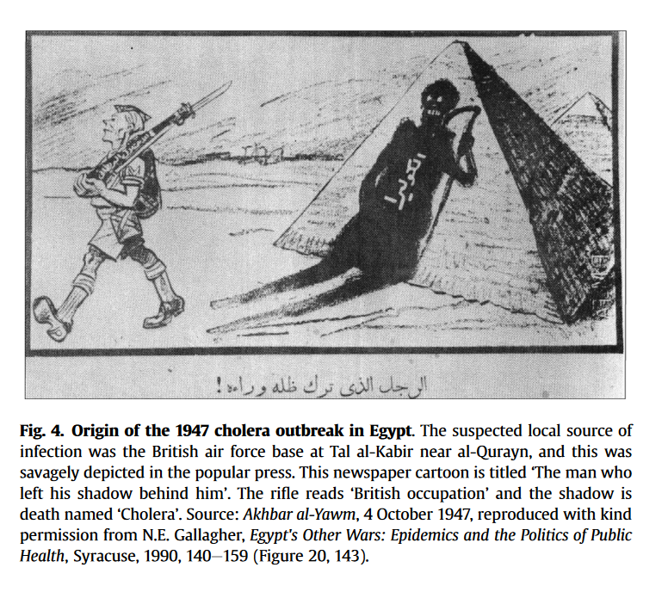
Planning for the World Health Organization began at a 1945 meeting of the United Nations
WHO originally promoted by Brazil and China (not the U.S. or Europe)
WHO aimed to have global membership
1947 saw the first crisis of WHO, a cholera outbreak in Egypt. WHO succeeded in preventing neighboring countries from imposing damaging quarantines; provided rehydration treatments, deployed sanitation measures and vaccination.
Notes:
Smallman-Raynor, M., & Cliff, A. D. (2016). The diffusion of cholera in Egypt, 1947: a time-space analysis of one of the largest single outbreaks in the twentieth century. Journal of Historical Geography, 54, 24-37.

Slide 64
With greater international legitimacy, WHO was formally established in 1948.
1955 WHO proposed global eradication of malaria, a disease most common in tropical countries of former colonies of Africa, Asia, and South America, although this attempt failed
1967 WHO began drive to eradicate smallpox, which was ultimately successful, twelve years later, in 1979

Slide 65
What are the legacies of colonialism in global health today?
Command-and-control top-down administration of responses to global health issues.
Eradication of a disease often stressed more than the long-term efforts to strengthen existing health systems and address the social and economic roots of disease
Although wealthier nations now extend health care help in a global context, their colonial governments aimed to keep developing nations less economically empowered, sometimes for centuries
Call are being made to ‘decolonize’ global health

Slide 66
What does “decolonializing” global health mean?
Reading/Questions 1
Addressing the legacy of power and control left by colonialism
Global health research largely dominated by Western researchers building their careers off studies of people who may not benefit from their participation
Relationships within global health are still heavily dominated by the idea that the Global North is "helping" the Global South.
Notes:
https://www.npr.org/sections/goatsandsoda/2019/12/30/784392315/opinion-its-time-to-end-the-colonial-mindset-in-global-health

Slide 67
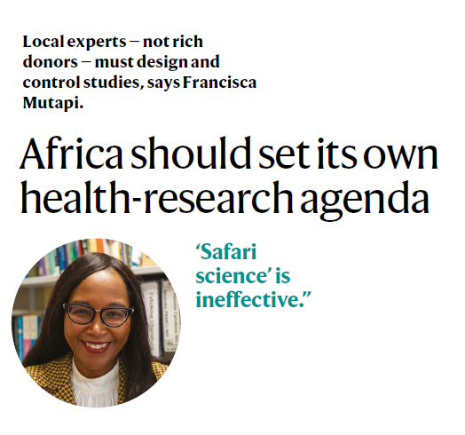
What is safari science?
Label given to some scientific studies that take place in developing world by scientists from wealthier nations
Local investigators function more as data collectors and translators than fully vested collaborators.
Funding originates from developed countries and most money goes to researchers and labs of these countries
Research questions guided by outside agencies rather than by local country priorities
Samples and data are extracted and housed outside of the countries where they originated
Benefits may not prioritize the countries where the research took place
Notes:
Mutapi, Francisca. "Africa should set its own health-research agenda." Nature 575.7784 (2019): 567.
https://www.nature.com/articles/d41586-019-03627-9

Slide 68
Reading/Questions 1
Notes:
https://www.persuasion.community/p/the-problem-with-decolonizing-global

