Slide 1
Are our energy supplies being exhausted?
Energy is a conserved quantity, meaning that it cannot be created or destroyed, but only converted from one form into another. Thus, the total energy of the universe always remains constant.
E = mc²

Slide 2
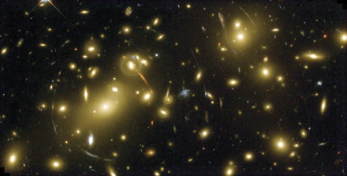
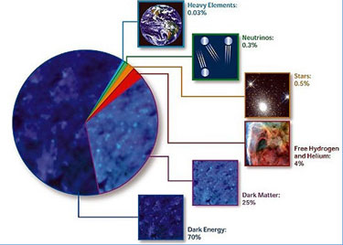

Contemplating the Universe`
Is energy rare in our universe?
NASA 2005, “70 percent or more of the universe consists of dark energy, about which we know next to nothing”!

Slide 3
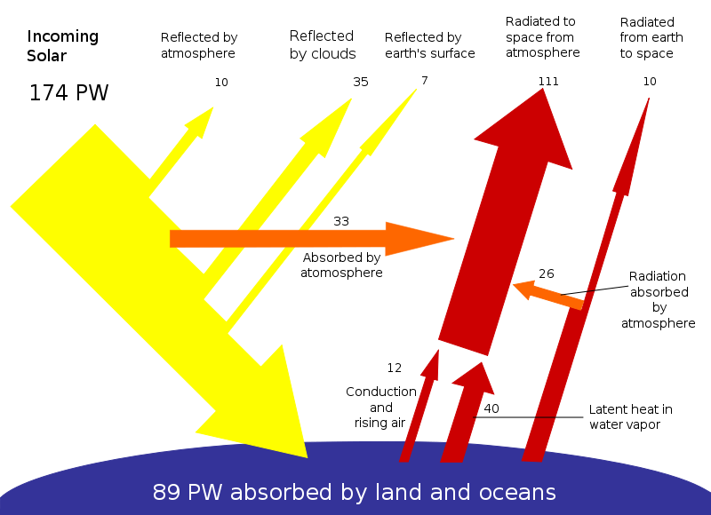

Slide 4
Did we move beyond the Stone Age for lack of stones?

Slide 5
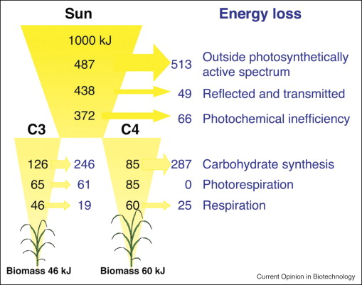
Zhu X.-G., Long S.P., Ort D.R. (2008) What is the maximum efficiency with which photosynthesis can convert solar energy into biomass? Current Opinion in Biotechnology 19:153-159.

Slide 6
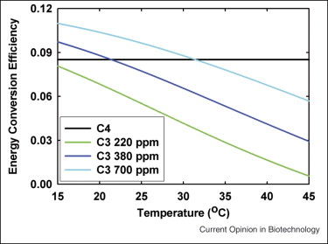
Max CO₂ fix: 50,000 kg ha⁻¹ yr⁻¹ (US DOE)

Slide 7
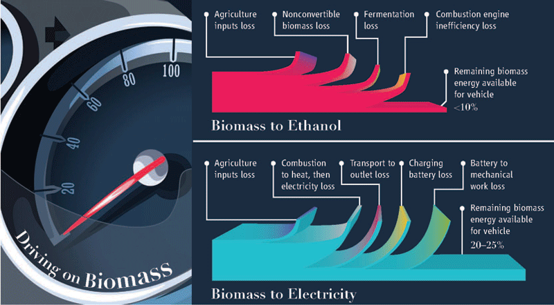
Ohlrogge, J., D. Allen, B. Berguson, D. DellaPenna, Y. Shachar-Hill, and S. Stymne. 2009. Driving on Biomass. Science 324:1019-1020.

Slide 8
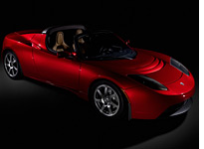
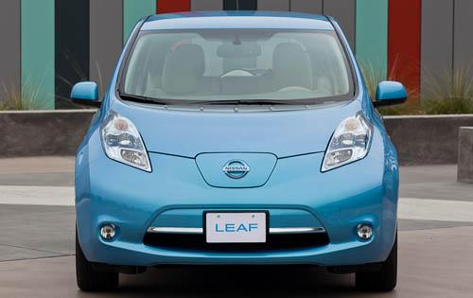
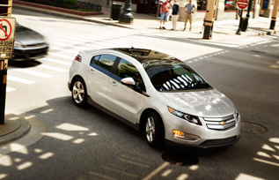
The future of passenger vehicle power is electric
A new breed of electric cars
135 mi/gal equil.
1 ¢/mi
Zero emmissions
250 mi/charge
Far, far less maintenance
0 – 60 in 4 sec.
“I've always marveled at how long the antique internal-combustion engine has survived. By 2006 standards, my car's power plant is a noisy, heat-blasting, poison-spewing monster with way too many moving parts.”

Slide 9
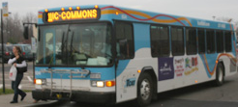
Meanwhile hybrid diesel vehicles are the best current option with the liquid fuel made from plant oils offering considerable advantages…
At least 40 cities and areas in the U.S. are using diesel-electric hybrid buses, including New York City; Washington, D.C.; Hartford, Conn.; Lansing, Mich.: Tulsa, Okla.; Orange County, Calif.; Seattle, Wash.; and Yosemite National Park, Calif.
Biodiesel powered trucks, buses and ships are likely to be used for some time to come with power increasingly shifting to electric.
Hybrid energy sources not hybrid engine systems…

Slide 10


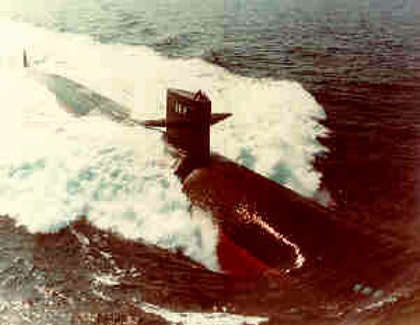
Fuel for US naval vessels?

Slide 11
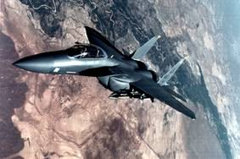
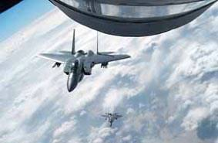
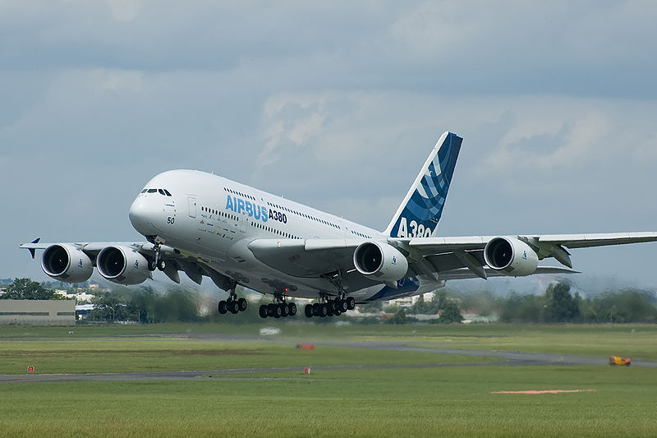
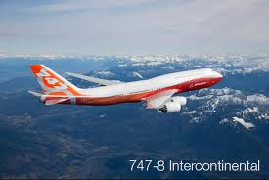
Jet Fuel

Slide 12
?

