Slide 1

A New Renewable Oil Source
D. Hildebrand, R. Geneve,
W. Jamboonsri & T. Phillips
Dept. OF PLANT AND SOIL SCIENCES

Slide 2
Hildebrand, D.F., and Makoto Kito. 1984. Role of lipoxygenases in soybean seed protein quality. J. Agric. Food Chem. 32:815-819.
Hildebrand, D.F., J. Terao, and M. Kito. 1984. Phospholipids plus tocopherols increase soybean oil stability. J. Am. Oil Chemist's Soc. 61:552-555.
J. TERAO and M. KITO, Research Institute for Food Science, Kyoto University, Uji, Kyoto 611

Slide 3
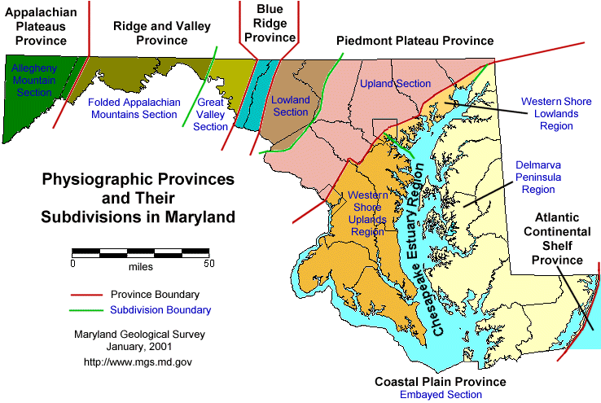





About Me—David Hildebrand

Slide 4
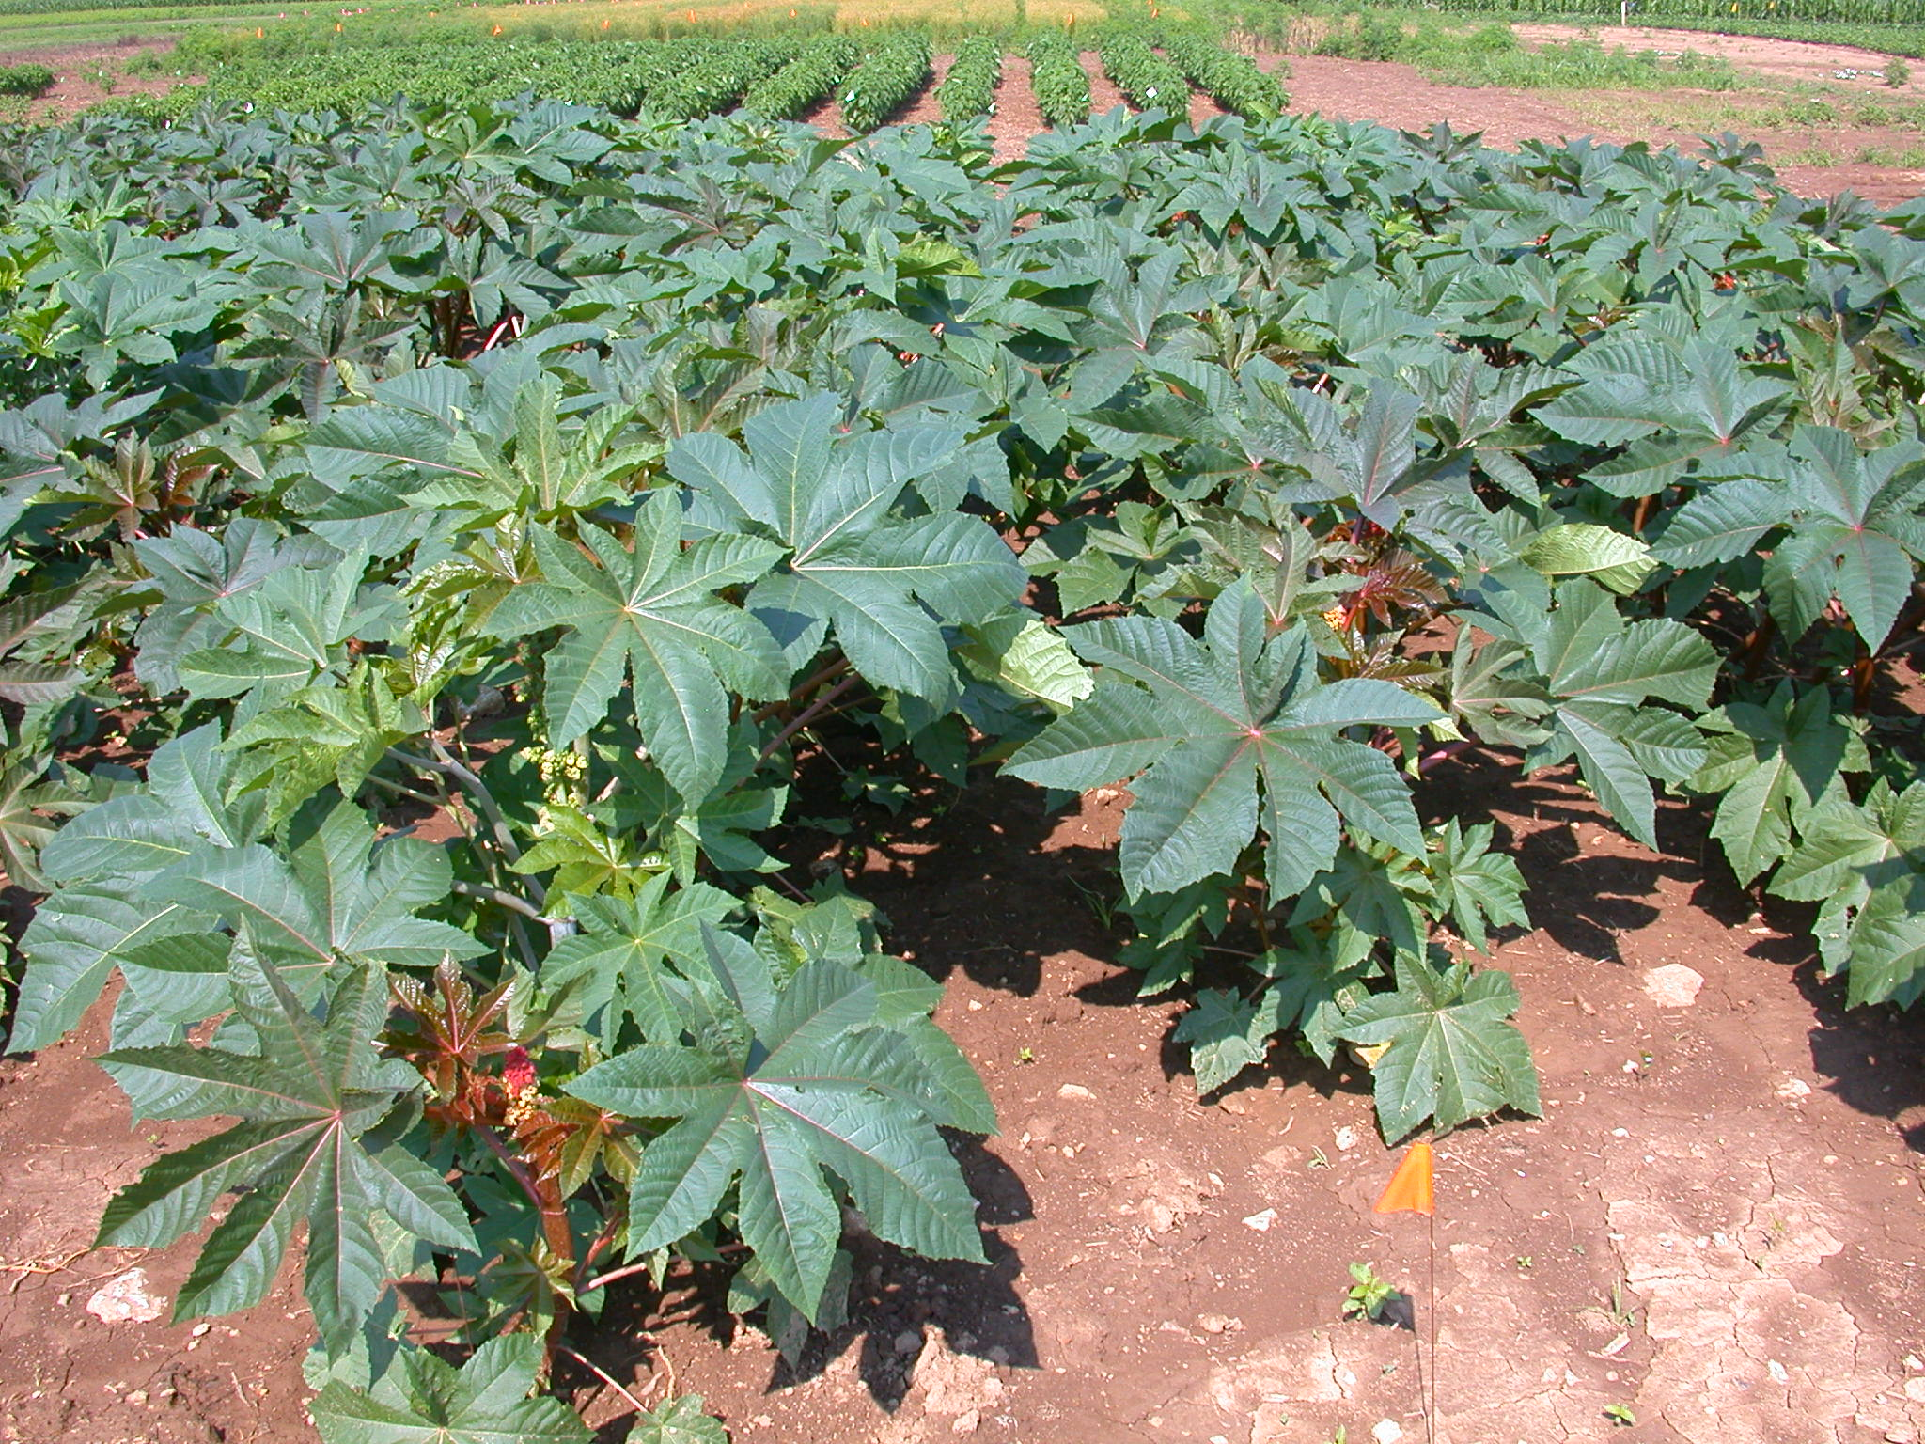

Slide 5
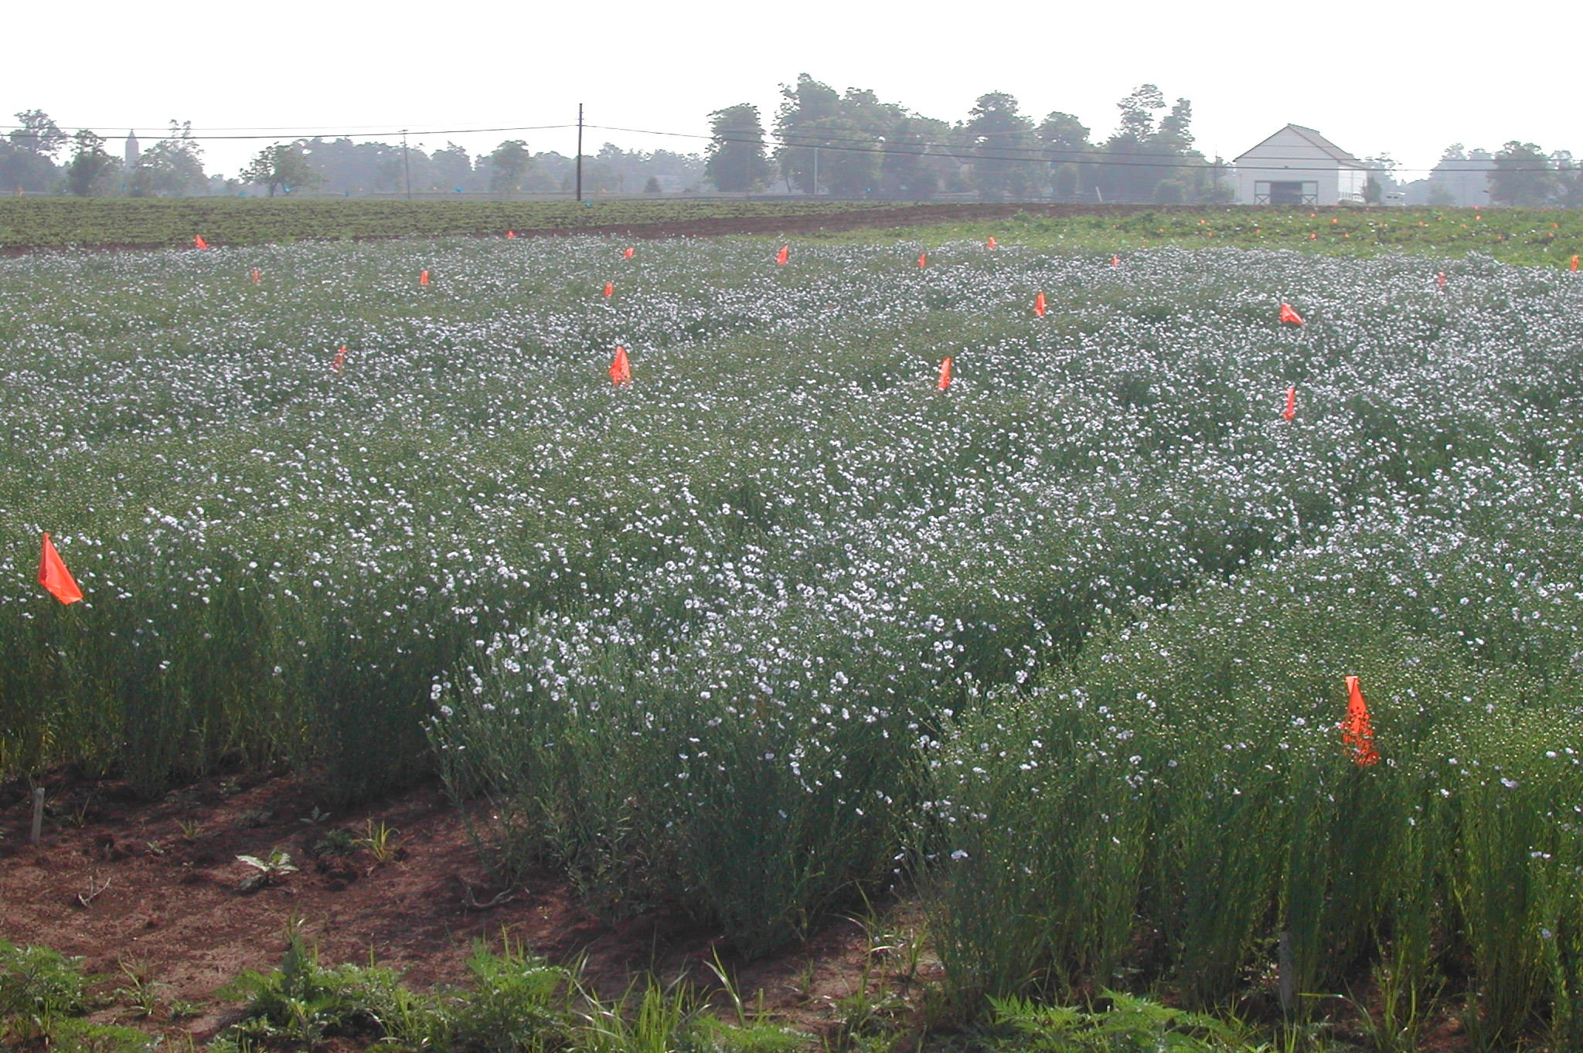
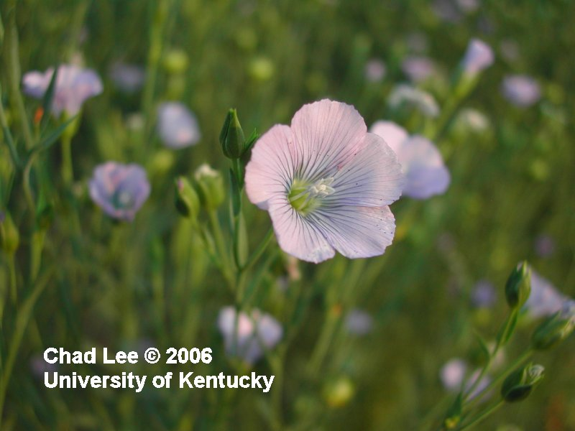
June 20 (Day 75)

Slide 6
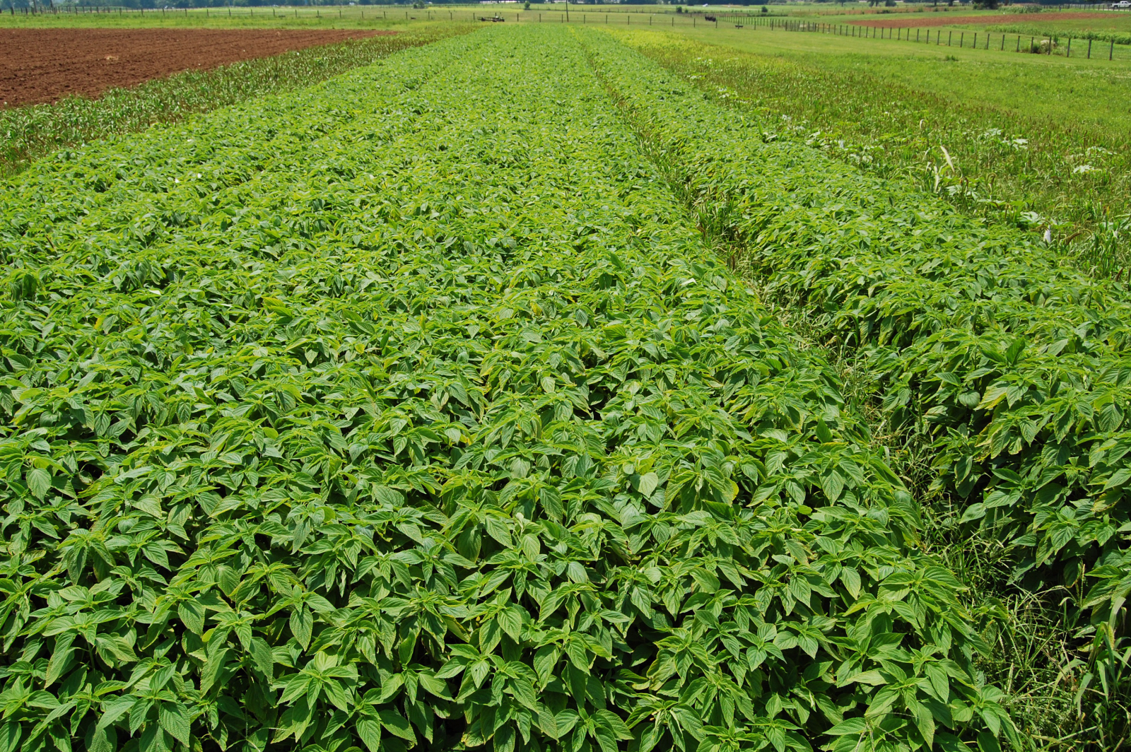
Doesn’t need weed control or fertilization!

Slide 7
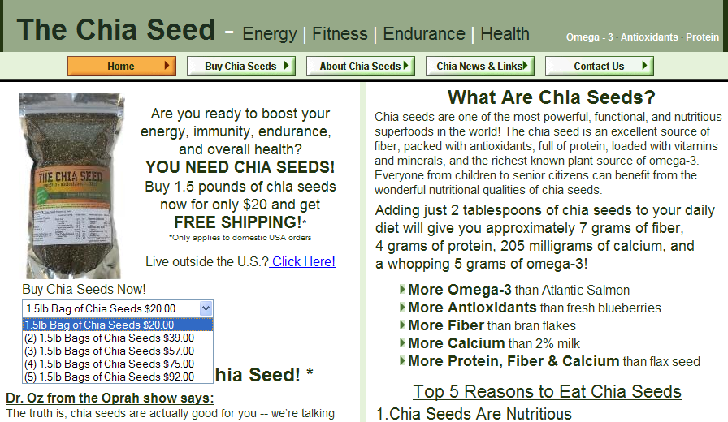
Why chia?
www.thechiaseed.com

Slide 8

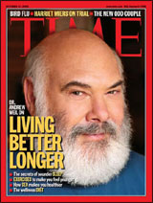

Dr. Oz from the Oprah show says, "they just may be one of the healthiest things around."
Nutrition expert Dr. Weil said,
"A healthful and interesting addition to my diet. My prediction? You will begin to see chia being added to more and more commercial products, such as prepared baby foods, nutrition bars, and baked goods."
How to Eat Chia Seeds (Including Recipes)
Chia seeds make an incredibly healthy—and often unnoticeable—addition to many foods.
Here are some great ways to enjoy chia seeds:
They can be eaten raw. (They have a nice "nutty" flavor.)
They can be soaked in fruit juice (in Mexico, they call this "chia fresca").
They're perfect in porridges and puddings.
They make an ideal addition to baked goods including breads, cakes and biscuits. “Nature’s Perfect Food”

Slide 9
Chia seed

Slide 10
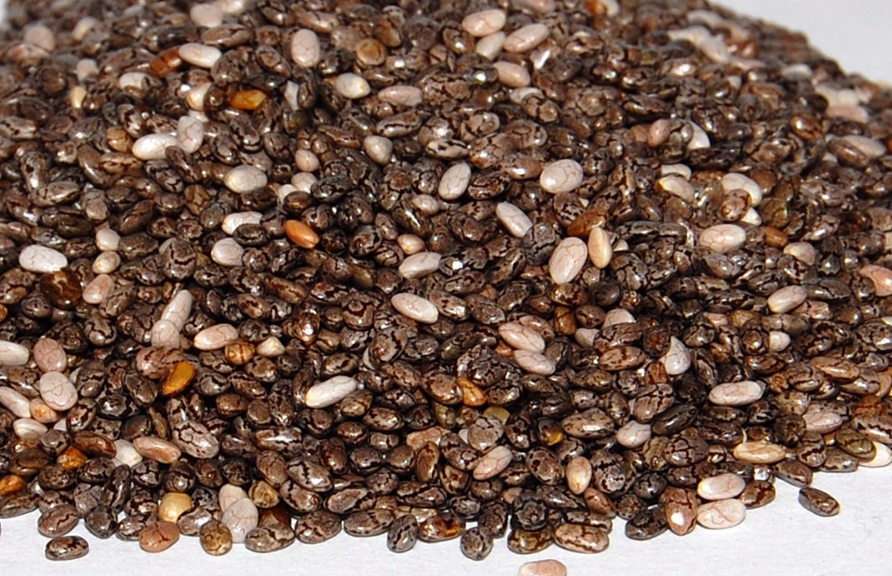
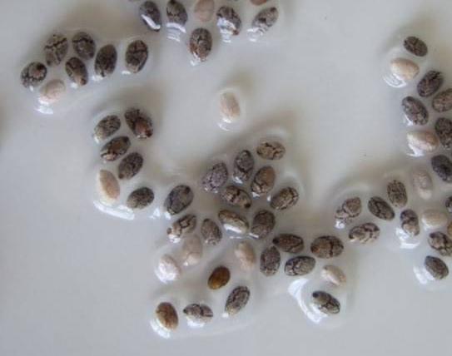
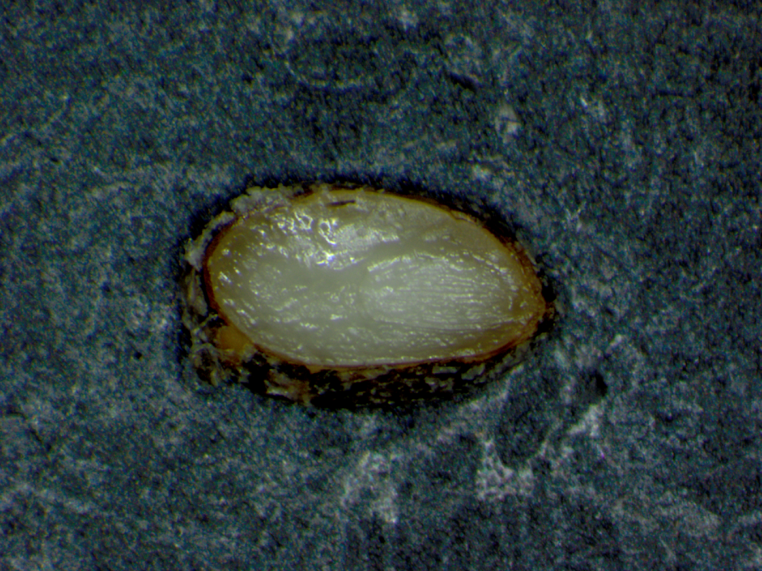
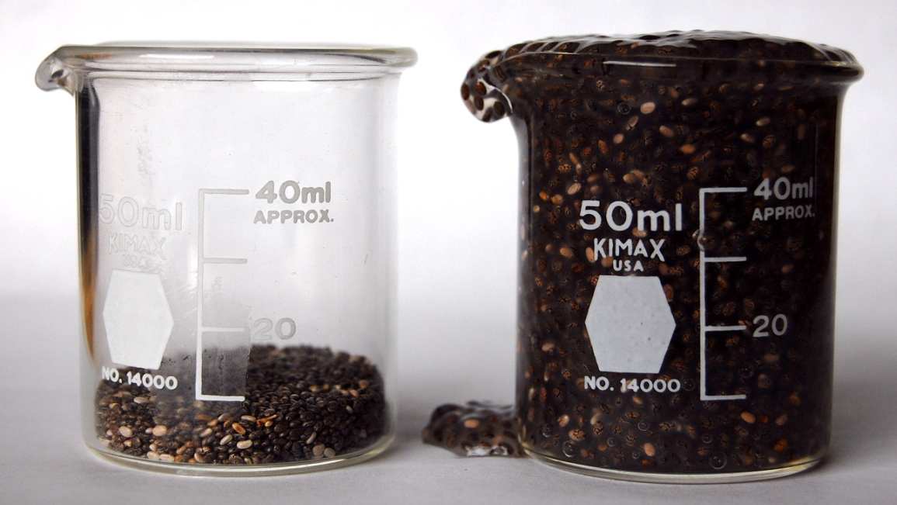
Chia seed
Endosperm
Embryo

Slide 11
Chia seed
64%+

Slide 12
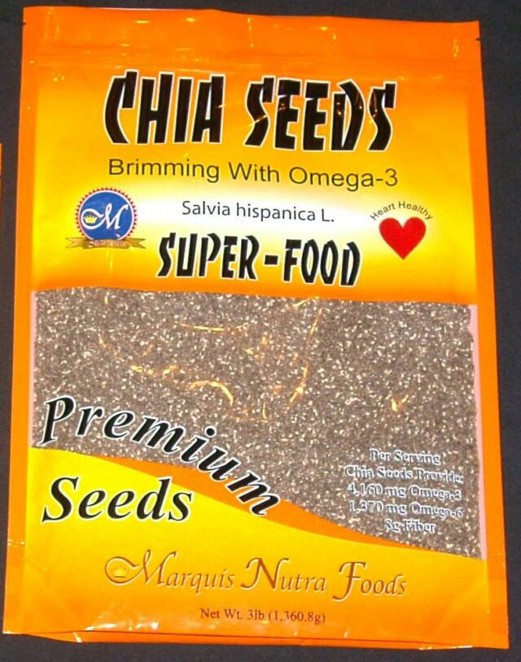
Accumulating Clinical Research on Health Benefits…
Chicco, A.G., M.E. D'Alessandro, G.J. Hein, M.E. Oliva, and Y.B. Lombardo. 2009. Dietary chia seed (Salvia hispanica L.) rich in alpha-linolenic acid improves adiposity and normalizes hypertriacylglycerolaemia and insulin resistance in dyslipalemic rats. British Journal of Nutrition 101:41-50.
Vuksan, V., E. Jovanovski, A. Dias, A. Lee, A. Rogovik, and A. Jenkins. 2009. COMPARABLE DOSE-RESPONSE GLUCOSE-LOWERING EFFECT WITH WHOLE VERSUS FINELY GROUND NOVEL OMEGA-3-RICH GRAIN SALBA (SALVIA HISPANICA L.) BAKED INTO WHITE BREAD. Pharmaceutical Biology 47:13-13.
Now available from many sources: Amazon Grocery [e.g. GoGoGreen], GNC, whole foods, groceries

Slide 13
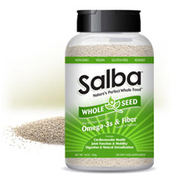





Salba - Nature's Perfect Whole Food

Slide 14
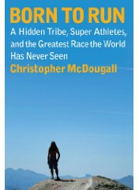
2009. Born to run. Alfred A. Knopf. New York. ISBN 978-0-307-26630-9
“I was very tired and at a loss how to climb the mountain … some 2,000 ft. above. But after having satisied my hunger and thirst with iskiate [chia seeds in water], …, I at once felt new strength, and, to my own astonishment, climbed the great height without much effort” …
“If you had to pick just one desert-island food, you couldn’t do much better than chia, at least if you were interested in building muscle, lowering cholesterol, and reducing your risk of heart disease; after a few months on the chia diet, you could probably swim home.”

Slide 15
Doesn’t need weed control or fertilization!

Slide 16
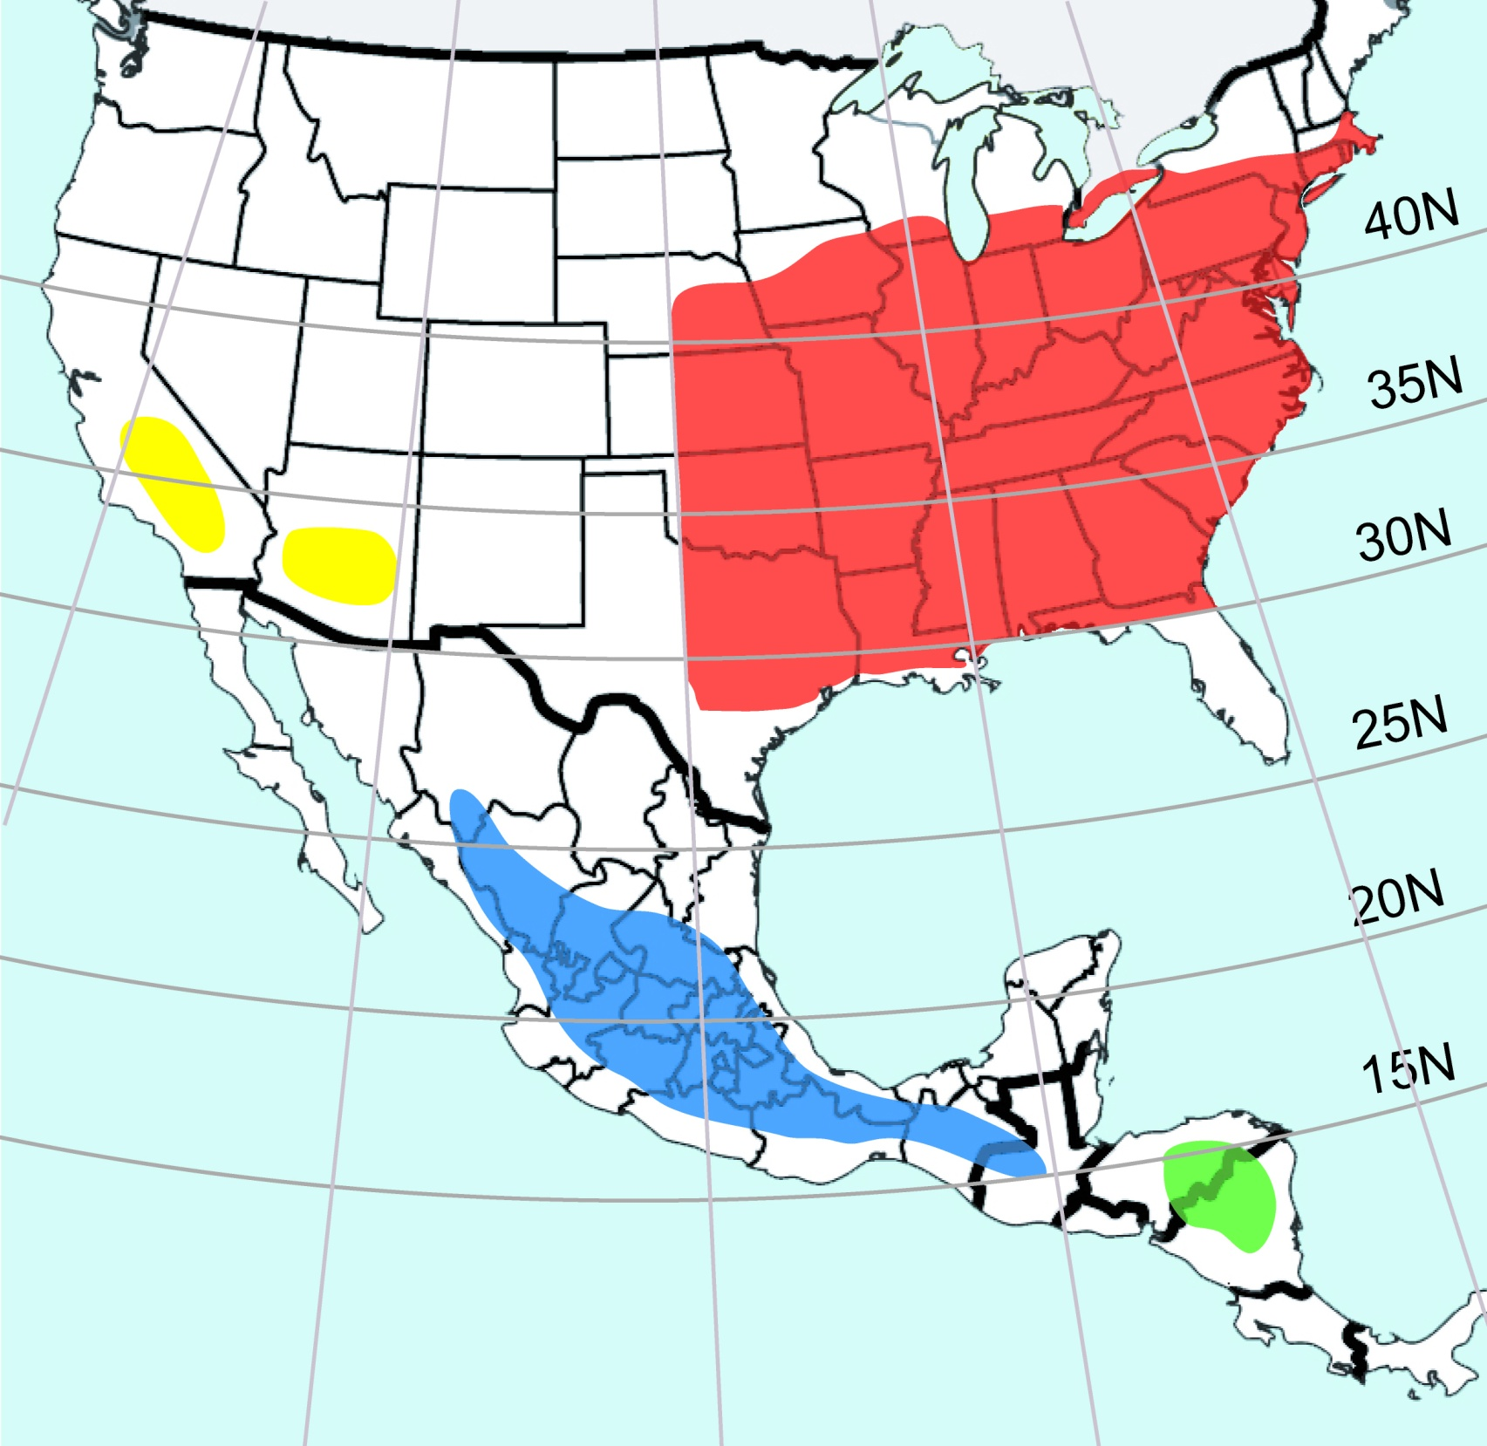

Slide 17
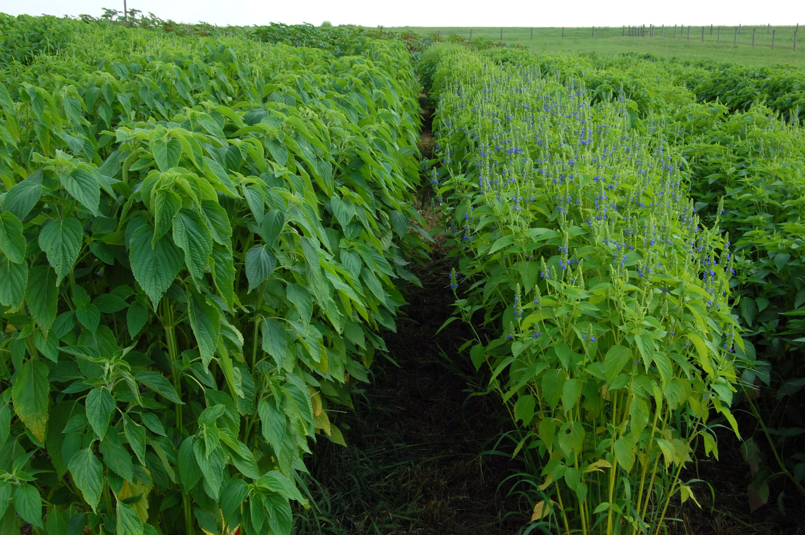
G1
Flowering
Most advance
wildtype
No flower bud

Slide 18
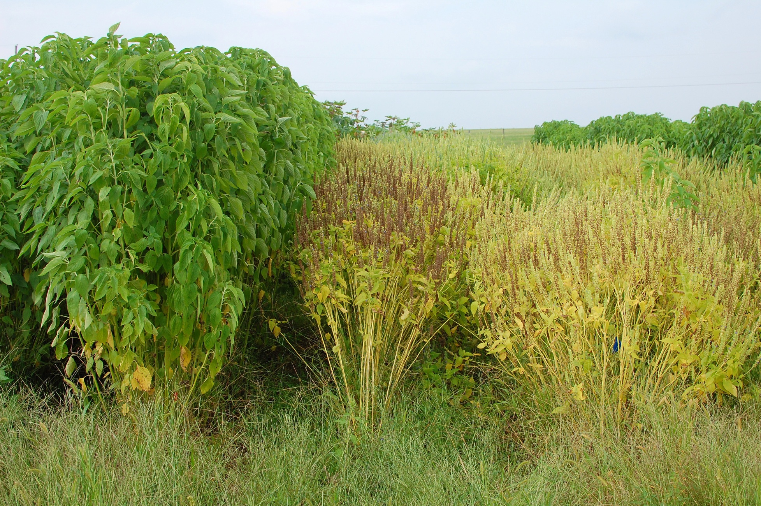
September, 2009
wildtype
G8
G9

Slide 19
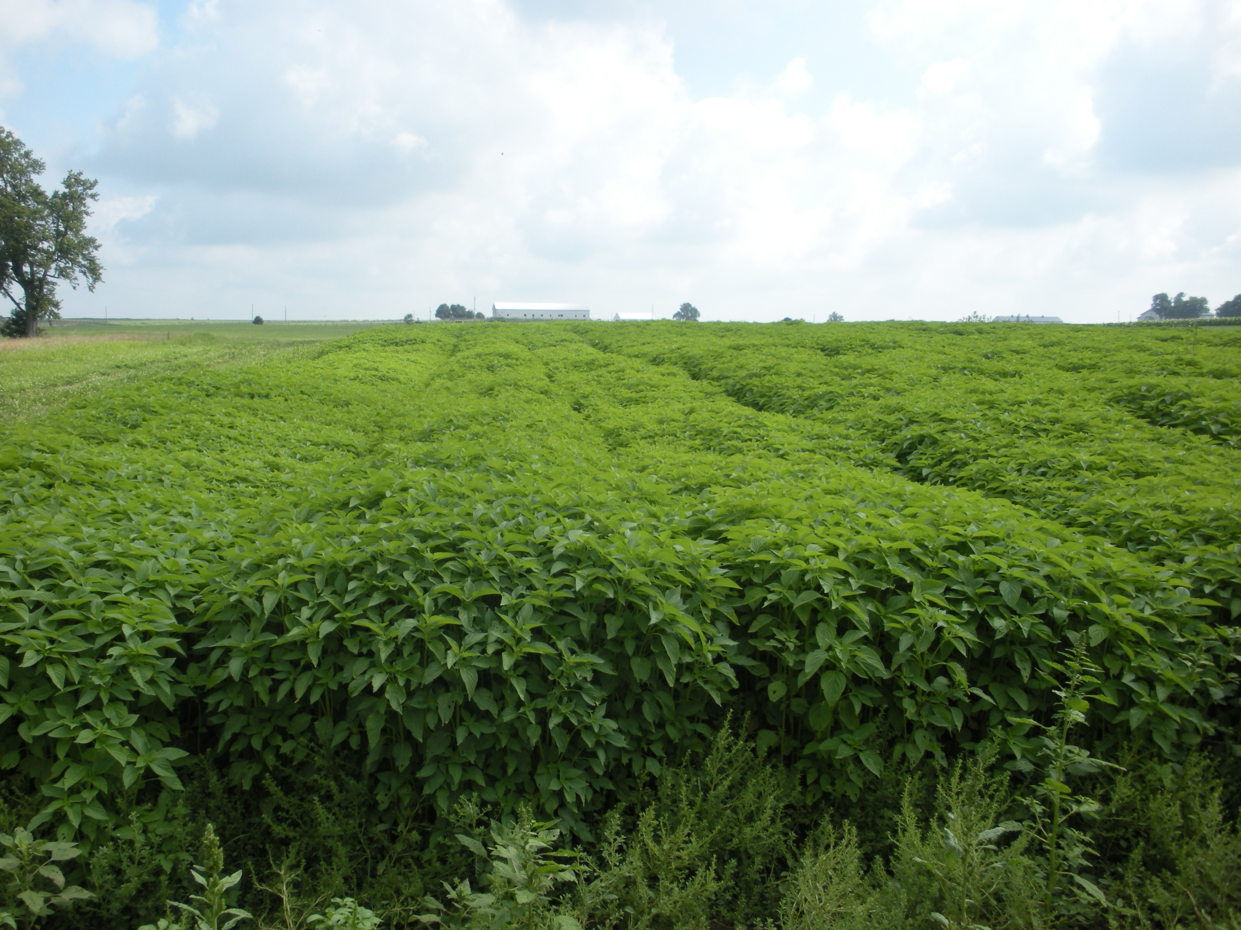

Slide 20

7-19-2010

Slide 21
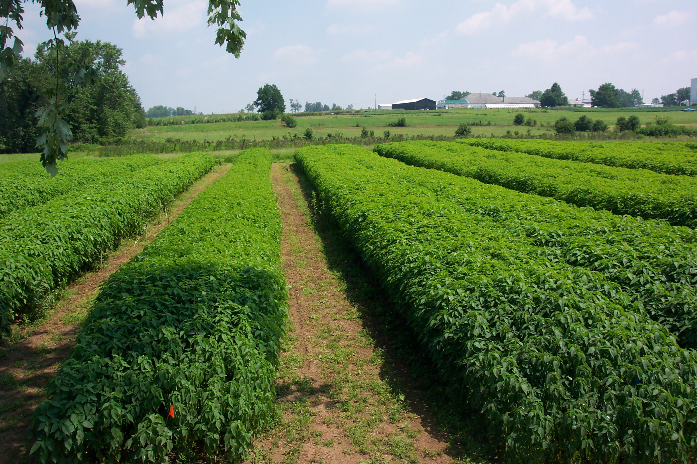
2010 Large increase strips: 5’ x 120’ per strip

Slide 22
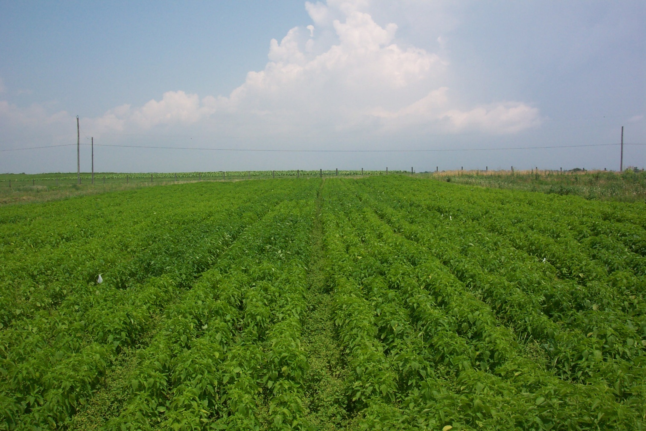
N Fertilizer response
Plots 25’ long, 4’ wide, 4 replications: 0, 25, 50, or 75 #N/A in 6 blocks

Slide 23
Glycemic Index!

Slide 24
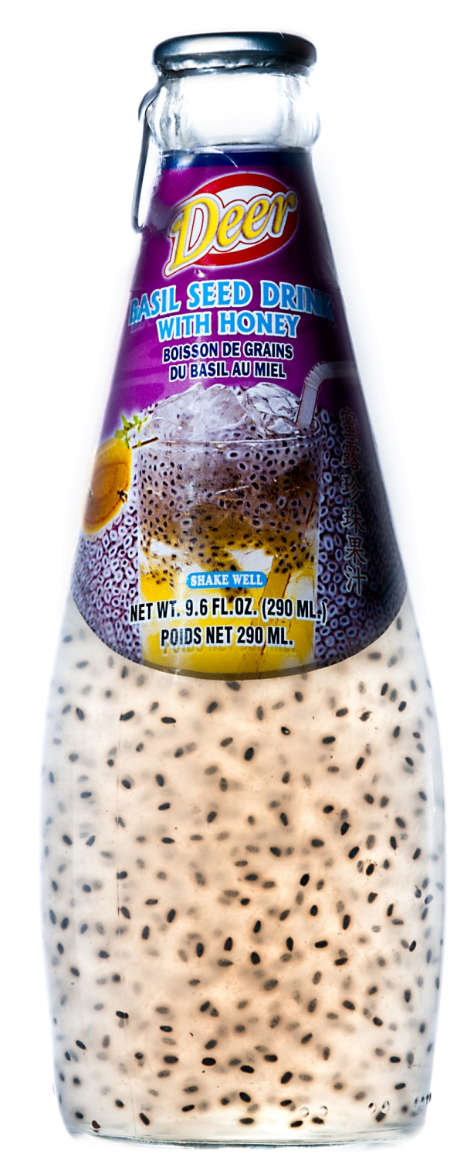
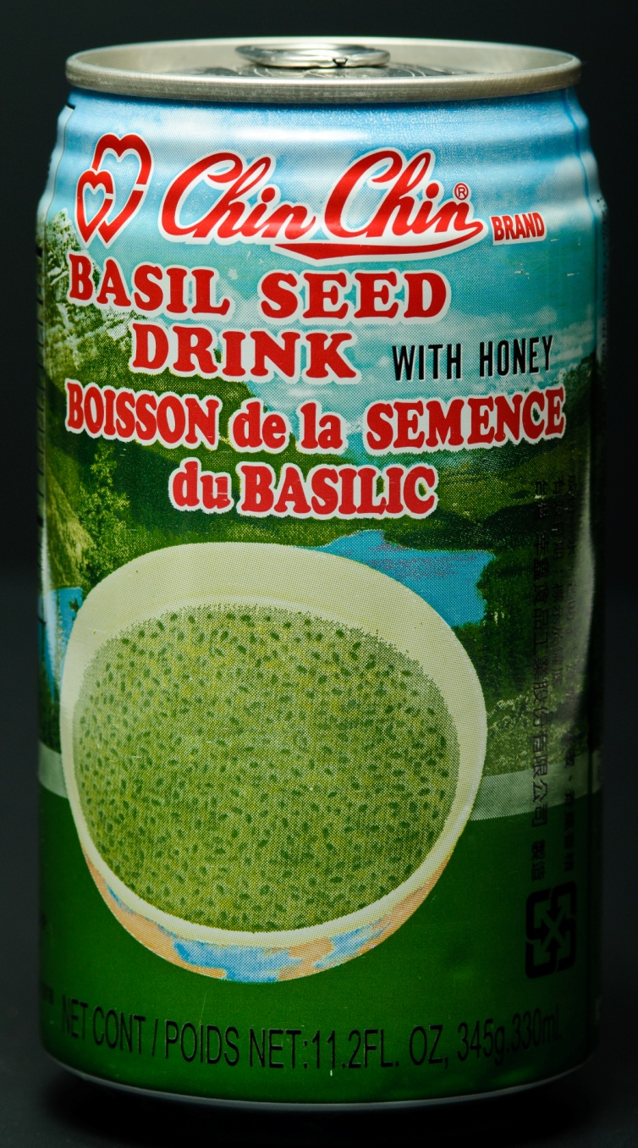
Ocimum basilicum

Slide 25
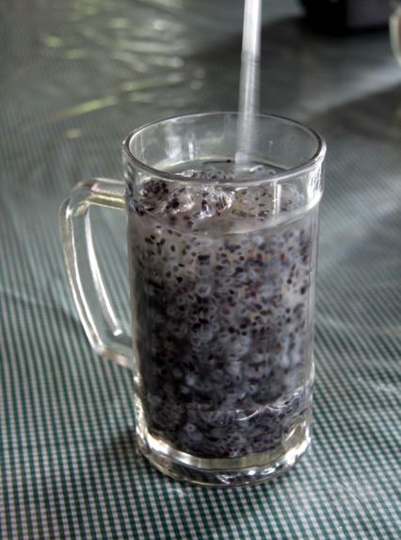
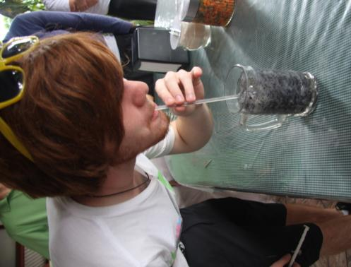
Hyptis suaveolens

Slide 27
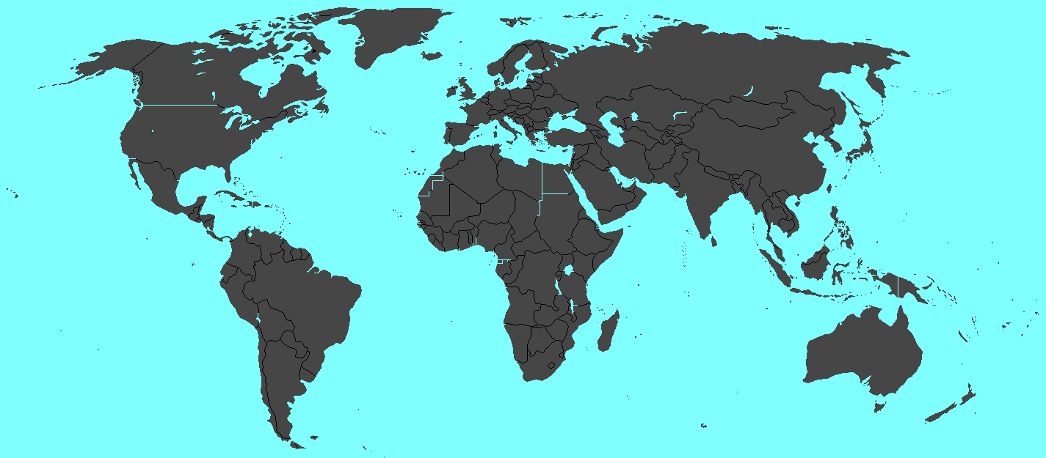

Slide 28
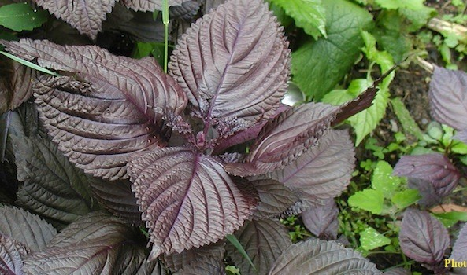
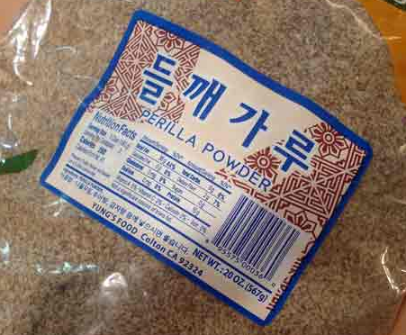
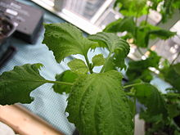
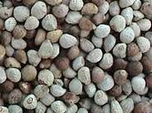
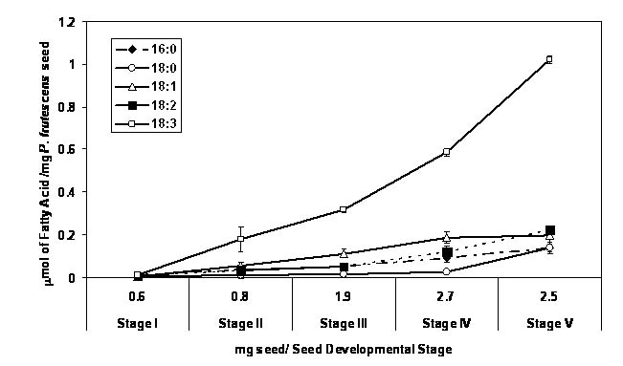
Akajiso (red shiso - Perilla frutescens)
deulkkae or tŭlkkae (들깨)
赤紫蘇
zisu 紫蘇

Slide 29
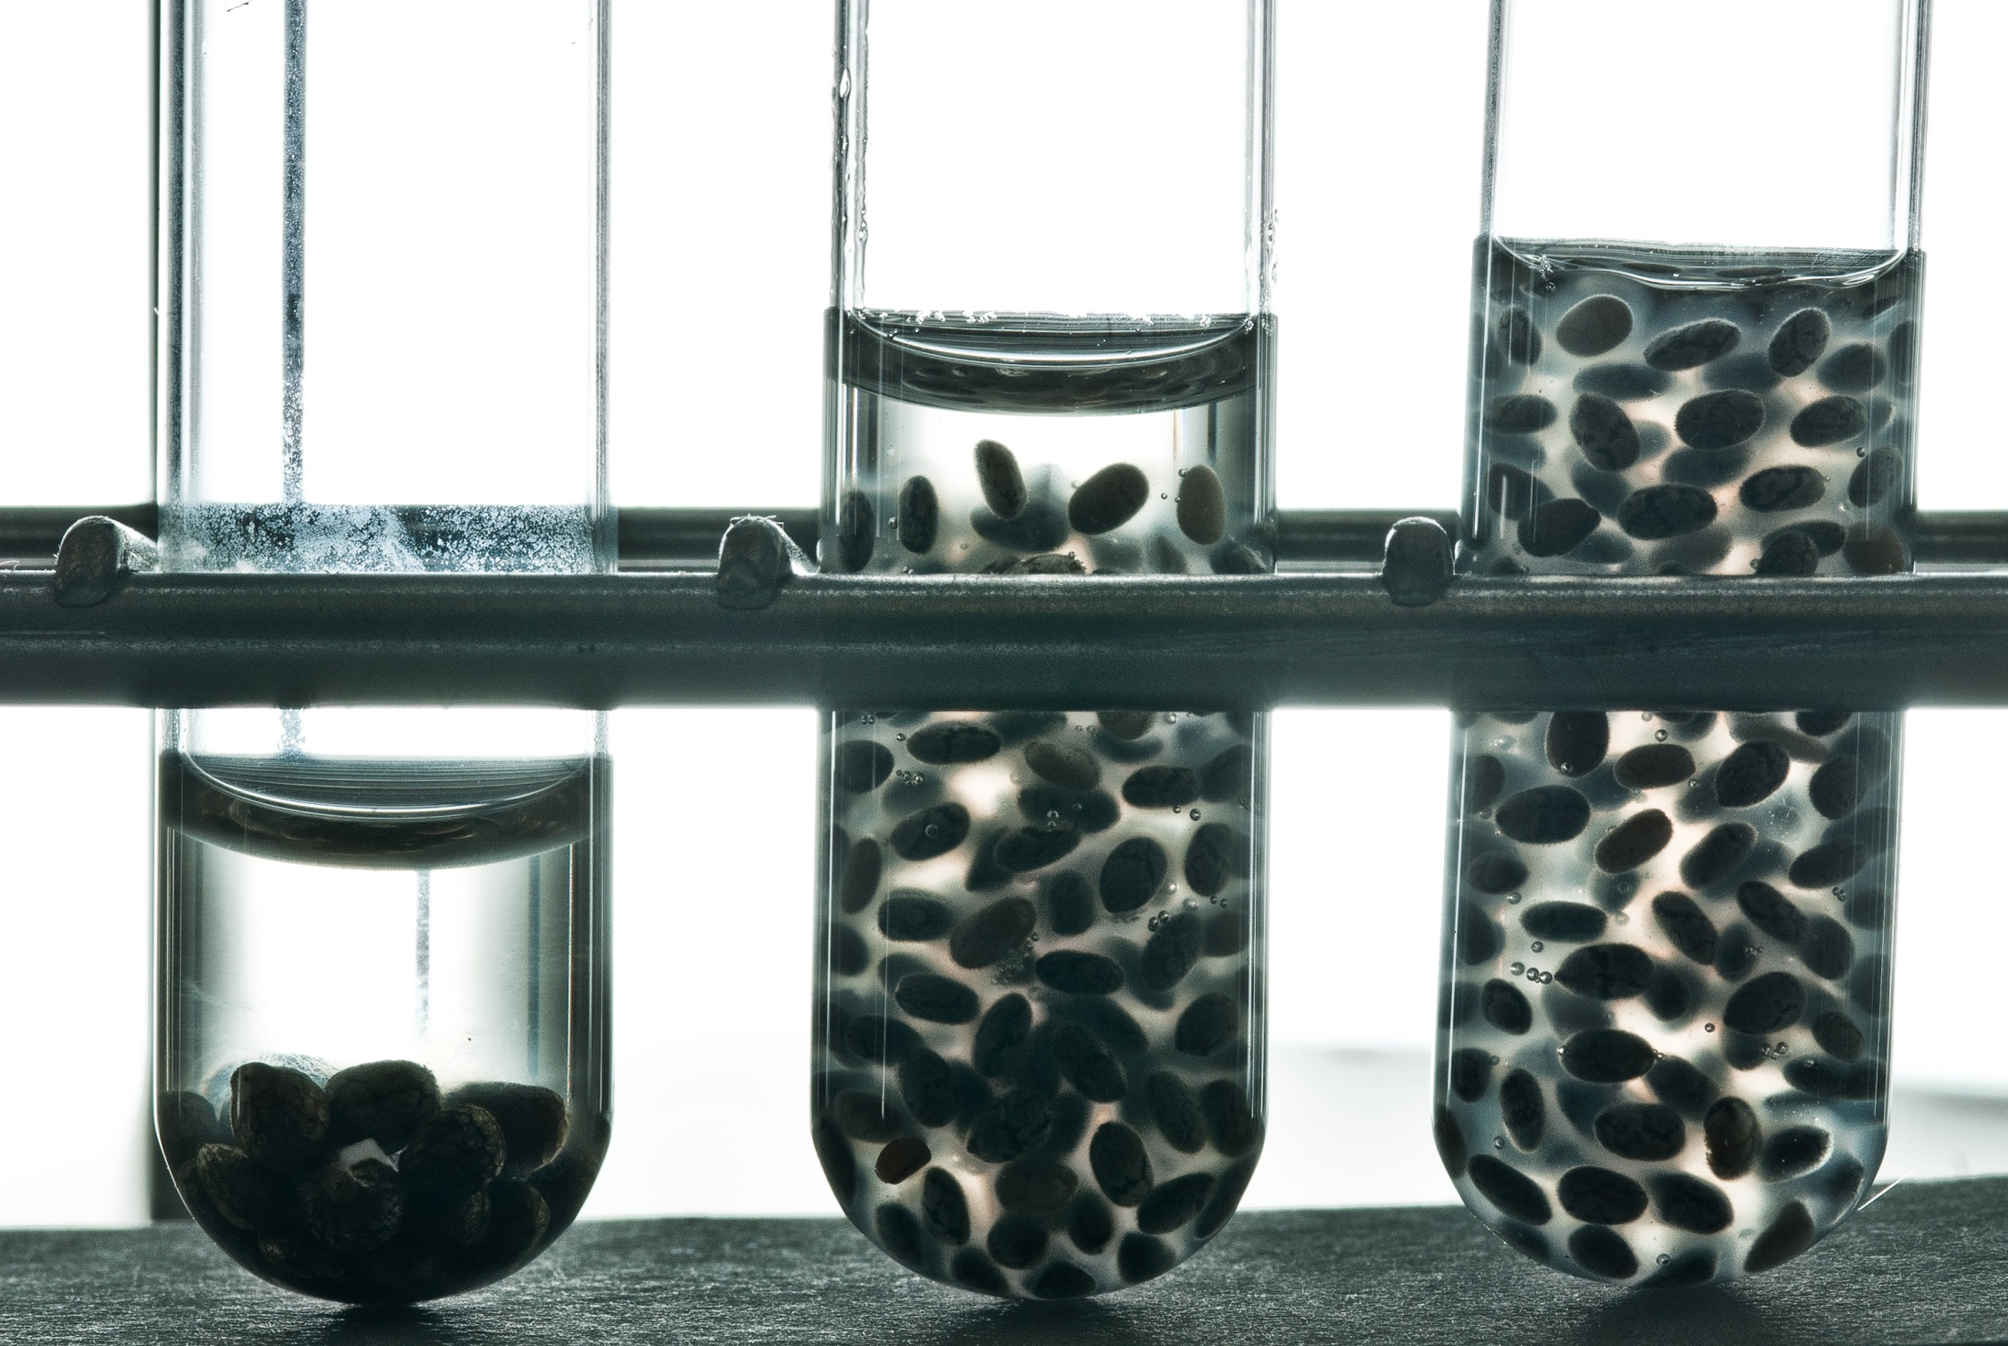

Slide 30
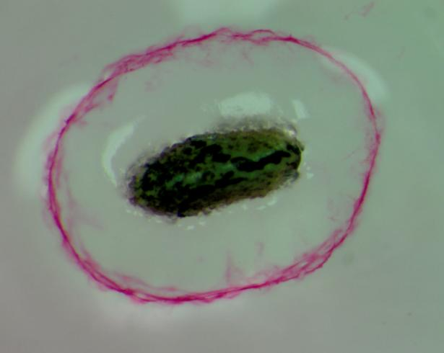
Salvia hispanica fruit
Nutrigel fiber
exudation stained with ruthenium red – Bob Geneve

Slide 31
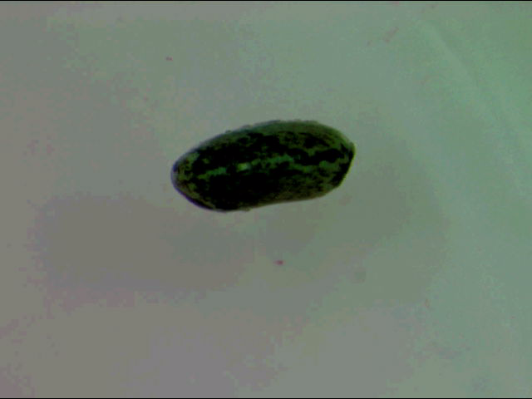

Slide 32
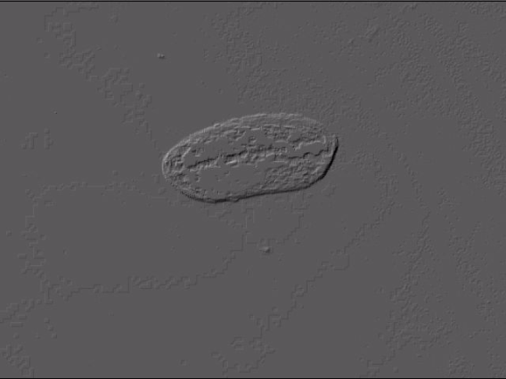

Slide 33
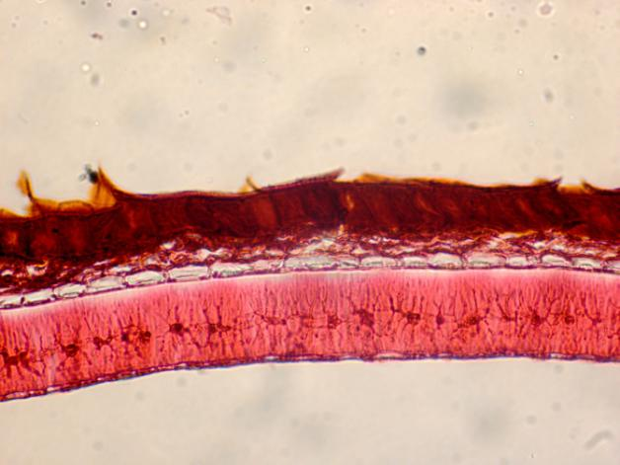
Chia (Salvia hispanica)
Dry seed
Pericarp
Endocarp
Seed coat

Slide 34
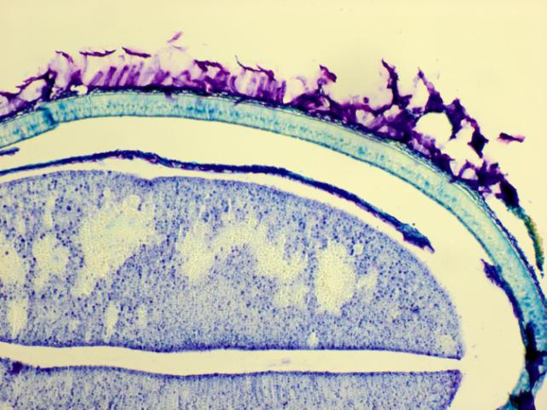
Chia (Salvia hispanica)
Less than one minute after imbibition
Pericarp
Cotyledon
Seed coat

Slide 35
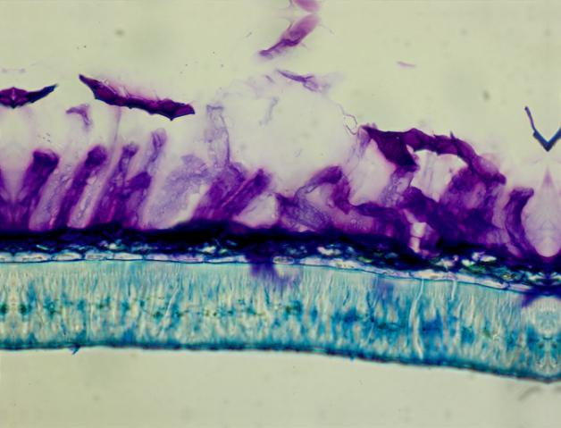
Chia (Salvia hispanica)
Less than one minute after imbibition
Pericarp cell wall
Mucilage
Endocarp
Seed coat

Slide 36
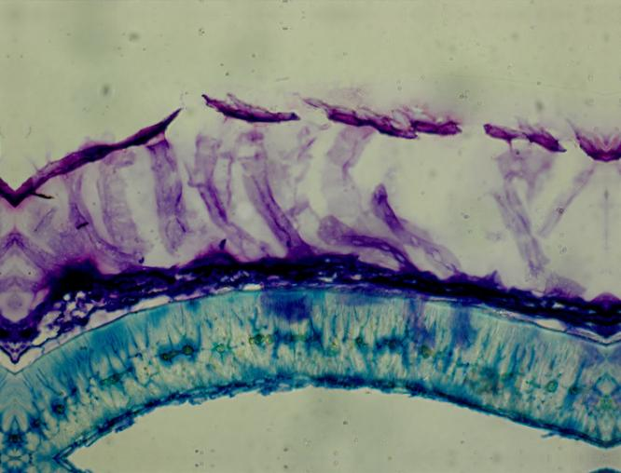
Chia (Salvia hispanica)
One minute after imbibition
Pericarp
Mucilage
Endocarp
Seed coat

Slide 37
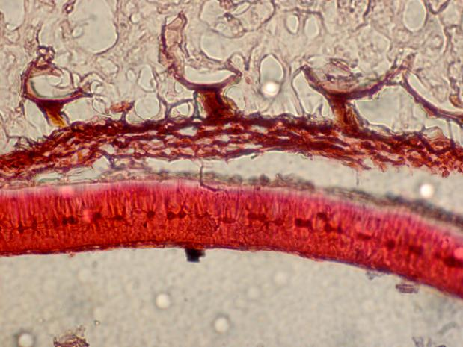
Chia (Salvia hispanica)
Three minutes after imbibition
Mucilage
Pericarp
Endocarp
Seed coat

Slide 38
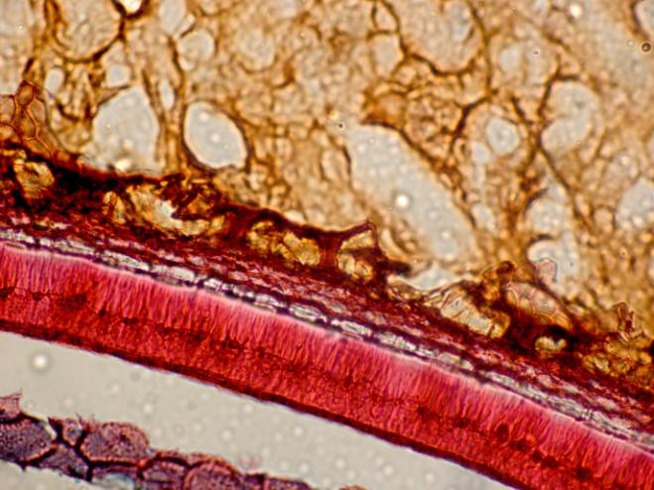
Chia (Salvia hispanica)
Three minutes after imbibition
Mucilage
Pericarp
Endocarp
Seed coat

Slide 39
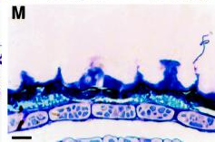
Chia (Salvia hispanica)
Arabidopsis
Seed coat
columellae

Slide 40
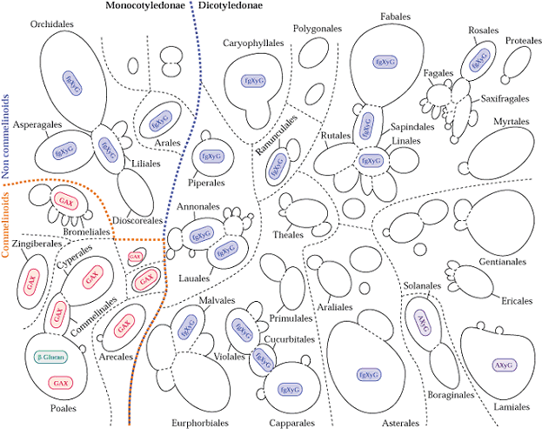

Slide 41
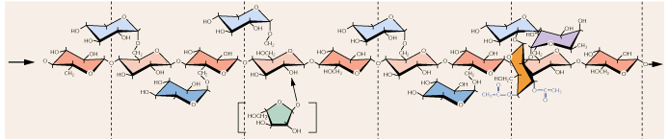
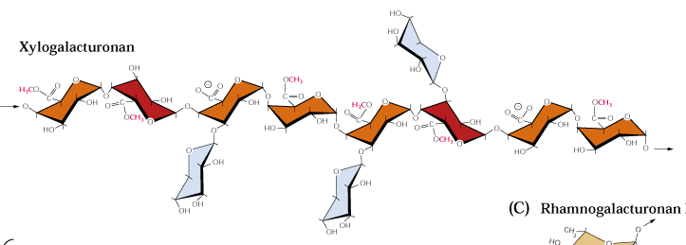
Hemicellulose
Pectin

Slide 42
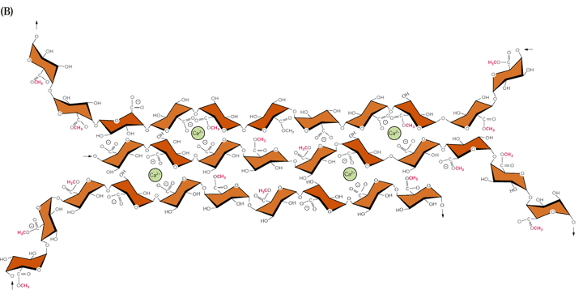

Slide 43
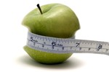
The Health Care costs Overweight ~ $100 billion in the US alone!
The potential of dietary fiber to aid weight loss and management is dependent on the type and structure of the fiber, but impressive results can be achieved for the right fibers, says a new review from Wageningen University and Kellogg Europe.
Greatest effect – viscous fibers that adsorb large amt. water gastrointestinal tract.
Wanders et al. Obesity Reviews Oct. 2011

Slide 44
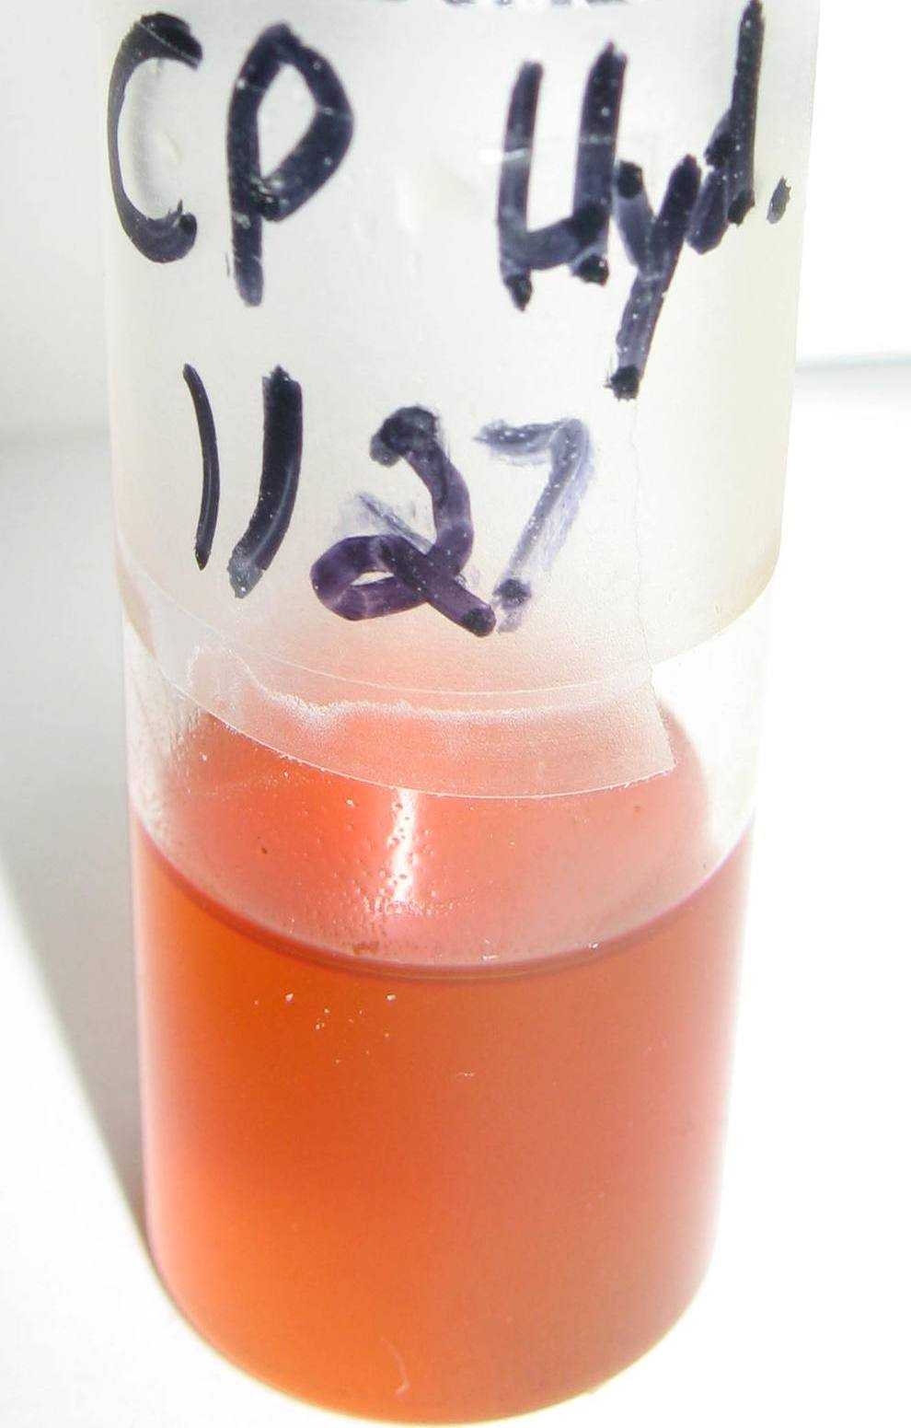
These cyclopropanated/fully hydrogenated oil derivatives can have the viscosity, lubricity and low temperature fluidity of high quality motor oils from petroleum. Preliminary tests indicate excellent stability also.

Slide 45
Conclusions
S. hispanica has great production potential
High ω3 source
Among highest antioxident sources
Outstanding soluble fiber source
Nutri-gel
Functional renewable chem. source

Slide 46
Acknowledgements
Bob Geneve Jessime Kirk
Ann Jamboonsri
Tim Philips

Slide 47
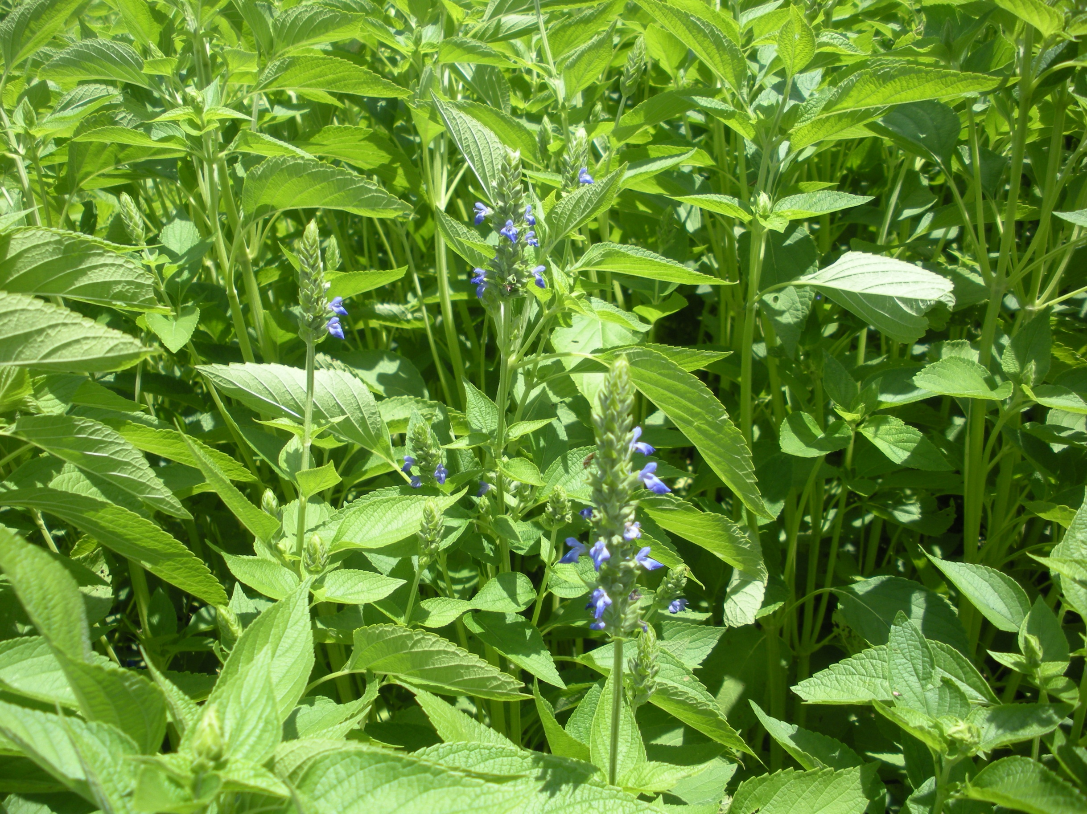
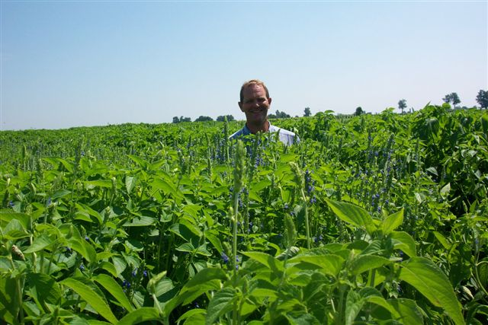

Slide 48
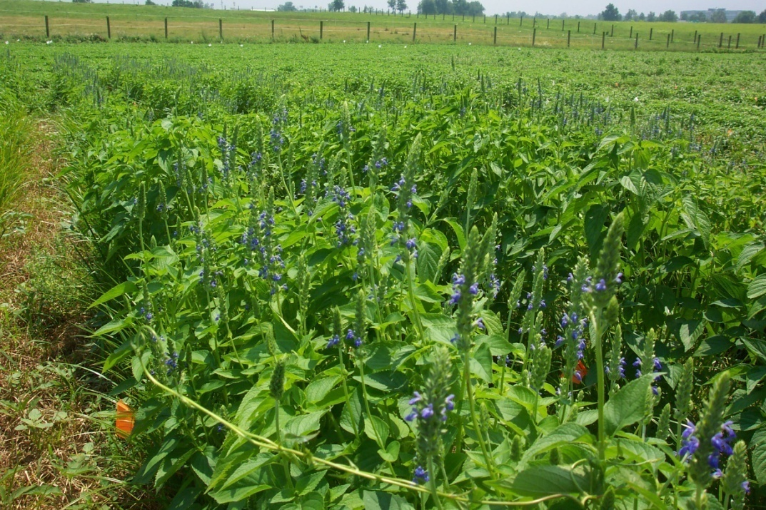

2011 field trials
Planting date: 5 lines, 4 replications
seeded April 21, May 5, May 19, June 2, June 16, June 30, and July 14.

Slide 49


Slide 50




