Slide 1
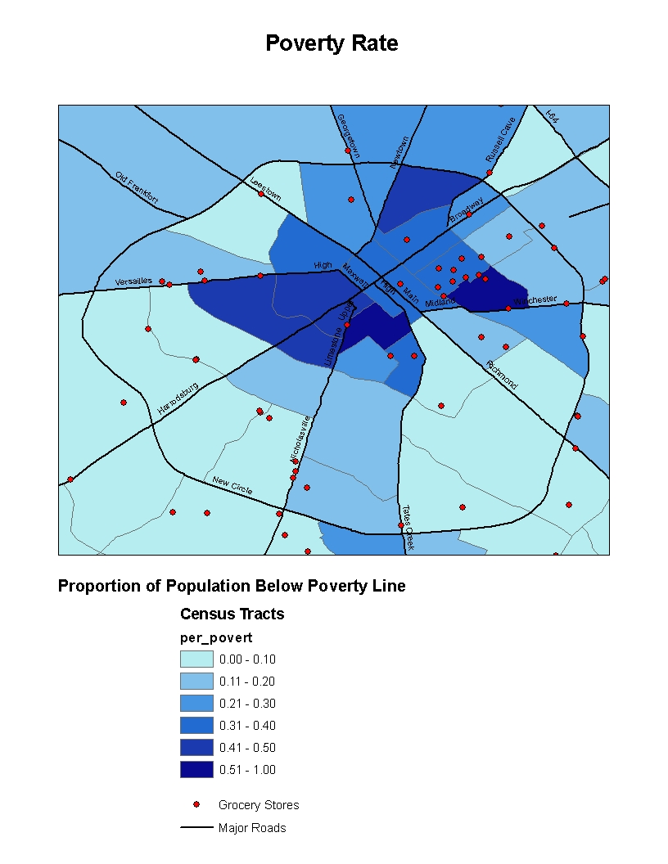
1-10%
11-20%
21-30%
41-50%
51-60%
61-70%
Source: US Census 2000; LFUG Health Department’s List 2006

