Slide 1

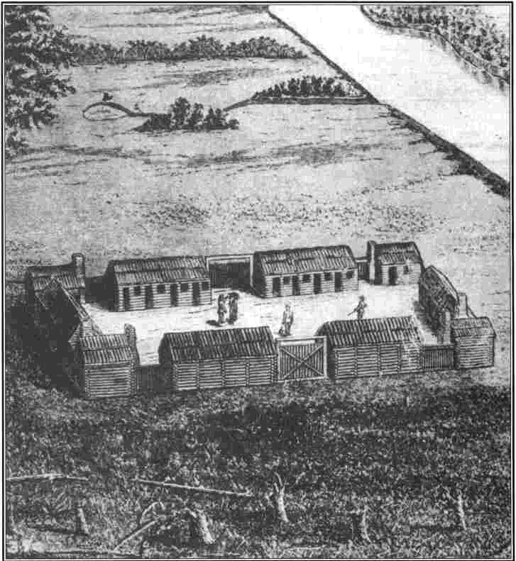
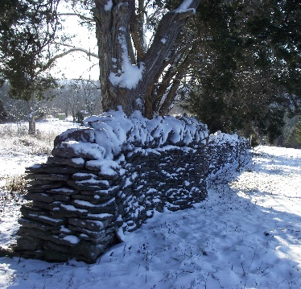
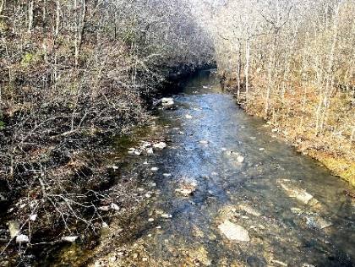
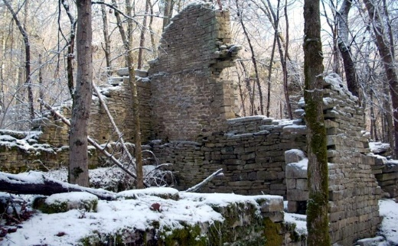
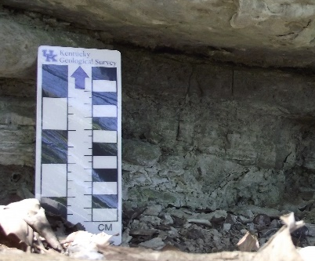
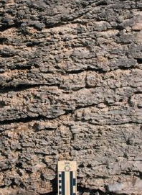
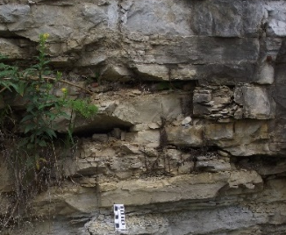
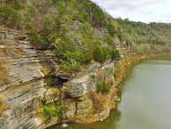
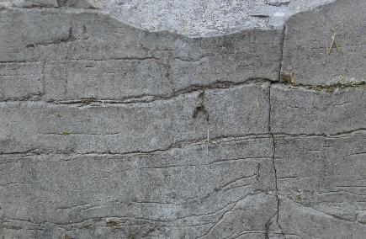
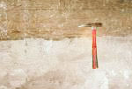
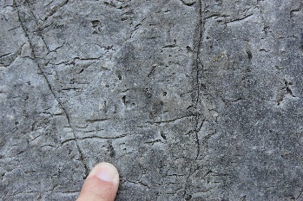
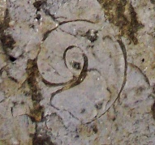
Geological Society of Kentucky
History of Lower Howard’s Creek:
What happened at Hall’s on the River
Richard Smath, Friday, April 22, 2022, at 7 p.m.
https://eku.zoom.us/j/98523120648
KENTUCKY
Lower Howard’s Creek
Fences
Fort Boonesborough
Grist Mill
2. Geology of the Ordovician High Bridge Group
Dr. Frank Ettensohn, Friday, May 20, 2022, at 7 p.m.
https://eku.zoom.us/j/91305528601
Bentonites
Camp Nelson Ls.
Oregon Fm.
Tyrone Ls.
Kentucky River Palisades
White
marker bed
Birdseye structure
Fossils
3. GSK Field Trip at Lower Howard’s Creek
Friday, May 28, or June 4, 2022. Final date will be announced.

