Slide 1
Compliance Requirements for MLS Majors
For compliance questions
Email: CHS-Compliance@uky.edu
https://www.uky.edu/chs/current-students/compliance-background-checks-and-drug-screens
C.T. Wethington Building Room 111

Slide 2
Clinical Requirements
Full Background Check
10 Panel Drug Screening
Clinical Requirements:
Health Insurance (annual)
Influenza Shot (annual)
Tuberculosis Two-Step Skin Test (initial) or IGRA blood test
One step TB test or IGRA blood test for annual renewal
Hepatitis B, MMR, Varicella and Tdap documents
Commitment to Behavioral Standard in Patient Care
Trainings
Bloodborne Pathogen Exposure Policy
Chemical Hygiene (Lab Safety) Training
Hazardous Waste Training
Fire Safety Training
HIPAA Training
Discrimination and Harassment Training

Slide 3
Due Dates
The full background check and drug screening are due BY August 1^{st,} prior to start of program.
The clinical requirements are due by September 15th, each year you are in the program.
Flu Immunization is due November 1st each year.
The trainings will be due 2-3 weeks after orientation. You will receive more information about how to complete these at orientation.
It is highly recommended that you do not wait until close to the deadline to complete these requirements. Get them done as early as possible in case problems arise!

Slide 4
How to get started: Create an account on Castle Branch

Slide 5
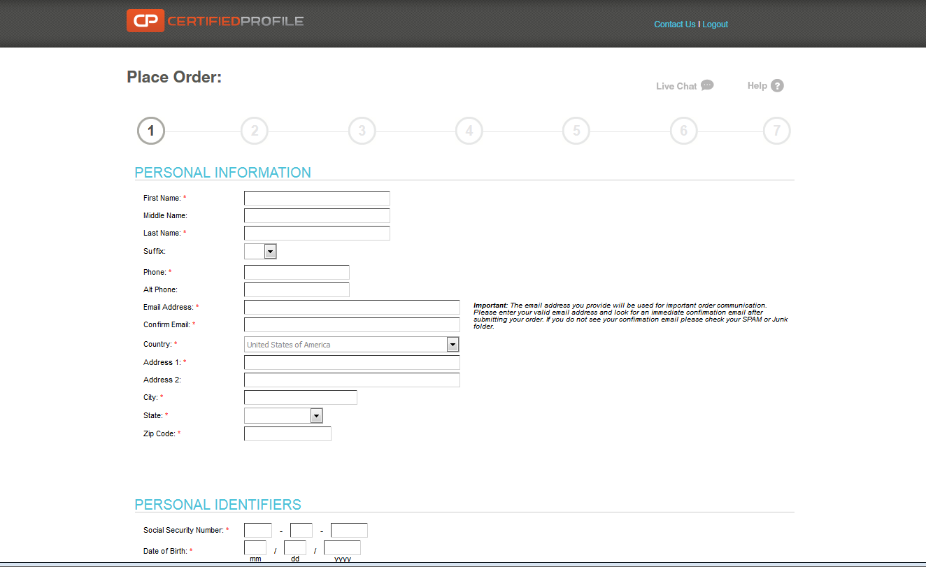
Go to:
https://uky-health.castlebranch.com/UK33
Select “College of Health Sciences”
Select your major (Medical Laboratory Sciences)
Select “I need to order my initial Background Check, Drug Test, and Medical Document Manager
You will then be directed to review your order, and then enter your personal details
The cost is $95.00

Slide 6
Background Check and Drug Screen
Your background check will begin immediately upon purchasing.
Instructions for your Drug Screening will be provided within your Castle Branch “To Do List” within three business days. You will be able to download the registration form and locate a LabCorp near you to process the specimen. It is your responsibility to make sure that you allow enough time for us to receive the result prior to the start of courses.

Slide 7
Clinical Requirements
Health Insurance (annual)
Commitment to Behavioral Standard in Patient Care
Influenza Shot (annual)
Hepatitis B, MMR, Varicella and Tdap documentation
Tuberculosis Two-Step Skin Test or IGRA blood test
An annual one-step skin test or IGRA blood test is required after the initial two-step test the first year.
OLE guide (annual)
HIPAA Education and Consent (annual)

Slide 8
Required Immunizations
Required Vaccines : please obtain documentation from your healthcare provider.
2 step TB skin test or IGRA blood test
Hepatitis B
MMR,
Varicella
Tdap
Vaccines can be administered by University Health Services (UHS)
Appointments may be made by calling 859-323-2778.

Slide 9
Health Insurance
You must provide a copy of your current health insurance card or proof of coverage.
If your name is different than the name listed on the card, you will need to upload documentation showing you are covered under the name listed on the card, along with a copy of the front and back of your insurance card confirming your coverage.
Make sure you upload a copy of the front AND back of the insurance card and any other documents needed as 1 upload.
Example of uploaded card:

Slide 10
Influenza Vaccination
You will need to get a flu shot for the current flu season SEPT 1 – MARCH 31.
Any flu shot administered outside of the current flu season will be rejected and you will need to get a second flu shot during the active flu season.
Note that this document will look a little different depending on where you get your flu shot.
Your document must show the current flu season.
This requirement has a different deadline than the others. You must complete this requirements by November 1st.

Slide 11
Tuberculosis Test
New MLS students are required to complete an initial two-step TB skin test or equivalent (IGRA).
TB skin tests and IGRA blood test can be completed at University Health Services. If you have had a TB test within the last year, please bring a copy of the results with you to your appointment
TB Tests do not have to be completed at UHS, but all TB documentation must be kept and uploaded to your CastleBranch Account

Slide 12
Commitment to Behavioral Standard in Patient Care
In Castle Branch, there is a link to this document. Follow this link to go to the document: https://www.uky.edu/chs/sites/chs.uky.edu/files/Behavioral-Standards-Commitment-Form.pdf
You will need to print, read, and sign this document.
Then, scan it and upload it to Castle Branch (there are scanner apps you can download for free on your phone.)

Slide 13
HIPAA and Discrimination and Harassment Trainings
Go to this link: https://uk.instructure.com/enroll/93PGHL
Enroll in the Canvas course. (NOTE: You will need your LinkBlue ID you will need your password to do so. If you do not yet have it, you will have to wait until you do.)
Go to “Assignments.” You will find the HIPAA training presentation and quiz. Before beginning the quiz, carefully read and review all the information in the presentation. When you are familiar with the material, take the quiz. You will have multiple attempts, but you MUST receive a 100% in order to get credit.
Follow the same instructions for the Discrimination training.
When both are complete, go to the “Grades” tab. You will then select the “Print Grades” option. Save the document as a PDF (you only need the first page that displays the two grades and your name).
Upload this PDF for BOTH the HIPAA and Discrimination training requirements in Castle Branch.

Slide 14
The document you upload for the HIPAA and Discrimination trainings should look like this:

Slide 15
Other Trainings
You will receive more information about the following trainings in August:
Chemical Hygiene (Lab Safety) Training
Hazardous Waste Training
Bloodborne Pathogens Training
Fire Safety Training

Slide 16
Important Notes
Pay attention to due dates! If you do not complete the requirements in time, a hold could be placed on your UK account.
If Castle Branch rejects one of your submissions, promptly address this. They will provide a reason for the rejection. If you still do not understand why a document is not being accepted, you can contact CastleBranch customer service: 888-723-4263 or Tammy Jo Edge at tammy.edge@uky.edu
Occasionally, flu shots get rejected if the flu season is not explicitly stated on the document or your birthdate. It is preferable for the date to be written on the document prior to uploading, but this can be overridden by Tammy Jo Edge if necessary. CHECK FIRST to see if this is the reason a flu shot is rejected.

