Slide 1
Compliance Requirements for Physical Therapy Students
For compliance questions
Email: CHS-Compliance@uky.edu
or
Phone: 859.218.0472
https://www.uky.edu/chs/current-students/compliance-background-checks-and-drug-screens
C.T. Wethington Building Room 111

Slide 2
Requirements
Full Background Check
10 Panel Drug Screening
Clinical Requirements:
Immunizations: MMR, Varicella, Hep B, and Tdap
  Health Insurance (annual)
  Influenza Shot (annual)
  Commitment to Behavioral Standard in Patient Care
  Tuberculosis: IGRA Blood test /updated annually
  CPR Certification (Basic Life Support for Healthcare providers)
  First Aid Certification
  Physical Examination
  Bloodborne Pathogens Certification
  Discrimination and Harassment Training
  HIPAA training

Slide 3
Due Dates
The full background check and drug screening are due August 1st, prior to start of program.
The clinical requirements are due by September 15th each year you are in the program.
Flu Immunization is due November 1st each year.
Bloodborne Pathogen training is due 8/1 the year AFTER you start the program.
It is highly recommended that you begin gathering these materials as early as possible, especially if you are an out-of-state student or you are far from your primary health care provider. Get them done as early as possible in case problems arise!

Slide 4
Instructions for current UK College of Health Sciences undergraduates:
If you are a current UK College of Health Sciences student and are planning to attend UK’s PT program, you will ONLY need to order an updated Background Check and Drug Screen.
Reach out to Tammy Jo Edge to make sure that you are moved to the PT cohort in CastleBranch.
Please go to https://uky-health.castlebranch.com/UK33 and follow the below steps:
1. Click on place order
2. Select Doctor of Physical Therapy
3. Select Lexington or Hazard Campus
4. Select Lexington UK40redt: I need to order my Recheck Background and drug test
OR
Select Hazard UK41redt: I need to order my Recheck Background and drug test
5. The cost is $58.

Slide 5
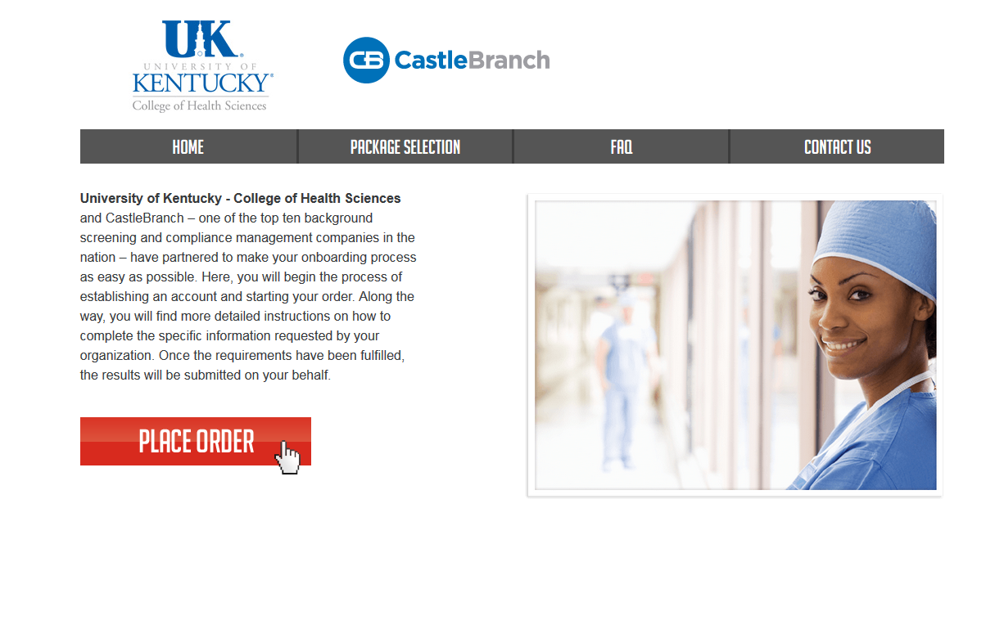
How to get started:
Create an account on Castle Branch

Slide 6
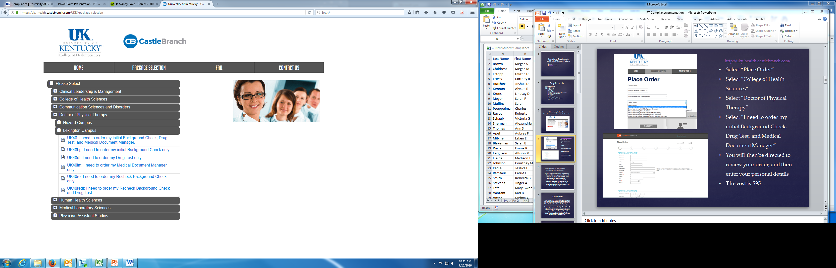
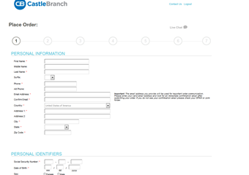
If you are a current UK College of Health Sciences student please follow slide 4!
New UK students follow these instructions below:
Go to: http://uky-health.castlebranch.com/
Select “Place Order”
Select “College of Health Sciences”
Select “Doctor of Physical Therapy”
Select “I need to order my initial Background Check, Drug Test, and Medical Document Manager”
You will then be directed to review your order, and then enter your personal details
The cost is $95.00 if ordered before 5/15/22. 5/15/22 or after, cost is $103.

Slide 7
Background Check and Drug Screen
Your background check will begin immediately upon purchasing.
Instructions for your Drug Screening will be provided within your Castle Branch “To Do List” within three business days. You must use a LabCorp location for your drug screening.
  You will be able to download the registration form and locate a LabCorp near you to process the specimen. It is your responsibility to make sure that you allow enough time for us to receive the result prior to the start of courses.
  For issues processing a drug screen, please call CastleBranch directly at (888) 723-4263.

Slide 8
Clinical Requirements
Health Insurance (annual) Make sure name is on card.
Flu Shot (annual)
Commitment to Behavioral Standard in Patient Care
Tuberculosis: IGRA, QuantiFERON, or 2 step TB skin tests (2 separate TB skin tests given at least 1 week apart and both done within current year).
BLS/CPR Certification (Basic Life Support for Healthcare Providers)
First Aid Certification
Physical Examination
Bloodborne Pathogens Certification
Discrimination and Harassment Training
HIPAA training
Immunizations: MMR, Varicella, Hep B and Tdap

Slide 9
Health Insurance
You must provide a copy of your current health insurance card or proof of coverage.
Please make sure your name is on card. If your name is different than the name listed on the card, you will need to upload documentation showing you are covered under the name listed on the card, along with a copy of the front and back of your insurance card.
Make sure that you upload a copy of the front AND the back of the insurance card and any other documents needed as 1 upload.
Example of uploaded card:

Slide 10
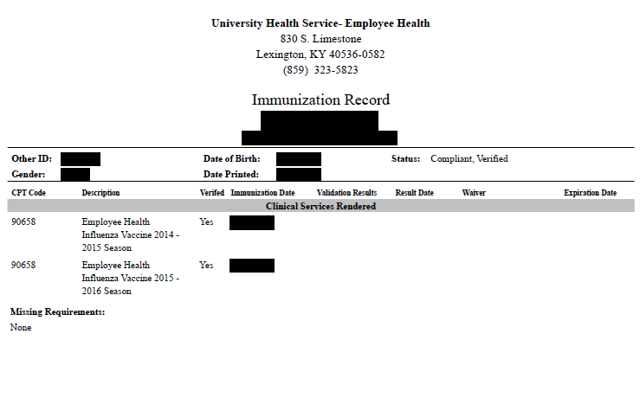
Influenza Vaccination
You will need to get a flu shot for the current flu season SEPT 1 – MARCH 31.
  Any flu shot administered outside of the current flu season will be rejected.
  Note that this document will look a little different depending on where you get your flu shot.
This requirement has a different deadline than the others. You must complete this by November 1st.

Slide 11
Required Immunizations
Required vaccines: please obtain documentation from your healthcare provider.
  Tuberculosis IGRA, QuantiFERON, or 2 Step TB skin test
  Hep B
  MMR
  Varicella
  Tdap
Vaccines can be administered by University Health Services (UHS).
Appointments may be made by calling 859-323-2778.

Slide 12
MMR Vaccine
MEASLES, MUMPS AND RUBELLA (MMR) vaccine Compliance can be obtained by providing: 1. Two MMR vaccines with first dose given at 1 year of age or older AND second dose given at age four or older; OR 2. Documentation of positive antibody titers showing proof of immunity for each of the three diseases: [measles (rubeola), mumps AND rubella] Note: If a student submits documentation of negative or indeterminate titers, but they have also submitted proof of two MMR vaccines as listed above, this is acceptable. Documentation must include: Student’s Name Student’s date of birth If series is completed, dates of each shot OR If titers are provided, dates of positive titers are required and information will include: “immune,” “positive” or number that when compared to range given on record indicates the student is positive/immune; AND Name of the healthcare provider OR UHS compliance form OR Employee compliance form OR state immunization certificate or registry.

Slide 13
Evidence of one dose of TDaP given at any time. Documentation must include: Student’s Name Student’s date of birth Date of TDaP shot; AND Name of the healthcare provider OR UHS compliance form OR Employee compliance form OR state immunization certificate or registry.
TDaP
(Tetanus-Diphtheria Acceular Pertussis)

Slide 14
VARICELLA (Please note that oral history of disease or an X on immunization record is not accepted.) Compliance may be obtained by providing: 1. Evidence of varicella two-dose series after one year of age; OR 2. Positive antibody titer showing proof of immunity; OR 3. Medically documented history of disease (chicken pox/varicella or shingles/zoster) from a healthcare provider (Doctor, APRN, or PA) with date of disease. An X on the immunization form by varicella is NOT acceptable proof of disease. Note: If a student submits documentation of negative or indeterminate titers, but they have also submitted proof of two varicella vaccines as listed above, this is acceptable
Documentation must include: Student’s Name Student’s date of birth If series is completed, dates of each shot; OR If titer is provided, date of positive titer is required and information will include: “immune,” “positive” or number that when compared to range given on record indicates the student is positive/immune; OR
If providing medical history, submit a medical record from healthcare provider (Physician, APRN or PA) stating patient diagnosed with Chicken pox (Varicella) or Shingles (Herpes zoster); AND Name of the healthcare provider OR UHS compliance form OR Employee compliance form OR state immunization certificate or registry.

Slide 15
HEPATITIS B
(Positive titer not accepted)
Compliance may be obtained by providing: 1. Evidence of three Hepatitis B vaccines; OR 2. If series is in process or historical documentation of vaccines could not be obtained, 2 vaccines are required upon initial submission to this requirement. You will be able to submit record of the third shot when it is due. Documentation must include: Student’s Name Student’s date of birth Dates of HEP B shots; AND Name of the healthcare provider OR UHS compliance form OR Employee compliance form OR state immunization certificate or registry. Subsequent Requirement: If only two initial vaccines obtained, Hepatitis B third dose due 6 months after the 1st dose.

Slide 16
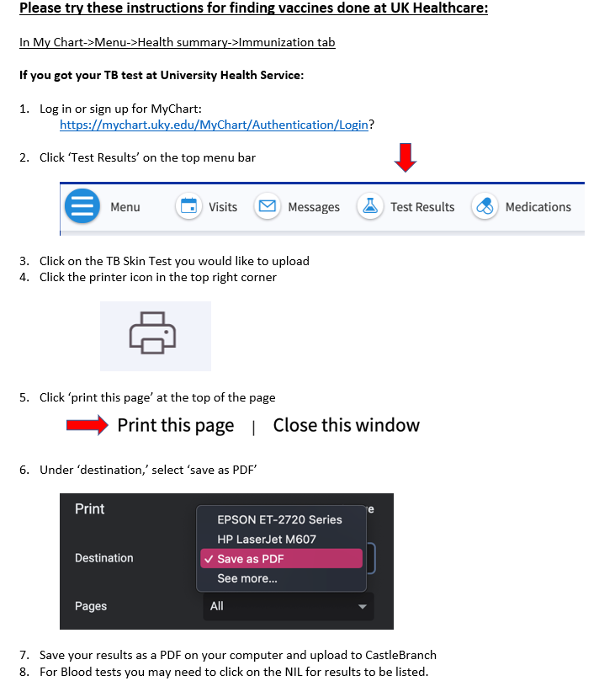
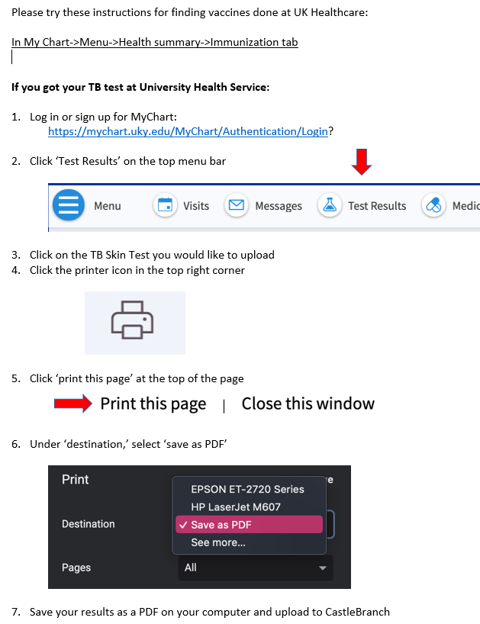
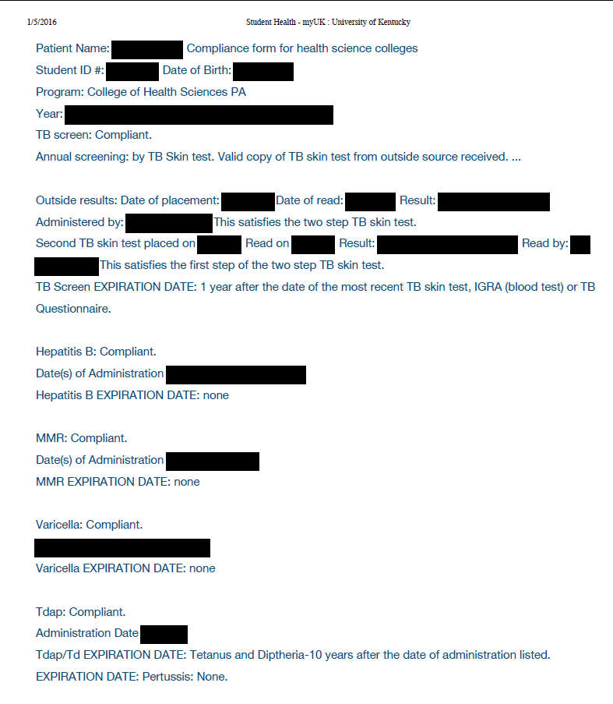
Tuberculosis Test
You must obtain one of the following to complete your TB requirement: IGRA blood test, QuantiFERON blood test, or 2 step TB skin test (2 separate TB skin tests given at least 1 week apart).
Each year you will have to renew your TB blood test or TB skin test.
Instructions for downloading documents from your MyChart in your myUK.

Slide 17
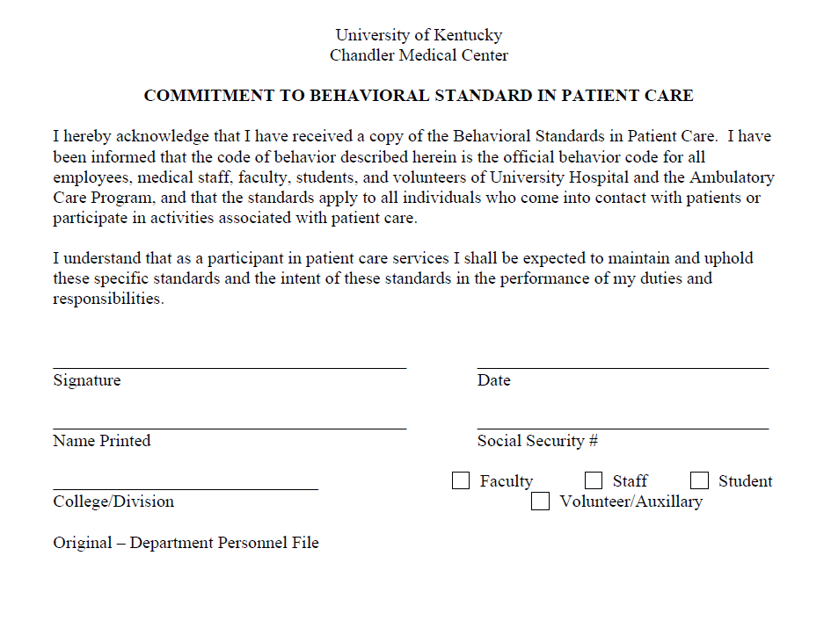
Commitment to Behavioral Standard in Patient Care
In Castle Branch, there is a link to this document. Follow this link to go to the document: https://www.uky.edu/chs/sites/chs.uky.edu/files/Behavioral-Standards-Commitment-Form.pdf
You will need to print, read, and sign this document.
Then, scan it and upload it to Castle Branch (there are scanner apps you can download for free on your phone.)

Slide 18
BLS/CPR Certification
Acceptable documents:
  American Heart Association Basic Life Support OR
  American Red Cross BLS/CPR for Healthcare Providers
  Must be an in-person course (not online)
A copy of BOTH the front and the back of your card is required and the card MUST be signed.
More information can be found at the following links:
  http://www.redcross.org/take-a-class/bls
  http://cpr.heart.org/AHAECC/CPRAndECC/Training/HealthcareProfessional/BasicLifeSupportBLS/UCM_473189_Basic-Life-Support-BLS.jsp

Slide 19
First Aid Certification
Upload copy of your current First Aid Certification card, front & back. Certification must be through the American Red Cross, American Heart Association or a comparable class.

Slide 20
Physical Examination
Here is the link for the UK DPT Physical form to be filled out by your healthcare provider:
https://www.uky.edu/chs/sites/chs.uky.edu/files/PT/pt_student_physical_form_health_record.docx
Upload documentation of your completed physical examination from a physician within the last 12 months to your CastleBranch account.

Slide 21
Bloodborne Pathogens Training Certification
This training will occur during the summer after your first year, so it will be due at the beginning of your second year (8/1).
When you complete the Bloodborne Pathogens training, upload copy of your UK certificate to this requirement. Student name must be included.
https://ehs.uky.edu/classes/classes_ohs_0001.php#bloodborne_pathogens_general

Slide 22
HIPAA and Discrimination and Harassment Trainings
Go to this link and enroll in the Canvas course. (NOTE: You will need your LinkBlue ID and password to do so. If you do not yet have it, you will have to wait until you do.)
Go to “Assignments.” You will find the HIPAA training presentation and quiz. Before beginning the quiz, carefully read and review all the information in the presentation. When you are familiar with the material, take the quiz. You will have multiple attempts, but you MUST receive a 100% in order to get credit.
Follow the same instructions for the Discrimination training.
When both are complete, go to the “Grades” tab. You will then select the “Print Grades” option. Save the document as a PDF (you only need the first page that displays the two grades and your name).
Upload this PDF for BOTH the HIPAA and Discrimination training requirements in Castle Branch.

Slide 23
The document you upload for the HIPAA and Discrimination training should look like this:

Slide 24
Important Notes
Pay attention to due dates! If you do not complete the requirements in time, a hold will be placed on your UK account.
If CastleBranch rejects one of your submissions, promptly address this. Castlebranch will provide a reason for the rejection in an email to you. If you still do not understand why a document is not being accepted, you can contact:
  CHS-Compliance@uky.edu
Occasionally, flu shots get rejected if the flu season is not explicitly stated on the document. Make sure your name, birthdate and date given is also listed on the document prior to uploading. Check your CB account to see what reason your flu shot is rejected.
Note that the flu shot has a different deadline than the other requirements and is due November 1st.

