Slide 1
Exploring Models of Disability and Bias
2021 KARRN Conference
Cara N. Whalen Smith, PT, DPT, MPH, CHES

Slide 2
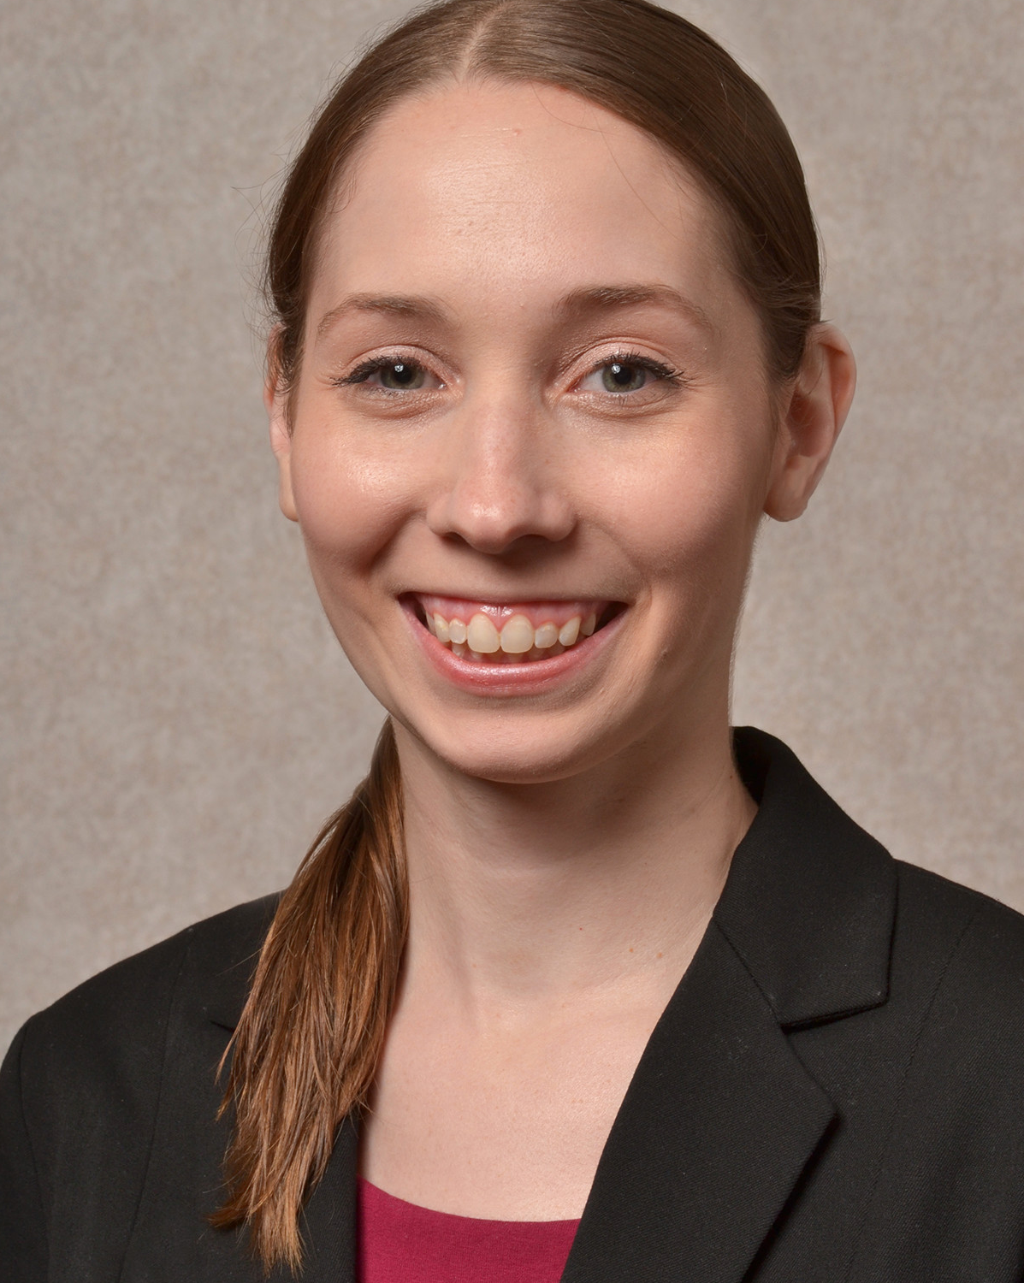
Introductions
Principal Investigator, The Ohio Colleges of Medicine Government Resource Center
Evaluator and subject matter expert, Ohio Disability and Health Program
Adjunct Faculty, The School of Health and Rehabilitation Sciences
Cara Whalen Smith, PT, DPT, MPH, CHES

Slide 3
Funding Acknowledgement
The Ohio Disability and Health Program is supported by the Centers for Disease Control and Prevention Cooperative Agreement Number 5U59DD000931-03. The contents of this presentation are solely the responsibility of the authors and do not necessarily represent the official views of the Centers for Disease Control and Prevention.

Slide 4
Definitions

Slide 5
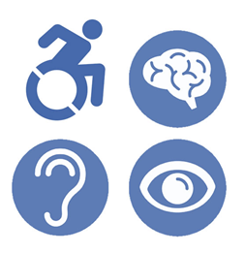
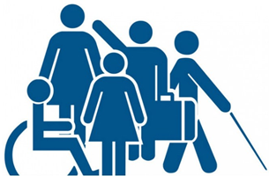
What is Disability?
According to the World Health Organization (WHO), a disability is any cognitive or physical impairment, activity limitation, and/or participation restriction
Disability is the interaction between an individual's health condition and personal and environmental factors

Slide 6
Common Disability Classifications
Physical/Mobility
Intellectual
Developmental
Mental/Behavioral Health
Sensory

Slide 7
Prevalence of Disability

Slide 8
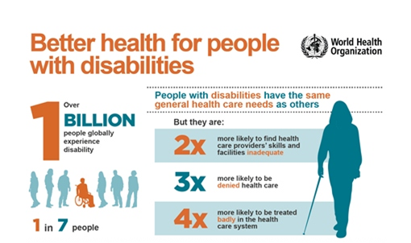
Prevalence of Disability Globally

Slide 9
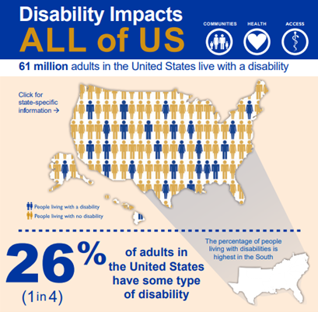
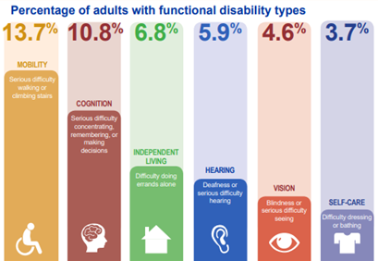
Prevalence of Disability Nationally

Slide 10
Prevalence of Disability in Kentucky

Slide 11
Bias in Healthcare

Slide 12
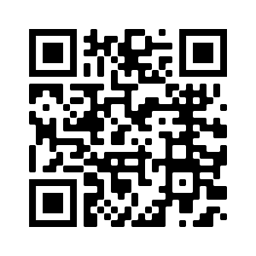
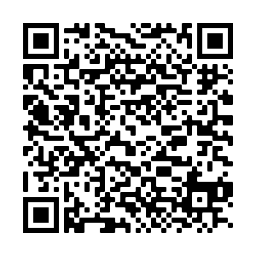
“One Man’s COVID-19 Death Raises the Worst Fears of Many People with Disabilities” (Shapiro, 2020)

Slide 13
Models of Disability

Slide 14
Early Models of Disability
Moral Model
People are morally responsible for their disability
Disability is a "curse" or "punishment" from higher being

Slide 15
Examples of the Moral Model
According to the African Child Policy Forum, common beliefs about childhood disability include:
Sin or promiscuity of the mother
Ancestral curse
Demonic possession

Slide 16
Early Models of Disability
Stella Young TED Talk
Charity Model
Encouraged charitable support towards people with disabilities
Did not focus on the rights or capabilities of people with disabilities

Slide 17
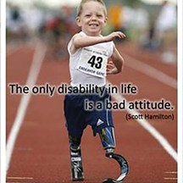
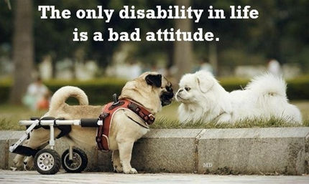
Media Representations of Disability: The "Inspiration" or "Super Human"

Slide 18
Media Representations of Disability: "The Villain"

Slide 19
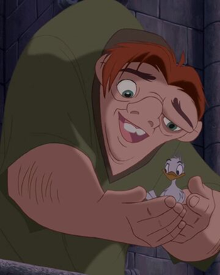
Media Representations of Disability: "The Victim"

Slide 20
Medical Model of Disability
Disability is a result of a person’s physical impairments and seeks to find a cure for those impairments even when they do not cause pain or illness

Slide 21
Social Model of Disability
Disability is a result of the way society is organized rather than by a person’s impairment and seeks to remove barriers that restrict quality of life

Slide 23
Human Rights Model of Disability
“Nothing about us without us” is the core of this model
Calls for full inclusion of people with disabilities as a human right

Slide 24
Biopsychosocial Model: International Classification of Functioning, Disability, and Health (ICF) Model of Disability

Slide 25
Disability Inclusion
"Inclusion means to transform communities based on social justice principles in which all community members:
Are presumed competent
Are recruited and welcomed as valued members of their community
Fully participate and learn with their peers
Experience reciprocal social relationships"
“Inclusion is not a strategy to help people fit into the systems and structures which exist in our societies; it is about transforming those systems and structures to make it better for everyone. Inclusion is about creating a better world for everyone.” (Diane Richler, past president of Inclusion International)

Slide 26
Health Disparities for People with Disabilities

Slide 27
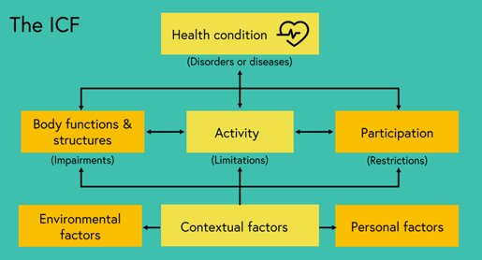
Disability and Health
The WHO defines health as “a state of complete physical, mental, and social well-being, not merely the absence of disease or infirmity” and makes the distinction between disability and health in the ICF model

Slide 28
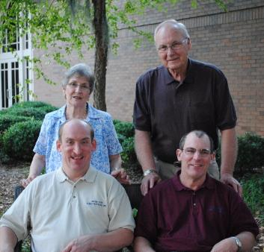
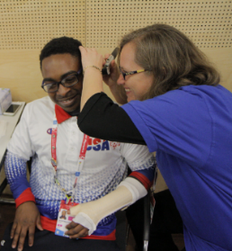
“People with disabilities are not destined to a life of poor health by virtue of their disability.”
Lack of institutional support and ableism contribute to poor health outcomes

Slide 29
Health Disparities
In comparison to the general population, PWDs experience worse health outcomes and overall decreased access to healthcare
PWDs are more likely to report being in ‘fair’ or ‘poor health’ than the general population
There is also a higher risk of disability among people with poor health and people in poverty

Slide 30
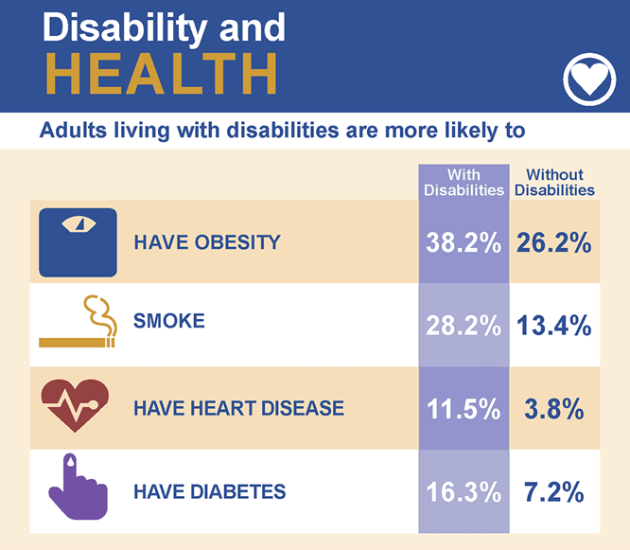

Slide 31
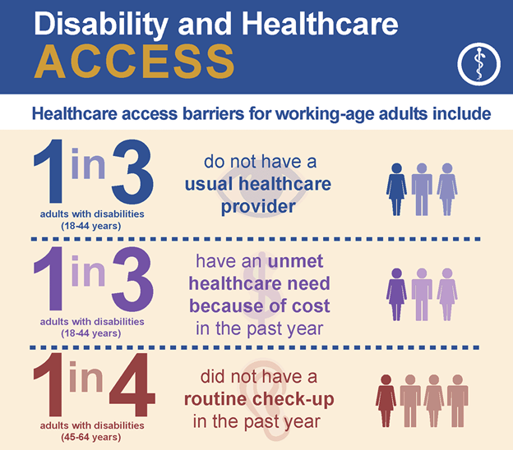

Slide 32
“One Man’s COVID-19 Death Raises the Worst Fears of Many People with Disabilities” (Shapiro, 2020)

Slide 33
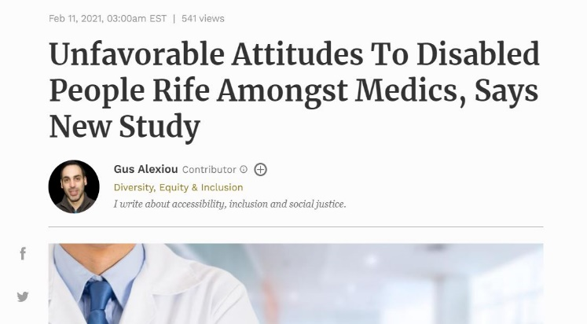
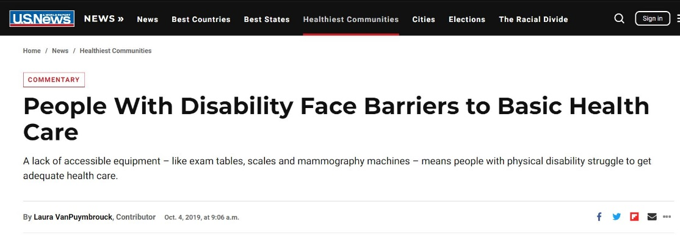
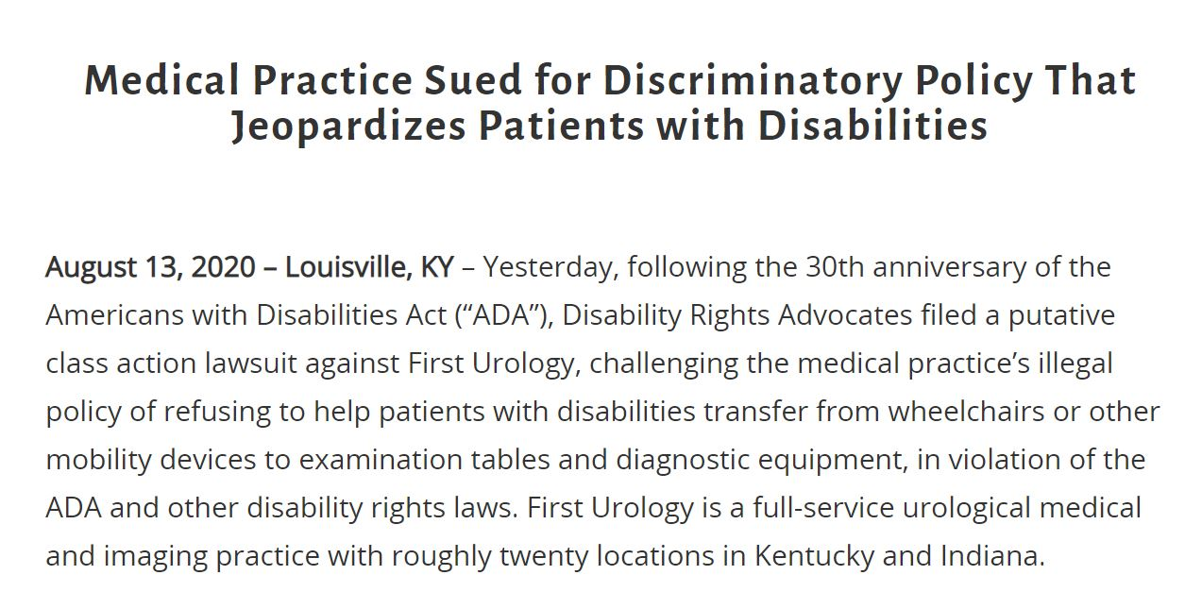
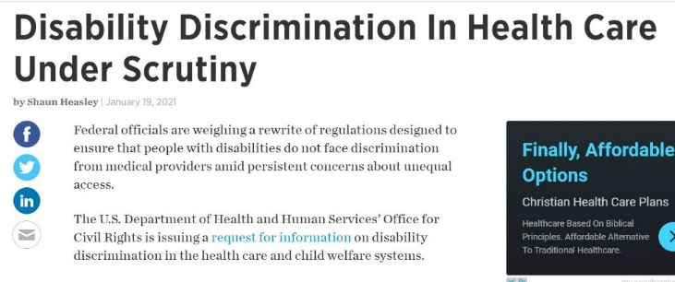

Slide 34
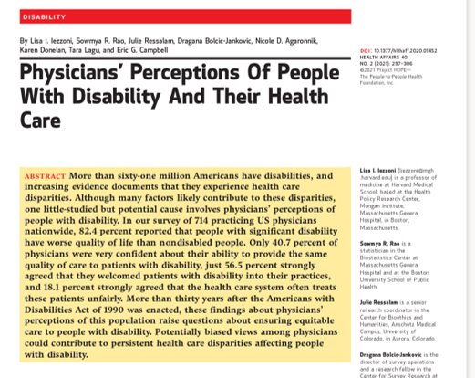

Slide 35
Perceptions of Quality of Life
Ray and West 1984: 60% of people with paraplegia reported feeling more positively about themselves since becoming disabled
Cushman and Dijkers 1990: Spinal cord injured rehabilitation patients were similar to the general population on self-ratings of depression, yet hospital staff consistently overestimated the patients' level of depression
Gerhart et al. (1994): 86% of spinal cord injured high-level quadriplegics rated their quality of life as average or better than average.
Only 17% of their ER doctors, nurses, and technicians thought they would have an average or better quality of life if they acquired quadriplegia

Slide 36
How can we improve health equity for people with disabilities?

Slide 37
Development of Disability Competencies
Individuals with Disabilities
National Delphi process
Family Members
Broad Consensus among stakeholders
Disability Advocates
Health Educators
Healthcare Professionals
Disability Professionals

Slide 38
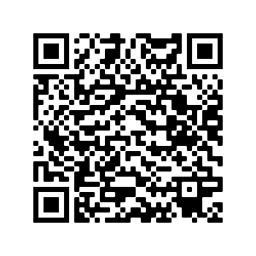
Core Competencies on Disability for Health Care Education

Slide 39
Developed Guiding Principles and Values and 6 competencies
Interprofessional
Cross-disability
Intellectual disability
Developmental disability
Sensory disability
Mobility disability
1.
Disability Frameworks
2.
Professionalism and Patient-Centered Care
6. Clinical Care
Guiding Principles and Values
5.
Clinical Assessment
3. Legal Obligations & Responsibilities
4.
Teams and Systems- based Practice

Slide 40
1.
Disability Frameworks
2.
Professionalism and Patient-Centered Care
Shift in Approach
From: Medical model – Disability is an attribute of the individual and is equated with pathology
To: Biopsychosocial model – Disability and functioning are outcomes of interactions between health conditions and the environment
6. Clinical Care
Guiding Principles and Values
3. Legal Obligations & Responsibilities
5.
Clinical Assessment
4.
Teams and Systems- based Practice

Slide 41
1.
Disability Frameworks
2.
Professionalism and Patient-Centered Care
Communication Skills and Relationship Building
Respect for the whole patient
Recognizing that implicit bias can impact care
6. Clinical Care
Guiding Principles and Values
3. Legal Obligations & Responsibilities
5.
Clinical Assessment
4.
Teams and Systems- based Practice

Slide 42
1.
Disability Frameworks
2.
Professionalism and Patient-Centered Care
6. Clinical Care
Guiding Principles and Values
Accessible health care is a human right
3. Legal Obligations & Responsibilities
5.
Clinical Assessment
4.
Teams and Systems- based Practice

Slide 43
1.
Disability Frameworks
2.
Professionalism and Patient-Centered Care
Working with Teams
Gain skills for team-based practice that include patients with disability at the center of the team
6. Clinical Care
Guiding Principles and Values
5.
Clinical Assessment
3. Legal Obligations & Responsibilities
4.
Teams and Systems- based Practice

Slide 44
1.
Disability Frameworks
Assessing the Whole Patient
Conduct exams that accommodate patients with disabilities
Consider patient’s physical environment, socioeconomic status, and social network in assessment
2.
Professionalism and Patient-Centered Care
6. Clinical Care
Guiding Principles and Values
3. Legal Obligations & Responsibilities
5.
Clinical Assessment
4.
Teams and Systems- based Practice

Slide 45
1.
Disability Frameworks
Quality Healthcare
Need age-appropriate screenings, health education, family planning, and end-of life care options
Provide accessible resources that promote healthy lifestyles and help patients minimize health risks
2.
Professionalism and Patient-Centered Care
6. Clinical Care
Guiding Principles and Values
3. Legal Obligations & Responsibilities
5.
Clinical Assessment
4.
Teams and Systems- based Practice

Slide 46
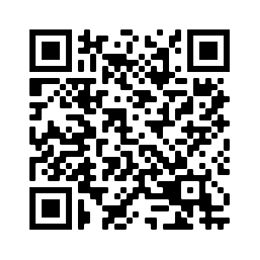
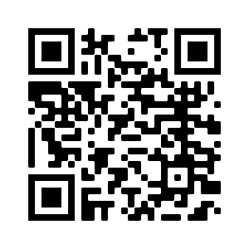
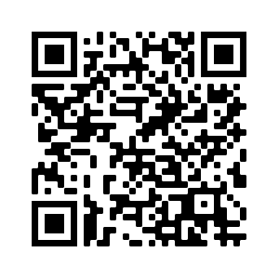
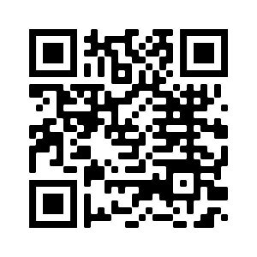
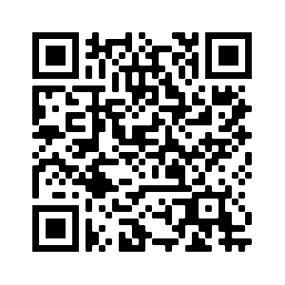
Suggested Resources to Improve Disability Competence
WHO Disability Overview:
World Report on Disability:
Rehab 2030: A Call for Action:
The Missing Billion:
CDC Disability and Health Promotion:

Slide 47
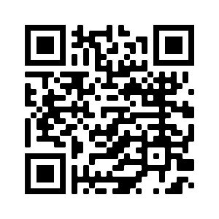
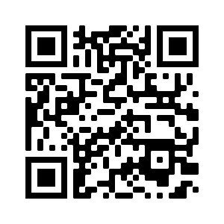
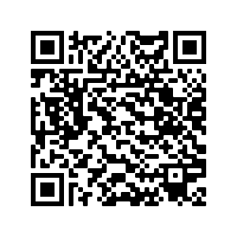
Suggested Resources to Improve Disability Competence
FutureLearn Disability Courses:
Healthcare Access for People with Disabilities Training for Healthcare Professionals:
Human Development Institute Seminar Series on Disability:
Other Disability Trainings:

Slide 48
Suggested Documentaries

Slide 49
#WeThe15 Campaign
https://www.wethe15.org/
https://www.youtube.com/watch?v=gHCDvdCaJhI&t=110s

Slide 50
How can we work to promote health equity?

Slide 51
Thank You! Cara.Whalen-Smith@osumc.edu https://www.linkedin.com/in/cara-whalen-smith/

Slide 52
References
World Health Organization (WHO) & the World Bank. World Report on Disability. Published 2011. Accessed December 23, 2020. http://www.who.int/disabilities/world_report/2011/en.
World Health Organization (WHO). International Classification of Functioning, Disability and Health (ICF). Published Geneva: 2001. Accessed December 23, 2020. https://www.who.int/classifications/international-classification-of-functioning-disability-and-health.
Centers for Disease Control and Prevention (CDC). Disability and Health Overview. Last updated September 16, 2020. Accessed December 23, 2020. https://www.cdc.gov/ncbddd/disabilityandhealth/disability.html.
Center for Disease Control and Prevention (CDC). Disability & Health U.S. State Profile Data for Ohio (Adults 18+ years of age). Last updated June 28, 2021. Accessed August 22, 2021. https://www.cdc.gov/ncbddd/disabilityandhealth/impacts/kentucky.html
Shapiro J. One man’s COVID-19 death raises the worst fears of many people with disabilities. 2020. Available at https://www.npr.org/2020/07/31/896882268/one-mans-covid-19-death-raises-the-worst-fears-of-many-people-with-disabilities. Accessed March 3/5/2021.

Slide 53
References
Kuper H, Myroslava T. Global Health and Disability. London School of Hygiene & Tropical Medicine. 2018. Accessed December 23, 2020. https://www.futurelearn.com/courses/global-disability.
The National Center on Physical Activity and Disability (NCHPAD). Discover inclusive events. 2020. Accessed December 23, 2020. https://www.nchpad.org/1770/6934/Discover~Inclusive~Events.
Bhaumik S, Watson JM, Thorp CF, Tyrer F, McGrother CW. Body mass index in adults with intellectual disability: Distribution, associations and service implications: A population‐based prevalence study. Journal of Intellectual Disability Research, 2008;52(4):287-298.
Blauwet CA, Iezzoni LI. From the Paralympics to public health: increasing physical activity through legislative and policy initiatives. Physical Medicine and Rehabilitation, 2014;6:S4-S10.
Burke É, O’Dwyer M, McGlinchey E, Foran S, Phadraig CM, Carroll R, McCallion P, McCarron M. Overview of the important physical health concerns. In Physical Health of Adults with Intellectual and Developmental Disabilities (pp. 27-52). 2019. Springer, Cham.

Slide 54
References
Cooper SA, Smiley E, Morrison J, Williamson A, Allan, L. Mental ill-health in adults with intellectual disabilities: Prevalence and associated factors. The British Journal of Psychiatry, 2007;190(1):27-35.
Havercamp SM, Scandlin D, Roth M. Health disparities among adults with developmental disabilities, adults with other disabilities, and adults not reporting disability in North Carolina. Public Health Reports, 2004;119(4):418-426.
Havercamp SM, Scott HM. National health surveillance of adults with disabilities, adults with intellectual and developmental disabilities, and adults with no disabilities. Disability and Health Journal, 2015;8(2):165-172. doi:10.1016/j.dhjo.2014.11.002.
Krahn GL, Walker DK, Correa-De-Araujo R. Persons with disabilities as an unrecognized health disparity population. American Journal of Public Health, 2015;105(S2):S198-S206.
Kuper H, Heydt P. The Missing Billion: Access to Health Services for 1 Billion People with Disabilities. Published July 2019. Accessed December 23, 2020. https://www.lshtm.ac.uk/media/38726.

Slide 55
References
McGrother CW, Bhaumik S, Thorp CF, Hauck A, Branford D, Watson JM. Epilepsy in adults with intellectual disabilities: Prevalence, associations and service implications. Seizure, 2006;15(6):376-386.
Okoro CA, Hollis ND, Cyrus AC, Griffin-Blake S. Prevalence of disabilities and health care access by disability status and type among adults — United States, 2016. MMWR Morb Mortal Wkly Rep, 2018;67:882–887.
Ouellette‐Kuntz, H. Understanding health disparities and inequities faced by individuals with intellectual disabilities. Journal of Applied Research in Intellectual Disabilities, 2005;18(2):113-121.
Reichard A, Stolzle H, Fox MH. Health disparities among adults with physical disabilities or cognitive limitations compared to individuals with no disabilities in the United States. Disability and Health Journal, 2011;4(2):59-67.
Rowland M, Peterson-Besse J, Dobbertin K, Walsh E, Horner-Johnson W. Health outcome disparities among subgroups of people with disabilities: a scoping review. Disability and Health Journal, 2014;7:136-150.

Slide 56
References
Vanderbom KA, Eisenberg Y, Tubbs AH, Washington T, Martinez AX, Rauworth A. Changing the paradigm in public health and disability through a knowledge translation center. International Journal of Environmental Research and Public Health, 2018;15:328.
Blick R, Franklin M, Ellsworth D, Havercamp S, Kornblau B. The double burden: health disparities among people of color living with disabilities. The Ohio Disability and Health Program. Published 2015. Accessed December 23, 2020. https://nisonger.osu.edu/sites/default/files/u4/the_double_burden_health_disparities_among_people_of_color_living_with_disabilities.pdf.
Iezzoni LI, Sowmya RR, Ressalam J, Bolcic-Jankovic D, Agaronnik ND, Donelan K, Lagu T, Campbell EG. Physicians’ perceptions of people with disability and their health care. Health Affairs, 2021;40(2): https://doi.org/10.1377/hlthaff.2020.01452.
Ray C, West J. Social, sexual, and personal implications of paraplegia. Paraplegia, 1984;22:75-86.
Cushman LA, Dijkers MP. Depressed mood in spinal cord injured patients: staff perceptions and patient realities. Arch Phys Med Rehabil, 1990;71(3):191-196.

Slide 57
References
Gerhart KA et al. Quality of life following spinal cord injury: knowledge and attitudes of emergency care providers. Annals of Emergency Medicine, 1994;23(4):807-812.
Havercamp SM, Barnhart WR, Robinson AC, Whalen Smith CN. What should we teach about disability? National consensus on disability competencies for health care education. Disabil Health J, 2020; doi: 10.1016/j.dhjo.2020.100989.
Alliance for Disability in Health Care Education (The Alliance). Core Competencies on Disability for Health Care Education. Peapack, NJ: Alliance for Disability in Health Care Education. http://www.adhce.org/. Published June 2019. Accessed December 23, 2020. https://nisonger.osu.edu/wp-content/uploads/2019/08/post-consensusCore-Competencies-on-Disability_8.5.19.pdf.

