Slide 1
Compliance Requirements for Physical Therapy Students
For Compliance questions, contact Tammy Jo Edge
859 218 0472
Tammy.edge@uky.edu
C.T. Wethington Building Room 111

Slide 2
Requirements
Full Background Check
10 Panel Drug Screening
Clinical Requirements:
  Health Insurance
  Influenza Shot
  Compliance Form
  Commitment to Behavioral Standard in Patient Care
  Tuberculosis Two-Step Skin Test
  CPR Certification
  First Aid Certification
  Physical Examination
  Bloodborne Pathogens Certification
  Discrimination and Harassment Training
  HIPAA training

Slide 3
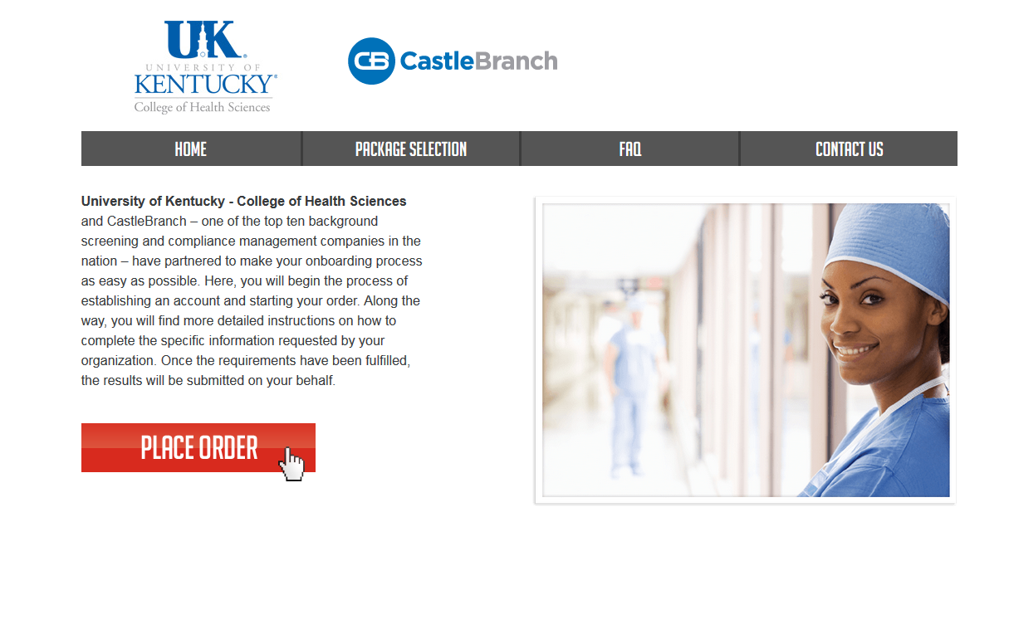
How to get started:
Create an account on Castle Branch

Slide 4
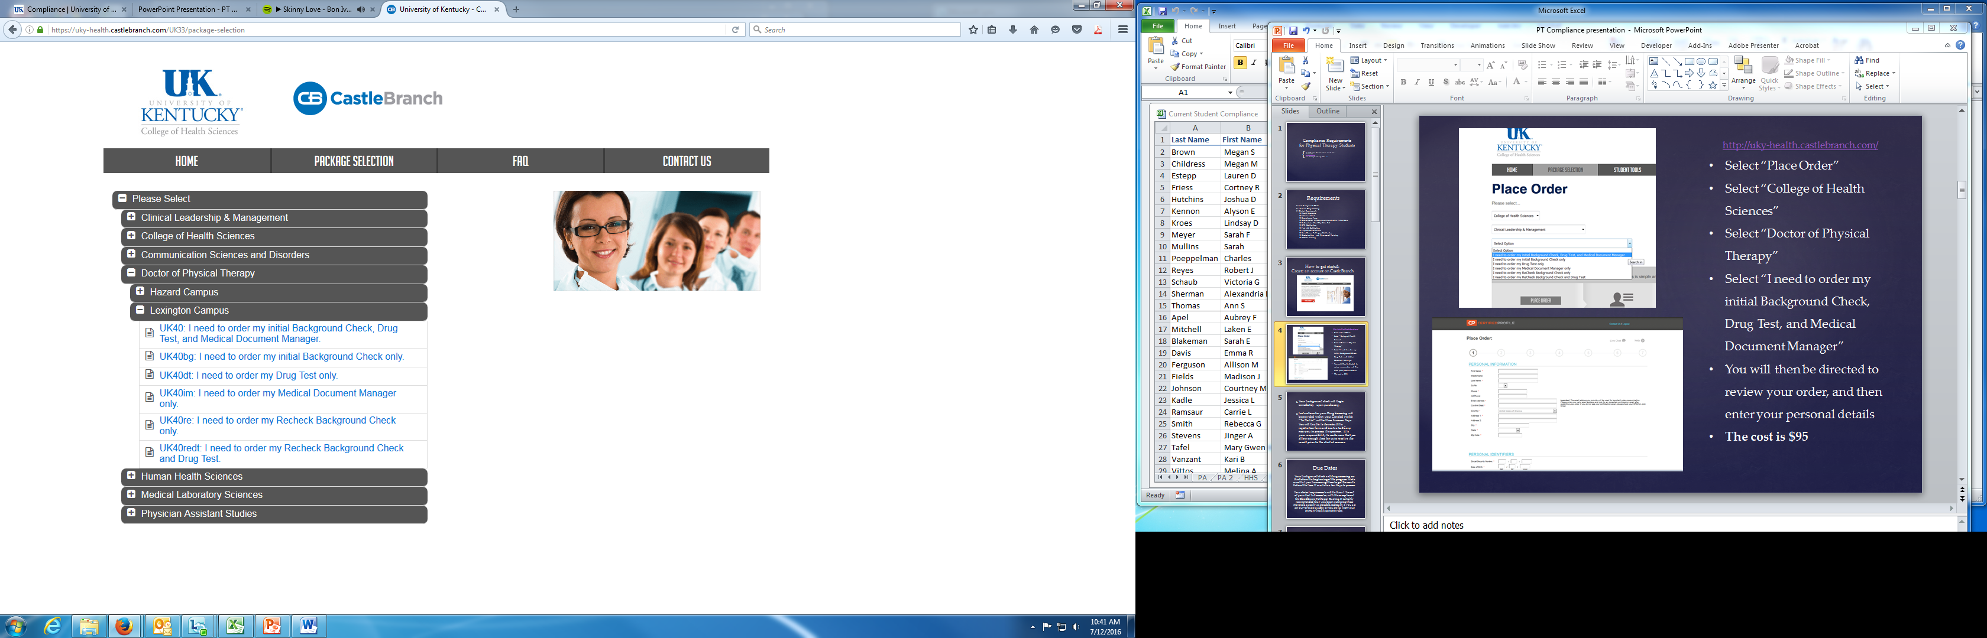
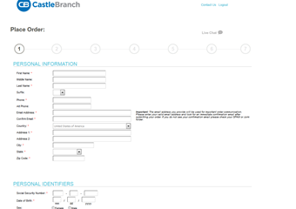
http://uky-health.castlebranch.com/
Select “Place Order”
Select “College of Health Sciences”
Select “Doctor of Physical Therapy”
Select “I need to order my initial Background Check, Drug Test, and Medical Document Manager”
You will then be directed to review your order, and then enter your personal details
The cost is $100.00

Slide 5
Your background check will begin immediately upon purchasing.
Instructions for your Drug Screening will be provided within your Castle Branch “To Do List” within three business days. You will be able to download the registration form and locate a LabCorp near you to process the specimen. It is your responsibility to make sure that you allow enough time for us to receive the result prior to the start of courses.

Slide 6
Due Dates
Your background check and drug screening are due before orientation in August. Make sure that you have enough time to get the results before this time. It can take a few days to process.
Your clinical requirements will be due at the end of your first fall semester, with the exception of the Bloodborne Pathogen Training and flu shot. The flu shot is due November 1st. The Bloodborne Pathogen Training is due the following summer. You will receive more information about this later on.
It is highly recommended that you begin gathering these materials as early as possible, especially if you are an out-of-state student or you are far from your primary health care provider.

Slide 7
Clinical Requirements

Slide 8
Health Insurance
You must provide a copy of your current health insurance card or proof of coverage.

Slide 9
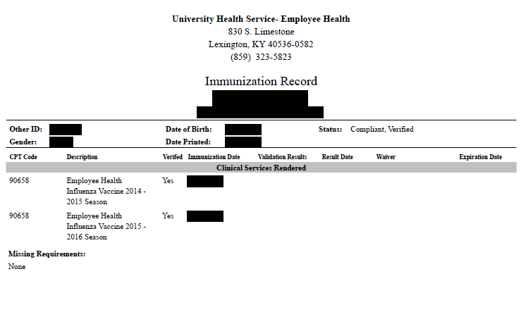
Influenza Vaccination
You will need to get a flu shot for the current flu season SEPT 1 – MARCH 31.
  Any flu shot administered outside of the current flu season will be rejected.
This document is NOT due at the same time as other requirements. You will need it for flu season. The deadline will be sometime in October.
Note that this document will look a little different depending on where you get your flu shot.

Slide 10
Required Immunizations
You must upload ALL your immunization records (TB, Hepatitis B, MMR, Varicella, and Tdap) to your Castlebranch Account
If you need updated immunizations:
Contact University Health Services. Appointments may be made by calling 859-323-2778.

Slide 11
MMR Vaccine
MEASLES, MUMPS AND RUBELLA (MMR) vaccine Compliance can be obtained by providing: 1. Two MMR vaccines with first dose given at 1 year of age or older AND second dose given at age four or older; OR 2. Documentation of positive antibody titers showing proof of immunity for each of the three diseases: [measles (rubeola), mumps AND rubella] Note: If a student submits documentation of negative or indeterminate titers, but they have also submitted proof of two MMR vaccines as listed above, this is acceptable. Documentation must include: Student’s Name Student’s date of birth If series is completed, dates of each shot OR If titers are provided, dates of positive titers are required and information will include: “immune,” “positive” or number that when compared to range given on record indicates the student is positive/immune; AND Name of the healthcare provider OR UHS compliance form OR Employee compliance form OR state immunization certificate or registry.

Slide 12
Note: TDaP is a different vaccine than the tetanus (Td) vaccine, which is recommended every 10 years. TDaP is also different than the childhood DTaP vaccine
Evidence of one dose of TDaP given at 11 years or older. If more than 10 years since date of TDap, then one dose of Td in the last 10 years. Documentation must include: Student’s Name Student’s date of birth Date of TDaP shot; AND Name of the healthcare provider OR UHS compliance form OR Employee compliance form OR state immunization certificate or registry.
TDaP
(Tetanus-Diphtheria Acceular Pertussis)

Slide 13
VARICELLA (Please note that oral history of disease or an X on immunization record is not accepted.) Compliance may be obtained by providing: 1. Evidence of varicella two-dose series after one year of age; OR 2. Positive antibody titer showing proof of immunity; OR 3. Medically documented history of disease (chicken pox/varicella or shingles/zoster) from a healthcare provider (Doctor, APRN, or PA) with date of disease. An X on the immunization form by varicella is NOT acceptable proof of disease. Note: If a student submits documentation of negative or indeterminate titers, but they have also submitted proof of two varicella vaccines as listed above, this is acceptable
Documentation must include: Student’s Name Student’s date of birth If series is completed, dates of each shot; OR If titer is provided, date of positive titer is required and information will include: “immune,” “positive” or number that when compared to range given on record indicates the student is positive/immune; OR
If providing medical history, submit a medical record from healthcare provider (Physician, APRN or PA) stating patient diagnosed with Chicken pox (Varicella) or Shingles (Herpes zoster); AND Name of the healthcare provider OR UHS compliance form OR Employee compliance form OR state immunization certificate or registry.

Slide 14
HEPATITIS B
(Positive titer not accepted)
Compliance may be obtained by providing: 1. Evidence of three Hepatitis B vaccines; OR 2. If series is in process or historical documentation of vaccines could not be obtained, 2 vaccines are required upon initial submission to this requirement. You will be able to submit record of the third shot when it is due. Documentation must include: Student’s Name Student’s date of birth Dates of HEP B shots; AND Name of the healthcare provider OR UHS compliance form OR Employee compliance form OR state immunization certificate or registry. Subsequent Requirement: If only two initial vaccines obtained, Hepatitis B third dose due 6 months after the 1st dose.

Slide 15
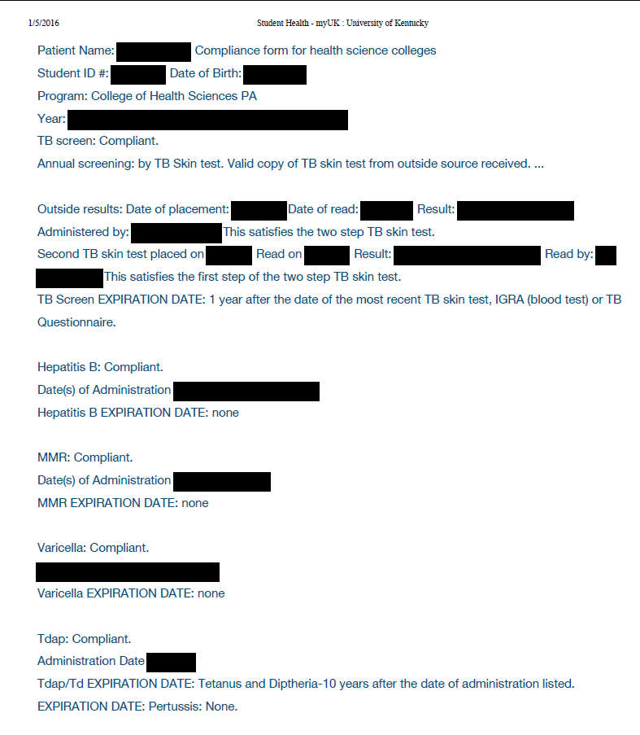
Tuberculosis Test
You must obtain a TWO-step TB test. Each year you will have to renew it with a one-step TB test.

Slide 16
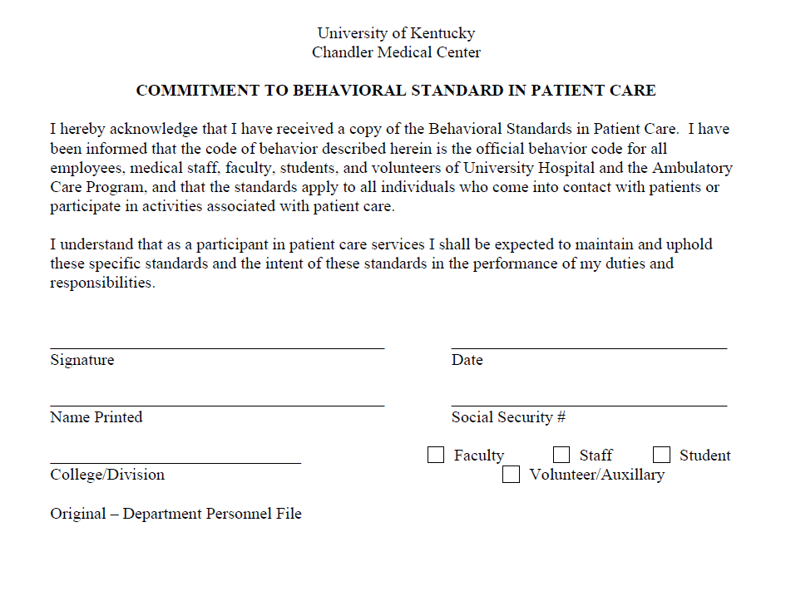
Commitment to Behavioral Standard in Patient Care
In Castle Branch, there is a link to this document. Follow this link or click here to go to the document.
You will need to print, read, and sign this document. Then, scan it and upload it to Castle Branch.

Slide 17
CPR Certification
Acceptable documents:
  American Heart Association Basic Life Support OR
  American Red Cross BLS/CPR for Healthcare Providers
  Must be an in-person course (not online)
A copy of BOTH the front and the back of your card is required and the card MUST be signed.
More information can be found at the following links:
  http://www.redcross.org/take-a-class/bls
  http://cpr.heart.org/AHAECC/CPRAndECC/Training/HealthcareProfessional/BasicLifeSupportBLS/UCM_473189_Basic-Life-Support-BLS.jsp

Slide 18
First Aid Certification
Upload copy of your current First Aid Certification card, front & back. Certification must be through the American Red Cross, American Heart Association or a comparable class.

Slide 19
Physical Examination
Upload documentation of your completed physical examination. The form must be completed and signed by a medical professional, be completed within the past 12 months, AND must be completed on the 2 page form available for download from the following link.
http://www.uky.edu/chs/sites/chs.uky.edu/files/UK%20Student%20Health%20Record%20FINAL.pdf

Slide 20
Bloodborne Pathogens Training Certification
This training will occur during the summer after your first year, so it will be due at the beginning of your second year.
When you complete the Bloodborne Pathogens training, upload copy of your UK certificate to this requirement. Student name must be included.

Slide 21
HIPAA and Discrimination and Harassment Trainings
Go to this link and enroll in the Canvas course. (NOTE: You will need your LinkBlue ID and password to do so. If you do not yet have it, you will have to wait until you do.)
Go to “Assignments.” You will find the HIPAA training presentation and quiz. Before beginning the quiz, carefully read and review all the information in the presentation. When you are familiar with the material, take the quiz. You will have multiple attempts, but you MUST receive a 100% in order to get credit.
Follow the same instructions for the Discrimination training.
When both are complete, go to the “Grades” tab. You will then select the “Print Grades” option. Save the document as a PDF (you only need the first page that displays the two grades and your name).
Upload this PDF for BOTH the HIPAA and Discrimination training requirements in Castle Branch.

Slide 22
The document you upload for the HIPAA and Discrimination training should look like this:

Slide 23
Important Notes
Pay attention to due dates! If you do not complete the requirements in time, a hold could be placed on your UK account.
If Castle Branch rejects one of your submissions, promptly address this. They will provide a reason for the rejection. If you still do not understand why a document is not being accepted, you can contact Tammy Jo Edge at tammy.edge@uky.edu
Occasionally, flu shots get rejected if the flu season is not explicitly stated on the document. It is preferable for the date to be written on the document prior to uploading, but this can be overridden by Tammy Jo Edge if necessary. CHECK FIRST to see if this is the reason a flu shot is rejected.

