Slide 1
Compliance Requirements for Human Health Sciences Majors
For compliance questions, contact Tammy Jo Edge
Phone: 859 218 0472
Email: Tammy.Edge@uky.edu
C.T. Wethington Building Room 111

Slide 2
Clinical Requirements
Full Background Check
10 Panel Drug Screening
Clinical Requirements:
Health Insurance (annual)
Influenza Shot (annual)
Commitment to Behavioral Standard in Patient Care
OLE Guide
HIPAA Education and Consent Form
Hepatitis B, MMR, Varicella and Tdap documentation
Tuberculosis Two-Step Skin Test
An annual one-step skin test is required after the initial two-step test

Slide 3
Due Dates
The full background check and drug screening are due BY January 15th before class registration and start of the program.
The clinical requirements are due March 15th each year you are in the program.
Flu Immunization is due November 1st each year.
It is highly recommended that you do not wait until close to the deadline to complete these requirements. Get them done as early as possible in case problems arise!

Slide 4
How to get started: Create an account on Castle Branch
Step 1: Go to https://uky-health.castlebranch.com/UK33 (copy and paste link)
Step 2: Select “Place Order”
Step 3: Select HUMAN HEALTH SCIENCES
Step 4: Select “UK37 “I need to order my initial Background Check, Drug Test, and Medical Document Manager”
Step 5: Review and place your order
You will need your personal information including SSN for this portion
For designation: undergraduate
Degree/certification: BS-HS /Bachelor of Science in Human Health Sciences
The cost is $95.00

Slide 5
Background Check and Drug Screen
Your background check will begin immediately upon purchasing.
Instructions for your Drug Screening will be provided within your Castle Branch “To Do List” within three business days.
Download the registration form and locate a LabCorp near you to process the specimen. It is your responsibility to make sure that you allow enough time for us to receive the result prior to the start of the semester.
For issues processing a drug screen, please call CastleBranch directly at (888) 723-4263

Slide 6
Clinical Requirements
Health Insurance (annual)
Commitment to Behavioral Standard in Patient Care
OLE Guide (annual)
HIPAA Education and Consent
Influenza Shot (annual)
Hepatitis B, MMR, Varicella and Tdap documentation
Tuberculosis Two-Step Skin Test
An annual one-step skin test is required after the initial two-step test

Slide 7
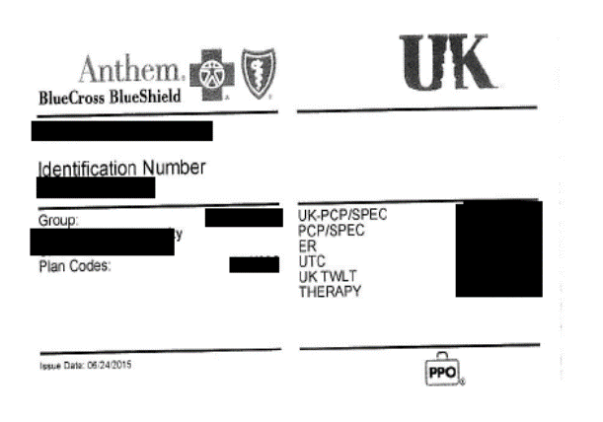
Health Insurance
Example of uploaded card:
You must provide a copy of your current health insurance card or proof of coverage.
If your name is different than the name listed on the card, you will need to upload documentation confirming your coverage.
Make sure that you upload a copy of the front AND back of the insurance card.

Slide 8
Influenza Vaccine
You will need to get a flu shot FOR THE CURRENT FLU SEASON RUNNING SEPT 1 – MARCH 31.
If you receive a flu vaccine outside of this window, it will be rejected and you will need to get a second flu shot during the active flu season
Your documentation must show the current flu season
This requirement has a different deadline than the others. You must complete this by November 1st.

Slide 9
Required Immunizations
Required Vaccines :
TB
Hepatitis B
MMR,
Varicella
Tdap
Vaccines can be administered by University Health Services (UHS)
Appointments may be made by calling 859-323-2778.

Slide 10
Tuberculosis Test
New College of Health Sciences students are required to complete an initial two-step TB skin test or equivalent (IGRA).
TB skin tests can be completed at University Health Services. If you have had a TB test within the last year, please bring a copy of the results with you to your appointment.

Slide 11
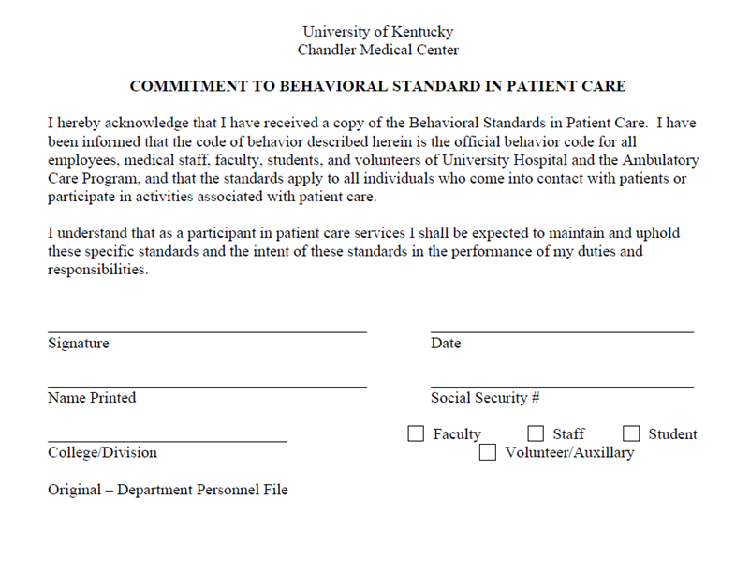
Commitment to Behavioral Standard in Patient Care
You will receive a copy of the Behavioral Standards in Patient Care at orientation
In CastleBranch, there is a link to this document.
You will need to print, read, and sign this document.
Scan the signed document or take a clear photo and upload it to CastleBranch (there are scanner apps you can download for free on your phone.)

Slide 12
Important Notes
Pay attention to due dates! If you do not complete the requirements in time, a hold could be placed on your UK account.
If CastleBranch rejects one of your submissions, promptly address this. They will provide a reason for the rejection. If you still do not understand why a document is not being accepted, you can contact Tammy Jo Edge at Tammy.Edge@uky.edu.
Occasionally, flu shots get rejected if the flu season is not explicitly stated on the document. It is preferable for the date to be written on the document prior to uploading, but this can be overridden by Tammy Jo Edge if necessary. CHECK FIRST to see if this is the reason a flu shot is rejected.
Note that the flu shot has a different deadline than the other requirements and is due November 1st.

