Slide 1
Benefits & Challenges of Using Amazon’s Mechanical Turk for Studying Violence Against Women
Claire M. Renzetti, Ph.D.
Judi Conway Patton Endowed Chair, CRVAW
Professor & Chair of Sociology

Slide 2
Mechanical Turk (MTurk)
Crowdsourcing website, owned and administered by Amazon
>500,000 Workers from 190 countries (75% from US & India)
~10,000 Requesters: recruit and compensate workers for completing Human Intelligence Tasks (HITs)
Mason, W., & Suri, S. (2012). Conducting behavioral research on Amazon’s Mechanical Turk. Behavior Research Methods, 44, 1-23.

Slide 3
MTurk Benefits & Challenges
Methodological: sample and data quality
Administrative or logistical

Slide 4
What is MTurk & how does it work for researchers?
Online labor market that allows Requesters (researchers) to post tasks to be completed (HITs) by Workers
Cost: compensation ranges from 1 cent - more than $10, depending on time required and level of difficulty + Amazon surcharge (min. 20%)
Qualifications: 1) workers’ geographic location; 2) workers’ approval rating/% [other “qualifications” (eligibility criteria) can be specified for additional cost]

Slide 5
What about MTurk Workers? (MTurkers)
Worker accounts are free
Must be at least 18 years old
Remain anonymous to Requesters through a unique Worker ID
May search for HITs by keywords, time required, compensation amount, or descriptions

Slide 6
Who works for MTurk? (How do they compare to the US population?)
Younger (average age: 30)
White (Asian Americans overrepresented; Black and Hispanic Americans underrepresented)
Better educated (college graduates)
Underemployed
Lower-middle to middle class (annual family income: $40,000-$100,000)
Heterosexual & married

Slide 7
My sample
MTurk samples
Younger (average age: 30)
White
Better educated (college graduates)
Underemployed
Lower-middle to middle class
Heterosexual & married
73% between 25-44
72% White; 10.6% Asian; 7.9% Black; 7.1% Hispanic
44% college degree; 13.5% graduate or professional degree
50% annual family income $70,000-$100,000
42% married and living with their partner

Slide 8
How representative of the general U.S. population are MTurk Workers?
More representative than college student samples, but not representative of the general US population.

Slide 9
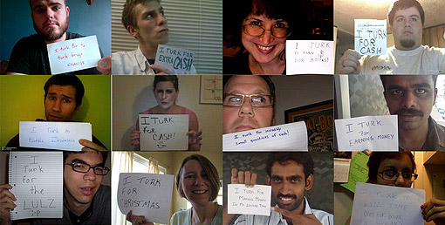
Why do people join the MTurk workforce?
Like completing surveys
To learn new things
To earn money

Slide 10
Insufficient Effort Responding (IER)
Response set in which the respondent answers survey with little or no effort
Post-screening methods to identify IER are somewhat controversial due to high measurement error
Time checking: exclude surveys completed in <60% of average completion time
MTurkers do not have higher IER rates and do show good consistency in responses over time

Slide 11
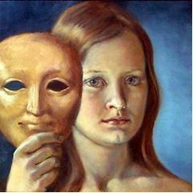
Social Desirability Bias
MTurk Workers score higher on social desirability measures
MTurkers appear to be particularly concerned with pleasing the Requester
MTurkers are no more or less likely to disclose sensitive information than other samples
No reason for researchers to be more concerned about dishonesty or inconsistency among MTurk Workers

Slide 12
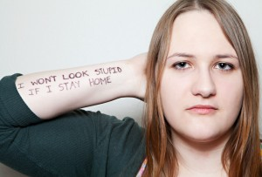
Clinical Symptoms
Clinical levels of social anxiety and symptoms of depression
Similar to other Internet samples
Younger and female MTurk workers have the highest rates of clinical symptoms

Slide 13
Buyer beware

