Slide 1
APEX Degree Planner Transfer Equivalencies and New Gen Ed What are the issues? March 4, 2011 Advising Network Meeting

Slide 2
What will not change for Fall 2011
Students who have earned an AA or AS from a regionally accredited KY school will have all UK Gen Ed requirements fulfilled.
Students who are GETAFULL (Gen Ed Fully Certified) will have all UK Gen Ed requirements fulfilled.
Students who have a Bachelor’s degree from a regionally accredited school will have all UK Gen Ed requirements fulfilled.
All scenarios will continue to show the same verbiage as they do now in APEX.

Slide 3
Regional Accreditation Agencies
Southern Association of Colleges and Schools
Middle States Association of Colleges and Schools
New England Association of Schools and Colleges
North Central Association of Colleges and Schools
Northwest Commission on Colleges and Universities
Western Association of Schools and Colleges

Slide 4
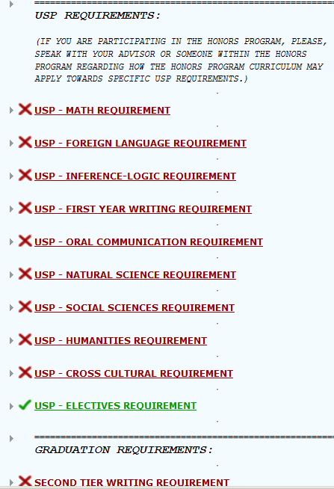
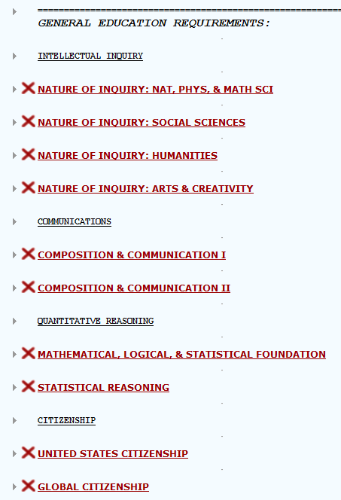
What does change
The look from USP to Gen Ed

Slide 5
Other Changes
As of Fall 2011, Any new transfer student who has an AA or AS from a regionally accredited institution will have earned credit for all UK Gen Ed requirements.
Transfer students from Kentucky institutions under the Statewide GETA agreement who are GETACOMM (GETA Communications Certified) will have met the new UK Composition & Communication requirements.
As of Fall 2011, What credit do students earn in Gen Ed for having transfer equivalencies for ENG 101, 102, 104, and COM classes?

Slide 6
Composition and Communication Issues *For Transfer students and UK students entering GEN ED Effective Fall 2011
Scenario | Outcome
ENG 101 + 102 and *COM Class | DONE with C&C
ENG 102 and *COM Class | DONE with C&C
ENG 104 and *COM Class | DONE with C&C
ENG 104 Only | Take WRD 111 or CIS 111
ENG 102 | Take WRD 111 or CIS 111
ENG 101 and 102 | Take WRD 111 or CIS 111
ENG 101 Only | Take WRD 111 or CIS 111
ENG 101 and *COM Class | Take WRD 111 or CIS 111
*COM Class Only | Take WRD 111 or CIS 111

Slide 7
Composition and Communication Issues -Current or readmitted students
Replacement of ENG 104 with CIS/WRD or A&S 100 (Comp & Comm)
Can students use repeat options?
NOT Possible
Not same course, issues with governance and oversight.
Students can use repeat option if they take:
CIS 110 then take WRD 110 or vice versa
A&S 100 (Comp & Comm) then CIS/WRD 110.

Slide 8
All other current GETA certification mappings to our new GEN ED program will be completed in APEX in the very near future. These include: GETA Math Certification GETA Natural Science Certification GETA Humanities Certification GETA Behavioral\Social Science Certification

Slide 9
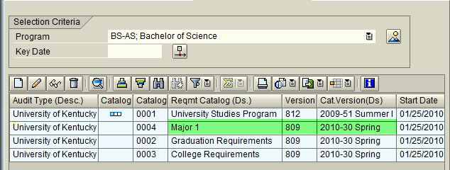
The ONLY catalog year which comes into APEX from SAP is the MAJOR Catalog Year. By default, this MAJOR Catalog Year is used as the Catalog Yr for: 1) USP / GEN ED 2) Grad Writing 3) Premajor 4) Minor 5) Honors

Slide 10
What triggers the catalog year to change in SAP?
Changes to a Degree Program
Changing from a BS-AS in Biology to a BS-CI in Communications for example.
NOTE: Changes from one major to another in the same program do not create catalog changes in SAP. Going from a BA-AS in English to a BA-AS in History would not cause a change. Hence, APEX would not change except to read the new major requirements.

Slide 11
3 possible scenarios
Scenario-1:
-Student with Fall 2010 Catalog year is changed to Fall 2011 catalog in SAP as a result of changing programs (BS to BA) resulting in the new Gen Ed replacing the USP (on audit), but student wants to complete the USP.
Scenario-2:
-Student with Fall 2009 Catalog year has no changes to catalog year and the USP displays on the audit. Then student comes to you or your Student Services area and decides to complete the new Gen Ed.
Scenario 3:
-Student with Fall 2010 Catalog year comes to your office in Fall 2011 and wants to change (BA to BS)degree programs. However, she wants to keep the current major requirements for the Fall 2010 which is the bulletin requirements she came in under, but she wants to move to Gen ED.

Slide 12
-Student first semester = Fall 2010 -USP starts out on audit -Major catalog year changed to Fall 2011 in SAP as a result of Program (BS to BA) change. -Gen Ed automatically replaces USP on audit -Major requirements for Fall 2011 will appear on audit -Student prefers to complete USP -Exception needed to replace GenEd with USP
Scenario-1

Slide 13
-Student prefers to complete USP but Gen Ed is on audit. -Use the Y1 exception
Scenario-1

Slide 14
NOTE: Must have approved security level to process and/or request exceptions.
Scenario-1
1.) Go to “Exceptions” menu selecting “Add Exception”.

Slide 15
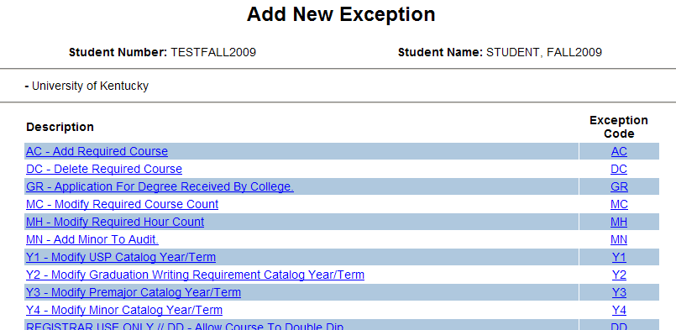
NOTE: Must have approved security level to process and/or request exceptions.
Scenario-1
2.) Select the Y1 exception (Modify USP Catalog Year/Term)

Slide 16
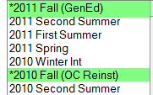
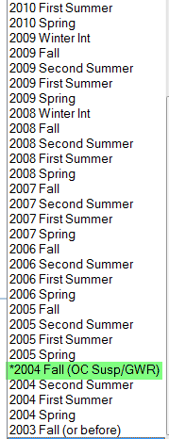
NOTE: The Y-exception’s catalog year drop down menu has specific catalog year values marked.

Slide 17
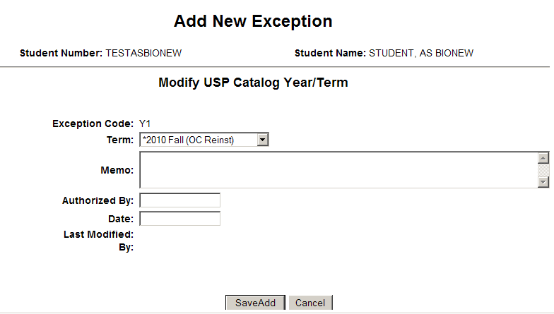
NOTE: Must have approved security level to process and/or request exceptions.
Scenario-1
3.) Complete exception form & click “SaveEdit” button.

Slide 18
-USP has replaced Gen Ed on audit
Scenario-1

Slide 19
-Student first semester = Fall 2009 -No change in major catalog year in APEX as no change was entered in SAP for major or program change. -USP remains on audit -Student interested in completing new Gen Ed -Y1 Exception needed to replace USP with Gen Ed
Scenario-2

Slide 20
-USP starts out on audit (Fall 2009)
Scenario-2

Slide 21
-No change in major catalog year -Student interested in completing new GenEd -Use the Y1 exception (follow instructions in previous slides)
Scenario-2

Slide 22
-Gen Ed has replaced USP on audit
Scenario-2

Slide 23
Scenario-3
Student started in Fall 2010 but comes to you in Fall 2011.
Wants to go by Fall 2010 major catalog but chooses to change programs. (BS to BA)
Also wants to go by new Gen Ed requirements.
Three step process.
Change program in SAP as you normally would.
Change the major requirements catalog back to Fall 2010 in SAP on the Requirements Catalog tab.
Add a Y1 (Fall 2011 catalog) exception in APEX so USP is replaced by Gen ED.

Slide 24
Other APEX issues
April 8 – Transfer Conference
Once GETA issues are resolved, APEX will migrate GEN ED requirements for Fall 2011.
Keep in mind that each major should be using the short form adopted by the Senate to show how requirements may change. These are due on April 8th.

Slide 25
What will be in APEX for April 8th
New Gen Ed requirements showing only courses that have been approved by April 7.
Currently coded Fall 2010 Major requirements since the changes for Fall 2011 are not going to get to us until April 8th or later.
GETA mappings and all other Transfer mappings – AA or AS, Bachelor’s degree, ENG and COM issues, etc…
These changes will be in APEX by March 31 so you may prepare for the Advising Conference on the 8th.

Slide 26
APEX
Major requirements will be updated throughout the summer with hope that all departments submit changes to requirements sooner rather than later.
It is imperative that the APEX College contacts communicate with Team APEX on a regular basis so that we may get all requirements coded appropriately as approved by the Senate processes.

Slide 27
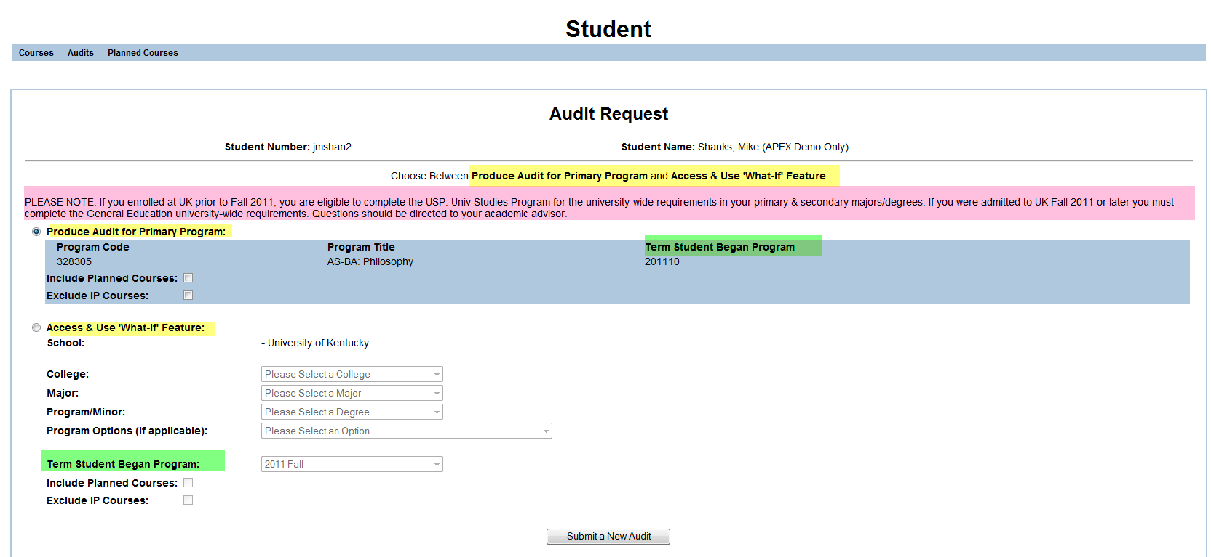

Slide 28
Transfer Equivalency Issues
Currently working with all departments to get active equivalencies updated due to SACS review and new Gen Ed. (Will be end dating equivalencies if UK no longer teaches the course) ENG 161, ENG 105, STA 200
We have over 122,800 active equivalencies in SAP to be reviewed.
Working with CPE to implement TES (Transfer Equivalency System). Implementation target date is January 2012. More information to follow.

Slide 29
UK Students Taking Transfer Work over Summer
Process
Review Transfer Equivalency information in myUK with the student.
If equivalency is established in myUK, student needs to send official transcript to admissions office immediately following grade being posted so work can get posted on UK record.
If equivalency is not established in myUK, send student to Transfer Equivalency Office. (Room 10 Funkhouser)
What if current equivalency in myUK is a course UK may no longer be offering? i.e. STA 200. Please send the student to the Transfer Equivalency Office, so that we can work with the STATS dept. to determine the correct equivalency. They may now get STA 210 or STA 291 instead of STA 200.

Slide 30
Questions?

