Slide 1



Self-Service Adoption
Analytics Open Lab Presentation
September 16, 2016
Heidi Hiemstra
Assessment Coordinator

Slide 2


Slide 3


Slide 4

Notes:
How to Get People in your College to Adopt Self-Service
Ambitious title! Can’t say I’ve done it enough to tell anyone else how to – lead a discussion and share ideas
Quick poll – take a moment to think about how many people in your college/unit other than tableau superusers go find theor own stuff on the server?

Slide 5
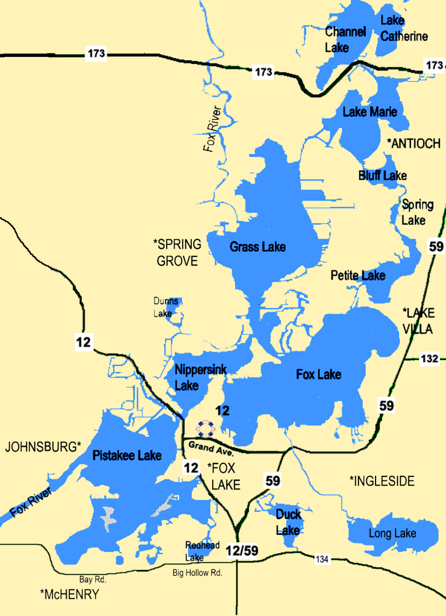

Assess the Terrain
Who’s thirsty?
Notes:
Data desert or land o’lakes? Where will you be successful?
Projects or people
Silos – have people built their own solutions? Not a good target

Slide 6

Executive Sponsorship
Title
Content
Notes:
You need it.
If you don’t have it, can you get it?
Demo project – choose carefully for success! (terrain issues)
Particular executive?
If you can’t get it, don’t spend much time on developing and maintaining open reports

Slide 7

Notes:
Hard for users is easy for us
Easy for users is hard for us
There is a tradeoff
And you have to make it easy

Slide 8
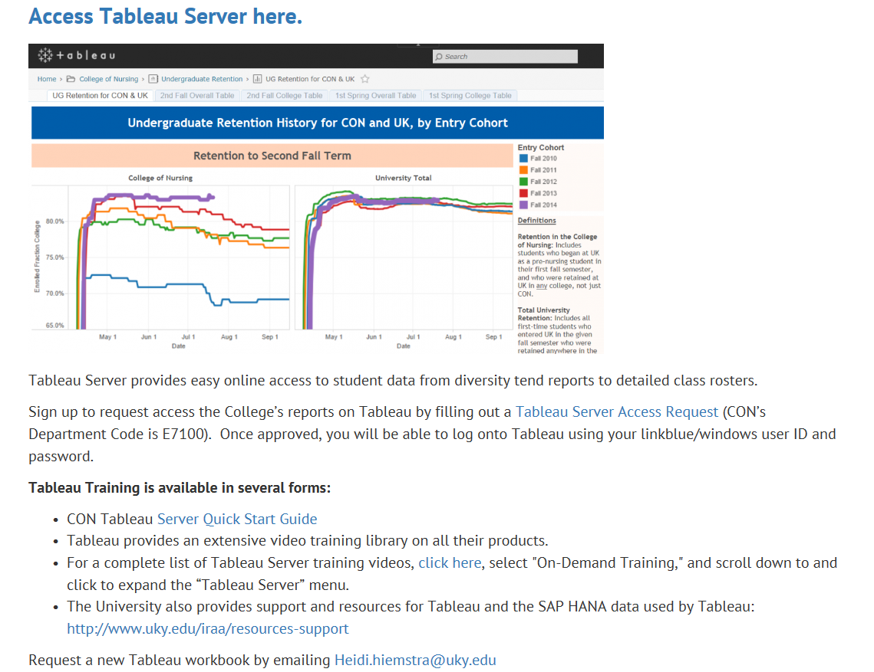
Provide support
Notes:
Put local support in one place
Go to – overview
Quick-start guide
System overview for experienced staff
CUSTOMIZED intro to the home page
Must be maintained!!!

Slide 9


Customize training
Notes:
You will have to provide training – formal sessions and one-on-one
Customized – what does this audience/individual need?
Provide customized materials – the quick-start guide

Slide 10
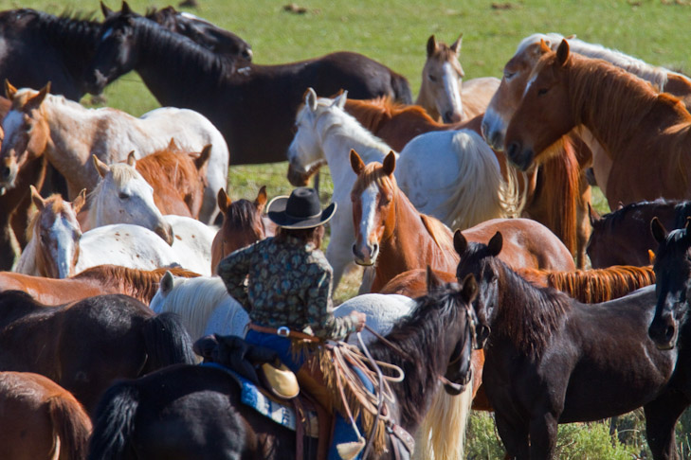
Drive to Tableau
Notes:
You’ve set it up, now drive them in…

Slide 11
Water when thirsty
-----Original Message-----
Could I have a list of all currently enrolled DNP students with their advisors, if such a thing exists? I have an old list (DNPs enrolled since 2014), but I don't have the fall 2015 cohort info.
Thanks so much!
-----Reply-----
Absolutely! That info and much more is available online in Tableau. To get an account, go to the link below and fill out the form. After you have access, I'd be happy to give you a guided tour in person or online....
https://docs.google.com/forms/d/1EkkUy8JrRBGtRIhteXpR3CGgNvOaEveIs5m70SNBU7I/viewform (our dept. code is E7100)

Slide 12
Water where YOU want
-----Original Message-----
When you get a chance, can you send me class rosters for both 301 & 410? Thanks!
-----Reply-----
You can use this report to pull up any class roster: https://analytics.uky.edu/views/ClassRosters-CON15014/ClassEnrollmentDemographics?:embed=y&:display_count=no
Notes:
Someone with an account already

Slide 13

Don’t get trampled
Not more PDFs!!
Notes:
Know your audience – many will want pretty paper/PDF reports – make them!
Download PDF from server

Slide 14
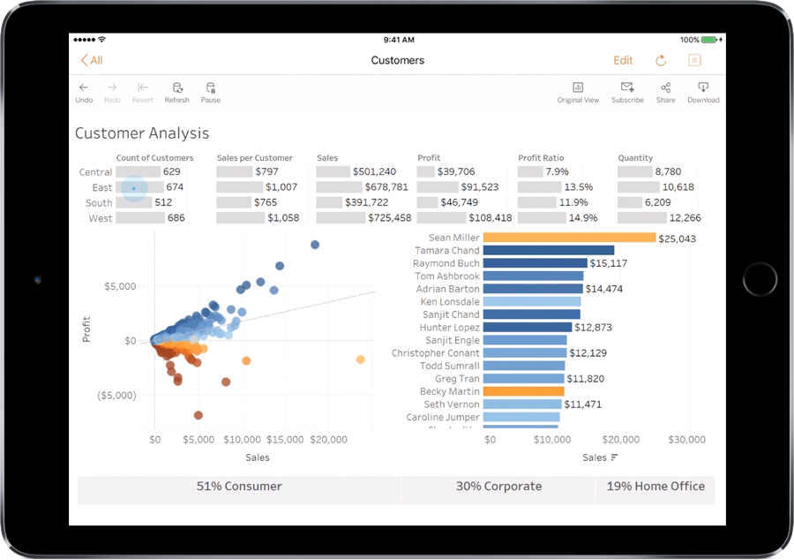

Other platforms?
Notes:
Has anyone used?

Slide 15
Self-Service Adoption
Analytics Open Lab Presentation
September 16, 2016
Heidi Hiemstra
Assessment Coordinator
Heidi.hiemstra@uky.edu

