Slide 2
“
“
How can I get automatically notified when
enrollment for my college increases by a
particular percentage?
How can I get alerted whenever the average
GPA for a class drops below a threshold?
Notes:
Conditional Subscriptions
We'll start off this presentation with two questions:
> How can I get automatically notified when enrollment for my college increases by a particular percentage?
and,
> How can I get alerted whenever the average GPA for a cohort drops below a threshold?
These may be the sort of questions that many of you and your customers have wanted to know for a long time.
> And Tableau begins to address these needs with the new conditional subscription feature.

Slide 3
Notes:
Conditional subscriptions are so easy to use they only take one checkbox to turn on.
Subscribe your viz to a schedule and click the “don’t send if view is empty” checkbox. When the subscription runs, if there’s data displayed on any worksheet in the viz, then Tableau will send an email.
> In this example, we’re measuring the patient flow in an emergency department. The model we’ve built generates a rating between 1 and 5 for the workload.
> Now, let’s say we want to send out the alert to hospital administrators on an hourly basis if the work load is 2.5 or greater.
That way, administrators can be ready to mobilize additional staff, handle patient complaints due to increased wait times, etc.
In this case, all we need to do in the view is add a filter for the workload measure.
Note that Tableau is still displaying the worksheet title and has changed the time to “All.” But there is no data returned to the view itself, and that’s the important point.
When Tableau Server runs the subscription, it will ignore this view. When the subscription does run, for example at 9PM, the resulting email looks like this:
> An image of the subscribed view that is hyperlinked back to the view, and a footer with some basic subscription information.

Slide 4
Notes:
Spatial File Connector
Working with spatial data isn’t a daily requirement for most of us, but this is an important feature that was released in Tableau 10.2.

Slide 5
Notes:
In this example, we’ve connected a shapefile from the City of Philadelphia. The file includes demographic profile attributes by census tract (basically subdivisions).
> From this file, we’ve picked the attribute we’re most interested in and simply dragged and dropped. Here is a viz of how many people carpool to work within the city.

Slide 6
Notes:
Legend Per Measure
The spatial file connector stole the show in Tableau 10.2, but the “legend per measure” feature will likely be more appealing to you all.

Slide 7
Notes:
What this new feature entails is that you can now create unique legends for each of the measures you have in your view.
The first step to use legends per measure in Tableau is to set up a table that uses the Measure Names field.
Next, place the Measure Values field on the Color Marks Card. In the past, this would result in one color legend for the measure values, with the same colors being applied across the entire table of different measure names. Giving you what you see here.
> With legends per measure, simply clicking on the Measure Values field on the Color Marks Card and choosing Use Separate Legends will result in independent legends for each measure in the table.
> And here is how the highlight table looks with legends per measure applied
You can also recombine the legends by clicking on the Measure Values field on the Color Marks Card again and choosing “Combine Legends”.

Slide 8
Notes:
Data Driven Alerts
Tableau 10.3 brings a new level of self-service to you. With data-driven alerts, users can receive email when a mark crosses a visual threshold in 3 easy steps.

Slide 9
Notes:
Select the axis you want to alert on.
> Click the Alert button in the toolbar.
> Choose the trigger condition and when to send it.
> Alert owners can sign themselves and any other users up to receive alert emails in Tableau Server. Each recipient manages their own alert preferences with one click, directly from the email.

Slide 10
Notes:
Recommended Tables
Have you ever connected to SAP HANA and wondered which of the 6 ”Enrollment” tables has the right data to look at?
Good news: The first feature to use Tableau’s new recommendation engine is coming in 10.3.
Recommended tables use machine learning on content published to Tableau Server to recommend relevant tables and provide smarter default joins. These features will save you time getting data ready for analysis by making it even easier to find and combine your data.

Slide 11
Notes:
First, make sure that you are signed into Tableau Server so that you can leverage the recommendations engine.
Next, connect to a database of interest.
> Once I am connected, I can see all of the tables in this database, as well as five recommended ones. Looking at the recommended tables tab shows me which tables are most popular.
> Now I can find the table I need (in this case, the _workbooks table), and Tableau will recommend other related tables. These are tables that others have joined to the _workbooks table in the past.

Slide 12
Notes:
When we work with data, sometimes we have a specific question in mind, and other times our questions appear as we explore.
Tooltip selection is a new feature in Tableau 10.3 that enables us to quickly discover new questions just by interacting with our visualization.

Slide 13
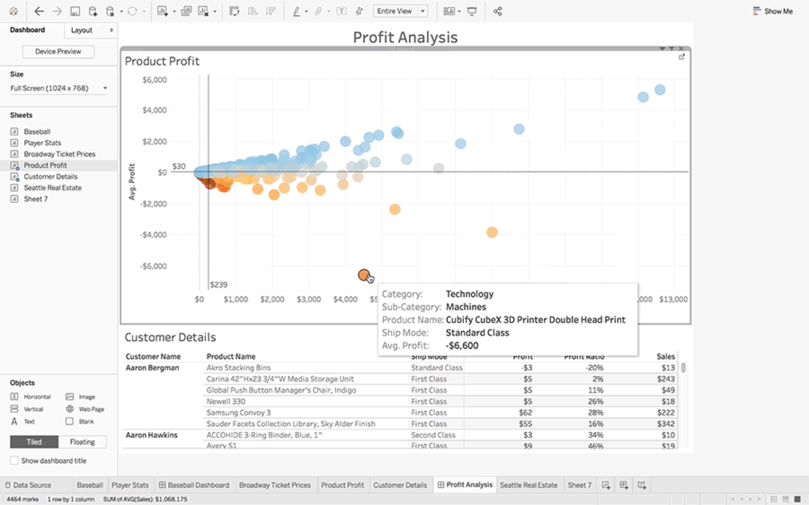
Notes:
Let’s look at an example using the Superstore workbook in Tableau.
In my Profit Analysis view, I want to understand profit profile by product.
I notice a mark—the lowest profit—and want to know more about it. From details in the tooltip, I learn the Category is Technology, the Sub-Category is Machines, and the Ship Mode is Standard Class.
Immediately, the question arises: Do other products like this one also have unusually low profit?
With tooltip selection, the answer is just one click away.

Slide 14
Notes:
By selecting Technology in the tooltip, I can quickly see that, overall, Technology product profits are much higher than average.
When I select Machines, I see the profit is still higher than the overall average, but not as high as Technology’s.
And when I select the Product Name, that’s where I stumble upon an actionable discovery: It looks like I’m losing less money when I ship this particular machine using First Class instead of Standard shipping.

Slide 15
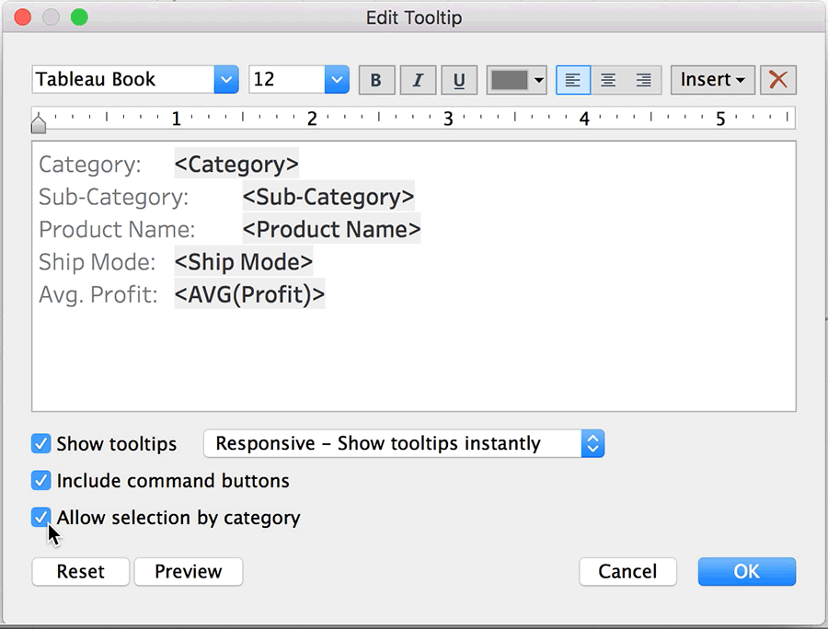
Notes:
By default, tooltip selection is enabled for new worksheets.
However, there may be a reason you prefer to have it off. To do so, simply toggle the “Allow selection by category” option in the tooltip editor.
For upgraded worksheets, tooltip selection is off by default. You can turn it on in the same tooltip editor.

Slide 17
Notes:
New Story Points navigator options. A dots style has been added that streamlines the navigator, plus a new display toggle.

Slide 18
Notes:
With the PDF connector, pre-processing data from PDF documents is a thing of the past.
Now you can connect to PDF documents like you can a text file, leverage all of Tableau’s awesome capabilities (cross data-source joins, parameters, and more), and build impactful visualizations with ease.

Slide 19
Notes:
Speaking of connectors, with Tableau 10.3, you can connect to data stored within Dropbox, OneDrive, and ServiceNow.

Slide 20
Notes:
Latest date presents let you start with up-to-date data. Set filters to display latest date values automatically, as soon as your workbook opens.
And, now, my second favorite feature.

Slide 21
autosave
noun | au·to·save | \ˈȯ-tō-ˌsāv\
a function of a computer program (such as a word processor or spreadsheet) that automatically saves an open file at regular intervals
Notes:
Autosave.

Slide 22
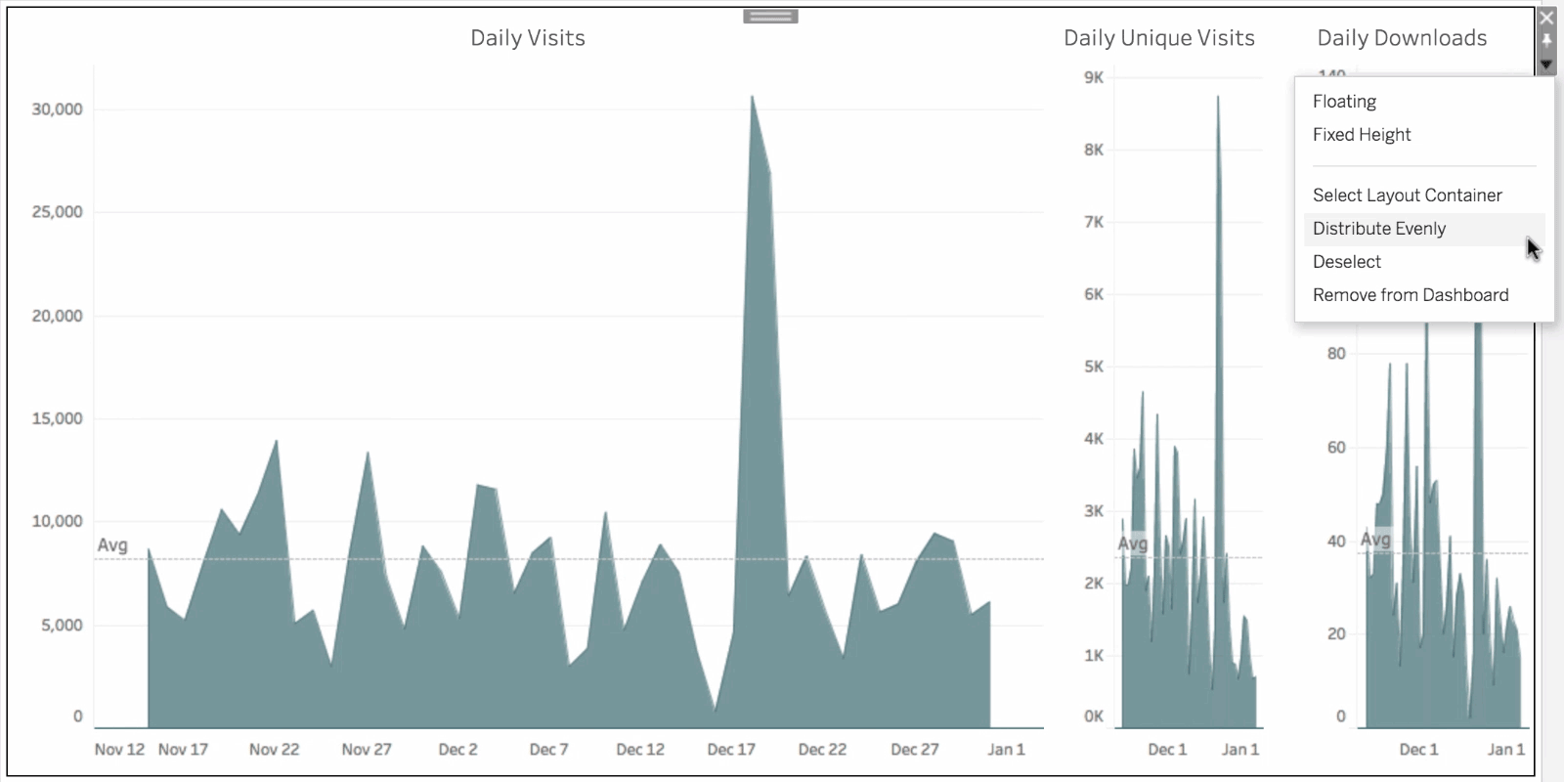
Notes:
And, last but not least, my favorite feature, Distribute Evenly. This new option lets you make a picture perfect dashboard faster.
Evenly distribute objects in your dashboard with a click.

Slide 23
When are we upgrading?
June 15

