Slide 1
Software Purchases and UK Protected Data

Slide 2
Why are we doing this?
UK Purchasing is responsible for our contracts. Risk have been identified that not all contracts are not being reviewed.
This process is designed to address the issues identified.
Currently 3rd party vendor risk assessments are done Ad-Hoc. This creates a delay in the process and several gaps.
Several laws and regulatory bodies require Vendor Risk Assessments (GLBA & PCI for example).
The University has a legal and moral responsibility to protect our data
This is a Pilot process, and we are looking for feedback to improve it.

Slide 3
Vendor Risk Assessments should be initiated as soon as possible in the purchasing process.
Risk scores can help in negotiating cost.
Higher Education data has become a lucrative target and data breaches are expensive. The average cost of a data breach in higher education is $3.7m
We have been lucky. Several of our peers have suffered much worse.

Slide 4
How to get started uky.service-now.com

Slide 5
The Who
The first section of the form is related to gather information about who is requesting the software and contact points for the software.

Slide 6
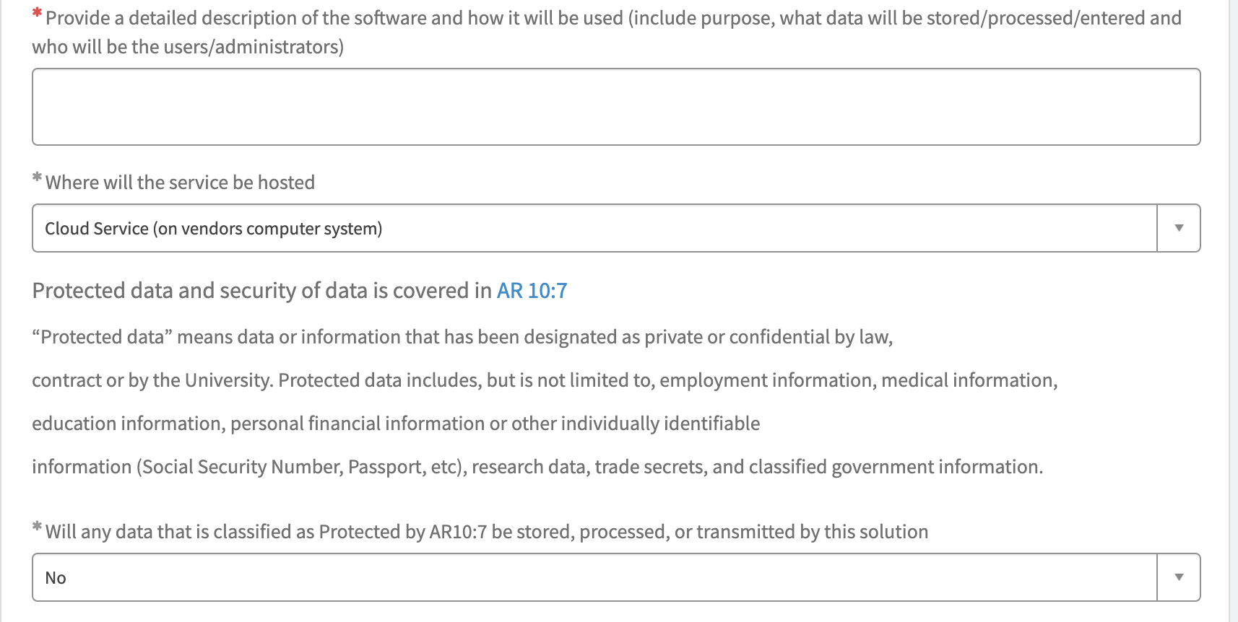
The What
We are asking you a detailed description of what the software will do and who will use it.
Where will the software be? Will it need space on campus or will it be on the Cloud?
Is this data Protected?

Slide 7
The What (cont)
Does this software have the ability to processes payments?
No = it doesn’t have the ability
Yes = it has the ability, but we are not going to use that function
Yes – and we will use credit card capability

Slide 8
The potential impact
How much of UK would be affected by an incident (breach, crash, etc.)
Single User = small group of users such as a single person or a small lab
Department
College/Unit = College of Fine Arts, ITS
Enterprise = This affects the majority of the University such as SAP or Microsoft 365
Essential to the Operation of the University = Can UK function if this goes down?
New Purchases of $10,000 or higher must be reviewed and approved by the CIO – has this been done?

Slide 9
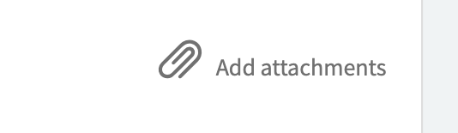
Attaching documentation
Please attach Contract and any documentation related to the purchase so they can be reviewed.
Only UK Purchasing can approve the Contract.
UK Purchasing is the Signatory for UK Purchasing Contracts, including recurring Contracts (AR 8-3)

Slide 10
What happens next?

Slide 11
How long will this take?
Initially we realize that this will increase the amount of time it takes to purchase software, but as the process is adopted it will decrease the total amount of time from request to purchase by standardizing it.
This will provide an internal catalogue of approved UK vendors.
The longest part of the Vendor Risk Assessment is waiting on the Vendors to provide the information. We are addressing this by looking to partner with a company that catalogues the assessments.
While we believe that this process is well designed, we need feedback from the subject matter experts. We want your opinions on how to improve it. Please feel free to contact me at Michael.Sheron@uky.edu
Our goal is to “go live” by October 1^{st.}

