Slide 1
Neonatal sepsis
Alan Chan, MD

Slide 2
outline
Definitions
Signs/symptoms
Evaluation
Treatment
Group B strep (GBS) prophylaxis
Question of the day

Slide 3
ABP content specs
Sepsis -- 1. Plan appropriate antimicrobial therapy for suspected sepsis in the immediate newborn period
Streptococcus agalactiae (group B streptococcus)
Understand the epidemiology of GBS
Plan the appropriate management of an infant born to a mother with a positive culture for GBS
Recognize the major clinical features associated with GBS, and manage appropriately
Plan the appropriate management of an infant born to a mother with chorioamnionitis (CAM)

Slide 4
The basics
Neonate < 28 days
Term > 37 weeks
Late preterm/near term 34-36 weeks
GBS – Gm pos, beta-hemolytic bacteria. Recognized in 1930s, most common cause of sepsis and meningitis < 3 months in 1970s.

Slide 5
Early onset sepsis (EOS) first days of life
Usually from vertical transmission by contaminated amniotic fluid or from vaginal delivery in lower genital tract
– bloodstream infection <= 72 hr of life
Early onset GBS – infection with symptoms up to day 6 of life
Originally defined from GBS research > 40 year ago. Consensus guidelines in 2002.

Slide 6
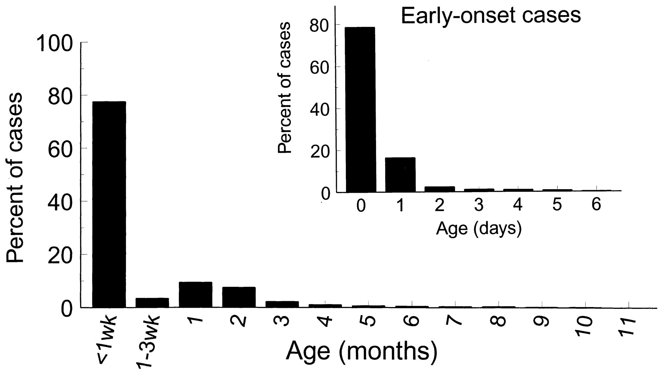
Age distribution of invasive GBS disease in infants, by age in months, weeks, or (for early-onset cases only) days.
Schuchat A Clin. Microbiol. Rev. 1998;11:497-513
Notes:
Age distribution of invasive GBS disease in infants, by age in months, weeks, or (for early-onset cases only) days. The data are based on active surveillance in four geographic areas of the United States in 1993 and were obtained from the CDC.

Slide 7
Late onset
maternal vertical transmission leading into later infection
Horizontal from providers or environment
Other common organisms is E. Coli – affecting mostly preterm infants.

Slide 8
Overall incidence of any sepsis - 1-5/1000 live births and lower in term births 1-2/1000
Incidence of EOS from GBS dropped after 2002 guidelines, but late onset increased, primarily in preterm infants.
Incidence of EOS from E. coli stable, but slight increase in late onset.

Slide 9
Big data
This data from Active Bacterial Core surveillance from CDC’s Emerging Infections Program
Network in 10 sites, about 42 million people.
Includes Group A and B strep, H. influenzae, N. meningitidis, S. pneumoniae, and MRSA.

Slide 10
Other bugs
Listeria – rare.
S. aureus – skin, bone, joint
Enterococcus – more rare
other Gm neg, eg Pseduomonas
Coag neg staph (CoNS) in nosocomial infections or considered contaminant in healthy term infants

Slide 11
Sign/symptoms
Fever
Tachycardia
Meconium in amniotic fluid
Low APGAR @ 5 min; score <= 6 had 36x likelihood of sepsis compared to >=7.
Temperature instability
Jaundice, respiratory distress, hepatomegaly, anorexia/poor feeding, emesis, lethargy, cyanosis, apnea, irritability, diarrhea

Slide 12
Maternal factors
Intrapartum temp >= 100.4
Delivery < 37 weeks (preterm!)
Chorioamnionitis (CAM)- sepsis risk increases 4x)
Rupture of membranes >= 18 hrs – 10x risk
Intrapartum antibiotic prophylaxis n.b. – ½ of moms delivering infants with EOS received abx.

Slide 13
Environmental risks
Mostly NICU based from 2001 survey.
Total parenteral nutrition (RR 3.66)
Mechanical ventilation (RR 3.2)
Arterial line (RR 2.43)
Central venous line (RR 2.37)
Peripheral catheter (RR 2.02)

Slide 14
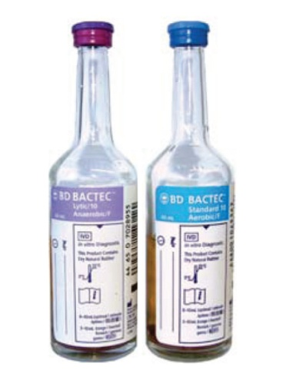
Labs and stuff
Blood cultures (19.80 plus sens)- get at least 0.5 ml, if not more. pos usually 24-36 hours
CBC (15.59) 6-12 hrs post delivery
Neutrophil count – neutropenia has better specificity. A little difficult.
Low with low gestational age
Low in C-sections
Low in arterial sample
Low in low altitudes

Slide 15
I/T ratio (9.54) – 90th percentile in healthy infants is 0.27; has a high Negative predictive value (if the test is negative, then the kid really does not have the disease)
CRP (9.78) – acute phase reactant – triggered by cytokines (TNF-alpha, IL-6) - good for following disease. If < 1 after 24-48hr on abx, then probably safe.
Procalcitonin (45.44) – release by parenchymal cells in response to bacterial toxins. Potentially better than CRP.

Slide 16
Lumbar puncture (23.73 plus culture) – AAP says do if pos blood culture, looks like sepsis either clinically or from labs, gets worse on abx.
Urine culture (7.28) in >=6 days (if urine is pos in younger, then it’s really bacteremia)
CXR (23.71 + 0.66 RVUs)
Other inflammatory markers – amyloid A, IL-1Beta, E-selectin??

Slide 17
Treatment
Amp and gent!!! - ampicillin 150-300 mg/kg/day per chronologic age (APH algorithm 200 div q8h and dose can be dropped if meningitis ruled out), gentamicin 4mg/kg/day)
Cefotax and gent
Vanc and nafcillin and gent
GBS known? – use PCN G
Follow the antimicrobial susceptibility chart

Slide 18
Supportive care
Oxygenation
Perfusion
“Thermoneutral” environment
Continue abx for 10-14 days for blood stream, 2-3 weeks for meningitis

Slide 19
Morbidity – preterm infants most affected
Sepsis increased risk in newborns with patent ductus arteriosus, bronchopulmonary dysplasia, necrotizing entercolitis, and duration of hospital stay.
Cognitive development – although study was in mostly ELBW/VLBW infants.

Slide 20
Debate in 2012
Committee for Fetus and Newborn – women with suspected CAM, continue abx in neonate if BCx neg and if labs abnormal. Then they said “discontinue if sepsis risk is low”.
Then they said “do not treat term neonate, whose mom was treated for CAM, with neg BCx beyond 48-72 hrs, even when infant’s blood work is abnormal.
Original CDC guidelines in 2002 resulted in 12-15% evaluations…

Slide 21
Effect of this???
Lowered costs without effecting short term harms (other EOS evaluations, total NICU admits, frequency infants were evaluated for other symptoms prior to discharge, or incidence of EOS)!
Less infants requiring EOS evaluations in term and late preterm
CDC with 2010 updates dropping 25% of those evaluations.

Slide 22
Polin RA, Watterberg K, Benitz W, et al. The Conundrum of Early-Onset Sepsis. Pediatrics. 2014; 133; 1122.

Slide 23
Intrapartum Antibiotic Prophylaxis (IAP)
Screen in 35-37 wk of gestation – swab vagina/rectum
Give if – positive screen, hx of infant with invasive GBS, or GBS bacteruria.
If latter early in pregnancy, treat, then document sterile urine and assume colonization.
OR if culture unknown at < 37 wks of gestation, ROM >= 18 hrs, temp > 100.4, OR positive PCR.
Give PCN/amox/keflex; clindamycin if allergy. If clindamycin allergy or resistant, desensitize mom to PCN.

Slide 24
workup of infant
Sepsis – see prior slides
CAM? – see last slide
Did mom get need GBS ppx? No – RNBC
Yes, got abx, then watch infant
NO, was term AND ROM < 18 hrs?
Yes, watch and maybe get cbc
NO, either was preterm OR ROM >=18 hrs, get more blood work (cbc, culture), watch
Can swing to sepsis workup anytime…
RNBC- routine newborn care.

Slide 25
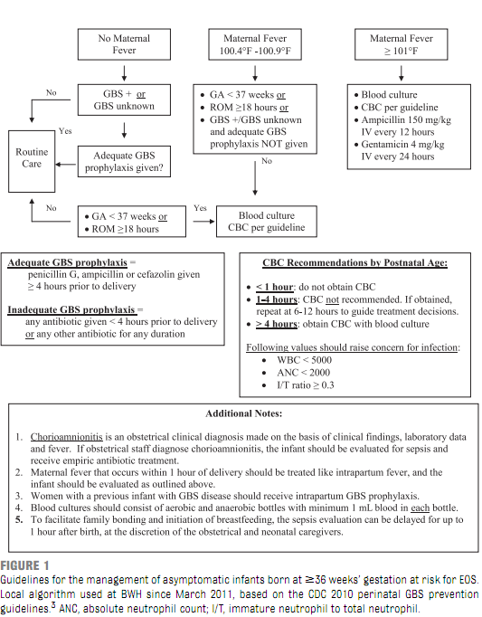

Slide 26
Question of the day?
Called for C-section of 42 wk b/c Failure to progress with severe oligohydramnios. Maternal screens neg, incld GBS. ROM at delivery shows scant fluid with meconium stain.
Exam – vigorous and good RR, HR > 100, central cyanosis, meconium stain with pelling “post dates” skin.
Give – BBO2 improving color, but then tachypnea and grunting at 5 min.
Go to specials, tubed, and CVL placed. Pre and post ductal sats at 97% on 60 % FiO2.

Slide 27
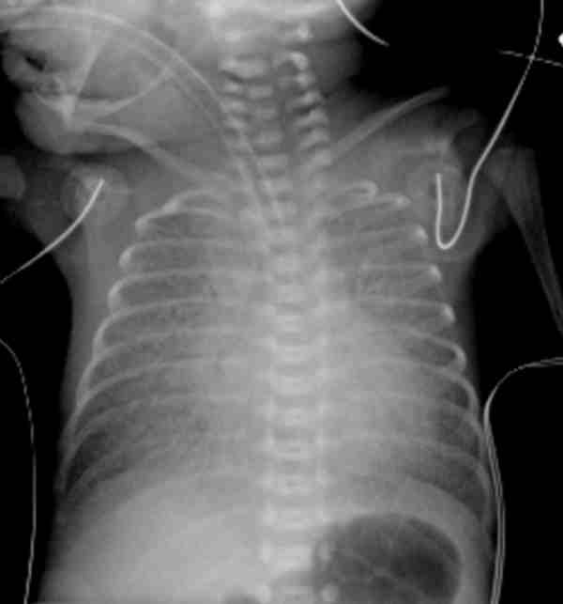
Diffuse patchy, pleural effusion, hyperinflation
What does this look like?
GBS pna
mec asp syndrome
Persistent pulm HTN
Retained fetal lung liquid syndrome
Transposition of great vessels

Slide 28
references
Schuchat A. Epidemiology of Group B Streptococcal Disease in the United States: Shifting Paradigms. Clin Micro Rev. 1998. 11: 3; 497-513
Hornik CP, Benjamin DK, Becker KC, et al. Use of the complete blood cell count in early-onset neonatal sepsis. Pediatr Infect Dis J 2012; 31:799.
Stoll BJ, Hansen NI, Adams-Chapman I, et al. Neurodevelopmental and growth impairment among extremely low-birth-weight infants with neonatal infection. JAMA 2004; 292:2357.
Stoll BJ, Hansen N, Fanaroff AA, et al. Late-onset sepsis in very low birth weight neonates: the experience of the NICHD Neonatal Research Network. Pediatrics 2002; 110:285.
Polin RA, Watterberg K, Benitz W, et al. The Conundrum of Early-Onset Sepsis. Pediatrics .2014 ; 133; 1122
Kiser C, Nawab U, McKenna K, et al. Role of Guidelines on Length of Therapy in Chorioamnionitis and Neonatal Sepsis. Pediatrics 2014. 133;992.
Edwards MS. Clinical features and diagnosis of sepsis in term and late preterm infants. Uptodate.com. Accessed on 8/1/2014
Edwards MS. Treatment and outcome of sepsis in term and late preterm infants. Uptodate.com. Accessed on 8/1/2014.
Weisman LE, Pammi M. Clinical features and diagnosis of bacterial sepsis in the preterm infant. Uptodate.com. Accessed on 8/1/2014.
Weisman, LE, Pammi M. Treatment and prevention of bacterial sepsis in the preterm infant. Uptodate.com. Accessed on 8/1/2014.
Mukhopadhyay S, Dukhovny D, Mao W, et al. 2010 Perinatal GBS Prevention Guideline and Resource Utilization. Pediatrics 2014. 133;196.
Yuan H, Huang J, Lv B, et al. Diagnosis Value of the Serum Amyloid A Test in Neonatal Sepsis: A Meta-Analysis. BioMed Res Internat 2013. Article ID 520294.
PREP questions.

