Slide 1
The pediatric UTI: urine gone unsterile…
Alan Chan, MD

Slide 2
outline
Sample cases
Definition
History
Presentation
Diagnosis
Mgmt
Controversies

Slide 3
Luigi
2 week old term white circumcised boy
Fever to 101 x 6 hrs
Fussy, poor feeding, 2 “large watery stools”,
“Spitting up” x a couple times, older sister with RSV
T 100.8 HR150 RR 36 BP86/45
Exam – crying, dec cap refill, tachy mucus membranes, rrr, clear lung snds

Slide 4
Peach
10 week old term white girl
T 102 at home. Fussy, diaper “smells bad”, had a blow out of liquid stool x 1, not feeding well
Mom is a cardiac ICU nurse and had c diff exposure
T 101 HR 130 RR 40 BP 88/46
Crying, dec cap refill, tachy mucus membranes, rrr, clear lung fields.

Slide 5
Ralph
3.5 yo previously healthy uncircumcised Asian boy with abd pain, T 103 for “hours”, runny nose, cough
Hx of constipation
T 102 HR 110 RR 30 BP 100/70
Crying, dec cap refill, tachy mucus membranes, rrr, clear lung fields, bowels snds throughout, lower abd TTP

Slide 6
Pearls…
Urine is sterile, but any stagnant urine has a high risk of infection.
Think--- Why is there stagnant urine?
Fever might the only sign of UTI in infants and young children

Slide 7
workup
Fever workup
History - chronic issues like growth, voiding, stooling, FHx, prior hx of UTI?
Physical - vitals, growth, abd and suprapubic exam, external genitalia (anatomic), foreign bodies, lower back (myelodysplasia)

Slide 8
Cystitis vs pyelonephritis?
Cannot tell in young kids (< 2 yo), so tx as same
Nonspecific presentation
Clean void > 100,000 CFU/ml
Cath > 50,000 CFU/ml (10 to 50,000? – maybe) – repeat
Suprapubic > 1000 CFU/ml
Bag sample? - not recommended for dipstick or micro, use only in healthy appearing kids to determine if cath sample is needed.

Slide 9
Nitrite pos – highly specific, low false pos rate!
Bacteriuria with pyuria (inflammation seen as leu esterase, >5 wbc on std microscopy)
Note that sterile pyuria can be seen in other conditions like Kawasaki disease or TB.

Slide 10
Risk factors
Clinical –
in term - fever, FFT, emesis, feeding, loose stools
in preterm – feeding, A/Bs, tachypnea, lethargy, abd distension
Female - urinary tract length (3x more likely in girls up to 1 year of age)
Circumcision – more colonization and bacterial adherence
White children have a 2-4x higher prevalence than black children – blood grp types postulated

Slide 11
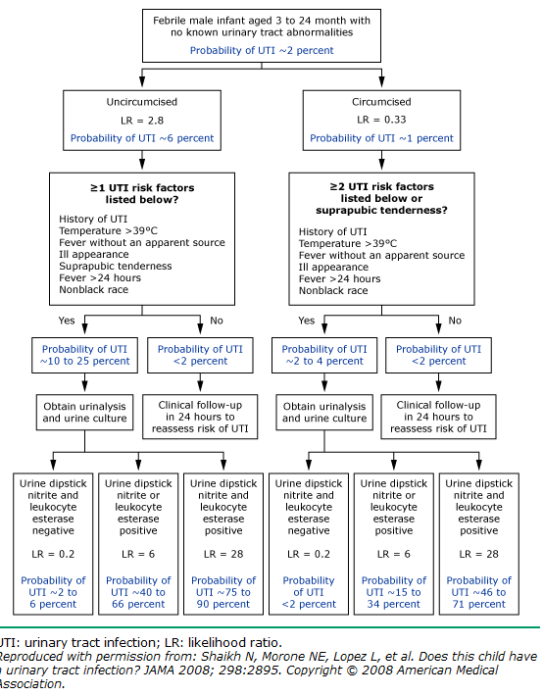

Slide 12
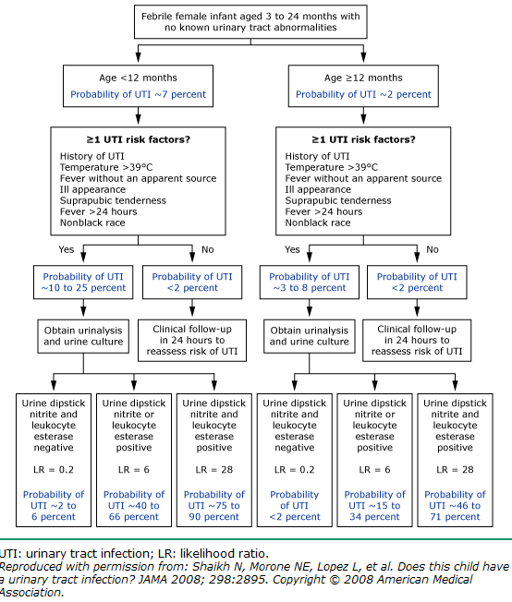

Slide 13
Bacteremia is common
E coli is common (80%) and other GM neg.
Gm pos (Staph and Enterococcus) are the more common ones.
Fungal? – more in premature

Slide 14
Treatment - abx
Cover E. Coli.
Oral tx can be considered in those > 2 months and tolerating PO intake.
Third generation cephalosporin (per antibiogram) good for APH flora (> 95%)
TMP/SMX only 71%
Add ampicillin if enterococcus is suspected
Normal vaginal flora like Lactobacillus spp and corynebacterium are not considered clinically relevant for healthy 2-24 month olds.

Slide 15
Treatment - length
Clinical improvement expected in 1-2 days.
7 to 14 days, however some review says 2 to 4 days may be just as good in lower UTIs.
Trial at NIH is on-going
Given a febrile UTI and question of pyelonephritis, longer treatment is warranted.

Slide 16
Imaging -- controversies
RBUS (renal/bladder ultrasound) - looks at anatomy, structure, size, thickness, dilation, stones.
VCUG (voiding cystourethrogram) – look for vesicoureteric reflux.
Radionuclide cystography – not as good as VCUG
Renal cortical scinitgraphy w 99 m Tc-DMSA (technetium-dimercaptosuccinic acid) or CT – look for scarring and changes from pyelonephritis.
Contrasted US – maybe?

Slide 17
Newborns – AAP guidelines say image all after abx.
RBUS - Do after abx
VCUG - Do 3-6 wk after abx or when urine sterile only when RBUS is abnl, or 2+ febrile UTI, or pos FHx, poor growth, or hypertension.
RCS - Do if US suggests it or follow up.

Slide 18
Why image?
Randomized Intervention for Children With Vesicoureteral Reflux study is ongoing to evaluate role of VUR and renal scarring and the link for UTI

Slide 19
Prophylactic antibiotics?
Current reviews do not show a statistically significant benefit of preventing febrile UTI/pyelo in infants with or without VUR
It is more important to quickly recognize signs and symptoms and start treatment.

Slide 20
Almost 10 year study
576 kids, avg age was 14mon, 64% girls, 42% with known reflux, at least 53% with grade III.
UTIs developed in 13% of those on trim/sulfa vs 19% of those without it.
Some would suggest use of Grade III or higher VUR.

Slide 21
Referrals
Obstructive uropathy, or dilating VUR (grade III to V)
Renal abnl seen on US
Impaired renal function
Hypertension

Slide 22
references
Jantausch, et al. Association of Lewis blood group phenotypes with urinary tract infection in children. J Pediatr. 1994 Jun;124(6):863-8.
AAP, Subcommittee on Urinary Tract Infection, Steering Committee on Quality Improvement and Management. Urinary Tract Infection: Clinical Practice Guideline for the Diagnosis and Management of the Initial UTI in Febrile Infants and Children 2 to 24 Months. Pediatrics. 2011;128;595-610.
National Institute for Health and Clinical Excellence. Urinary Tract Infection in Children: Diagnosis, Treatment, and Long-term Management: NICE Clinical Guideline 54. London, England: National Institute for Health and Clinical Excellence; 2007. Available at: www.nice.org.uk
Craig et al. Antibiotic prophylaxis and recurrent urinary tract infection in children. N Engl J Med. 2009 Oct 29;361(18):1748-59.
Uptodate.com

Slide 23
questions/comments/ideas?

