Slide 1
7
Regression Analysis
Business Analytics, 2e
By Sanjiv Jaggia, Alison Kelly, Kevin Lertwachara, and Leida Chen

Slide 2
Chapter 7 Learning Objectives (LOs)
LO 7.1 Estimate and interpret a linear regression model.
LO 7.2 Interpret goodness-of-fit measures.
LO 7.3 Conduct tests of significance.
LO 7.4 Address common violations of the OLS assumptions.

Slide 3
Introductory Case: College Scorecard (1/2)
College costs and student debt are on the rise
Students and parents struggle to find clear, reliable data on critical questions of college affordability and value.
The Department of Education (DOE) published a redesigned College Scorecard that reports the most reliable national data on college costs and students’ outcomes at specific colleges.
Fiona Schmidt, a college counselor, believes that the information from the College Scorecard can help her as she advises families.
Fiona wonders what college factors influence post-college earnings and wants answers to the following questions:
  If a college costs more or has a higher graduation rate, should a student expect to earn more after graduation?
  If a greater percentage of the students are paying down debt after college, does this somehow influence post-college earnings?
  And finally, does the location of a college affect post-college earnings?

Slide 4
Introductory Case: College Scorecard (2/2)
Information from 116 colleges on the following variables:
  Annual post-college earnings (Earnings in $)
  The average annual cost (Cost in $)
  The graduation rate (Grad in %)
  The percentage of students paying down debt (Debt in %)
  Whether or not a college is located in a city (City equals 1 if a city location, 0 otherwise)
Use the information to:
  Make predictions for post-college earnings using regression analysis
  Interpret goodness-of-fit measures for the post-college earnings model
  Determine which factors are statistically significant in explaining post-college earnings

Slide 5
7.1: The Linear Regression Model (1/26)
Regression analysis is one of the most widely used techniques in predictive analytics.
  Captures the relationship between two or more variables.
  Predict an outcome of a target variable based on several input variables
  Make assessments and robust predictions by determining which of the relationships matter the most and which we can ignore
Formulate a mathematical model that relates the outcome of a target variable, called the response variable, to one or more other input variables, called the predictor variables.
Use information on the predictor variables to describe and/ or predict changes in the response variable.

Slide 6
7.1: The Linear Regression Model (2/26)
Regression models are known to perform well for making predictions.
Often, they fail to establish a cause-and-effect relationship between the variables because of the nonexperimental nature of most applications.
A regression model may appear to search for causality when it basically detects correlation.
Causality can only be established through randomized experiments and/or advanced statistical models.

Slide 7
7.1: The Linear Regression Model (3/26)
No matter the response variable, we cannot expect to predict its exact (unique) value.
If the value of the response variable is uniquely determined by the values of the predictor variables, the relationship between the variables is deterministic.
However, the relationship between the response variable and the predictor variables is stochastic, due to the omission of relevant factors (sometimes not measurable) that influence the response variable.

Slide 8
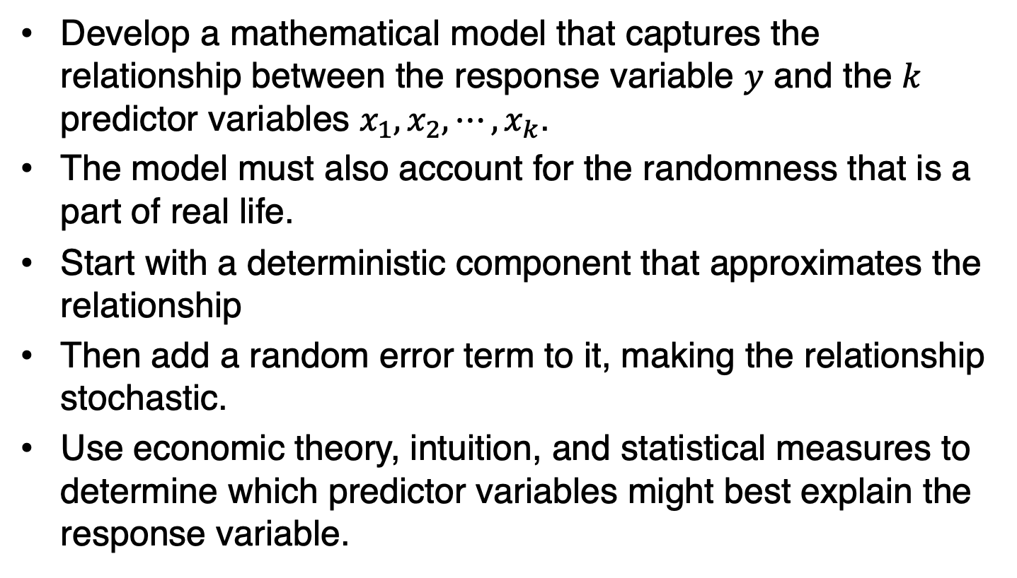
7.1: The Linear Regression Model (4/26)
Develop a mathematical model that captures the relationship between the response variable $y$ and the $k$ predictor variables $x_{1},x_{2},⋯,x_{k}$.
The model must also account for the randomness that is a part of real life.
Start with a deterministic component that approximates the relationship
Then add a random error term to it, making the relationship stochastic.
Use economic theory, intuition, and statistical measures to determine which predictor variables might best explain the response variable.

Slide 9
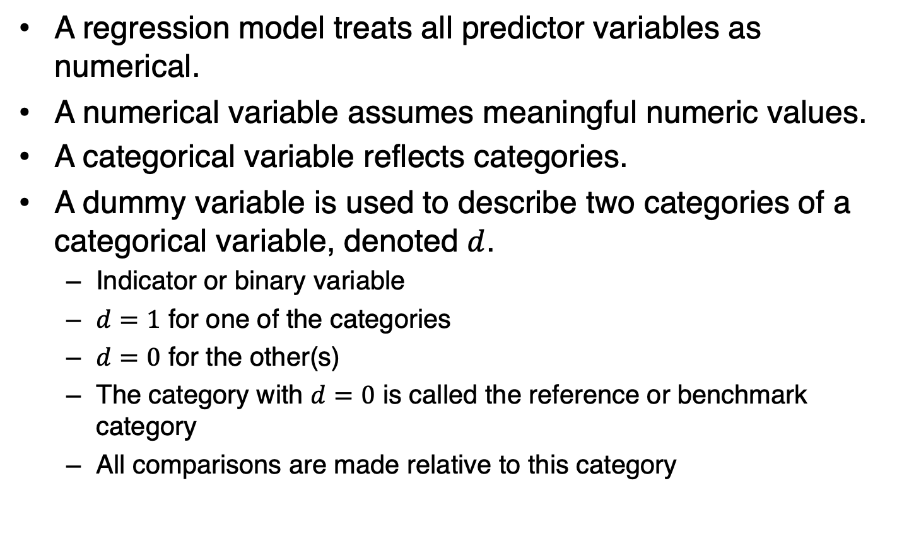
7.1: The Linear Regression Model (5/26)
A regression model treats all predictor variables as numerical.
A numerical variable assumes meaningful numeric values.
A categorical variable reflects categories.
A dummy variable is used to describe two categories of a categorical variable, denoted $d$.
  Indicator or binary variable
  $d=1$ for one of the categories
  $d=0$ for the other(s)
  The category with $d=0$ is called the reference or benchmark category
  All comparisons are made relative to this category

Slide 10
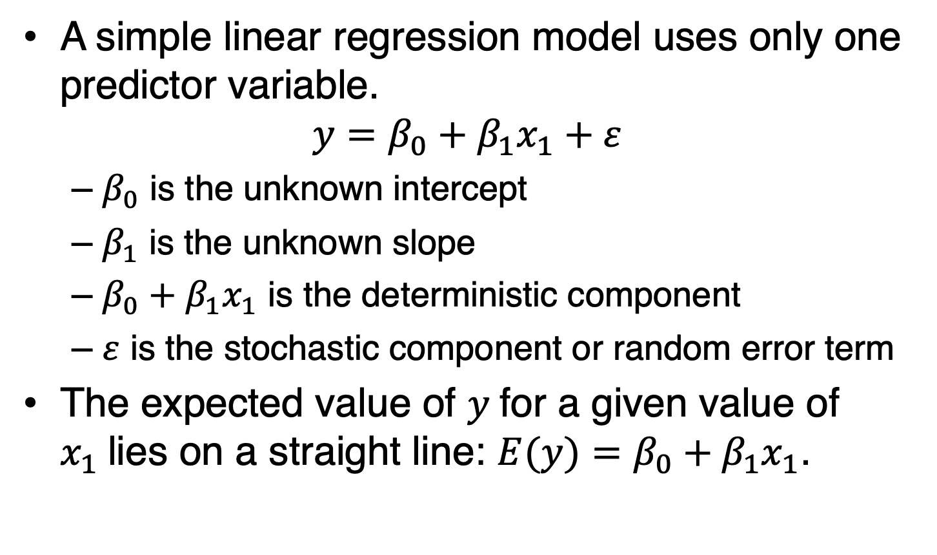
7.1: The Linear Regression Model (6/26)
A simple linear regression model uses only one predictor variable.
$$y=β_{0}+β_{1}x_{1}+ε$$
  $β_{0}$ is the unknown intercept
  $β_{1}$ is the unknown slope
  $β_{0}+β_{1}x_{1}$ is the deterministic component
  $ε$ is the stochastic component or random error term
The expected value of $y$for a given value of $x_{1}$lies on a straight line: $E(y)=β_{0}+β_{1}x_{1}$.

Slide 11
7.1: The Linear Regression Model (7/26)

Slide 12
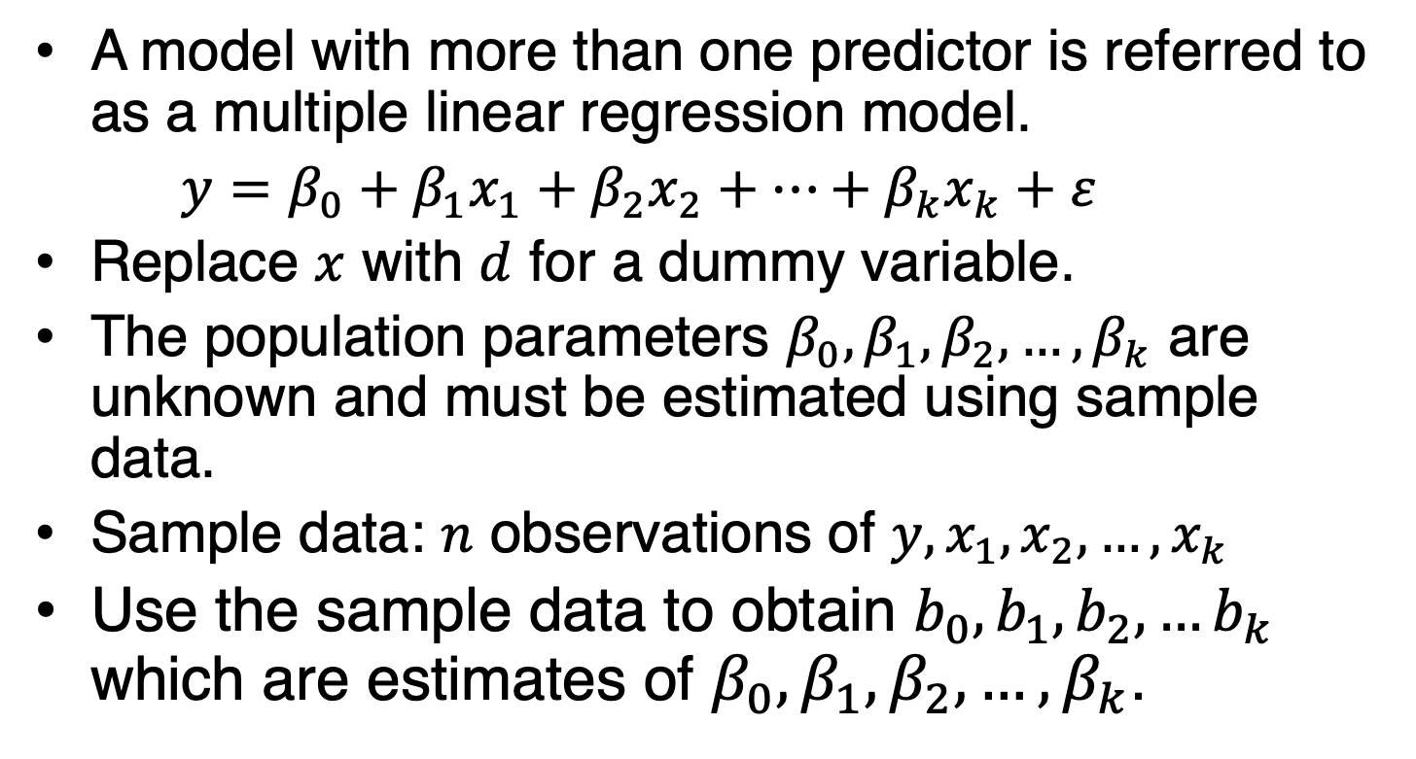
7.1: The Linear Regression Model (8/26)
A model with more than one predictor is referred to as a multiple linear regression model.
$y=β_{0}+β_{1}x_{1}+β_{2}x_{2}+…+β_{k}x_{k}+ε$
Replace $x$ with $d$ for a dummy variable.
The population parameters $β_{0},β_{1},β_{2},…,β_{k}$ are unknown and must be estimated using sample data.
Sample data: $n$ observations of $y,x_{1},x_{2},…,x_{k}$
Use the sample data to obtain $b_{0},b_{1},b_{2},…b_{k}$ which are estimates of $β_{0},β_{1},β_{2},…,β_{k}$.

Slide 13
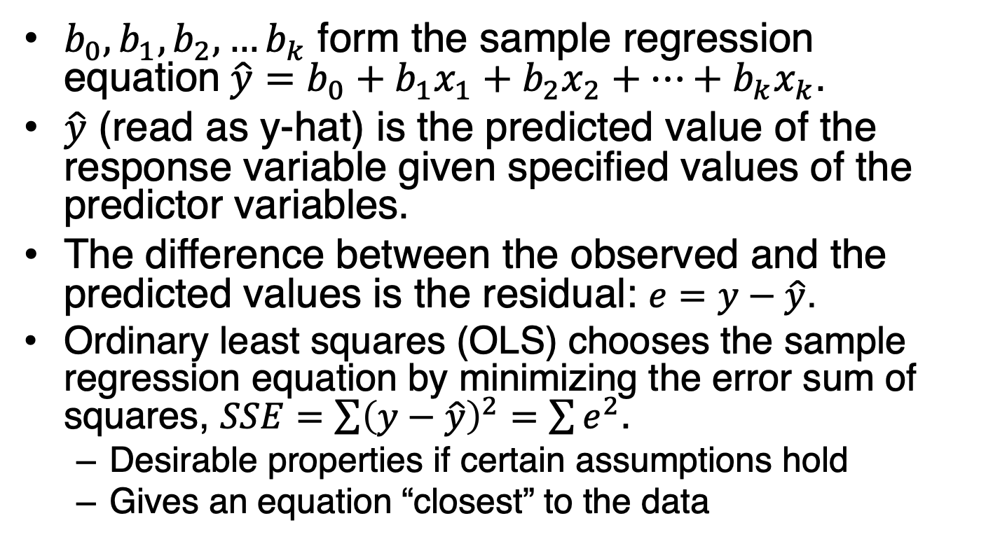
7.1: The Linear Regression Model (9/26)
$b_{0},b_{1},b_{2},…b_{k}$ form the sample regression equation$\hat{y}=b_{0}+b_{1}x_{1}+b_{2}x_{2}+…+b_{k}x_{k}$.
$\hat{y}$ (read as y-hat) is the predicted value of the response variable given specified values of the predictor variables.
The difference between the observed and the predicted values is the residual: $e=y−\hat{y}$.
Ordinary least squares (OLS) chooses the sample regression equation by minimizing the error sum of squares, $SSE=\sum{{\left(y−\hat{y}\right)}^{2}}=$ $\sum{e^{2}}$.
  Desirable properties if certain assumptions hold
  Gives an equation “closest” to the data

Slide 14
7.1: The Linear Regression Model (10/26)

Slide 15
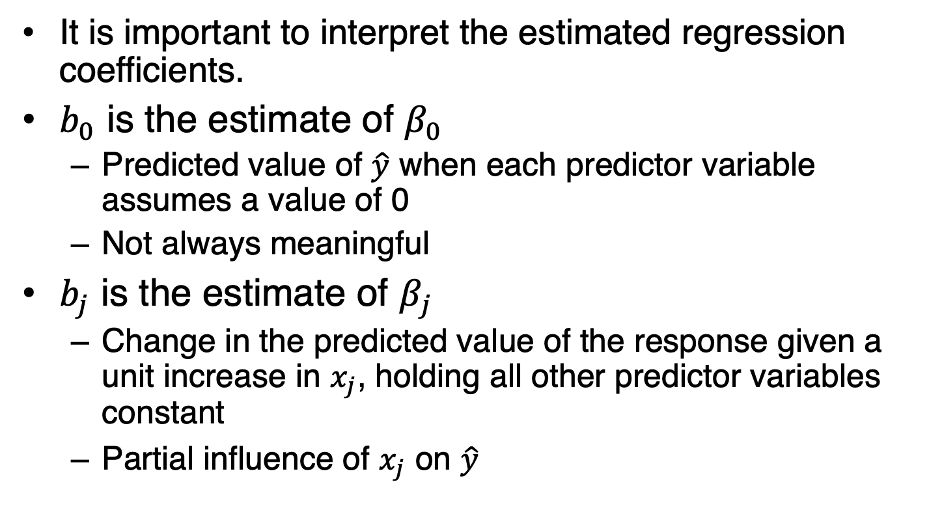
7.1: The Linear Regression Model (11/26)
It is important to interpret the estimated regression coefficients.
$b_{0}$ is the estimate of $β_{0}$
  Predicted value of $\hat{y}$ when each predictor variable assumes a value of 0
  Not always meaningful
$b_{j}$ is the estimate of $β_{j}$
  Change in the predicted value of the response given a unit increase in $x_{j}$, holding all other predictor variables constant
  Partial influence of $x_{j}$ on $\hat{y}$

Slide 16
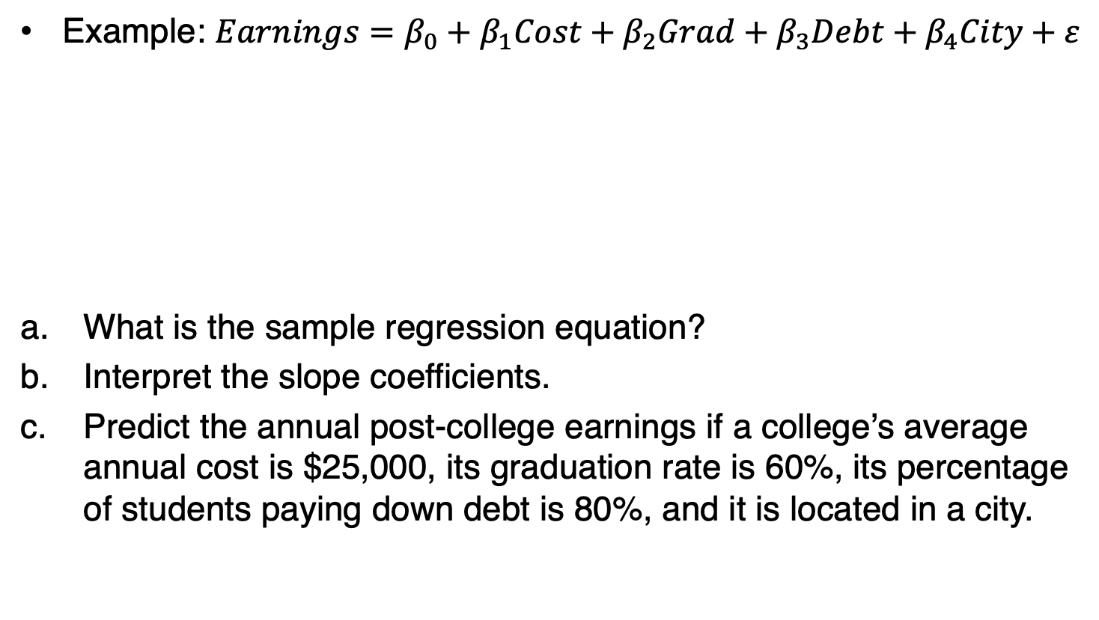
7.1: The Linear Regression Model (12/26)
Example: $Earnings=β_{0}+β_{1}Cost+β_{2}Grad+β_{3}Debt+β_{4}City+ε$
What is the sample regression equation?
Interpret the slope coefficients.
Predict the annual post-college earnings if a college’s average annual cost is $25,000, its graduation rate is 60%, its percentage of students paying down debt is 80%, and it is located in a city.

Slide 17
7.1: The Linear Regression Model (13/26)
Example continued

Slide 18
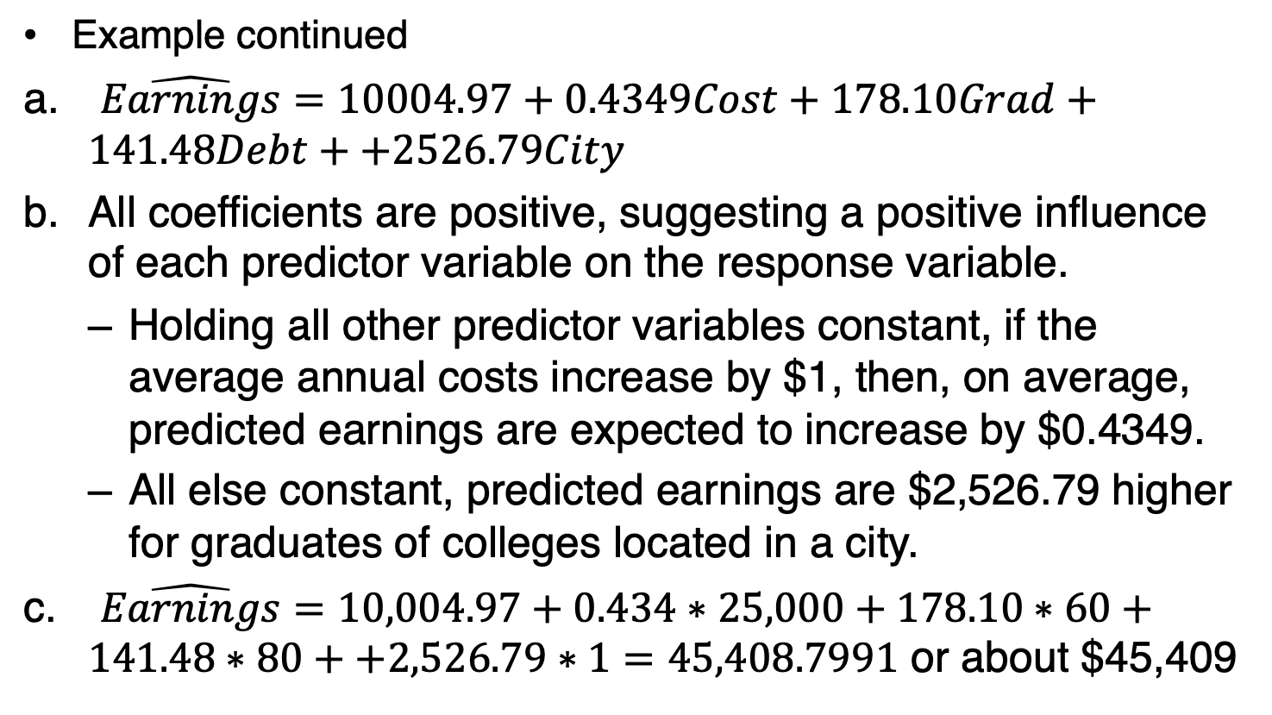
7.1: The Linear Regression Model (14/26)
Example continued
$\hat{Earnings}=10004.97+0.4349Cost+178.10Grad+141.48Debt++2526.79City$
All coefficients are positive, suggesting a positive influence of each predictor variable on the response variable.
  Holding all other predictor variables constant, if the average annual costs increase by $1, then, on average, predicted earnings are expected to increase by $0.4349.
  All else constant, predicted earnings are $2,526.79 higher for graduates of colleges located in a city.
$\hat{Earnings}=10,004.97+0.434∗25,000+178.10∗60+141.48∗80++2,526.79∗1=45,408.7991$ or about $45,409

Slide 19
7.1: The Linear Regression Model (15/26)
Example continued with Excel
Open the College data file
Data > Data Analysis > Regression from the menu

Slide 20
7.1: The Linear Regression Model (16/26)
Example continued with R
Import the College data file into a data frame and label it myData

Slide 21
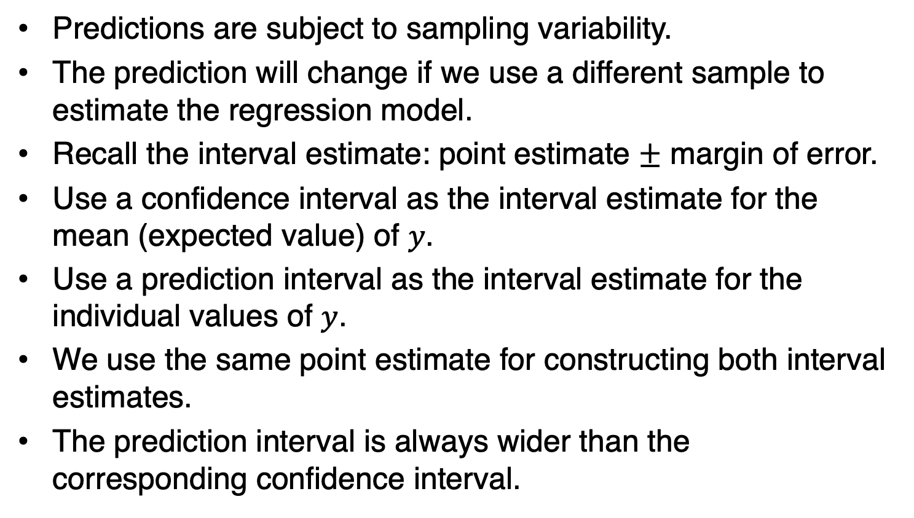
7.1: The Linear Regression Model (17/26)
Predictions are subject to sampling variability.
The prediction will change if we use a different sample to estimate the regression model.
Recall the interval estimate: point estimate $±$ margin of error.
Use a confidence interval as the interval estimate for the mean (expected value) of $y$.
Use a prediction interval as the interval estimate for the individual values of $y$.
We use the same point estimate for constructing both interval estimates.
The prediction interval is always wider than the corresponding confidence interval.

Slide 22
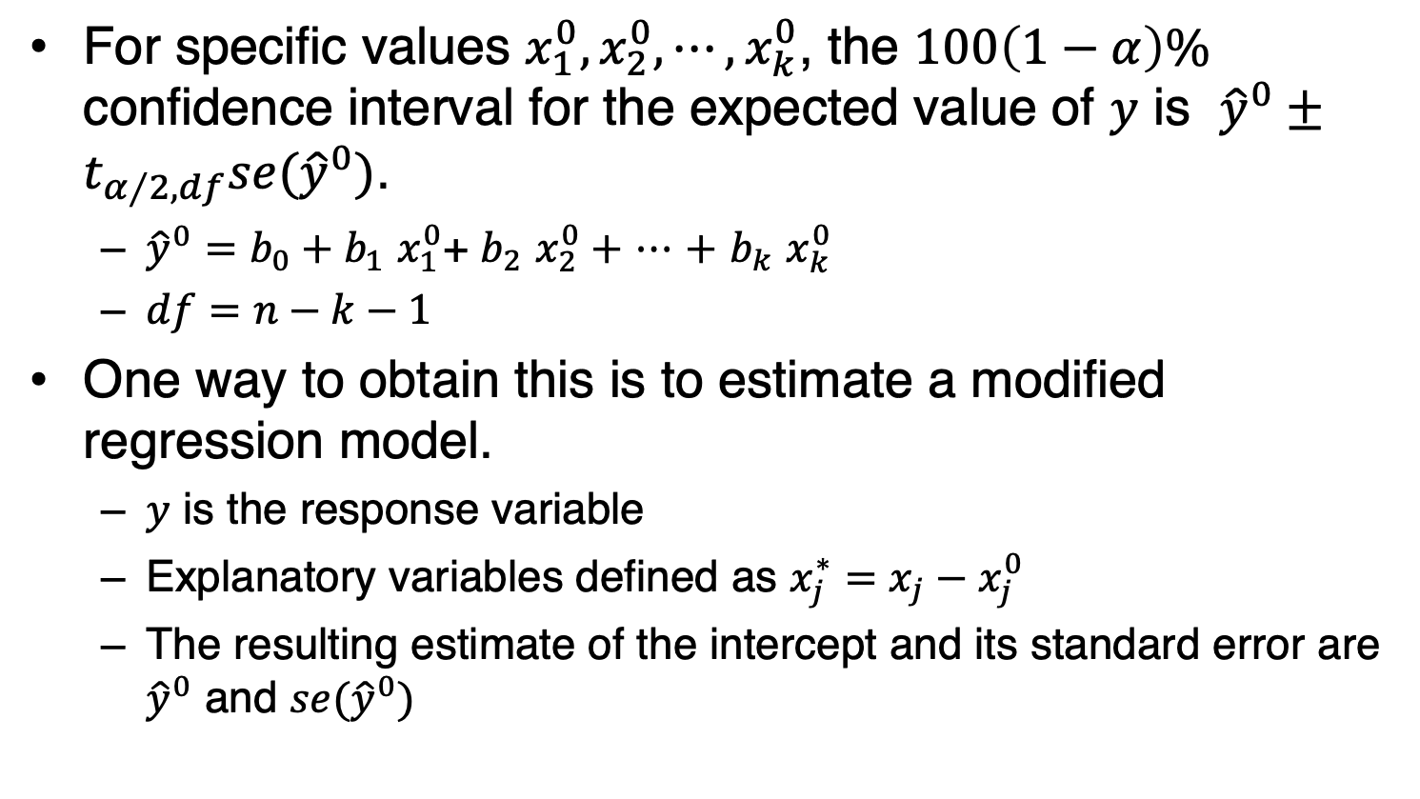
7.1: The Linear Regression Model (18/26)
For specific values $x_{1}^{0},x_{2}^{0},⋯,x_{k}^{0}$, the $100\left(1−α\right)\%$ confidence interval for the expected value of $y$ is ${\hat{y}}^{0}±t_{α∕2,df}se({\hat{y}}^{0})$.
  ${\hat{y}}^{0}=b_{0}+b_{1}$ $x_{1}^{0}$+ $b_{2}$ $x_{2}^{0}+$ $⋯$ $+$ $b_{k}$ $x_{k}^{0}$
  $df=n−k−1$
One way to obtain this is to estimate a modified regression model.
  $y$ is the response variable
  Explanatory variables defined as $x_{j}^{∗}=x_{j}−x_{j}^{0}$
  The resulting estimate of the intercept and its standard error are ${\hat{y}}^{0}$ and $se({\hat{y}}^{0})$

Slide 23

7.1: The Linear Regression Model (19/26)
Example: $Earnings=β_{0}+β_{1}Cost+β_{2}Grad+β_{3}Debt+β_{4}City+ε$
Construct the 95% confidence interval for the expected Earnings if Cost equals $25,000, Grad equals 60, Debt equals 80, and City equals 1.

Slide 24
7.1: The Linear Regression Model (20/26)
Example continued
Using this 95% confidence interval, we can state that the mean Earnings fall between $43,393 and $47,425 when Cost equals 25,000, Grad equals 60, Debt equals 80, and City equals

Slide 25
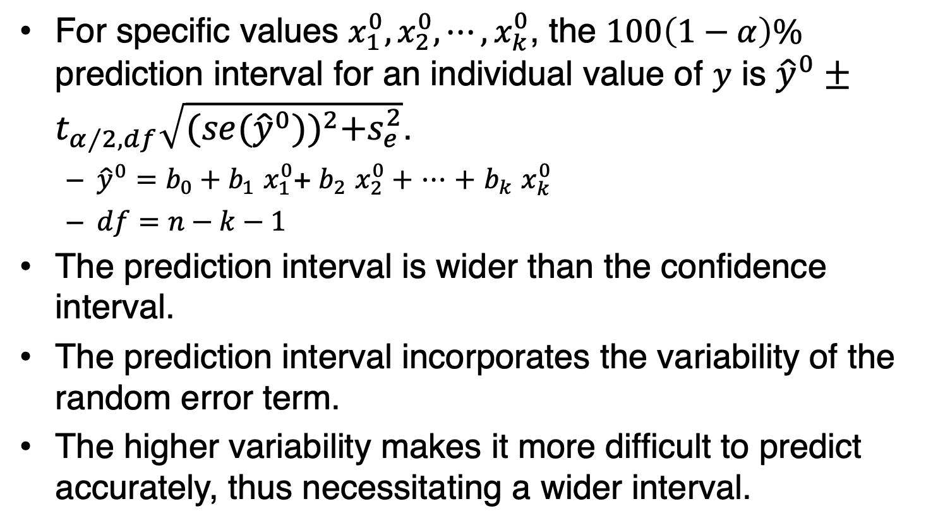
7.1: The Linear Regression Model (21/26)
For specific values $x_{1}^{0},x_{2}^{0},⋯,x_{k}^{0}$, the $100\left(1−α\right)\%$ prediction interval for an individual value of $y$ is ${\hat{y}}^{0}±t_{α∕2,df}\sqrt{{(se({\hat{y}}^{0}))}^{2}+s_{e}^{2}}$.
  ${\hat{y}}^{0}=b_{0}+b_{1}$ $x_{1}^{0}$+ $b_{2}$ $x_{2}^{0}+$ $⋯$ $+$ $b_{k}$ $x_{k}^{0}$
  $df=n−k−1$
The prediction interval is wider than the confidence interval.
The prediction interval incorporates the variability of the random error term.
The higher variability makes it more difficult to predict accurately, thus necessitating a wider interval.

Slide 26
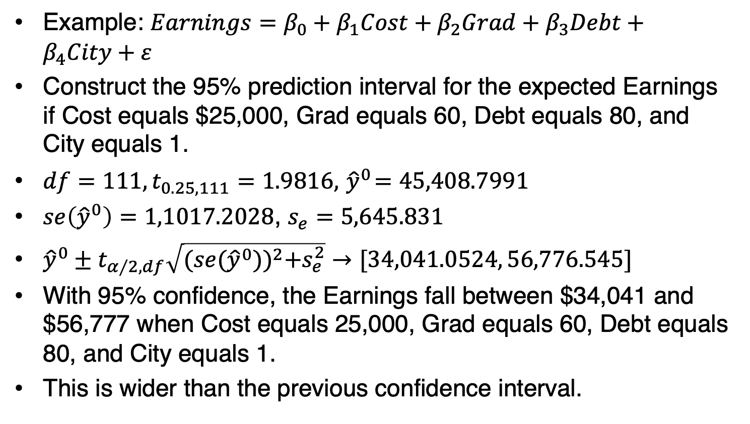
7.1: The Linear Regression Model (22/26)
Example: $Earnings=β_{0}+β_{1}Cost+β_{2}Grad+β_{3}Debt+β_{4}City+ε$
Construct the 95% prediction interval for the expected Earnings if Cost equals $25,000, Grad equals 60, Debt equals 80, and City equals 1.
$df=111, t_{0.25,111}=1.9816,{ \hat{y}}^{0}=45,408.7991$
$se\left({\hat{y}}^{0}\right)=1,1017.2028$, $s_{e}=5,645.831$
${\hat{y}}^{0}±t_{α∕2,df}\sqrt{{(se({\hat{y}}^{0}))}^{2}+s_{e}^{2}}→[34,041.0524, 56,776.545]$
With 95% confidence, the Earnings fall between $34,041 and $56,777 when Cost equals 25,000, Grad equals 60, Debt equals 80, and City equals 1.
This is wider than the previous confidence interval.

Slide 27
7.1: The Linear Regression Model (23/26)
Example continued with R
Import the College data file into a data frame and label it myData

Slide 28
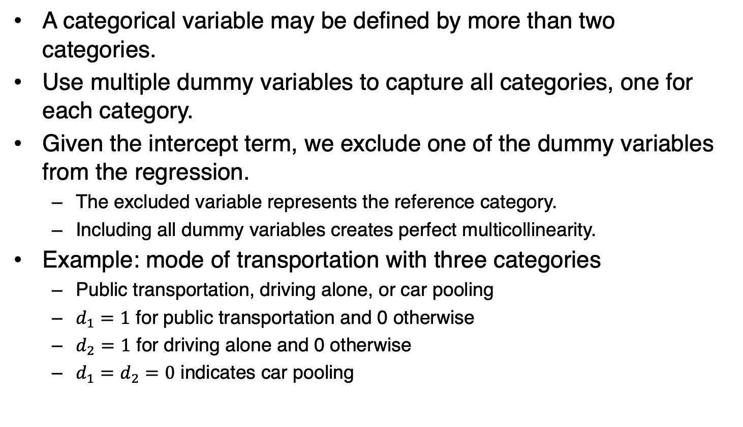
7.1: The Linear Regression Model (24/26)
A categorical variable may be defined by more than two categories.
Use multiple dummy variables to capture all categories, one for each category.
Given the intercept term, we exclude one of the dummy variables from the regression.
  The excluded variable represents the reference category.
  Including all dummy variables creates perfect multicollinearity.
Example: mode of transportation with three categories
  Public transportation, driving alone, or car pooling
  $d_{1}=1$ for public transportation and 0 otherwise
  $d_{2}=1$ for driving alone and 0 otherwise
  $d_{1}=d_{2}=0$ indicates car pooling

Slide 29
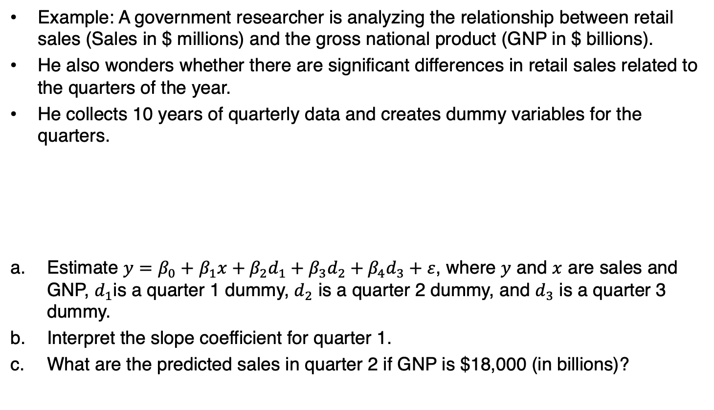
7.1: The Linear Regression Model (25/26)
Example: A government researcher is analyzing the relationship between retail sales (Sales in $ millions) and the gross national product (GNP in $ billions).
He also wonders whether there are significant differences in retail sales related to the quarters of the year.
He collects 10 years of quarterly data and creates dummy variables for the quarters.
Estimate $y=β_{0}+$ $β_{1}x+β_{2}d_{1}+β_{3}d_{2}+β_{4}d_{3}+ε$, where $y$ and $x$ are sales and GNP, $d_{1}$is a quarter 1 dummy, $d_{2}$ is a quarter 2 dummy, and $d_{3}$ is a quarter 3 dummy.
Interpret the slope coefficient for quarter 1.
What are the predicted sales in quarter 2 if GNP is $18,000 (in billions)?

Slide 30
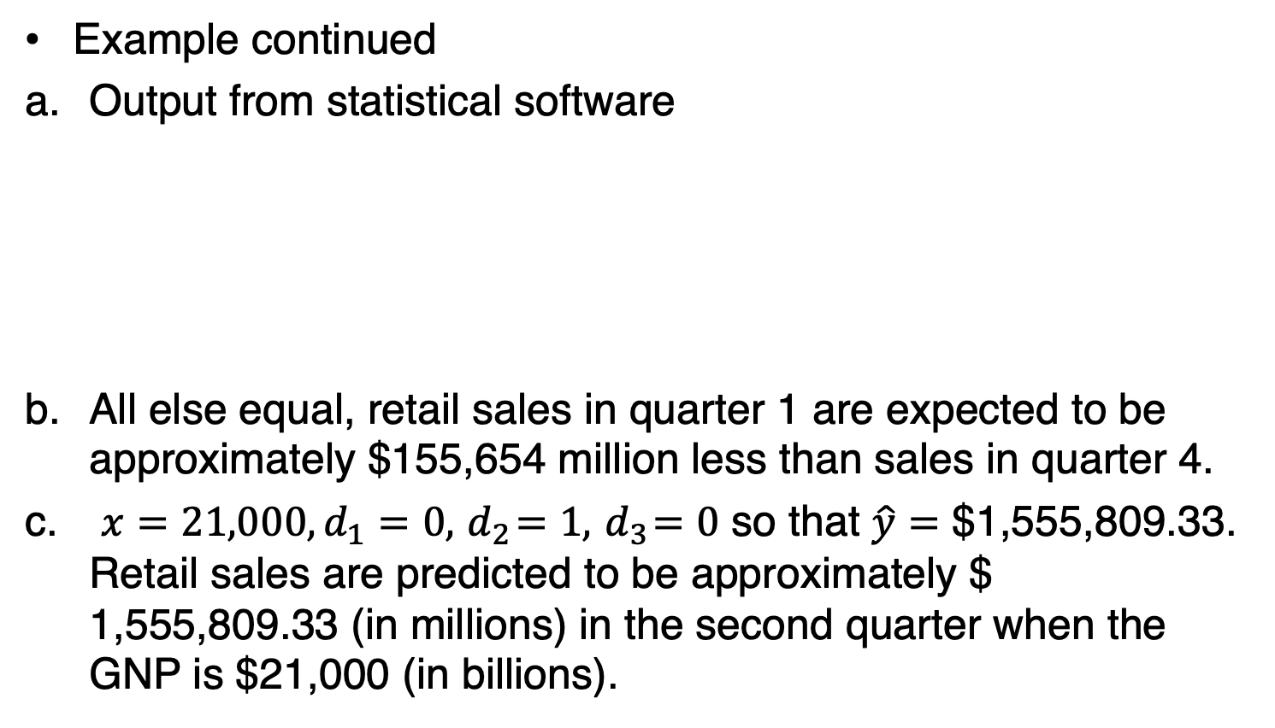
7.1: The Linear Regression Model (26/26)
Example continued
Output from statistical software
All else equal, retail sales in quarter 1 are expected to be approximately $155,654 million less than sales in quarter 4.
$x=21,000, d_{1}=0, { d}_{2}=1, { d}_{3}=0$ so that $\hat{y}=\text{\$}\text{1,555,809.33}$. Retail sales are predicted to be approximately $ $\text{1,555,809.33}$ (in millions) in the second quarter when the GNP is $21,000 (in billions).

Slide 31
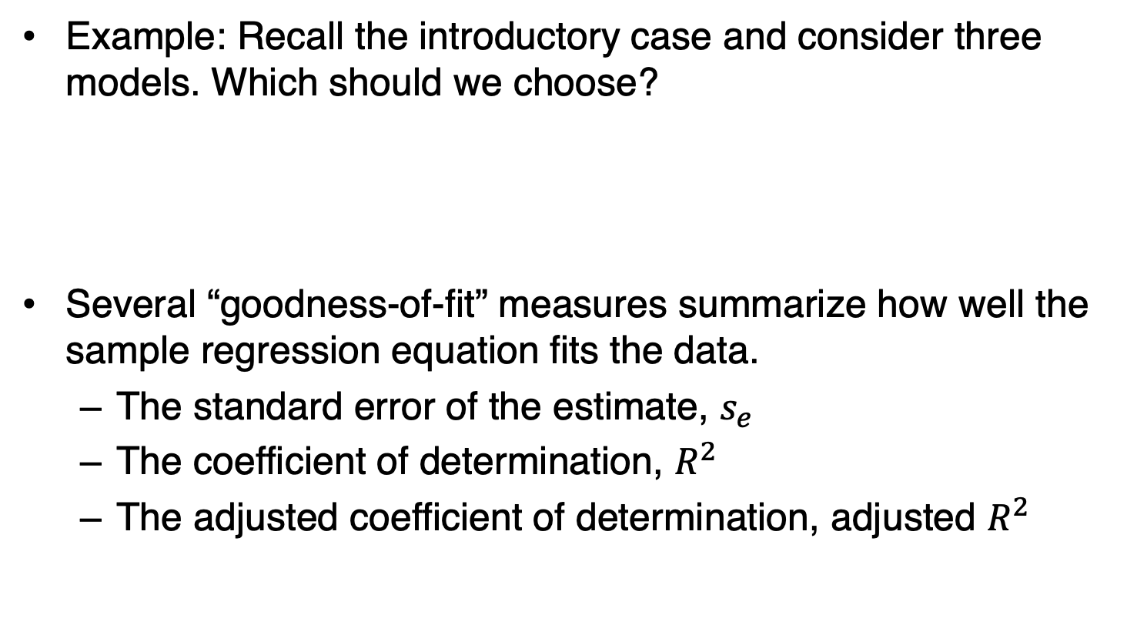
7.2: Model Selection (1/22)
Example: Recall the introductory case and consider three models. Which should we choose?
Several “goodness-of-fit” measures summarize how well the sample regression equation fits the data.
  The standard error of the estimate, $s_{e}$
  The coefficient of determination, $R^{2}$
  The adjusted coefficient of determination, adjusted $R^{2}$

Slide 32
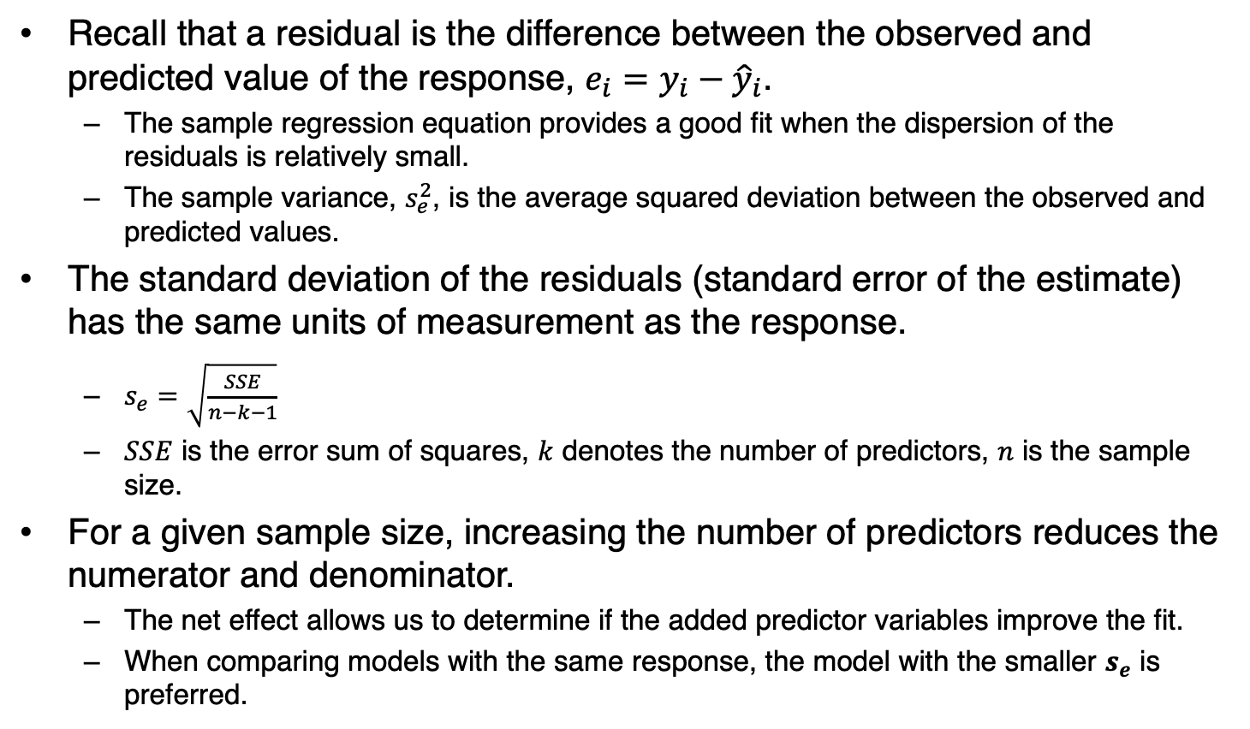
7.2: Model Selection (2/22)
Recall that a residual is the difference between the observed and predicted value of the response, $e_{i}=y_{i}−{\hat{y}}_{i}$.
  The sample regression equation provides a good fit when the dispersion of the residuals is relatively small.
  The sample variance, $s_{e}^{2}$, is the average squared deviation between the observed and predicted values.
The standard deviation of the residuals (standard error of the estimate) has the same units of measurement as the response.
  $s_{e}=\sqrt{\frac{SSE}{n−k−1}}$
  $SSE$ is the error sum of squares, $k$ denotes the number of predictors, $n$ is the sample size.
For a given sample size, increasing the number of predictors reduces the numerator and denominator.
  The net effect allows us to determine if the added predictor variables improve the fit.
  When comparing models with the same response, the model with the smaller $s_{e}$ is preferred.

Slide 33
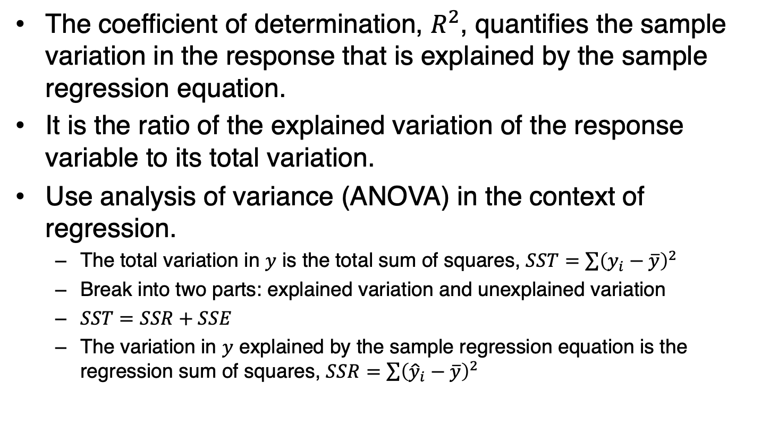
7.2: Model Selection (3/22)
The coefficient of determination, $R^{2}$, quantifies the sample variation in the response that is explained by the sample regression equation.
It is the ratio of the explained variation of the response variable to its total variation.
Use analysis of variance (ANOVA) in the context of regression.
  The total variation in $y$ is the total sum of squares, $SST=\sum{{\left(y_{i}−\overline{y}\right)}^{2}}$
  Break into two parts: explained variation and unexplained variation
  $SST=SSR+SSE$
  The variation in $y$ explained by the sample regression equation is the regression sum of squares, $SSR=\sum{{\left({\hat{y}}_{i}−\overline{y}\right)}^{2}}$

Slide 34

7.2: Model Selection (4/22)
$R^{2}=\frac{SSR}{SST}=1−\frac{SSE}{SST}$
  The proportion of the sample variation in the response explained by the sample regression equation.
  Falls between 0 and 1
  The closer to 1, the better the fit

Slide 35
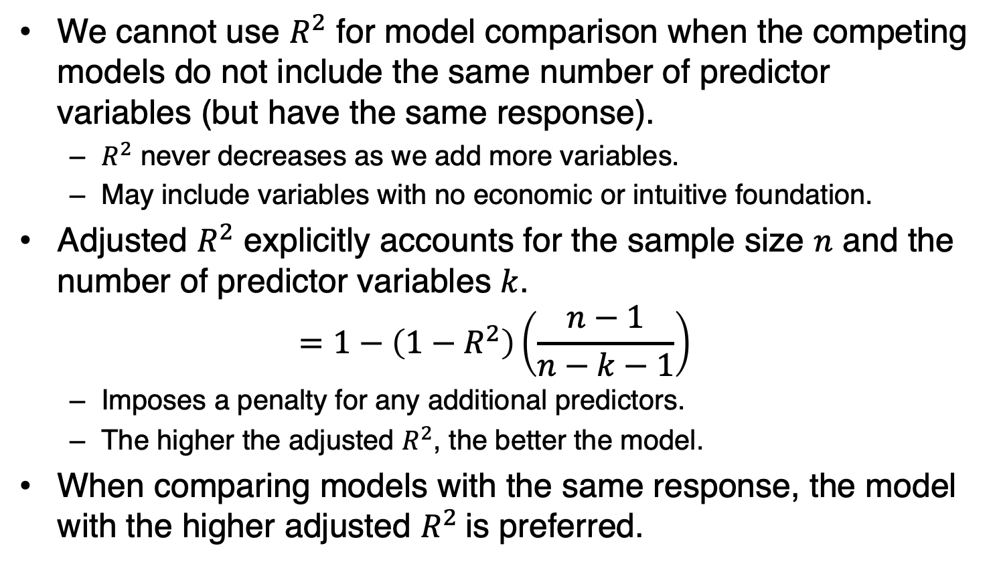
7.2: Model Selection (5/22)
We cannot use $R^{2}$ for model comparison when the competing models do not include the same number of predictor variables (but have the same response).
  $R^{2}$ never decreases as we add more variables.
  May include variables with no economic or intuitive foundation.
Adjusted $R^{2}$ explicitly accounts for the sample size $n$ and the number of predictor variables $k$.
$$=1−\left(1−R^{2}\right)\left(\frac{n−1}{n−k−1}\right)$$
  Imposes a penalty for any additional predictors.
  The higher the adjusted $R^{2}$, the better the model.
When comparing models with the same response, the model with the higher adjusted $R^{2}$is preferred.

Slide 36
7.2: Model Selection (6/22)
Example: Recall the introductory case and consider three models.
Which of the three models is the preferred model?
Interpret the coefficient of determination for the preferred model.
What percentage of the sample variation in annual post-college earnings is unexplained by the preferred model?

Slide 37
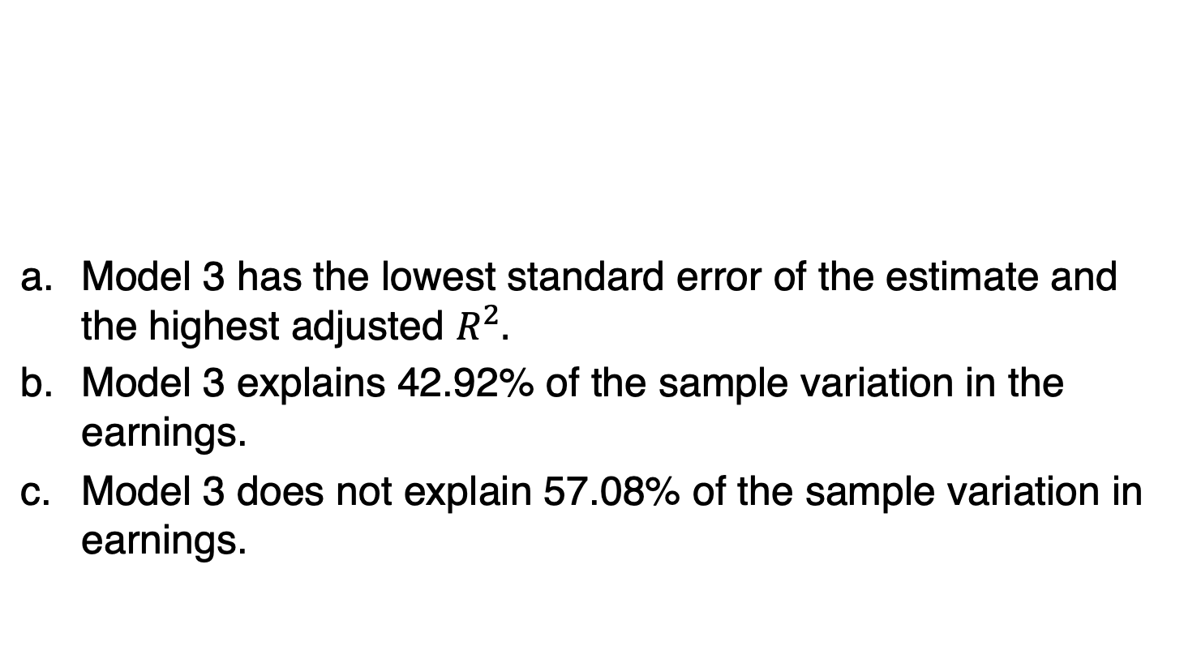
7.2: Model Selection (7/22)
Model 3 has the lowest standard error of the estimate and the highest adjusted $R^{2}.$
Model 3 explains 42.92% of the sample variation in the earnings.
Model 3 does not explain 57.08% of the sample variation in earnings.

Slide 38
7.2: Model Selection (8/22)
Note that goodness-of-fit measures discussed in this section use the same sample to build the model to asses it.
Unfortunately, this procedure does not gauge how well the estimated model will predict in an unseen sample.
We will discuss cross-validation techniques that evaluate predictive models by dividing the original sample into a training set to build (train) the model and a validation set to evaluate (validate) it.
The validation set is used to provide an independent performance assessment by exposing the model to unseen data.

Slide 39
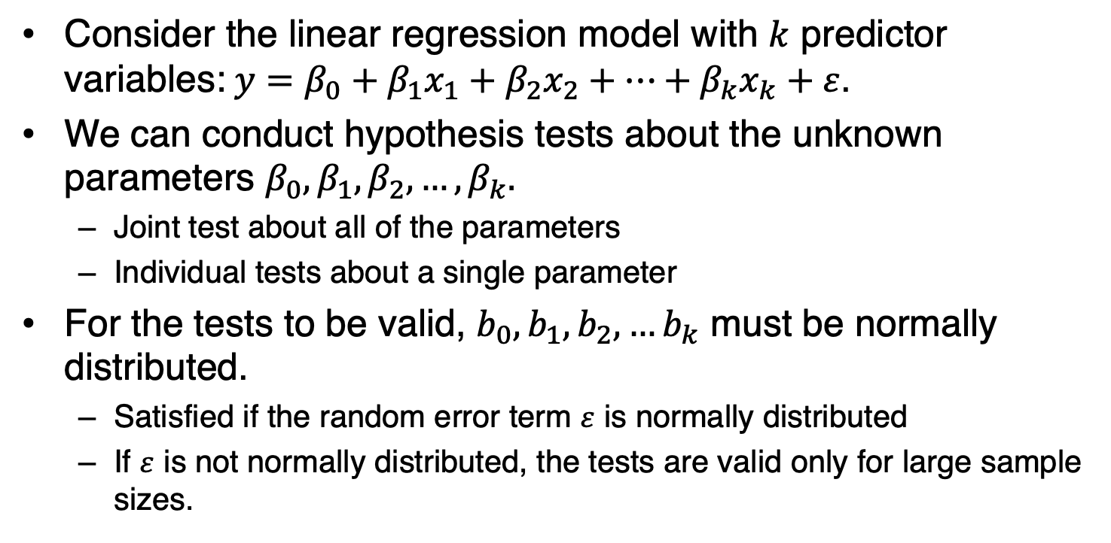
7.2: Model Selection (9/22)
Consider the linear regression model with $k$ predictor variables:$y=β_{0}+β_{1}x_{1}+β_{2}x_{2}+…+β_{k}x_{k}+ε$.
We can conduct hypothesis tests about the unknown parameters $β_{0},β_{1},β_{2},…,β_{k}.$
  Joint test about all of the parameters
  Individual tests about a single parameter
For the tests to be valid, $b_{0},b_{1},b_{2},…b_{k}$ must be normally distributed.
  Satisfied if the random error term $ε$ is normally distributed
  If $ε$ is not normally distributed, the tests are valid only for large sample sizes.

Slide 40
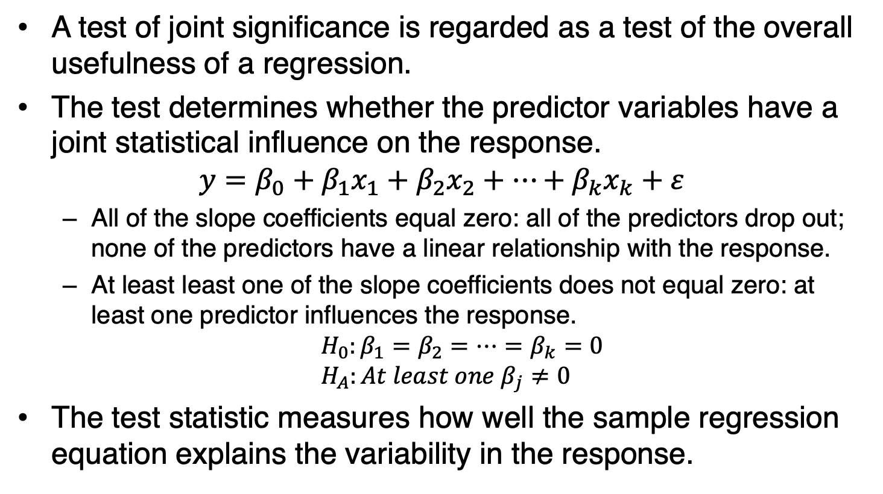
7.2: Model Selection (10/22)
A test of joint significance is regarded as a test of the overall usefulness of a regression.
The test determines whether the predictor variables have a joint statistical influence on the response.
$$y=β_{0}+β_{1}x_{1}+β_{2}x_{2}+…+β_{k}x_{k}+ε$$
  All of the slope coefficients equal zero: all of the predictors drop out; none of the predictors have a linear relationship with the response.
  At least least one of the slope coefficients does not equal zero: at least one predictor influences the response.
$${ H}_{0}:β_{1}=β_{2}=…=β_{k}=0$$
$$H_{A}:At least one β_{j}≠0$$
The test statistic measures how well the sample regression equation explains the variability in the response.

Slide 41
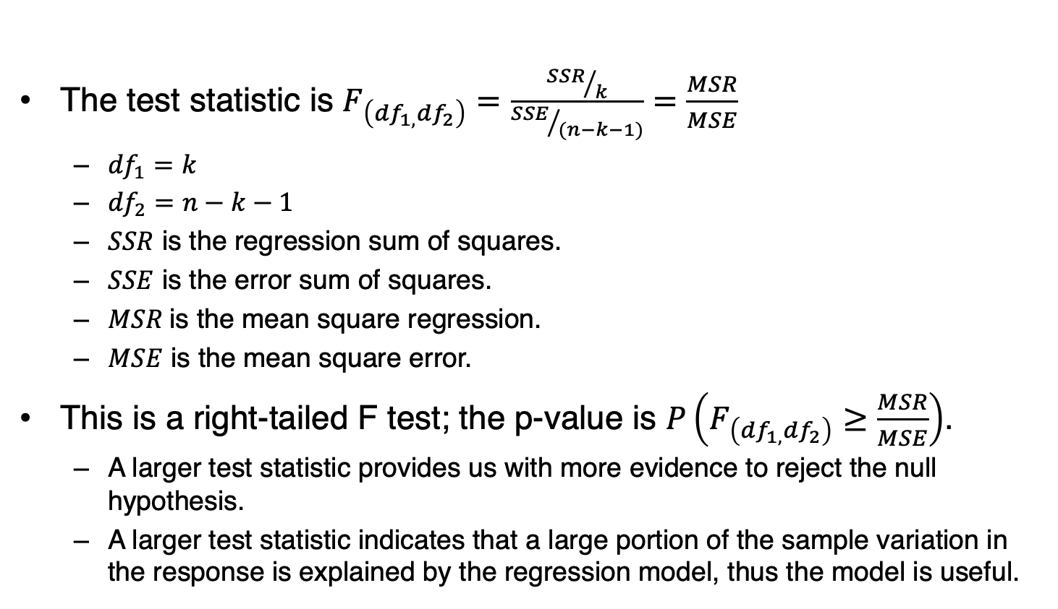
7.2: Model Selection (11/22)
The test statistic is $F_{\left({df}_{1,}{df}_{2}\right)}=\frac{{SSR}/k}{{SSE}/{(n−k−1)}}=\frac{MSR}{MSE}$
  ${df}_{1}=k$
  ${df}_{2}=n−k−1$
  $SSR$ is the regression sum of squares.
  $SSE$ is the error sum of squares.
  $MSR$is the mean square regression.
  $MSE$ is the mean square error.
This is a right-tailed F test; the p-value is $P\left(F_{\left({df}_{1,}{df}_{2}\right)}≥\frac{MSR}{MSE}\right)$.
  A larger test statistic provides us with more evidence to reject the null hypothesis.
  A larger test statistic indicates that a large portion of the sample variation in the response is explained by the regression model, thus the model is useful.

Slide 42
7.2: Model Selection (12/22)
Most statistics packages, such as Excel and R, report the below table.
With R: use the function anova

Slide 43
7.2: Model Selection (13/22)
Example: Recall that Model 3 was the preferred model.
Conduct a hypothesis test to determine if the predictor variables are jointly significant in explaining earnings.

Slide 44
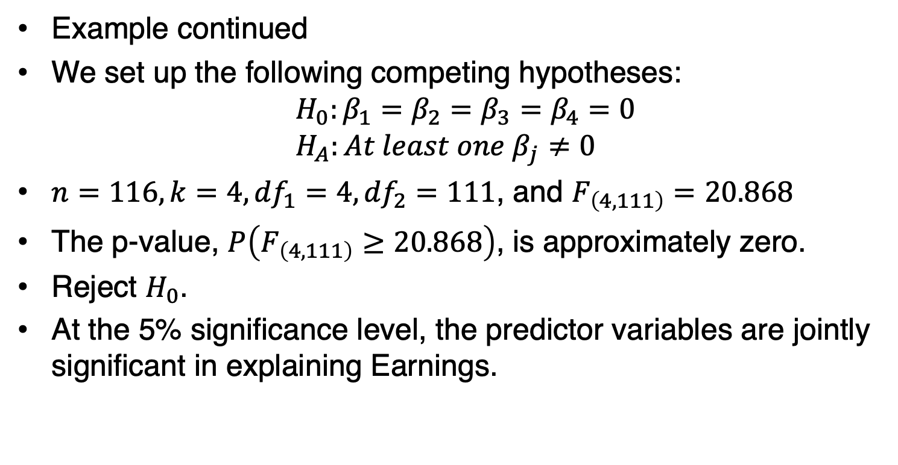
7.2: Model Selection (14/22)
Example continued
We set up the following competing hypotheses:
$${ H}_{0}:β_{1}=β_{2}=β_{3}=β_{4}=0$$
$$H_{A}:At least one β_{j}≠0$$
$n=116, k=4, {df}_{1}=4,{df}_{2}=111$, and $F_{\left(4,111\right)}=20.868$
The p-value, $P\left(F_{\left(4,111\right)}≥20.868\right)$, is approximately zero.
Reject $H_{0}$.
At the 5% significance level, the predictor variables are jointly significant in explaining Earnings.

Slide 45
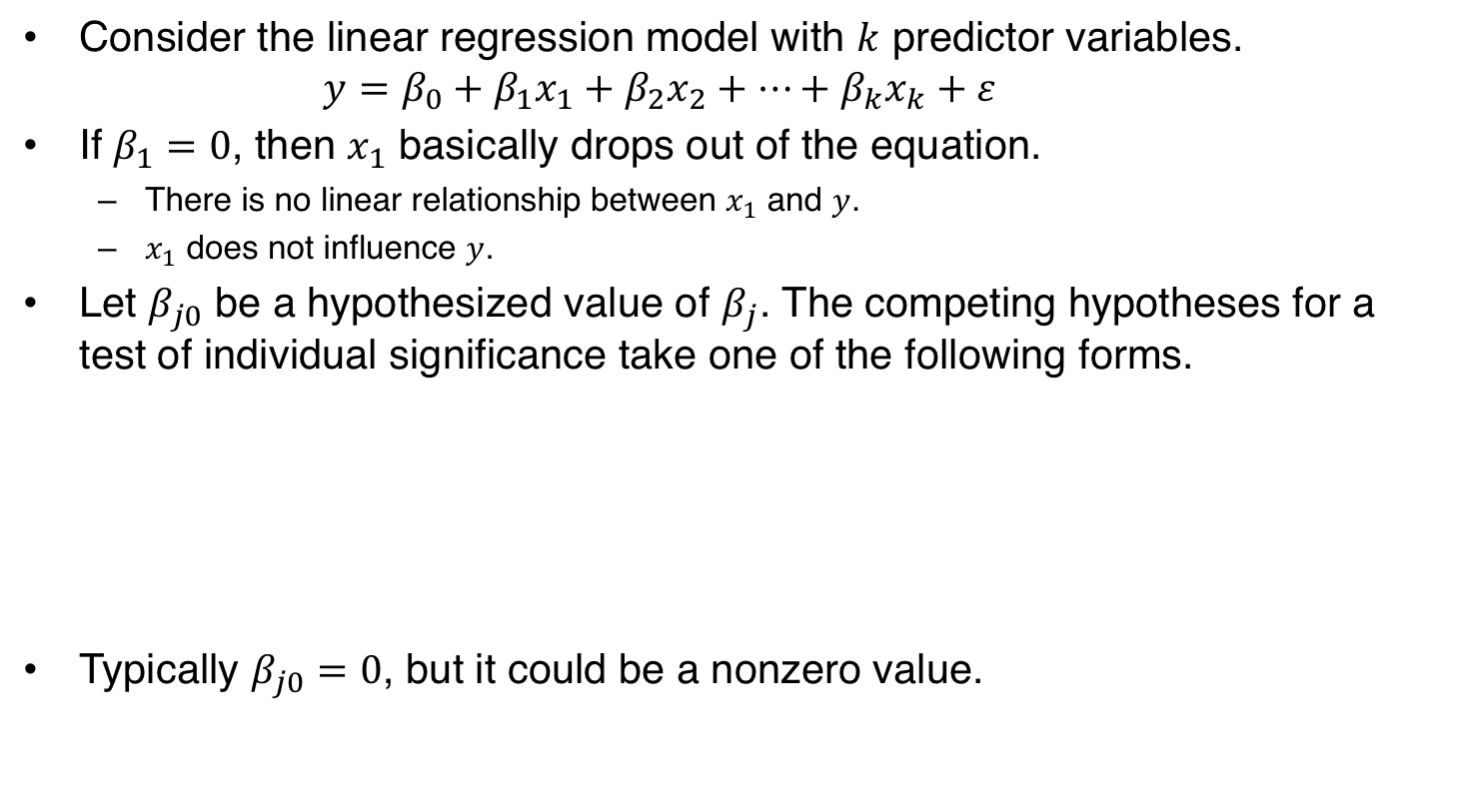
7.2: Model Selection (15/22)
Consider the linear regression model with $k$ predictor variables.
$$y=β_{0}+β_{1}x_{1}+β_{2}x_{2}+…+β_{k}x_{k}+ε$$
If $β_{1}=0$, then $x_{1}$ basically drops out of the equation.
  There is no linear relationship between $x_{1}$ and $y$.
  $x_{1}$ does not influence $y$.
Let $β_{j0}$ be a hypothesized value of $β_{j}$. The competing hypotheses for a test of individual significance take one of the following forms.
Typically $β_{j0}=0$, but it could be a nonzero value.

Slide 46
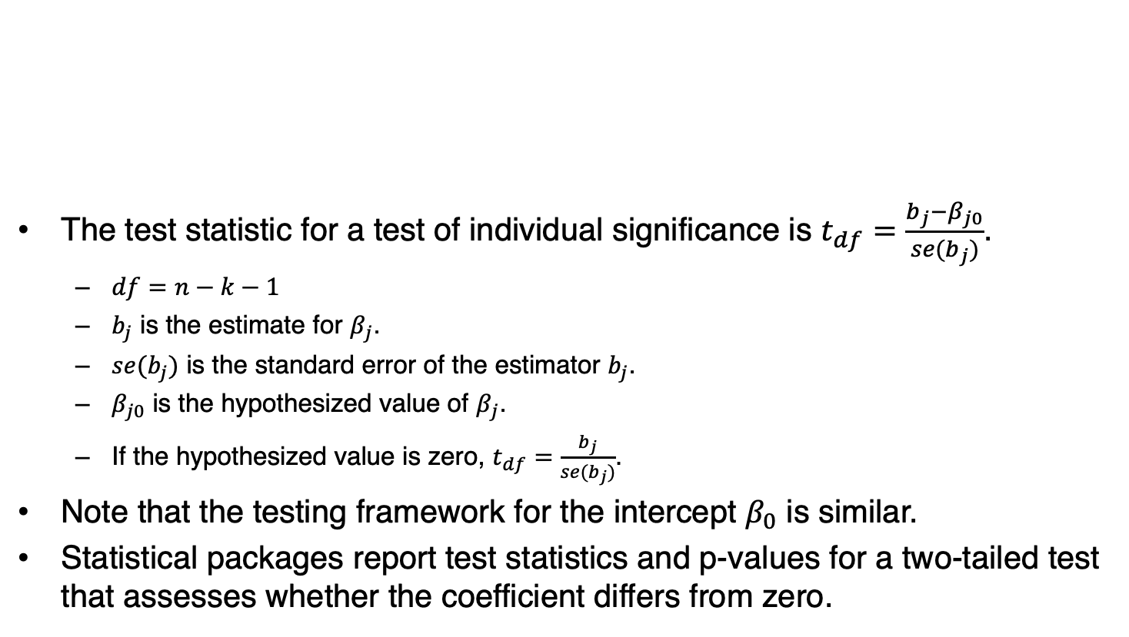
7.2: Model Selection (16/22)
The test statistic for a test of individual significance is $t_{df}=\frac{b_{j}−β_{j0}}{se(b_{j})}$.
  $df=n−k−1$
  $b_{j}$ is the estimate for $β_{j}$.
  $se(b_{j})$ is the standard error of the estimator $b_{j}$.
  $β_{j0}$ is the hypothesized value of $β_{j}$.
  If the hypothesized value is zero, $t_{df}=\frac{b_{j}}{se(b_{j})}$.
Note that the testing framework for the intercept $β_{0}$ is similar.
Statistical packages report test statistics and p-values for a two-tailed test that assesses whether the coefficient differs from zero.

Slide 47
7.2: Model Selection (17/22)
Example: Recall Model 3 was the preferred model.
Conduct a hypothesis test to determine whether cost influences earnings at the 5% significance level.

Slide 48
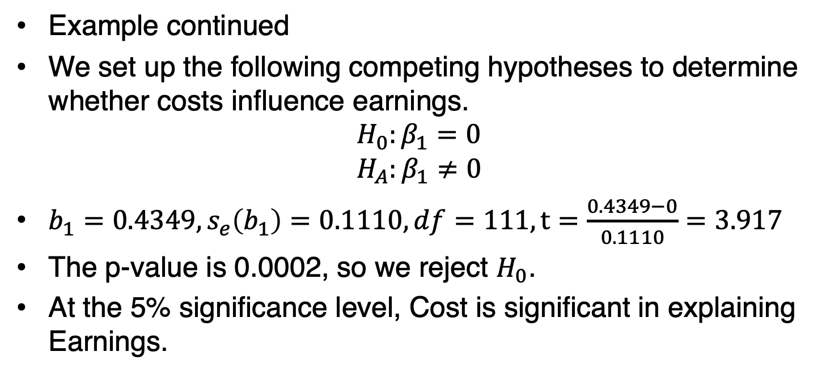
7.2: Model Selection (18/22)
Example continued
We set up the following competing hypotheses to determine whether costs influence earnings.
$$H_{0}:β_{1}=0$$
$$H_{A}:β_{1}≠0$$
$b_{1}=0.4349, s_{e}\left(b_{1}\right)=0.1110, df=111, t=\frac{0.4349−0}{0.1110}=3.917$
The p-value is 0.0002, so we reject $H_{0}$.
At the 5% significance level, Cost is significant in explaining Earnings.

Slide 49
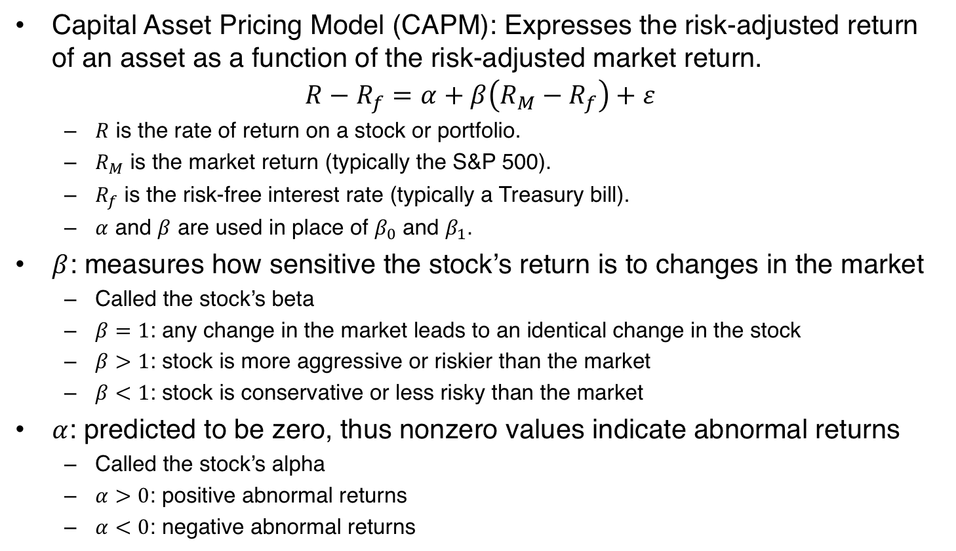
7.2: Model Selection (19/22)
Capital Asset Pricing Model (CAPM): Expresses the risk-adjusted return of an asset as a function of the risk-adjusted market return.
$$R−R_{f}=α+β\left(R_{M}−R_{f}\right)+ε$$
  $R$ is the rate of return on a stock or portfolio.
  $R_{M}$ is the market return (typically the S&P 500).
  $R_{f}$ is the risk-free interest rate (typically a Treasury bill).
  $α$ and $β$ are used in place of $β_{0}$ and $β_{1}$.
$β$: measures how sensitive the stock’s return is to changes in the market
  Called the stock’s beta
  $β=1$: any change in the market leads to an identical change in the stock
  $β>1$: stock is more aggressive or riskier than the market
  $β<1$: stock is conservative or less risky than the market
$α$: predicted to be zero, thus nonzero values indicate abnormal returns
  Called the stock’s alpha
  $α>0$: positive abnormal returns
  $α<0$: negative abnormal returns

Slide 50
7.2: Model Selection (20/22)
Example: Johnson & Johnson monthly stock returns.
At the 5% significance level, is the beta coefficient less than one?
At the 5% significance level, are there abnormal returns? In other words, is the alpha coefficient significantly different from zero?

Slide 51
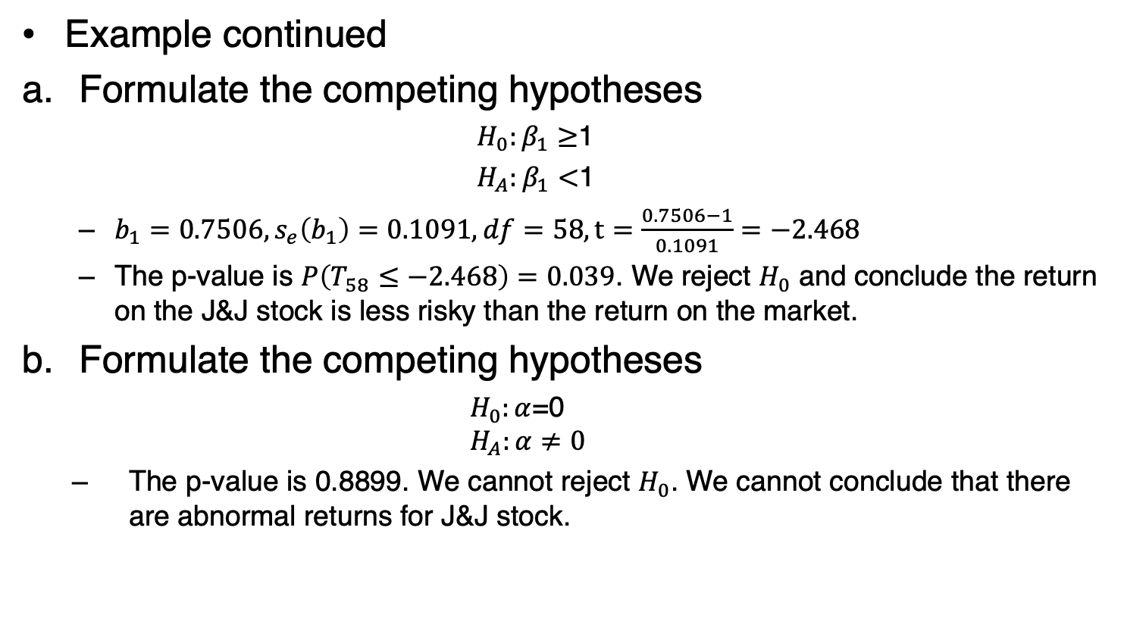
7.2: Model Selection (21/22)
Example continued
Formulate the competing hypotheses
  $H_{0}:β_{1}≥$1
  $H_{A}:β_{1}<$1
  $b_{1}=0.7506, s_{e}\left(b_{1}\right)=0.1091, df=58, t=\frac{0.7506−1}{0.1091}=−2.468$
  The p-value is $P\left(T_{58}≤−2.468\right)=0.039$. We reject $H_{0}$ and conclude the return on the J&J stock is less risky than the return on the market.
Formulate the competing hypotheses
  $H_{0}:α$=0
  $$H_{A}:α≠0$$
  The p-value is 0.8899. We cannot reject $H_{0}$. We cannot conclude that there are abnormal returns for J&J stock.

Slide 52
7.2: Model Selection (22/22)
Regression results are often reported in a table.

Slide 53
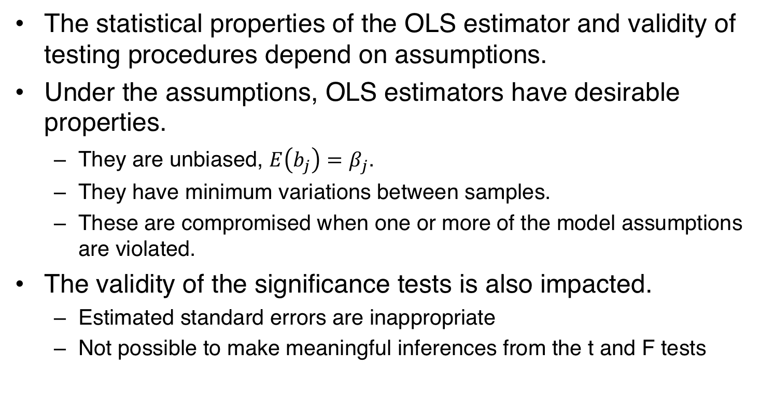
7.3: Model Assumptions and Common Violations (1/18)
The statistical properties of the OLS estimator and validity of testing procedures depend on assumptions.
Under the assumptions, OLS estimators have desirable properties.
  They are unbiased, $E\left(b_{j}\right)=β_{j}$.
  They have minimum variations between samples.
  These are compromised when one or more of the model assumptions are violated.
The validity of the significance tests is also impacted.
  Estimated standard errors are inappropriate
  Not possible to make meaningful inferences from the t and F tests

Slide 54
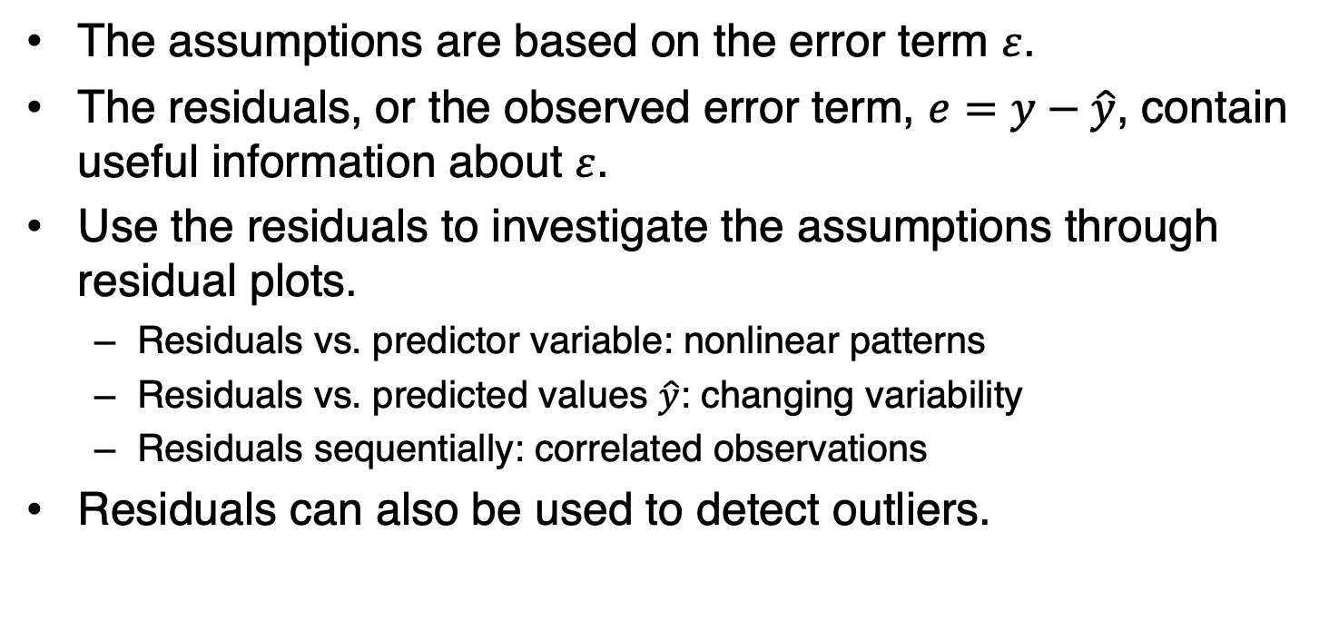
7.3: Model Assumptions and Common Violations (2/18)
The assumptions are based on the error term $ε$.
The residuals, or the observed error term, $e=y−\hat{y}$, contain useful information about $ε$.
Use the residuals to investigate the assumptions through residual plots.
  Residuals vs. predictor variable: nonlinear patterns
  Residuals vs. predicted values $\hat{y}$: changing variability
  Residuals sequentially: correlated observations
Residuals can also be used to detect outliers.

Slide 55
7.3: Model Assumptions and Common Violations (3/18)
Recall that outliers are observations that stand out from the rest of the data.
An outlier observation will stand out in the residual plot.
Outliers can greatly impact the estimates
It is not always clear what to do with them.
Outliers may indicate bad data due to incorrectly recorded (or included) observations.
These observations should be corrected or simply deleted.
Alternatively, outliers may just be due to random variations, in which case the relevant observations should remain.

Slide 56
7.3: Model Assumptions and Common Violations (4/18)
Plot the residuals on the vertical axis and the predictor variable or predicted values on the horizontal axis.
This is a residual plot with no violated assumptions.

Slide 57
7.3: Model Assumptions and Common Violations (5/18)
Assumption 1: The regression model is linear in the parameters and is correctly specified.
  The linearity is in the parameters not in the variables
  Make economic and intuitive sense
  Include all relevant predictor variables
  Incorporate nonlinearities
Detection
  Use residual plots to identify nonlinear patterns
  Linearity is justified if the residuals are randomly dispersed
  A discernible trend in the residuals indicates a nonlinear pattern
Remedy
  Employ nonlinear regression
  Transform the response and predictor variables

Slide 58
7.3: Model Assumptions and Common Violations (6/18)
Example: A sociologist wishes to study the relationship between age and happiness.
He interviews 24 individuals and collects data on each person’s age and happiness, where happiness is measured on a scale from 0 to 100 .

Slide 59
7.3: Model Assumptions and Common Violations (7/18)
Example continued

Slide 60
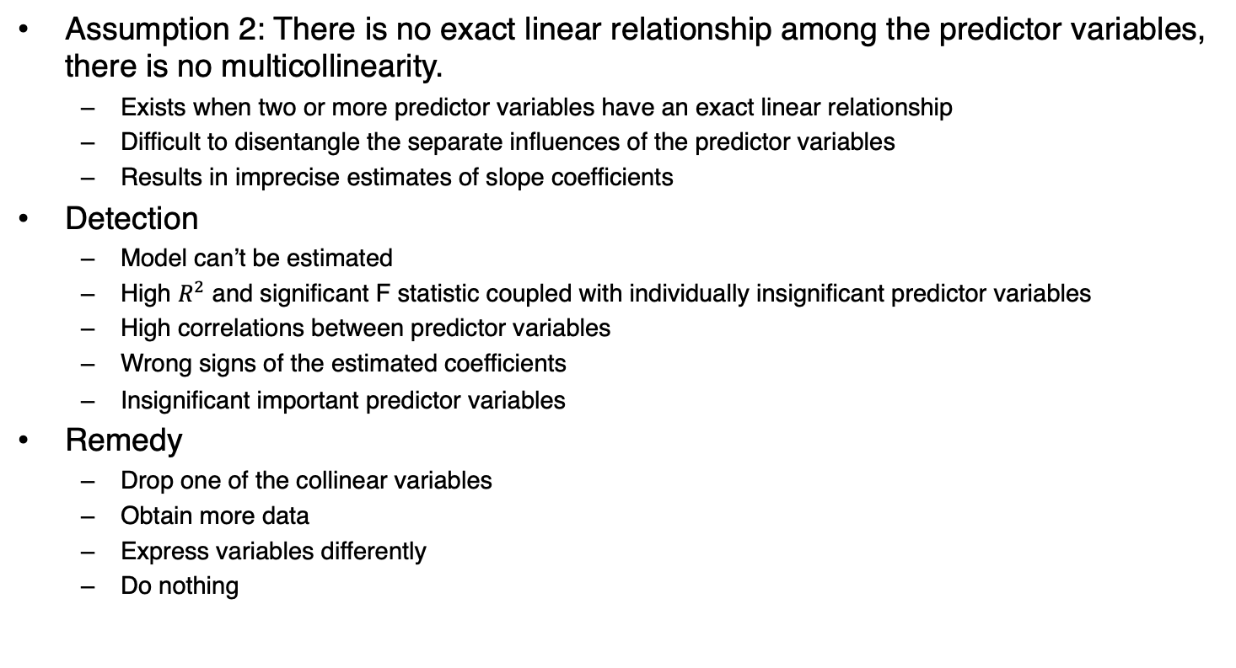
7.3: Model Assumptions and Common Violations (8/18)
Assumption 2: There is no exact linear relationship among the predictor variables, there is no multicollinearity.
  Exists when two or more predictor variables have an exact linear relationship
  Difficult to disentangle the separate influences of the predictor variables
  Results in imprecise estimates of slope coefficients
Detection
  Model can’t be estimated
  High $R^{2}$ and significant F statistic coupled with individually insignificant predictor variables
  High correlations between predictor variables
  Wrong signs of the estimated coefficients
  Insignificant important predictor variables
Remedy
  Drop one of the collinear variables
  Obtain more data
  Express variables differently
  Do nothing

Slide 61
7.3: Model Assumptions and Common Violations (9/18)
Example: A linear regression model that uses median home values (in $) as the response variable and median household incomes (in $), per capita incomes (in $), and percentage of owner-occupied homes as the predictor variables.
The significance and sign of the coefficient for Per Cap Inc changes when HH Income is included in the model.

Slide 62
7.3: Model Assumptions and Common Violations (10/18)
Assumption 3: Conditional on the values of the predictors, the variance of the error term is the same for all observations.
  Constant variability
  No heteroskedasticity
  Often breaks down cross-sectional data
  Exists when the variability in the response changes with at least one other predictor variable
  OLS estimators are still unbiased
  But the standard errors are not appropriate
  Can’t use the t and F tests
Detection
  Plot the residuals against each predictor variable or predicted values
  Residuals should be randomly dispersed
  Violated when the variability of the residuals increases or decreases
Remedy
  Correct the standard errors
  Called White’s robust standard errors
  Not available in Excel
  R has packages

Slide 63
7.3: Model Assumptions and Common Violations (11/18)
Example: Consider a simple regression model that relates a store’s monthly sales (Sales in $1,000s) to its square footage (Sqft) for a chain of convenience stores.

Slide 64
7.3: Model Assumptions and Common Violations (12/18)
Assumption 4: Conditional on the predictor variables, the error term is uncorrelated across observations.
  No serial correlation
  Often breaks down with time series data
  OLS estimates are still unbiased
  Standard errors are inappropriate, distorted downward making the model look better than it really is
  The t and F tests may suggest the predictor variables are significant when they are not
Detection
  Plot the residuals sequentially over time
  Should show no pattern
  Positive (or negative) residuals followed by positive (or negative) residuals consecutively
  Switching between positive and negative residuals
Remedy: Use Newey-West robust standard errors in R.

Slide 65

7.3: Model Assumptions and Common Violations (13/18)
Example: Consider a model that uses advertising ($x_{1}$) and unemployment rate ($x_{2}$) to predict the sales of a sushi restaurant over time ($y$).

Slide 66
7.3: Model Assumptions and Common Violations (14/18)
Assumption 6: The error term is Normally distributed.
Allows the construction of interval estimates and hypothesis tests.
If the error term is no normally distributed, then the interval estimates and hypothesis tests are valid only for large samples.

Slide 67
7.3: Model Assumptions and Common Violations (15/18)
Use Excel to obtain a residual plot.
Open the Stores data file.
Data > Data Analysis > Regression.
For Input Y Range, select the Sales observations, and for Input X Range, select the Sqft observations. Select Residual Plots.

Slide 68
7.3: Model Assumptions and Common Violations (16/18)
Use Excel to obtain a residual plot sequentially over time
Open the Sushi data file
Data > Data Analysis > Regression
Given the regression output, select the residuals and choose Insert > Scatter

Slide 69
7.3: Model Assumptions and Common Violations (17/18)
Use R to obtain White’s robust standard errors.
Import the Stores data file into a data frame (table) and label it myData.

Slide 70
7.3: Model Assumptions and Common Violations (18/18)
Use R to obtain Newey-West Robust Standard Errors
Import the Sushi data file

