Slide 1
9
Logistic Regression
Business Analytics, 2e
By Sanjiv Jaggia, Alison Kelly, Kevin Lertwachara, and Leida Chen

Slide 2
Chapter 9 Learning Objectives (LOs)
LO 9.1 Estimate and interpret linear and logistic regression models.
LO 9.2 Calculate and interpret odds and accuracy.
LO 9.3 Use cross-validation to assess classification performance.

Slide 3
Introductory Case: Spam Detection System (1/2)
Electronic mail (e-mail) is one of the most widely used Internet services.
While e-mails can greatly benefit productivity, they are susceptible to unsolicited, unwanted, and possibly virus-infested spam messages from illegitimate e-mail addresses.
Peter Derby works as a cybersecurity analyst at a private equity firm.
His colleagues at the firm have been overwhelmed by large-scale spam e-mails.
Peter would like to implement an effective spam detection system on the company’s e-mail server.
He has been tasked to create spam filters that detect spam e-mails and stop them from getting into e-mail inboxes.

Slide 4
Introductory Case: Spam Detection System (2/2)
He analyzes a sample of 500 spam and legitimate e-mails.
Peter would like to use the information to:
  Develop a logistic regression model for spam detection.
  Assess the performance of the estimated model.
  Make spam predictions for specific predictor variable values.

Slide 5
9.1: The Linear Probability and the Logistic Regression Models (1/11)
We have considered regression models where dummy (binary) variables are used only as predictor variables.
The response variable thus far has been quantitative.
Binary choice (classification) models have a binary response variable.
Example: Whether or not to approve a loan.
In these models, the response variable is binary.
  The class designated as 1 is the target or positive class
  The class designated as 0 is the nontarget or negative class positive class
This choice can be related to a host of factors: the predictor variables.

Slide 6
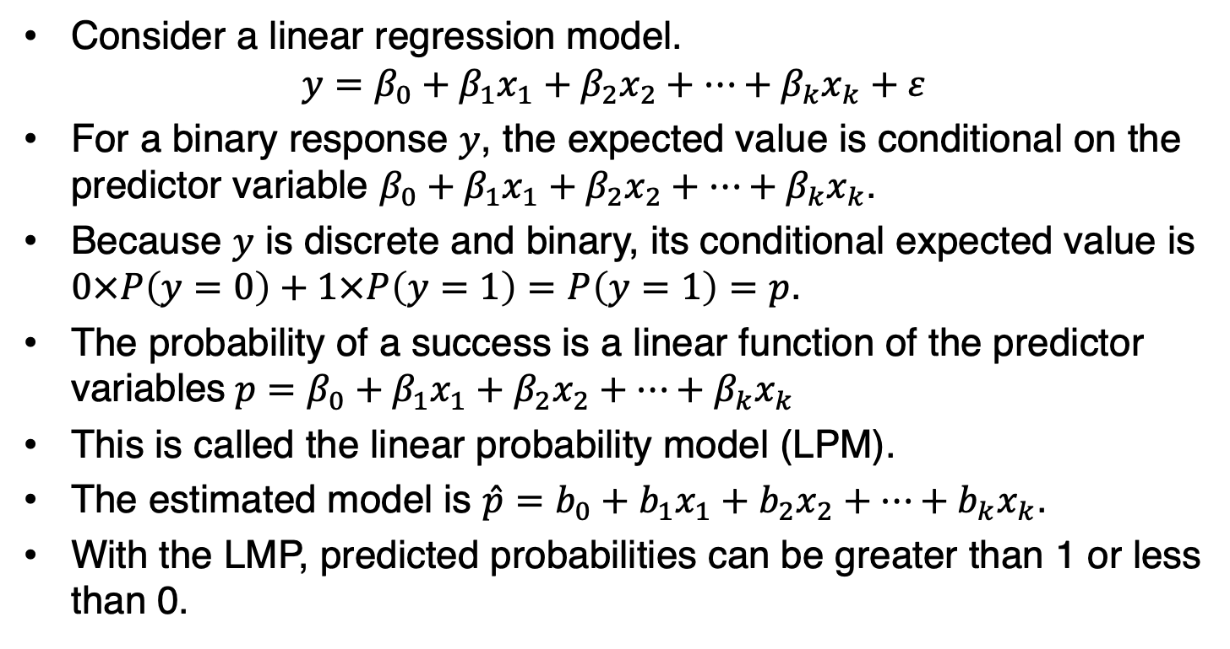
9.1: The Linear Probability and the Logistic Regression Models (2/11)
Consider a linear regression model.
$$y=β_{0}+β_{1}x_{1}+β_{2}x_{2}+…+β_{k}x_{k}+ε$$
For a binary response $y$, the expected value is conditional on the predictor variable $β_{0}+β_{1}x_{1}+β_{2}x_{2}+…+β_{k}x_{k}$.
Because $y$ is discrete and binary, its conditional expected value is $0×P\left(y=0\right)+1×P\left(y=1\right)=P\left(y=1\right)=p$.
The probability of a success is a linear function of the predictor variables$p=β_{0}+β_{1}x_{1}+β_{2}x_{2}+…+β_{k}x_{k}$
This is called the linear probability model (LPM).
The estimated model is $\hat{p}=b_{0}+b_{1}x_{1}+b_{2}x_{2}+…+b_{k}x_{k}$.
With the LMP, predicted probabilities can be greater than 1 or less than 0.

Slide 7
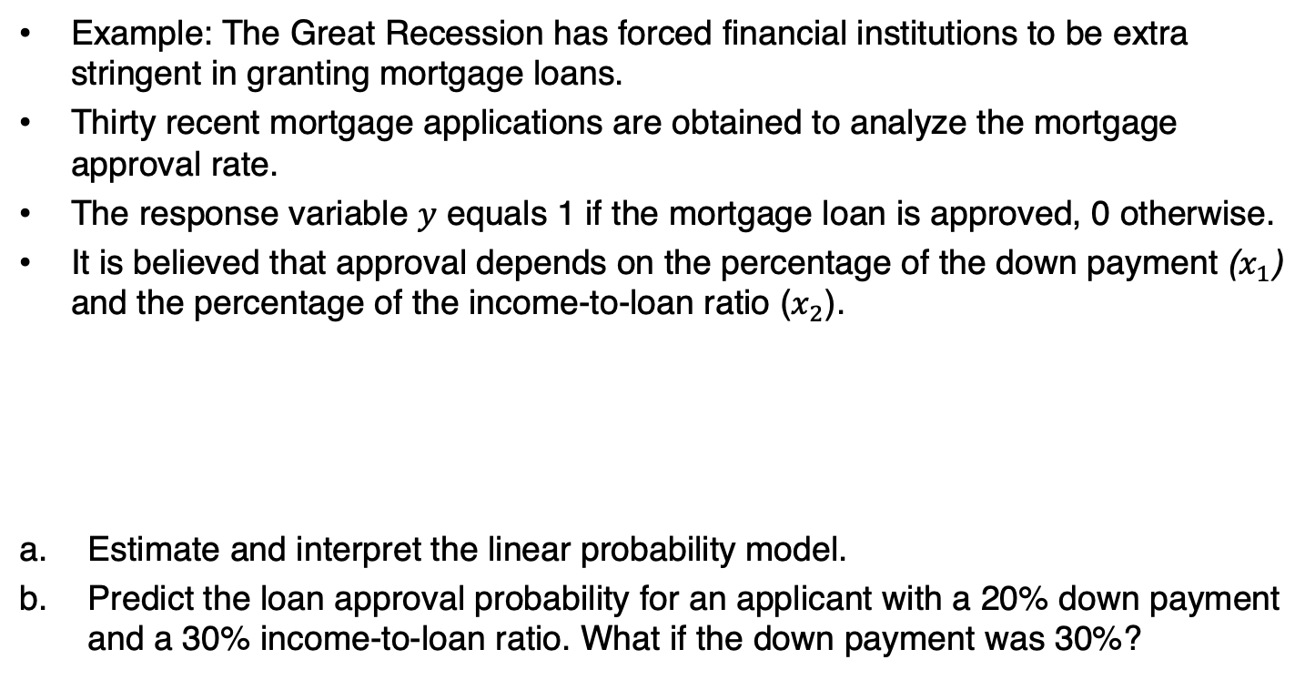
9.1: Linear Probability and Logistic Regression Models (3/11)
Example: The Great Recession has forced financial institutions to be extra stringent in granting mortgage loans.
Thirty recent mortgage applications are obtained to analyze the mortgage approval rate.
The response variable $y$ equals 1 if the mortgage loan is approved, 0 otherwise.
It is believed that approval depends on the percentage of the down payment ($x_{1}$) and the percentage of the income-to-loan ratio ($x_{2}$).
Estimate and interpret the linear probability model.
Predict the loan approval probability for an applicant with a 20% down payment and a 30% income-to-loan ratio. What if the down payment was 30%?

Slide 8
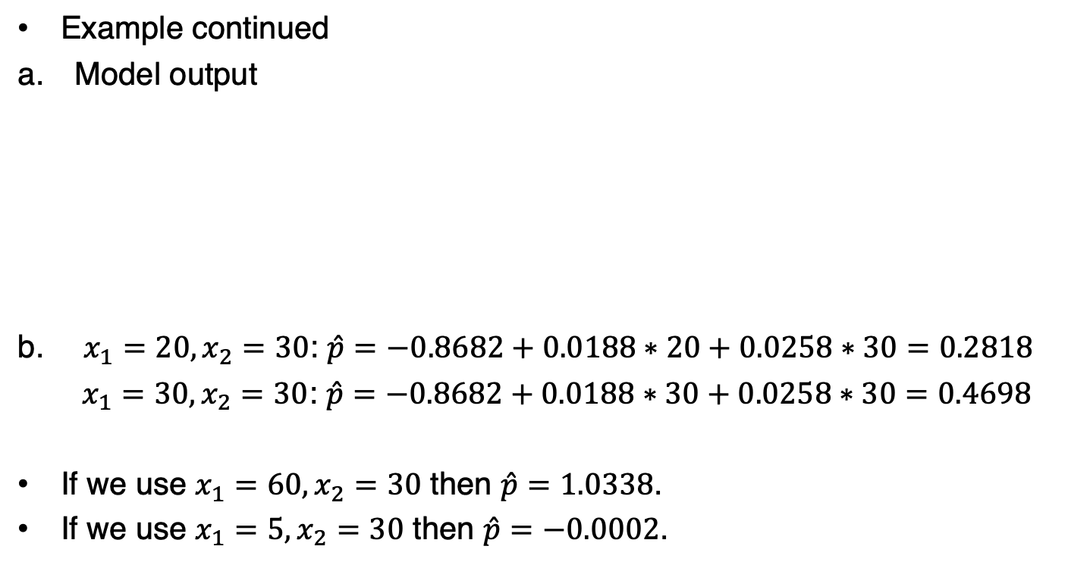
9.1: Linear Probability and Logistic Regression Models (4/11)
Example continued
Model output
$x_{1}=20, x_{2}=30$: $\hat{p}=−0.8682+0.0188∗20+0.0258∗30=0.2818$
$x_{1}=30, x_{2}=30$: $\hat{p}=−0.8682+0.0188∗30+0.0258∗30=0.4698$
If we use $x_{1}=60, x_{2}=30$ then $\hat{p}=1.0338$.
If we use $x_{1}=5, x_{2}=30$ then $\hat{p}=−0.0002$.

Slide 9
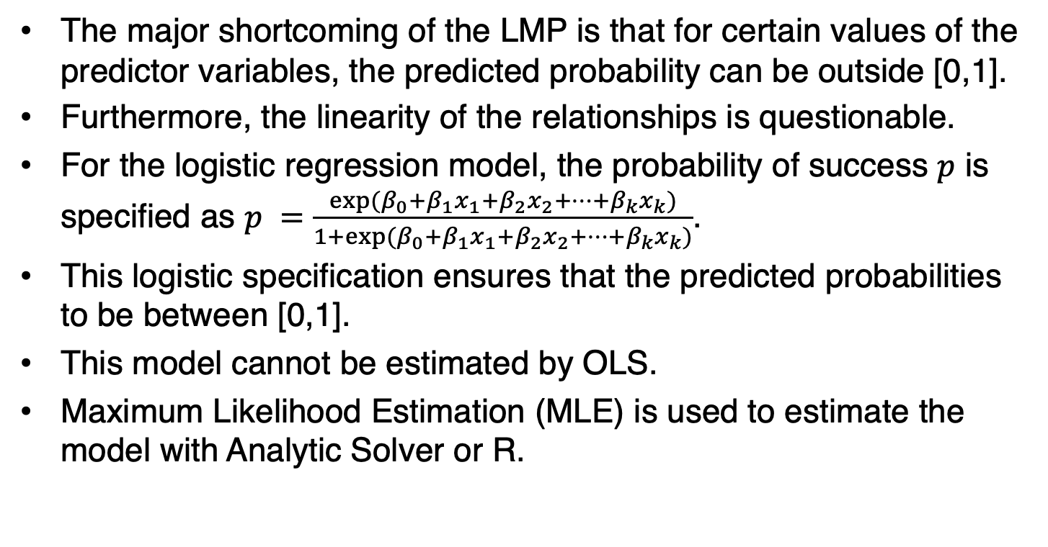
9.1: The Linear Probability and the Logistic Regression Models (5/11)
The major shortcoming of the LMP is that for certain values of the predictor variables, the predicted probability can be outside [0,1].
Furthermore, the linearity of the relationships is questionable.
For the logistic regression model, the probability of success $p$ is specified as $p =\frac{exp⁡(β_{0}+β_{1}x_{1}+β_{2}x_{2}+…+β_{k}x_{k})}{1+exp⁡(β_{0}+β_{1}x_{1}+β_{2}x_{2}+…+β_{k}x_{k})}$.
This logistic specification ensures that the predicted probabilities to be between [0,1].
This model cannot be estimated by OLS.
Maximum Likelihood Estimation (MLE) is used to estimate the model with Analytic Solver or R.

Slide 10
9.1: The Linear Probability and the Logistic Regression Models (6/11)

Slide 11
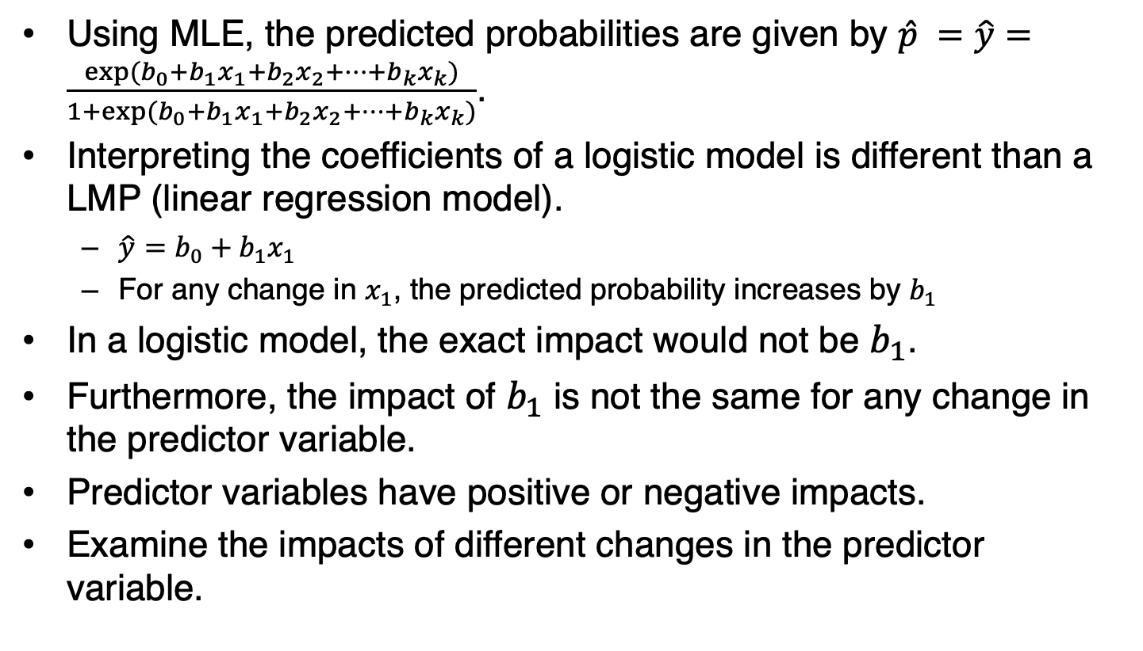
9.1: The Linear Probability and the Logistic Regression Models (7/11)
Using MLE, the predicted probabilities are given by $\hat{p} =\hat{y}=\frac{exp⁡(b_{0}+b_{1}x_{1}+b_{2}x_{2}+…+b_{k}x_{k})}{1+exp⁡(b_{0}+b_{1}x_{1}+b_{2}x_{2}+…+b_{k}x_{k})}$.
Interpreting the coefficients of a logistic model is different than a LMP (linear regression model).
  $\hat{y}=b_{0}+b_{1}x_{1}$
  For any change in $x_{1}$, the predicted probability increases by $b_{1}$
In a logistic model, the exact impact would not be $b_{1}$.
Furthermore, the impact of $b_{1}$ is not the same for any change in the predictor variable.
Predictor variables have positive or negative impacts.
Examine the impacts of different changes in the predictor variable.

Slide 12
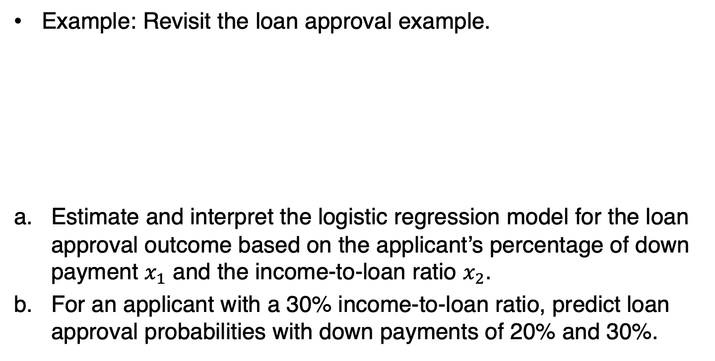
9.1: Linear Probability and Logistic Regression Models (8/11)
Example: Revisit the loan approval example.
Estimate and interpret the logistic regression model for the loan approval outcome based on the applicant’s percentage of down payment $x_{1}$ and the income-to-loan ratio $x_{2}$.
For an applicant with a 30% income-to-loan ratio, predict loan approval probabilities with down payments of 20% and 30%.

Slide 13
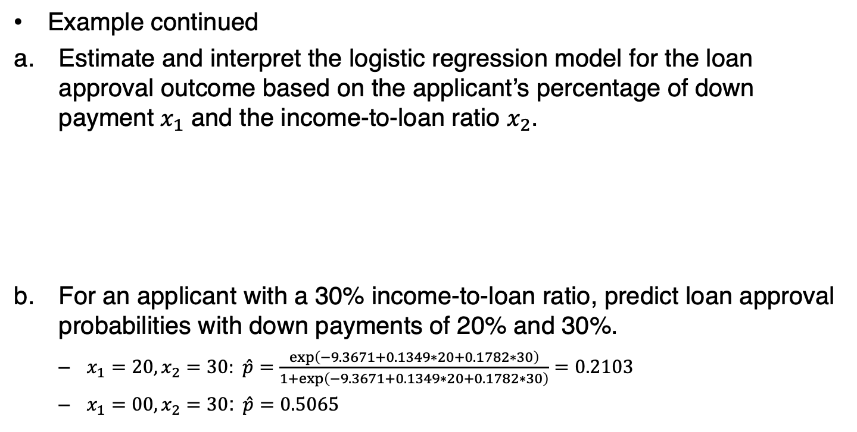
9.1: Linear Probability and Logistic Regression Models (9/11)
Example continued
Estimate and interpret the logistic regression model for the loan approval outcome based on the applicant’s percentage of down payment $x_{1}$ and the income-to-loan ratio $x_{2}$.
For an applicant with a 30% income-to-loan ratio, predict loan approval probabilities with down payments of 20% and 30%.
  $x_{1}=20, x_{2}=30$: $\hat{p}=\frac{exp⁡\left(−9.3671+0.1349∗20+0.1782∗30\right)}{1+exp⁡\left(−9.3671+0.1349∗20+0.1782∗30\right)}=0.2103$
  $x_{1}=00, x_{2}=30$: $\hat{p}=0.5065$

Slide 14
9.1: Linear Probability and Logistic Regression Models (10/11)
Example continued with Excel
Open the Mortgage data file
Choose Data Mining > Classify > Logistic Regression from the menu

Slide 15
9.1: Linear Probability and Logistic Regression Models (11/11)
Example continued with R
Import the Mortgage data file into a data frame and label it myData

Slide 16
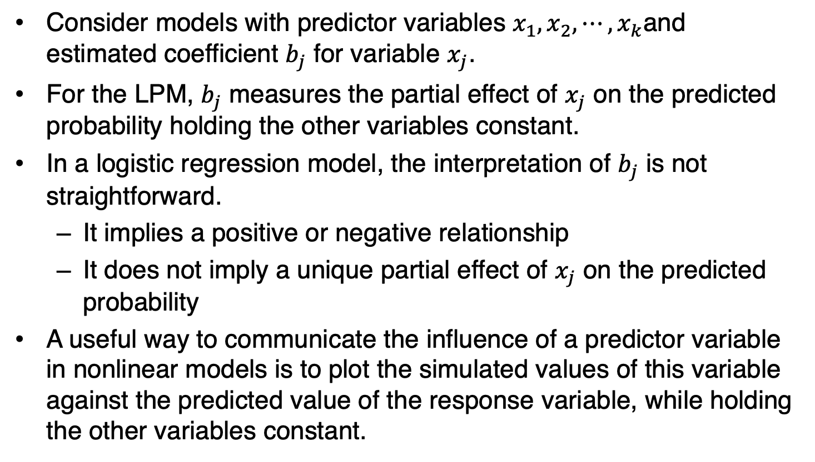
9.2: Odds and Accuracy Rate (1/13)
Consider models with predictor variables $x_{1},x_{2},⋯,x_{k}$and estimated coefficient $b_{j}$ for variable $x_{j}$.
For the LPM, $b_{j}$ measures the partial effect of $x_{j}$ on the predicted probability holding the other variables constant.
In a logistic regression model, the interpretation of $b_{j}$ is not straightforward.
  It implies a positive or negative relationship
  It does not imply a unique partial effect of $x_{j}$ on the predicted probability
A useful way to communicate the influence of a predictor variable in nonlinear models is to plot the simulated values of this variable against the predicted value of the response variable, while holding the other variables constant.

Slide 17
9.2: Odds and Accuracy Rate (2/13)
Example: The objective outlined in the introductory case is to detect spam based on the number of recipients, the number of hyperlinks, and the number of characters for each e-mail.
Estimate the linear and the logistic regression models for spam detection.
Use simulations to highlight the partial effect of Recipients on the predicted spam probability, while holding Hyperlinks and Characters fixed at their sample means.

Slide 18
9.2: Odds and Accuracy Rate (3/13)
Example continued

Slide 19
9.2: Odds and Accuracy Rate (4/13)
Example continued
Highlight the partial effect of Recipients on the predicted probability by varying it between 10 and 50.
Hold Hyperlinks and Characters at their average sample values of 6.226 and 58.602.

Slide 20
9.2: Odds and Accuracy Rate (5/13)
Example continued

Slide 21
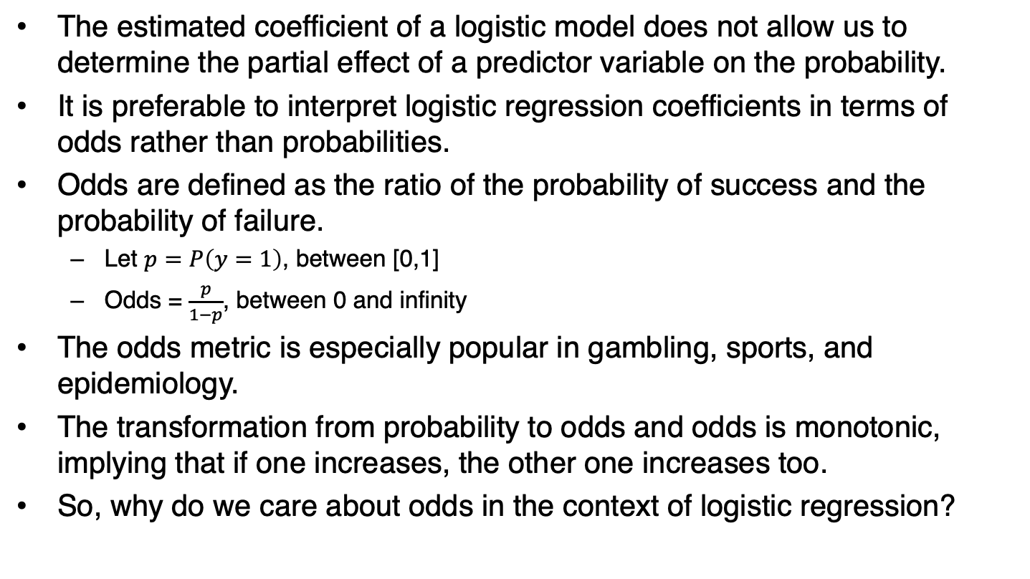
9.2: Odds and Accuracy Rate (6/13)
The estimated coefficient of a logistic model does not allow us to determine the partial effect of a predictor variable on the probability.
It is preferable to interpret logistic regression coefficients in terms of odds rather than probabilities.
Odds are defined as the ratio of the probability of success and the probability of failure.
  Let $p=P\left(y=1\right)$, between [0,1]
  Odds = $\frac{p}{1−p}$, between 0 and infinity
The odds metric is especially popular in gambling, sports, and epidemiology.
The transformation from probability to odds and odds is monotonic, implying that if one increases, the other one increases too.
So, why do we care about odds in the context of logistic regression?

Slide 22
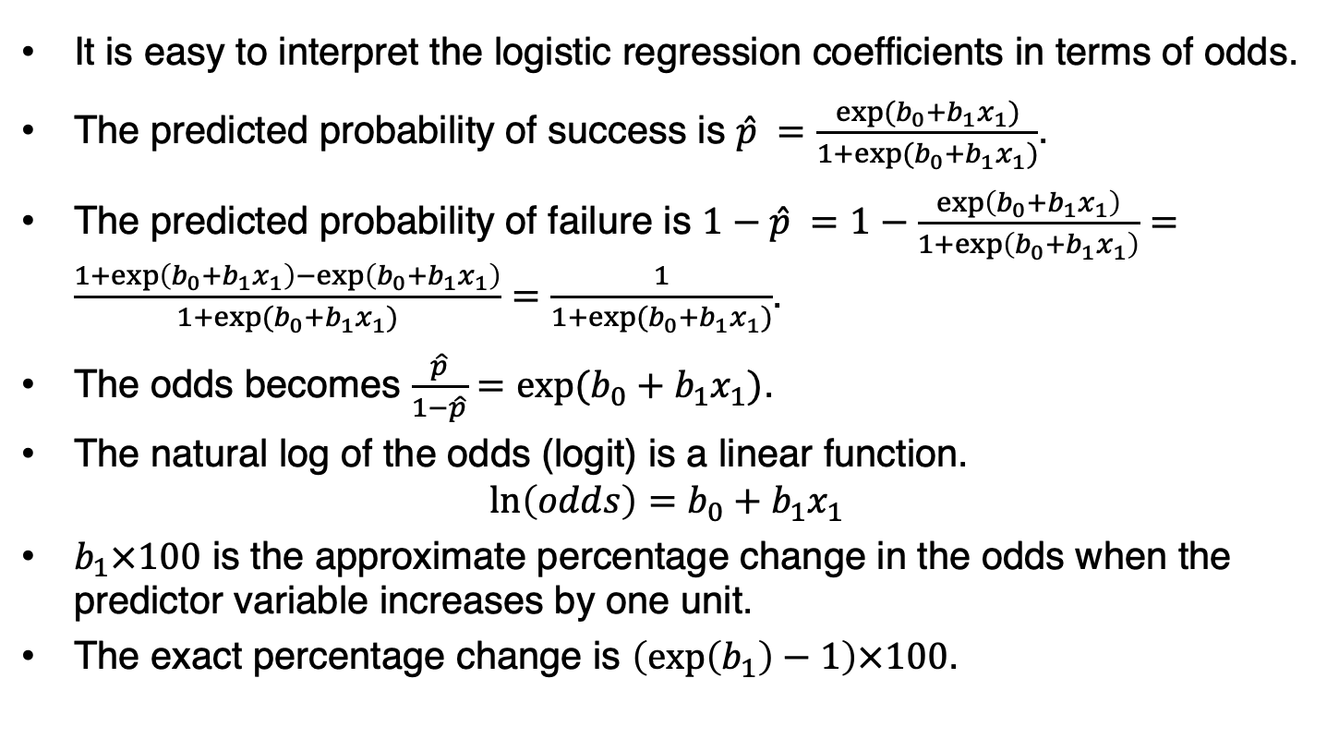
9.2: Odds and Accuracy Rate (7/13)
It is easy to interpret the logistic regression coefficients in terms of odds.
The predicted probability of success is $\hat{p} =\frac{exp⁡(b_{0}+b_{1}x_{1})}{1+exp⁡(b_{0}+b_{1}x_{1})}$.
The predicted probability of failure is $1−\hat{p} =1−\frac{\exp\left(b_{0}+b_{1}x_{1}\right)}{1+\exp\left(b_{0}+b_{1}x_{1}\right)}=\frac{1+\exp\left(b_{0}+b_{1}x_{1}\right)−\exp\left(b_{0}+b_{1}x_{1}\right)}{1+exp⁡(b_{0}+b_{1}x_{1})}=$ $\frac{1}{1+exp⁡(b_{0}+b_{1}x_{1})}$.
The odds becomes $\frac{\hat{p}}{1−\hat{p}}=exp⁡(b_{0}+b_{1}x_{1})$.
The natural log of the odds (logit) is a linear function.
$$\ln\left(odds\right)=b_{0}+b_{1}x_{1}$$
$b_{1}×100$ is the approximate percentage change in the odds when the predictor variable increases by one unit.
The exact percentage change is $\left(\exp\left(b_{1}\right)−1\right)×100$.

Slide 23
9.2: Odds and Accuracy Rate (8/13)
Example: Revisit the estimated logistic regression model from the introductory case.
Interpret the partial effect of each predictor variable on the odds of spam.

Slide 24
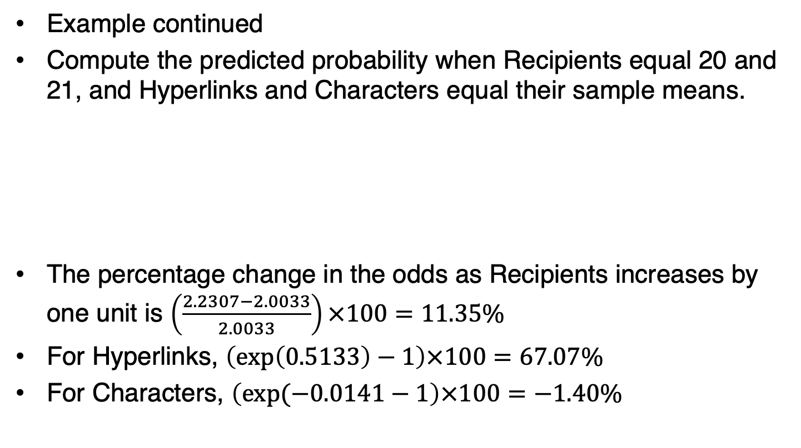
9.2: Odds and Accuracy Rate (9/13)
Example continued
Compute the predicted probability when Recipients equal 20 and 21, and Hyperlinks and Characters equal their sample means.
The percentage change in the odds as Recipients increases by one unit is $\left(\frac{2.2307−2.0033}{2.0033}\right)×100=11.35\%$
For Hyperlinks, $\left(\exp\left(0.5133\right)−1\right)×100=67.07\%$
For Characters, $\left(\exp{(−0.0141}−1\right)×100=−1.40\%$

Slide 25
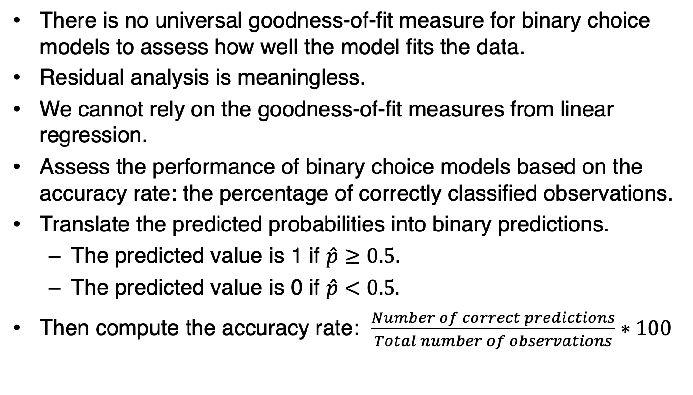
9.2: Odds and Accuracy Rate (10/13)
There is no universal goodness-of-fit measure for binary choice models to assess how well the model fits the data.
Residual analysis is meaningless.
We cannot rely on the goodness-of-fit measures from linear regression.
Assess the performance of binary choice models based on the accuracy rate: the percentage of correctly classified observations.
Translate the predicted probabilities into binary predictions.
  The predicted value is 1 if $\hat{p}≥0.5$.
  The predicted value is 0 if $\hat{p}<0.5.$
Then compute the accuracy rate: $\frac{Number of correct predictions}{Total number of observations}∗100$

Slide 26
9.2: Odds and Accuracy Rate (11/13)
Example: Revisit the introductory case and compare the accuracy rates of the estimated LPM and the estimated logistic model.

Slide 27
9.2: Odds and Accuracy Rate (12/13)
Example continued
Out of 500 sample records, the binary predictions match the spam values in 394 and 397 of the records for LPM and the logistic model, respectively.
The accuracy rate is 78.80% for LPM and 79.40% for the logistic model
Based on the accuracy rate, the logistic model is the preferred predictive model.

Slide 28
9.2: Odds and Accuracy Rate (13/13)
Example continued with R
Import the Spam data into a data frame and label it myData

Slide 29
9.3: Cross-Validation of Binary Choice Models (1/14)
We have used the accuracy rate to assess the performance of classification models.
This performance measure was calculated for the sample that was also used in estimation.
A model may perform very well with the estimation sample but then perform poorly when making out-of-sample predictions.
A useful method to assess the predictive power of a model is to test it on a data set not used in estimation.
Use cross-validation to assess models by partitioning the sample.
  Training set: use to build/train the model
  Validation set: use to evaluate/validate the model
A validation set provides an independent assessment by exposing the model to unseen data.

Slide 30
9.3: Cross-Validation of Binary Choice Models (2/14)
The holdout method partitions the sample data set into two independent and mutually exclusive data sets.
  Partition the sample into two parts: training and validation sets.
  Use the training set to estimate competing models.
  Use the estimates from the training set to make predictions in the validation set.
  Calculate the accuracy rats and selection the model with the highest value.

Slide 31
9.3: Cross-Validation of Binary Choice Models (3/14)
Example: The objective outlined in the introductory case is to detect spam based on the number of recipients, the number of hyperlinks, and the number of characters for each e-mail.
Use the holdout method to compare the accuracy rates of two competing logistic models for spam.
Use the first 375 observations for training and the remaining 125 observations for validation.
Model 1: Recipients, Hyperlinks, and Characters as predictor variables
Model 2: Drops the predictor variable(s) found to be statistically insignificant in Model 1.

Slide 32
9.3: Cross-Validation of Binary Choice Models (4/14)
Example continued
Model 1 accuracy rate: 68.00%
Model 2 accuracy rate: 65.60%

Slide 33
9.3: Cross-Validation of Binary Choice Models (5/14)
Example continued with Excel
Open the Spam data file. In column F of the data file, create a variable called Flag with the letter T for the first 375 observations and the letter V for the remaining 125 observations; here T and V denote training and validation, respectively.
Data Mining > Partition > Standard Partition
Data Mining > Classify > Logistic Regression.

Slide 34
9.3: Cross-Validation of Binary Choice Models (6/14)
Example continued with R
Import the Spam data into a data frame and label it myData

Slide 35
9.3: Cross-Validation of Binary Choice Models (7/14)
Recall that the holdout method is sensitive to how the data are partitioned.
It is preferable to use the k-fold cross-validation method
Perform the holdout method k times and use the average of the performance measures for model selection.
The greater the k, the greater will be the reliability.
When k equals the sample size, the resulting method is also called the leave-one-out cross-validation method.

Slide 36
9.3: Cross-Validation of Binary Choice Models (8/14)
Example: Revisit the Spam data to apply the k-fold cross validation method, with k = 4, to compare the predictability of the two logistic models.
Model 1 average accuracy rate: 77.8%
Model 2 average accuracy rate: 75.8%

Slide 37
9.3: Cross-Validation of Binary Choice Models (9/14)
Accuracy is one of the most common metrics used to evaluate the performance of binary choice models.
We may want to assess how well the model predicts the target class and the nontarget class.
It is important to report the percentage of correctly classified observations for both the target class and the nontarget class.
Sensitivity is the proportion of target class cases that are classified correctly.
Specificity is the proportion of nontarget class cases that are classified correctly.

Slide 38
9.3: Cross-Validation of Binary Choice Models (10/14)
Example: We used the holdout method to compare two logistic models using the first 375 observations for training and the remaining 125 observations for validation.
Model 1: Recipients, Hyperlinks, and
Model 2: Recipients and Hyperlinks
Revisit the data to compare the models in terms of accuracy, sensitivity, and specificity.

Slide 39
9.3: Cross-Validation of Binary Choice Models (11/14)
Example continued with R

Slide 40
9.3: Cross-Validation of Binary Choice Models (12/14)
The relevance of sensitivity and specificity is especially true when the response variable has many ones and a few zeros (or many zeros and a few ones).
The data set for such applications is referred to as imbalanced.
With imbalanced data, the percentage of correctly classified observations can be high even when the model predicts the less likely outcome poorly.
There is some degree of imbalance in all data sets, but a severe imbalance is challenging and may require specialized techniques.
The relevance of sensitivity and specificity depends on the related misspecification costs.
If the misspecification costs due to incorrectly predicting the target class are high, then the default cutoff of 0.50 for converting predictions into binary predictions may not be appropriate.
Sometimes, it is preferable to use a cutoff that equals the proportion of observations in the target class.

Slide 41
9.3: Cross-Validation of Binary Choice Models (13/14)
Example: The transition from high school to college can be daunting for young adults.
For some students, college anxieties turn into clinical depression with possible thoughts of suicide.
Early identification and intervention are critical for reducing the adverse effects of depression.
The human resource department at a community college has developed a logistic model to identify students who are likely to develop clinical depression.

Slide 42
9.3: Cross-Validation of Binary Choice Models (14/14)
Example continued

