Slide 1
16
Risk Analysis and Simulation
Business Analytics, 2e
By Sanjiv Jaggia, Alison Kelly, Kevin Lertwachara, and Leida Chen

Slide 2
Chapter 16 Learning Objectives (LOs)
LO 16.1 Perform risk analysis.
LO 16.2 Generate random observations from probability distributions.
LO 16.3 Develop and apply Monte Carlo simulations.

Slide 3
Introductory Case: FashionTech Operation and Staffing Strategy
FashionTech’s best-selling item is a red pullover jacket for women. Abigail the company’s operations manager, is looking for a better, more data-driven strategy for production and staffing for this product.
Although the production process for the pullover is partly automated, many important steps are done manually by skilled tailors.
Abigail wants to get a better estimate of the demand of the pullover and determine how many tailors she needs to hire.
In addition, she is considering increasing the level of automation in the manufacturing process.
Abigail would like to accomplish the following tasks.
  Develop a simulation to examine the profit at each staffing level as well as evaluate the plan to increase the automation level in the production process.
  Examine the profit variability given the uncertainty of the demand and the production rate.

Slide 4
16.1: Overview of Prescriptive Analytics (1/2)
Prescriptive analytics is a process of using analysis tools to improve decision making.
In many cases, prescriptive analytics can help a decision maker determine the best course of action among different alternatives.
Some people regard prescriptive analytics as a very broad term that encompasses all analytics techniques with an overall goal of improving business decision making.
Most people prefer making a distinction between descriptive, predictive, and prescriptive analytics.
Prescriptive analytics uses simulation and optimization techniques to quantify the effect of different possible actions by a decision maker.

Slide 5
16.1: Overview of Prescriptive Analytics (2/2)
There are three analytics techniques used to extract value from data and make better business decisions.
Descriptive statistics summarizes “what has happened.”
  Gathering, organizing, tabulating, visualization
Predictive analytics predicts “what could happen.”
  Using historical data for predictive models
Prescriptive analytics provides advice on “what should we do.”
  Process of using decision analysis tools to improve decision making
  Simulation is an attempt to imitate a real-world process examine the outcome of different scenarios
  Optimization is an attempt to find an optimal way to achieve an objective under given constraints

Slide 6
16.2: Assessing Risk (1/18)
Simulation has been extensively used in a wide variety of applications to explore alternative solutions or improve decision making.
Risk can be defined as the possibility or probability that an undesirable outcome may occur.
Risk analysis (also called scenario analysis) refers to a process of examining and assessing different scenarios in order to better understand the possibility of both intended and undesired outcomes.
We can assess and model risk using random variables and risk analysis.
Use random variables to capture the inherently uncertain nature of processes to make better-informed decisions.

Slide 7
16.2: Assessing Risk (2/18)
Examine multiple scenarios with different possible outcomes to assess risk.
Consider at least three scenarios to evaluate a range of outcomes from multiple scenarios.
  Most likely
  Pessimistic (worst case)
  Optimistic (best case)
Also consider the average scenario or others.
It may be difficult to determine what the best/worst cases are.
Use historical data to help estimate the best/worst cases.
Considering at least these three scenarios reasonably captures some of the uncertainty of a real-life process

Slide 8
16.2: Assessing Risk (3/18)
Example: A company in the western United States manufactures and distributes women’s hand- bags to retail stores around the country.
To manufacture a handbag, the company usually incurs a variable cost of $40 per handbag, but the actual costs in the past have ranged from $35 to $46 per handbag.
The overall fixed cost is usually $43,000 but may vary between $31,000 and $52,000.
The retail price of each handbag is $65. Based on a small amount of sales data available, the demand has fluctuated between 2,500 and 5,000 handbags per quarter, but in most quarters the demand has been about 3,500 handbags.
Conduct a risk analysis to assess the quarterly profitability of the company.

Slide 9
16.2: Assessing Risk (4/18)
Example continued with Excel
Profit = (Retail price per handbag − Variable cost per handbag) × Demand − Fixed cost
Open the Handbag worksheet

Slide 10
16.2: Assessing Risk (5/18)
Example continued with R

Slide 11
16.2: Assessing Risk (6/18)
We also use random variables to assess risk and uncertainty.
A random variable is a function that assigns numerical values to the outcome of an experiment.
Important discrete random variables:
  Discrete uniform
  Binomial
  Poisson
Important continuous random variables:
  Continuous uniform
  Normal
  Exponential
  Triangular

Slide 12
16.2: Assessing Risk (7/18)
Example: A company estimates that 30% of its customers would react positively to its new web features.
Here, we demonstrate how to generate random observations that represent the number of customers who react positively to the company’s new web features in a randomly selected group of 10 customers.
Simulate random observations based on 100 groups of 10 customers.

Slide 13
16.2: Assessing Risk (8/18)
Example continued with Excel
Use BINOM.INV and RAND
Data > Data Analysis > Random Number Generation

Slide 14
16.2: Assessing Risk (9/18)
Example continued with R
Use sample to sample from a discrete uniform
Use rpois to sample from the Poisson distribution

Slide 15
16.2: Assessing Risk (10/18)
In many real-world settings, the appropriate probability distribution of a random variable is not known in advance.
Plot the data and inspect the histogram for distinctive shapes corresponding to theoretical distributions.
But many real-life events and the data we obtain from these events may not conform to any theoretical probability distributions.
Construct and use an empirical probability distribution by using historical or empirical data.
  An empirical probability distribution can be represented by a relative frequency table.
  Cumulative relative frequencies are then used to generate random observations that reflect the pattern observed in the historical data.

Slide 16
16.2: Assessing Risk (11/18)
Example: A medical supply provider examines the weekly demand by hospitals for respiratory ventilators.
Construct 100 weekly demands for ventilators based on the empirical probability distribution.

Slide 17
16.2: Assessing Risk (12/18)
Example continued with Excel
Data > Data Analysis > Random Number Generation

Slide 18
16.2: Assessing Risk (13/18)
Example continued with R

Slide 19
16.2: Assessing Risk (14/18)
A triangular distribution is a simplistic representation of a continuous probability distribution with a triangular shape.
It is defined by three parameters: the minimum value, the maximum value, and the mode.
Sometimes the minimum value represents the worst-case scenario and the maximum value represents the best-case scenario.
To represent the most likely scenario, we usually use the mode.
Sometimes, we also consider the average value to represent the most likely scenario.
When symmetrical, the mode and mean are the same.

Slide 20
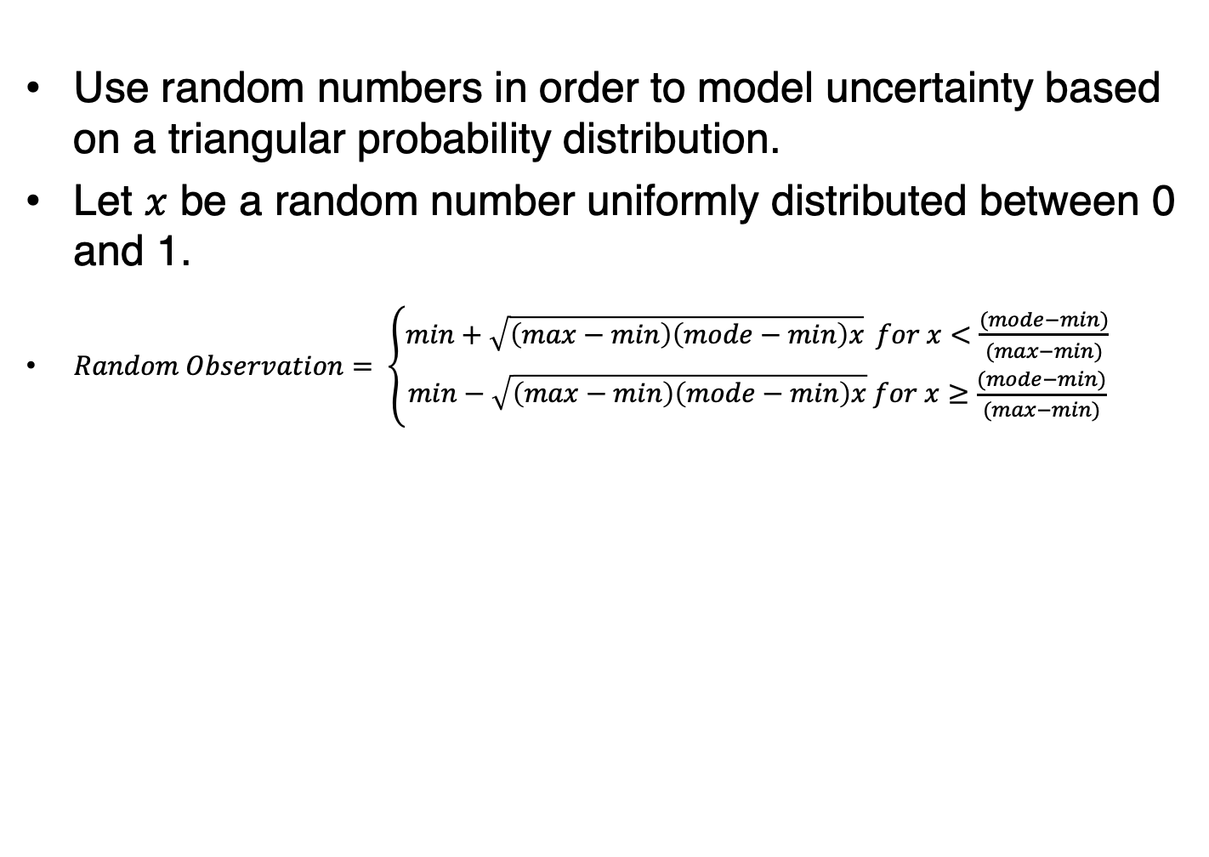
16.2: Assessing Risk (15/18)
Use random numbers in order to model uncertainty based on a triangular probability distribution.
Let $x$ be a random number uniformly distributed between 0 and 1.
$Random Observation= \left\{\begin{matrix}min+\sqrt{\left(max−min\right)\left(mode−min\right)x⁡} for x<\frac{(mode−min)}{(max−min)} \\ min−\sqrt{\left(max−min\right)\left(mode−min\right)x} for x≥\frac{(mode−min)}{(max−min)}\end{matrix}\right.$

Slide 21
16.2: Assessing Risk (16/18)
Example: The handbag manufacturer determines that its worst, best, and most likely profit (or loss) are −$4,500, $119,000, and $44,500, respectively.
Because we have no detailed historical data or additional information to make assumptions about any theoretical distribution, we use a triangular probability distribution to assess the uncertainty of the manufacturer’s profit.
Generate 100 random observations based on a triangular probability distribution.

Slide 22
16.2: Assessing Risk (17/18)
Example continued with Excel
Data > Data Analysis > Random Number Generation

Slide 23
16.2: Assessing Risk (18/18)
Example continued with R

Slide 24
16.3: Monte Carlo Simulation (1/10)
Computer simulation is often synonymous with the Monte Carlo method.
Named after the Monte Carlo Casino in Monaco.
Monte Carlo simulation is used to understand the impact of the risk and uncertainty in a wide variety of real-world process or system.
The technique relies on random variables to mimic the odds of all possible outcomes.
Monte Carlo simulation is also called probabilistic or stochastic simulation.

Slide 25
16.3: Monte Carlo Simulation (2/10)
There are five steps to Monte Carlo simulation.
Data collection
  Gather historical data to make an assumption about the probability distribution
  Estimate the empirical probability distribution
Random number generation and assignment
Model formulation
  Construct a quantitative model to represent the relationship
  Capture the uncertainty of the random variables as related to the outcome
Performing and repeating the analysis
Interpretation of results

Slide 26
16.3: Monte Carlo Simulation (3/10)
Example: Abigail wants to develop an analytical model to analyze the demand and production information for a red pullover jacket for women, the top-selling product for FashionTech.
She obtains relevant demand and cost information from her corporate database.
Develop a Monte Carlo simulation to help Abigail examine the profit at each staffing level.

Slide 27
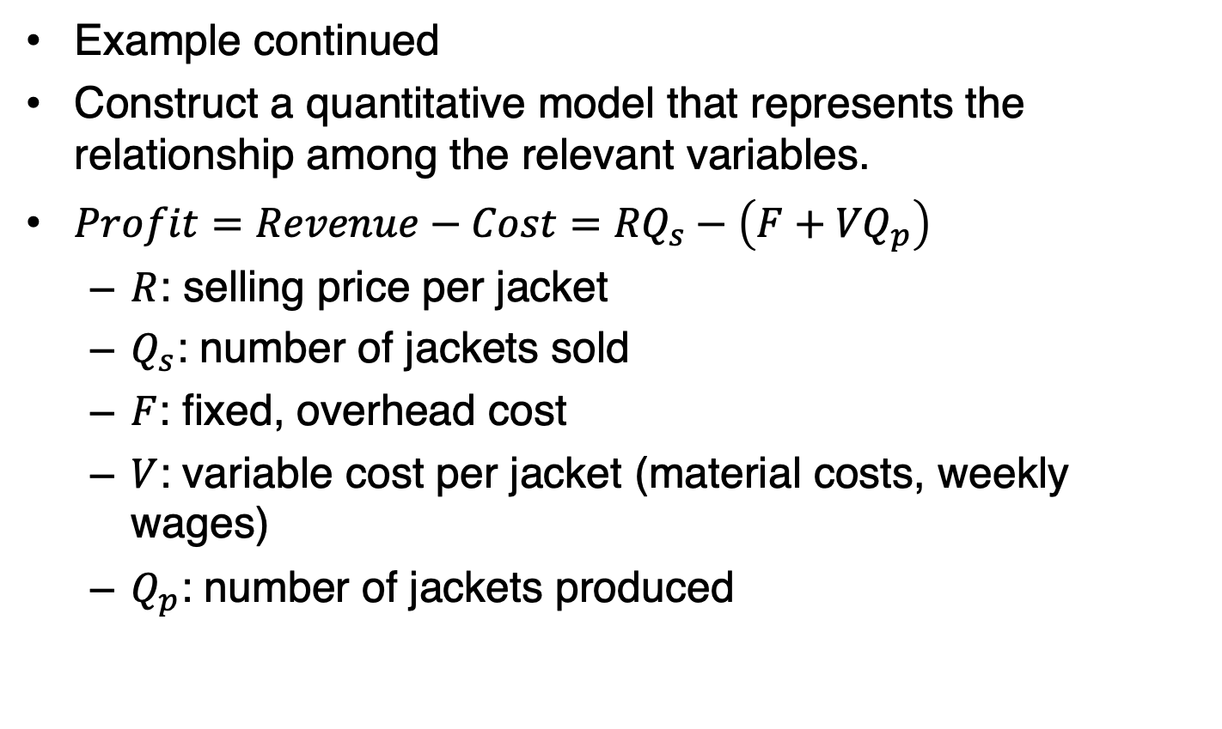
16.3: Monte Carlo Simulation (4/10)
Example continued
Construct a quantitative model that represents the relationship among the relevant variables.
$Profit=Revenue−Cost={RQ}_{s}−\left(F+{VQ}_{p}\right)$
  $R$: selling price per jacket
  $Q_{s}$: number of jackets sold
  $F$: fixed, overhead cost
  $V$: variable cost per jacket (material costs, weekly wages)
  $Q_{p}$: number of jackets produced

Slide 28
16.3: Monte Carlo Simulation (5/10)
Example continued with Excel
Data Analysis > Random Number Generation

Slide 29
16.3: Monte Carlo Simulation (6/10)
Example continued with Excel

Slide 30
16.3: Monte Carlo Simulation (7/10)
Example continued with Excel

Slide 31
16.3: Monte Carlo Simulation (8/10)
Example continued with R

Slide 32
16.3: Monte Carlo Simulation (9/10)
Example continued with R

Slide 33
16.3: Monte Carlo Simulation (10/10)
Example continued with R

