Slide 1
17
Optimization: Linear Programming
Business Analytics, 2e
By Sanjiv Jaggia, Alison Kelly, Kevin Lertwachara, and Leida Chen

Slide 2
Chapter 17 Learning Objectives (LOs)
LO 17.1 Formulate and solve a maximization linear programming problem.
LO 17.2 Formulate and solve a minimization linear programming problem.
LO 17.3 Describe special cases and potential issues in linear programming.

Slide 3
Introductory Case: Optimizing Manufacturing Plan (1/2)
Abigail Kwan is an operations manager at FashionTech, a manufacturer of clothing for families with an active and outdoor lifestyle.
One of the difficult decisions that Abigail has to make every winter season is to decide how many parkas and winter jackets for women to produce.
Both products use the same materials and require very similar sewing and stitching skills and manufacturing steps, and, therefore, compete for the same resources.
She starts by focusing on analyzing data for the medium-sized jackets and parkas.
The amount of machine time needed to produce a jacket and a parka are 1.5 hours and 2 hours, respectively.
A tailor usually spends about 2 hours on sewing and stitching for a winter jacket and about 3 hours for a parka.

Slide 4
Introductory Case: Optimizing Manufacturing Plan (2/2)
FashionTech has a monthly contract with its supplier to procure 4,000 feet of the required fabric.
The amount of machine time allocated to producing the two products is 650 hours per month, and each month a number of skilled tailors are assigned to these products for approximately 900 hours.
Historically, FashionTech has never sold more than 400 jackets and 150 parkas in a month.
The monthly production rate of parkas and winter jackets need not be more than these historical limits.
Abigail would like to:
  Determine how many winter jacket her company should make each winter.
  Understand the impact that each production resource has on the overall profit.

Slide 5
17.1: Optimization with Linear Programming (1/19)
Optimization is a family of quantitative techniques for obtaining optimal solutions to complex problem under constraints.
  Start with a well-defined objective function
  Find a set of inputs that maximizes or minimizes the value of an objective function
Linear Programming (LP) is a simple way to perform optimization by assuming linear relationships among relevant variables.
  Maximize or minimize a linear function subject to resource constraints
  Few assumptions helps solve a very complex problem
  Widely used

Slide 6
17.1: Optimization with Linear Programming (2/19)
The first step in performing LP is to formulate a problem into a series of mathematical expressions.
The mathematical representation of most LP problems has four essential components: an objective function, decision variables, constraints, and parameters.
Objective function: A mathematical representation of an objective, usually expressed as a maximization or minimization function of a single variable, such as profit or cost.
  Assumed to be linear
  Maximization: profit, revenue, return
  Minimization: cost, time, distance

Slide 7
17.1: Optimization with Linear Programming (3/19)
Decision variables: Choices (or alternatives) available ta a decision maker maximize or minimize the value of the objective function.
Constraints: Limitations due to the limited resources available to the decision maker.
  Assumed to be linear
  Reflects the knowledge gained from historical data or human expertise
  Intuitive assumptions about the LP problem
Parameters: Numerical values in the LP mathematical expression associated with the objective function, the decision variables, and the constraints.
  Might be derived from historical data
  Input parameters usually remain constant and do not change when the solution to the LP problem is implemented, unless there are changes to the external factors

Slide 8
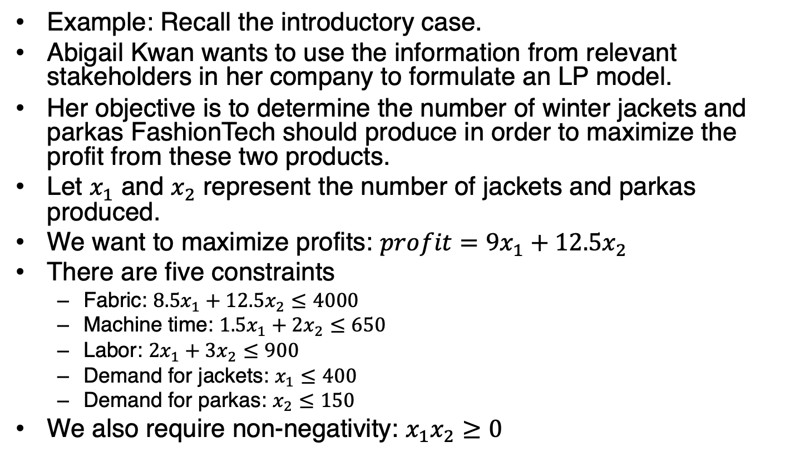
17.1: Optimization with Linear Programming (4/19)
Example: Recall the introductory case.
Abigail Kwan wants to use the information from relevant stakeholders in her company to formulate an LP model.
Her objective is to determine the number of winter jackets and parkas FashionTech should produce in order to maximize the profit from these two products.
Let $x_{1}$ and $x_{2}$ represent the number of jackets and parkas produced.
We want to maximize profits: $profit=9x_{1}+12.5x_{2}$
There are five constraints
  Fabric: $8.5x_{1}+12.5x_{2}≤4000$
  Machine time: $1.5x_{1}+2x_{2}≤650$
  Labor: $2x_{1}+3x_{2}≤900$
  Demand for jackets: $x_{1}≤400$
  Demand for parkas: $x_{2}≤150$
We also require non-negativity: $x_{1}x_{2}≥0$

Slide 9
17.1: Optimization with Linear Programming (5/19)
The mathematical expressions used are called the standard form
This is the most common and intuitive way to formulate an LP problem.
In the standard form, the right-hand side of the constraints is usually a constant and the left-hand side usually includes decision variables.
Most software applications, including Excel’s Solver and R, use the standard form to represent an LP model.

Slide 10
17.1: Optimization with Linear Programming (6/19)
To gain an understanding of a linear programming technique, we solve an LP problem with two decision variables through graphical representation.
The objective function and constraints are linear.
Plot the mathematical expressions in a line chart and identify possible solutions that satisfy the constraints.
To find an optimal solution to a maximization problem, identify the values of the decision variables that maximize the profit while satisfying all the constraints.

Slide 11

17.1: Optimization with Linear Programming (7/19)
Machine time: $1.5x_{1}+2x_{2}≤650$
Demand for jackets: $x_{1}≤400$
Demand for parkas: $x_{2}≤150$

Slide 12
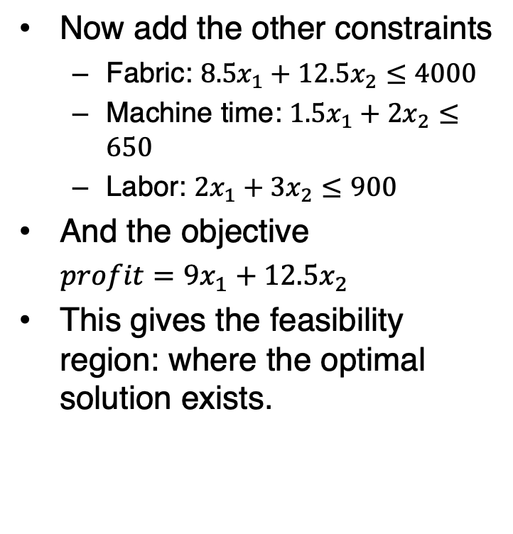
17.1: Optimization with Linear Programming (8/19)
Now add the other constraints
  Fabric: $8.5x_{1}+12.5x_{2}≤4000$
  Machine time: $1.5x_{1}+2x_{2}≤650$
  Labor: $2x_{1}+3x_{2}≤900$
And the objective
$profit=9x_{1}+12.5x_{2}$
This gives the feasibility region: where the optimal solution exists.

Slide 13
17.1: Optimization with Linear Programming (9/19)
Increase the profit as long as part of the profit line remains within the feasibility region to maximize the profit.
Normally, an optimal solution can be found at the boundary or at a corner of the feasibility region.
With only two decision variables, we can plot the LP model onto a two-dimensional line chart and find an optimal solution.
However, this approach is not suitable for LP problems with more than two decision variables.
Use an algebraic procedure called the simplex method (or simplex algorithm) to manually solve the LP problem with multiple decision variables.

Slide 14
17.1: Optimization with Linear Programming (10/19)
The simplex method says that, if the optimal solution exists, it will occur at one of the corners or boundaries of the feasibility region.
The feasibility region contains solutions that satisfy all the constraints in the LP problem.
  Don’t evaluate every possible feasible solution
  By evaluating corners/boundaries, it is more efficient to find the optimal solution even for a complex LP problem
  Evaluate a feasible solution at one of the corners of the feasibility region
  Then, iteratively move to an adjacent corner to determine if the current solution can be improved
  This process is continued until the optimal solution is found
The simplex method can solve both maximization and minimization problems.

Slide 15
17.1: Optimization with Linear Programming (11/19)
Example: Recall the introductory case.
Maximize the objective function given the five constraints.
With Excel:
  Open the Parkas worksheet
  Make sure Solver is activated by going to File > Options > Add-ins > Go
  Verify that Solver is under the Data tab
  Navigate to the Parameters section of the Parkas worksheet

Slide 16
17.1: Optimization with Linear Programming (12/19)
Example continued with Excel

Slide 17
17.1: Optimization with Linear Programming (13/19)
Example continued with Excel
Launch Solver by navigating to the Data tab and click Solver

Slide 18
17.1: Optimization with Linear Programming (14/19)
Example continued with Excel

Slide 19
17.1: Optimization with Linear Programming (15/19)
Example continued with Excel
Optimal values: 300 jackets and 100 parkas
Uses 3,800 feet of fabric of the 4,000 available
Remaining 200 feet is called slack, an excess of supply.
Uses all of the allotted machine time and labor
There is no slack.

Slide 20
17.1: Optimization with Linear Programming (16/19)
Slack is the amount of available resources that are not exhausted when an LP solution is implemented for a maximization problem.
Surplus refers to the amount in excess of minimum requirements in the constraints when an LP solution is implemented for a minimization problem.
Binding constraints:
  Without slack or surplus
  Increasing or decreasing the resources will impact the LP solution and optimized values
Nonbinding constraints:
  Have slack or surplus
  Adding or reducing the nonbinding constraint value by one unit will not change the LP solution.

Slide 21
17.1: Optimization with Linear Programming (17/19)
Example: Recall the introductory case.
Consider the sensitivity report.

Slide 22
17.1: Optimization with Linear Programming (18/19)
Shadow price:
  Dual price
  The change in the optimized value of an objective function due to a 1-unit change in a binding constraint, holding all other parameters constant
  Note that the optimized value of an objective function will not change due to a one-unit change in a nonbinding constraint
Range of optimality:
  The range of objective function coefficients between the allowable increase and decrease
  Within which the optimal solution for an LP problem remains unchanged
Range of feasibility:
  The range of values of a binding constraint
  Within which the shadow price remains the same

Slide 23
17.1: Optimization with Linear Programming (19/19)
Example: Recall the introductory case.
With R

Slide 24
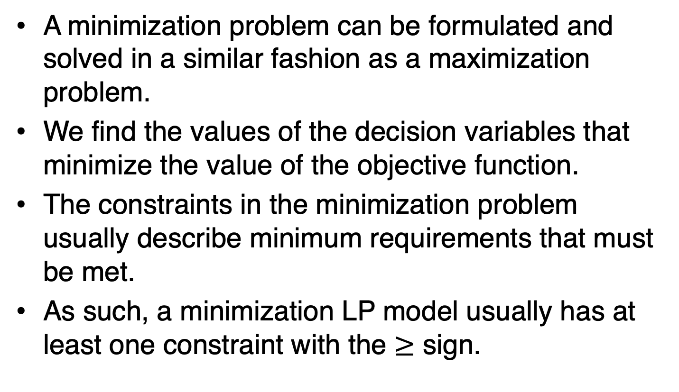
17.2: Minimization Problems in Linear Programming (1/9)
A minimization problem can be formulated and solved in a similar fashion as a maximization problem.
We find the values of the decision variables that minimize the value of the objective function.
The constraints in the minimization problem usually describe minimum requirements that must be met.
As such, a minimization LP model usually has at least one constraint with the $≥$ sign.

Slide 25
17.2: Minimization Problems in Linear Programming (2/9)
Example: Yerba Buena Tea is a manufacturer and wholesaler of high-quality tea products.
Spiced chai is becoming increasingly popular among younger consumers, and Yerba Buena offers two chai products: spiced chai powder mix and spiced chai concentrate.
An older production facility costs $190 per hour to operate and, for each hour of operation, can produce 295 ounces of the powder mix and 260 ounces of the tea concentrate.
Because of its age, the old facility cannot operate longer than 8 consecutive hours at a time.

Slide 26
17.2: Minimization Problems in Linear Programming (3/9)
Example continued
A newer facility costs $260 per hour to operate and produces 385 ounces of the powder mix and 375 ounces of the tea concentrate per hour.
Yerba Buena also owns a small, single-purpose facility that costs $150 per hour to operate and produces 350 ounces of the powder mix per hour.
Several coffee shops have placed orders for a total of 5,500 ounces of the chai powder mix and 4,000 ounces of the tea concentrate.
Anika Patel, the general manager at Yerba Buena, has none of the two products left in inventory and needs to decide how many hours to operate each facility to fulfill the orders while minimizing the production cost.
Formulate and solve this problem for Yerba Buena.

Slide 27
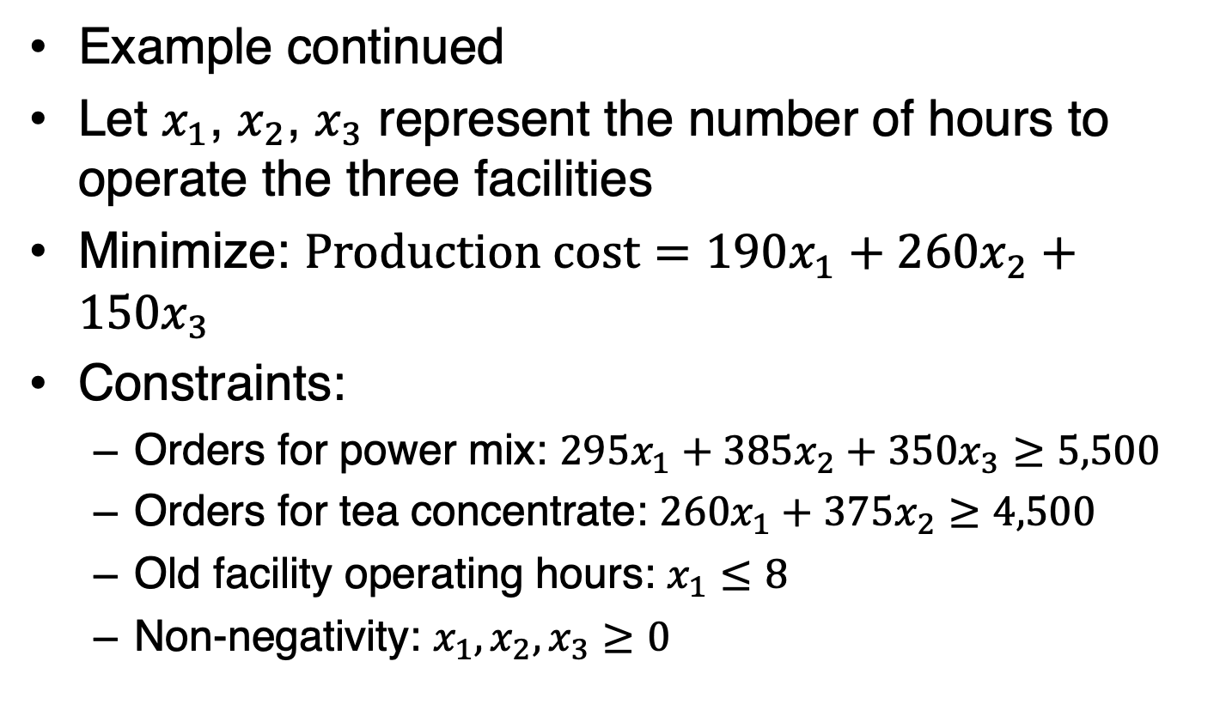
17.2: Minimization Problems in Linear Programming (4/9)
Example continued
Let $x_{1}$, $x_{2}$, $x_{3}$ represent the number of hours to operate the three facilities
Minimize: $Production cost=190x_{1}+260x_{2}+150x_{3}$
Constraints:
  Orders for power mix: $295x_{1}+385x_{2}+350x_{3}≥5,500$
  Orders for tea concentrate: $260x_{1}+375x_{2}≥4,500$
  Old facility operating hours: $x_{1}≤8$
  Non-negativity: $x_{1},x_{2},x_{3}≥0$

Slide 28
17.2: Minimization Problems in Linear Programming (5/9)
Example continued with Excel
Open the Chai worksheet and enter the parameter values from the minimization model

Slide 29
17.2: Minimization Problems in Linear Programming (6/9)
Example continued with Excel
Data > Solver

Slide 30
17.2: Minimization Problems in Linear Programming (7/9)
Example continued with Excel

Slide 31
17.2: Minimization Problems in Linear Programming (8/9)
Example continued with Excel

Slide 32
17.2: Minimization Problems in Linear Programming (9/9)
Example continued with R

Slide 33
17.3: Special Cases in Linear Programming (1/5)
Real-world optimization problems are usually complex and involve multiple decision variables and constraints.
Simplifying assumptions, such as linear relationships among variables in the LP model, we can solve these problems.
When we formulate an LP model to reflect the complexity of a real-life situation, the LP model may yield more than one optimal solution.
In other scenarios, an LP model may not yield any feasible solution at all.
These situations may stem from a variety of reasons.
  Missing constraints in the model
  Errors in specifying the constraints or parameter values

Slide 34
17.3: Special Cases in Linear Programming (2/5)
An LP model may yield multiple optimal solutions that have the same maximized or minimized value of the objective function.
This may reflect the diverse options available to a decision maker.
This is not necessarily an adverse outcome.
It may allow a decision maker to incorporate other qualitative criteria to choose the most desirable course of action.
If the allowable increase or decrease of a decision variable is zero, this indicates that the LP problem may have multiple optimal solutions.
R and Excel can only show one solution.

Slide 35
17.3: Special Cases in Linear Programming (3/5)
A linear programming problem is infeasible when there is no solution for which all constraints in the LP model are satisfied.
  Incorrectly formulating some of the constraints
  Erroneous signs in a constraint
Excel/R will analyze and identify an LP model with no feasible solutions.
The source of infeasibility is not always easy to detect, especially in an LP model with a large number of constraints.
In many cases, each mathematical expression in the LP model needs to be carefully examined in order to identify the cause of infeasibility.

Slide 36
17.3: Special Cases in Linear Programming (4/5)

Slide 37
17.3: Special Cases in Linear Programming (5/5)
Linear programming problems are unbounded when the objective function can attain an infinite value without violating any constraints.
  Maximization: the objective function can increase to positive infinity
  Minimization: the objective function can decrease to negative infinity
These solutions are not realistic as it is not possible for a company to continue to increase a revenue or profit indefinitely or reduce cost indefinitely.
The unbounded problem is usually caused by mistakes in the formulation of the LP problem.
  A maximization problem is erroneously solved with a minimization objective function
  Necessary constraints are missing from the LP formulation
We should revisit the underlying problem and identify any necessary constraints that are not being explicitly included in the model.

