Slide 1
18
More Applications in Optimization
Business Analytics, 2e
By Sanjiv Jaggia, Alison Kelly, Kevin Lertwachara, and Leida Chen

Slide 2
Chapter 18 Learning Objectives (LOs)
LO 18.1 Formulate and solve an integer programming problem.
LO 18.2 Apply optimization techniques to business and nonbusiness problems.
LO 18.3 Formulate and solve a nonlinear programming problem.

Slide 3
Introductory Case: North Star Biotech: Pharmaceutical Project Decisions (1/2)
North Star Biotech, a multinational pharmaceutical company, is exploring six new vaccine development projects over the next five-year period.

Slide 4
Introductory Case: North Star Biotech: Pharmaceutical Project Decisions (2/2)
Gordon Liu, the chief financial officer at North Star Biotech, is responsible for determining which of the six projects the company should fund.
Even though each vaccine development project is net positive, the company cannot fund all six projects because of financial constraints.
The amount of cash available to North Star Biotech is $10 million in Year 1, $8 million in Year 2, $7 million in Year 3, $5 million in Year 4, and $3 million in Year 5.
Gordon would like to use the above information to:
Develop an integer programming model to determine which of the six projects should be funded so that the total net present value of the capital budgeting projects is maximized.
Evaluate the impact of the funding decisions on the amount of excess cash available each year.

Slide 5
18.1: Optimization with Integer Programming (1/7)
Linear programming (LP) finds an optimal solution for the decision variables that can take on fractional values.
In some applications, it is critical that the decision variables are integers.
Include an additional constraint to the LP formulation that requires decision variables to be integer.
Integer programming (IP) is a linear optimization technique that provides integer solutions for the decision variables.

Slide 6
18.1: Optimization with Integer Programming (2/7)
The process for IP modeling is similar to LP.
  Four components: objective function, decision variables, constraints, parameters
  Include a constraint that requires the decision variables to be integer
Software applications can force an integer solution.
  Do not include a sensitivity analysis
  Difficult to compute the range of feasibility, shadow price, range of optimality
Rounding to integer values may give a suboptimal solution or an infeasible solution.
If the coefficients are small and the decision variables are large, rounding may not have a significant impact.

Slide 7
18.1: Optimization with Integer Programming (3/7)
Example: Recall the introductory case from Chapter 17.
Yerba Buena Tea receives orders for 5,500 ounces of the chai powder mix and 4,000 ounces of the tea concentrate.
An older production facility costs $190 per hour to operate and can produce 295 ounces of the powder mix and 260 ounces of the tea concentrate per hour.
Because of its age, the old facility cannot operate longer than 8 consecutive hours at a time.
A new facility costs $260 per hour to operate and produces 385 ounces of the powder mix and 375 ounces of the tea concentrate per hour.
A single-purpose facility costs $150 per hour to operate and produces 350 ounces of the powder mix per hour.
Modify the LP model into an IP formulation.

Slide 8
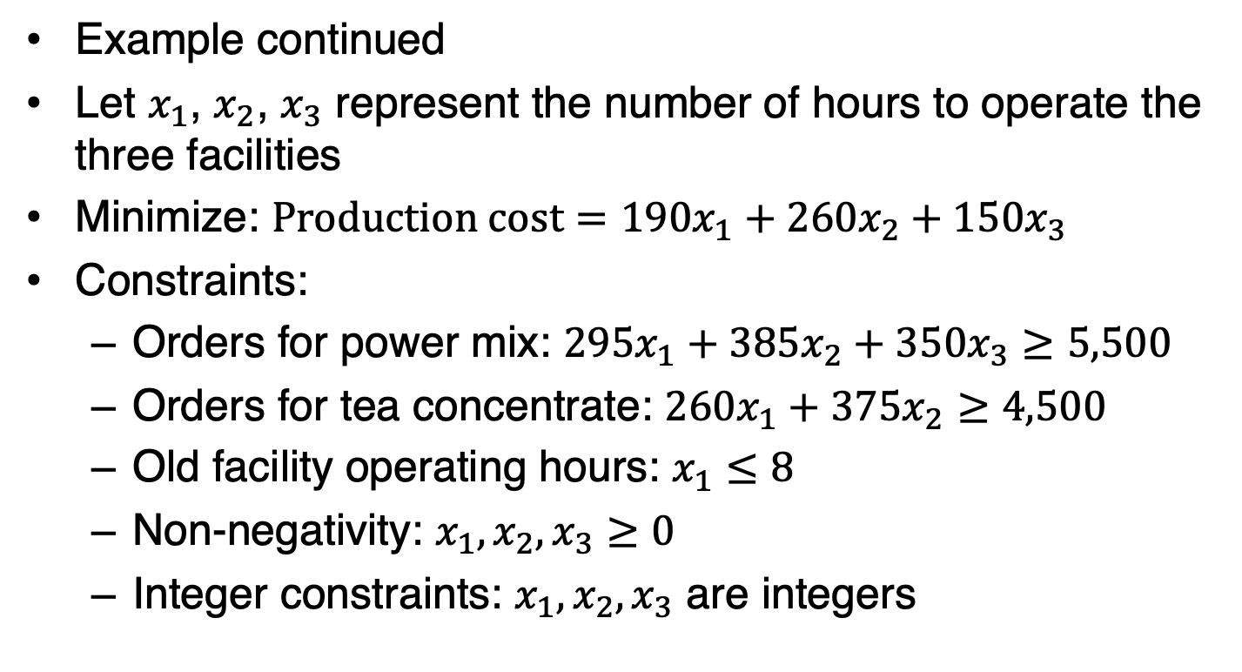
18.1: Optimization with Integer Programming (4/7)
Example continued
Let $x_{1}$, $x_{2}$, $x_{3}$ represent the number of hours to operate the three facilities
Minimize: $Production cost=190x_{1}+260x_{2}+150x_{3}$
Constraints:
  Orders for power mix: $295x_{1}+385x_{2}+350x_{3}≥5,500$
  Orders for tea concentrate: $260x_{1}+375x_{2}≥4,500$
  Old facility operating hours: $x_{1}≤8$
  Non-negativity: $x_{1},x_{2},x_{3}≥0$
  Integer constraints: $x_{1},x_{2},x_{3}$ are integers

Slide 9
18.1: Optimization with Integer Programming (5/7)
Example continued with Excel
Open the Chai worksheet and enter the parameter values from the minimization model

Slide 10
18.1: Optimization with Integer Programming (6/7)
Example continued with Excel
Data > Solver

Slide 11
18.1: Optimization with Integer Programming (7/7)
Example continued with R

Slide 12
18.2: Other Applications of Linear and Integer Programming (1/33)
Linear and integer programming techniques can be used to solve many real-world problems.
We discuss five of the most common applications of linear and integer programming:
Capital-budgeting for selection of investment projects
A transportation problem for selection of supply locations for product delivery
An assignment problem where employees are assigned to specific tasks
Workforce scheduling where a manager establishes the schedule of workers to meet the demand
W facility location problem where a decision maker determines the optimal placement of new facilities.

Slide 13
18.2: Other Applications of Linear and Integer Programming (2/33)
In a typical capital budgeting problem, a decision maker tries to choose from a number of potential projects.
These situations are often referred to as a “go vs. no-go” decision.
It does not make sense to partially fund individual projects
The set of decision variables that are limited to only an integer value of 0 or 1.
These decision variables are often called binary decision variables where a positive decision is represented by the value 1 and 0 otherwise.

Slide 14
18.2: Other Applications of Linear and Integer Programming (3/33)
Example: Recall the introductory case.
Gordon Liu, a CFO of North Star Biotech, needs to deter- mine which of the six pharmaceutical vaccine projects should receive the funding.
His objective is to maximize the total net present value from the funded projects.
Use the information provided in the introductory case to help Gordon formulate this problem into an IP model.

Slide 15
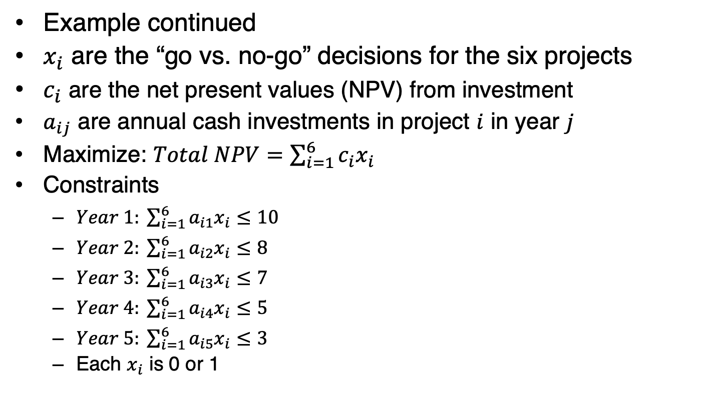
18.2: Other Applications of Linear and Integer Programming (4/33)
Example continued
$x_{i}$ are the “go vs. no-go” decisions for the six projects
$c_{i}$ are the net present values (NPV) from investment
$a_{ij}$ are annual cash investments in project $i$ in year $j$
Maximize: $Total NPV=\sum_{i=1}^{6}{c_{i}x_{i}}$
Constraints
  $Year 1: \sum_{i=1}^{6}{a_{i1}x_{i}≤10}$
  $Year 2: \sum_{i=1}^{6}{a_{i2}x_{i}≤8}$
  $Year 3: \sum_{i=1}^{6}{a_{i3}x_{i}≤7}$
  $Year 4: \sum_{i=1}^{6}{a_{i4}x_{i}≤5}$
  $Year 5: \sum_{i=1}^{6}{a_{i5}x_{i}≤3}$
  Each $x_{i}$ is 0 or 1

Slide 16
18.2: Other Applications of Linear and Integer Programming (5/33)
Example continued with Excel
Open the Biotech worksheet
Make sure the Solver add-in is activated
Data > Solver

Slide 17
18.2: Other Applications of Linear and Integer Programming (6/33)
Example continued with Excel

Slide 18
18.2: Other Applications of Linear and Integer Programming (7/33)
Example continued with R

Slide 19
18.2: Other Applications of Linear and Integer Programming (8/33)
Transportation problems are solved with special LP and IP models.
  Objective: minimize costs for transporting goods from a set of sources to a set of destinations
  Subject to the demand and supply constraints
  A set of constraints that the product shipments satisfy the demand and do not exceed the supply limit
If the demand and supply both have integer values, the transportation model usually produces an integer solution.
The transportation model deals with distributing goods or products contained in packages or large bundles.

Slide 20
18.2: Other Applications of Linear and Integer Programming (9/33)
Example: Rainier Spring Water has two warehouses that service three retail stores.
Every week, the first warehouse can supply up to 160 pallets of bottled water and the second warehouse can supply up to 155 pallets.
The manager at Rainier Spring Water receives a weekly order from the three retail stores for 85, 125, and 100 pallets, respectively.
The shipping cost for each pallet varies among the warehouses and retail stores, depending on the distance, traffic, and road conditions.
Develop an integer programming model to help the manager decide how many pallets of bottled water to ship from each warehouse to individual stores to fulfill the orders while minimizing the total shipping cost.

Slide 21
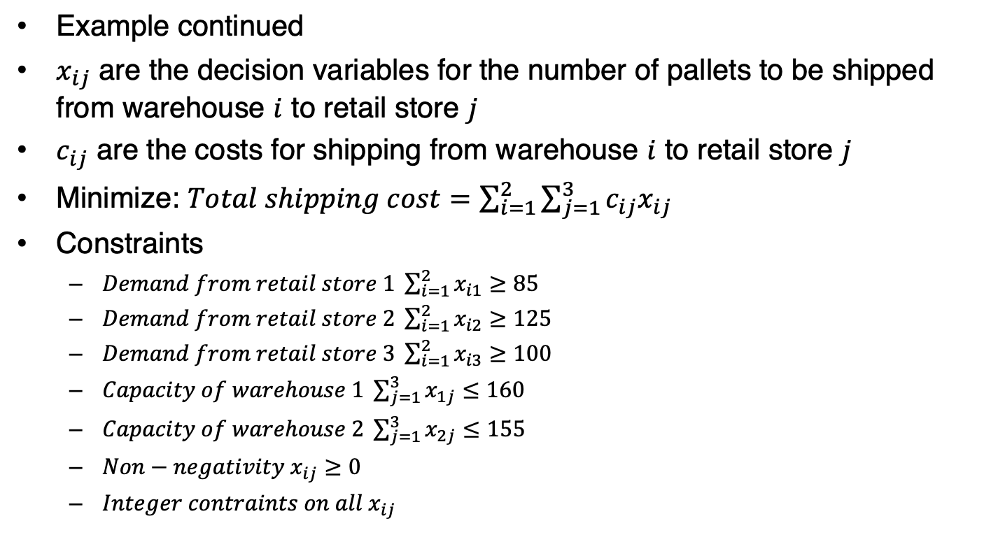
18.2: Other Applications of Linear and Integer Programming (10/33)
Example continued
$x_{ij}$ are the decision variables for the number of pallets to be shipped from warehouse $i$ to retail store $j$
$c_{ij}$ are the costs for shipping from warehouse $i$ to retail store $j$
Minimize: $Total shipping cost=\sum_{i=1}^{2}{\sum_{j=1}^{3}{c_{ij}x_{ij}}}$
Constraints
  $Demand from retail store 1 \sum_{i=1}^{2}{x_{i1}≥85}$
  $Demand from retail store 2 \sum_{i=1}^{2}{x_{i2}≥125}$
  $Demand from retail store 3 \sum_{i=1}^{2}{x_{i3}≥100}$
  $Capacity of warehouse 1 \sum_{j=1}^{3}{x_{1j}≤160}$
  $Capacity of warehouse 2 \sum_{j=1}^{3}{x_{2j}≤155}$
  $Non−negativity x_{ij}≥0$
  $Integer contraints on all{ x}_{ij}$

Slide 22
18.2: Other Applications of Linear and Integer Programming (11/33)
Example continued with Excel
Open the Rainier worksheet
Make sure the Solver add-in is activated
Navigate to the Data tab and click Solver

Slide 23
18.2: Other Applications of Linear and Integer Programming (12/33)
Example continued with Excel

Slide 24
18.2: Other Applications of Linear and Integer Programming (13/33)
Example continued with R
Install and load the lpSolve package that includes the lp.transport function

Slide 25
18.2: Other Applications of Linear and Integer Programming (14/33)
One common applications in optimization involves a manager assigning employees or team members to individual tasks or roles.
This application is relevant to a wide range of real-life situations such as in healthcare, education, project management, and sports.
An assignment problem may be formulated as a maximization or minimization problem
The decision variables in an assignment problem are usually defined as binary variables.

Slide 26
18.2: Other Applications of Linear and Integer Programming (15/33)
Example: A fitness studio offers four group exercise classes: yoga, stationary cycling, weightlifting, and high-intensity cardio training.
There are four professional trainers who are certified to teach the four classes.
The fitness studio regularly conducts a survey where gym members evaluate the classes taught by the four trainers.
The studio manager wants to assign the trainers to teach appropriate classes in order to maximize the overall class evaluation.
Formulate an IP model to find the optimal class assignments.

Slide 27
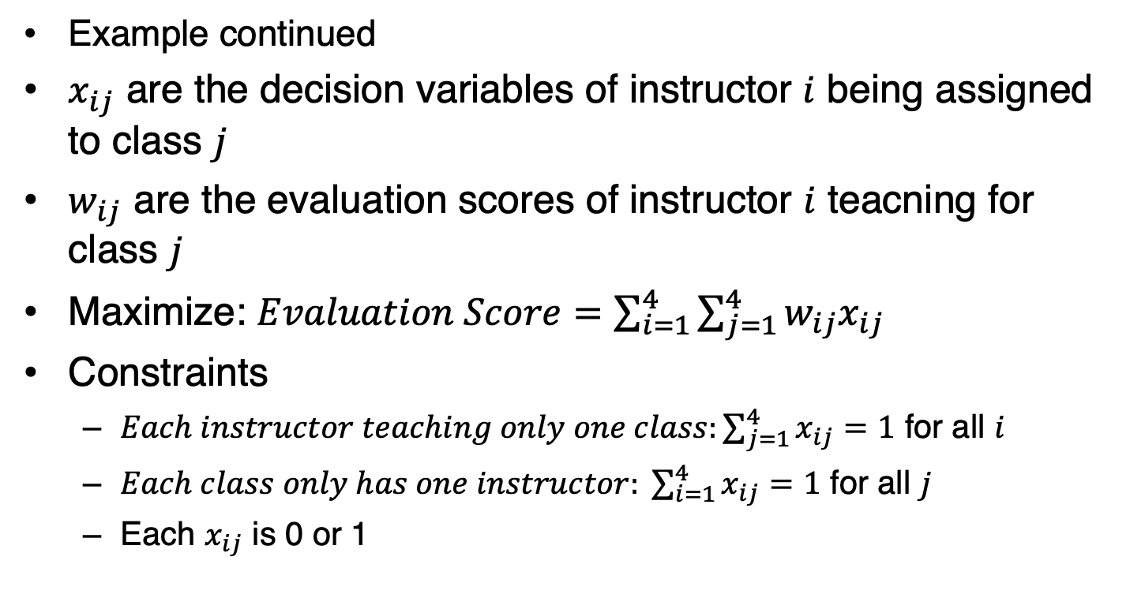
18.2: Other Applications of Linear and Integer Programming (16/3)
Example continued
$x_{ij}$ are the decision variables of instructor $i$ being assigned to class $j$
$w_{ij}$ are the evaluation scores of instructor $i$ teacning for class $j$
Maximize: $Evaluation Score=\sum_{i=1}^{4}{\sum_{j=1}^{4}{w_{ij}x_{ij}}}$
Constraints
  $Each instructor teaching only one class:\sum_{j=1}^{4}{x_{ij}}=1$ for all $i$
  $Each class only has one instructor: \sum_{i=1}^{4}{x_{ij}}=1$ for all $j$
  Each $x_{ij}$ is 0 or 1

Slide 28
18.2: Other Applications of Linear and Integer Programming (17/33)
Example continued with Excel
Open the Assignments worksheet and enter the evaluation scores from
Data > Solver

Slide 29
18.2: Other Applications of Linear and Integer Programming (18/33)
Example continued with Excel

Slide 30
18.2: Other Applications of Linear and Integer Programming (19/33)
Example continued with R
Install and load the lpSolve package that includes the lp.assign

Slide 31
18.2: Other Applications of Linear and Integer Programming (20/33)
Many organizations have to schedule their workforce while meeting the minimum demand for goods and services.
  Have a direct impact on the financial resources, productivity, and efficiency of the organization
  Hiring too many employees may lead to idle time and wasted financial resources
  Scheduling an inadequate number of staff could result in unmet demand, dissatisfied customers, and work overloads
A scheduling problem often has multiple optimal solutions that achieve the same value of the objective function.
Having multiple optimal solutions in a scheduling problem may be useful as they allow the decision maker to choose from multiple staffing schedules.

Slide 32
18.2: Other Applications of Linear and Integer Programming (21/33)
Example: A telecommunications company plans to open a call center to provide phone support for its customers.
The call center needs to operate 7 days a week to serve the customers seeking help with technical and billing problems.
The company needs to determine the number of employees needed to meet the daily demand.
The number of employees needed to handle the phone calls varies each day.

Slide 33
18.2: Other Applications of Linear and Integer Programming (22/33)
Example continued
All employees are contracted to work for five consecutive days, followed by two days off.
However, the company can ask individual employees to start their 5-day schedule on any day of the week.
Use the provided information to formulate and solve the employee scheduling problem to determine the minimum number of employees needed to be hired for the new call center.

Slide 34
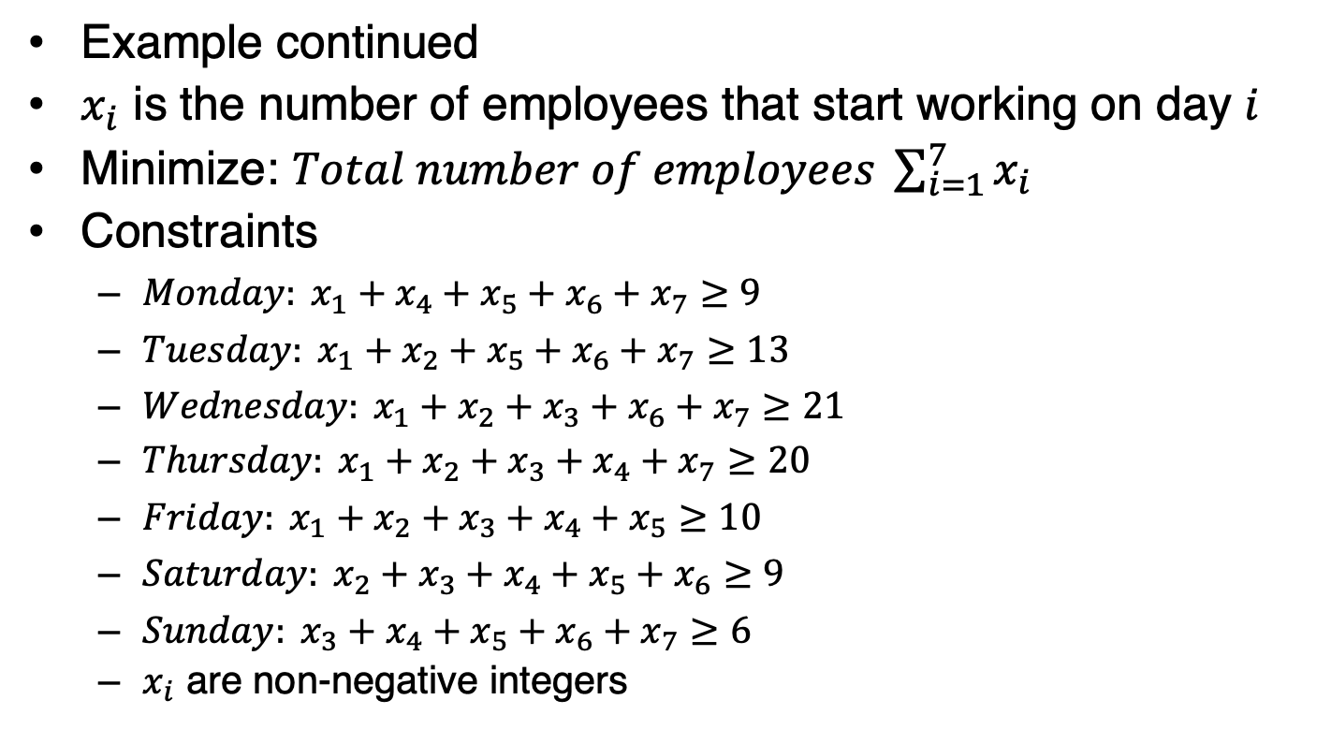
18.2: Other Applications of Linear and Integer Programming (23/33)
Example continued
$x_{i}$ is the number of employees that start working on day $i$
Minimize: $Total number of employees \sum_{i=1}^{7}{x_{i}}$
Constraints
  $Monday: x_{1}+x_{4}+x_{5}+x_{6}+x_{7}≥9$
  $Tuesday: x_{1}+x_{2}+x_{5}+x_{6}+x_{7}≥13$
  $Wednesday: x_{1}+x_{2}+x_{3}+x_{6}+x_{7}≥21$
  $Thursday: x_{1}+x_{2}+x_{3}+x_{4}+x_{7}≥20$
  $Friday: x_{1}+x_{2}+x_{3}+x_{4}+x_{5}≥10$
  $Saturday: x_{2}+x_{3}+x_{4}+x_{5}+x_{6}≥9$
  $Sunday: x_{3}+x_{4}+x_{5}+x_{6}+x_{7}≥6$
  $x_{i}$ are non-negative integers

Slide 35
18.2: Other Applications of Linear and Integer Programming (24/33)
Example continued with Excel
Open the Schedules worksheet and enter the number of employees needed on each day
Data > Solver

Slide 36
18.2: Other Applications of Linear and Integer Programming (25/33)
Example continued with Excel

Slide 37
18.2: Other Applications of Linear and Integer Programming (26/33)
Example continued with R
Install and load the lpSolve package

Slide 38
18.2: Other Applications of Linear and Integer Programming (27/33)
Example continued

Slide 39
18.2: Other Applications of Linear and Integer Programming (28/33)
One of the earliest applications of the optimization technique involves selecting suitable locations
  Emergency shelters, distribution centers, and medical facilities
  Meeting the demand and requirements for all constituents
  Long history and many interdisciplinary applications
  Numerous variations but are collectively referred to as facility location (or location) problems
A facility location problem usually seeks to minimize the number of facilities and therefore the total cost, while satisfying the needs of all constituents.

Slide 40
18.2: Other Applications of Linear and Integer Programming (29/33)
Example: A public health department needs to set up vaccine clinics to serve the residents of six rural towns.
With its limited budget, the health department cannot set up a vaccination site in every town and must minimize the number of vaccine clinics.
The public health department wants to make sure that the travel time from any given town to a vaccination site is no more than 30 minutes.
Formulate the location problem to determine where the health department should set up the location.

Slide 41
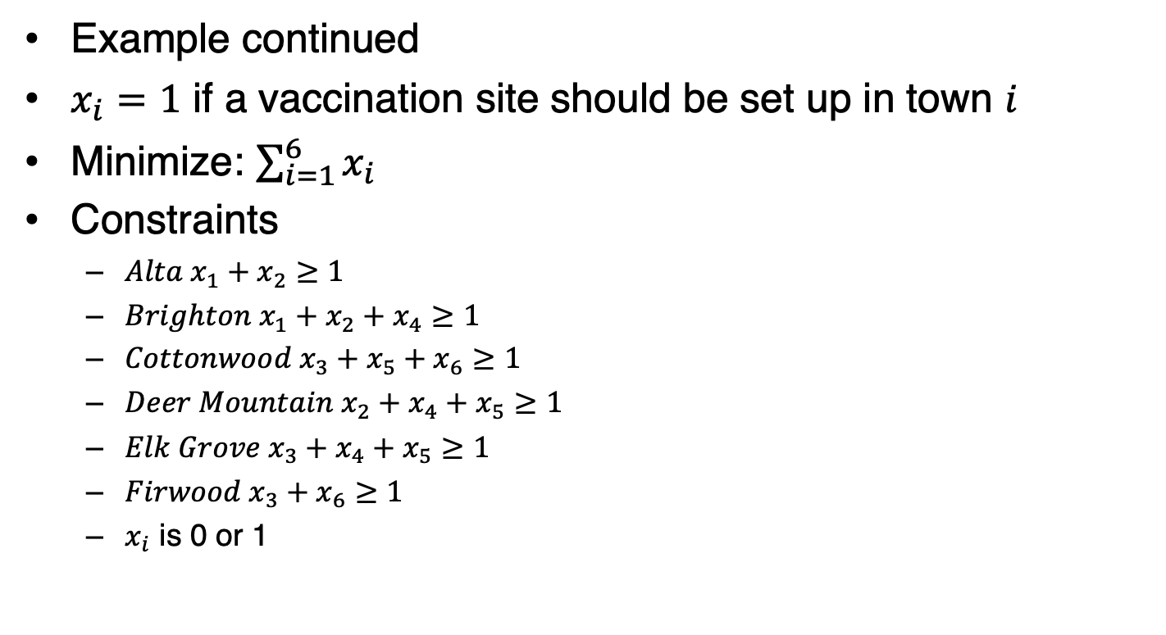
18.2: Other Applications of Linear and Integer Programming (30/33)
Example continued
$x_{i}=1$ if a vaccination site should be set up in town $i$
Minimize: $\sum_{i=1}^{6}{x_{i}}$
Constraints
  $Alta x_{1}+x_{2}≥1$
  $Brighton x_{1}+x_{2}+x_{4}≥1$
  $Cottonwood x_{3}+x_{5}+x_{6}≥1$
  $Deer Mountain{ x}_{2}+x_{4}+x_{5}≥1$
  $Elk Grove{ x}_{3}+x_{4}+x_{5}≥1$
  $Firwood x_{3}+x_{6}≥1$
  $x_{i}$ is 0 or 1

Slide 42
18.2: Other Applications of Linear and Integer Programming (31/33)
Example continued with Excel
Open the Locations worksheet
Enter the travel times
Data > Solver

Slide 43
18.2: Other Applications of Linear and Integer Programming (32/33)
Example continued with Excel

Slide 44
18.2: Other Applications of Linear and Integer Programming (33/33)
Example continued with R
Install and load the lpSolve package

Slide 45
18.3: Optimization with Nonlinear Programming (1/11)
Many real-world cases are nonlinear in nature.
Variables in the objective functions or constraints have nonlinear relationships.
Nonlinear programming (NLP) is a technique for solving an optimization problem where the variables in the objective function or constraints have nonlinear relationships.
Finding an optimal solution to an NLP model is usually more difficult than in an LP model
The optimal solution to an NLP problem can be found anywhere.
Nonlinear functions are also more difficult to model, as they can take on many forms and structures.

Slide 46
18.3: Optimization with Nonlinear Programming (2/1)
Obtain the best solution that is as good or better than all other solutions.
  Overall optimal solution is referred to as the global optimum
  An NLP algorithm does not always produce the global optimum
Many NLP algorithms yield a solution that is optimal only within a limited range of the decision variables
Better solutions may exist in another range of the decision variables.
The global optimum may exist elsewhere beyond the local optimum’s immediate neighborhood.

Slide 47
18.3: Optimization with Nonlinear Programming (3/11)

Slide 48
18.3: Optimization with Nonlinear Programming (4/11)
Most software applications implement two types of NLP algorithms: derivative-based and derivative-free methods.
Derivative-based (also called gradient-based) methods usually require that the nonlinear functions have a derivative or are differentiable
  Do not work well with a problem where nonlinear functions are not continuous or not smooth
  Start by finding a random feasible solution
  Repeatedly search for a better solution until an improvement cannot be found within the next few iterations
  Relatively fast but cannot guarantee a global optimum

Slide 49
18.3: Optimization with Nonlinear Programming (5/11)
Derivative-free methods (also known as gradient-free methods) can solve an NLP problem whose objective functions or constraints are not differentiable or not smooth.
  Continuous objective functions or constraints are too complex to find a derivative
  Cannot guarantee a global optimum but will generally yield a very good or near optimal solution.
Compared to the derivative-based methods, derivative-free algorithms tend to be inefficient and often require the user to specify a boundary on the feasibility region.
As in the case of LP and IP models, an NLP problem can be either a maximization problem or a minimization problem.

Slide 50
18.3: Optimization with Nonlinear Programming (6/11)
Example: BeanTown Gourmet Coffee produces regular and decaffeinated ground coffee and sells them to local coffee shops.
The company has a machine for roasting and grinding the coffee beans to produce both types of ground coffee.
Facing a rising demand, the manager wants to increase the weekly ground coffee production.
Recently BeanTown Gourmet Coffee has been operating near its capacity, but the manager believes that the machine can still operate for up to 50 additional hours per week.
Two new employees have been trained to operate the machine and can work up to 80 hours per week.

Slide 51
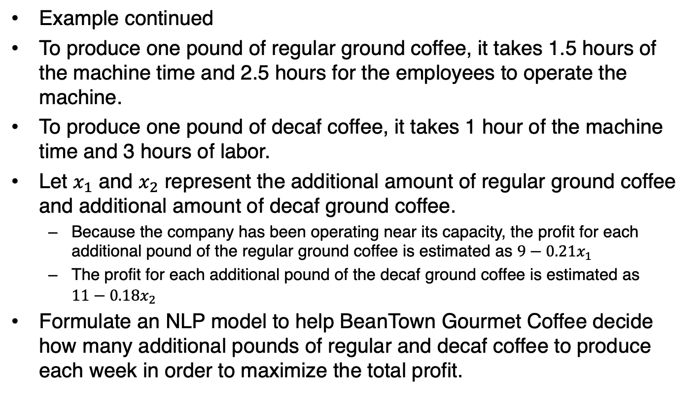
18.3: Optimization with Nonlinear Programming (7/11)
Example continued
To produce one pound of regular ground coffee, it takes 1.5 hours of the machine time and 2.5 hours for the employees to operate the machine.
To produce one pound of decaf coffee, it takes 1 hour of the machine time and 3 hours of labor.
Let $x_{1}$ and $x_{2}$ represent the additional amount of regular ground coffee and additional amount of decaf ground coffee.
  Because the company has been operating near its capacity, the profit for each additional pound of the regular ground coffee is estimated as ${9−0.21x}_{1}$
  The profit for each additional pound of the decaf ground coffee is estimated as ${11−0.18x}_{2}$
Formulate an NLP model to help BeanTown Gourmet Coffee decide how many additional pounds of regular and decaf coffee to produce each week in order to maximize the total profit.

Slide 52
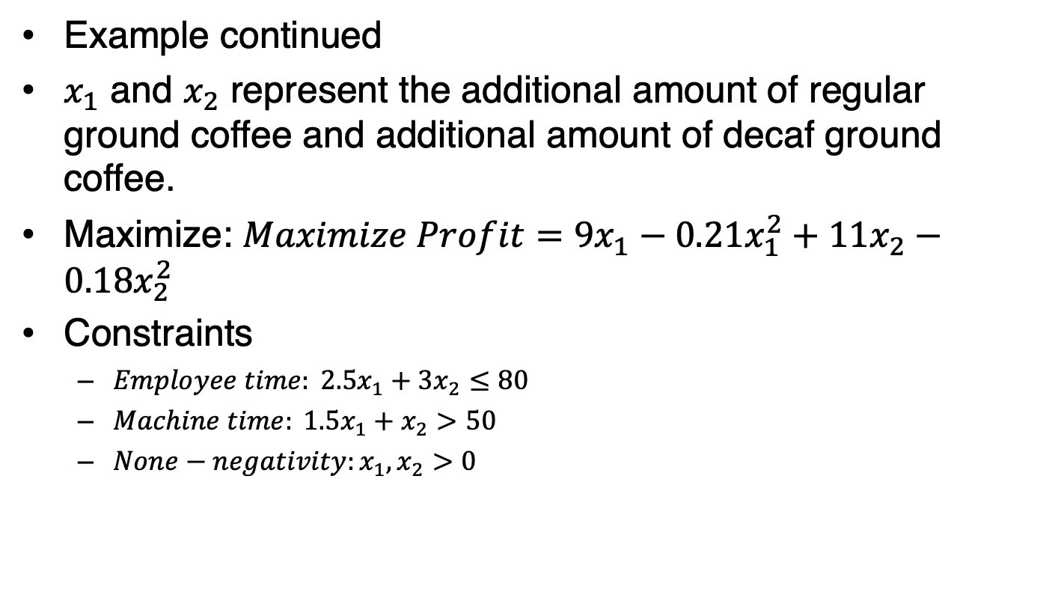
18.3: Optimization with Nonlinear Programming (8/11)
Example continued
$x_{1}$ and $x_{2}$ represent the additional amount of regular ground coffee and additional amount of decaf ground coffee.
Maximize: $Maximize Profit=9x_{1}−0.21x_{1}^{2}+11x_{2}−0.18x_{2}^{2}$
Constraints
  $Employee time: 2.5x_{1}+3x_{2}≤80$
  $Machine time: 1.5x_{1}+x_{2}>50$
  $None−negativity:x_{1}, x_{2}>0$

Slide 53
18.3: Optimization with Nonlinear Programming (9/11)
Example continued with Excel
Open the Coffee worksheet

Slide 54
18.3: Optimization with Nonlinear Programming (10/11)
Example continued with Excel
Data > Solver

Slide 55
18.3: Optimization with Nonlinear Programming (11/11)
Example continued with Excel

