Slide 1
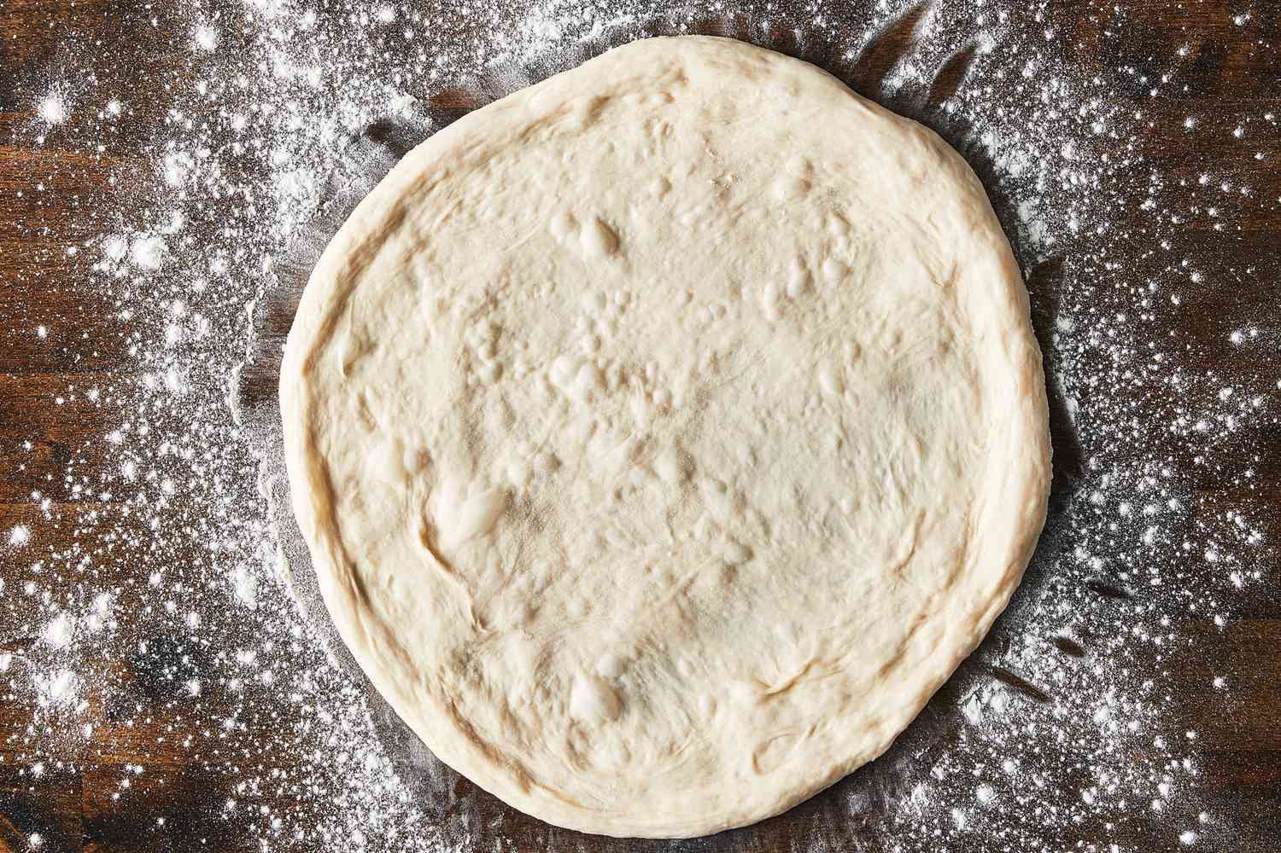
Avoiding Burnt Pizza: Ingredients
Pizza Topping Order
1. Dough

Slide 2
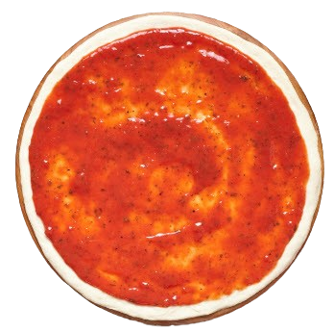
Avoiding Burnt Pizza: Ingredients
Pizza Topping Order
2. Sauce

Slide 3
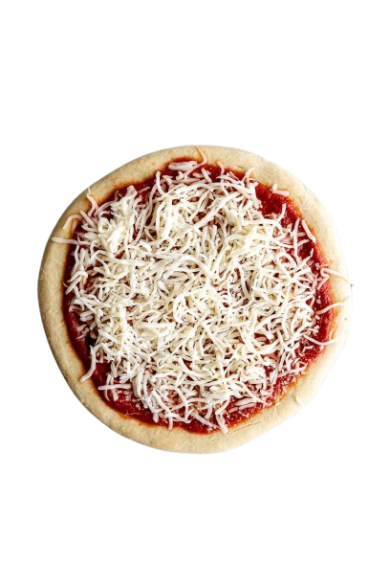
Avoiding Burnt Pizza: Ingredients
Pizza Topping Order
3. Cheese

Slide 4
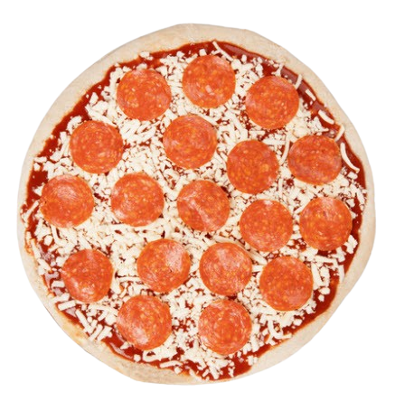
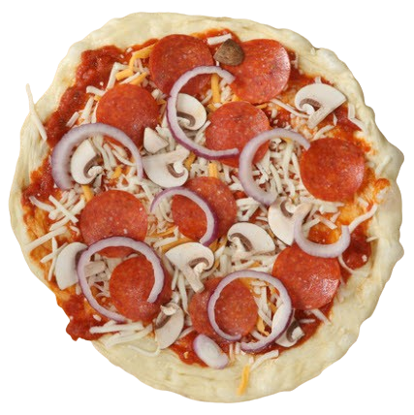
Avoiding Burnt Pizza: Ingredients
Pizza Topping Order
4. Meat and/or Other Toppings

Slide 5
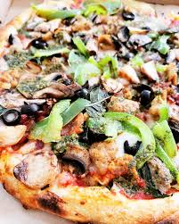
Avoiding Burnt Pizza: Ingredients
*Warning: Adding too many toppings can cause improper heating.

Slide 6
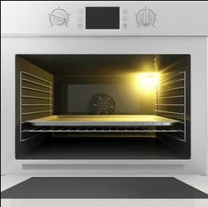
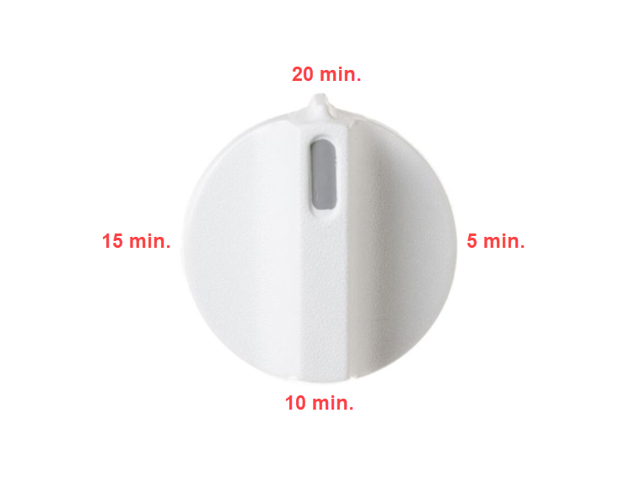
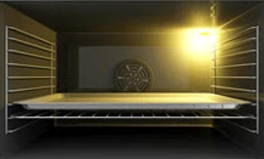
Avoiding Burnt Pizza: Process
Cook for less than or equal to 20 minutes, depending on your oven.
425 - 450°
Preheat the oven to ensure even heating.
Make sure the pizza pan is placed on the bottom rack in the oven.

Slide 7
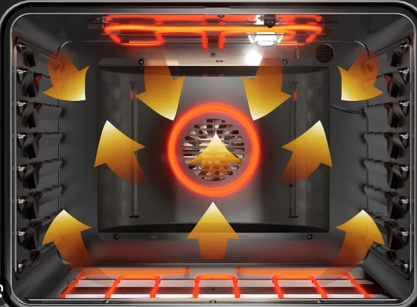
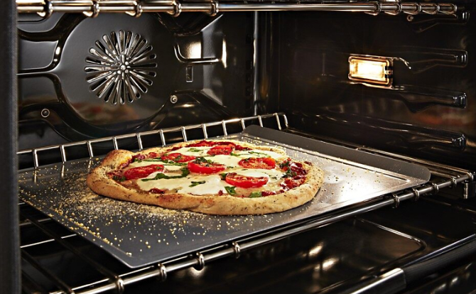
Avoiding Burnt Pizza: Equipment
425 - 450°
Make sure the oven is set between 425-450 degrees, or less.
Make sure the pizza is placed on an adequate pizza pan.
Use the convection setting on the oven, if available, to circulate heat for more even heating.

Slide 8
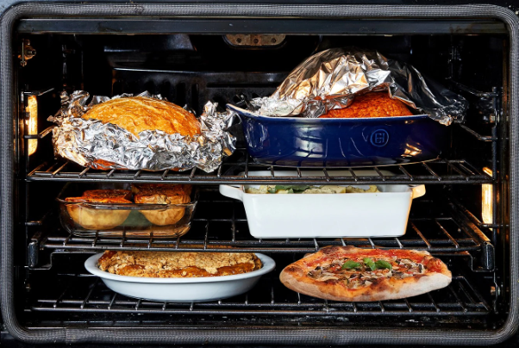
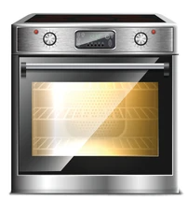
Avoiding Burnt Pizza: Environment
Temp
Time
Higher altitudes affect baking time and require adjustments in temperature or timing.
Keep the oven door closed while baking to prevent change in cooking temperatures.
Too many items in the oven can block airflow and cause the pizza to burn.

Slide 9
Avoiding Burnt Pizza: People
Get familiar with the proper cooking time or temperature settings for pizza.
Carefully read all cooking instructions to ensure you set the right temperature and/or time.
Stay focused and set a timer so you don’t forget about the pizza in the oven.
Be patient! Cranking up the oven temperature to cook faster could lead to a burnt pizza.

