Slide 1
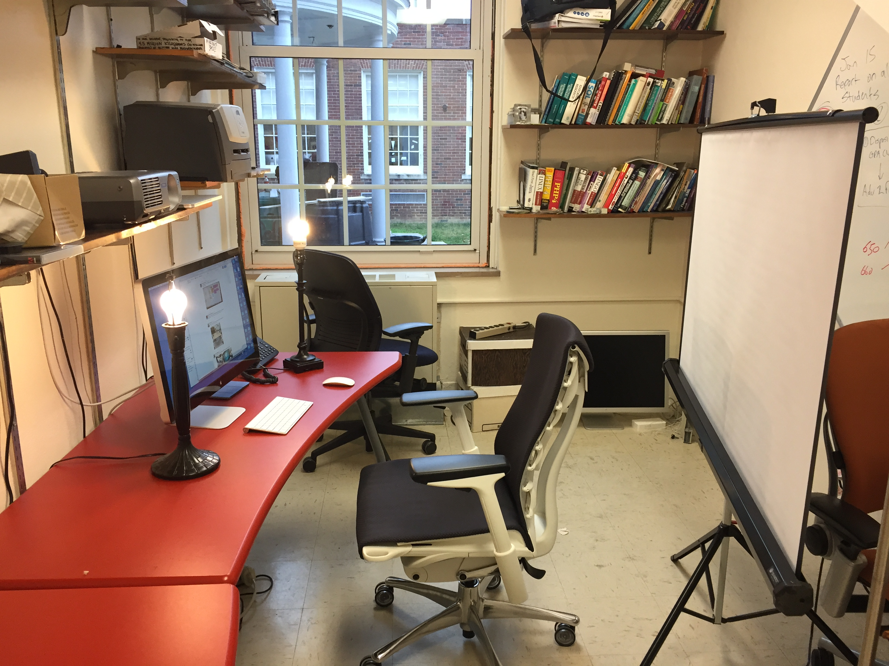
Key Light
Ceiling as Back Light
Fill Light
Click to Continue

Slide 2
All Off
See office

Slide 3
Ceiling Only
See office

Slide 4
Key Only
See office

Slide 5
Key + Fill
See office

Slide 6
Fill Only
See office

Slide 7
No Key
See office

Slide 8
No Fill
See office

Slide 9
All On
See office

