Slide 1
Juggling with Gerry

Slide 2
Step 1: Get your juggling objects

Slide 3
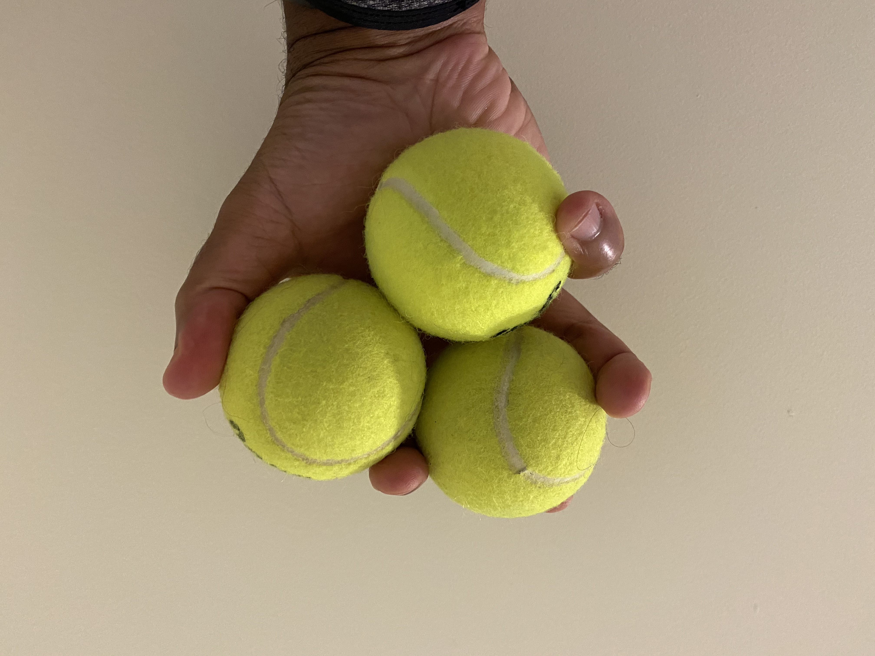

Slide 4
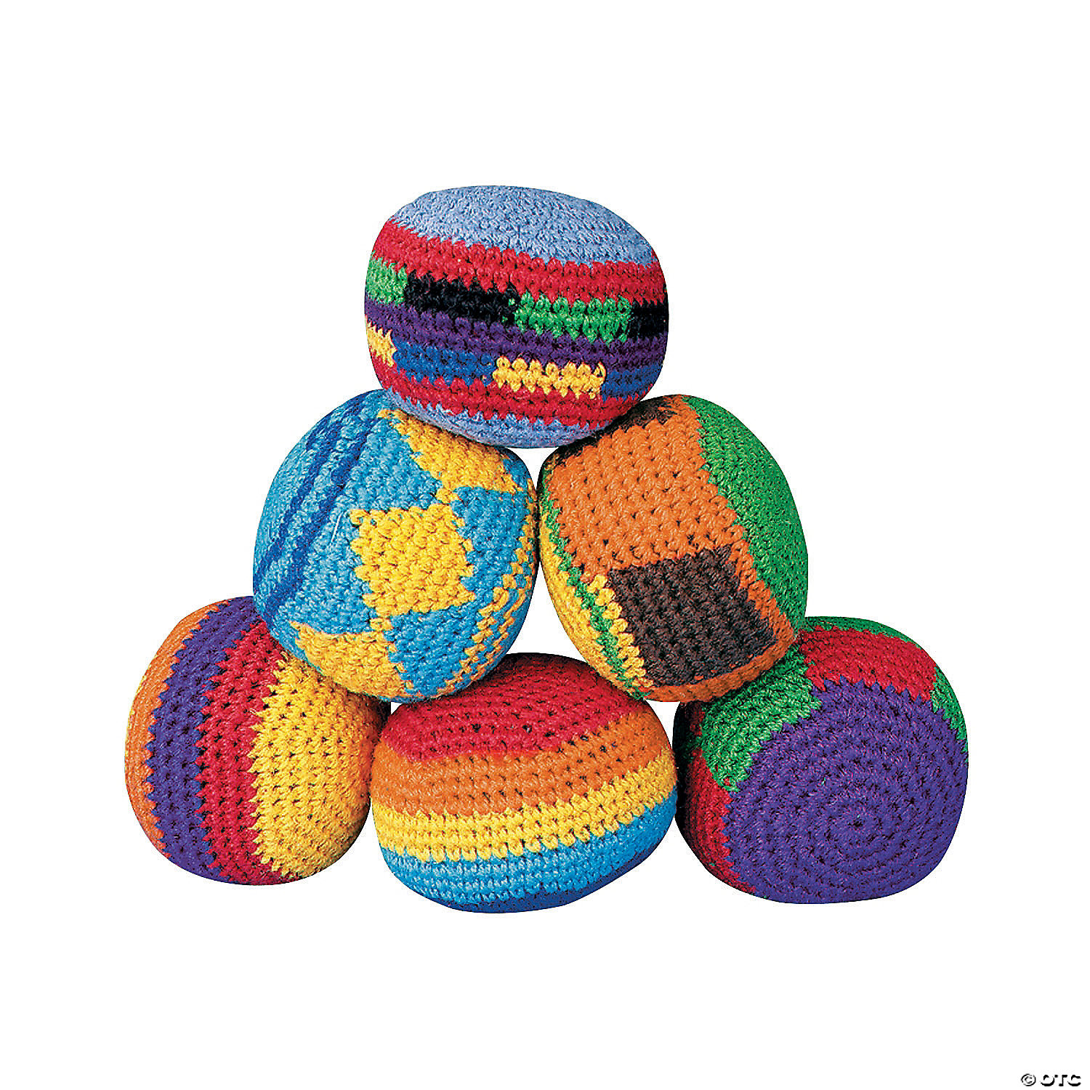

Slide 5
Step 2: Smoothly throw and catch 1 ball

Slide 6
Step 3: Throw one ball to your other hand and throw/catch with your other hand

Slide 7
The trick to juggling is you have to throw one ball away right before catching the incoming one.

Slide 8
The trick to juggling is you have to throw one ball away right before catching the incoming one.

Slide 9
Step 4: Keep the cycle going

