Slide 1
Annotation: How to Have a Conversation with the Text
By LL

Slide 2
Guidelines For Annotating A Text
Assignment Requirements/ Objective
First, identify the assignment requirements or your objective for reading. What do you need to do with the text? Keep that in mind as you read.
Make Comments and Ask Questions
Next, listen to your thoughts as you read. Write questions and comments to the text.
Identify English Language Arts Concepts
As you read, identify any English Language Arts concepts in the text that you find, especially ones related to the assignment requirements or your objective for reading.
Make Text-to-Self/ Text/ World Connections
As you read, make text-to-self, text-to-text, and text-to-world connections. Identify how the text is relevant to your life, other texts you have read, and the world around you.

Slide 3
Wow, what a mess! Do I have to annotate every page I read like this?
Example: “The Big Trip Up Yonder” by Kurt Vonnegut (the first few paragraphs of the story)
Gramps sounds like he might be a grumpy character.
What does that word mean?
Gramps Ford, his chin resting on his hands, his hands on the crook of his cane, was staring irascibly at the five-foot television screen that dominated the room. On the screen, a news commentator was summarizing the day's happenings. Every thirty seconds or so, Gramps would jab the floor with his cane-tip and shout, "Hell, we did that a hundred years ago!”
Emerald and Lou, coming in from the balcony, where they had been seeking that 2185 A.D. rarity—privacy—were obliged to take seats in the back row, behind Lou's father and mother, brother and sister-in-law, son and daughter-in-law, grandson and wife, granddaughter and husband, great-grandson and wife, nephew and wife, grandnephew and wife, great-grandniece and husband, great-grandnephew and wife—and, of course, Gramps, who was in front of everybody. All save Gramps, who was somewhat withered and bent, seemed, by pre-anti-gerasone standards, to be about the same age—somewhere in their late twenties or early thirties. Gramps looked older because he had already reached 70 when anti-gerasone was invented. He had not aged in the 102 years since.
"Meanwhile," the commentator was saying, "Council Bluffs, Iowa, was still threatened by stark tragedy. But 200 weary rescue workers have refused to give up hope, and continue to dig in an effort to save Elbert Haggedorn, 183, who has been wedged for two days in a ...”
"I wish he'd get something more cheerful," Emerald whispered to Lou.
Text-to-world: Privacy is rare in 2185 A.D., but it’s rare now, too.
Setting: the future.
Gramps seems to run the place since he’s in front.
Wow, that’s a lot of relatives! And many are ”great.”
What’s this?
It sounds like anti-gerasone means anti-aging
Universal idea: death
Theme: Humans will do anything to keep themselves from dying, including inventing a medicine to extend life.
Wow, I can’t imagine living that old!
Gramps is a grumpy character who controls what the family watches, and the family seems afraid of him.

Slide 4
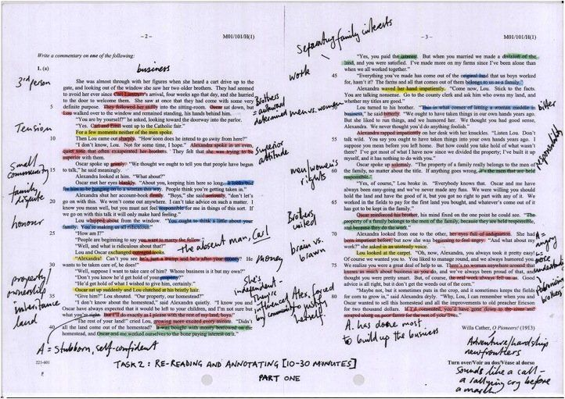
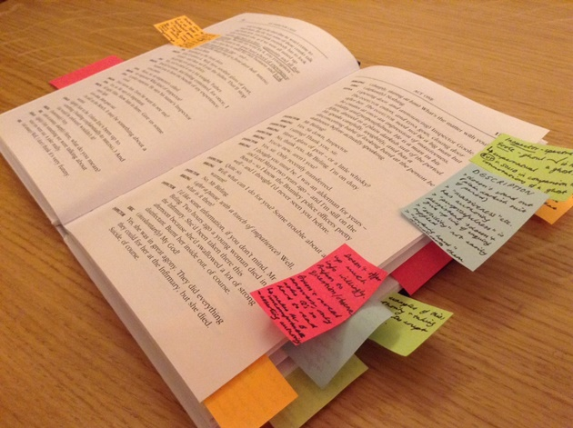
Annotation Density
You do not have to annotate every text that extensively. But, as a rule of thumb:
Shorter texts should get denser annotations (more annotations per paragraph and/ or page).
Longer texts can get less dense annotations (less annotations per paragraph and/ or page).

Slide 5
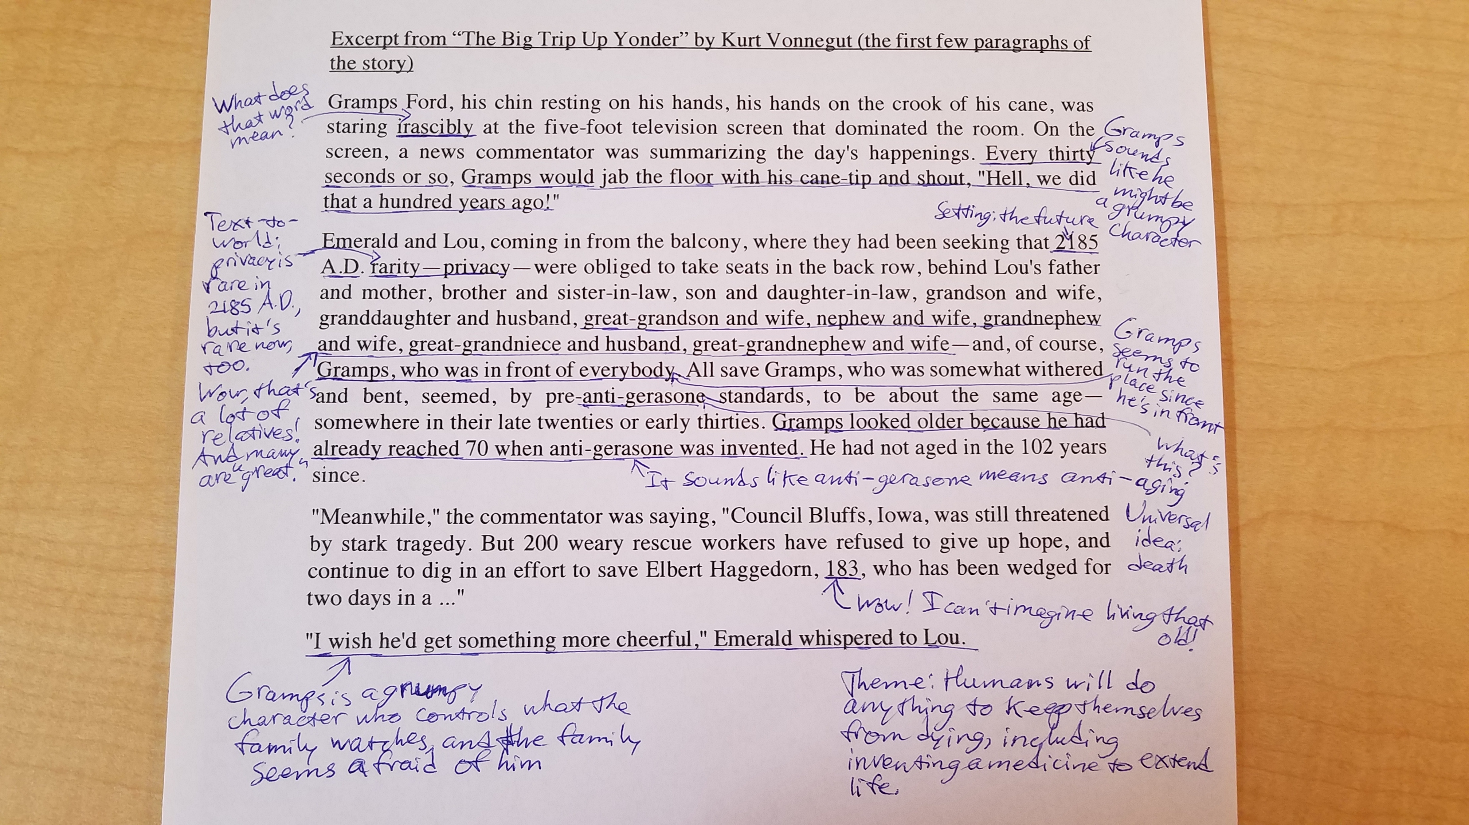
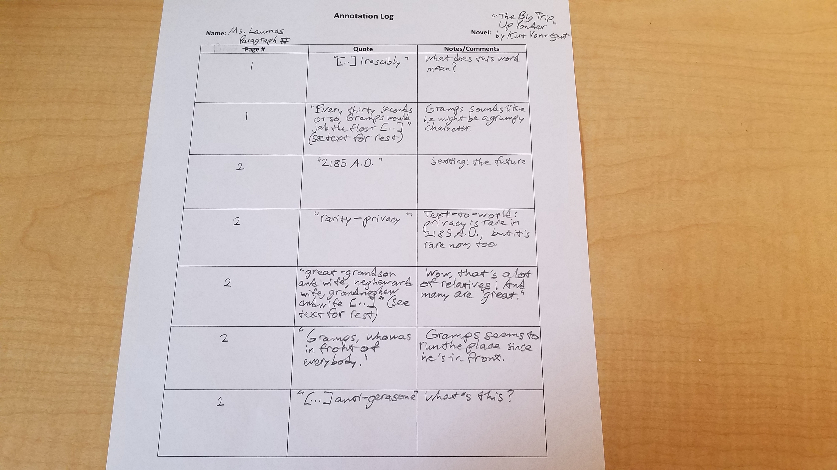
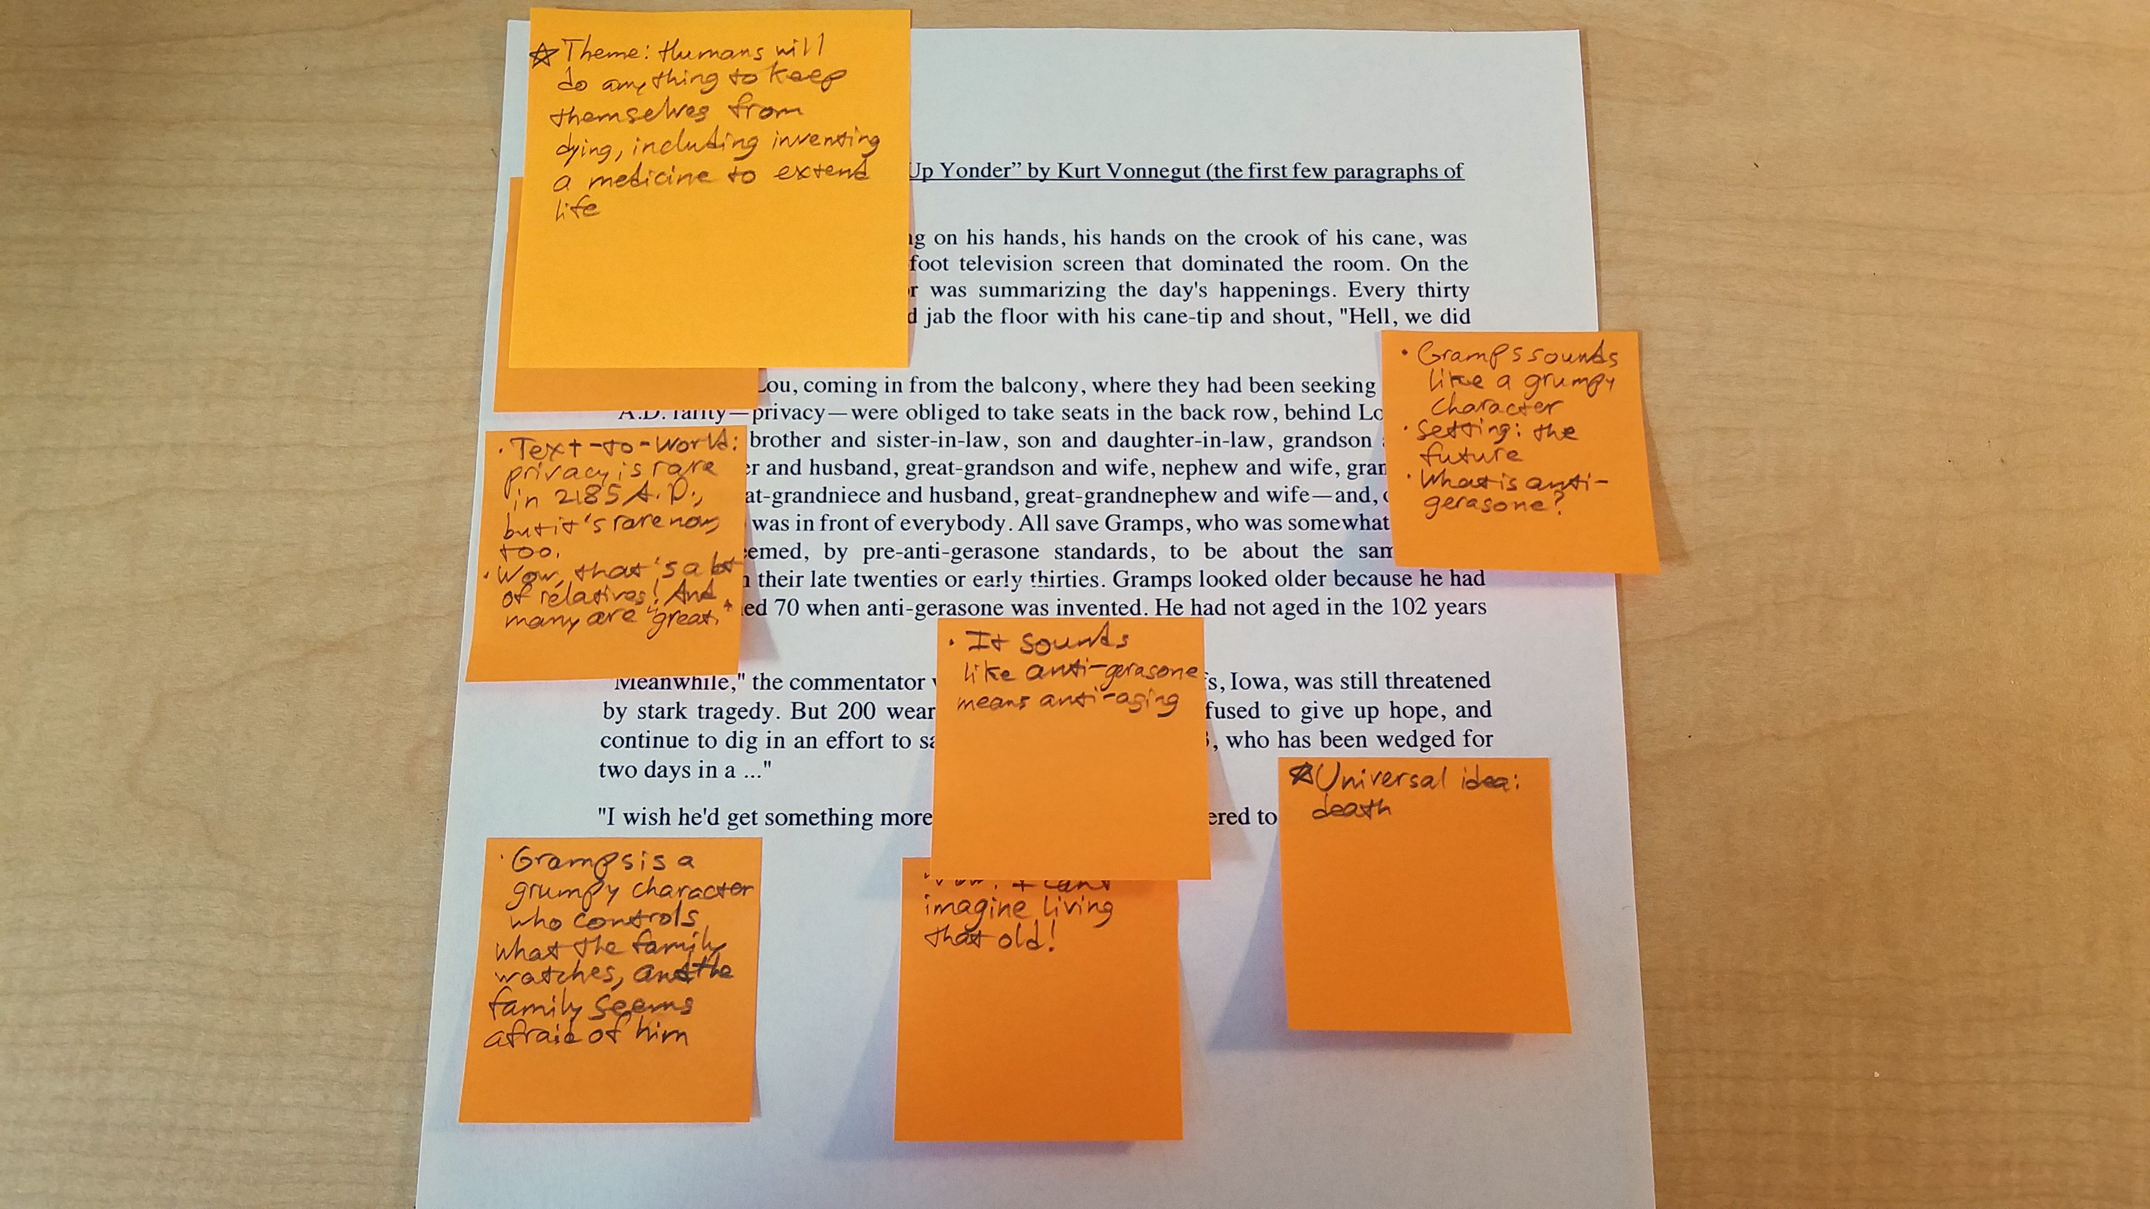
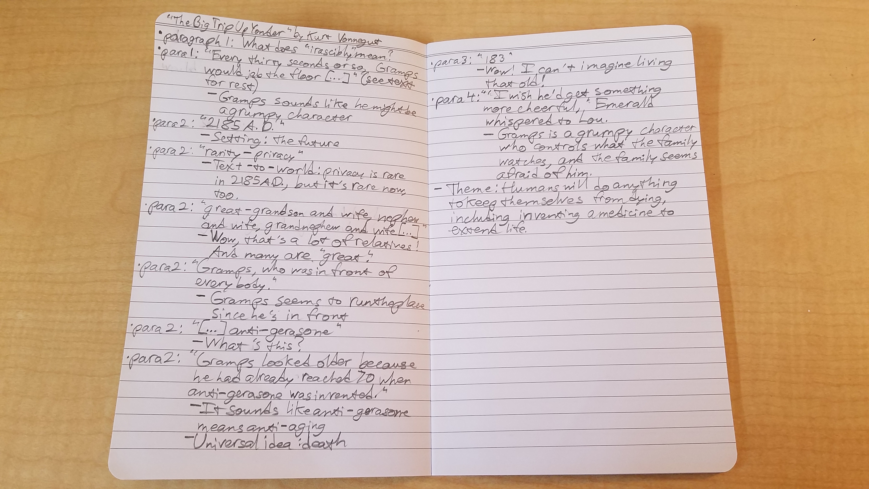
Forms of Annotation Using “The Big Trip Up Yonder” by Kurt Vonnegut Example
Annotating on the Text
Annotating on an Annotation Log
Recommended for texts you are allowed to write on. This lets you see your annotations right next to and on the text itself.
Recommended for texts you are not allowed to write on. This lets you organize your notes in a neat structure, and you can keep your notes after returning the text to its owner.
Annotating on Sticky Notes
Annotating in a Journal
Recommended for long texts and texts you are not allowed to write on. This lets you keep your notes in the text itself, but be aware that you will have to remove them if you have to return the text to its owner eventually.
Recommended for texts you are not allowed to write on. This lets you organize your notes in your own structure, and you can keep your notes after you return the text.

Slide 6
References
Font Awesome Icons. (n.d.) Font Awesome icons. Retrieved from https://www.slidescarnival.com/extra-free-
resources-icons-and-maps
Oliveira, Cris. (2017). These strategically placed notes. Retrieved from https://blog.elo7.com.br/faca-voce-mesmo/30-
imagens-de-material-escolar-tumblr.html
Vonnegut, Kurt. (1953/2009). The Big Trip Up Yonder. Retrieved from https://www.gutenberg.org/ebooks/30240
Wikiversity. (2015). Annotated Text. Retrieved from
https://en.wikiversity.org/wiki/A_Reader%27s_Guide_to_Annotation

