Slide 1
From Data to Knowledge | Classroom Metaphor
Classroom 3
Classroom 4
Classroom 1
Classroom 2
school

Slide 2
From Data to Knowledge | Classroom Metaphor
Classroom 3
Classroom 4
Classroom 1
Classroom 2
school

Slide 3
From Data to Knowledge | Classroom Metaphor
Classroom 3
Classroom 4
= girl
= boy
achievement
Classroom 1
Classroom 2
school

Slide 4
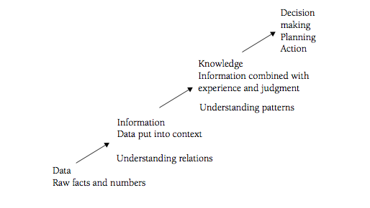
From Data to Knowledge | Classroom Metaphor
Classroom 3
Classroom 4
= girl
= boy
achievement
Classroom 1
Classroom 2
school

Slide 5
Single Loop/ Double Loop
Problem = Attendance
On Time and
Present
Leaves Early
Single Loop Solution:
Start school later, end earlier
Double Loop Solution:
ID kids and when they are not in school, group them, sort them and address individual problems
Absent
Tardy
school

