Slide 1


INFORMATI0N SYSTEMS
THE
INDIVIDUAL
Dedicated Resources
NETWORKS
DATA
KNOWLEDGE MANAGEMENT: the strategic use of resources to foster the creation, sharing, organization, and use of knowledge within an organization
ORGANIZATIONAL
LEARNING

Slide 2
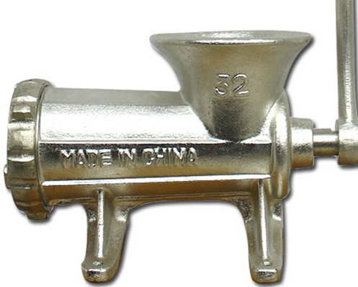
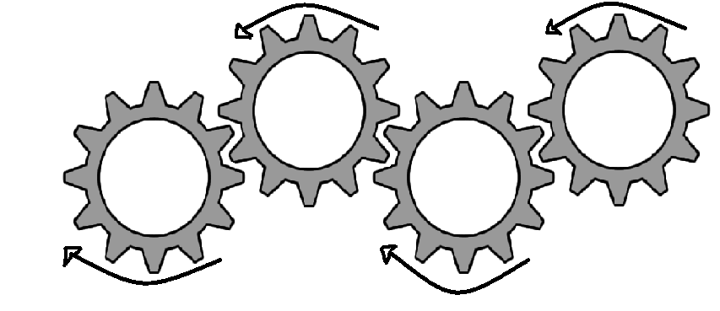
A LOOK INSIDE…
Contribution of acquired knowledge
Fusion
Codification
Socialization

Slide 3
Fostering knowledge by engendering a dialogue between TACIT and EXPLICIT knowledge:
TACIT
EXPLICIT
EXPLICIT
TACIT
Contribution of acquired knowledge
Fusion
Codification
Socialization
EXPLICIT
EXPLICIT
TACIT
TACIT

