Slide 1

STOP KID!!
DON’T DO IT! Bagaaaawk!
I’m just going to retype the data from this one spreadsheet into the new one!

Slide 2
So you want to use a pivot table, but your data is in two different sheets? Bagaaaawk!
Student ID | K-PREP Score
1 | N
2 | P
3 | A
4 | D
5 | P
Time you landlubbers learned about VLOOKUP()
Student ID | Course Grades
1 | C
2 | B
3 | C
4 | A
5 | A

Slide 3
A | B | C
Student ID | KPREP | Has Account
1 | N | =VLOOKUP(A2,Sheet2!$A$2:$B$6,2,FALSE)
2 | P
3 | A
4 | D
5 | P
VLOOKUP will match the ID columns, get the value from the matching row and stick it in the cell where you put the formula. Then you can use pivot tables to explore patterns!
A | B
Student ID | Course Grade
1 | A
2 | B
3 | B
4 | C
5 | C

Slide 4
STOP KID!!
DON’T DO IT! Bagaaaawk!
I need to figure out which values are missing from this one sheet

Slide 5
So you want to use a pivot table, but your data is in two different sheets? Bagaaaawk!
Student ID | K-PREP Score
1 | N
2 | P
3 | A
4 | D
5 | P
Time you landlubbers learned about VLOOKUP()
Student ID | Course Grades
1 | C
2 | B
3 | C
4 | A
5 | A

Slide 6
A | C
Student ID | Has Account
1 | =VLOOKUP(A2,Sheet2!$A$2:$B$6,2,FALSE)
2
3
4 | This row throws an #N/A rather than a 1
5
VLOOKUP will match the ID columns, get the value from the matching row and stick it in the cell where you put the formula. If no match is found you get a #N/A
A | B
Student ID | FLAG
1 | 1
2 | 1
3 | 1
5 | 1

Slide 7

And Voila!
Now you know!!
And knowing is half the battle! Bagaaaawk!

Slide 8
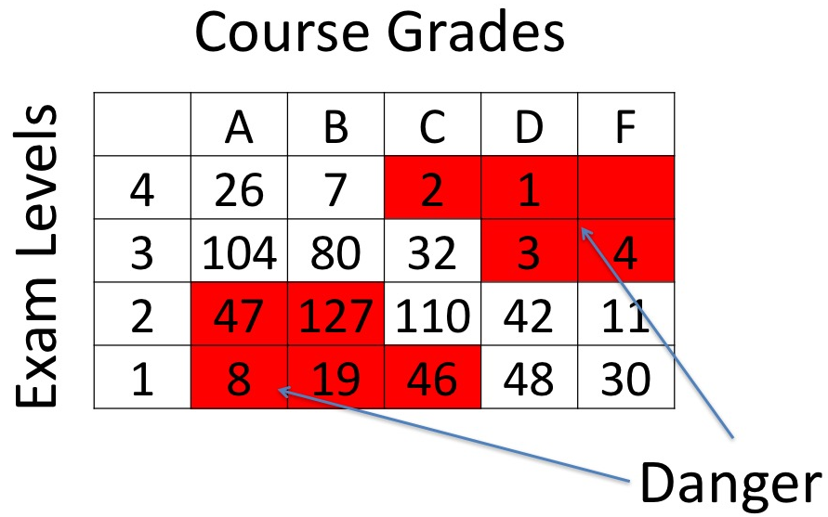
And Voila!
Now you know!!
And knowing is half the battle! Bagaaaawk!

Slide 9

I told Murdock I needed first and last name in separate columns. Instead he sent me last, first all in the same field. Normally I would pity that fool… HARD, but instead I’ll just use these formulas to transform the data.
A | B | C
Last, First | First Name | Last Name
Smith, Bob | Bob | Smith
=RIGHT(A3,LEN(A3)-FIND(",",A3)-1)
=LEFT(A2,FIND(",",A2)-1)

Slide 10


Need to get names out of an email address? You don’t need to type them if you use a formula. Now you know...
… and knowing is half the battle.
A | B | C
Email | First Name | Last Name
hugh.jass@keister.kyschools.us | Hugh | Jass
=PROPER(LEFT(B2, SEARCH(".", B2)-1))
=PROPER(MID(B2,FIND(".",B2)+1,FIND("@",B2)-FIND(".",B2)-1))

