Slide 1
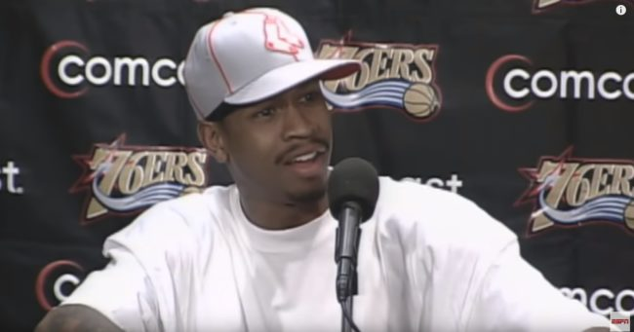
We here talking about tactics.

Slide 2
Tactics are how we implement strategy
(The same tactic can be used to serve various strategies)

Slide 3
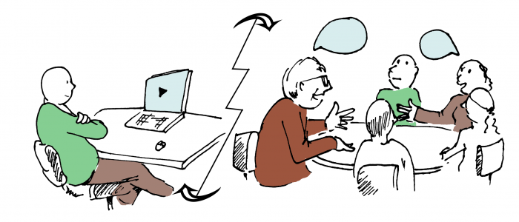
Flipped Instruction

Slide 4
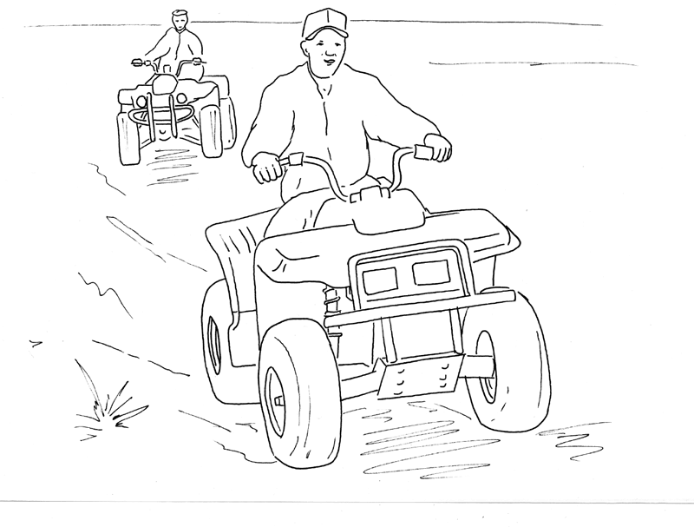
Simulations
The boys arrive at the gate and begin replacing the hinges on the gate post. Their work is done in about an hour. Then they drop their tools at the gate and decide to have a race around the pasture (see Figure 5).
On the second lap Zack is catching up with Brad who is traveling at 35 mph. As Brad looks back over his right shoulder to see where Zack is, he unintentionally turns the handlebars to the right. Zack sees Brad’s ATV heading directly toward a plank fence about 50 feet ahead. What should they do?
1. | Zack can yell “Watch out!” and point to the fence.
2. | Zack can accelerate and pass Brad on the left so Brad will look ahead and see the fence in time to stop or to swerve to the left of the fence.
3. | If Brad looks ahead and sees the fence he can steer his ATV around it.
4. | If Brad looks ahead and sees the fence he can jump off the ATV to prevent his body from hitting the fence.

Slide 5
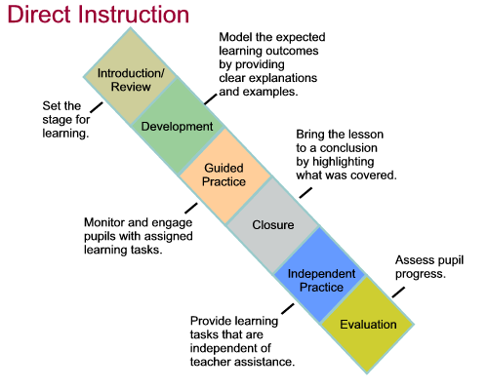
Direct Instruction

Slide 6
Student Team Activity Division

Slide 7
Think-Pair-Share

Slide 8
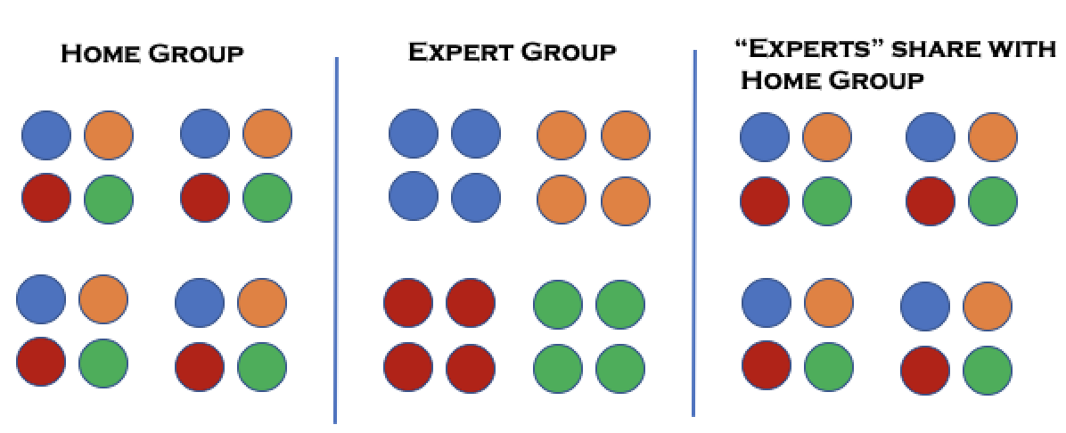
Jigsaw

Slide 9
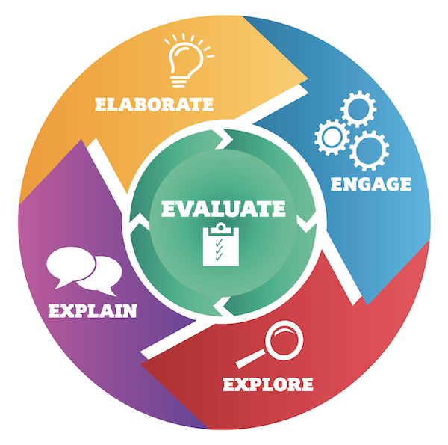
Inquiry Learning (5E Model)

Slide 10
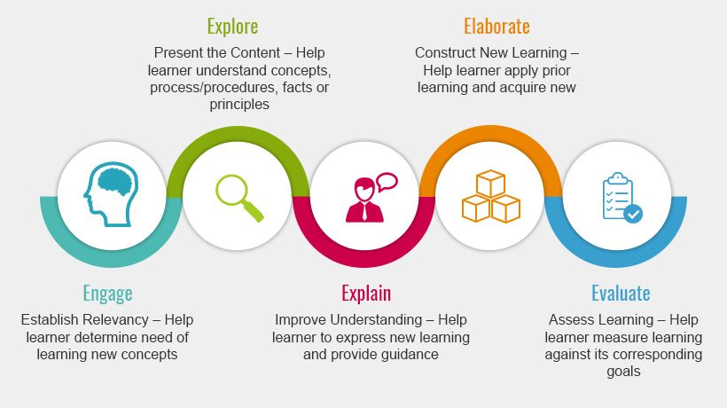
5E (Another version)

