Slide 1
David Kolb (1939-)
Big Idea:
Learning occurs through experiences in a sequence of concrete experience, reflective observation, abstract conceptualization, and active experimentation.
Christine Goble

Slide 2
Rules
Engage students in hands-on activities.
Encourage students to reflect on what they learned/observed and how those ideas might apply in other applications.
Provide opportunities to test their ideas through experimentation in practical situations.

Slide 3
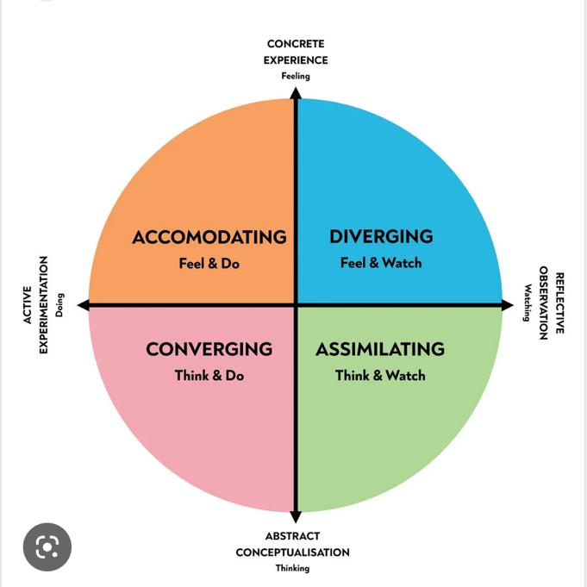
Kolb Learning Styles
People with a converging learning style prefer to learning through abstract conceptualization and active experimentation.
Those with a diverging learning style prefer concrete experience and reflective observation.
The assimilating style is associated with abstract conceptualization and reflective observation.
The accommodating learning style is linked to concrete experience and active experimentation
Primary Source: www.verywellmind.com

