Slide 1
What is Assessment?

Slide 2
What is Grading?

Slide 3
How are they related?

Slide 4
Assessments:
Measures we use to let us know how individuals or groups are performing/feeling about something
Grading:
When we set thresholds for assessments that are used to categorize results.

Slide 5
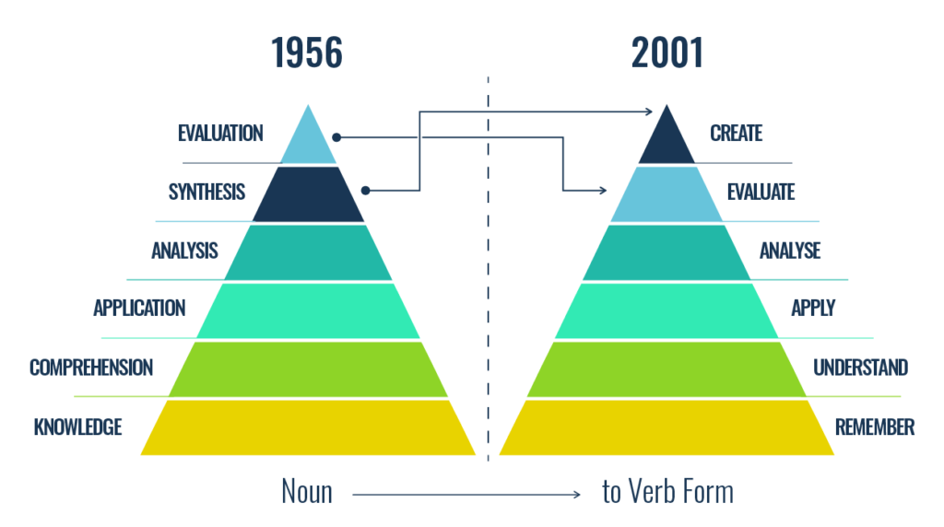
Bloom’s Taxonomy

Slide 6
Item Writing
There is a difference between the difficulty of the item (psychometric –percent correct) and the complexity of the item (cognitive – how demanding). The taxonomy is ordered according to hypothetical complexity not difficulty.
List the states and the capitals west of the Mississippi river.
Imagine you are in car, stopped at a traffic light, headed north in St. Louis, Missouri. Which way would you turn to head toward California?

Slide 7
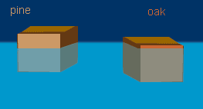
Which block is more dense?

Slide 8
A guy sitting in a boat has a huge 200lb rock with him. The boat is floating in an enclosed pool of water. The rock is thrown overboard and sinks. What happens to the level of water on the side of the pool? And why?

Slide 9
Item Writing
Major goals are to measure important things and have congruence between what the item measures and what the teacher intends.
The Table of Specifications directs the item writer - the teacher directs the Table of Specifications

Slide 10
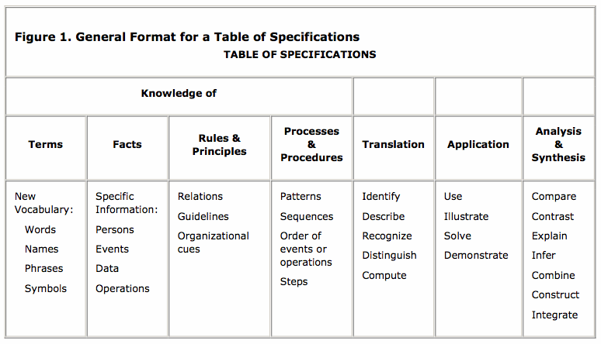

Slide 11
Item Writing
One piece of content can be approached in a number of ways. Those ways may “impose” an hierarchy on the content.
Define the median of a set of scores (Knowledge)
Given a skewed distribution, choose an appropriate center; defend the choice (Comprehension)
Why does the census bureau report the median income in the United States rather than the mean? (Application)

Slide 12
Item Writing
Item writing is writing; one could do worse than go with Orwell*
i) Never use a metaphor, simile, or other figure of speech which you are used to seeing in print.
(ii) Never us a long word where a short one will do.
(iii) If it is possible to cut a word out, always cut it out.
(iv) Never use the passive where you can use the active.
(v) Never use a foreign phrase, a scientific word, or a jargon word if you can think of an everyday English equivalent.
(vi) Break any of these rules sooner than say anything outright barbarous.
*George Orwell: ‘Politics and the English Language’ First published: Horizon. — GB, London. — April 1946

Slide 13
Item Writing
Keep it simple: If the goal is to have a child add one digit numbers to get a one digit result:
What is 2 + 2?
Not: There were two cats and two dogs in the window of a pet store. How many animals were in the window?
And certainly not: Take one-half the number of legs of a giraffe and add that to the number of legs of a human being.

Slide 14
Item Writing
Its not the form of the question that counts, its what is to be measured that counts.
Multiple choice items do not allow students to give reasons, for example
Constructed response items, items from performance events, and essay questions can demand those reasons
In general, we do not ask enough questions that demand justification (do we teach such?)

Slide 15
Rubrics
 | Basic | Moderate | Functioning | Productive
Combining Elements | Has basic entry and reporting | Uses form elements to speed up entry | Decreases user error through error trapping | User specific reporting and filtering.
Database Structure | Flat file | Minimal first degree Normalization | At least 2nd degree Normalization non- redundant tables | Speeds up performance with indexes.
Application Usability | Creates more work for users with no added value | Replicates a current process with no added value | Improves the work flow over the current process | Creates opportunities for changing the way work is done

Slide 16
Single-Point Rubrics aka Checklist
 | Criteria
Combining Elements | Uses form elements to speed up entry
Database Structure | Minimal first degree Normalization
Application Usability | Replicates a current process with no added value

Slide 17
Example: Scout Badges
Do the following:
(a) Float faceup in a resting position for at least three minutes with minimal movement.
(b) Demonstrate survival floating for at least five minutes.
(c) While wearing a properly fitted U.S. Coast Guard-approved life jacket, demonstrate the HELP and huddle positions. Explain their purposes.
(d) Explain why swimming or survival floating will hasten the onset of hypothermia in cold water.
In water over your head, but not to exceed 10 feet, do each of the following:
(a) Use the feet first method of surface diving and bring an object up from the bottom.
(b) Do a headfirst surface dive (pike or tuck), and bring the object up again.
(c) Do a headfirst surface dive to a depth of at least 5 feet and swim underwater for three strokes. Come to the surface, take a breath, and repeat the sequence twice.

Slide 18
Metrics
Number of help desk visits
Use of a particular service
Weight of trash cans

Slide 19
Describing Assessment
Indirect | Direct
Formative | Summative
Conceptual | Procedural
Formal | Informal

Slide 20
Formative Assessment

Slide 21
C
D
B
F
A
Figure: Distribution of Achievement in Traditional Classrooms
Recreated from Guskey, 2010

Slide 22
Recreated from Guskey, 2010
B
A
C
D
B
C
F
A
Distribution of Achievement in Traditional Classrooms
Distribution of Achievement in Mastery Learning Classrooms

Slide 23
Unit 1
Enrichment Activities
Unit 2
Assessment
Correctives
Assessment
Figure: The Mastery Learning Instructional Process
Recreated from Guskey, 2010

Slide 24
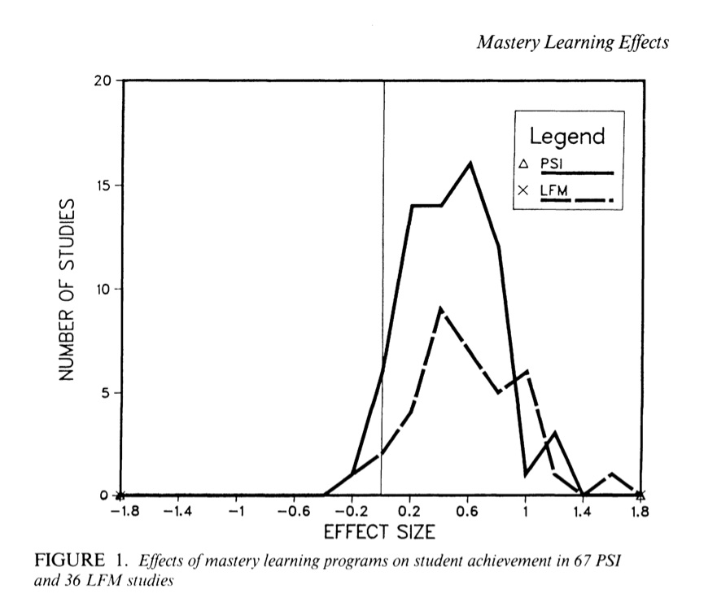

Slide 25
Unit 1
Enrichment Activities
Unit 2
Assessment
Correctives
Assessment
Figure: The Mastery Learning Instructional Process
Recreated from Guskey, 2010

Slide 26
Unit 1
Unit 2
Unit 3
Unit 4
Summative Assessment

Slide 27
Unit 1
Unit 2
Unit 3
Unit 4
Summative Assessment

Slide 28
Unit 1
Unit 2
Unit 3
Unit 4
Summative Assessment

Slide 29
Assessments:
Measures we use to let us know how individuals or groups are performing/feeling about something
Grading:
When we set thresholds for assessments that are used to categorize results.

Slide 30
What is the purpose of this real grading scale from Duke School of Business?

Slide 31
We use the following grading scale:
Superior Pass (SP) 4.0
High Pass (HP) 3.5
Pass (P) 3.0
Low Pass (LP) 2.5
Fail (F)-0
The Fuqua recommended distribution of grades in CORE courses is:
No more than 25 percent SP
40 percent HP
At least 35 percent P, LP and F
The recommended distribution for ELECTIVE courses is:
No more than 30 percent SP
45 percent HP
At least 25 percent P, LP and F

Slide 32
What is the purpose of Duke’s grading scale?
Systems can have different goals/drivers for grading and assessment

Slide 33
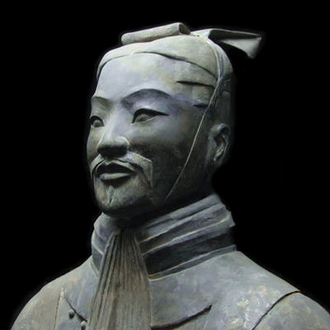
All men can see the tactics whereby I conquer, but what none can see is the strategy out of which victory is evolved.
- Sun Tzu

Slide 34
What does/could this mean?
82%

Slide 35
Criteria Used in Grading
1. Product Criteria
2. Process Criteria
3. Progress Criteria

Slide 36
Mathematical Precision is Not A Grading Policy
It is a false sense of objectivity

Slide 38
2
3
1

Slide 41
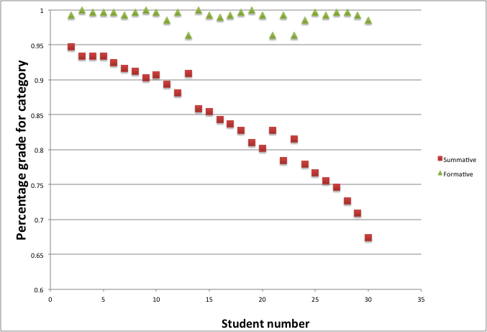

Slide 42
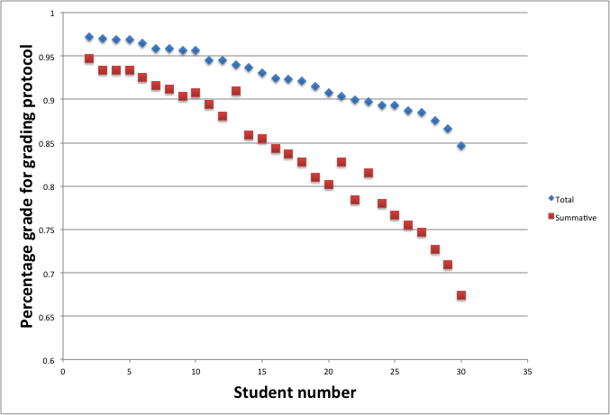

Slide 43
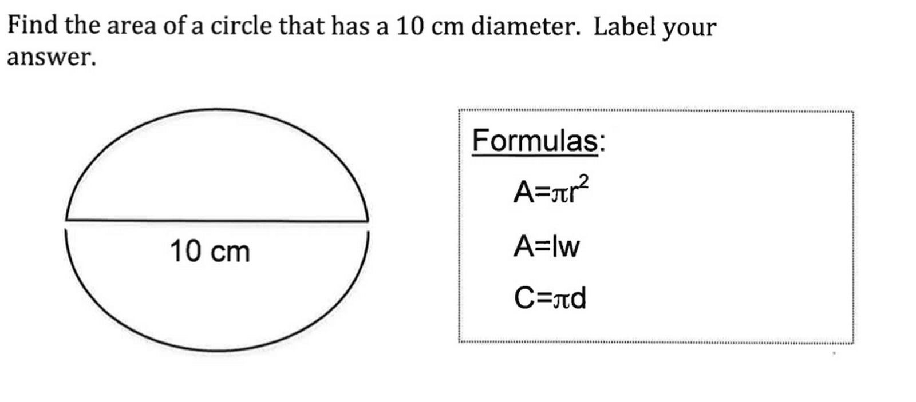

Slide 44
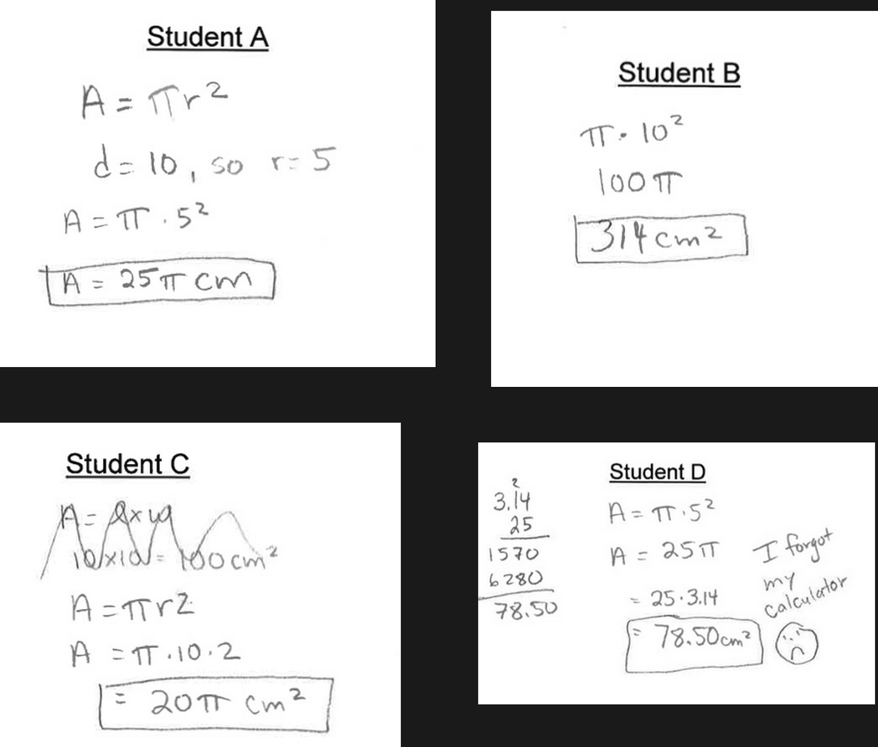

Slide 49
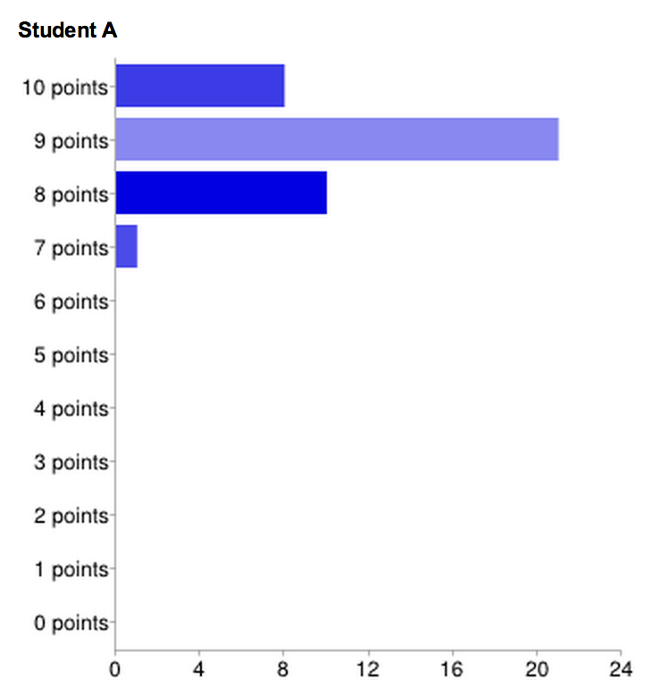

Slide 50
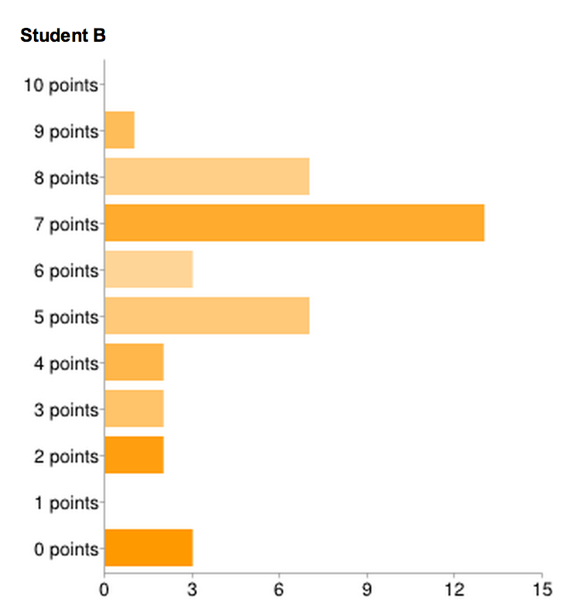

Slide 51
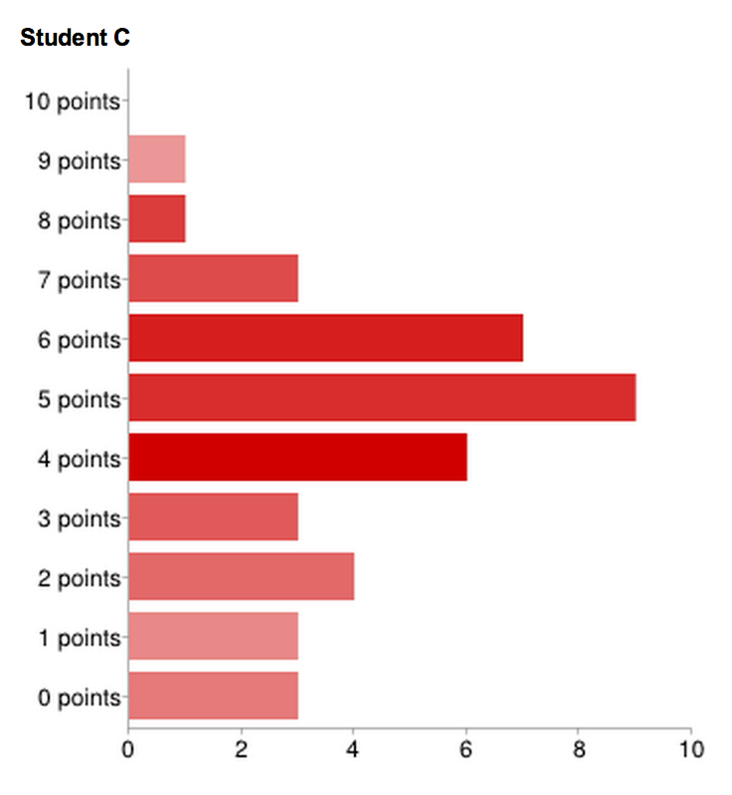

Slide 52
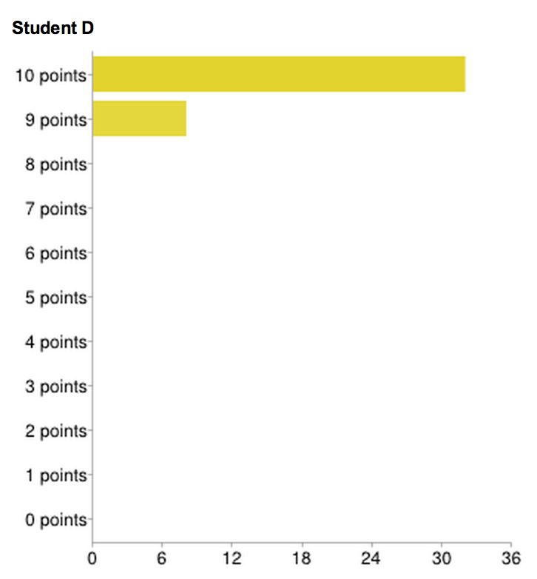

Slide 53
What’s an A?

Slide 54
Is this a high grade?
70%

Slide 55
You Don’t Have to Average

Slide 56
When you build something, you to need to fasten stuff

Slide 57
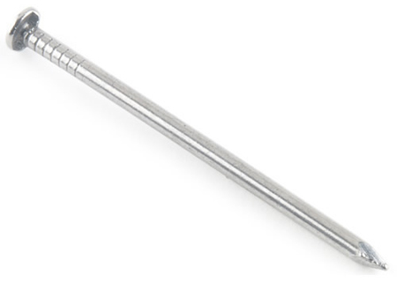

Slide 58
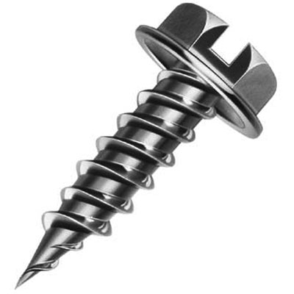

Slide 59
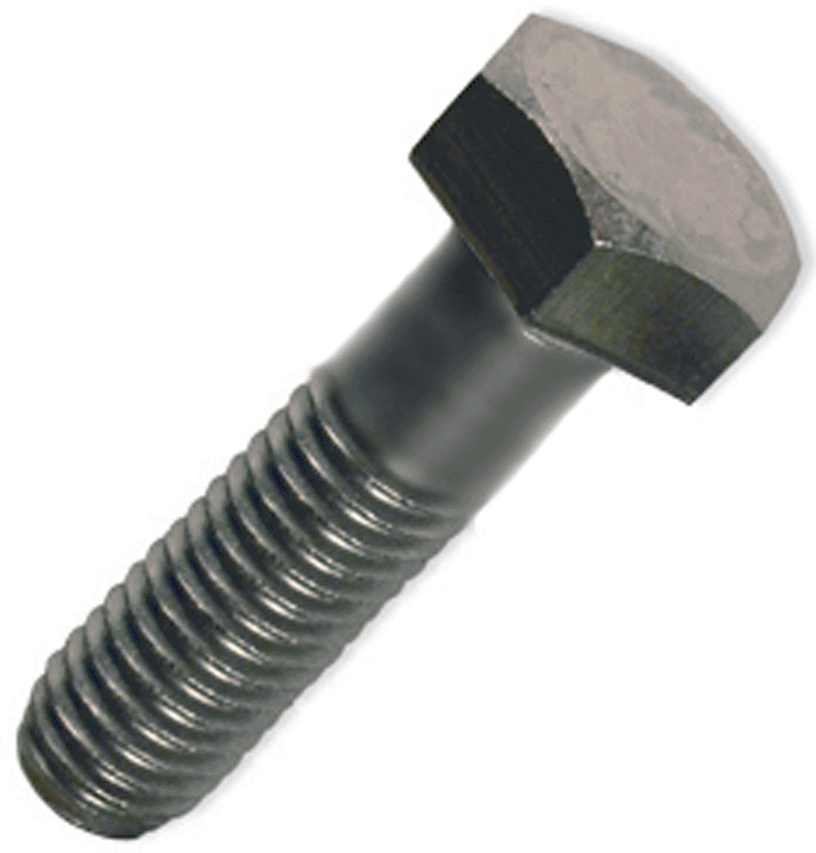

Slide 61
In determining grades we have to “fasten” pieces of evidence together.

Slide 62
Why limit ourselves to using the nail of grading (averaging of percentage scores)?

Slide 63
Consider this burning question:
What % of the total grade should EOC exams count?

Slide 64
20%, 30%, 40%

Slide 65
Take this student….
Q1 = 58%
Q2 = 68%
Q3 = 77%
Q4 = 85%
EOC = 93%

Slide 66
Take these student….
Q1 = 58%
Q2 = 68%
Q3 = 77%
Q4 = 85%
EOC = 93%
Q1 = 93%
Q2 = 85%
Q3 = 77%
Q4 = 68%
EOC = 58%

Slide 67
73.6% = C

Slide 68
What if we said a student that scores > 90% on the EOC must get at least a B-?

Slide 69
What if we said a student must score at least 60% on the EOC to get an A?

Slide 70
I’m not saying averaging is bad, but it’s just one type of fastener.

Slide 71
When you build your new structure, look at all your options.

Slide 72
 | Project 1 | Project 2 | Project 3 | Project 4 | Project 5 | Final
Jen | B | A | B | B | C
James | B | A | A | B | B
Jeremy | C | C | C | B | B
Jessica | A | A | A | B | C
Jane | A | B | B | A | B

