Slide 1
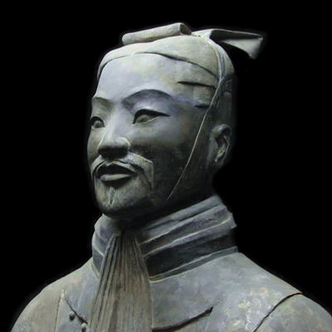
Strategy without tactics is the slowest route to victory. Tactics without strategy is the noise before defeat.
- Sun Tzu

Slide 2
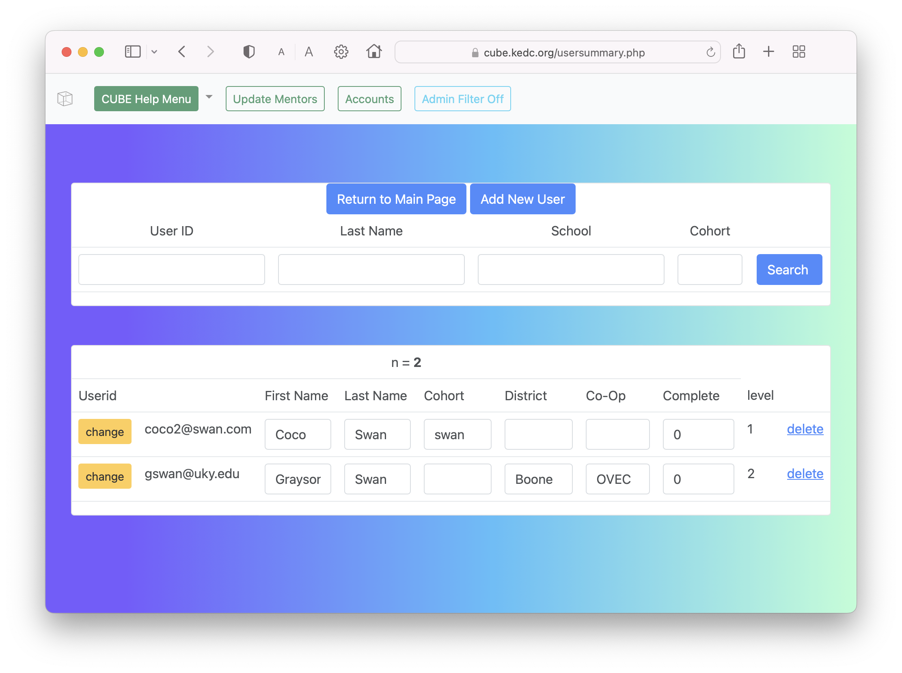
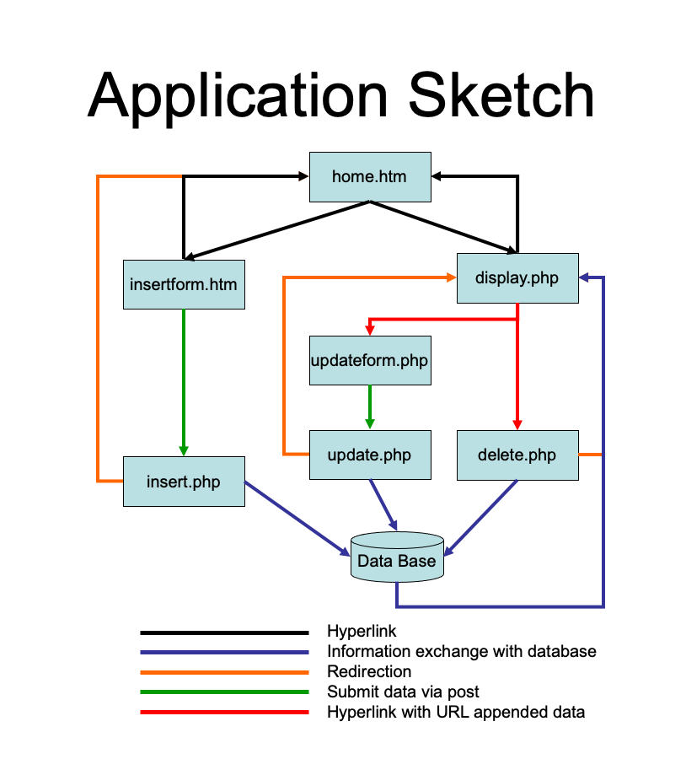
Tactic: Expert to Novice Worked Examples
This approach provided layers of scaffolded material that learners access based on confusion/inability to complete the task. This approach is inspired by the “expertise reversal effect” (Kalyuga, 2007) that the more expert a learner is, the less scaffolding and direction needed. Useful for Internalization efforts.
Authentic Task
Demo Solution
Provide
Overview
Detailed Explanation
Component 1
If needed
If needed
If needed
e.g. Creating an auto-save update form.
Allow learners to interact with example solution
Walkthrough the structure of the worked example and the pieces
Detailed Explanation
Component 2
Detailed Explanation
Component 3

Slide 3
Tactic: Collaborative Design Challenges
This approach asks learners to use 2 or more N2E examples to a different (but not too foreign) example. This practice gets at the socialization/externalization aspects of the learning cycle.
N2E Worked Example
Reinforced understanding
N2E Worked Example

