Slide 1
David Kolb
“Learning is the process whereby knowledge is created through the transformation of experience”
Notes:
Three Takeaways:
1. Learning is done through activities and experiences, hands on learning
2. Ensure activities are designed in ways that offer every learner the chance to engage in the manner that suits them best
3. Activities and material should be developed in ways that draw each stage of the experiential learning cycle and take learners through the whole process

Slide 2
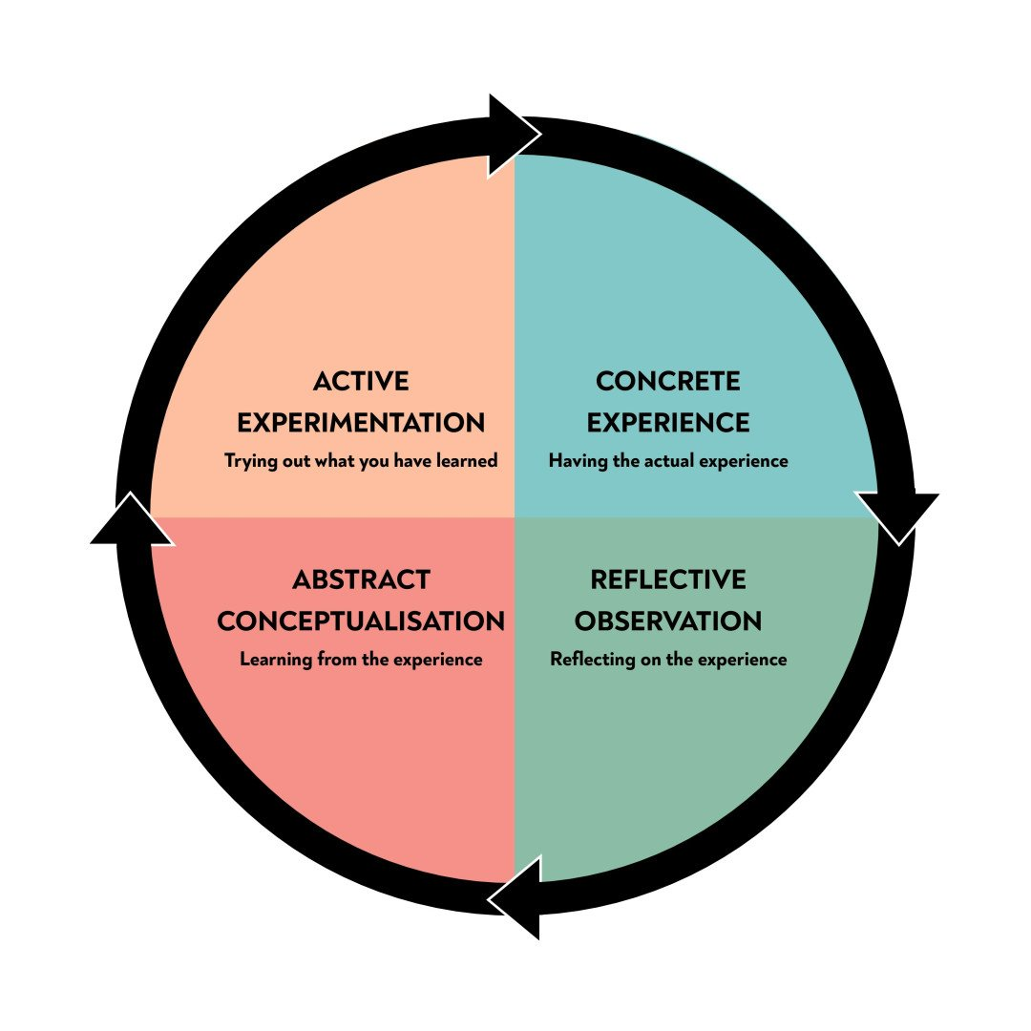
Experiential Learning Cycle
A four-stage learning cycle in which the learner “touches all the bases”
Notes:
Concrete Experience – the learner encounters a concrete experience. This might be a new experience or situation, or a reinterpretation of existing experience in the light of new concepts.
Reflective Observation of the New Experience – the learner reflects on the new experience in the light of their existing knowledge. Of particular importance are any inconsistencies between experience and understanding.
Abstract Conceptualization – reflection gives rise to a new idea, or a modification of an existing abstract concept (the person has learned from their experience).
Active Experimentation – the newly created or modified concepts give rise to experimentation. The learner applies their idea(s) to the world around them to see what happens.

Slide 3
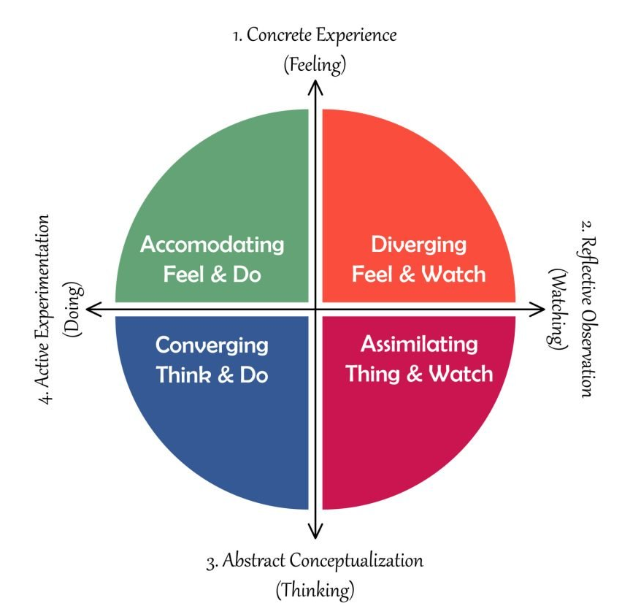
Kolb’s Learning Continuums
Processing Continuum
how we approach a task
Perception Continuum
how we think or feel about it
We cannot perform both variables on a single axis at the same time
Our learning style is a product of these two choice decisions.
Notes:
The learning style preference itself is actually the product of two pairs of variables, or two separate “choices” that we make, which Kolb presented as lines of an axis, each with “conflicting” modes at either end.
A typical presentation of Kolb’s two continuums is that the east-west axis is called the Processing Continuum (how we approach a task), and the north-south axis is called the Perception Continuum (our emotional response, or how we think or feel about it).
Kolb believed that we cannot perform both variables on a single axis at the same time (e.g., think and feel).
Our learning style is a product of these two choice decisions.

Slide 4
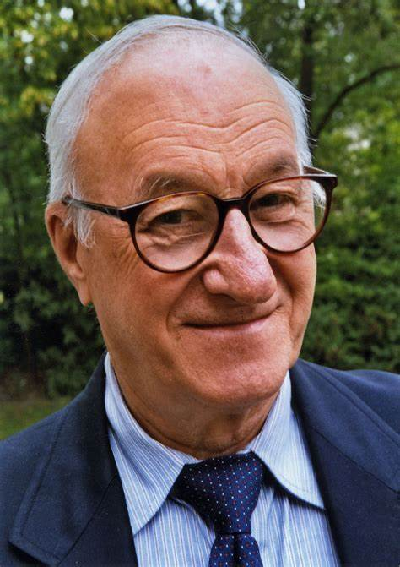
Albert Bandura
learning occurs because people observe the consequences of other people's behaviors

Slide 5
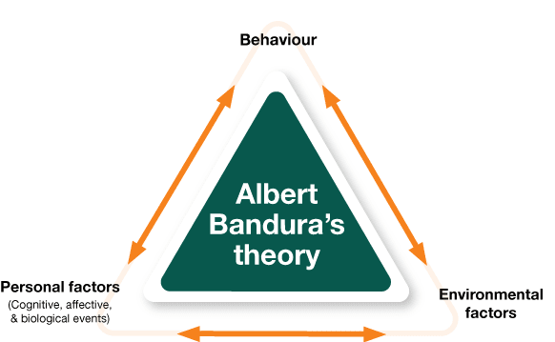
Social Learning Theory
Notes:
learning occurs through observation, imitation, and modeling
Learning is influenced by factors such as attention, motivation, attitudes, and emotions.
The theory accounts for the interaction of environmental and cognitive elements that affect how people learn.

