Slide 1
All men can see the tactics whereby I conquer, but what none can see is the strategy out of which victory is evolved.
- Sun Tzu

Slide 2
Strategy vs. Tactics
Strategy is the bird’s eye view of a problem and what needs to be done to address it. Tactics are a way to deploy strategy in a specific context. Both are necessary to complete an objective. Without the necessary technology or resources, the best strategies can fail and vice versa, the best technology and resources will fall short if a strategy is faulty.
All of the technology available to us as instructional designers are tools that can be used to execute a tactic, but without an effective strategy, tools and tactics result in nothing but expenditures of money and personnel.

Slide 3
A strategy that guides the use of audience response systems.
High Stakes Assessment
Increased Attendance
Greater Learning

Slide 4
Uses clickers (tool) to “quiz” for attendance and paying attention during lecture.
Class begins with “check-in” question for some number of points.
Lecture/presentation is given.
Questions are given to quiz students for understanding for some number of points.

Slide 5
A BETTER strategy that guides the use of audience response systems.
Increased Interaction
Better Feedback
Greater Learning

Slide 6
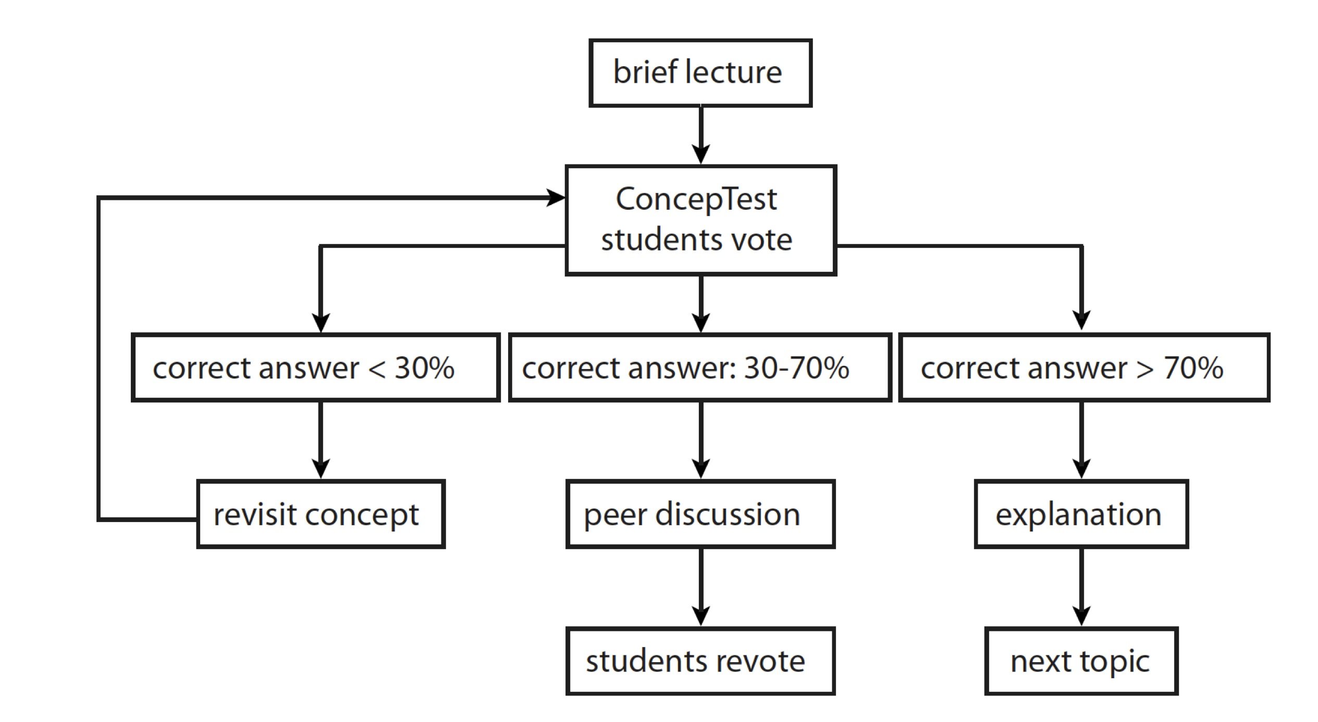
Uses clickers (tool) to enact think-pair-share (tactic)

Slide 7
Nonaka’s KM Cycle is a strategy for thinking about designing organizational learning
Socialization
Externalization
Tacit
Tacit
Tacit
Explicit
e.g. tactic: workshop participants discussing a concept.
e.g. tactic: Creating a visual metaphor for a concept
Internalization
Combination
Explicit
Tacit
Explicit
Explicit
e.g. tacti: Reading a paper about a concept or topic
e.g. tactic: Converting two data sets into a new graph

Slide 8
The programmed instruction is an example of a tactic derived from Skinner’s frameworks (i.e. strategies) on how people learn. The teaching machine (tool) was developed (over and over again) to deploy this tactic.

Slide 9
Your challenge
Create a visual that sums up your strategy. This can come from your reflection on your own experiences or a theorist you are particularly fond of.
It can be linear, or circular or some other configuration. The main thing is that you capture the essence of what is going to drive your approach to design the learning experiences that will meet your objectives.

