Slide 1
Resources and population: global issues of consumption
Global issues of abundance
  Electronic waste
  Microplastics
Global issues of scarcity in relation to demand
  Sea floor mining
  Conflict minerals

Slide 2

Notes:
https://youtu.be/ihv0eZ3uGCY?si=iPP4ghsoHEBPeX8D

Slide 3
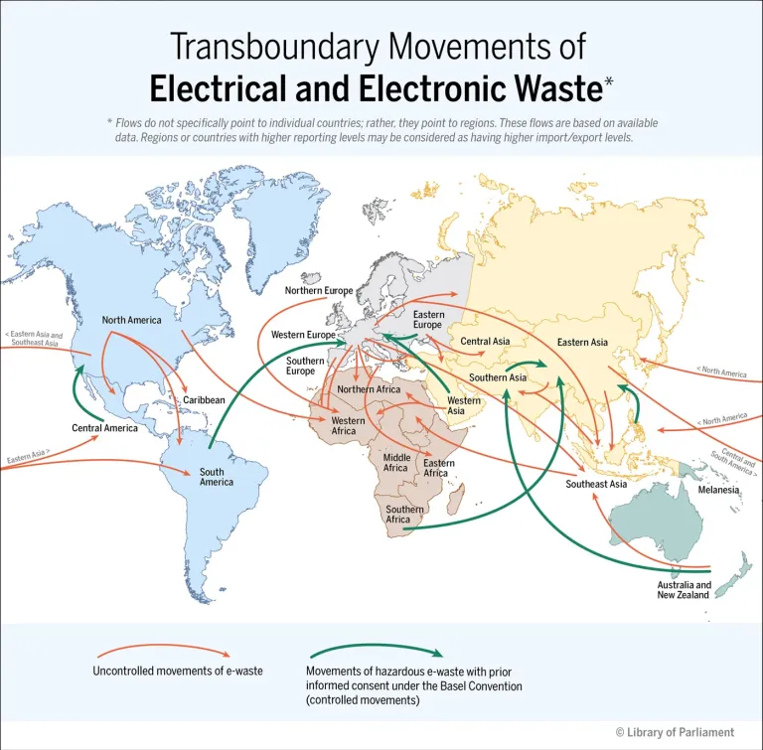
Notes:
https://hillnotes.ca/2023/06/05/electrical-and-electronic-equipment-waste-continued-environmental-considerations-and-transboundary-movements/

Slide 4
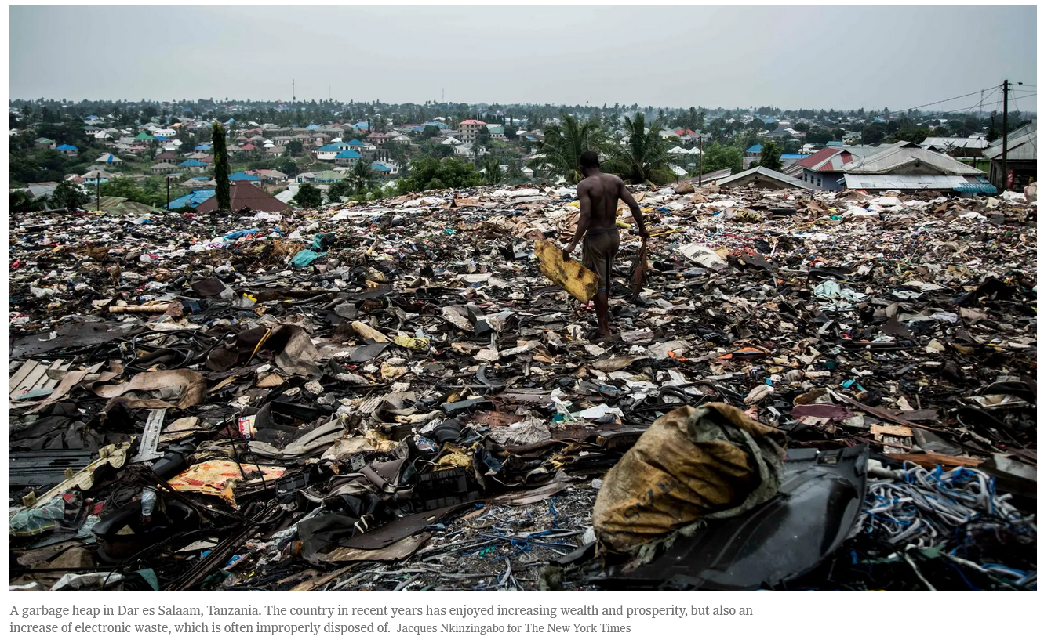
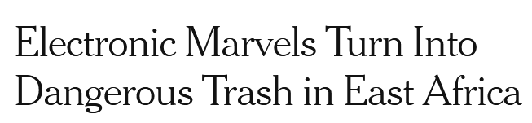
Notes:
The discourse this reading challenges is that e-waste in Africa is not all what wealthy countries export to poor countries, a problem that does exist. The issue is that as African countries develop and become more affluent they are developing their own internal e-waste problem. Electronic waste is the fastest growing waste stream worldwide and is among the top three illicitly traded.

Slide 5
Electronic marvels turn into dangerous trash in east Africa (NY Times reading)
Rising incomes in Africa allow people to buy more electronic devices
Electrical blackouts can create a demand for batteries and solar cells
Lack of infrastructure to collect and process e-waste
Investment and training to handle growing amounts of e-waste is lacking in parts of Africa
The hesitation of companies to pay for recycling their e-waste because of lack of regulation
Improper e-waste recycling contributes to environmental lead pollution

Slide 6


Notes:
https://www.nytimes.com/2023/01/11/style/plastic-free.html
The discourse that gets overturned here is that it is all a matter of recycling and eliminating the use of plastic straws. Plastics are around us to such an extent that it near impossible to live without plastics. It would not be easy to reduce our dependence on plastics quickly.

Slide 7
Trying to live a day without plastics (NY Times reading)
Plastics are unavoidable and we encounter them constantly each day
Living without plastic would be hard to do unless you were wealthy and willing to make a lot of lifestyle changes
Some uses of plastic improve fuel economy and enhance efficiencies, such as the use of plastic in automobiles
Reducing single use plastics is a more feasible and likely to help than banning all plastic everywhere
Plastics manufacturers who need to be held more accountable for producing so much plastic
The burden of reducing exposure to many of these chemicals remains with consumers.
Notes:
The discourse has become that consumers are responsible for plastics. For recycling and avoiding exposures to the chemicals in plastics. However, that is a way of displacing responsibility on consumers when manufacturers as well as product designers are the ones that should be changing their practices

Slide 8

Plastic can also harm our health
Plastic additives — such as BPA and phthalates — may disrupt the endocrine system in humans

Slide 9
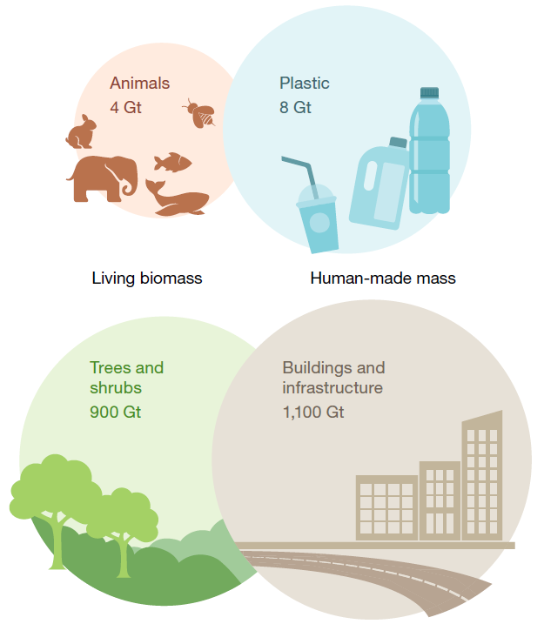
Notes:
https://www.nature.com/articles/s41586-020-3010-5
Contrasting key components of global biomass and anthropogenic mass in the year 2020 (dry-weight basis). The ratio between the circle areas within each pair represents the corresponding mass ratio of the two illustrated masses. For visual clarity, the two pairs use different scales. The plastic estimate includes plastic currently in use and plastic waste, taking into account recycling.
Infrastructure includes the mass of constructed elements, such as roads

Slide 10
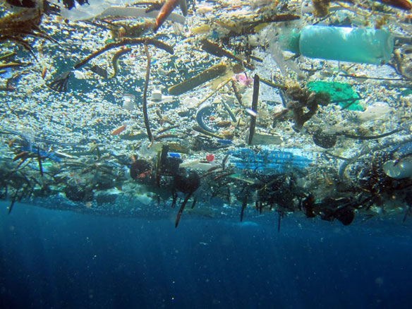

Slide 11
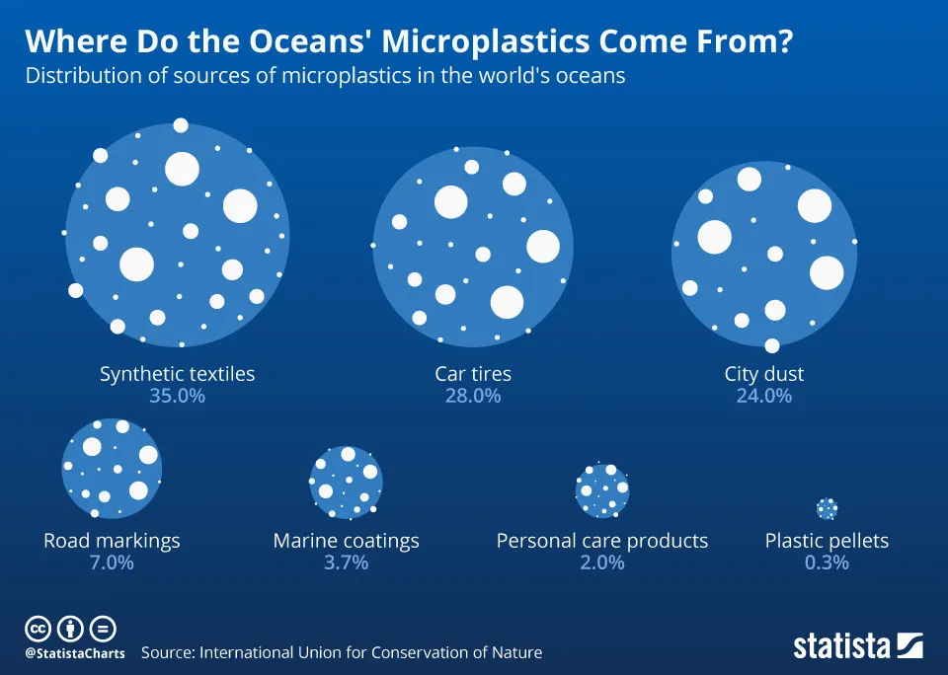
Notes:
Although ocean plastics break down over time, microscopic remnants remain in the water and could enter the food chain. There could be a million times more microplastics floating around our oceans than previously thought, according to new research suggesting existing studies could have seriously underestimated the problem.
https://new.nsf.gov/news/microplastics-million-times-more-abundant-ocean

Slide 12

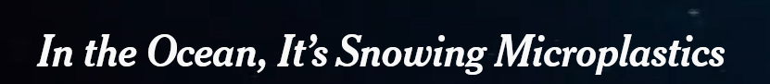
Notes:
The discourse here that gets challenged is the one that focuses only on the surface plastic in the ocean. Most of the plastic actually sinks.

Slide 13
In the ocean, it’s snowing microplastics (NY Times reading)
Only one percent of plastics in the ocean remains at the surface
Microplastics and microbial life growing on it fuse with marine snow that alters how fast these particle fall to the deep sea floor bottom
The rate of sinking is not well understood, but given the amount of plastics in the ocean, and the importance of marine snow as a carbon sink it is a consequential question
Faster snowfall could help store microplastics in deep sea sediments
Slower snowfall could prevent carbon from being sequestered in deep sea sediments – a slow down in the ocean’s biological carbon pump
Changes in rate of snowfall can alter marine food webs
Notes:
https://eos.org/articles/microplastics-are-the-not-so-secret-ingredient-in-marine-snow

Slide 14
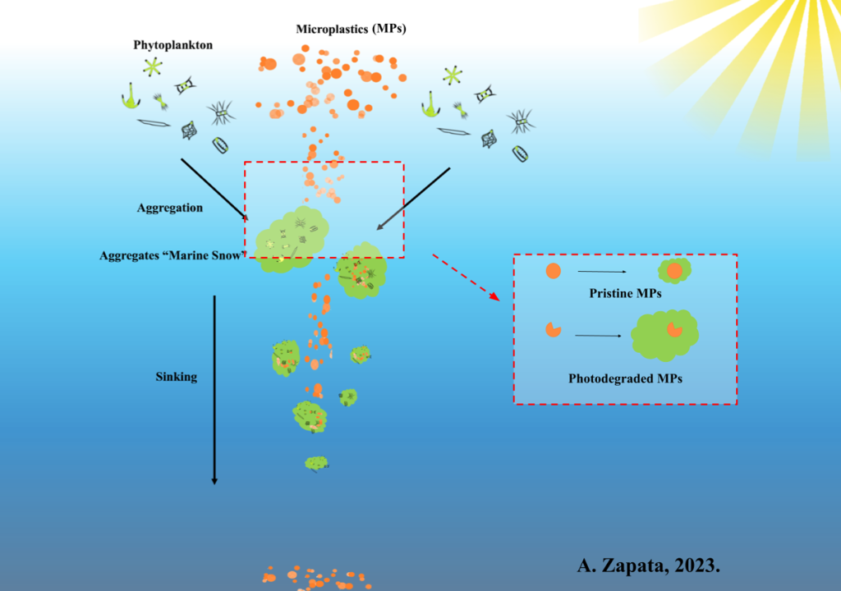
Notes:
https://eos.org/articles/microplastics-are-the-not-so-secret-ingredient-in-marine-snow

Slide 15
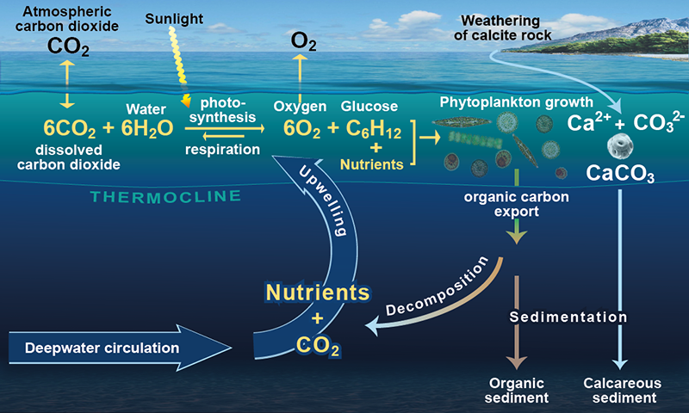

Slide 16
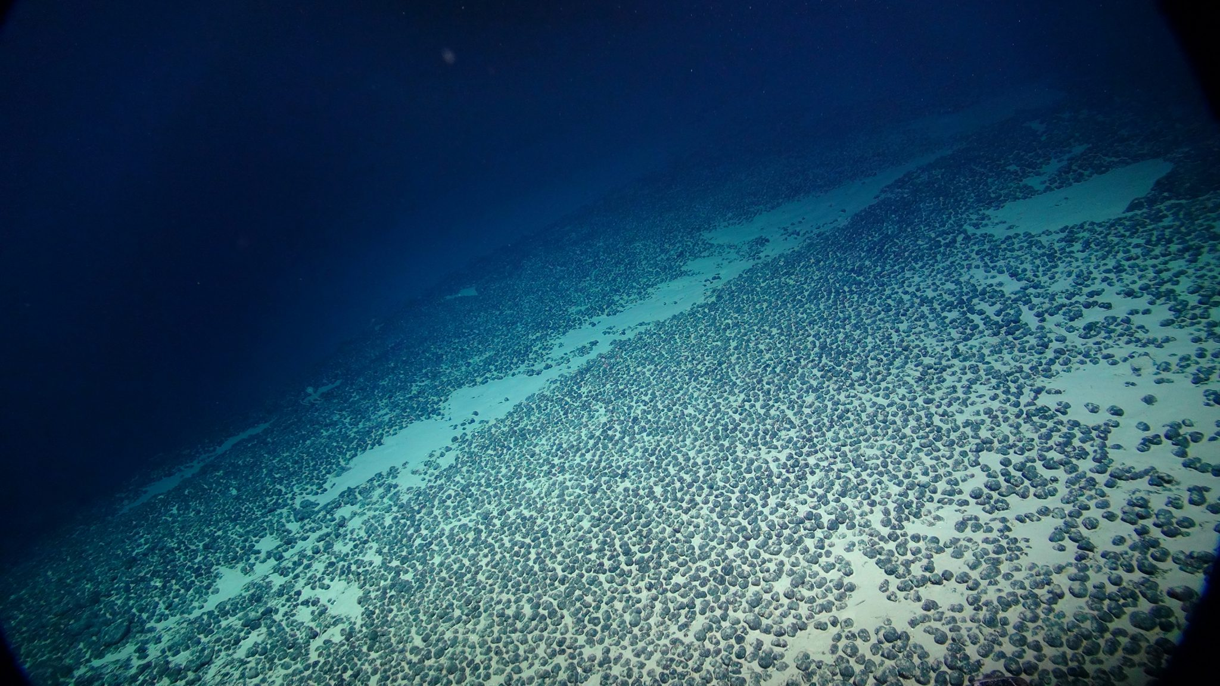

Slide 17
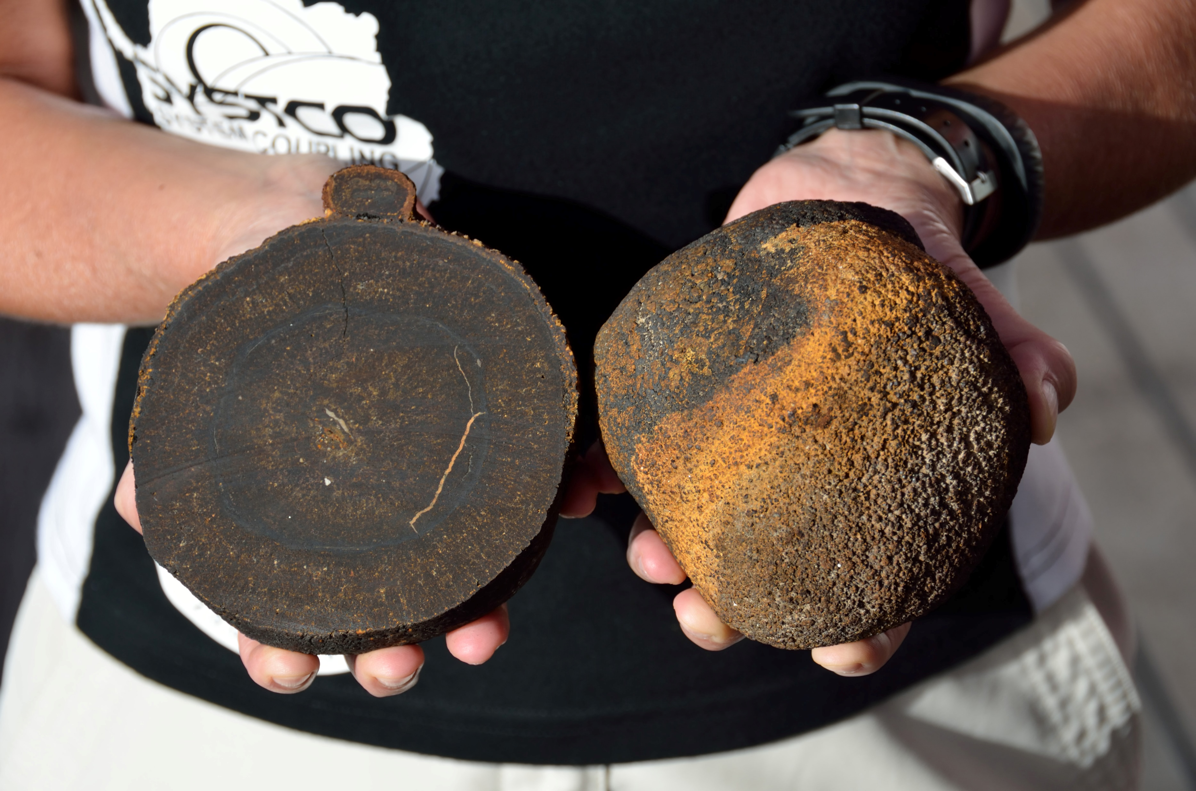
Notes:
These contain nickel, cobalt, copper, and manganese

Slide 18
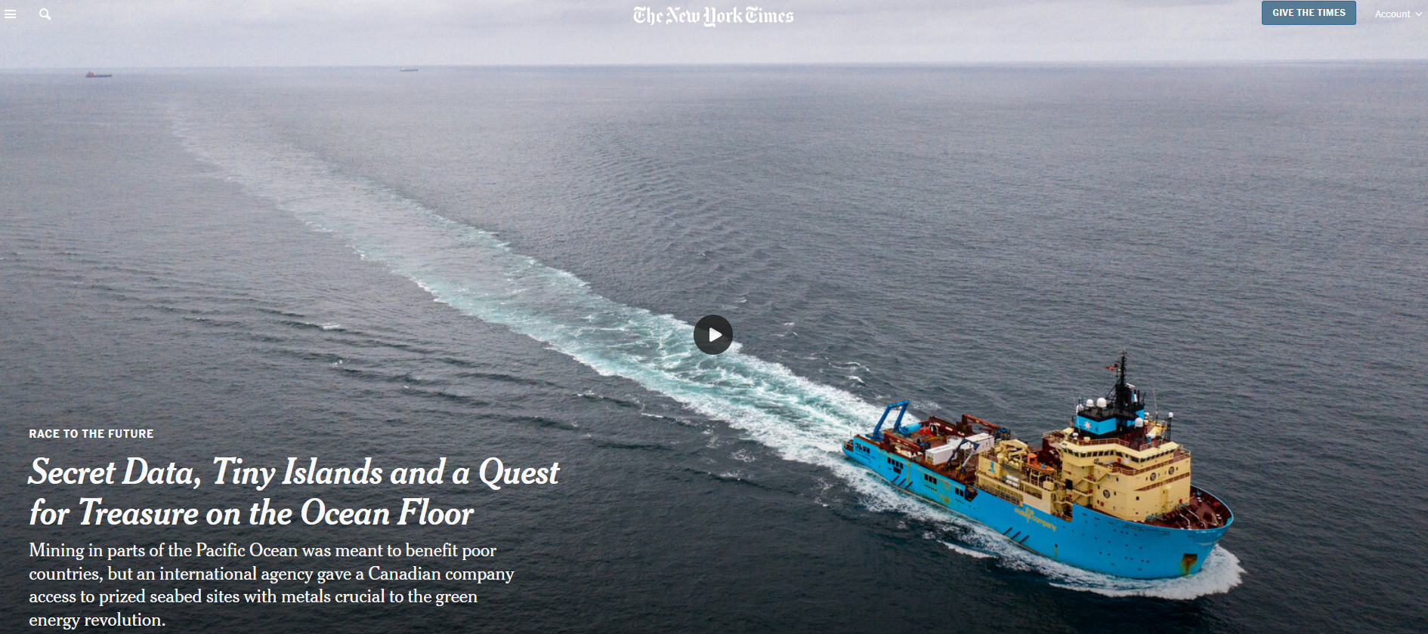

Slide 19
Secret data, tiny islands, and a quest for treasure on the ocean floor (NYT reading)
Abundant polymetallic nodules on sea floor can provide enormous quantities of battery-grade metals for the green economy
United Nations Convention on the Law of the Sea established the Seabed Authority and gave it jurisdiction to govern sea floor resources in international waters
The Seabed Authority’s mandate was to make sure the resources of the sea floor would be equitably distributed

Slide 20

However, the Seabed Authority secretly set aside highly valuable tracts of nodules a private corporation for their future use and profit taking.
This has raised concerns about the Seabed Authority’s commitment to protecting life on the ocean floor.
The Pacific Island nations Nauru and Tonga are listed developing nation partners of this company in name only

Slide 21
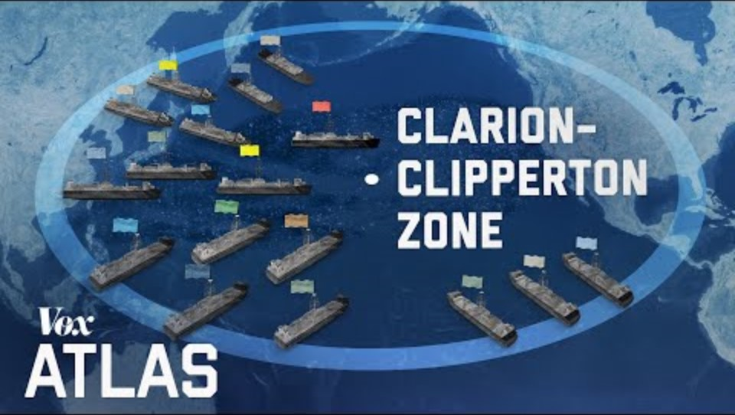

Slide 22
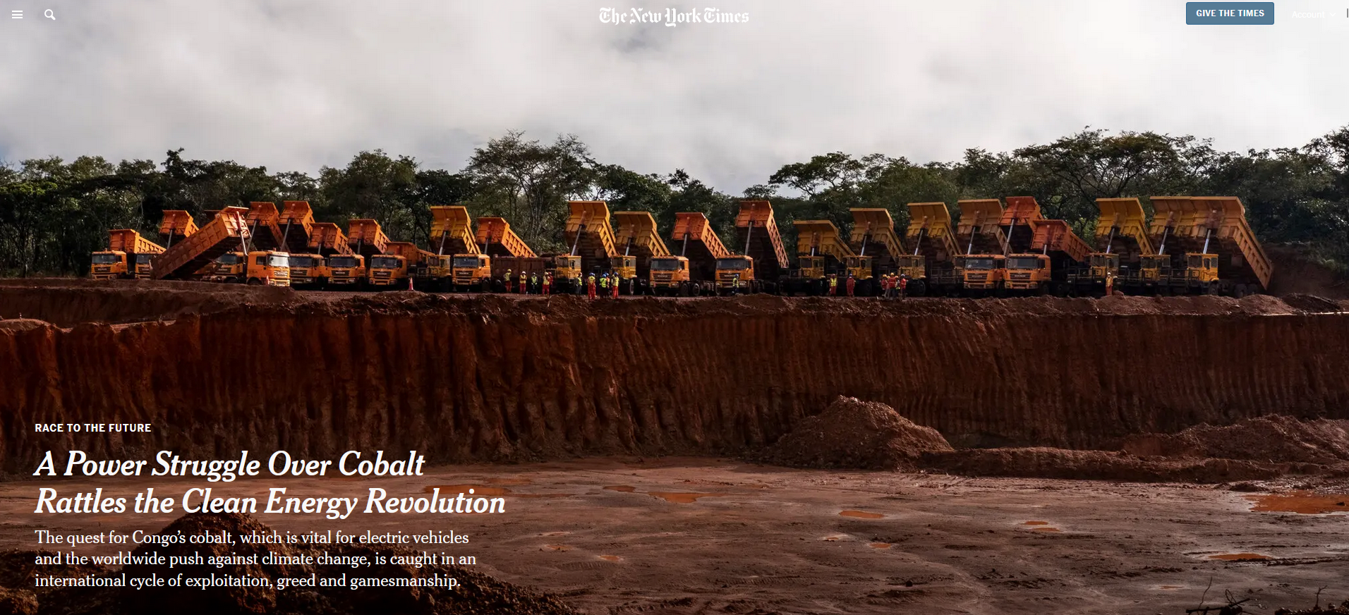
Notes:
https://www.nytimes.com/2021/11/20/world/china-congo-cobalt.html

Slide 23
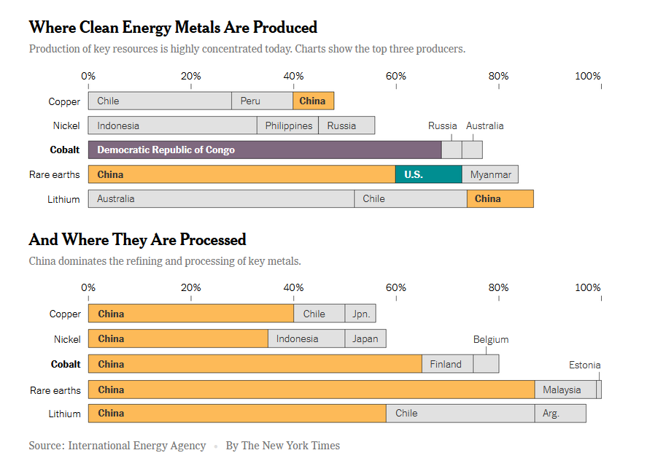

Slide 24
A power struggle over cobalt rattles the clean energy revolution (NY Times reading)
Cobalt is used in batteries to help them run longer and is used in all rechargeable lithium batteries today
Democratic Republic of Congo has the largest and purest untapped cobalt reserves in the world
China has a near monopoly to mine, process, and acquire much of this cobalt because Chinese companies offered the DRC loans and their assistance to build basic infrastructure in exchange for cobalt access
These loans are backed by the Chinese government – the companies are essentially the Chinese government
China invested in the DRC when international banks and US companies would not because of political instability there
Notes:
https://www.npr.org/sections/goatsandsoda/2023/02/01/1152893248/red-cobalt-congo-drc-mining-siddharth-kara

Slide 25
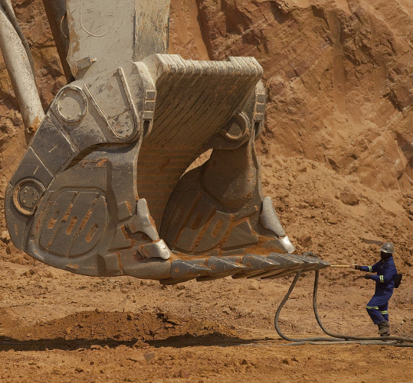
As part of a lobal power struggle for this cobalt, Chinese companies have come under scrutiny as to whether
  they are fulfilling their contractual obligations to deliver billions of dollars’ worth of new roads, bridges, power plants to the DRC
  they have cheated the DRC government out of billions of dollars in payments
  they endorsed the use of violence to thwart trespassers from nearby villages trying to scavenge cobalt
  they are responsible for a decrease in workplace safety and increase in workplace injuries
Notes:
https://www.bloomberg.com/graphics/2018-china-cobalt/

Slide 26
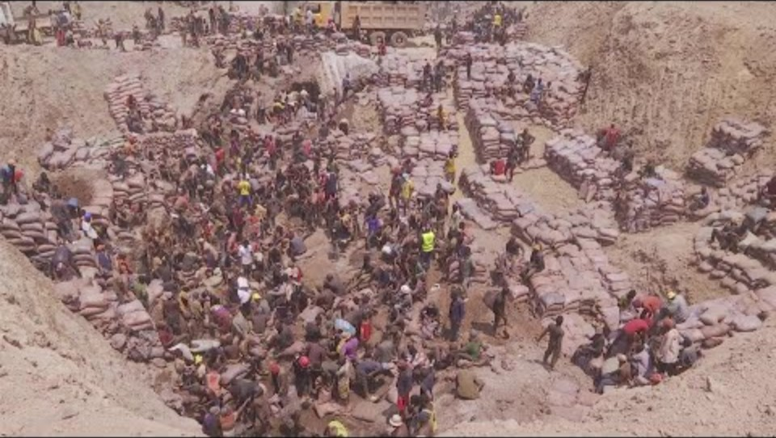
Notes:
This is an artisanal mine – it is unregulated, but the cobalt ends up being sold to Chinese companies

Slide 27
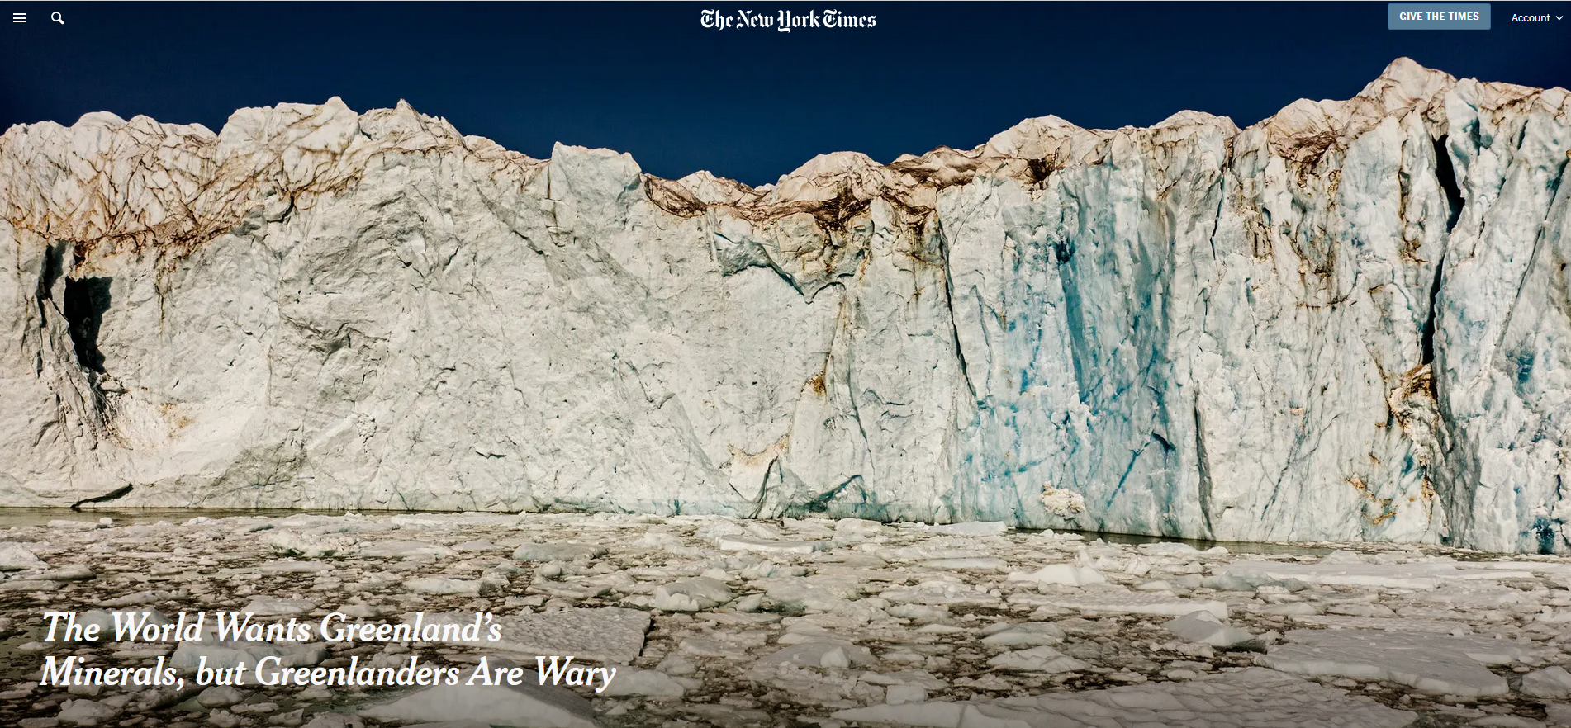

Slide 28
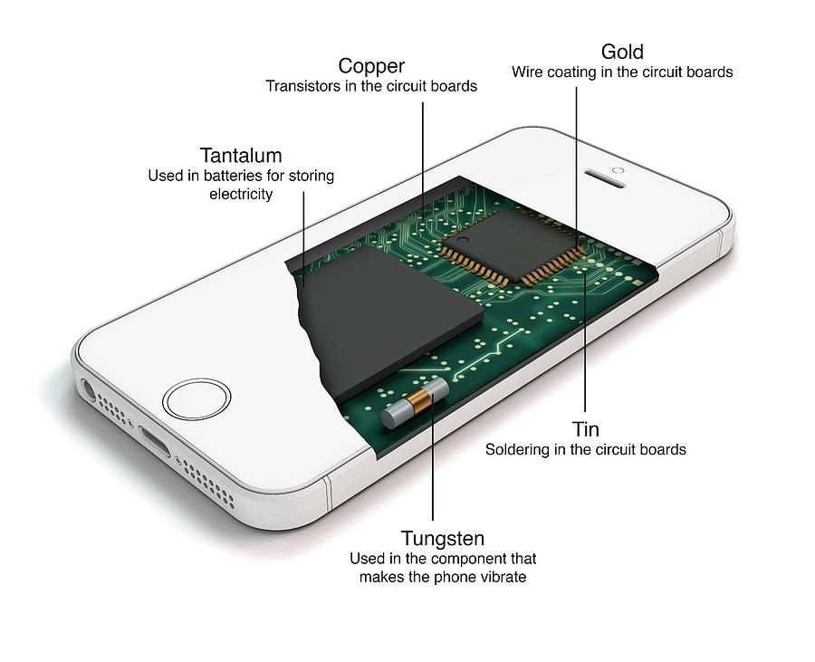
The world wants Greenland’s minerals, but Greenlanders are wary (NYT reading)
Greenland’s extensive mineral deposits are becoming accessible as climate warms and glacial ice retreats
These deposits include tantalum, a key component of mobile phones. Greenland also contains large deposits of rare earth elements, like yttrium, scandium, neodymium and dysprosium. These have unique properties ideal for several industrial applications
Notes:
Mobile phones contain tantalum in capacitors. Capacitors regulate voltage supply from the battier and keep it from spiking. When the phone is almost ready to discharge the capacitor helps provide a boost of power for a short duration of time.

Slide 29
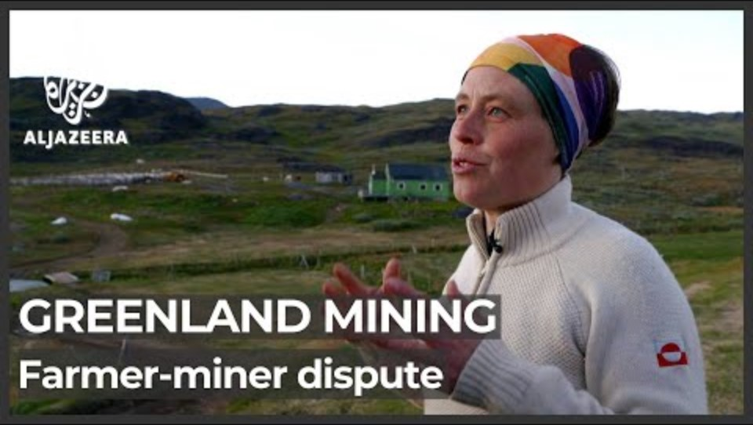
The world wants Greenland’s minerals, but Greenlanders are wary (NYT reading)
Greenland is a self-governing Danish territory. Greenlanders manage its domestic affairs independent of Denmark, but foreign policy and budget is dictated by Denmark
The US see Greenland as a ‘solution’ because China has a near monopoly on many of the green economy minerals elsewhere

